Slide 1


codeacademy
Learn SQL from Scratch
John Janenda | 2018.05.31

Slide 2
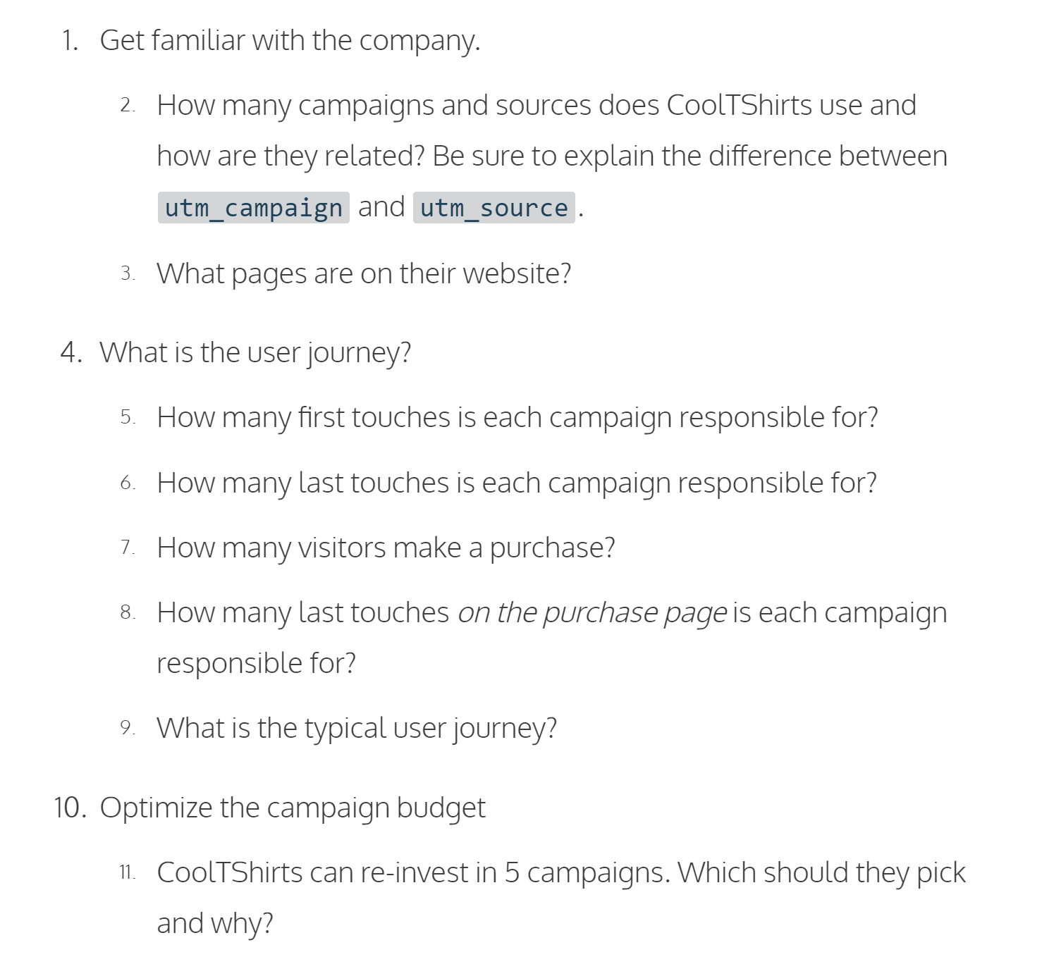
Table of contents
Get familiar with CoolTShirts
What is the user journey?
Optimize the campaign budget

Slide 3
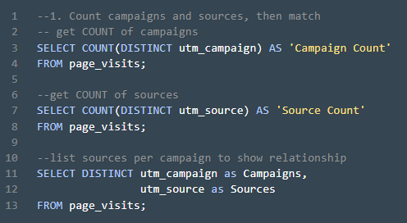
1. Get familiar with CoolTShirts
How many campaigns and sources does CoolTShirts use? Which source is used for each campaign?
A source is the type of communication, like email, or site on which a campaign is shared with prospective customers, like google, Facebook, Medium, Buzzfeed or the New York Times
A campaign is a specific message designed to elicit a specific response from a specific group of prospective customers.
A source, like email, can run multiple campaigns, like ‘retargeting’ or ‘weekly newsletter’.
The same campaign could be run across multiple sources, although that is not represented in this dataset.
Campaign Count
8
Source Count
6
Campaigns | Sources
getting-to-know-cool-tshirts | nytimes
weekly-newsletter | email
ten-crazy-cool-tshirts-facts | buzzfeed
retargetting-campaign | email
retargetting-ad | facebook
interview-with-cool-tshirts-founder | medium
paid-search | google
cool-tshirts-search | google

Slide 4

Get familiar with CoolTShirts – cont’d
What pages are on the CoolTShirts website?
Find the distinct values of the page_name column. A simple ‘SELECT DISTINCT’ query answers this question quickly.
Pages names shown are presumably a subset of actual pages on site and denote the specific page the campaign directed the prospective customer to upon clicking the link in the campaign. For instance, there are no specific ‘product_pages’ or ‘department_pages’.
Page Names
1 - landing_page
2 - shopping_cart
3 - checkout
4 - purchase

Slide 5
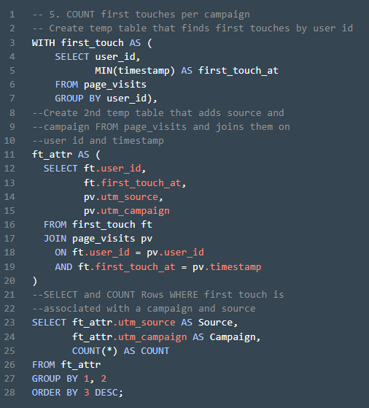
4. What is the User Journey?
How many first touches is each campaign responsible for?
By identifying the timestamps with the MIN date for each user, it is possible to determine which source and campaign first captured the prospects attention and prompted them to click through to the site.
Interesting to note that out of 1,979 unique visitors only 4 campaigns of the 8 active were responsible for first touch.
Source* | Campaign | Count
medium | interview-with-cool-tshirts-founder | 622
nytimes | getting-to-know-cool-tshirts | 612
buzzfeed | ten-crazy-cool-tshirts-facts | 576
google | cool-tshirts-search | 169
*Note that while prompt did not require addition of ‘Source’ column, the ‘Hint’ under the prompt suggested including it.

Slide 6
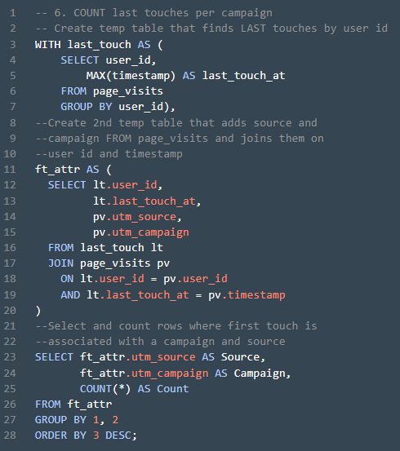
4. What is the User Journey? – cont’d
How many last touches is each campaign responsible for?
By identifying the timestamps with the MAX date for each user, it is possible to determine which source and campaign was responsible for driving the prospects last visit to the site.
Worth noting that the campaigns which drove the majority of first touches drop significantly down the list when examining last touches.
Source* | Campaign | Count
email | weekly-newsletter | 447
facebook | retargetting-ad | 443
email | retargetting-campaign | 245
nytimes | getting-to-know-cool-tshirts | 232
buzzfeed | ten-crazy-cool-tshirts-facts | 190
medium | interview-with-cool-tshirts-founder | 184
google | paid-search | 178
google | cool-tshirts-search | 60
*Note that while prompt did not require addition of ‘Source’ column, the ‘Hint’ under the prompt suggested including it.

Slide 7
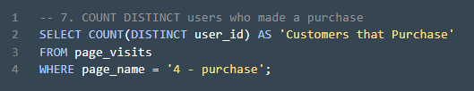
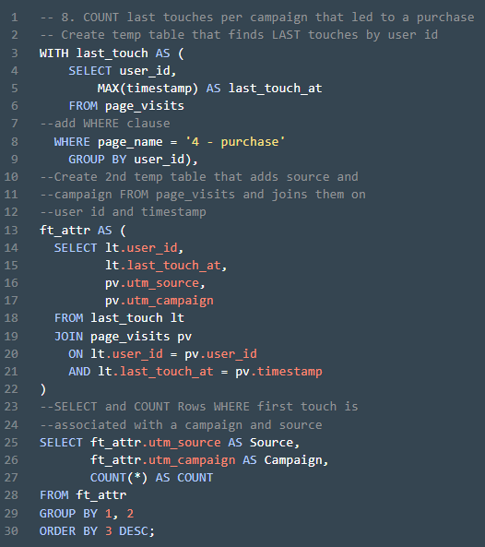
4. What is the User Journey? – cont’d
How many visitors make a purchase?
Conversion rate from visitor to ‘customer’ is a solid 18% (361 / 1,979 = 18%)
How many last touches on the purchase page is each campaign responsible for?
By isolating MAX timestamp where the page visited was the ‘purchase page’ we can identify the sources and campaigns that were responsible for conversion and ultimately revenue for the company.
Again, initial traffic generating campaigns continue to drop in effectiveness
Customers that Purchase
361
Source* | Campaign | Count
email | weekly-newsletter | 115
facebook | retargetting-ad | 113
email | retargetting-campaign | 54
google | paid-search | 52
buzzfeed | ten-crazy-cool-tshirts-facts | 9
nytimes | getting-to-know-cool-tshirts | 9
medium | interview-with-cool-tshirts-founder | 7
google | cool-tshirts-search | 2
*Note that while prompt did not require addition of ‘Source’ column, the ‘Hint’ under the prompt suggested including it.

Slide 8
9. What is the ‘Typical’ User Journey?
‘Story’ campaigns draw users to site
91% of users first come to the site via one of these ‘story’ campaigns:
Interview with CoolTShirts Founder
Getting to Know CoolTShirts
Ten Crazy CoolTShirts Facts
But, users need additional reminders to stay engaged
31% of users that came to site via a ‘story’ campaign don’t return and ‘story’ campaigns only account for 6% of purchases
The majority of prospects require a 2nd campaign to become purchasing customers.
And those reminders generate most of the revenue
78% of purchases were generated via email newsletter, email retargeting, or Facebook retargeting ads.

Slide 9
9. What is the ‘Typical’ User Journey? Cont’d
78%
91%
57%
31%
6%
Story Campaigns
Retargeting Campaigns

Slide 10
Optimizing the campaign budget Which 5 campaigns should CoolTShirts re-invest in?
Limiting re-investment to 5 campaigns will likely leave money on the table as there are at least 6 high performing campaigns.
If CoolTShirts can only invest in 5, data recommends that all 3 ‘story’ campaigns highlighted in blue are exceptional at generating interest, they should be continued
In addition, retargeting is critical, so the two remaining campaigns should be based on a retargeting strategy.
Perhaps slightly counter-intuitive, but suggest that weekly newsletter be discontinued, despite it’s success, under the assumption that all ‘touches’ that remind customer of company ‘may’ be equal
Suggest continuing the email retargeting campaign and place a premium on email capture as part of journey from story campaign to site as email newsletters and retargeting campaigns account for 47% of sales. Having customer email address is extremely important to conversion. Would have been interesting to see how many email addresses were in the database as compared to visitors.
Further suggest extending retargeting ad campaigns as they have the potential to reach 100% of prospects that interact with site, INCLUDING those that do not provide an email address. Would strongly consider purchasing retargeting ads on additional sites like NYT, Buzzfeed and Medium, if possible, as they generate excellent traffic from ‘story’ campaigns.
Campaign | 1st Touches | % 1st Touches | Last Touches | % Last Touches | Purchases | % Purchases
interview-with-cool-tshirts-founder | 622 | 31% | 184 | 9% | 7 | 2%
getting-to-know-cool-tshirts | 612 | 31% | 232 | 12% | 9 | 2%
ten-crazy-cool-tshirts-facts | 576 | 29% | 190 | 10% | 9 | 2%
cool-tshirts-search | 169 | 9% | 60 | 3% | 2 | 1%
weekly-newsletter | 0 | 0% | 447 | 23% | 115 | 32%
retargetting-ad | 0 | 0% | 443 | 22% | 113 | 31%
retargetting-campaign | 0 | 0% | 245 | 12% | 54 | 15%
paid-search | 0 | 0% | 178 | 9% | 52 | 14%

Slide 11
Optimizing the campaign budget Rationale for discontinued campaigns
A note on the discontinued campaigns
As noted previously regarding weekly-newsletter, would prefer to keep it active, but assuming that possibly any appearance in customer’s inbox will trigger a response and since a newsletter costs ‘something’ to produce, perhaps that money can be spent on increasing retargeting ads to additional sites beyond Facebook (see note on ‘Extra’s’ page regarding traffic by source.
Organic search, presumably generated via SEO activities generates 9% of traffic – not insignificant, but if budget needs to be cut, this is a less effective means of reaching prospects for initial capture, presumably because brand recognition for CoolTShirts is relatively low and there are likely hundreds of competitors in the t-shirt space.
Paid search accounts for 14% of actual purchases, so it is valuable, but only after customers have been introduced to site via ‘story’ campaigns as it does not appear in initial visit data. If something needs to be cut, this is a candidate.
Campaign | 1st Touches | % 1st Touches | Last Touches | % Last Touches | Purchases | % Purchases
interview-with-cool-tshirts-founder | 622 | 31% | 184 | 9% | 7 | 2%
getting-to-know-cool-tshirts | 612 | 31% | 232 | 12% | 9 | 2%
ten-crazy-cool-tshirts-facts | 576 | 29% | 190 | 10% | 9 | 2%
cool-tshirts-search | 169 | 9% | 60 | 3% | 2 | 1%
weekly-newsletter | 0 | 0% | 447 | 23% | 115 | 32%
retargetting-ad | 0 | 0% | 443 | 22% | 113 | 31%
retargetting-campaign | 0 | 0% | 245 | 12% | 54 | 15%
paid-search | 0 | 0% | 178 | 9% | 52 | 14%

Slide 12
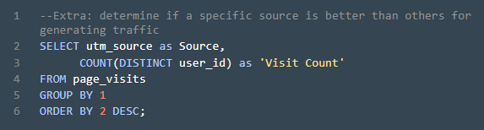
EXTRAS
Retargeting ads should be considered for New York Times, Buzzfeed and Medium as they all appear better at generating traffic than Facebook or Google
Source | Visit Count
nytimes | 747
email | 696
buzzfeed | 648
medium | 625
facebook | 445
google | 339

