Slide 1

Hej Assistant
AI-powered daily commercial briefing
for IKEA store managers
RiverHacks Hackathon 2025

Slide 2
THE CHALLENGE
Store managers are overwhelmed by data
Every morning, IKEA store managers must check multiple systems to understand their store's commercial performance. This wastes time and creates blind spots.
5+
45m
0
Systems to check
Minutes lost daily
Proactive alerts
Sales, stock, forecasts, promotions, margins — scattered across tools
Manual data gathering before the store even opens
No system tells managers what to focus on today
Hej Assistant | RiverHacks 2025

Slide 3
One AI co-worker. One morning briefing.
Hej Assistant generates a daily commercial briefing powered by AI — combining sales, stock, margin, and forecast data into actionable insights.
Daily Briefing
Ask Me Anything
Proactive Alerts
AI-generated report with KPIs, trends, and prioritised actions. Export to PDF.
Chat with your store data. What-if scenarios, deep dives, follow-ups.
Auto-surfaced critical issues on page load. No manual checks needed.
Hej Assistant | Three core capabilities

Slide 4
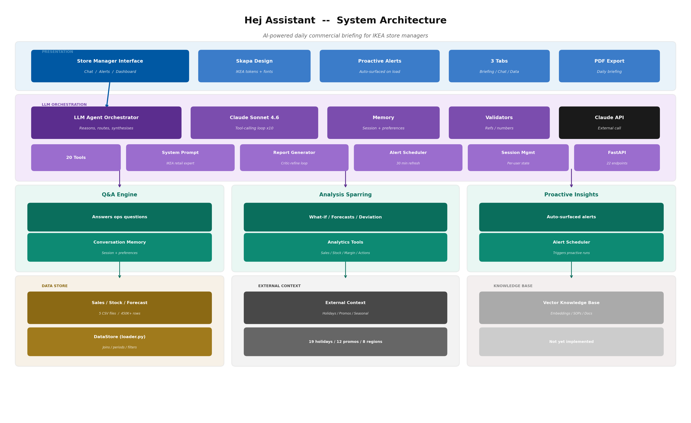
LIVE DEMO
The Store Manager Experience
Store selector with 8 IKEA locations
Real-time KPI snapshot cards
Proactive alerts banner with severity levels
AI-generated briefing with PDF export
IKEA Skapa design language
Hej Assistant | Built with FastAPI + Claude Sonnet 4.6 + Skapa Design

Slide 5
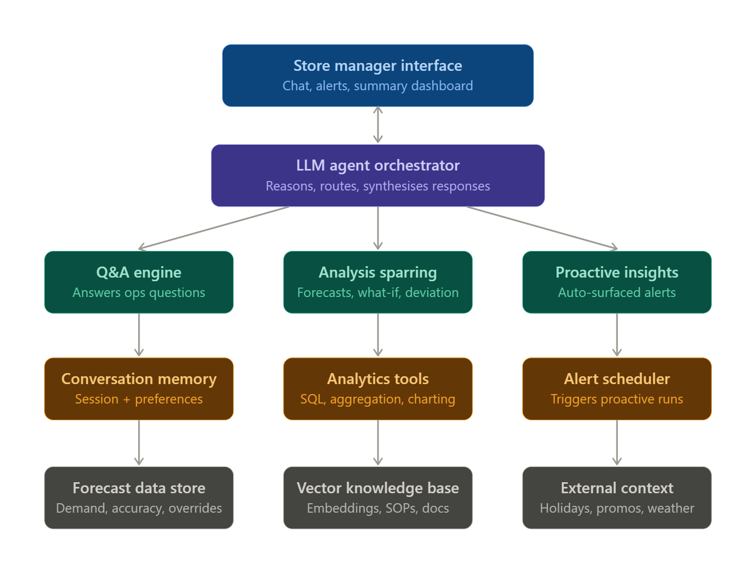
SYSTEM ARCHITECTURE
How It Works
Target Vision
Current Implementation
Hej Assistant | 10 of 11 target components built

Slide 6
TECHNOLOGY
Built for Speed, Quality, and IKEA Identity
Claude Sonnet 4.6
FastAPI + Python
Skapa Design
LLM with tool-calling.
20 tools, 10-round loop,
critic-refine pipeline.
22 REST endpoints.
Async, lightweight,
single deployable unit.
IKEA design tokens.
Noto IKEA font.
Brand-native UI.
pandas Analytics
Alert Scheduler
Railway Deploy
450K+ rows analysed.
17 analysis functions.
Real-time aggregation.
Background refresh every
30 min. Pre-warmed
insights cache per store.
One-click deployment.
Health checks, auto-scale.
Environment config.
Hej Assistant | Technology Stack

Slide 7
AI AGENT PROCESS
How the AI Agent Reasons
1
User Query
2
Tool Selection
3
Data Analysis
Store manager asks a question or requests a briefing
Claude analyses intent and selects from 20 analysis tools
Tools query sales, stock, margin, and forecast data
4
Synthesis
5
Validation
6
Response
Claude combines results into IKEA-tone narrative
Article references and numbers are verified
Actionable insights delivered to the manager
20 Tools: Sales (5) + Stock (4) + Margin (4) + Actions (1) + What-If (3) + Insights (1) + Context (1) + Memory (1)
Hej Assistant | Agent Loop: up to 10 tool-calling rounds per request

Slide 8
DATA & TESTING
Data Foundation & Quality Assurance
Data
Quality Assurance
Source | Volume | Content
Sales | 363,000 rows | Transactions per article per store per day
Forecast | 87,000 rows | Demand predictions with accuracy tracking
Stock | 87,000 rows | Availability, OOS, burn rates
Products | 30 articles | HFB, series, colours, descriptions
Stores | 8 IKEA locations | Berlin, Amsterdam, Stockholm, ...
Article reference validator
Number reasonableness checks
Critic-refine-evaluate loop for reports
What-if price elasticity evaluation
Mixed date format auto-detection
Session isolation per user
Pre-warmed insights cache (no cold starts)
450K+ data rows | 22 API endpoints | 20 LLM tools | 8 stores | Full 2024 calendar year
Hej Assistant | Data & Quality

Slide 9
IMPLEMENTATION STATUS
10 of 11 Target Components Built
Component | Status | Implementation
Store manager interface | Built | HTML/CSS/JS with Skapa design, 3 tabs
LLM agent orchestrator | Built | Claude tool-calling, 20 tools, critic-refine
Q&A engine | Built | Conversational Q&A with store context
Analysis sparring | Built | Price, availability, demand what-if (via chat)
Proactive insights | Built | Auto-surfaced alerts, 30-min refresh
Conversation memory | Built | Session history + persistent preferences
Analytics tools | Built | 17 analysis functions (sales/stock/margin)
Alert scheduler | Built | Background refresh, pre-warmed cache
Forecast data store | Built | CSV-based demand and accuracy data
External context | Built | 19 holidays, 12 promos, seasonal patterns
Vector knowledge base | Roadmap | Embeddings, SOPs, document retrieval
Hej Assistant | 91% of target architecture implemented

Slide 10
FUTURE POTENTIAL
From Prototype to Platform
This hackathon prototype demonstrates what a production-ready AI assistant for IKEA retail could look like. The path forward:
HIGH
Vector Knowledge Base
Embed SOPs, playbooks, and corporate guidelines for RAG-based retrieval. Enables answers grounded in IKEA documentation.
HIGH
Real Data Integration
Connect to live IKEA data sources (sales APIs, inventory systems, promotion calendars) instead of CSV snapshots.
MED
User Authentication
Store-level login for personalised preferences, audit trails, and role-based access control.
MED
Live External APIs
Real-time holiday calendars, weather data, and campaign management system integration.
LOW
Multi-language
Localise UI and AI responses per store region (Swedish, Dutch, German, etc.)
Vision: Every IKEA store manager starts their day with an AI co-worker that knows their store, anticipates problems, and recommends actions.
LOW
Chart Visualisations
Interactive charts for trend analysis, comparisons, and data exploration.
Hej Assistant | Roadmap

Slide 11
Tack!
Hej Assistant — making every store morning smarter.
RiverHacks 2025

