Slide 2
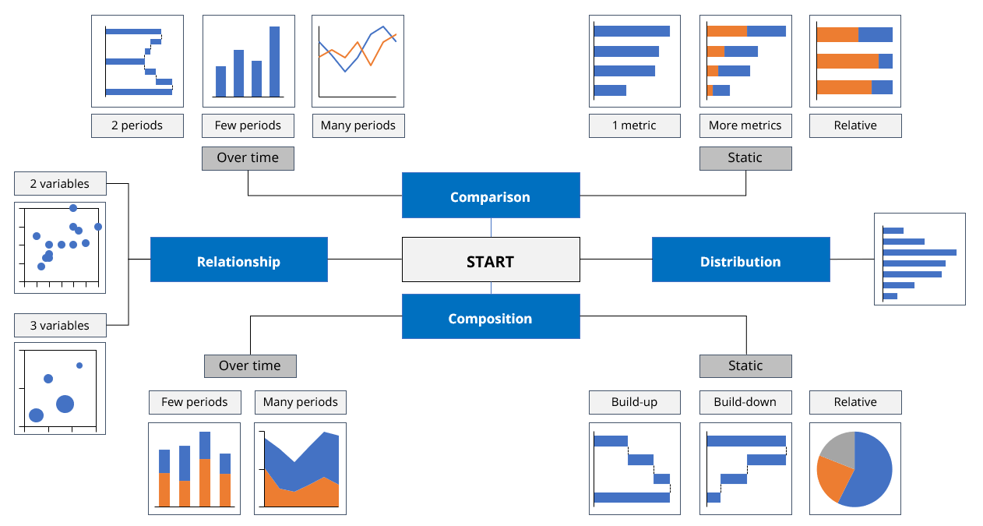
Visualization checklist
Are your visualizations supporting the message? Or distracting from it? (Where is Waldo?)
Is your slide stripped of all redundant information?
Information processing
Graphs
Did you use graphs instead of tables or text?
Did you follow the rules?
Natural reading order: top-down, left to right
X-axis for time, Y-axis for everything else
No line in a graph if the information is not continuous
Logical start- and endpoint of your graphs (i.e. pie charts start at 12 o’clock)
Does the graph visualize the message?
Is the message supported by number(s) and can these number(s) directly be found on the slide?
Did you use the right graph?
Does the graph have a title?
Is clear for each component of
the graph which value is
represented (€, #, $, etc)?
Slide Design
Are the objects properly aligned and distributed? Both mutually and on the slide?
Are you consistent with font type, size, shape and color? Use font Noto IKEA Latin 12
Did you avoid too large font sizes and bright colors?
Did you use the IKEA template?
Is the color association correct (red = bad, green = good?
Is your slide peaceful and orderly?

Slide 3
ACTIONABLE HEADER: Doing X will result in Y
Monthly slide guidelines
SUBTITLE: BRIEF DESCRIPTIVE, MAX 1 LINE
Evidence for the header
Graphs all in think-cell
Use View → guides for aligning
If it does not support the header, leave it out (less is more)
Situation, complication, question intro (SCQ)
More explanation on the answer (A) if needed
Next steps, implementation, etc.

