Slide 1

RMHI PALS
Friday 26th April 9am-12pm

Slide 2
Disclaimer
We are not professionals.
We’re all students here so don’t just feel free to chime in every once in a while,
We’d go as far as to encourage you to criticise us as much as you can!
You’re all free to discuss with each other in groups if you’d prefer.
(No shouting or screaming though.)
And we would recommend having something to write on or type on open.

Slide 3
Structure
Review of Core concepts
Review of Association concepts
Review of Prediction concepts
Review of Difference concepts
Again, we would like to note that we would prefer everyone to engage with and discuss the material, so feel free to ask as many questions as you’d like!

Slide 4
Core Concepts: Research Questions
3 parts to a good RQ: Constructs, Population and Relationships.
A research question is not a research hypothesis.
A research hypothesis is not a statistical hypothesis.

Slide 5
Core Concepts: Constructs, Measures and Score
Constructs are unobservable attributes that we label to describe hypothetical behaviours.
Measures are proven (valid and reliable) methods to obtain a numerical representation of unobservable constructs.
Construct scores are what measures output- the numerical representation of unobservable constructs.
The scaling of these scores can be arbitrary or meaningful.

Slide 6
Core Concepts: Manipulating scores
4 different types of scores:
Raw/Observed scores: untouched metric from measure,
Deviation score: scaled to the metric mean,
Standardised score: scaled to a specified mean and a specified amount of standard deviations per unit,
Z score: a type of standardised score with mean 0 and 1 standard deviation per unit.

Slide 7
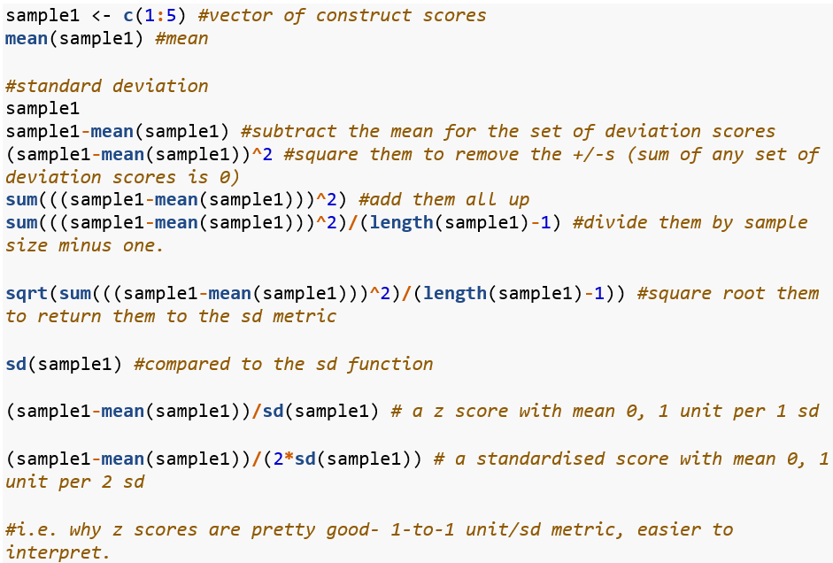
Sidebar: Standard Deviation (SD)

Slide 8
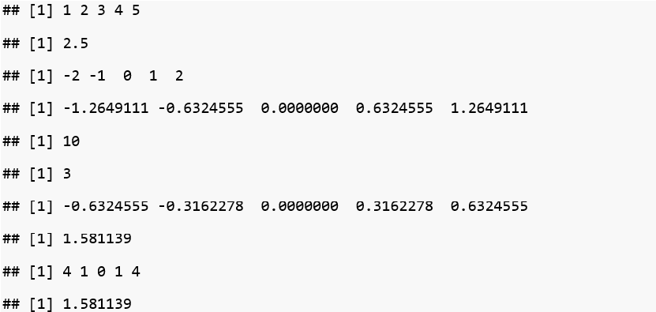
Sidebar: SD Exercise- Match the Output

Slide 9
Side-sidebar: Why n-1?
Why n-1? (Bessel's correction) it allows us to get an unbiased estimate of population variance. It's a long story, but essentially as long as we believe that a population parameter always defines the population distribution- and we don’t have the entire population at hand, our sample is always missing something. the "-1" is there to acknowledge that, while parameters define the RVs we are trying to represent through the calculated statistics we make, we subtract the one to account for the one value in the population that is not free to vary. By representing that concept in the sample variance denominator it becomes less biased. don't quote me on that.

Slide 10
Core Concepts: Popu Paras and Sample Stats
Similarities:
Numeric representation of summary characteristics
Differences:
Multiple sample statistics (multiple random samples)
A single theorised population parameter.

Slide 11
Core Concepts: Random Variables
A variable consisting of the set of all possible outcomes defined by one or more population parameters.
I understand RVs to be the perpetually unknowable variable defined by the existing parameters of the natural world.
If it’s easier to grasp as an infinite set ranging from infinity to negative infinity- that may be correct in some situations.

Slide 12
Core Concepts: Random Variables
What we do know is that they come in two flavours:
Continuous (e.g. height, temperature, etc.) If naturally occurring decimals make sense- it’s a continuous variable (13.4 cm, 34.2 celsius)
Discrete (or Factor in R) (e.g. measure responses, no. of errors made, etc.) Ones where naturally occurring decimals make no sense.
What matters is that we know these numbers behave differently- don’t take continuous variables to be discrete and vice versa.

Slide 13
Sidebar: Statistical framework
The notions of probability we’re working with belongs to the Frequentist framework, where probability is considered ‘in the long run’.
We do not go into the Bayesian framework where probability is updated.

Slide 14
Core Concepts: Distributions
The set of different numerical values defined by summary characteristics.
Different distributions:
Sample distribution: the set of different scores collected,
Population distribution: the hypothetical distribution of all scores,
Mathematical probability distribution: theoretical distributions that are defined by population parameters,
Sampling distribution: distributions of sample statistics (one meta-level up).

Slide 15
Core Concepts: Distributions
The first two refer to distributions of a single data entries.
The other two are a little different-
We know that there can be multiple sample statistics, but only one population parameter.
This means that sample stats have a distribution of their own- they behave like random variables themselves!
Neat applet: http://onlinestatbook.com/stat_sim/sampling_dist/

Slide 16
Core Concepts: Describing Distributions
Features to look out for:
Shape: +ve skew (right skew), -ve skew (left skew), bell-shaped, symmetric
Centre: typically mean, median for skewed data, mode for ordinal/nominal data, etc.
Spread: SD, IQR

Slide 17
Sidebar: Standard Error
The standard deviation of a sampling distribution is called a standard error- why?
A way to think about this is that a sampling distribution talks of the set of different statistics you can get, so the spread in that distribution is the typical amount the statistic is different by, i.e. the typical amount of error from your computed statistic.

Slide 18
Sidebar: Observed Test Statistic
An application of the sampling distribution (I believe) is the calculation of the observed test statistic.
If you know what Z-scores are, you know what observed test statistics are.
This is your t-statistic, chi-square statistic, regression coefficient, etc.
Corresponds with a p-value (more on that in a bit).

Slide 19
Core Concepts: Theoretical Probability Distribution
Sampling distributions are cool, but these are even cooler- because they exist by mathematical functions and don’t need an unfeasible amount of resources to make.
A standardised sampling distribution is equivalent to a theoretical probability distribution.
As seen in the applet above, fitted normal curves are equivalent to sampling distributions- so we have the distributions that have the same properties as the sampling distributions without actually needing to construct them manually.

Slide 20
Sidebar: Estimation
We use sample stats to estimate popu paras.
Estimation is the process of calculating parameter values based on sample data- point estimation is for single values, interval estimation is for a range of values.
Estimation is the process of using an estimator to produce an estimand.

Slide 21
Sidebar: Properties of Estimators
Unbiased. The notion of bias is distance away from the real population parameter. So we want as unbiased of an estimate as possible.
Consistency. If bias decreases as sample size increases, that estimator is considered to be consistent. So if we have a biased estimator, we’d like it to be consistent.
Efficient. The smaller the standard error, the more efficient. If we encounter two estimators, we’d prefer the more efficient one (provided it isn’t biased and inconsistent)

Slide 22
Core Concepts: NHST
Good ol’ null hypothesis significance testing.
Yes, I know there’s been less of an emphasis on constructing and interpreting p values, but I do think that knowledge on the p-value (and consequently how it can be manipulated and misinterpreted) is very important.
So what’s a p-value? The p-value is a widely used statistical inference method to evaluate statistical hypotheses (e.g. null hypotheses). Note that statistical inference is different from scientific inference, scientific inference may involve statistical inference, but you cannot say that a statistical inference implies a scientific inference. No. The tools we use are not infallible and reflects the researcher’s intentions of inferring ideas from data.

Slide 23
Core Concepts: NHST
Set null and alternative hypotheses,
Decide the alpha (typically .05 and consequently the critical test statistic(Tcrit)),
Calculate the observed test statistic (Tobs) from relevant sample stats,
Find the p-value corresponding to the Tobs of the data,
If p < alpha, reject (consequently if |Tobs| > |Tcrit|, reject) otherwise, retain.

Slide 24
Sidebar: p-value rant.
The tobs (on both sides) represent the distance between the h0 and the tobs. In other words, the tobs is directly equivalent to the range of RV explained in the theoretical probability distribution (the p value). i.e. probability of less than 1 in a continuous dist = probability of 0 + -1 + -2 + … + -infinity
P(Tobs|h0 is true) that is ALL p-value can say.
The probability of observing your observed test statistic given that you assume the null to be true. That’s it.
Why do we do this: to declare if something isn’t 0 = declaring that it’s SOMETHING.
It’s kind of an upside-down inference. (blame Popper for this one)

Slide 25
Sidebar: What the p-value is NOT.
It’s NOT:
The probability of the scientific hypothesis being true,
The probability of your alternative statistical hypothesis being false,
The probability of your null hypothesis being true,
The probability of your null hypothesis being false,
The probability of observing your sample statistic.

Slide 26
Core Concepts: Confidence Intervals (CIs)
CIs are a function of p-values (and of standard error in general)
The margin of error (interval area) is defined by what we don’t consider to be statistically significantly different- and therefore ‘plausible’.
Remember, the sampling distribution represents multiple samples- and values within the confidence interval are ‘plausible’ as a function of the preset alpha value and standard error of the sampling distribution to determine what values are ‘plausible’ in other samples.
In other words, it depends on the standard error value and our preset alpha criterion value.

Slide 27
Sidebar: Alpha criterion
These serve to control type-1 error rates, and define boundaries of statistical significance.
P(Rejecting H0|H0 = T) is what the alpha represents.
In the metric of sampling distributions, the alpha criterion is directly equivalent to the critical test statistic (the value that the observed test statistic has to exceed to declare statistical significance).

Slide 28
Core Concepts: Effect Size
Last one. Hurray!
Kind of an ambiguous term to refer to a method of describing the strength of a relationship.
Examples are Pearson’s r, Cramer’s V, standardised regression coefficients or R-squared.
Effect size measures can also have their own statistical assumptions, and it is important to evaluate the effectiveness of certain measures based on your data (and its possible violated assumptions).
E.g. Bonett’s delta, Hedges’ g

Slide 29
Association
Systematic co-occurrence.
‘These things occur together’ is what association represents.

Slide 30
Association: Continuous Variables
We use pearson’s correlation coefficient (I just call it Pearson’s r)
But first, scatter-plots and covariance!
A neat game: http://guessthecorrelation.com/

Slide 31
Association: Covariance
The covariance of the plots directly refer to how two variables vary together- how much a sample varies on two variables together. In other words, it can tell you the strength (in its own metric) and direction of how much a sample systematically varies on two variables.
But here’s a problem- it’s in its own metric, so how do we change it to be meaningful?
We standardise it!
And that is what correlation is- standardised covariance. Or to be specific, covariance of z-scored variables.

Slide 32
Association: Pearson’s r
r ranges from -1 and +1 and captures the strength and direction of association between two continuous variables.
‘r’ is the sample coefficient, the population coefficient is symbolised as rho (ρ).

Slide 33
Association: Categorical Variables
Contingency/Frequency tables!
The Cramer’s V statistic is essentially a rescaled chi-square statistic to fit between 0 to 1.
The higher the V the stronger the association.
No direction since the chi-sq stat doesn’t have a direction.

Slide 34
Association: Odds
Odds are the probability of something occurring relative to it not occurring.
i.e. 4:1 odds mean 80% to 20%, 9:1 odds mean 90:10.
20% chance it’ll rain = 4:1 odds of not raining. (4 times more likely for it to not rain than it is to rain)
10% chance I’ll bring my umbrella = 9:1 odds of not bringing my umbrella (9 times less likely for me to bring my umbrella than me bringing my umbrella)

Slide 35
Association: Odds Ratios
Odds ratios (OR) take it a step further. The OR represents the ratio of two odds:
(9/1 / 4/1) = 2.25
It is 2.25x more likely for me to not bring my umbrella when it doesn’t rain.
The reciprocal holds true too
4/9 = 0.44 (4/1 / 9/1)
It is 0.44x more likely for me to bring my umbrella when it doesn’t rain.

Slide 36
Association: Odds Ratios
Provided you don’t mess with the raw numerical values (never mess with raw values!!), you can twist your odds ratio around to brain-numbing ways.
1/9 / 4/1 odds ratio of me bringing my umbrella when it doesn’t rain
It is 1/36x more likely for me to bring my umbrella when it doesn’t rain relative to not bringing my umbrella when it does.
9/1 / 1/4 odds ratio of me not bringing my umbrella when it rains
It is 36x more likely for me to not bring my umbrella when it rains relative to bringing my umbrella when it doesn’t rain.

Slide 37
Cheeky SAQs
What is the difference between a set of deviation scores and that set’s standard deviation?
Can a p-value of 0.09, equivalent to an observed test statistic of -1.65, be considered statistically significant if we’ve set the critical test statistic to be 1.6? (Arbitrary values, assuming a two-tailed null hypothesis)
What is the value of a 0% Confidence Interval?
Why are values in a confidence interval considered to be ‘plausible’?
Why can covariance and correlation be negative, whereas variance can only be a positive value?

Slide 38
Answers to said Cheeky SAQs
A set of deviation scores refer to a set of scores that have been scaled to the mean. Standard deviation is the typical amount of deviation in the set of deviation scores, as computed through the variance (sum of any set of deviation scores equal to 0) and then squared to return the value to its own metric.
Yes, it is considered statistically significant because the absolute observed test statistic is larger than the critical test statistic.
A 0% confidence interval would return the sample statistic used to compute the interval. The confidence level is determined by (1-alpha level), and a confidence level of 0 would mean an alpha level of 1- everything would be statistically significant, so there would be no range of plausible values. This is less a practical question and more on the understanding of constructions of CIs.

Slide 39
Answers to said Cheeky SAQs
4) Values within a confidence interval are considered ‘plausible’ as an effect of the level of significance and the computed standard error. The notion of ‘plausibility’ refers to how the range of values cannot be considered statistically significant from the computed statistic- and are therefore possible in other samples
5) Covariance and Correlation can have negative values since they are not squared values. Variance is squared, so it can never have a negative value.

Slide 40
Prediction
Prediction of a variable usually refers to use of regression, specifically for this course, we’ll be considering two types of regression:
Simple linear regression,
Multiple linear regression.

Slide 41
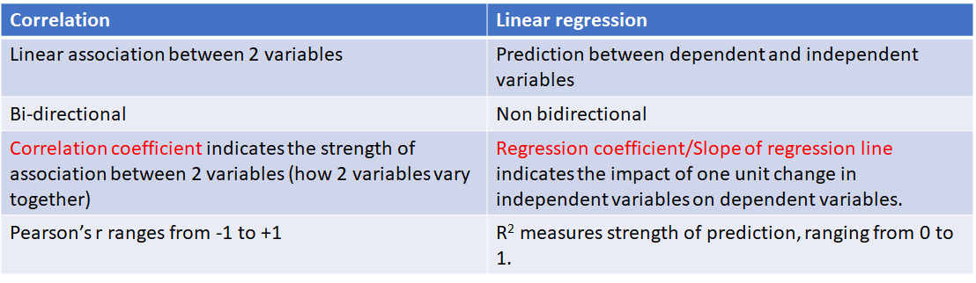
Prediction: Not Association

Slide 42
Prediction: Concepts
Variance: The total amount of variability between observed scores and the mean. Can be referred to as ‘sums of squares’ (SS), and there are different types of sums of squares in regression models (SStotal = SSreg + SSres)
Standard deviation: Square root of the variance, back to the scale’s metric.
Correlation Coefficient: Standardised covariance coefficient.
Covariance: An unstandardised measure of calculating how much two variables vary together.
Standardised measures are typically more informative- since they are interpretable in terms of standard deviation opposed to the raw metric.

Slide 43
Prediction: Linear Regression
The Full simple linear regression line is expressed as:
Y = a + bX + e
Y is the dependent variable (predicted)
X is the independent variable (predictor)
a is the intercept of the line
b is the slope of the linear function- and indicates the direction of the relationship between variables.
And e is the ‘error’ term- also called residual.

Slide 44
Prediction: Linear Regression
The simplified linear regression line is written as
Y(hat) = a + bX
There aren’t any error terms in the simplified linear regression line because Y(hat) refers to the predicted value of the dependent variable. In other words, Y = Y(hat) + error

Slide 45
Prediction: Least Squares Regression
We will be using Ordinary Least Squares (OLS) regression for estimating our regression line.
What OLS regression does is minimise the value of the error terms- or to minimise the sums of squares of residuals (minimising the proportion of variance attributed to residuals)

Slide 46
Prediction: Multiple Linear Regression
Y = a + b1X1 + b2X2 + b3X3 + … + bnXn + e
The multiple regression line can be considered to be very similar to the simple regression line, but with multiple independent variables- and this results in a very important consideration.

Slide 47
Prediction: Partialling out variables
Independent variables (IV) like to vary with each other- this can lead to difficulties in inferring a direction of causality. If we say that B predicts A in a model where B and C are very highly correlated, the reality could be that C predicts A, but it appears that B predicts A because we’re not considering C’s influence on B and A.
The notion of ‘partialling’ out variables is to hold other variables constant- to ensure that they don’t vary while we vary the IV of interest. By doing so, we can infer the predictive effect of that IV, holding constant all other IVs.

Slide 48
Prediction: R-squared
R-squared (Coefficient of determination) is the proportion of variance explained by the regression model (SSreg/SStotal).
It is a method to assess the strength of the complete regression model (all IVs are taken into consideration).
Another important aspect to consider is that SStotal is additively decomposed, SSreg + SSres will always equal to SStotal.

Slide 49
Prediction: R-squared considerations
R-squared is not the same thing as adjusted R-squared.
The computed R-squared statistic may be biased if:
There are a large amount of predictors,
There is a small sample size.
The adjusted R-squared returns a less biased statistic of the R-squared, so pay attention if the model has a large amount of IVs and a small sample size.

Slide 50
Prediction: Strength of IVs
Standardised regression coefficients: by using standardised data instead of data in its own metric, we can evaluate our model in terms of standard deviation and can allow you to compare strengths of multiple IVs- since they’re now on the same metric: SD.
Semi-partial correlation: the correlation between the chosen IV and the DV, holding all other IVs constant.
Squared semi-partial correlation: The proportion of variance the chosen IV explains in the DV, holding all other IVs constant.

Slide 51
Prediction: Statistical Assumptions
Independence of observations: one participant’s scores are observed and recorded independently of other participants.
Linearity. Linearity between the predictors and the predicted variable (multiple IVs and the one DV)
Homoscedasticity (Constant residual variance). This big chungus of a word ensures that errors vary independently (errors aren’t associated to IVs).
Normality of residuals. We’d like our residuals to be normally distributed.

Slide 52
Prediction MCQs
For the following regression line, which option is incorrect?
Y = 2.6 – 0.41X₁ + 0.51X₂
When X₁ increases by 1 and X₂ increases by 1, Y will increase by 0.10
The value of Y is 2.6 when scores on all independent variables are zero
Holding the scores on X₁ constant, 1 unit increase in X₂ predicts 0.51 unit increase in Y.
Holding the scores on X₂ constant, 1 unit increase in X₁ predicts 0.41 unit decrease in Y.

Slide 53
Prediction MCQs
2. Which of the following sentences is correct about R-squared values?
When R-squared gets larger, the average size of residuals also gets larger.
R-squared statistics indicates the variation of dependent predicted by each independent variable, holding scores on other independent variables constant.
The huge difference in observed R-squared and adjusted R-squared indicate strong bias in the value of observed R-squared.
R-squared will be less biased when there are more IVs.

Slide 54
Prediction MCQs
3. Which of the following description is closest to the concept of heteroscedasticity?
Constant residual variance on different predicted values of dependent variables.
Non-constant residual variance on different values of independent variables
Residuals are distributed equally above and below zero
Residuals are not distributed equally above and below zero

Slide 55
Prediction MCQs
4. Under which conditions is the R-squared value least biased?
Sample size and the number of IVs are large
sample size and the number of IVs are small
R-square statistic is computed repeatedly
Sample size is large but the number of IVs is small

Slide 56
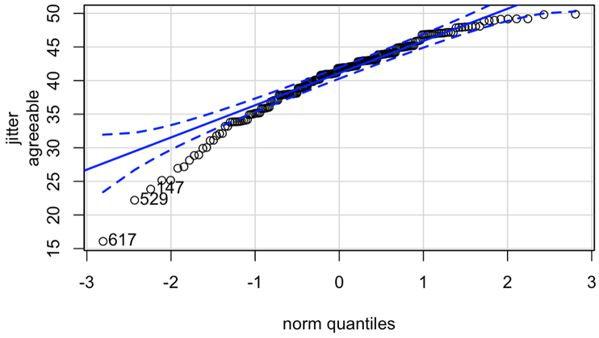
Prediction MCQs
5. What can be inferred from the following QQplot?
A. residuals distribution is slightly negatively skewed
B. assumption of residual normality is violated
C. residuals distribution is slightly positively skewed
D. outliers in this distribution are very influential

Slide 57
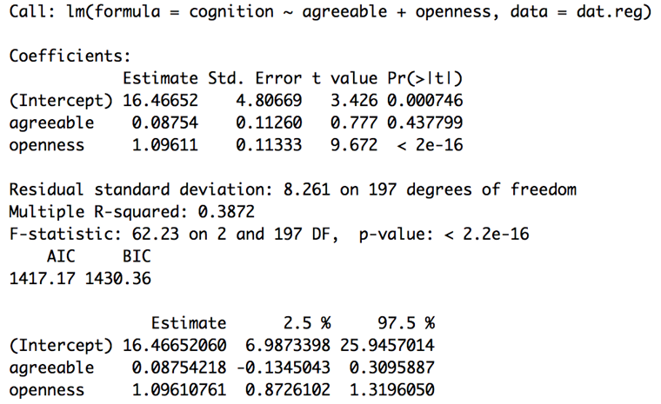
Prediction MCQs
6. Which of the following sentences is the most correct interpretation of the following analysis?
Openness is a statistically significantly stronger predictor of ”need for cognition” than agreeableness
Agreeableness is a significant predictor of cognition
The evidence is consistent with no prediction by agreeableness
Openness is a strong predictor of cognition

Slide 58
Prediction MCQ Answers
For the following regression equation, which option is the incorrect?
Y = 2.6 – 0.41X₁ + 0.51X₂
When X₁ increases by 1 and X₂ increases by 1, Y will increase by 0.10
The value of Y is 2.6 when scores on all independent variables are zero
Holding the scores on X₁ constant, 1 unit increase in X₂ predicts 0.51 unit increase in Y.
Holding the scores on X₂ constant, 1 unit increase in X₁ predicts 0.41 unit decrease in Y.

Slide 59
Prediction MCQ Answers
2. Which of the following sentences is correct about R-squared statistics?
When R-squared gets larger, the average size of residuals also gets larger
R-squared statistics indicates the variation of dependent predicted by each independent variable, holding scores on other independent variables constant.
The huge difference in observed R-squared and adjusted R-squared indicate strong bias in the value of observed R-squared.
R-squared will be less biased when there are more IVs.

Slide 60
Prediction MCQ Answers
3. Which of the following description is closest to the concept of heteroscedasticity?
Constant residual variance on different predicted values of dependent variables.
Non-constant residual variance on different values of independent variables
Residuals are distributed equally above and below zero
Residuals are not distributed equally above and below zero

Slide 61
Prediction MCQ Answers
4. Under which conditions that R-squared is least biased?
Sample size and the number of IVs are large
sample size and the number of IVs are small
R-square statistic is computed repeatedly
Sample size is large but the number of IVs is small

Slide 62
Prediction MCQ Answers
5. What can be inferred from the following QQplot?
A. residuals distribution is slightly negatively skewed
B. assumption of residual normality is violated
C. residuals distribution is slightly positively skewed
D. outliers in this distribution are very influential

Slide 63
Prediction MCQ Answers
6. Which of the following sentences is the most correct interpretation of the following analysis?
Openness is a statistically significantly stronger predictor of ”need for cognition” than agreeableness
Agreeableness is a significant predictor of cognition
The evidence is consistent with zero prediction probability by agreeableness
Openness is a strong predictor of cognition

Slide 64
RESEARCH QUESTIONS
FOR GROUP DIFFERENCES

Slide 65
Examine probability functions
encountered in the course

Slide 66
PROBABILITY FUNCTIONS
Construct confidence intervals
Calculate p-values for null hypothesis tests
CUMULATIVE DISTRIBUTION FUNCTION
Specify the probability of a corresponding continuous random variable by calculating
confidence interval
P-values
look at the total probability of anything below it
DENSITY FUNCTION
Specify the probability of random variable falling within a particular range of values
Bell-shaped curve
look at probability at one point

Slide 67
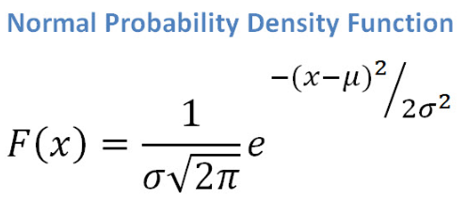
MCQs
Normal density function is defined by
Z-score
Variance
Mean
B and C

Slide 68
MCQs
Normal density function is defined by
Z-score
Variance
Mean
B and C
=> defined by parameters mean and variance

Slide 69
Core Concepts: Probability functions
Note that the horrible formula above refers to the function that is responsible for determining the normal distribution.
The probability functions create mathematical probability distributions- which we then use to construct p-values and confidence intervals.
Tl;dr these functions are determined by parameters, and are useful in statistical inference.

Slide 70
2. Research questions
addressing differences
between
TWO GROUPS

Slide 71
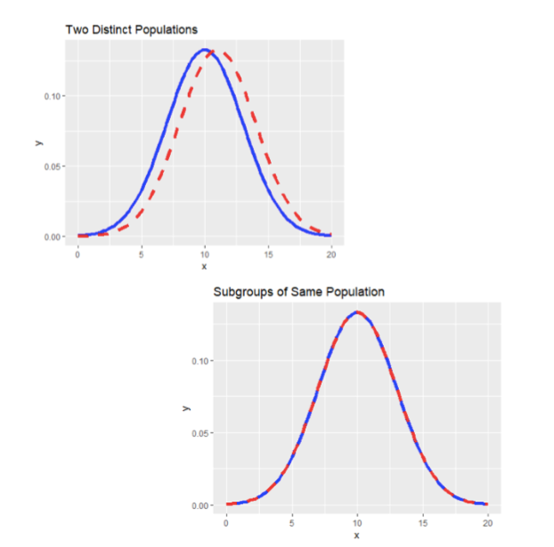
RQs for differences between
two groups
Distinct populations
Subgroups within the same population

Slide 72
Differences
When we talk of differences, we are asking how two groups vary on a construct score.
In this instance, the mean difference between the two scores are being examined.
When the two groups are a subgroup of the same population, we would expect the two means to be equal to each other.

Slide 73
3. Understand how two groups
can be formed as either
being independent
or dependent

Slide 74
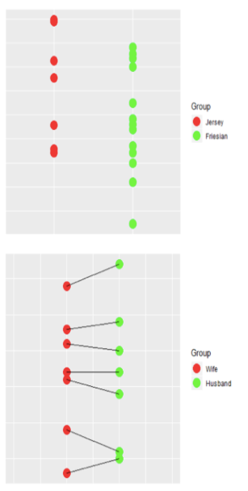
Group
Formation
Two mutually-exclusive groups
each score in one group is independent of all scores in the other group
participants can only belong to one group
the size of each group does not necessarily have to be the same
Two mutually-paired groups
each score in one group is linked to one particular score in the other group
same person being measured twice
two people having a common dependency
the size of each group must be the same by design
Mutually-exclusive groups (independent)
Mutually-Paired Groups (Dependent)

Slide 75
MCQs
Which example represents dependent groups?
RMHI and ARMP study
Time 1 and Time 2 study
Female and Male study
Jersey and Friesian study

Slide 76
MCQs
Which example represents dependent groups?
RMHI and ARMP study
Time 1 and Time 2 study
Female and Male study
Jersey and Friesian study

Slide 77
Differences: Independence
When we talk of Independent and Dependent groups- we specifically refer to the notion of independence in terms of the data.
In dependent data, we would expect the data to be related to the other in some way- this can be time series or paired data.
In independent data, we would expect the two groups to be independent of one another- we don’t expect group 2 to vary if we varied group 1.

Slide 78
4. Know how to undertake
investigations of
two group differences

Slide 79
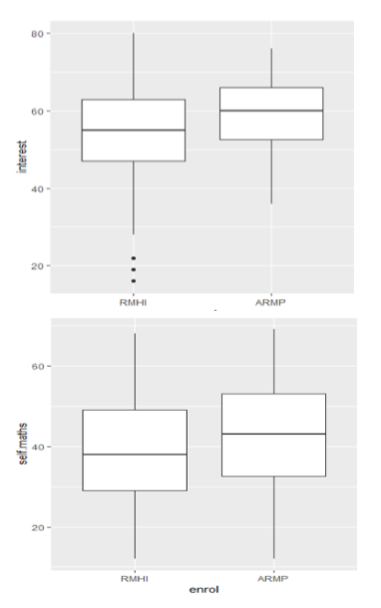
MEAN
DIFFERENCES
between
two
INDEPENDENT
GROUPS
Is there a difference in interest in statistics between ARMP and RMHI students in 2019?
Is there a difference in maths self-concept between ARMP and RMHI students in 2019?
Median
Whiskers
Outliers
Symmetric distribution

Slide 80
TRUE MEAN DIFFERENCES
vs SAMPLING VARIABILITY
There will always be a DIFFERENCE between sample means of two groups:
random sampling variability when groups from the same populations
random sampling variability plus a difference in population means when groups from different populations

Slide 81
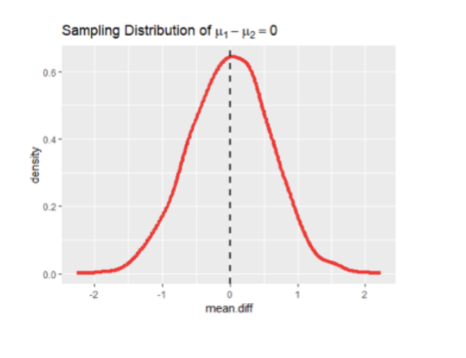
SAMPLING DISTRIBUTIONS
SAME POPULATION
no difference in population means
sampling distributions center around 0
Sampling distribution of group mean differences from the same population means will have a mean difference in the sampling distribution = 0

Slide 82
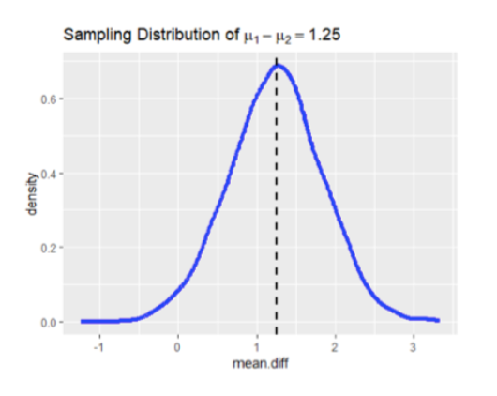
SAMPLING DISTRIBUTIONS
DIFFERENT POPULATION
Sampling distribution of group mean differences from the different populations will have differences in population means

Slide 83
MCQs
Negative sample mean differences indicate:
two distinct groups from different populations
two subgroups from the same population
the first experimental group has high sample mean than the second one
the second experimental group has high sample mean than the first one

Slide 84
MCQs
Negative sample mean differences indicate:
two distinct groups from different populations
two subgroups from the same population
the first experimental group has high sample mean than the second one
the second experimental group has high sample mean than the first one

Slide 85
Differences: Sampling Distribution in t-tests
The t-test examines the sampling distribution of the mean difference- so the parameter in question is the mean of group 1 - mean of group 2.
If the two groups did not differ, we would assume the mean difference to be 0, and if the two groups did differ, the mean difference would not be 0.

Slide 86
5. Examine assumptions of differences between two groups
and how these may affect
robustness of inferences

Slide 87
ASSUMPTIONS for
MEAN
DIFFERENCES
between two
INDEPENDENT
GROUPS
Observations are independent
Observed scores on the construct measure are normally distributed
Variances in two groups are the same
Levene’s Test
Fligner-Killeen’s Test
Homogeneity of variance assumption
Balanced/ Unbalanced design
Standardized/ Unstandardized confidence intervals against non-normality

Slide 88
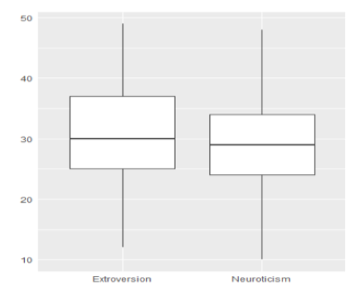
MEAN
DIFFERENCES
between
two
DEPENDENT
GROUPS
Is there a difference in level of extraversion and neuroticism between ARMP and RMHI students in 2019?
Difference Score
TWO POSSIBILITIES at the population level:
if the population mean difference scores is 0, then there is no difference between the two dependent groups on the construct
if the population mean differences scores is not 0, then there is a difference between the two dependent groups on the construct

Slide 89
ASSUMPTIONS for
MEAN
DIFFERENCES
between two
DEPENDENT
GROUPS
Observations are independent
Observed scores on the construct measure are normally distributed
Homogeneity of variance assumption is not relevant because the analysis is undertaken on the different scores
Possible effects of violation in sample data:
The robustness of confidence intervals to violation of normality assumptions depends on which type of interval is being used
Standardized confidence intervals are not robust against mild non-normality in different scores
Unstandardized confidence intervals are robust against mild-to-moderate non-normality in different scores

Slide 90
Differences: Statistical Assumptions
For independent t-tests:
Independent observations.
Normality of the two groups.
Homogeneity of Variance- the two groups are approximately normally distributed.
For dependent t-tests:
Independent observations. (this is separate from independent groups)
Normality of the difference data.

Slide 91
Differences: Statistical Assumptions
Note that homogeneity of variance is not an assumption in the dependent t-test. This is because the dependent t-test works on only the set of different scores, rather than the two sets of scores from different groups.
If a design is ‘balanced’ (equal sample sizes), then it is robust to violations of homogeneous variance and normality.
When sample size is roughly above 30, it is then somewhat robust to violations of normality (because of the central limit theorem).

Slide 92
Core Concepts: “Robust”
The notion of “robustness” refers to how good our tools are in capturing what they are set to capture.
If say an alpha is set to 5%, but in reality (or through tons of simulations), the real alpha (type-1 error rate- the rate of false rejections) is 10%, it is called liberal.
The opposite isn’t particularly good either- if the real error rate is 2% instead of the set 5%, it is called conservative- and is still an issue since our tools aren’t doing what they’re supposed to.

Slide 93
Research questions
addressing differences
between
THREE or more GROUPS
examine differences
only independent groups

Slide 94
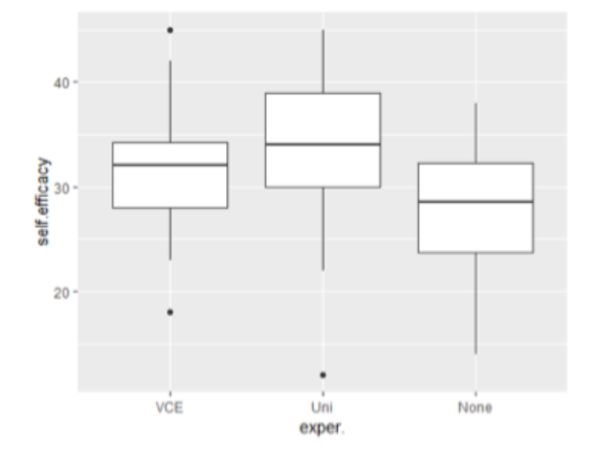
RQs for differences between
three groups
The differences of statistical self-efficacy between 3 groups: VCE, Uni, and others.
Median
Whiskers
Outliers
Symmetric distribution

Slide 95
FACTOR VARIABLES IN R
Purpose:
to deal easily with categorical variables
“Levels” of the factor do not operate as numbers
Factor variables
a variable defined as a factor type in has 2 or more levels
each level corresponds to one particular category
each level has an associated label attached it and shown in R

Slide 96
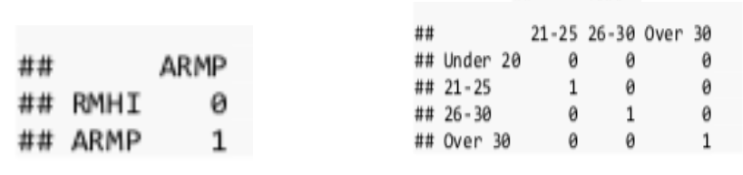
DUMMY VARIABLE CODING
Purpose: Dummy variables are used as devices to sort data into mutually exclusive categories (indicate the mutual co-occurrence of different categories)
Dummy coding transforms a categorical variable with g categories into a meaningful set of g - 1 dummy variables that each have values of either 0 or 1
3 CATEGORIES
2 CATEGORIES

Slide 97
Afterword
We’ve gone through a LOT in a short amount of time.
Don’t let anyone tell you otherwise, these concepts take time and practice to understand.
Thank you everyone for listening and give yourselves a pat on the back!

Slide 98
Afterword
I’d also like to have you all think about these tools a bit in your own time.
Research tools are limited to the extent of the researcher’s goals and ability to communicate them.
Believe me or not, I feel that understanding these tools are the easy part- communicating them and describing what they mean in practical terms take even more practice! And I’d argue that proper communication and understanding of these tools are immensely important in any piece of research.

Slide 99
We’d very much appreciate your feedback!
We’d really appreciate it if you could fill out this google form for feedback regarding the session we’ve just held.
https://bit.ly/2IHVd4Z

