Slide 1

An Analytical Survey of Song Recommendation Methods
SEIS 734-01 Spring 2015
Baker, Janzen, Moyo, Stevens, Waheed

Slide 2
Schedule
Review project overview and goals
Show Million Song Dataset
Describe data mining algorithm implementation
Association Rules
Collaborative Filtering
Naïve Bayes
Address testing methodology and quality
Provide recommendation
Questions

Slide 3
Overview
Millions of people buy and listen to songs on the Internet every year ¹
Music providers try to engage customers by recommending new songs to them²
Increased engagement -> song purchases = increased revenue
Challenge: What is the best algorithm to recommend new songs to music listeners?
Solution: Analyze three common data mining algorithms to determine the best fit

Slide 4
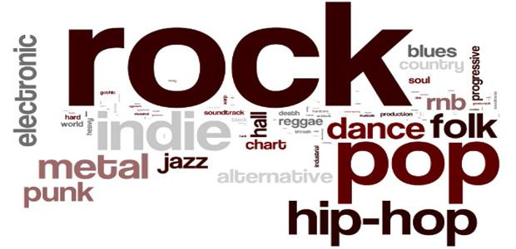
Million Song Dataset
Notes:
The database keeps track of activities in the emergency room.
It allows us the monitor…search…evaluate…
In the next 5 minutes, I will walk you through 10 examples of business questions we can answer using this database.

Slide 5
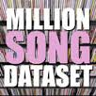
Million Song Dataset
1 Million popular songs curated by LabROSA (Columbia University)³
Taste Profile Subset: Real song listening transactions provided by The Echo Nest
Over 48 million transactions
Over 1 million unique listeners
380,000 distinct songs
Every user listened to at least 10 songs (avg = 48 & max = 9,600!)
Most listened to song? Katy Perry, Firework

Slide 6
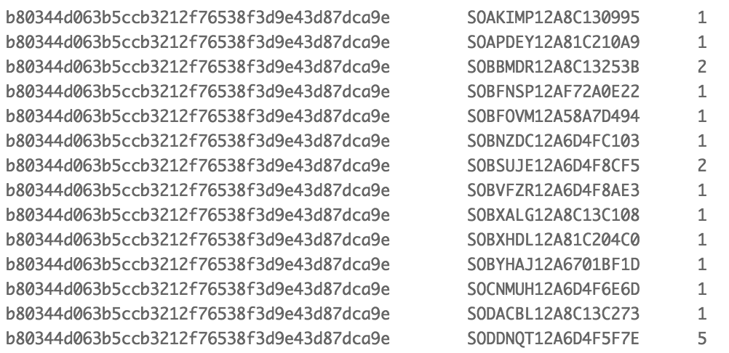
Taste Profile Subset
Anonymous User ID
Song ID
# Plays
Transactions

Slide 7

Data Mining Algorithms
Notes:
The database keeps track of activities in the emergency room.
It allows us the monitor…search…evaluate…
In the next 5 minutes, I will walk you through 10 examples of business questions we can answer using this database.

Slide 8
Association Rules (AR)
Market-basket analysis of song play transactions
Used HANA to generate 2-itemset ARs
Combined set of ARs for a song
determines predictions ranked by
confidence
Expensive due to the number of frequent items
Generating itemsets > 3 on HANA led to
out-of-memory errors
Algorithm assumptions:
Max Item Set = 2
Minimum Support = 0.00001 (~ 10 users played song)
Minimum Confidence = 0.20
Generated ~1,500,000 rules
Rule | Confidence
SOXKSAJ12A8C14588D => SOGDNKT12A8C1447DA | 0.4663072776280323
SOZZWDF12A8C14144C => SOKPDCL12A8C13B5E7 | 0.6455223880597015
SOFLQTC12A67021CCA => SOCHRFO12AF729B18C | 0.4196891191709845

Slide 9
Collaborative Filtering (CF)
Crowd based recommender algorithm which aggregates users’ song selections
Example:
A New User listens to Song D, and we
need to recommend songs:
Find song D in matrix and users who listened to it: U{2, 3}
Identify other songs users (U) listened to and rank
Result: 1st Song Recommended B, 2nd is A, with none for C
Song | A | B | C | D
User 1 | 1 | 1 | 1 | 0
User 2 | 0 | 1 | 0 | 1
User 3 | 1 | 1 | 0 | 1
Recommend Song | Count of User | Rank
B | 2 | 1
A | 1 | 2

Slide 10
Naïve Bayes (NB)
Uses probabilities to classify and rank recommendations
Example:
Calculate probabilities User
listened to song A & D:
P(Listened to Both/Total User Just D) = 1/2 = 50%
P(Not listened) = (Total Users – Both)/Total Users = (3 -1)/3 = 66%
Adjusted Probability = 50%/(50%+66%) = 43.1%
Algorithm assumptions: Songs with very few plays (<10% of plays vs. driver) removed to prevent unrealistic recommendations
User Play History
Song | A | B | C | D
User 1 | 1 | 1 | 1 | 0
User 2 | 0 | 1 | 0 | 1
User 3 | 1 | 1 | 0 | 1

Slide 11
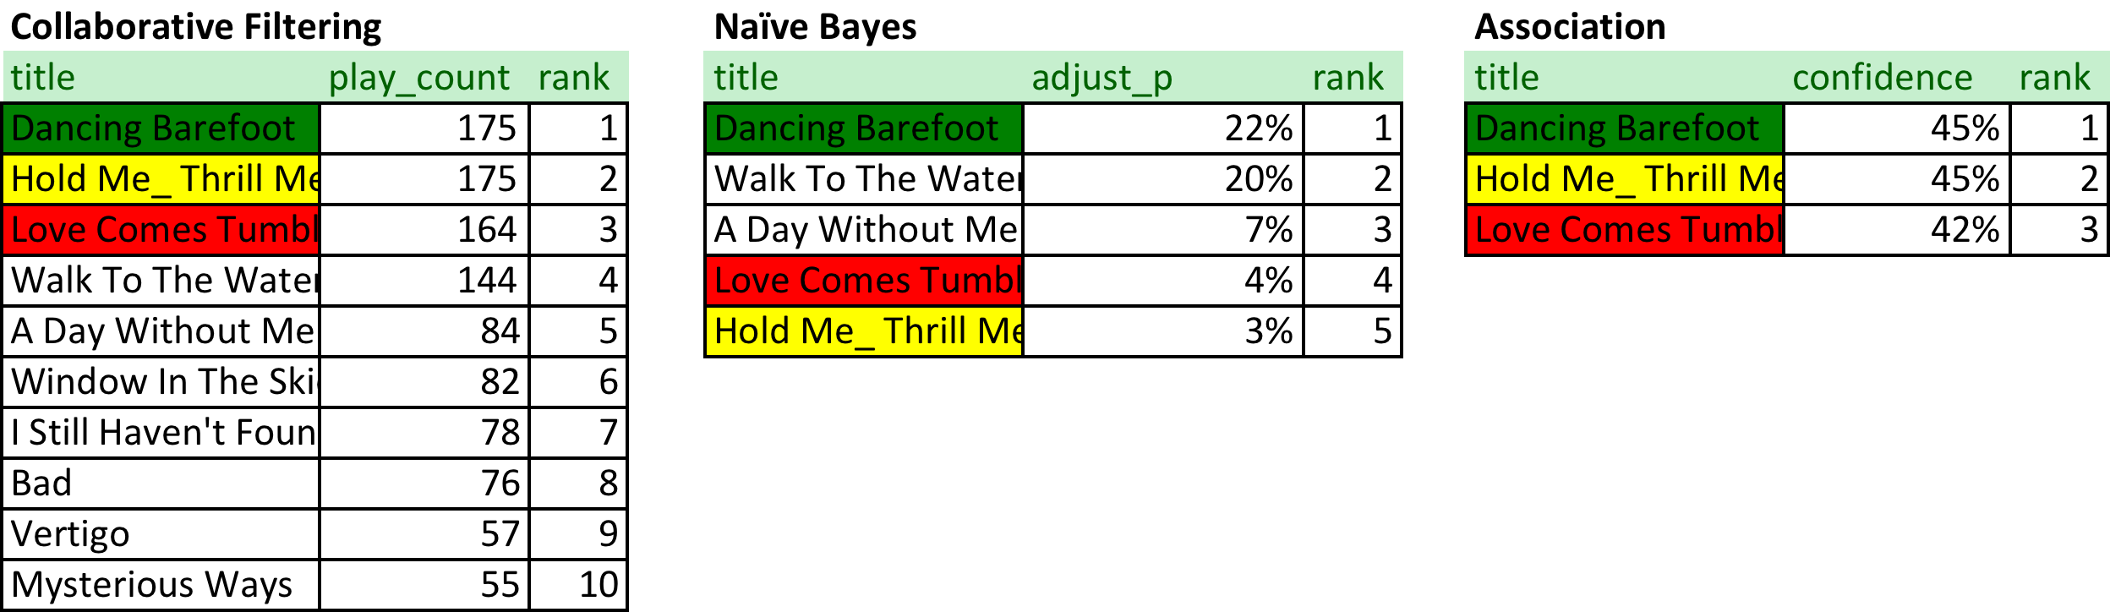
Quick comparison of models
Driver Song: U2 – Endless Deep

Slide 12

Testing Methodology and Quality Assessment
Notes:
The database keeps track of activities in the emergency room.
It allows us the monitor…search…evaluate…
In the next 5 minutes, I will walk you through 10 examples of business questions we can answer using this database.

Slide 13
Testing Methodology
Split the Taste Profile Subset into two datasets:
Training dataset containing transactions for ~1 million users
Test dataset containing transactions for 1 thousand users
Generate predictions using each algorithm for each user in the testing dataset
Tested predictions:
Split Test Dataset into Driver Set and Target Set
Determined how well our Driver Set could predict our Target Set
Created confusion matrices at varying thresholds to quantify algorithm comparison

Slide 14
Testing Results
Collaborative Filtering exhibits a relatively gradual decline in precision as the threshold is made less stringent across the test range

Slide 15
Testing Results
Business Imperatives:
Keep user engaged by providing relevant recommendations → PRECISION
Provide a reasonable number of recommendations to give user options
Use metric directly impactful to actual business application → AVERAGE RECOMMENDATIONS PER SONG
Strike a balance between the two measures

Slide 16
Testing Results
Collaborative Filtering
Exhibiting a gradual decline in precision in the test data
Possibly scalable based on the particular requirements of application
Association Rules
Higher precision for fewer recommendations but exhibiting a sharper decline.
Seemingly better suited to formats where fewer recommendations are passable

Slide 17

Recommendation and lessons learned
Notes:
The database keeps track of activities in the emergency room.
It allows us the monitor…search…evaluate…
In the next 5 minutes, I will walk you through 10 examples of business questions we can answer using this database.

Slide 18
Recommendations
Naïve Bayes
Precision not favorable at comparable level of recommendations
Dead-zones
Collaborative Filtering
Sustained precision
Scales well for larger datasets
Inexpensive computationally
Association Rules ( ✓ Our Recommendation)
Highest attained precision but sharper decline with increase in recall
Dead-zone of average recommendations per song

Slide 19
Lessons learned
Be prepared to iterate through the entire process rather than just within components
Development, implementation and testing
High volume of short life-cycle code
Establish clear methodology—plan multiple iterations
Experimentation necessary to discover interesting trends and patterns

Slide 20


Questions & Answers

Slide 21
Citations
Sisario, B. (2014, September 25). U.S. Music Sales Drop 5%, as Habits Shift Online. Retrieved May 2, 2015, from http://www.nytimes.com/2014/09/26/business/media/music-sales-drop-5-as-habits-shift-online.html?_r=0
Kaufman, Jaime C., "A Hybrid Approach to Music Recommendation: Exploiting Collaborative Music Tags and Acoustic Features" (2014). UNF Theses and Dissertations. Paper 540.
Thierry Bertin-Mahieux, Daniel P.W. Ellis, Brian Whitman, and Paul Lamere. The Million Song Dataset. In Proceedings of the 12th International Society for Music Information Retrieval Conference (ISMIR 2011), 2011.

