Slide 1
NFL Player Tracker
By John Jaroch

Slide 2
It’s Your Information Get It Now!
A user will be able to access real time information on about NFL Players
The database is accessible from any computer with internet access
A sleek and easy to use application that can be utilized by anybody to track NFL Players
Search Anytime With Fast Results!

Slide 3
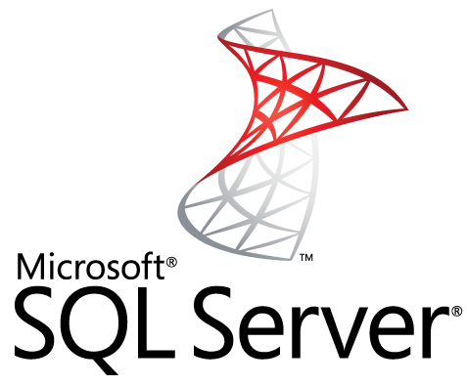
SQL Server
SQL Database will be utilized through a web based application that allows input and many other functions of a powerful database

Slide 4

Java Based
The programming on the web page will be wrote in Java and link directly to a database

Slide 5
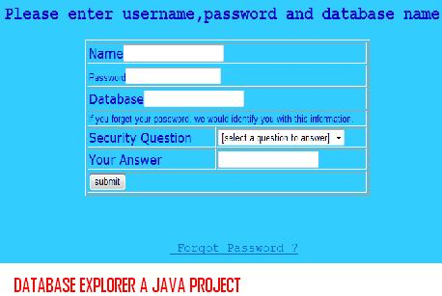
Just Log In And Take Control
Simply Log In From Any Computer
Database Has User Accounts And Groups To Restrict Access For Novice Users
Special Access Is Allowed For Administrators

Slide 6
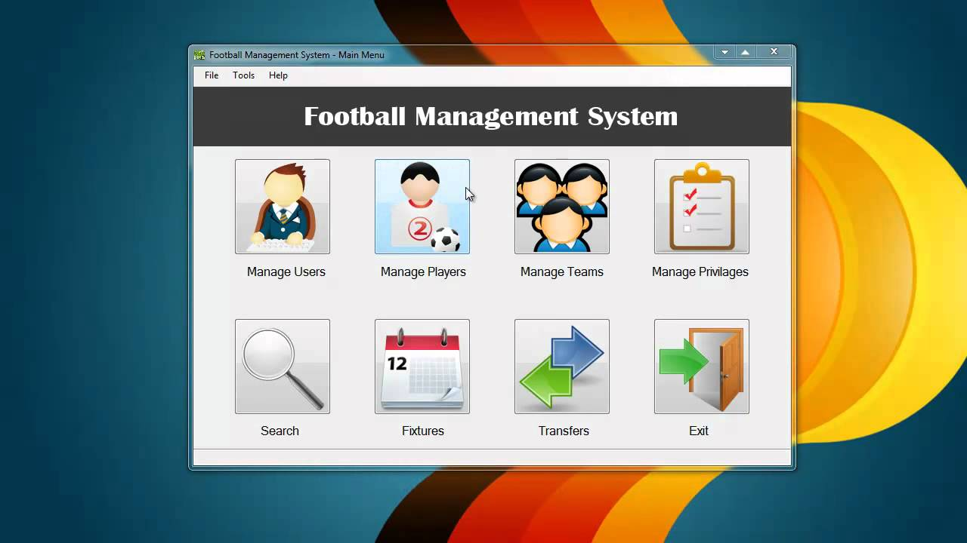
Slick Interface Fast Performance
When Using A Java Program And SQL The Results Are Amazing And Easy To Understand For The End User
* Sample Only

