Slide 1

Optimizing Plant Growth
John Jarvis
CS422

Slide 2


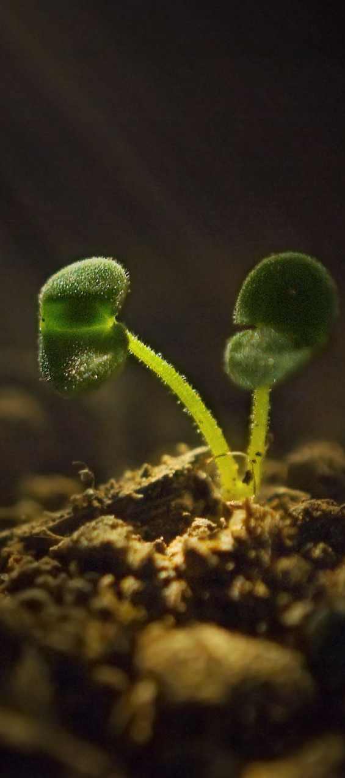

Problem Description
Plants have many different requirements to thrive (water, soil, temperature, etc.)
Different plants have different requirements
Most home gardeners don’t have access to controlled environments, so identifying optimal conditions for most plants could be beneficial

Slide 3

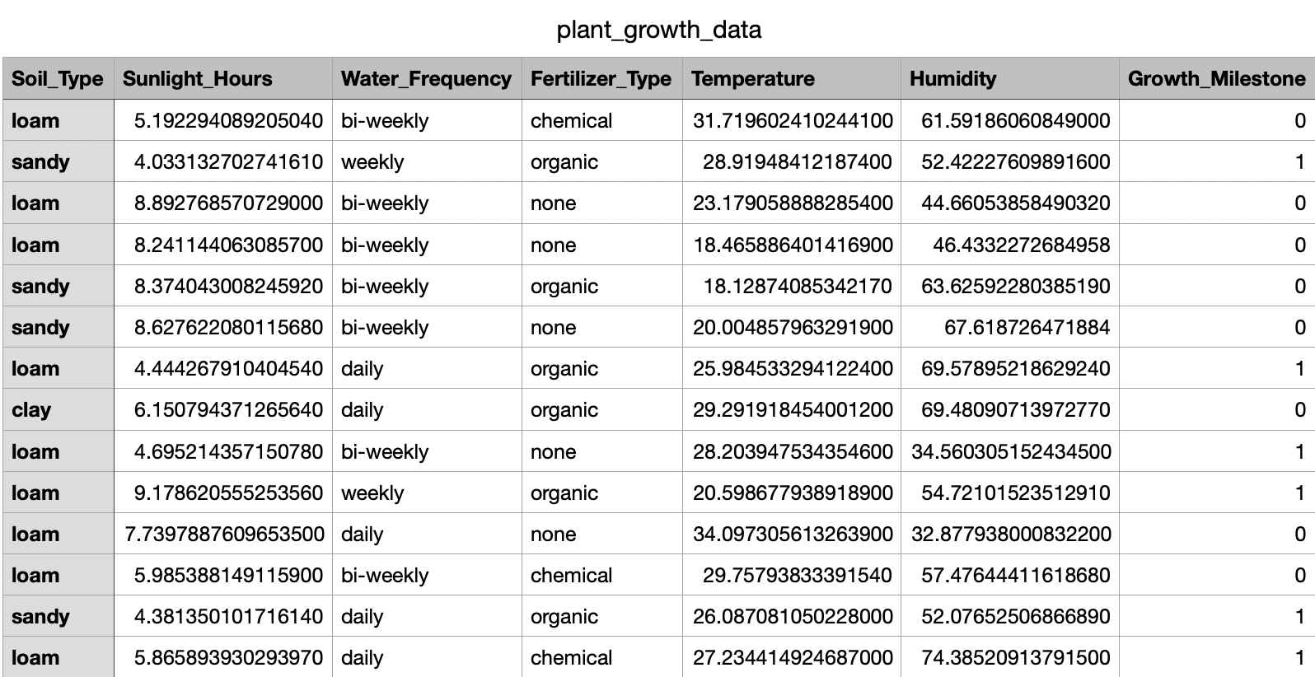
Data being used 194 samples

Slide 4
Machine Learning Methods
Goal:
With the data available, be able to predict whether a plant was likely to succeed given a certain set of growing conditions
Actions:
Analyze feature importances
Test different classification models
Determine best models
See if we can predict whether a plant will succeed or fail in certain conditions

Slide 5
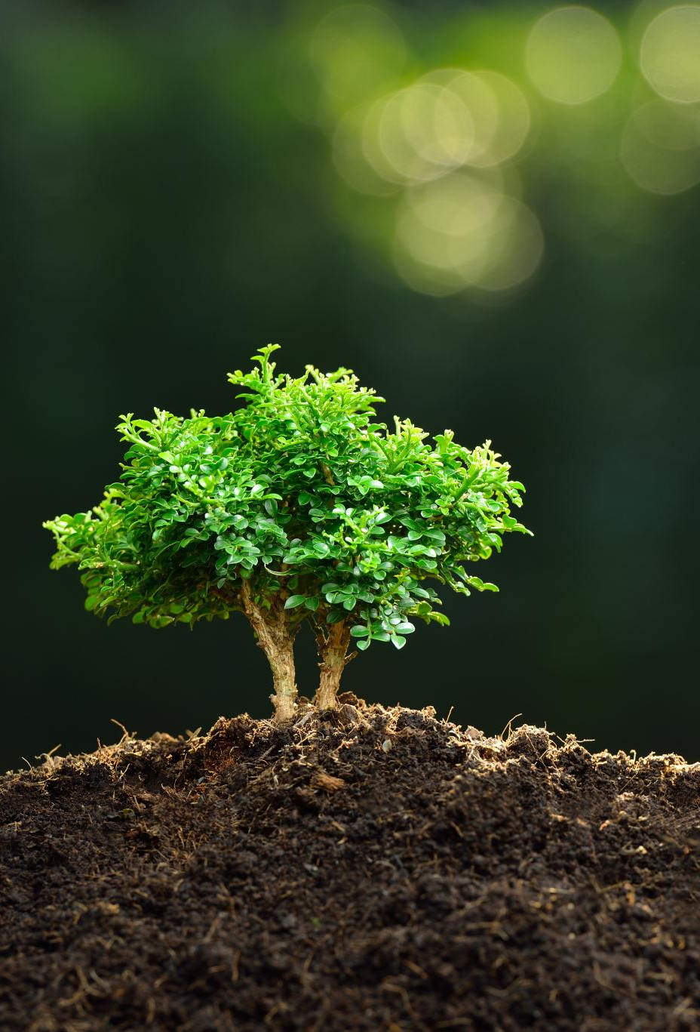
Methods Tested/Used
Random Forest Classifier
Logistic Regression
Gaussian Naïve Bayes
Decision Tree Classifier
Support Vector Classifier
Gradient Boosting Classifier
KNN

Slide 6
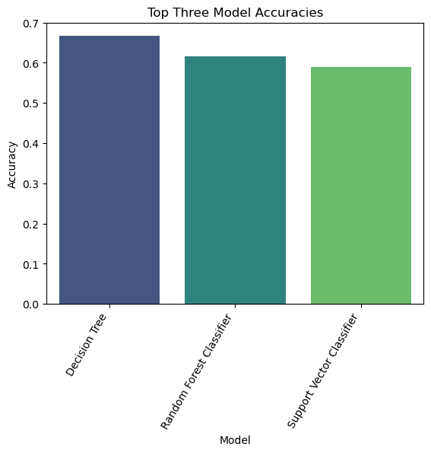
Top 3 Methods (by Accuracy)

Slide 7
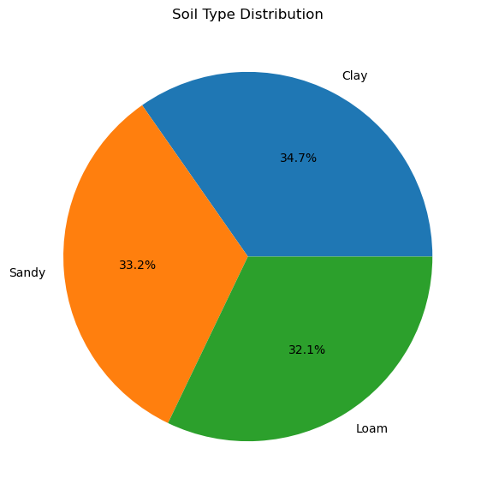
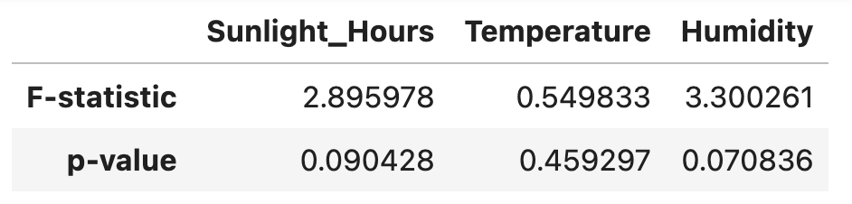
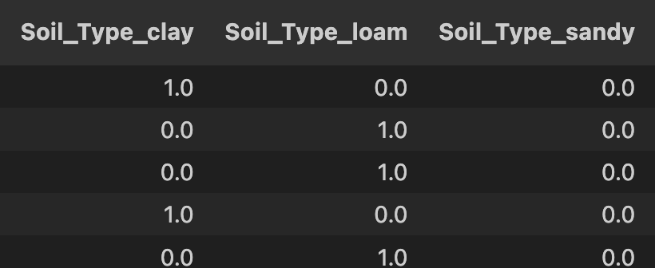
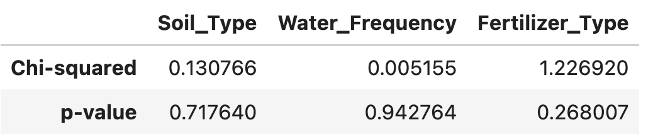
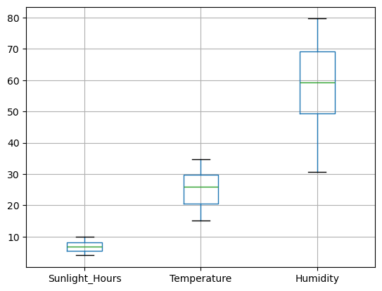
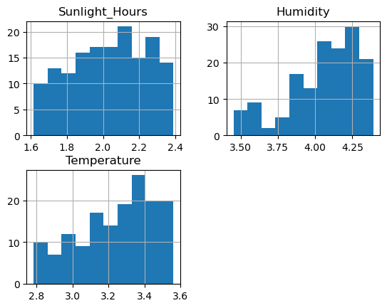
Phases:
Visualize Data and Interactions
01
Statistical Analysis
02
Preprocess Data
03
Train, Test, and Compare Models
04
Summarize Findings
05
One Hot
Encoding
Find top 3 models:
Decision Tree
Random Forest
Support Vector
Cross validate each to assess the best
ANOVA
Chi Squared
Transformations
log
std
cbrt

Slide 8
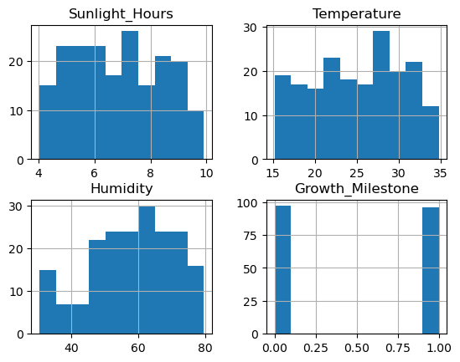
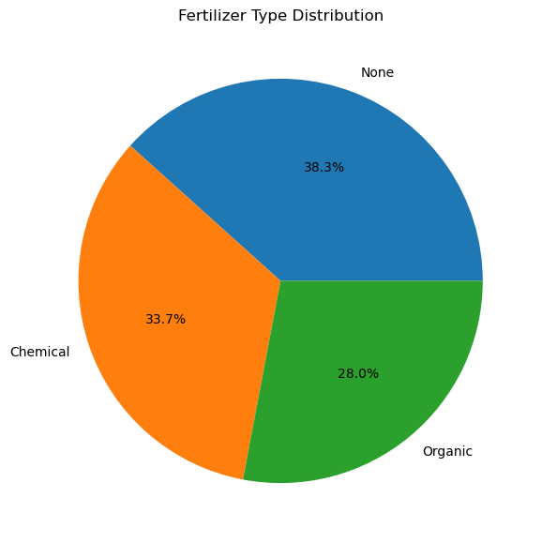
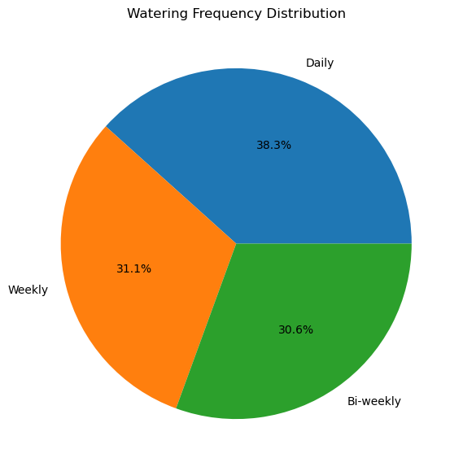
1.
Visualization

Slide 9
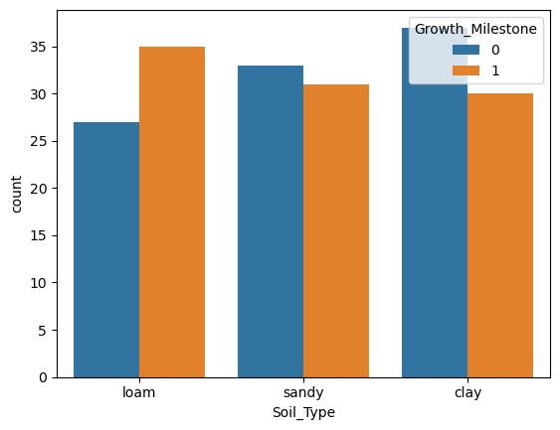
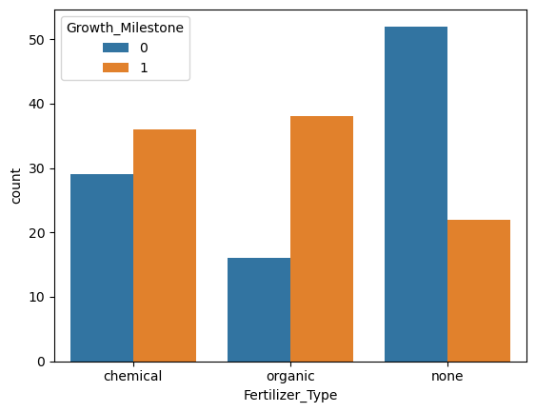
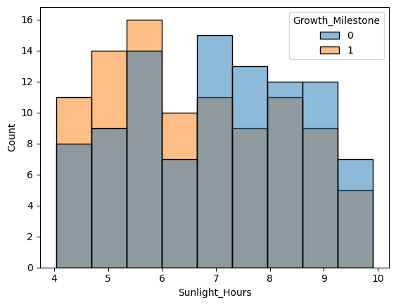
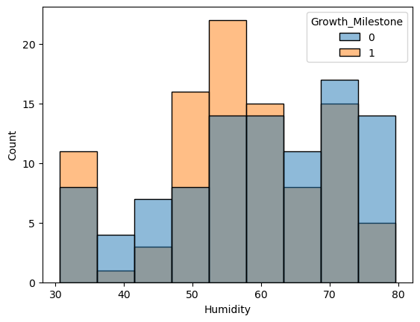
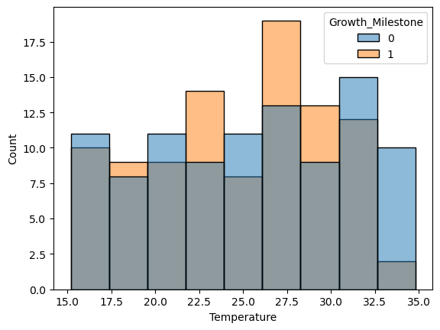
1.
Visualization:
Features vs. Success

Slide 10
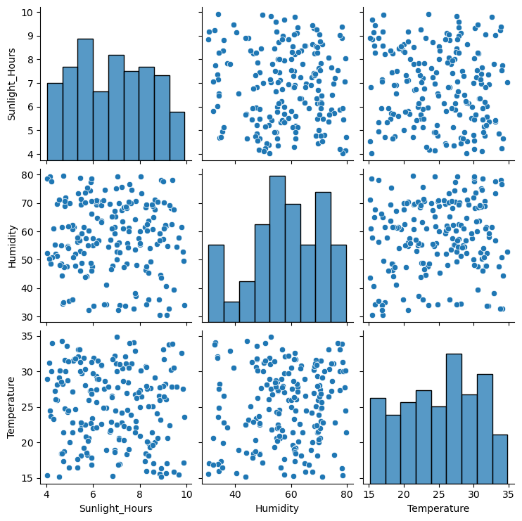
2.
ANOVA:
Chi-square:

Slide 11
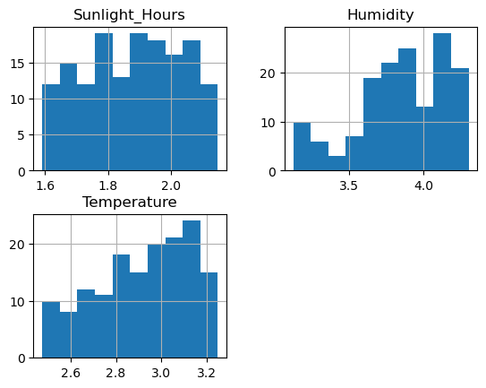
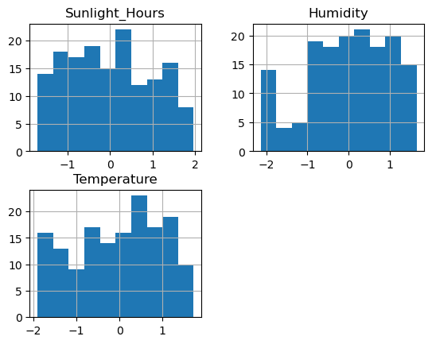
3.
Preprocessing:
One Hot encoding:
Logarithmic
CBRT
Standard Scaler

Slide 12
Results from Modeling
Decision Tree initially had the best accuracy (67%)
Cross-validation for the top 3 models didn’t improve scores much, if anything it centered the scores
Unfortunately, none of the models were very accurate with our dataset

Slide 13
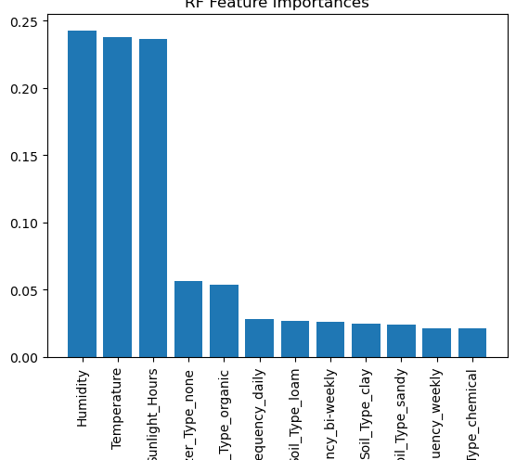
Observations/Takeaways
This particular dataset was not optimal for training a prediction model
With this dataset, its probably more beneficial to observe the feature importances and their correlations with the likelihood for plant success
The addition of fertilizer, whether chemical or organic, is a controllable factor that a gardener can take advantage of
Overexposure to sunlight is something that can be mitigated by considering planting location

Slide 14
Final Thoughts
The data that I used for this project wasn’t the best, but I think there was some useful information that was found even if I couldn’t find an accurate model
As we become more aware of our effects on the environment (and the long-term repercussions), it’s important that we look at comparisons such as chemical vs. organic fertilizer and realize we might be able to achieve the same quantifiable goal with a qualitative/subjective method
I still think this project is worth pursuing, and will likely continue to do so, even if I need to collect my own data
Note: for what its worth, I did attempt to find better data than what I used. I looked around at several publicly available datasets and this still was the closest I could find to something I could try to build a model with. I also reached out to one person who had conducted a similar greenhouse study that stated they’d provide the data for good cause, but I never heard back.

Slide 15
Dataset Source:
https://www.kaggle.com/datasets/gorororororo23/plant-growth-data-classification/code

