Slide 1
Synthesis of Formaldehyde using Methanol
A Presentation by
1. Manish Ojha 2013A1PS455G
2. Kushal Lohiya 2013A1PS592G
3. Jai Bassi 2013A1PS703G
4. Sudheer.k 2013A1PS903G

Slide 2
Formaldehyde:
Formaldehyde, HCHO or CH2O is the simplest of aldehydes. At ordinary temperature it is a gas with a very pungent odor.
Formalin is a trade name for a solution containing 40% formaldehyde and 60% water or water and methyl alcohol.
Processes in the upper atmosphere contribute up to 90% of the total formaldehyde in the environment.
Formaldehyde occurs in nature and it is formed from organic material by photochemical processes in the atmosphere. Formaldehyde is an important metabolic product in plants and animals (including humans), where it occurs in low but measurable concentrations.
Production of formaldehyde in 2015 is 52 million tons globally.

Slide 3
Properties:
Physical Properties:
Colorless gas at ambient temperature that has a pungent, suffocating odor.
It is a highly flammable gas with flashpoint of 50°c
Formaldehyde gas is readily soluble in polar solvent
Boiling point at 101.3 kPa = -19.2°c
Melting point = -118°c
Density at –80°c = 0.9151g/cm3

Slide 4
Properties:
2. Chemical Properties:
Formaldehyde is one of the most reactive organic compounds known
At 150°c formaldehyde undergoes heterogeneous decomposition to form methanol and CO2 mainly. Above 350°c it tends to decompose in to CO and H2.
Polymerization: Gaseous formaldehyde polymerizes slowly at temperatures below 100°c. It is catalyzed by addition of impurities like acids.

Slide 5
Properties:
Formaldehyde is readily reduced to methanol with hydrogen over many metal and metal oxide catalysts. It is oxidized to formic acid or CO2 and H2O.
Formaldehyde condenses with urea, melamine, urethanes, cyanamide, aromatic sulfonamides and amines, and phenols to give wide range of resins.

Slide 6
Applications of Formaldehyde:
Formaldehyde is an important industrial chemical and is employed in the manufacture of many industrial products and consumer articles.
Formaldehyde is used extensively in the woodworking and cabinet-making industries. It is also used in photography for colour negative film and in pre bleaching.
Formaldehyde is a common building block for the synthesis of more complex compounds and materials.
Products generated from formaldehyde include urea formaldehyde resin, melamine resin, phenol formaldehyde resin, polyoxymethylene plastics, 1,4-butanediol, and methylene diphenyl diisocyanate.

Slide 7
Applications of Formaldehyde:
The textile industry uses formaldehyde-based resins as finishers to make fabrics crease-resistant.
. Formaldehyde-based acetal resins are key to the manufacture of automobiles, and used to make components for the transmission, electrical system, engine block, door panels, axles and brake shoes.

Slide 8
Methods of production:
Catalytic oxidation-dehydrogenation of methanol
Oxidation of methanol is done by combustion with oxygen
Major product formed in this process is Formaldehyde so distillation of it from methanol is easier.
Tail gases are mostly non reactive (nitrogen, inert gases, little amount of water)
Cost of production of formaldehyde is cheaper.

Slide 9
Methods of production:
2. Partial Oxidation of methane or LPG
Partial oxidation of methane/ LPG is done which is comparatively difficult.
A Lot of side products are formed in this process because of different level of oxidation
Its difficult to separate formaldehyde from other side products by distillation.

Slide 10
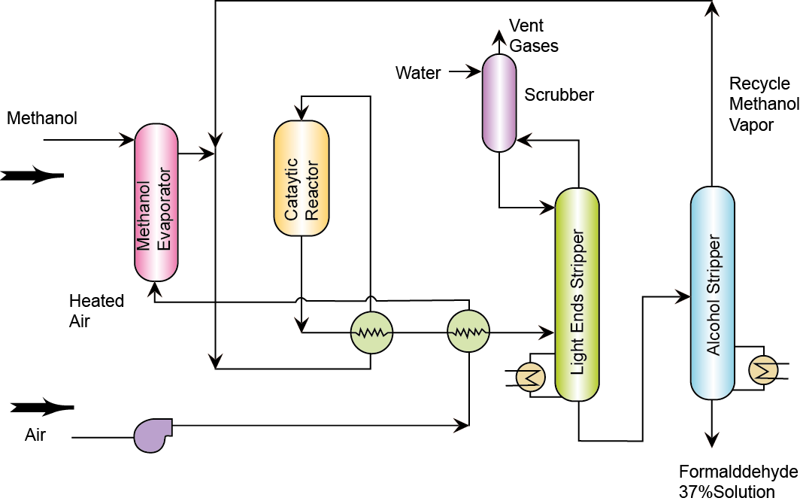
Basic flow sheet :

Slide 11
Process equipment used :
Methanol evaporator : In the methanol evaporator, it can go through complex processes, such as bubbling, heating, evaporation, mixing, separating and heating, thus a large number of steam be can saved.
Catalytic reactor : Most widely used in case of precious metal catalysts to minimize attrition losses. Catalyst usually in the form of pellets.

Slide 12
Process equipment used
Absorption tower : Used for taking up soluble gas in a solvent liquid and producing a solution plus a lean exit gas
Reboiler : used natural circulation to circulate fractionating tower bottom in heat exchange with steam. ex: it provides heat for fractionation.
Condenser : Usually water cooled tubular construction to provide reflux and overhead product from fractionating column.

Slide 13
Process & flow sheet Description
By: Sudheer

Slide 14
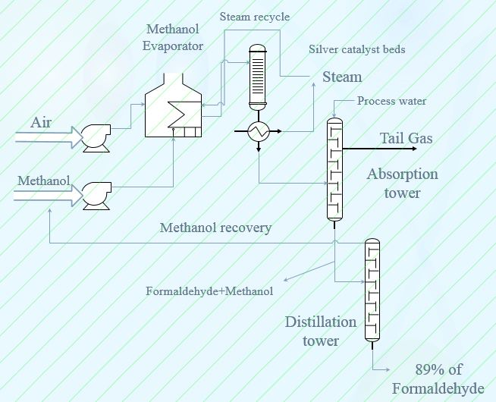

Slide 15
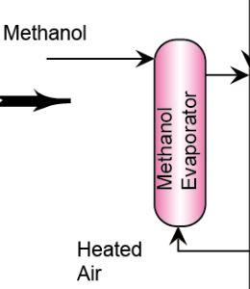
Methanol evaporator :
Air & Methanol enters the evaporator at 54°c
Feed ratio ( methanol/Oxygen ) is around 0.3-0.5
Basically evaporation of methanol and mixing with hot air takes place in this equipment.
Reaction: Pyrolysis: CH3OH HCHO + H2
H = +19.8Kcal

Slide 16
Catalytic bed reactor :
Reactions involved :
a)Oxidation: CH3OH + 0.5 O2 HCHO + H2O. H= -37Kcal
b)Undesired reaction: CH3OH + 1.5 O2 2H2O + CO2. H= -162Kcal
Catalyst used : Silver or zinc oxide catalysts are used.
Reactor conditions : 450-600°c

Slide 17
Heat exchanger :
Basically a “shell & tube” heat exchanger is used to generate steam
by heating water with the heat released in the reactor. The steam is formed within the heat exchanger is used as heat source for the methanol vaporizer.
some part of the steam is also used to generate electricity using steam turbines ( principle of rankine cycle )

Slide 18
Absorption tower : (water as absorbent)
It’s main function is to absorb any formaldehyde vapour from the reactor product stream and removing any inert or unreacted gases.
The column contains 10 trays each of them are 30% efficient. Due to high water solubility of Formaldehyde and methanol, 33 mole %
formaldehyde and 4 mole % methanol solution is produced. Nitrogen and trace amounts of formaldehyde and methanol are purged in the off gas stream. The product is sent into the distillation column for further removal of methanol to meet product specifications.

Slide 19
Distillation tower :
The distillation column removes remaining 56% of the methanol that was not combusted in the reactor. The column contains 30 trays as well as a reboiler and a partial condenser. The top product contain 99% methanol which is recycled and mixed with methanol feed prior to pumping. The bottom product contains “formaldehyde” and 1 weight % methanol which is subsequently sent to storage tank.

Slide 20
Storage of Formalin :
Storage of formaldehyde is difficult because there is a chance of formation of “formic acid” is favoured at temperature above 25C
In dilute quantities methanol may be used to inhibit the degree of polymerization of formalin with 1 wt.% methanol typically used.
Formic acid is readily formed when formaldehyde vapours are readily oxidized by atmospheric oxygen. The extent of acid formation may be reduce by storing the formalin under an inert gas blanket.

Slide 21
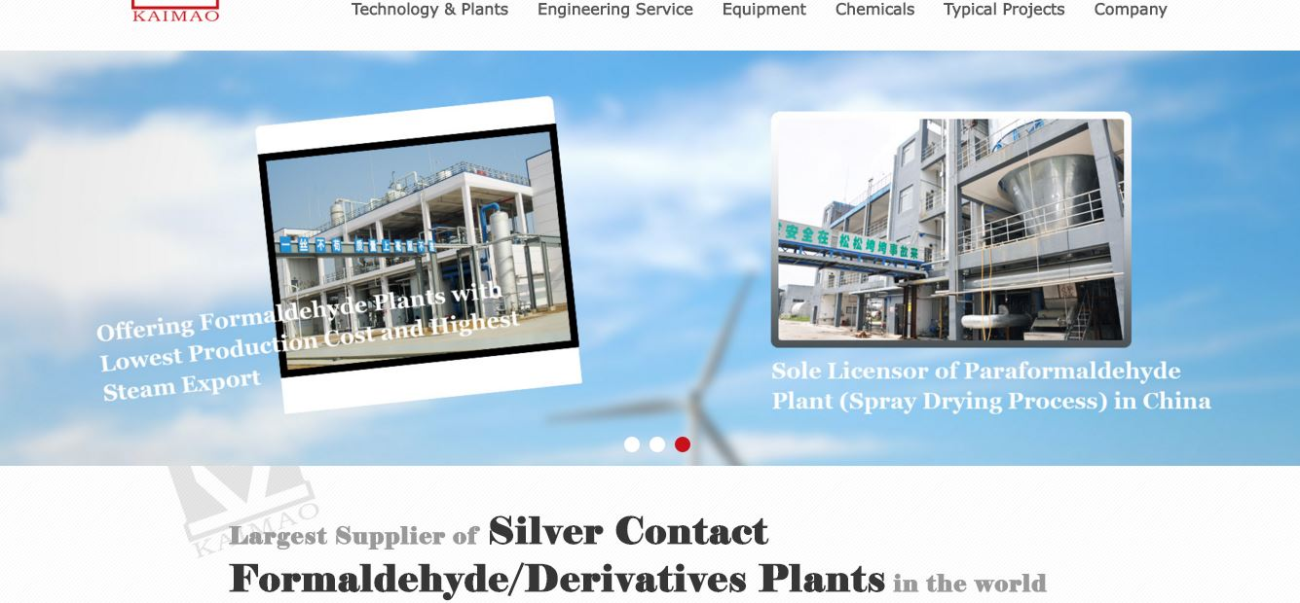

Slide 22
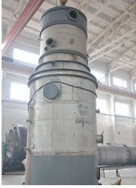
Methanol evaporator
JiangsuYimao International Trade Co Ltd

Slide 23
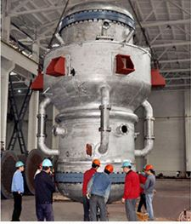
Catalytic reactor :
JiangsuYimao International Trade Co Ltd

Slide 24
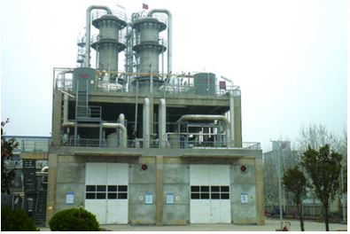
Absorption tower :
JiangsuYimao International Trade Co Ltd

Slide 25
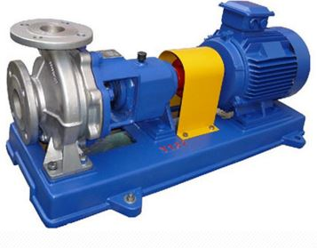
Centrifugal pump
JiangsuYimao International Trade Co Ltd

Slide 26
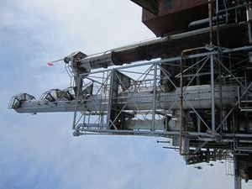
Distillation tower :
International Process Plants

Slide 27
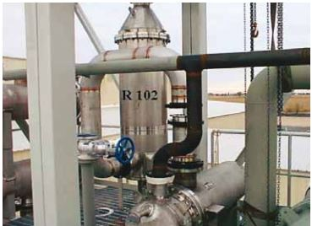
Catalytic Recuperative Oxidizer(CATOX)
Installed by HALDOR TOPSOE at Saudi Formaldehyde Chemical Co Ltd.

Slide 28
Formaldehyde industry, Indian scenario :
Presently, there are about 25 formaldehyde plants having total installed capacity of about 3,59,700 tonne per annum
Based on the growth in various end use segments of formaldehyde, demand for formaldehyde has been estimated to be about 8,14,630 tonne per annum.
At present silver process is predominant in the Indian formaldehyde industry. About 72% of the total capacity is based on silver process.

Slide 29
Major producers of formaldehyde in India
Kanoria Chemicals & Industries Ltd
Allied Resins & Chemicals Ltd
D&B in collaboration with TATA chemicals.

Slide 30
FORMALDEHYDE INDUSTRY : GLOBAL SCENARIO
The total installed capacity of formaldehyde in world is estimated at about 15 million tonne and the capacity utilisation is about 85-90% worldwide
Of the present total capacity, about 30% is based in USA and Canada; about 32% in Western Europe and about 8% in Japan.
The major producers of formaldehyde in the world are the following:
Borden, USA 2. DuPont, USA 3. Perstorp, Sweden 4. Georgia Pacific, USA
5. Degussa, Germany 6. Jiangsu kimao, china

Slide 31
Technology status in India
Out of 25 formaldehyde plants, only 4 plants are based on metal oxide process; while the rest of the plants are based on silver catalyst process.
Raw Materials: Methanol consumption per ton of formaldehyde is observed in the range of 450-500 kgs. in the units based on metal oxide process, and 430-440 kgs. in the units based on silver catalyst process.
Electricity Consumption: Electricity consumption per ton of formaldehyde is found to be about 25- 40 KWH in the units based on silver catalyst process while it is 70-80 KWH in the units based on Metal Oxide process.

Slide 32
Environmental Aspects:
Solid and liquid waste are not generated in the formaldehyde plants. The off-gas is the only possible source of pollution. Most of the domestic units are recycling 2/3rd part of the tail gases and remaining 1/3rd part is incinerated by CATOX

Slide 33
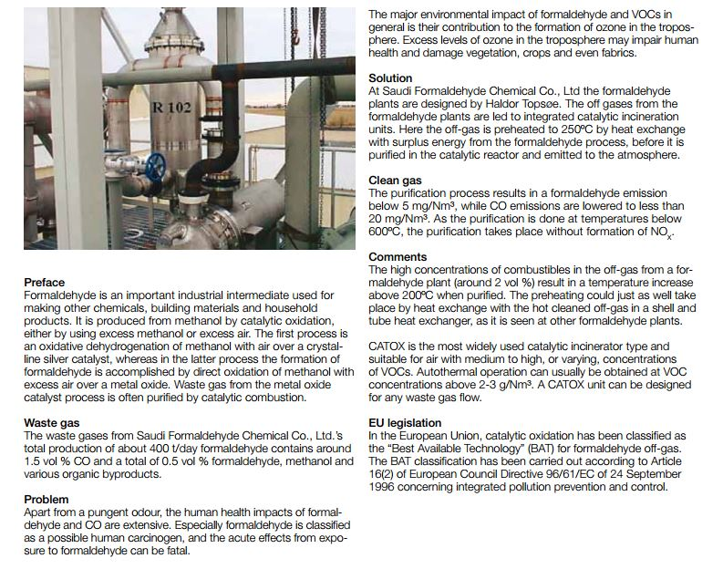
Case study : Waste gases from formaldehyde production plants

Slide 34
Continued:
Waste gas: The waste gases from Saudi Formaldehydes Chemical CO Ltd’s total production of 400tonnes/day formaldehyde contains around 1.5%vol CO & 0.5%vol of formaldehyde, methanol and various organic by products.
Problem: Apart from a pungent odour, the human health impacts of formaldehyde and CO are extensive. Especially formaldehyde is classified as a possible human carcinogen, and the acute effects from exposure to formaldehyde can be fatal.
Solution: The off gases from the formaldehyde plants are led to integrated catalytic incineration units. Here the off-gas is preheated to 250ºC by heat exchange with surplus energy from the formaldehyde process, before it is purified in the catalytic reactor and emitted to the atmosphere.

Slide 35
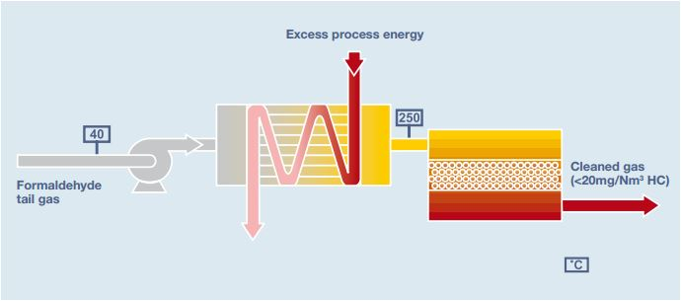

Slide 36
The CATOX Advantage:
cleaning efficiency: > 99.5%
No NOx formation
catalyst lifetime: > 30,000 hours of operation
low or no fuel consumption
automatic operation, 24 h/day

Slide 37
Raw Materials
The major raw materials required for the production of formaldehyde are methanol and silver catalyst or metallic oxide catalyst.
In addition to these raw materials, packing material for finished product is required as auxiliary raw material for the production of formaldehyde.
The annual requirement and cost of raw material is indicated in Table (next slide).
The total annual cost of raw material is estimated at Birr 2,570,500 which is equivalent to INR 80 lakhs. *( 1 birr = 3Rs/- )

Slide 38
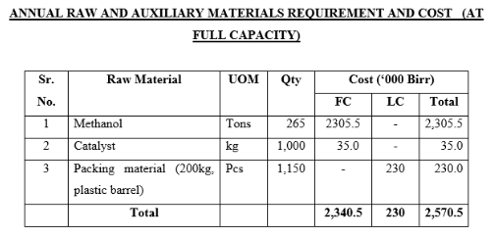

Slide 39
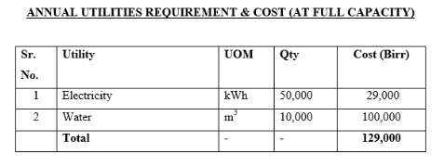
Utilities Used
Electricity, furnace oil, steam and water are utilities of the proposed project. The total annual cost of utilities is estimated at Birr 129,000 which is approximately INR 4 lakhs.
The annual consumption and cost of these inputs is indicated in the following table.

Slide 40
Environmental Implications
The adverse impact in relation to the formaldehyde production process is caused by the exhaust gas to be generated from the oxidation reaction and hence the exhaust gas is catalytically treated before discharged to the atmosphere.
In this study the answer was sought to the question whether staying in a much cleaner environment for a substantial duration had any beneficial effect on their respiratory health. Paharpur Business Centre follows an eco-friendly approach to maintain a high level of Indoor Air Quality. Outside air is washed with water in a scrubber before it is allowed inside the building, to reduce the level of water-soluble components like SO₂, NO₂ and SPM. (Suspended Particulate Matter)

Slide 41
Environmental Implications
The washed air is then passed through a green house of selected plants that effectively remove formaldehyde, benzene and carbon monoxide from the air and enrich it with fresh oxygen.
The processed air is passed through micro-V filter to remove bacteria and pumped into the building as fresh air. The entire building is a no-smoking zone, which is strictly maintained. There are several offices in the building and a number of people work there for 8-10 hours per day.

Slide 42
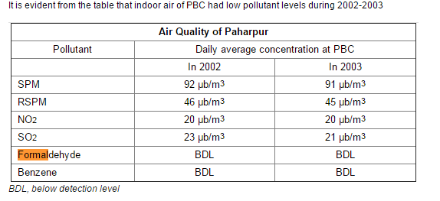

Slide 43
Safety Aspects
The major toxic effects caused by acute formaldehyde exposure via inhalation are eye, nose, and throat irritation and effects on the nasal cavity. Other effects seen from exposure to high levels of formaldehyde in humans are coughing, wheezing, chest pains, and bronchitis
Repeated contact with liquid solutions of formaldehyde has resulted in skin irritation and allergic contact dermatitis in humans.
Animal studies have reported effects on the nasal respiratory epithelium and lesions in the respiratory system from chronic inhalation exposure to formaldehyde.

Slide 44
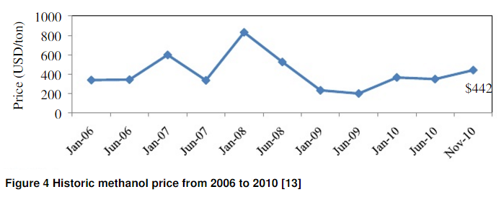
Economic Factors
Methanol Price: Methanol is the primary feed in this plant. Methanol is directly converted into formaldehyde and therefore it serves as essential part of the production. By examining the methanol price in the past few years, it was observed that it fluctuated in very high magnitude month by month. For example in January 2008,the price went up to $832/ton whereas a year later in 2009, the price was marked at $233/ton.

Slide 45
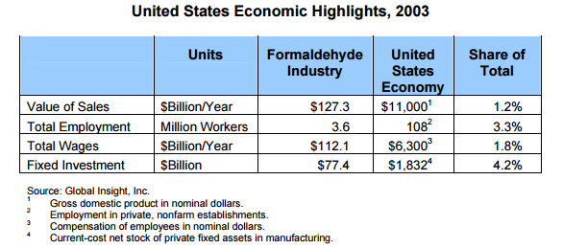
The cost of raw material account for 32.96% of the production cost hence the costs of raw materials should be reduced.
Transportation Costs are extensive.

Slide 46
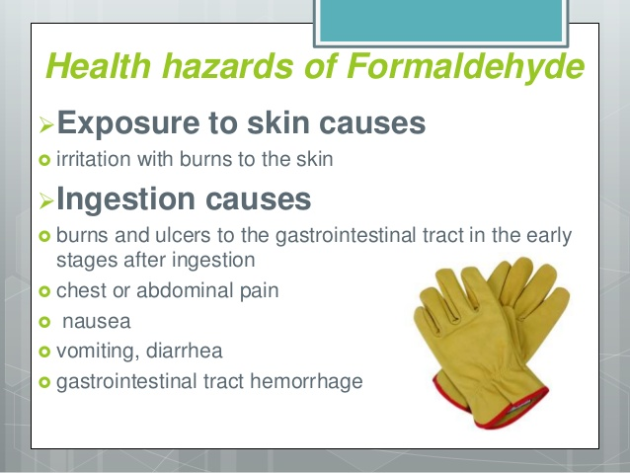
Future Scope
Special attention should be given to low-concentration effects on the skin of the face (cheeks, eyes) for both surface exposure and inhaled air mixtures.
The possible potentiation of sensory irritation by formaldehyde at low concentrations should be further investigated in mixtures of irritants with different durations of exposure.
Sensory effects, when human beings are exposed either to air containing formaldehyde or air without formaldehyde, should be compared.

Slide 47
There is a need for extensive follow-up studies on working populations already investigated (maybe in excess of 20 years), because a long minimum latent period may be a feature of the response of the human nasal epithelium to cancer-causing agents.
Epidemiological studies should also be re-evaluated for mortality due to cancers of the buccal cavity and pharynx, (human beings are not obligate nose breathers).
Research should be directed to the formaldehyde concentrations producing such effects as well as to the skin parameters conditioning the start of the irritative skin contact reaction.

Slide 48
References:
http://www.kaimao-chem.com
http://www.topsoefuelcell.com/
http://www.dsir.gov.in/
King Fahd University Of Petroleum & Minerals
http://www.scielo.cl/
http://nortech.oulu.fi/SkyPro/Proceedings/Ref_pp_070-073_Niskala.pdf

Slide 49


