Slide 1
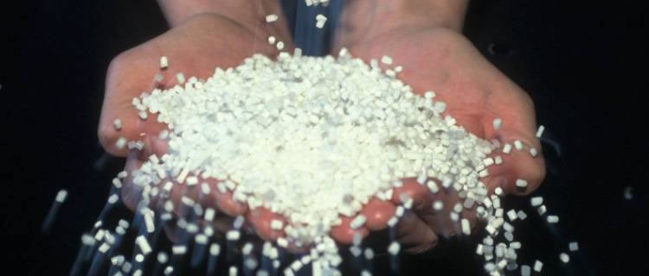
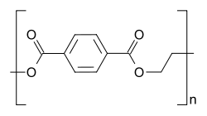
Polyethylene terephthalate Production
Rishu Garg
Arnabh Kumar
Shivam Srivastava
Priyanshu Lilha

Slide 2
Introduction -Arnabh Kumar
PET stands for poly-ethylene terephthalate and is one of the most common thermoplastic polymer.
It was patented in 1941 in England
It accounts for around 18% of the worlds polymer production which puts it in third place after polyethylene and polypropylene.
PET consists of polymerized repeating units of the monomer Ethylene Terephthalate with repeating unit C₁₀H₈O₄ .
It can exist in both amorphous as well as semi crystalline polymer state.

Slide 3
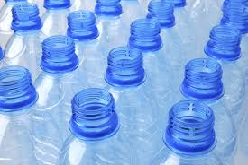
Production
It is produced in two major steps as discussed below:
Esterification: The reactants i.e. ethylene glycol and terephthalic acid combine to form intermediate product BHET.
Polycondensation: The intermediate product BHET undergoes polycondensation and gives the final polymer PET which is our final product.

Slide 4
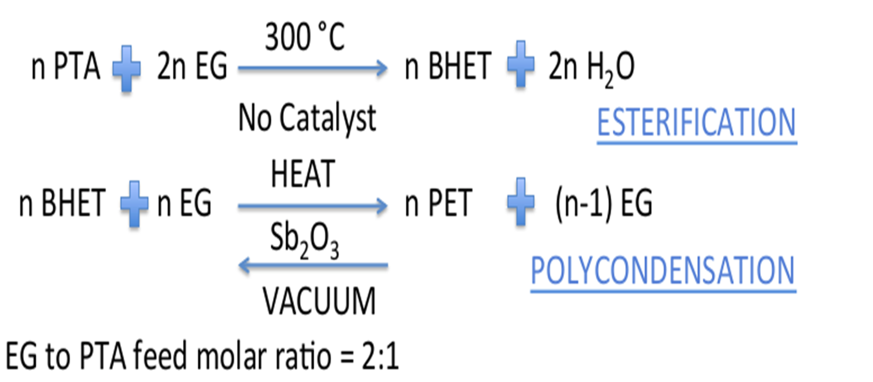
Reactions

Slide 5
Uses of PET
It is used in the manufacture of plastic bottles which are commonly used in soft drink packaging. This is because it is an exceptionally good moisture barrier material.
PET on treatment can be converted to ‘Mylar’ which on further treatment with metal gives MPET.
MPET has reduced permeability and is reflective and opaque. These properties are useful in applications like food packaging and thermal insulation (Eg: Space Blankets).
Its further uses include its involvement in clothing industry and as an engineering resin on combination with glass fiber.

Slide 6
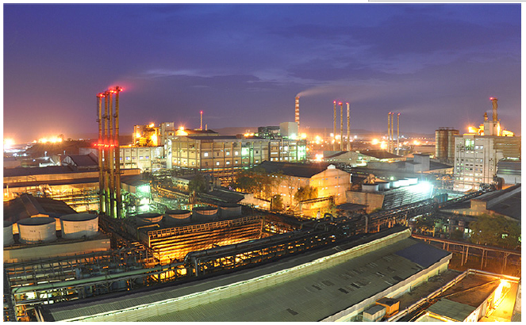
Indorama Nagpur Plant
Courtesy : INDORAMA (Nagpur)

Slide 7
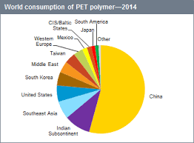
India and World Market Scenario
Reliance is an major producer in India with four major plants. The biggest plant (Dahej) installed for PET production has a production capacity of 650 kiloton/year. (Courtesy: Business Standard)
Dhunseri tea and petrochem plant in Haldia produces 410 kiloton/year. (Courtesy : Dhunseri Tea )

Slide 8
PROCESS EQUIPMENTS - Shivam Srivastava
CSTR
DRR
HEAT EXCHANGER
Jet Ejector
Liquid ring pump

Slide 9
CSTR
A CSTR uses a continuous agitated-tank reactor to reach a specified output.
In the modelling process, we assume that the composition remains uniform inside
However the mean residence time of each molecule is not the same
The Esterifier 1, Esterifier 2 and prepolycondensor are CSTR type reactors

Slide 10
Disc Ring Reactor
A horizontal DRR with single shaft sealing operates as multistage cascade system
Fluid going through the reactor maybe modeled as flowing through the reactor as series of infinitely thin coherent
Plugs each with uniform composition, traveling in the axial direction of the reactor, with each plug having different Composition from the ones before and after it.

Slide 11

The disks are initially closer and gradually the distance between them increases for building up the intrinsic viscosity of the product
The temperature also gradually increases along the length of the reactor

Slide 12
Heat exchangers
Continuous polymerization plant mainly uses three types of heat exchanger
Shell and Tube Heat exchanger
Plate and Frame heat exchanger
Phase Change heat exchanger

Slide 13
Shell and Tube Heat Exchanger
The industry generally uses a Two-pass Shell and tub heat exchanger
The tube bundles inside may be composed by several types of tubes: plain, longitudinal n finned etc.
It is generally used to cool down the hot ethylene glycol using water as coolant

Slide 14
Plate and Frame heat exchanger
This exchanger uses metal plate to transfer heat between two fluids.
The fluids are exposed to a large surface area as they spread over the plates, thus facilitating the heat transfer

Slide 15
Phase Change Heat Exchanger
Heat exchanger can either be used to vaporize a fluid or condense a vapor
It is a special type of shell and tube heat exchanger but with some gap left in the above potion to allow for the phase change to occur
This heat exchanger is generally used to vaporize the DOWTHERM

Slide 16
Jet Ejector
A jet ejector pump uses a venturi effect of a converging-diverging nozzle to convert pressure energy of a motive fluid (in this case EG) to kinetic energy.
This creates a low pressure zone that draws in and entrains a suction fluid.
After passing through the throat of the injector, the mixed fluid expands and the velocity is reduced by reconverting KE back to pressure energy

Slide 17
Liquid Ring Pump
The liquid ring pump is used as a gas compressor.
Vanes are an integral part of the rotor pump and churn a rotating ring of liquid to form a compressor chamber seal.
This pump compresses gas by rotating a vaned impeller located eccentrically within a cylindrical casing.
EG vapors are compressed in this pump.

Slide 18

Flowsheet

Slide 19
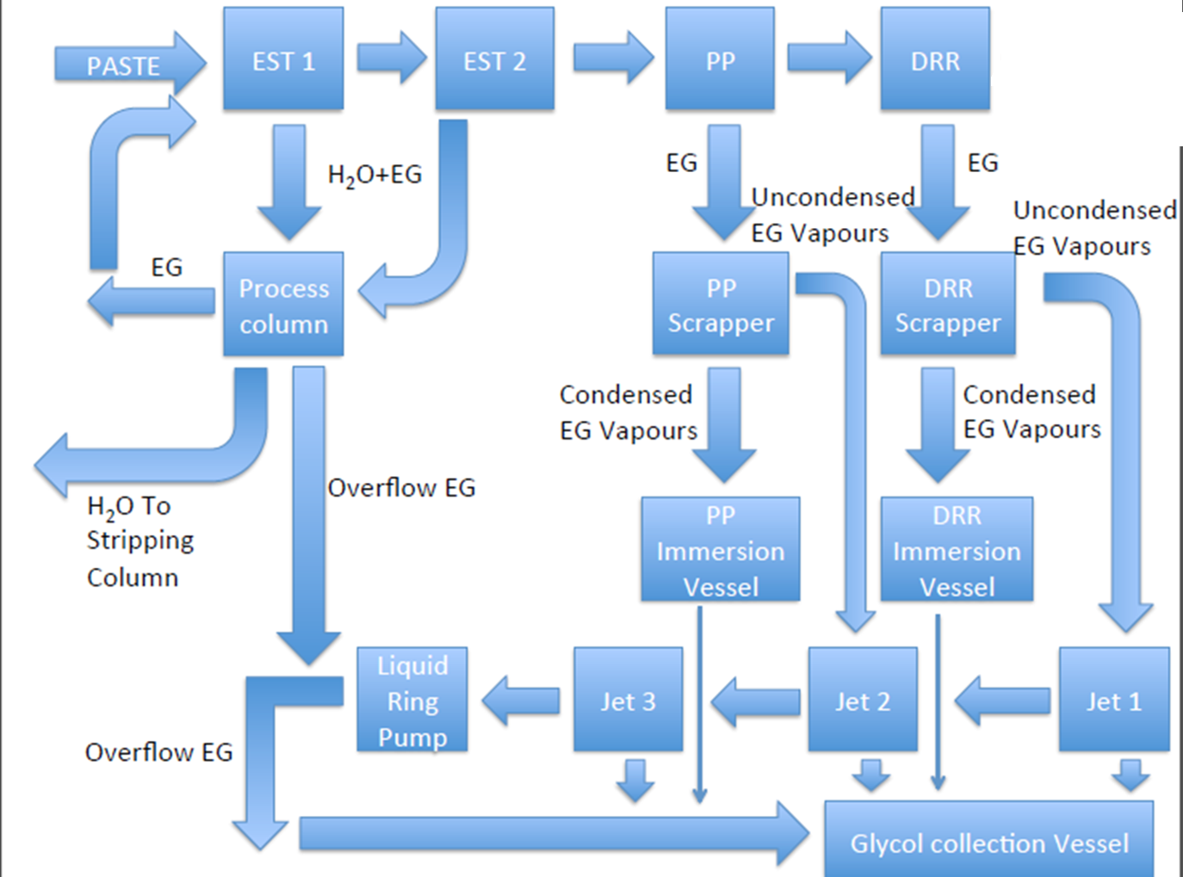

Slide 20
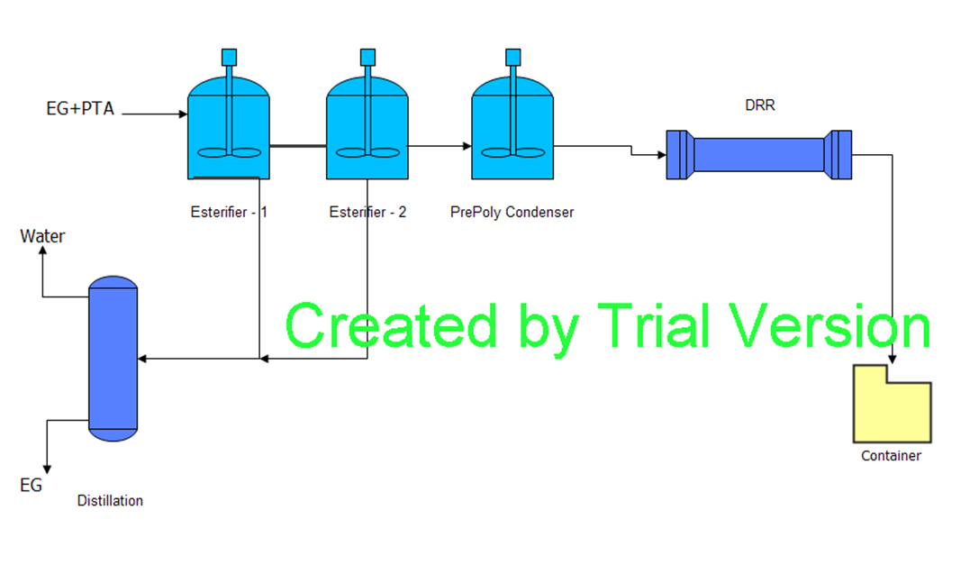

Slide 21
Arguments in Flowsheet -Priyanshu Lilha
Side reactions
PET degradation
Polymer loss in the transfer lines

Slide 22
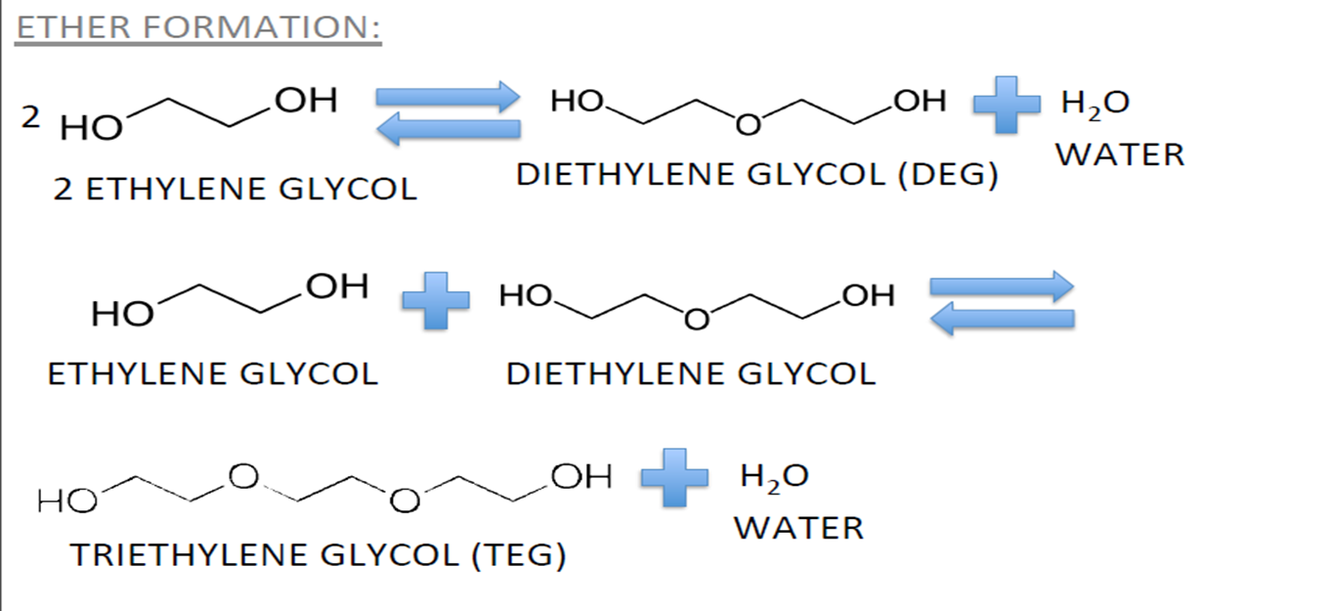
Side Reactions
Side reactions reduce the efficiency of the process and diminish the product quality.

Slide 23
To suppress side reactions
Keep optimum EG feed so that the excess is only within 10% of the required value. To achieve this the CSTR could be replaced with a PFR with side inlets but then other issues like cost and flow control of the components comes into picture.
The side reactions take place at around 350 deg Celsius hence the reactor temp. should be kept below this temperature. To achieve this temperature control has to be more accurate which in turn means more investment in the process.

Slide 24
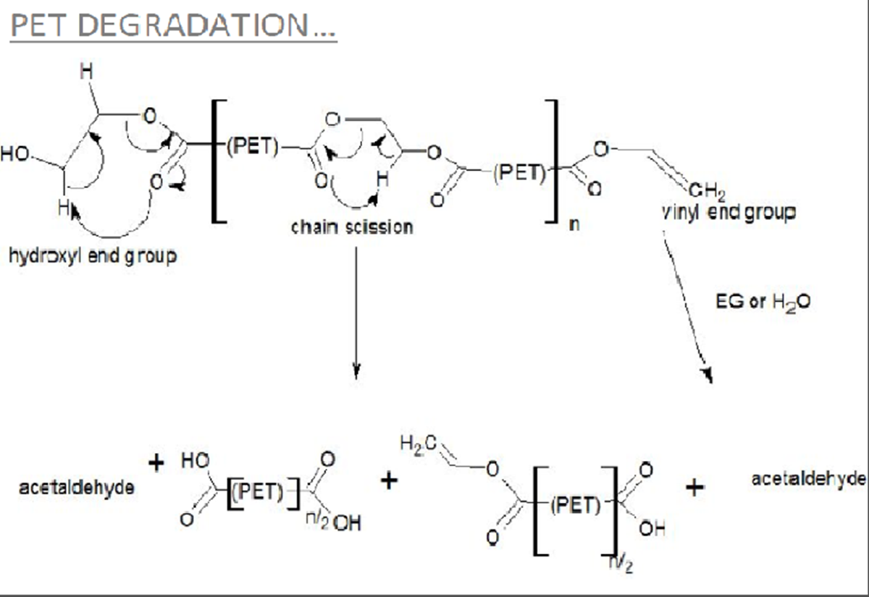
PET Degradation

Slide 25
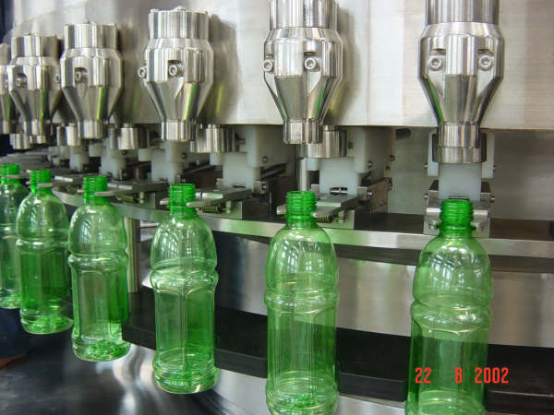
Effects of PET Degradation
Thermal degradation of PET results in :
Decrease in weight and viscosity
Increase in carboxyl content
Color becomes less white
Evolution of toxic and highly flammable gases
Formation of gels

Slide 26
Degradation of PET is a direct function of temperature, hold up time, and the presence of oxygen.
Polymer hold‐up time and temperature are kept as low as possible but in the operable range.
All vessels and pipelines are designed to eliminate or reduce potential stagnation of polymer.

Slide 27
Loss in Transfer Lines
In transfer lines due to sudden drop in temperature it is possible that the polymer may solidify and block the line. To deal with this problem the lines have to be heated by external sources.
Issues with using steam as a utility are that is results in rusting of pipelines and also a whole system has to be setup to convert water to steam.
Instead of using steam, the drawn fibers and filaments and the catalyst preparation vessel can also be heated using DOWTHERM supplied at the required temperature and pressure.

Slide 28
DOWTHERM is already supplied in the reactors for the very specific purpose of heating, the coal losses incurred will be less as it is being used for the same purpose.
Therefore, the required temperature of around 200°C will be produced at a much lower vapor pressure of DOWTHERM resulting in cost savings.
DOWTHERM reduces the chances of any rusting of the machines, equipment and transfer lines.
It reduces any chance of oxidation of the fibers and filaments (Oxidation of polymer results in cross-linking and Chain scission, thereby causing breakages an hence, waste production.)

Slide 29
Conclusion and Future Aspects Future Scope -Rishu Garg
A major concerned faced by the industry is that PET products are non-biodegradable
Incineration of PET leads to release of harmful toxins whereas dumping it in land fills leads to soil pollution
rPET or Recyclable PET can be the solution to this problem
Production of rPET is less energy consuming than to produce virgin polymer

Slide 30
Another problem is caused by the metal catalysts used in the production process of PET
Antimony Trioxide, the catalyst used is harmful even in trace amounts
IBM and Stanford report having demonstrated that organic catalysts can rival metal-based catalysts(Antimony Trioxide)
IBM plans to launch a pilot PET recycling project that will help determine whether the new organic catalysts can help develop cheap and easily recyclable plastic products

Slide 31
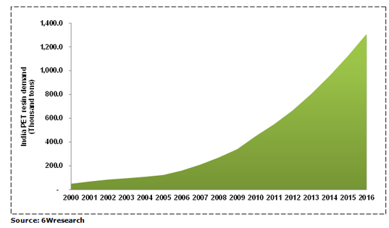
PET Demand

Slide 32
At present, the production is not at par with the consumption of PET.
Since the demand of PET is rapidly increasing, there is scope for new players to enter the market.
Substitutes for the product have come up in the last decade. The best example is that of PEN (polyethylene naphthalene) which is superior to PET in various aspects but costs 3 to 4 times more.

Slide 33
Raw Material and Economics
The PET industry uses two major raw material:
Ethylene Glycol
Purified Terepthalic Acid
Both raw materials are easily available

Slide 34
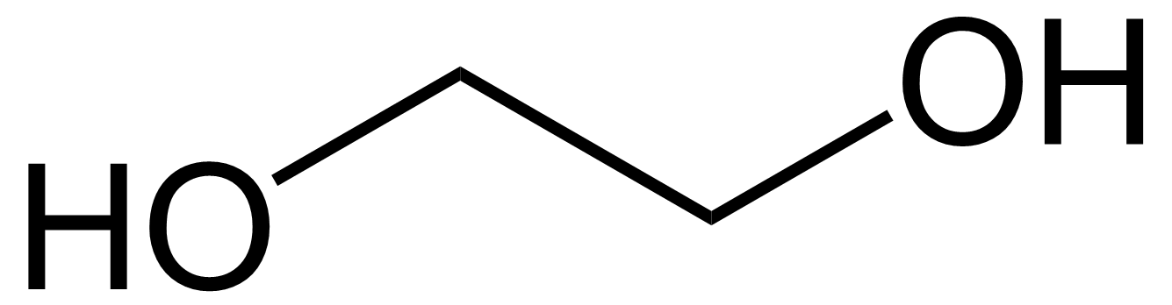
Ethylene glycol
MEG is a colourless, odourless, non-volatile liquid. It is completely miscible in water and many organic solvents
It was first prepared ethylene glycol in 1856
Ethylene glycol is produced from ethylene (ethene), via the intermediate ethylene oxide. Ethylene oxide reacts with water to produce ethylene glycol according to the chemical equation:
C₂H₄O + H₂O → HO–CH₂CH₂–OH
I kg costs about 40 USD

Slide 35
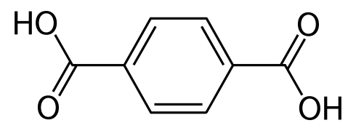
Purified Terepthalic Acid
This white solid is a commodity chemical, used as a precursor to the polyester
The first companies to commercialize the use polyethylene terephthalate were Imperial Chemical Industries in the UK in 1949 and DuPont in the US in 1953
In the Amoco process, terephthalic acid is produced by oxidation of p-xylene by oxygen in air
Cost 1200USD / MT

Slide 36
References
A.K. van der Vegt & L.E. Govaert, Polymeren, van keten tot kunstof
J. G. Speight, Norbert Adolph Lange
Chetna Sharon; Madhuri Sharon (2012). Studies on Biodegradation of Polyethylene terephthalate
Ulrich K. Thiele (2007) Polyester Bottle Resins Production, Processing, Properties and Recycling
Frank Boos, Ulrich Dr Thiele, "Reprocessing pulverised polyester waste without yellowing“
John Rex Whinfield and James Tennant Dickson (1941) "Improvements Relating to the Manufacture of Highly Polymeric Substances

Slide 37
Thank you!!

