Slide 1
Fluid Flow Operations
Lecture 1: Introduction
BITS PILANI, GOA CAMPUS
Dr. Srinivas Krishnaswamy
ASSISTANT PROFESSOR
CHEMICAL ENGINEERING

Slide 2


Fluid Mechanics Overview
BITS PILANI, GOA CAMPUS
Fluid
Mechanics
Gas
Liquids
Statics
Dynamics
, Flows
Air, He, Ar, N₂, etc.
Water, Oils, Alcohols, etc.
Stability
Pressure
Buoyancy
Compressible/
Incompressible
Surface
Tension
Laminar/
Turbulent
Compressibility
Density
Viscosity
Steady/Unsteady
Vapor
Pressure
Viscous/Inviscid
Chapter 1: Introduction
Fluid Dynamics:
Rest of Course
Chapter 2: Fluid Statics

Slide 3
Characteristics of Fluids
BITS PILANI, GOA CAMPUS
Gas or liquid state
“Large” molecular spacing relative to a solid
“Weak” intermolecular cohesive forces
Can not resist a shear stress in a stationary state
Will take the shape of its container
Generally considered a continuum
Viscosity distinguishes different types of fluids

Slide 4
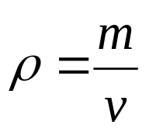
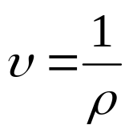
Measures of Fluid Mass and Weight: Density
BITS PILANI, GOA CAMPUS
The density of a fluid is defined as mass per unit volume.
m = mass, and v = volume.
Different fluids can vary greatly in density
Liquids densities do not vary much with pressure and temperature
Gas densities can vary quite a bit with pressure and temperature
Density of water at 4° C : 1000 kg/m³
Density of Air at 4° C : 1.20 kg/m³
Alternatively, Specific Volume:

Slide 5

Measures of Fluid Mass and Weight: Specific Weight
BITS PILANI, GOA CAMPUS
The specific weight of fluid is its weight per unit volume.
g = local acceleration of gravity, 9.807 m/s²
Specific weight characterizes the weight of the fluid system
Specific weight of water at 4° C : 9.80 kN/m³
Specific weight of air at 4° C : 11.9 N/m³

Slide 6
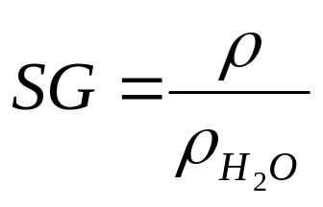
Measures of Fluid Mass and Weight: Specific Gravity
BITS PILANI, GOA CAMPUS
The specific gravity of fluid is the ratio of the density of the fluid to the density of water @ 4° C.
Gases have low specific gravities
A liquid such as Mercury has a high specific gravity, 13.2
The ratio is unitless.
Density of water at 4° C : 1000 kg/m³

Slide 7
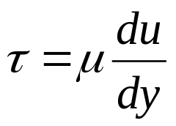
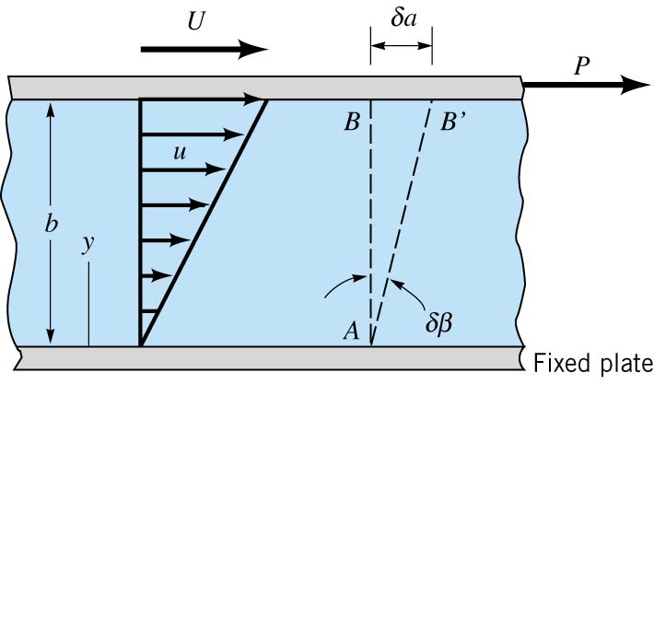
Viscosity: Introduction
BITS PILANI, GOA CAMPUS
The viscosity is measure of the “fluidity” of the fluid which is not captured simply by density or specific weight. A fluid can not resist a shear and under shear begins to flow. The shearing stress and shearing strain can be related with a relationship of the following form for common fluids such as water, air, oil, and gasoline:
is the absolute viscosity or dynamics viscosity of the fluid, u is the velocity of the fluid and y is the vertical coordinate as shown in the schematic below:
“No Slip Condition”

Slide 8
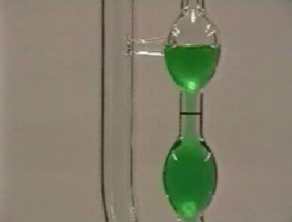
Viscosity: Measurements
BITS PILANI, GOA CAMPUS
A Capillary Tube Viscometer is one method of measuring the viscosity of the fluid.
Viscosity Varies from Fluid to Fluid and is dependent on temperature, thus temperature is measured as well.
Units of Viscosity are N·s/m² or lb·s/ft²

Slide 9
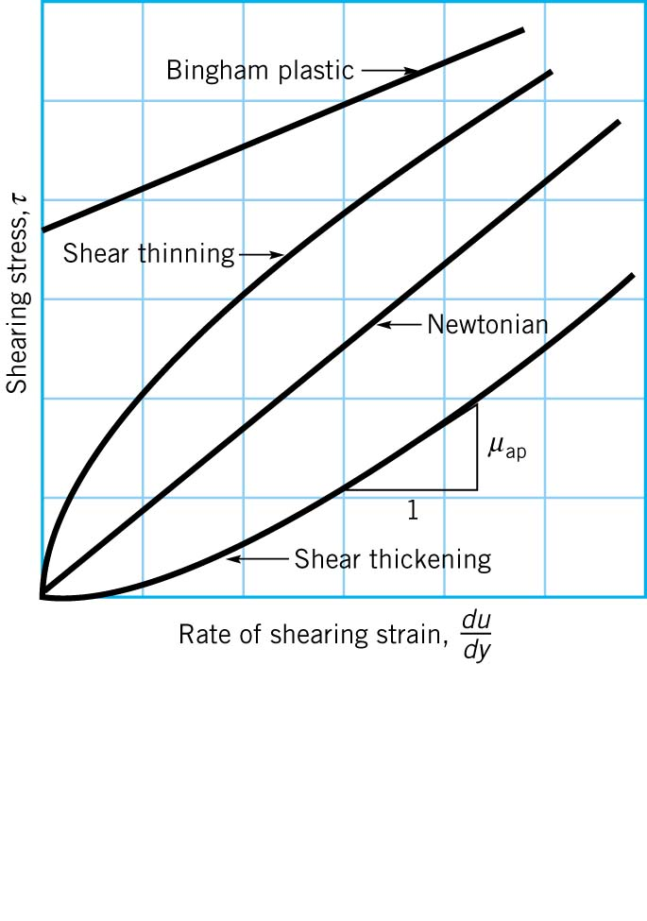
Viscosity: Newtonian vs. Non-Newtonian
BITS PILANI, GOA CAMPUS
Toothpaste
Latex Paint
Corn Starch
Newtonian Fluids are Linear Relationships between stress and strain: Most common fluids are Newtonian.
Non-Newtonian Fluids are Non-Linear between stress and strain

Slide 10
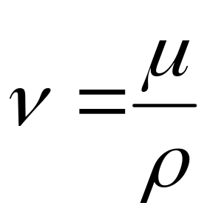
Viscosity: Kinematic Viscosity
BITS PILANI, GOA CAMPUS
Kinematic viscosity is another way of representing viscosity
Used in the flow equations
The units are of L²/T or m²/s and ft²/s

Slide 11
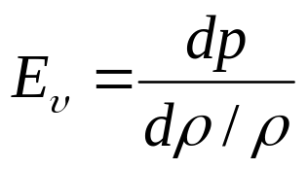
Compressibility of Fluids: Bulk Modulus
BITS PILANI, GOA CAMPUS
P is pressure, and ρ is the density.
Measure of how pressure compresses the volume/density
Units of the bulk modulus are N/m² (Pa) and lb/in.² (psi).
Large values of the bulk modulus indicate incompressibility
Incompressibility indicates large pressures are needed to compress the volume slightly
It takes 3120 psi to compress water 1% at atmospheric pressure and 60° F.
Most liquids are incompressible for most practical engineering problems.

Slide 12

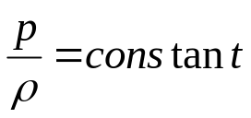

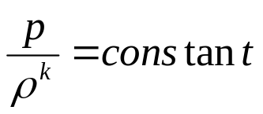

Compressibility of Fluids: Compression of Gases
BITS PILANI, GOA CAMPUS
Ideal Gas Law:
P is pressure, ρ is the density, R is the gas constant, and T is Temperature
Isothermal Process (constant temperature):
Math
Isentropic Process (frictionless, no heat exchange):
Math
k is the ratio of specific heats, c_{p} (constant pressure) to
c_{v} (constant volume), and R = c_{p} – c_{v}.
If we consider air under at the same conditions as water, we can show that air is 15,000 times more compressible than water. However, many engineering applications allow air to be considered incompressible.

Slide 13
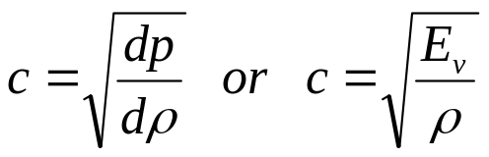
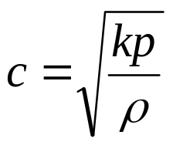
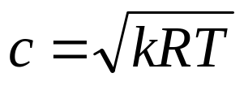
Compressibility of Fluids: Speed of Sound
BITS PILANI, GOA CAMPUS
A consequence of the compressibility of fluids is that small disturbances introduced at a point propagate at a finite velocity. Pressure disturbances in the fluid propagate as sound, and their velocity is known as the speed of sound or the acoustic velocity, c.
Isentropic Process (frictionless, no heat exchange because):
Ideal Gas and Isentropic Process:

Slide 14

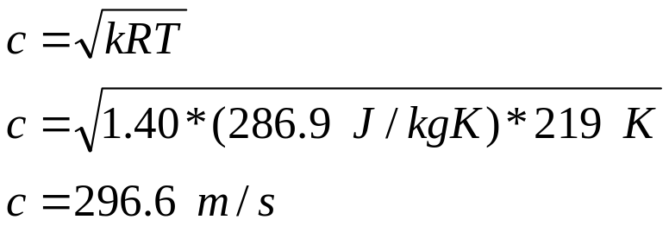
Compressibility of Fluids: Speed of Sound
BITS PILANI, GOA CAMPUS
Speed of Sound in Air at 60 °F ≈ 1117 ft/s or 300 m/s
Speed of Sound in Water at 60 °F ≈ 4860 ft/s or 1450 m/s
If a fluid is truly incompressible, the speed of sound is infinite, however, all fluids compress slightly.
Example: A jet aircraft flies at a speed of 250 m/s at an altitude of 10,700 m, where the temperature is -54 °C. Determine the ratio of the speed of the aircraft, V, to the speed of sound, c at the specified altitude. Assume k = 1.40
Ideal Gas and Isentropic Process:

Slide 15
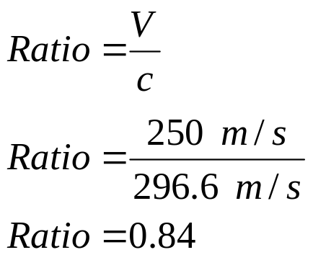
Compressibility of Fluids: Speed of Sound
BITS PILANI, GOA CAMPUS
Example (Continued):
The above ratio is known as the Mach Number, Ma
For Ma < 1 Subsonic Flow
For Ma > 1 Supersonic Flow
For Ma > 1 we see shock waves and “sonic booms”:
Wind Tunnel Visualization known as Schlieren method
2) Condensation instigated from jet speed allowing us to see a shock wave

Slide 16
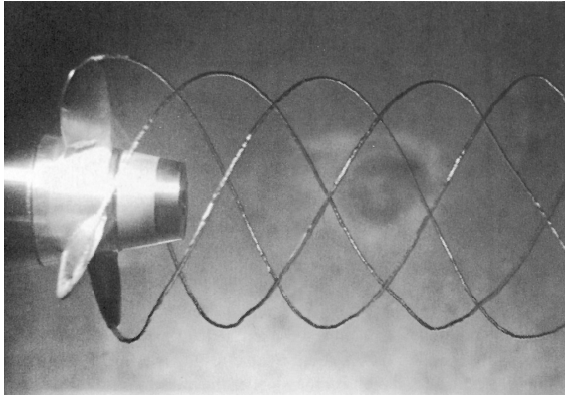
Vapor Pressure: Evaporation and Boiling
BITS PILANI, GOA CAMPUS
Evaporation occurs in a fluid when liquid molecules at the surface have
sufficient momentum to overcome the intermolecular cohesive forces and escape
to the atmosphere.
Vapor Pressure is that pressure exerted on the fluid by the vapor in a closed
saturated system where the number of molecules entering the liquid are the same
as those escaping. Vapor pressure depends on temperature and type of fluid.
Boiling occurs when the absolute pressure in the fluid reaches the vapor pressure.
Boiling occurs at approximately 100 °C, but it is not only a function of temperature,
but also of pressure. For example, in Colorado Spring, water boils at temperatures
less than 100 °C.
Cavitation is a form of
Boiling due to low pressure
locally in a flow.

Slide 17
Surface Tension
BITS PILANI, GOA CAMPUS
At the interface between a liquid and a gas or two immiscible liquids, forces
develop forming an analogous “skin” or “membrane” stretched over the
fluid mass which can support weight.
This “skin” is due to an imbalance of cohesive forces. The interior of the fluid is
in balance as molecules of the like fluid are attracting each other while on the
interface there is a net inward pulling force.
Surface tension is the intensity of the molecular attraction per unit length along
any line in the surface.
Surface tension is a property of the liquid type, the temperature, and the other fluid at the interface.
This membrane can be “broken” with a surfactant which reduces the surface tension.

Slide 18
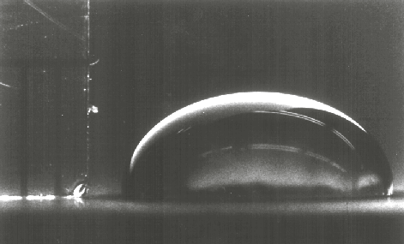
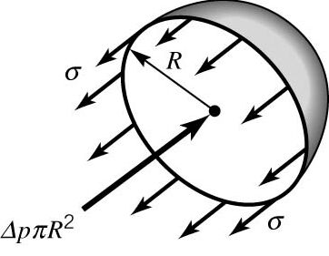
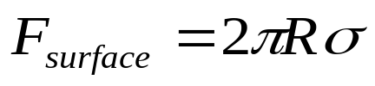
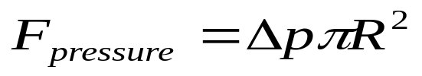
Surface Tension: Liquid Drop
BITS PILANI, GOA CAMPUS
The pressure inside a drop of fluid can be calculated using a free-body diagram:
Real Fluid Drops
Mathematical Model
R is the radius of the droplet, σ is the surface tension, Δp is the pressure
difference between the inside and outside pressure.
The force developed around the edge due to surface tension along the line:
Applied to Circumference
This force is balanced by the pressure difference Δp:
Applied to Area

Slide 19
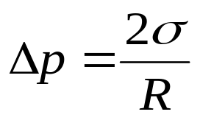
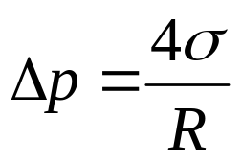
Surface Tension: Liquid Drop
BITS PILANI, GOA CAMPUS
Now, equating the Surface Tension Force to the Pressure Force, we can estimate Δp = p_{i} – p_{e}:
This indicates that the internal pressure in the droplet is greater that the external pressure since the right hand side is entirely positive.
Is the pressure inside a bubble of water greater or less than that of a droplet of water?
Prove to yourself the following result:

Slide 20
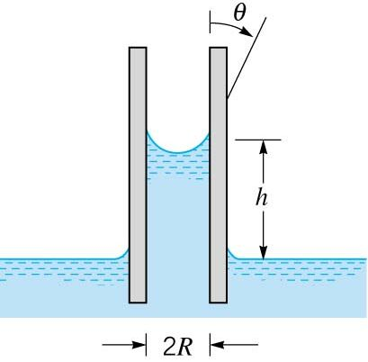
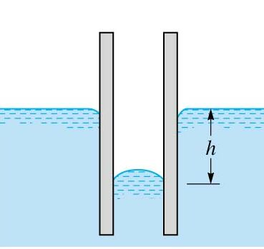
Surface Tension: Capillary Action
BITS PILANI, GOA CAMPUS
Capillary action in small tubes which involve a liquid-gas-solid interface is caused by surface tension. The fluid is either drawn up the tube or pushed down.
“Wetted”
“Non-Wetted”
Adhesion
Cohesion
Adhesion
Cohesion
Adhesion > Cohesion
Cohesion > Adhesion
h is the height, R is the radius of the tube, θ is the angle of contact.
The weight of the fluid is balanced with the vertical force caused by surface
tension.

Slide 21
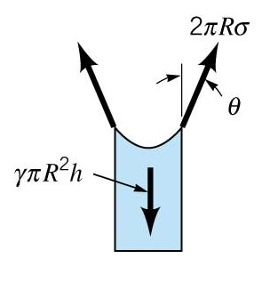

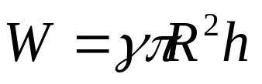
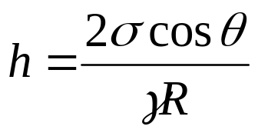
Surface Tension: Capillary Action
BITS PILANI, GOA CAMPUS
Free Body Diagram for Capillary Action for a Wetted Surface:
Equating the two and solving for h:
For clean glass in contact with water, θ ≈ 0°, and thus as R decreases, h increases, giving a higher rise.
For a clean glass in contact with Mercury, θ ≈ 130°, and thus h is negative or there is a push down of the fluid.

Slide 22
Surface Tension: Capillary Action
BITS PILANI, GOA CAMPUS
At what value of contact angle θ does the liquid-solid interface become “non-wetted”?
θ > 90°
Surface tension is apparent in many practical problems such as movement of liquid through soil and other porous media, flow of thin films, formation of drops and bubbles, and the breakup of liquid jets.

