Slide 1
MAE 3130: Fluid Mechanics
Lecture 2: Fluid Statics (Part A)
Spring 2003
BITS PILANI, GOA CAMPUS
Dr. Srinivas Krishnaswamy
ASSISTANT PROFESSOR
CHEMICAL ENGINEERING

Slide 2
Outline
BITS PILANI, GOA CAMPUS
Overview
Pressure at a Point
Basic Equations for the Pressure Field
Hydrostatic Condition
Standard Atmosphere
Manometry and Pressure Measurements
Example Problems

Slide 3


Fluid Mechanics Overview
BITS PILANI, GOA CAMPUS
Fluid
Mechanics
Gas
Liquids
Statics
Dynamics
, Flows
Air, He, Ar, N₂, etc.
Water, Oils, Alcohols, etc.
Stability
Pressure
Buoyancy
Compressible/
Incompressible
Surface
Tension
Laminar/
Turbulent
Compressibility
Density
Viscosity
Steady/Unsteady
Vapor
Pressure
Viscous/Inviscid
Chapter 1: Introduction
Fluid Dynamics:
Rest of Course
Chapter 2: Fluid Statics

Slide 4
Fluid Statics
BITS PILANI, GOA CAMPUS
By definition, the fluid is at rest.
Or, no there is no relative motion between adjacent particles.
No shearing forces is placed on the fluid.
There are only pressure forces, and no shear.
Results in relatively “simple” analysis
Generally look for the pressure variation in the fluid

Slide 5
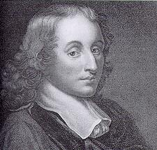
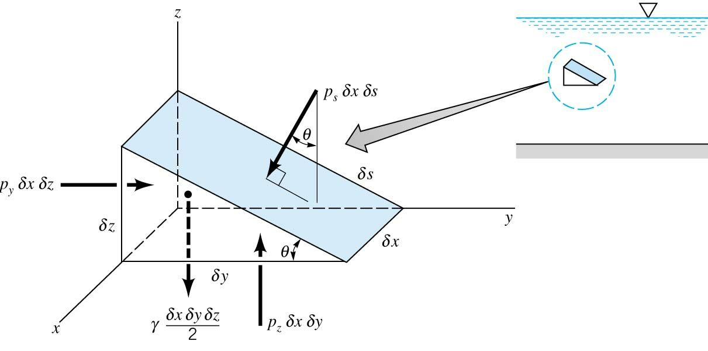
Pressure at a Point: Pascal’s Law
BITS PILANI, GOA CAMPUS
Pressure is the normal force per unit area at a given point acting on a given plane within a fluid mass of interest.
Blaise Pascal (1623-1662)
How does the pressure at a point vary with orientation of the plane passing through the point?
Pressure Forces
F.B.D.
Gravity Force
Wedged Shaped Fluid Mass
p is average pressure in the x, y, and z direction.
P_{s} is the average pressure on the surface
θ is the plane inclination
is the length is each coordinate direction, x, y, z
δs is the length of the plane
γ is the specific weight
V = (1/2δyδz)*δx

Slide 6
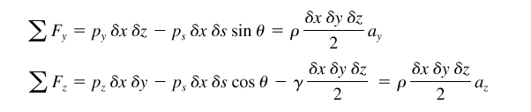

BITS PILANI, GOA CAMPUS
Pressure at a Point: Pascal’s Law
For simplicity in our Free Body Diagram, the x-pressure forces cancel and do not need to be shown. Thus to arrive at our solution we balance only the the y and z forces:
Pressure Force in the y-direction on the y-face
Rigid body motion in the y-direction
Pressure Force on the plane in the y-direction
Pressure Force in the z-direction on the z-face
Pressure Force in the plane in the z-direction
Rigid body motion in the z-direction
Weight of the
Wedge
Now, we can simplify each equation in each direction, noting that δy and δz can be rewritten in terms of δs:

Slide 7
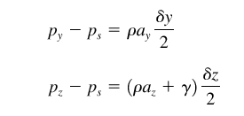

BITS PILANI, GOA CAMPUS
Pressure at a Point: Pascal’s Law
Substituting and rewriting the equations of motion, we obtain:
Math
Now, noting that we are really interested at point only, we let δy and δz go to zero:
Pascal’s Law: the pressure at a point in a fluid at rest, or in motion, is independent of the direction as long as there are no shearing stresses present.

Slide 8
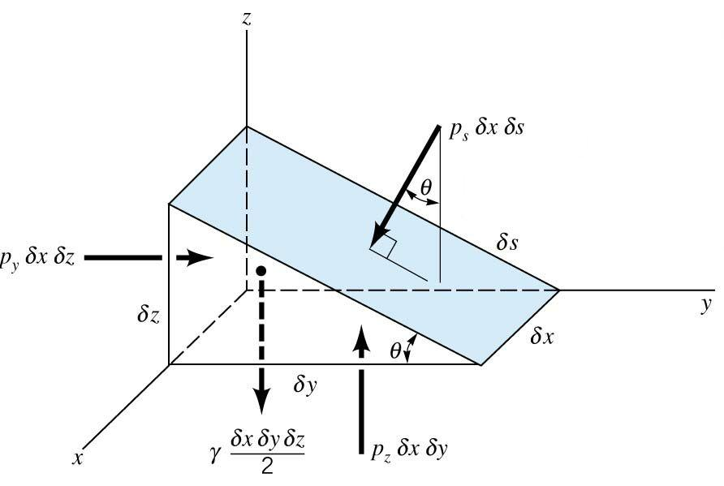
BITS PILANI, GOA CAMPUS
Pressure at a Point: Pascal’s Law
p₁δxδs
p_{s}δxδs
p₂δxδs
p_{s} = p₁ = p₂
Note: In dynamic system subject to shear, the normal stress representing the pressure in the fluid is not necessarily the same in all directions. In such a case the pressure is taken as the average of the three directions.

Slide 9
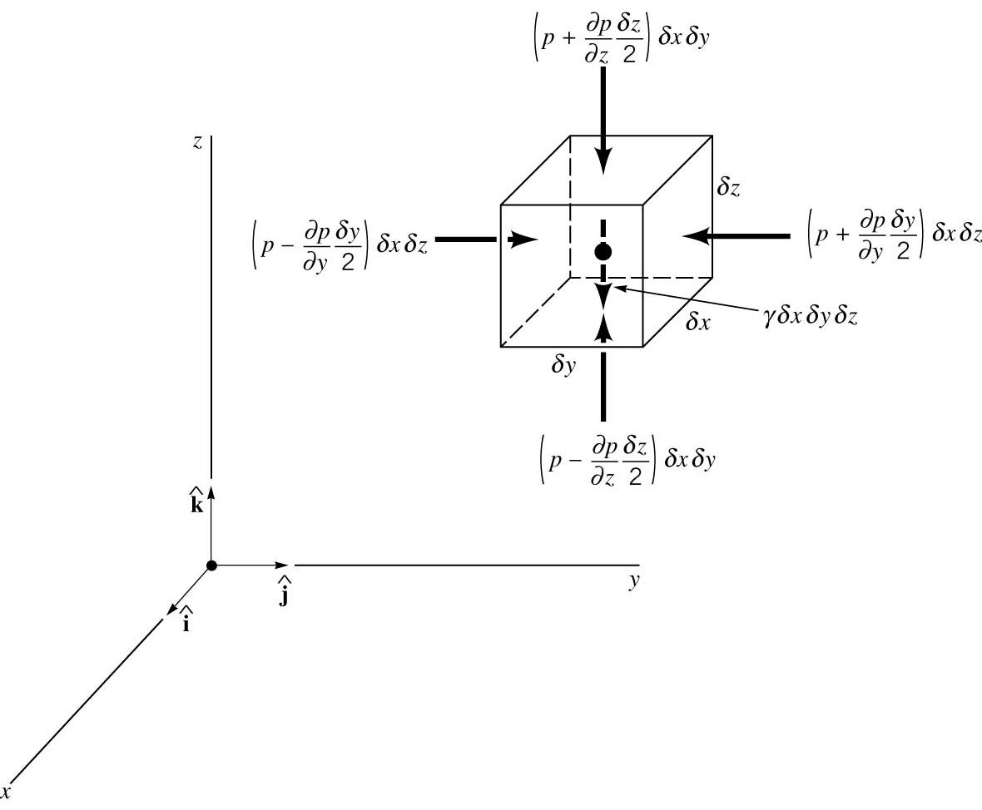
BITS PILANI, GOA CAMPUS
Pressure Field Equations
How does the pressure vary in a fluid or from point to point when no shear stresses are present?
Consider a Small Fluid Element
p is pressure
is specific weight
Surface Forces
Taylor Series
Body Forces
V = δyδzδx
For simplicity the x-direction surface forces are not shown

Slide 10
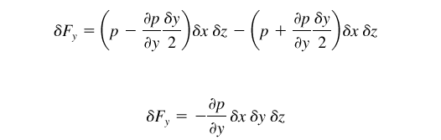



BITS PILANI, GOA CAMPUS
Pressure Field Equations
Looking at the resultant surface forces in the y-direction:
Similarly, looking at the resultant surface forces in the x and z-direction, we obtain:
Expressing these results in vector form:

Slide 11




BITS PILANI, GOA CAMPUS
Pressure Field Equations
Now, we note by definition, the “del” operator or gradient is the following :
Then,
Now, rewriting the surface force equation, we obtain the following:
Now, we return the body forces, and we will only consider weight:

Slide 12

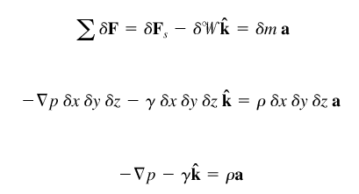
BITS PILANI, GOA CAMPUS
Pressure Field Equations
Use Newton’s Second Law to Sum the Forces for a Fluid
Element:
δm is the mass of the fluid element, and a is acceleration.
Then summing the surface forces and the body forces:
δm
“Most General Form” for No Shear

Slide 13





BITS PILANI, GOA CAMPUS
Hydrostatic Condition: a = 0
0
Writing out the individual vector components:
This leads to the conclusion that for liquids or gases at rest, the
Pressure gradient in the vertical direction at any point in fluid depends only on the specific weight of the fluid at that point. The pressure does not depend on x or y.
Hydrostatic Equation

Slide 14
BITS PILANI, GOA CAMPUS
Hydrostatic Condition: Physical Implications
Pressure changes with elevation
Pressure does not change in the horizontal x-y plane
The pressure gradient in the vertical direction is negative
The pressure decreases as we move upward in a fluid at rest
Pressure in a liquid does not change due to the shape of the container
Specific Weight γ does not have to be constant in a fluid at rest
Air and other gases will likely have a varying γ
Thus, fluids could be incompressible or compressible statically

Slide 15

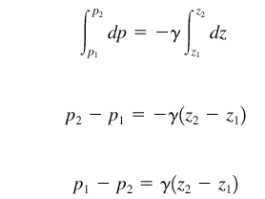
BITS PILANI, GOA CAMPUS
Hydrostatic Condition: Incompressible Fluids
The specific weight changes either through ρ, density or g, gravity. The change in g is negligible, and for liquids ρ does not vary appreciable, thus most liquids will be considered incompressible.
Starting with the Hydrostatic Equation:
We can immediately integrate since γ is a constant:
where the subscripts 1 and 2 refer two different vertical levels as in the
schematic.

Slide 16
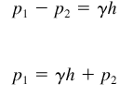

BITS PILANI, GOA CAMPUS
Hydrostatic Condition: Incompressible Fluids
As in the schematic, noting the definition of h = z₂ –z₁:
Linear Variation with Depth
h is known as the pressure head. The type of pressure distribution is known as a hydrostatic distribution. The pressure must increase with depth to hold up the fluid above it, and h is the depth measured from the location of p₂.
The equation for the pressure head is the following:
Physically, it is the height of the column of fluid of a specific weight, needed to give the pressure difference p₁ – p₂.

Slide 17

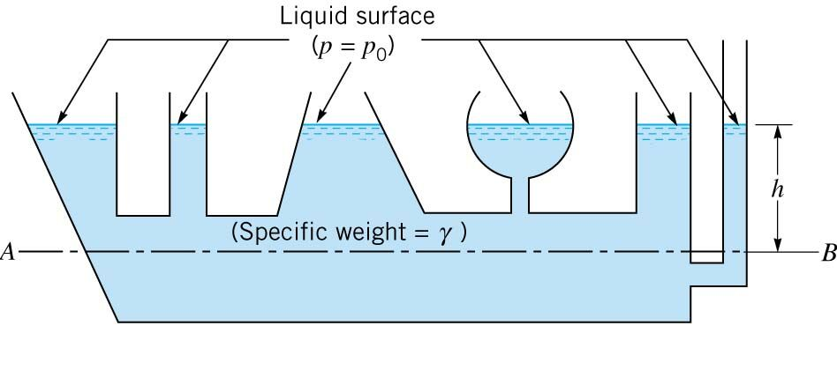
BITS PILANI, GOA CAMPUS
Hydrostatic Condition: Incompressible Fluids
If we are working exclusively with a liquid, then there is a free surface at the liquid-gas interface. For most applications, the pressure exerted at the surface is atmospheric pressure, p_{o}. Then the equation is written as follows:
The Pressure in a homogenous, incompressible fluid at rest depends on the depth of the fluid relative to some reference and is not influenced by the shape of the container.
Lines of constant Pressure
p = p_{o}
h₁
p = p₁
p = p₂
For p₂ = p = γh + p_{o}
For p₁ = p = γh₁ + p_{o}

Slide 18
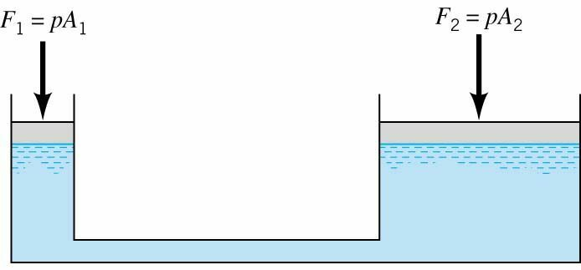
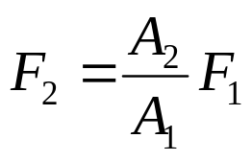
BITS PILANI, GOA CAMPUS
Hydrostatic Application: Transmission of Fluid Pressure
Mechanical advantage can be gained with equality of pressures
A small force applied at the small piston is used to develop a large force at the large piston.
This is the principle between hydraulic jacks, lifts, presses, and hydraulic controls
Mechanical force is applied through jacks action or compressed air for example

Slide 19

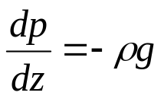
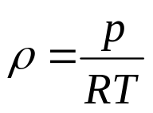


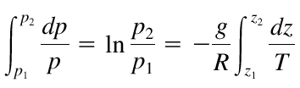

BITS PILANI, GOA CAMPUS
Hydrostatic Condition: Compressible Fluids
Gases such as air, oxygen and nitrogen are thought of as compressible, so we must consider the variation of density in the hydrostatic equation:
Note: γ = ρg and not a constant, then
R is the Gas Constant
T is the temperature
ρ is the density
By the Ideal gas law:
Thus,
Then,
For Isothermal Conditions, T is constant, T_{o}:

Slide 20
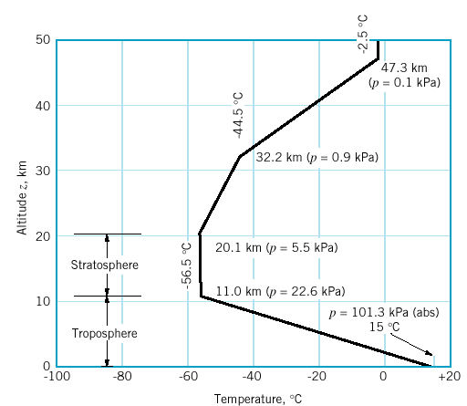
BITS PILANI, GOA CAMPUS
Hydrostatic Condition: U.S. Standard Atmosphere
Idealized Representation of the Mid-Latitude Atmosphere
Standard Atmosphere is used in the design of aircraft, missiles and spacecraft.
Stratosphere:
Isothermal, T = T_{o}
Troposphere:
Linear Variation, T = T_{a} - βz

Slide 21

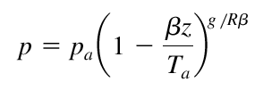
BITS PILANI, GOA CAMPUS
Hydrostatic Condition: U.S. Standard Atmosphere
Starting from,
Now, for the Troposphere, Temperature is not constant:
β is known as the lapse rate, 0.00650 K/m, and T_{a} is the temperature at sea level, 288.15 K.
Substitute for temperature and Integrate:
p_{a} is the pressure at sea level, 101.33 kPa, R is the gas constant, 286.9 J/kg.K

Slide 22
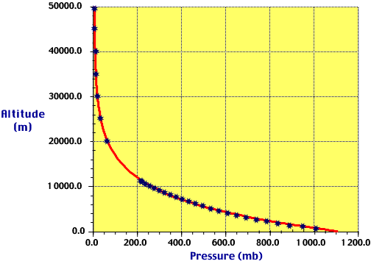
BITS PILANI, GOA CAMPUS
Pressure Distribution in the Atmosphere

Slide 23
BITS PILANI, GOA CAMPUS
Measurement of Pressure
Absolute Pressure: Pressure measured relative to a perfect vacuum
Gage Pressure: Pressure measured relative to local atmospheric pressure
A gage pressure of zero corresponds to a pressure that is at local atmospheric pressure.
Absolute pressure is always positive
Gage pressure can be either negative or positive
Negative gage pressure is known as a vacuum or suction
Standard units of Pressure are psi, psia, kPa, kPa (absolute)
Pressure could also be measured in terms of the height of a fluid in a column
Units in terms of fluid column height are mm Hg, inches of Hg, inches of H₂0,etc
Example: Local Atmospheric Pressure is 14.7 psi, and I measure a 20 psia (“a” is for absolute). What is the gage pressure?
The gage pressure is 20 psia – 14.7 psi = 5.3 psi
If I measure 10 psia, then the gage pressure is -4.7 psi, or is a “vacuum”.

Slide 24
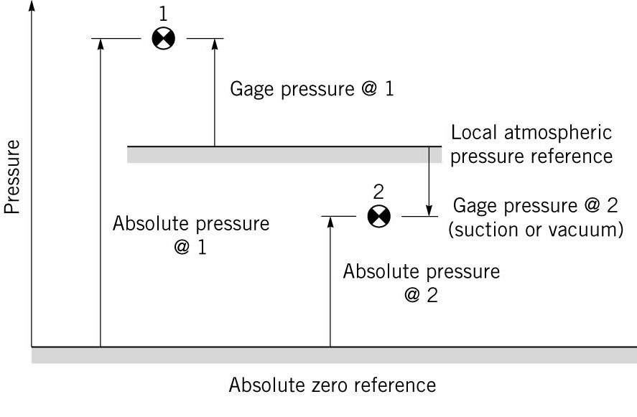
BITS PILANI, GOA CAMPUS
Measurement of Pressure: Schematic
+
-
+
+

Slide 25
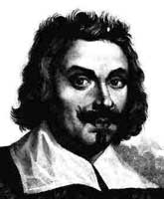
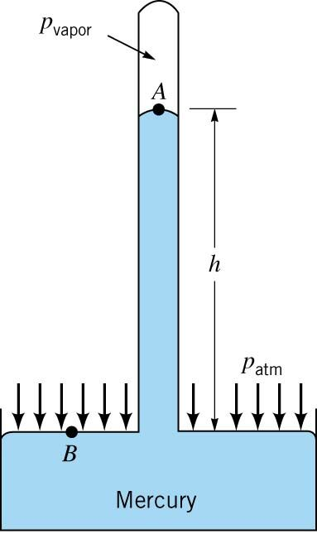

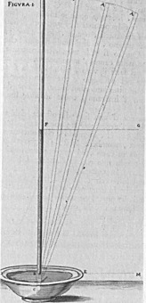
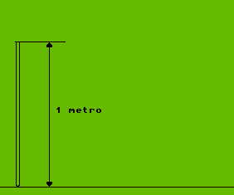

BITS PILANI, GOA CAMPUS
Measurement of Pressure: Barometers
The first mercury barometer was constructed in 1643-1644 by Torricelli. He showed that the height of mercury in a column was 1/14 that of a water barometer, due to the fact that mercury is 14 times more dense that water. He also noticed that level of mercury varied from day to day due to weather changes, and that at the top of the column there is a vacuum.
Evangelista Torricelli (1608-1647)
Torricelli’s Sketch
Schematic:
Animation of Experiment:
Note, often p_{vapor} is very small, 0.0000231 psia at 68° F, and p_{atm} is 14.7 psi, thus:

Slide 26

BITS PILANI, GOA CAMPUS
Measurement of Pressure: Manometry
Manometry is a standard technique for measuring pressure using liquid columns in vertical or include tubes. The devices used in this manner are known as manometers.
The operation of three types of manometers will be discussed today:
The Piezometer Tube
The U-Tube Manometer
The Inclined Tube Manometer
The fundamental equation for manometers since they involve columns of fluid at rest is the following:
h is positive moving downward, and negative moving upward, that is pressure in columns of fluid decrease with gains in height, and increase with gain in depth.

Slide 27
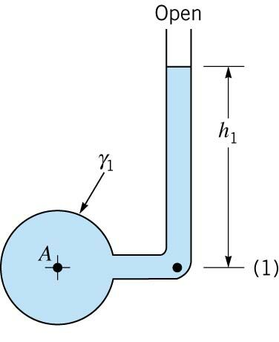
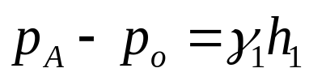

BITS PILANI, GOA CAMPUS
Measurement of Pressure: Piezometer Tube
p_{o}
Disadvantages:
1)The pressure in the container has to be greater than atmospheric pressure.
2) Pressure must be relatively small to maintain a small column of fluid.
3) The measurement of pressure must be of a liquid.
Move Up the Tube
Closed End “Container”
p_{A (abs)}
Moving from left to right:
p_{A(abs)}
- γ₁h₁
= p_{o}
Rearranging:
Gage Pressure
Then in terms of gage pressure, the equation for a Piezometer Tube:
Note: p_{A} = p₁ because they are at the same level

Slide 28
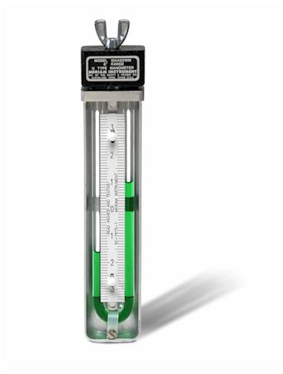
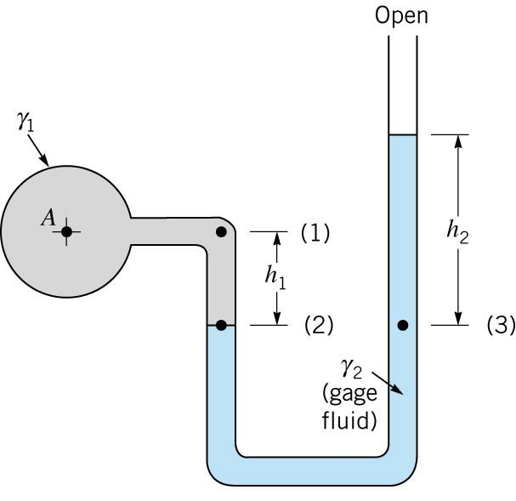
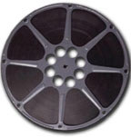


BITS PILANI, GOA CAMPUS
Measurement of Pressure: U-Tube Manometer
Closed End “Container”
Note: in the same fluid we can “jump” across from 2 to 3 as they are at the sam level, and thus must have the same pressure.
The fluid in the U-tube is known as the gage fluid. The gage fluid type depends on the application, i.e. pressures attained, and whether the fluid measured is a gas or liquid.
p_{A}
Since, one end is open we can work entirely in gage pressure:
Moving from left to right:
p_{A}
+ γ₁h₁
- γ₂h₂
= 0
Then the equation for the pressure in the container is the following:
If the fluid in the container is a gas, then the fluid 1 terms can be ignored:

Slide 29
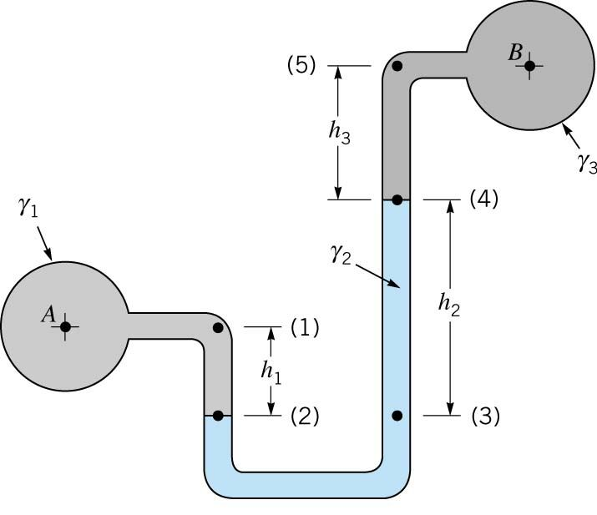

BITS PILANI, GOA CAMPUS
Measurement of Pressure: U-Tube Manometer
Measuring a Pressure Differential
Closed End “Container”
p_{B}
Final notes:
1)Common gage fluids are Hg and Water, some oils, and must be immiscible.
2)Temp. must be considered in very accurate measurements, as the gage fluid properties can change.
3) Capillarity can play a role, but in many cases each meniscus will cancel.
Closed End “Container”
p_{A}
Moving from left to right:
p_{A}
+ γ₁h₁
- γ₂h₂
- γ₃h₃
= p_{B}
Then the equation for the pressure difference in the container is the following:

Slide 30
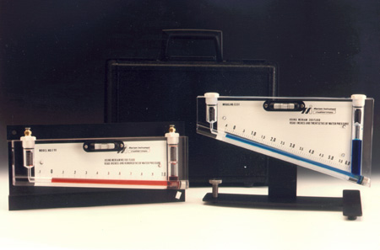
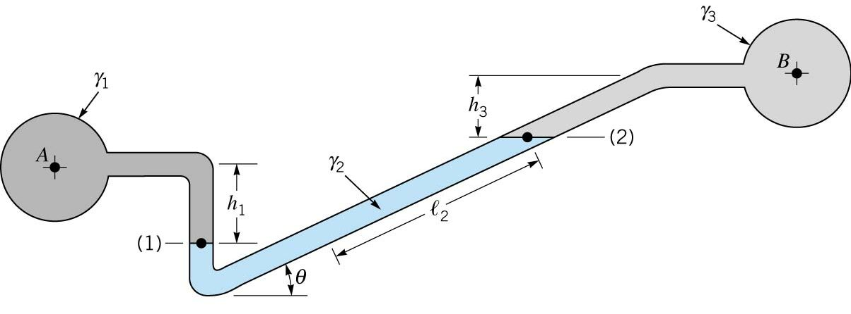
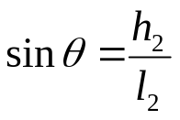




BITS PILANI, GOA CAMPUS
Measurement of Pressure: Inclined-Tube Manometer
This type of manometer is used to measure small pressure changes.
p_{B}
p_{A}
h₂
l₂
h₂
θ
θ
Moving from left to right:
p_{A}
+ γ₁h₁
- γ₂h₂
- γ₃h₃
= p_{B}
Substituting for h₂:
Rearranging to Obtain the Difference:
If the pressure difference is between gases:
Thus, for the length of the tube we can measure a greater pressure differential.

Slide 31
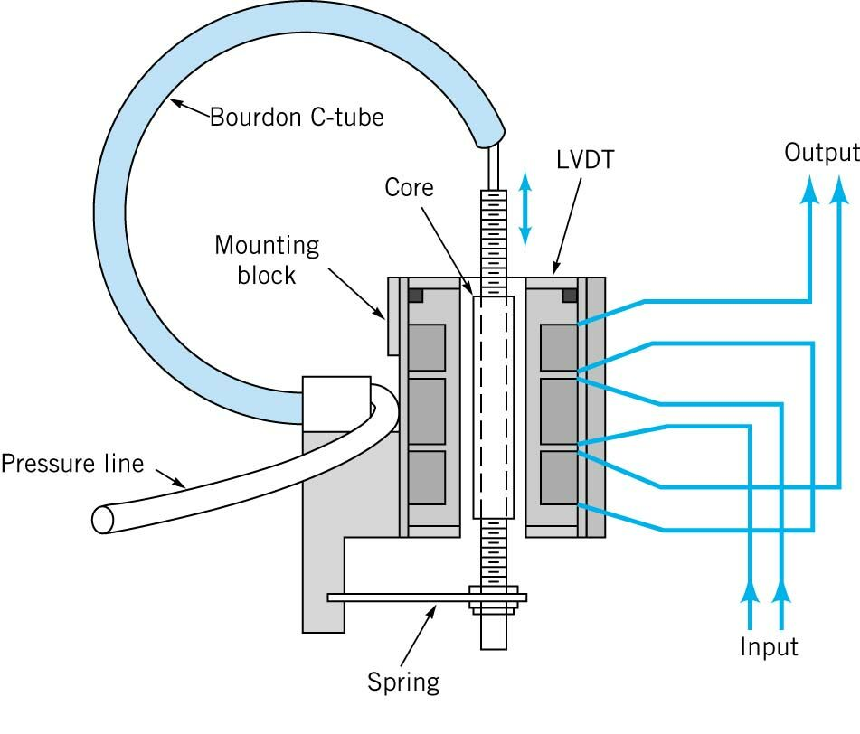
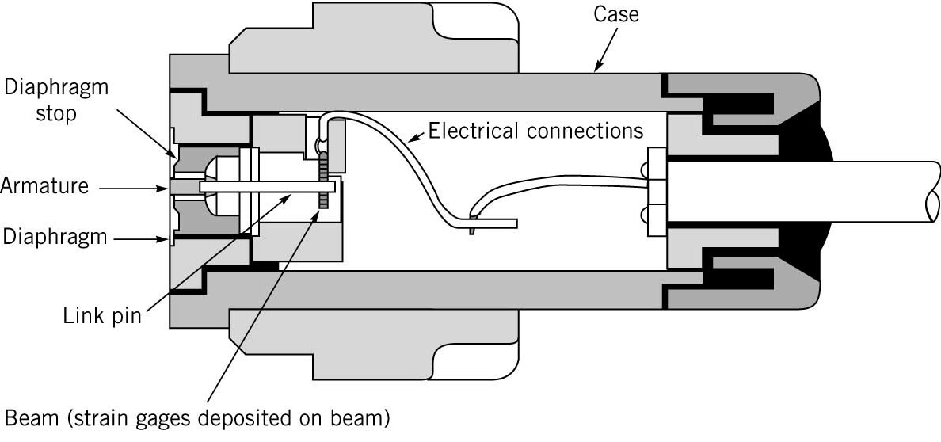
BITS PILANI, GOA CAMPUS
Measurement of Pressure: Mechanical and Electrical Devices
Spring
Bourdon Gage:
Diaphragm:

