Slide 1
MAE 3130: Fluid Mechanics
Lecture 3: Fluid Statics (Part B)
Spring 2003
BITS PILANI, GOA CAMPUS
Dr. Srinivas Krishnaswamy
ASSISTANT PROFESSOR
CHEMICAL ENGINEERING

Slide 2
Outline
BITS PILANI, GOA CAMPUS
Hydrostatic Force on a Plane Surface
Pressure Prism
Hydrostatic Force on a Curved Surface
Buoyancy, Flotation, and Stability
Rigid Body Motion of a Fluid
Example Problems

Slide 3



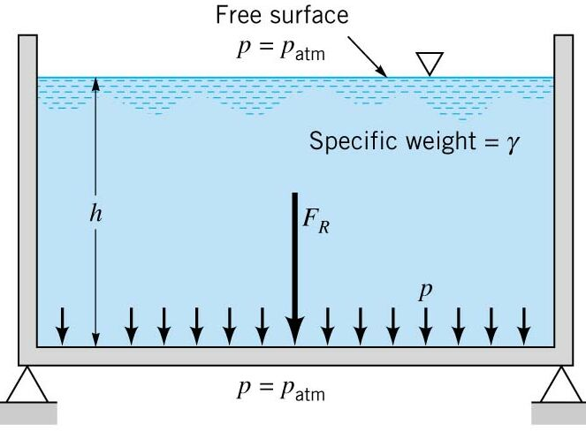


BITS PILANI, GOA CAMPUS
Hydrostatic Force on a Plane Surface: Tank Bottom
Simplest Case: Tank bottom with a uniform pressure distribution
-
=
-
Now, the resultant Force:
=
p
A
Acts through the Centroid
A = area of the Tank Bottom

Slide 4
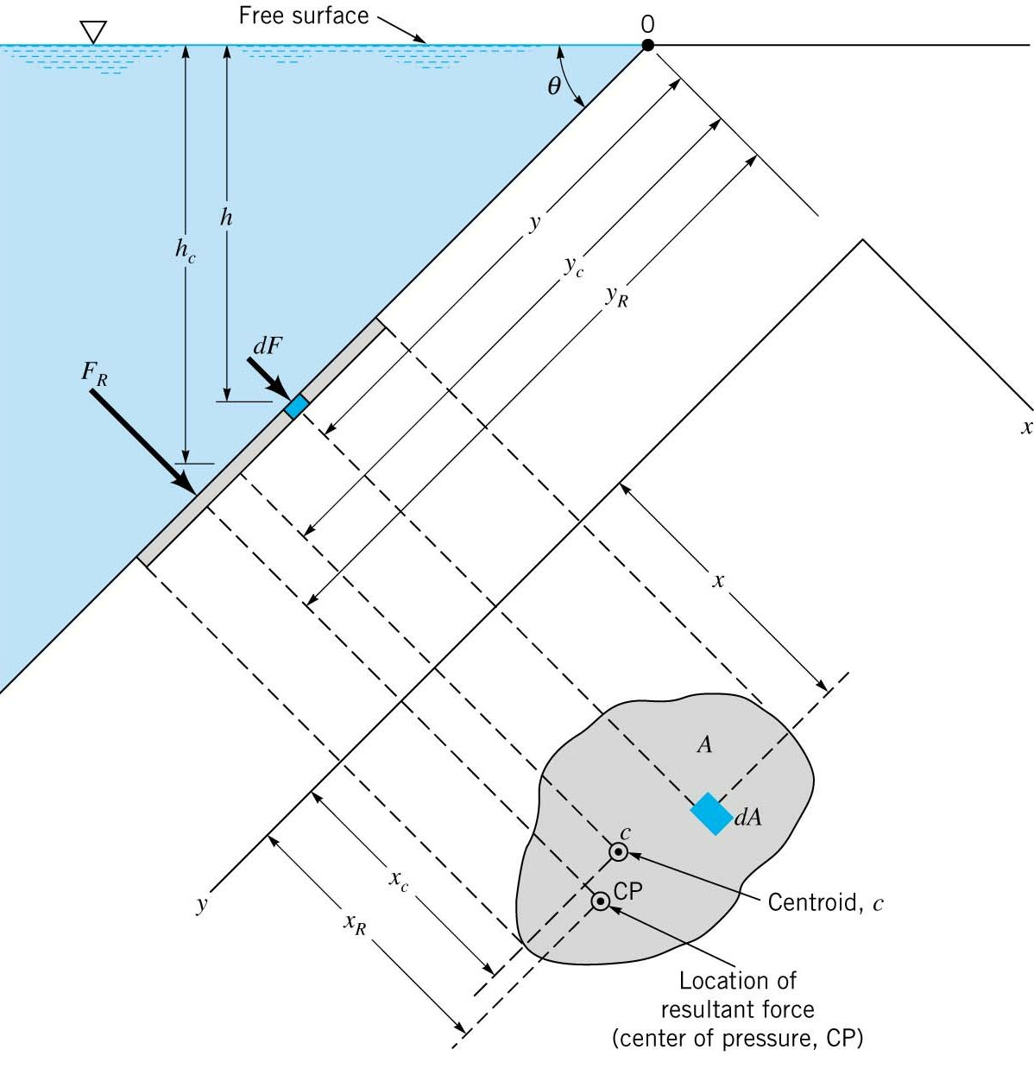
BITS PILANI, GOA CAMPUS
Hydrostatic Force on a Plane Surface: General Case
The origin O is at the Free Surface.
θ is the angle the plane makes
with the free surface.
y is directed along the plane surface.
A is the area of the surface.
dA is a differential element of the surface.
dF is the force acting on the differential element.
C is the centroid.
General Shape: Planar View, in the x-y plane
CP is the center of Pressure
F_{R} is the resultant force acting through CP

Slide 5





BITS PILANI, GOA CAMPUS
Hydrostatic Force on a Plane Surface: General Case
Then the force acting on the differential element:
Then the resultant force acting on the entire surface:
We note h = ysinθ
With γ and θ taken as constant:
We note, the integral part is the first moment of area about the x-axis
Where y_{c} is the y coordinate to the centroid of the object.
h_{c}

Slide 6






BITS PILANI, GOA CAMPUS
Hydrostatic Force on a Plane Surface: Location
Now, we must find the location of the center of Pressure where the Resultant Force Acts:
“The Moments of the Resultant Force must Equal the Moment of the Distributed Pressure Force”
Moments about the x-axis:
And, note h = ysinθ
We note,
Second moment of Intertia, I_{x}
Then,
Parallel Axis Thereom:
I_{xc} is the second moment of inertia through the centroid
Substituting the parallel Axis thereom, and rearranging:
We, note that for a submerged plane, the resultant force always acts below the centroid of the plane.

Slide 7






BITS PILANI, GOA CAMPUS
Hydrostatic Force on a Plane Surface: Location
Moments about the y-axis:
And, note h = ysinθ
We note,
Second moment of Intertia, I_{xy}
Then,
Parallel Axis Thereom:
I_{xc} is the second moment of inertia through the centroid
Substituting the parallel Axis thereom, and rearranging:

Slide 8
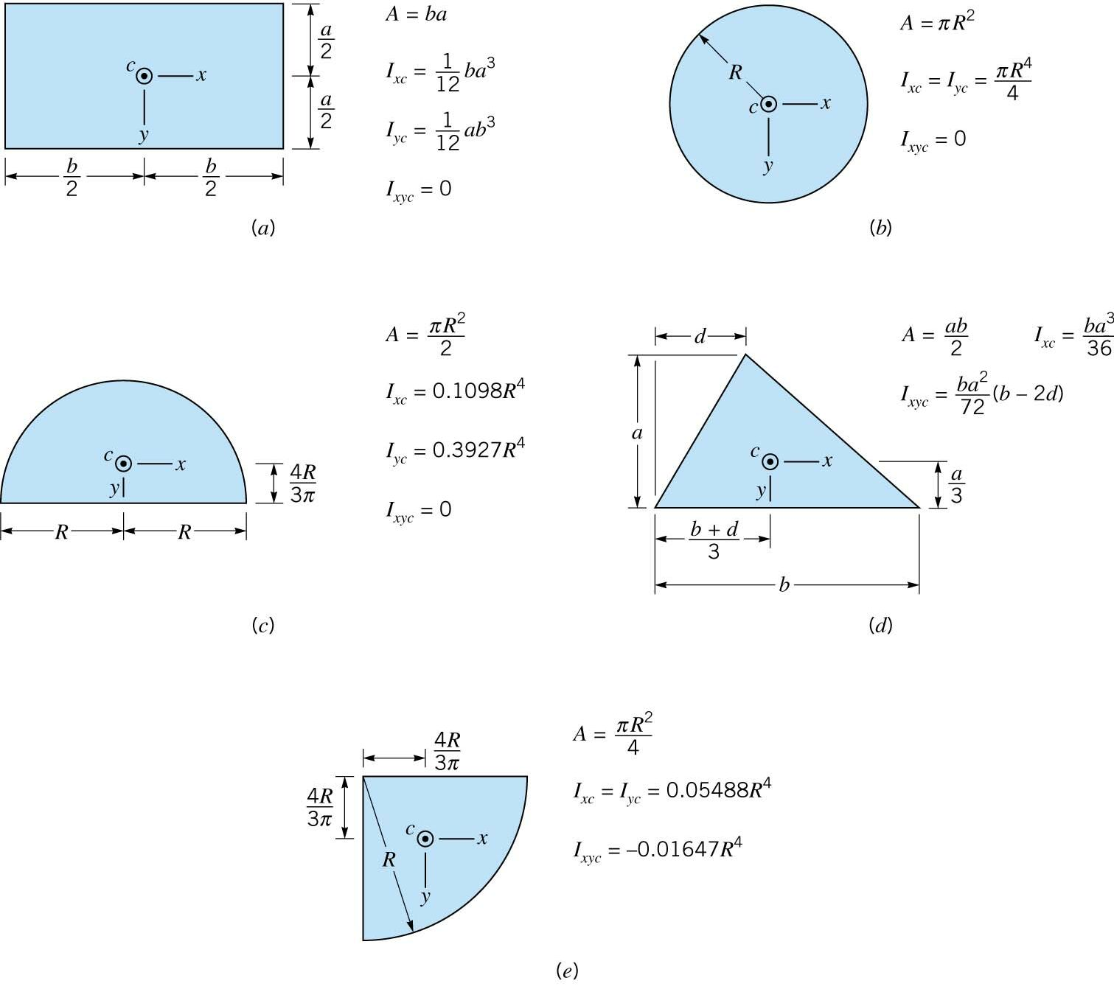
BITS PILANI, GOA CAMPUS
Hydrostatic Force on a Plane Surface: Geometric Properties
Centroid Coordinates
Areas
Moments of Inertia

Slide 9
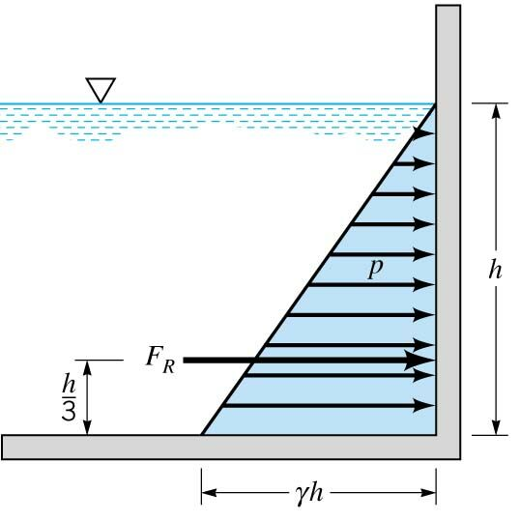



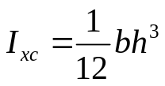
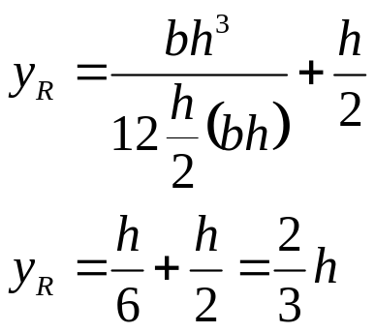
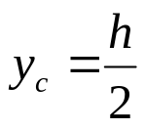

BITS PILANI, GOA CAMPUS
Hydrostatic Force: Vertical Wall
Find the Pressure on a Vertical Wall using Hydrostatic Force Method
Pressure varies linearly with depth by the hydrostatic equation:
The magnitude of pressure at the bottom is p = γh
The depth of the fluid is “h” into the board
O
The width of the wall is “b” into the board
y_{R} = 2/3h
By inspection, the average pressure occurs at h/2, p_{av} = γh/2
The resultant force act through the center of pressure, CP:
y-coordinate:

Slide 10
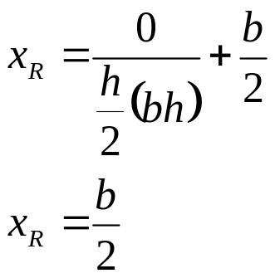

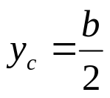
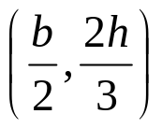
BITS PILANI, GOA CAMPUS
Hydrostatic Force: Vertical Wall
x-coordinate:
Center of Pressure:
Now, we have both the resultant force and its location.
The pressure prism is a second way of analyzing the forces on a vertical wall.

Slide 11

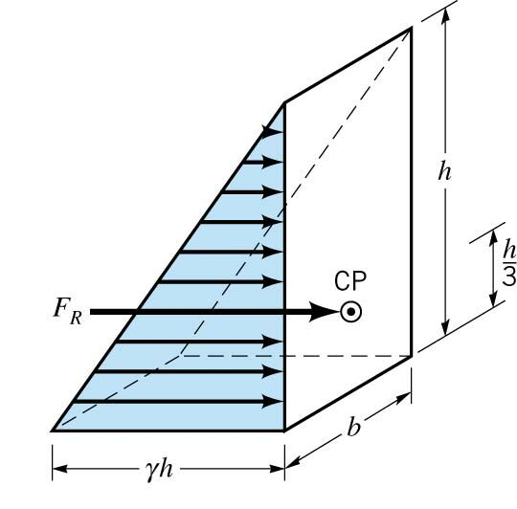
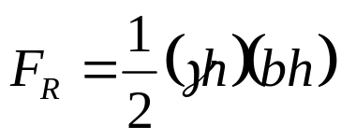
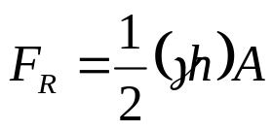
BITS PILANI, GOA CAMPUS
Pressure Prism: Vertical Wall
Pressure Prism: A graphical interpretation of the forces due to a fluid acting on a plane area. The “volume” of fluid acting on the wall is the pressure prism and equals the resultant force acting on the wall.
Resultant Force:
O
Volume
Location of the Resultant Force, CP:
The location is at the centroid of the volume of the pressure prism.
Center of Pressure:

Slide 12
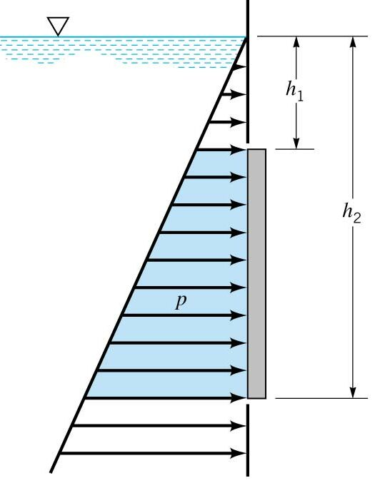
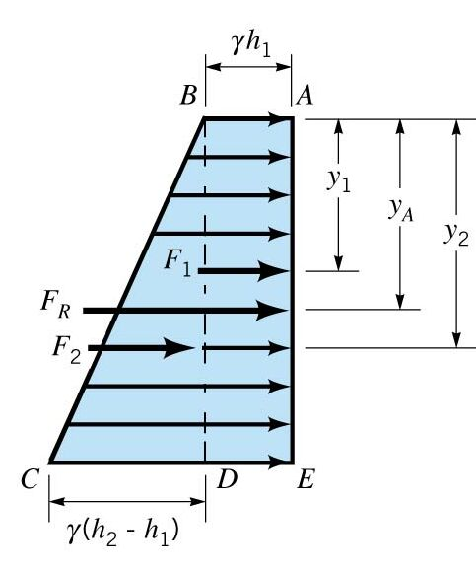


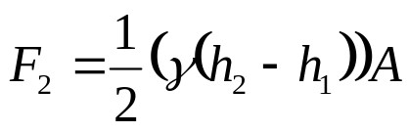

BITS PILANI, GOA CAMPUS
Pressure Prism: Submerged Vertical Wall
Trapezoidal
The Resultant Force: break into two “volumes”
Location of Resultant Force: “use sum of moments”
Solve for y_{A}
y₁ and y₂ is the centroid location for the two volumes where F₁ and F₂ are the resultant forces of the volumes.

Slide 13
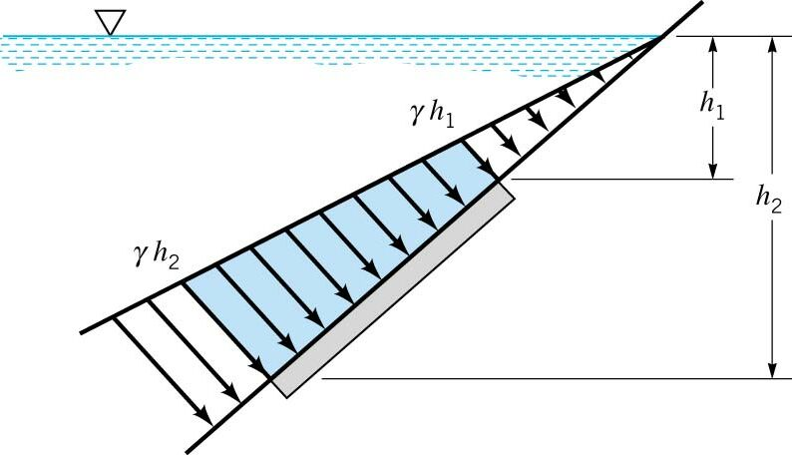
BITS PILANI, GOA CAMPUS
Pressure Prism: Inclined Submerged Wall
Now we have an incline trapezoidal volume. The methodology is the same as the last problem, and we affix the coordinate system to the plane.
The use of pressure prisms in only convenient if we have regular geometry, otherwise integration is needed
In that case we use the more revert to the general theory.

Slide 14
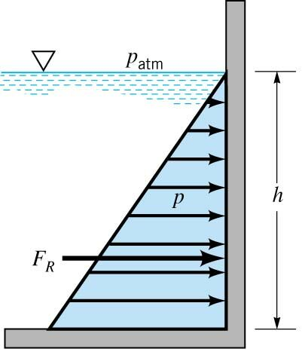
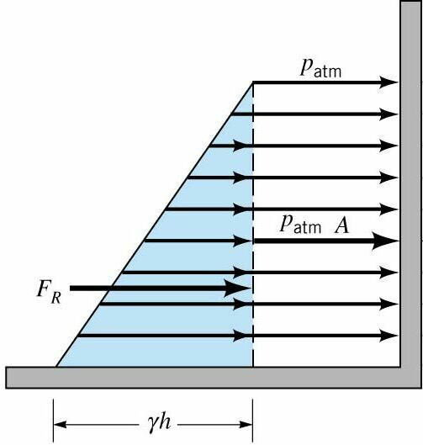
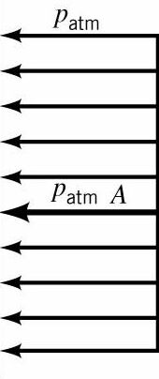
BITS PILANI, GOA CAMPUS
Atmospheric Pressure on a Vertical Wall
Gage Pressure Analysis
Absolute Pressure Analysis
But,
So, in this case the resultant force is the same as the gag pressure analysis.
It is not the case, if the container is closed with a vapor pressure above it.
If the plane is submerged, there are multiple possibilities.

Slide 15
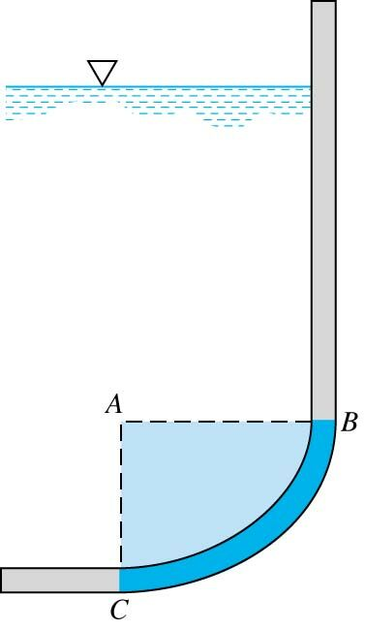
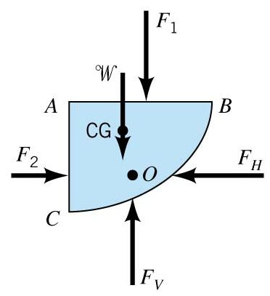
BITS PILANI, GOA CAMPUS
Hydrostatic Force on a Curved Surface
General theory of plane surfaces does not apply to curved surfaces
Many surfaces in dams, pumps, pipes or tanks are curved
No simple formulas by integration similar to those for plane surfaces
A new method must be used
Then we mark a F.B.D. for the volume:
Isolated Volume
Bounded by AB an AC and BC
F₁ and F₂ is the hydrostatic force on each planar face
F_{H} and F_{V} is the component of the resultant force on the curved surface.
W is the weight of the fluid volume.

Slide 16
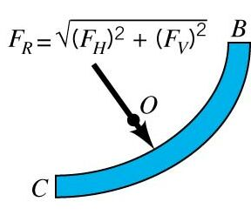

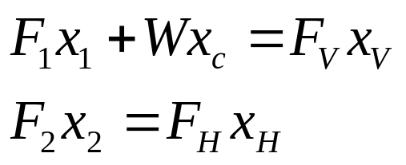
BITS PILANI, GOA CAMPUS
Hydrostatic Force on a Curved Surface
Now, balancing the forces for the Equilibrium condition:
Horizontal Force:
Vertical Force:
Resultant Force:
The location of the Resultant Force is through O by sum of Moments:
Y-axis:
X-axis:
Soda Pop Bottle Curved Surface:

Slide 17
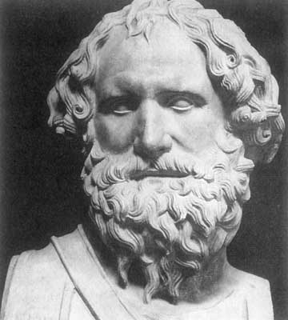
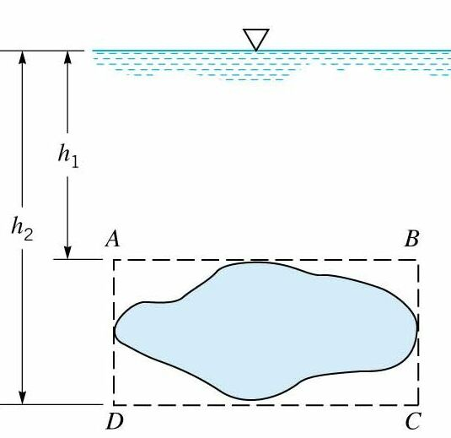
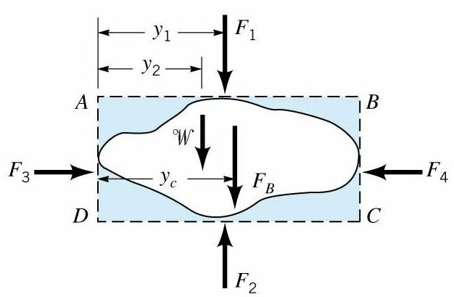
BITS PILANI, GOA CAMPUS
Buoyancy: Archimedes’ Principle
Archimedes’ Principle states that the buoyant force has a magnitude equal to the weight of the fluid displaced by the body and is directed vertically upward.
Archimedes (287-212 BC)
Story
Buoyant force is a force that results from a floating or submerged body in a fluid.
The force results from different pressures on the top and bottom of the object
The pressure forces acting from below are greater than those on top
Now, treat an arbitrary submerged object as a planar surface:
Forces on the Fluid
Parallelpiped
Arbitrary Shape
V

Slide 18

BITS PILANI, GOA CAMPUS
Buoyancy and Flotation: Archimedes’ Principle
Balancing the Forces of the F.B.D. in the vertical Direction:
Then, substituting:
W is the weight of the shaded area
F₁ and F₂ are the forces on the plane surfaces
F_{B} is the bouyant force the body exerts on the fluid
Simplifying,
The force of the fluid on the body is opposite, or vertically upward and is known as the Buoyant Force.
The force is equal to the weight of the fluid it displaces.

Slide 19


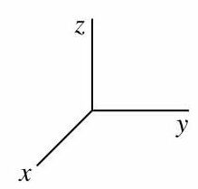
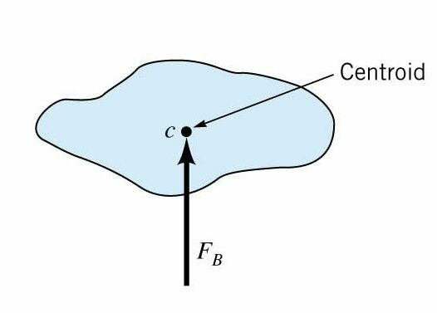
BITS PILANI, GOA CAMPUS
Buoyancy and Flotation: Archimedes’ Principle
Find where the Buoyant Force Acts by Summing Moments:
Sum the Moments about the z-axis:
V_{T} is the total volume of the parallelpiped
We find that the buoyant forces acts through the centroid of the displaced volume.
The location is known as the center of buoyancy.

Slide 20
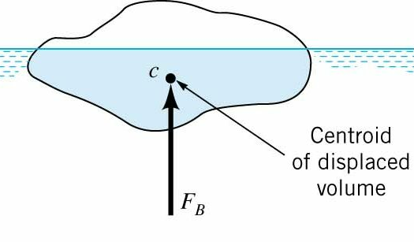
BITS PILANI, GOA CAMPUS
Buoyancy and Flotation: Archimedes’ Principle
We can apply the same principles to floating objects:
If the fluid acting on the upper surfaces has very small specific weight (air), the centroid is simply that of the displaced volume, and the buoyant force is as before.
If the specific weight varies in the fluid the buoyant force does not pass through the centroid of the displaced volume, but through the center of gravity of the displaced volume.

Slide 21
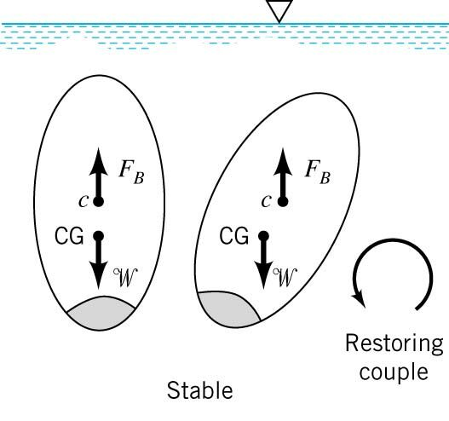
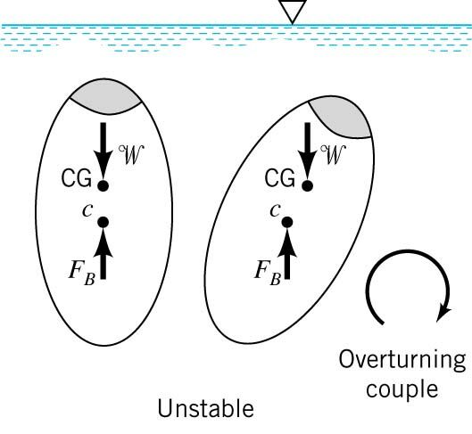
BITS PILANI, GOA CAMPUS
Stability: Submerged Object
Stable Equilibrium: if when displaced returns to equilibrium position.
Unstable Equilibrium: if when displaced it returns to a new equilibrium position.
Stable Equilibrium:
Unstable Equilibrium:
C > CG, “Higher”
C < CG, “Lower”

Slide 22
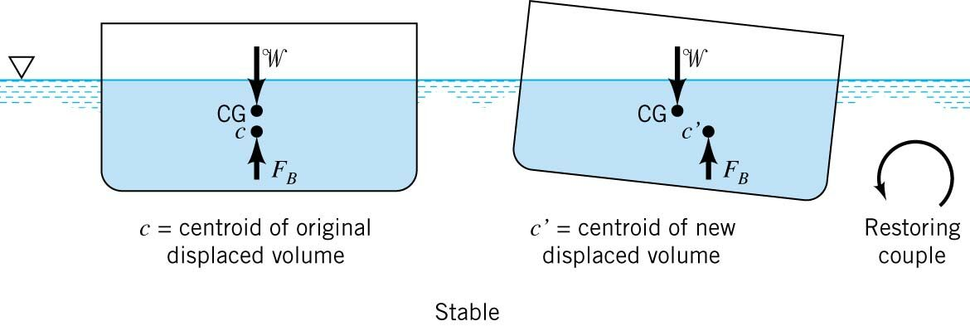
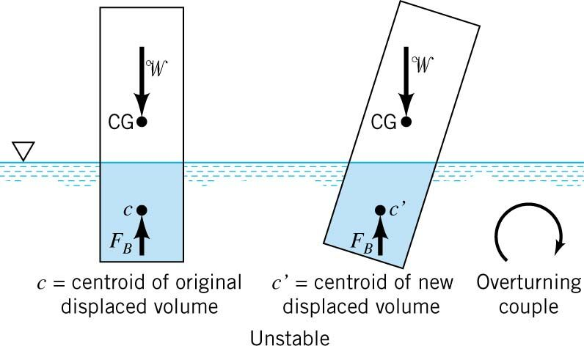
BITS PILANI, GOA CAMPUS
Buoyancy and Stability: Floating Object
Slightly more complicated as the location of the center buoyancy can change:

Slide 23




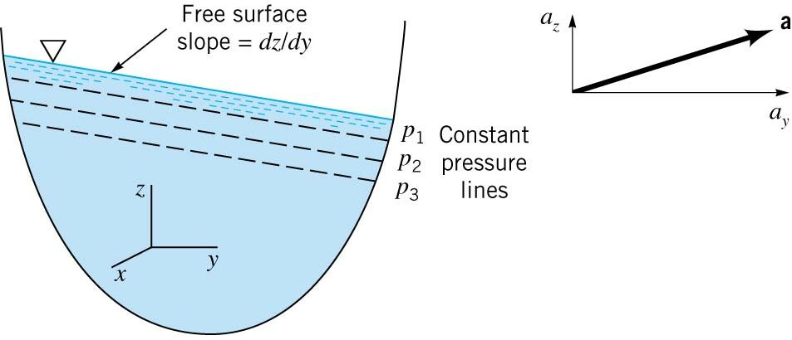
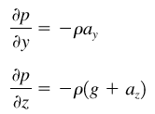



BITS PILANI, GOA CAMPUS
Pressure Variation, Rigid Body Motion: Linear Motion
Governing Equation with no Shear (Rigid Body Motion):
The equation in all three directions are the following:
Consider, the case of an open container of liquid with a constant acceleration:
Estimating the pressure between two closely spaced points apart some dy, dz:
Substituting the partials
Along a line of constant pressure, dp = 0:
Inclined free surface for a_{y}≠ 0

Slide 24
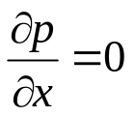
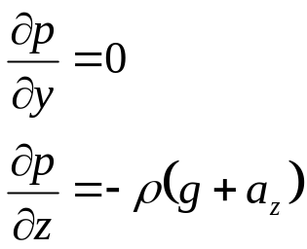

BITS PILANI, GOA CAMPUS
Pressure Variation, Rigid Body Motion: Linear Motion
Now consider the case where a_{y} = 0, and a_{z} ≠ 0:
Recall, already:
Then,
So,
Non-Hydrostatic
Pressure will vary linearly with depth, but variation is the combination of gravity and externally developed acceleration.
A tank of water moving upward in an elevator will have slightly greater pressure at the bottom.
If a liquid is in free-fall a_{z} = -g, and all pressure gradients are zero—surface tension is all that keeps the blob together.

Slide 25
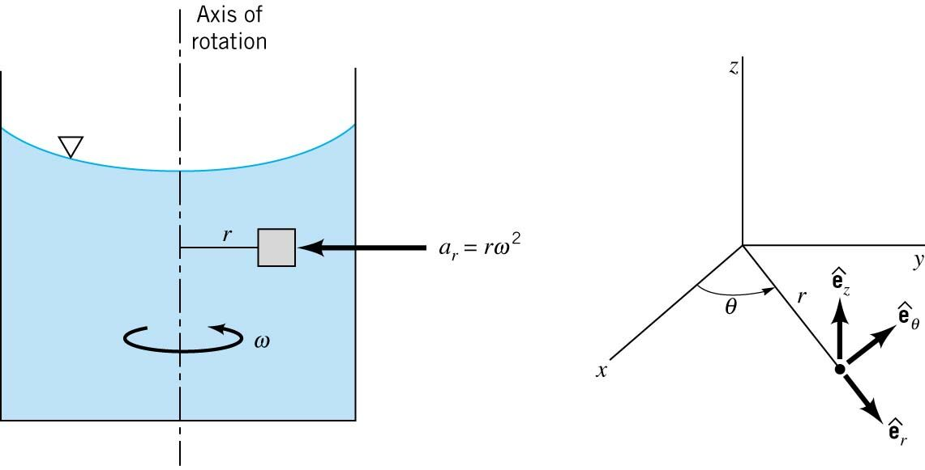


BITS PILANI, GOA CAMPUS
Pressure Variation, Rigid Body Motion: Rotation
Governing Equation with no Shear (Rigid Body Motion):
Motion in a Rotating Tank:
Write terms in cylindrical coordinates for convenience:
Pressure Gradient:
Accceleration Vector:

Slide 26






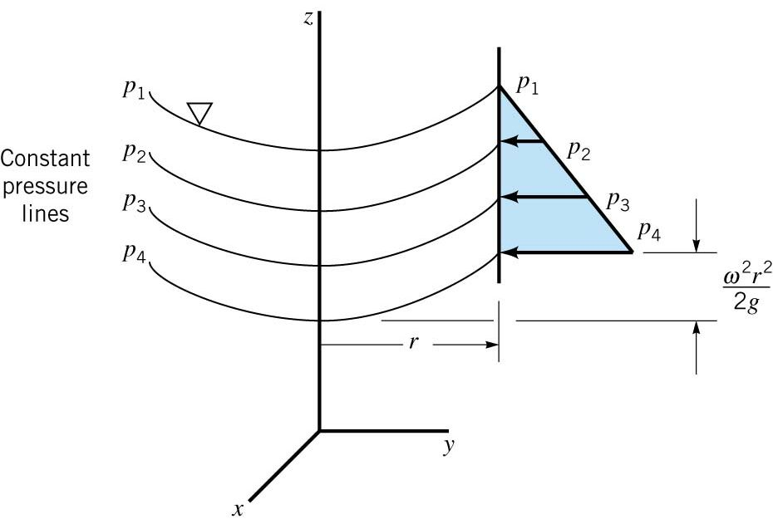

BITS PILANI, GOA CAMPUS
Pressure Variation, Rigid Body Motion: Rotation
The equation in all three directions are the following:
Estimating the pressure between two closely spaced points apart some dr, dz:
Substituting the partials
Along a line of constant pressure, dp = 0:
Equation of constant pressure surfaces:
The surfaces of constant pressure are parabolic

Slide 27


BITS PILANI, GOA CAMPUS
Pressure Variation, Rigid Body Motion: Rotation
Now, integrate to obtain the Pressure Variation:
Pressure varies hydrostaticly in the vertical, and increases radialy

