Slide 1

BITS, PILANI – K. K. BIRLA GOA CAMPUS
Process Control- CHE C441
Chapter #11
Dynamic Behavior of Closed-Loop Control Systems
Dr. Saroj Sundar Baral
Department of Chemical Engineering
BITS, PILANI – K. K. BIRLA GOA CAMPUS

Slide 2
Topic to be covered
Block diagram representation
Closed-loop transfer functions
Closed-loop response of simple control system
Stability of closed-loop control system
Root locus Diagram
BITS, PILANI – K. K. BIRLA GOA CAMPUS

Slide 3
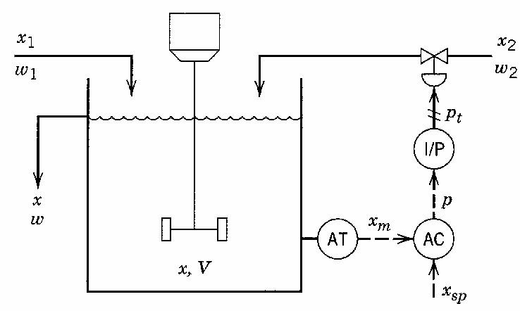
Block diagram representation
BITS, PILANI – K. K. BIRLA GOA CAMPUS

Slide 4
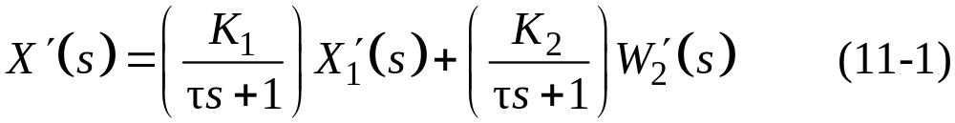
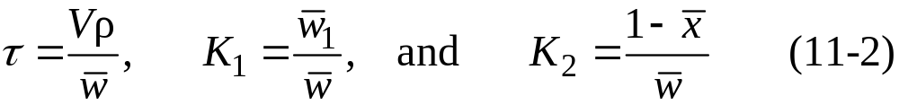
Next, we develop a transfer function for each of the five elements in the feedback control loop. For the sake of simplicity, flow rate w₁ is assumed to be constant, and the system is initially operating at the nominal steady rate.
Process
In section 4.1 the approximate dynamic model of a stirred-tank blending system was developed:
where
BITS, PILANI – K. K. BIRLA GOA CAMPUS

Slide 5
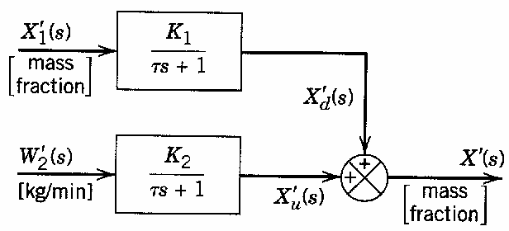
Block diagram of the process
BITS, PILANI – K. K. BIRLA GOA CAMPUS

Slide 6
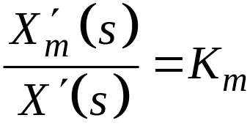
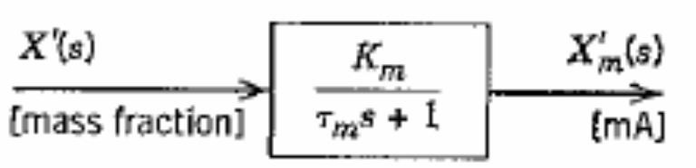
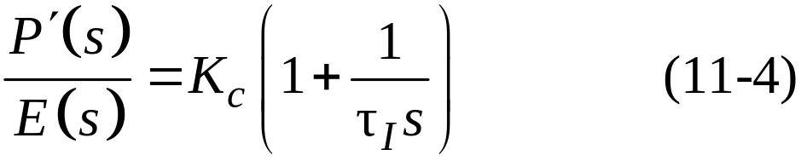
Composition Sensor-Transmitter (Analyzer)
We assume that the dynamic behavior of the composition sensor-transmitter can be approximated by a first-order transfer function, but τ_{m} is small so it can be neglected.
Controller
Suppose that an electronic proportional plus integral controller is used.
where and E(s) are the Laplace transforms of the controller output and the error signal e(t). K_{c} is dimensionless.
BITS, PILANI – K. K. BIRLA GOA CAMPUS

Slide 7

Block diagram for controller
The symbol denotes the internal set-point composition expressed as an equivalent electrical current signal. is related to the actual composition set point by the composition sensor-transmitter gain K_{m}:
BITS, PILANI – K. K. BIRLA GOA CAMPUS

Slide 8
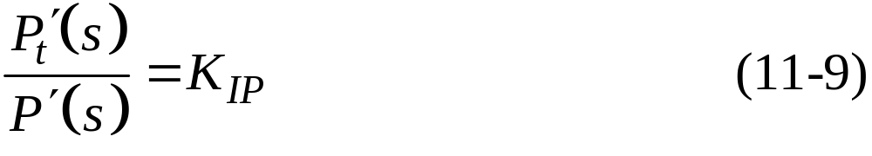
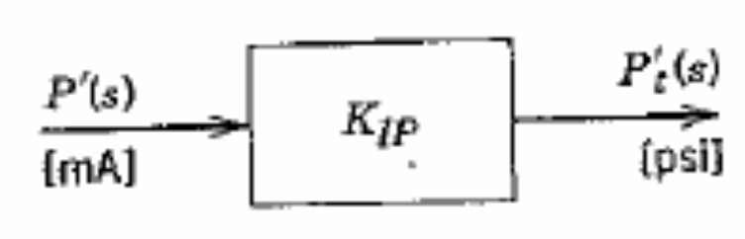
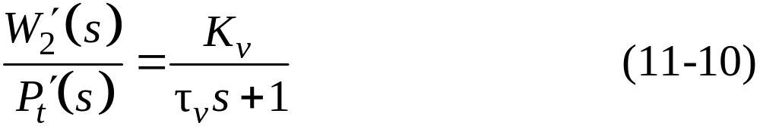
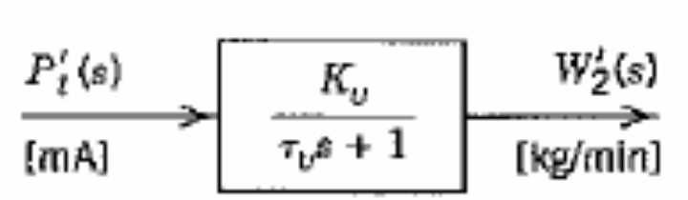
Current-to-Pressure (I/P) Transducer
The transducer transfer function merely consists of a steady-state gain K_{IP}:
Control Valve
As discussed in Section 9.2, control valves are usually designed so that the flow rate through the valve is a nearly linear function of the signal to the valve actuator. Therefore, a first-order transfer function is an adequate model
BITS, PILANI – K. K. BIRLA GOA CAMPUS

Slide 9
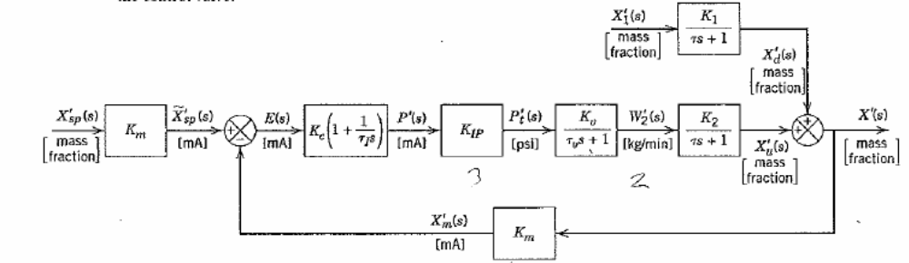
Block diagram for the entire blending process
BITS, PILANI – K. K. BIRLA GOA CAMPUS

Slide 10
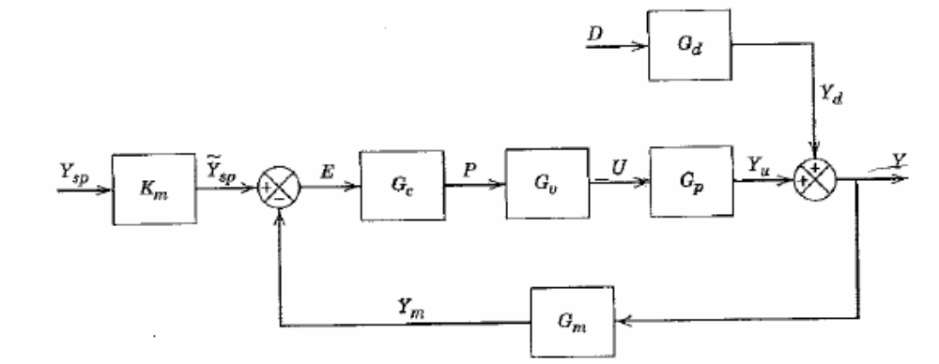
General block diagram for a feed-back control system
BITS, PILANI – K. K. BIRLA GOA CAMPUS

Slide 11
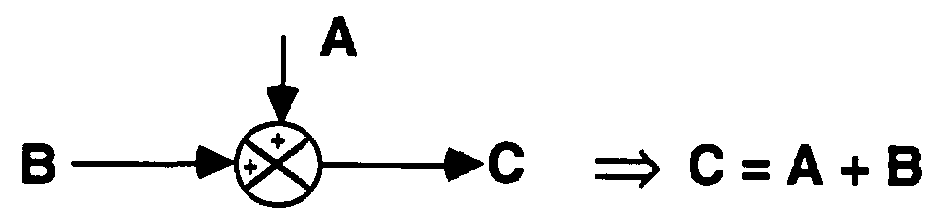
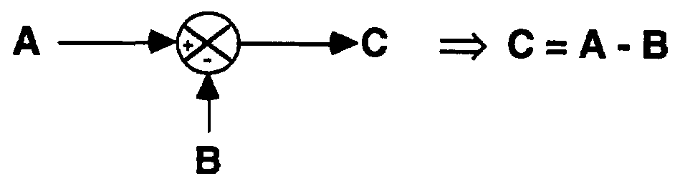
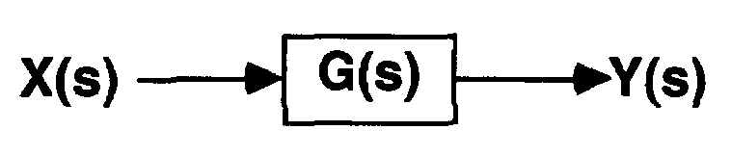


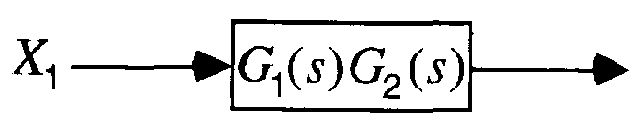
1. Summer
2. Comparator
3. Block
Blocks in Series
are equivalent to...
BITS, PILANI – K. K. BIRLA GOA CAMPUS

Slide 12
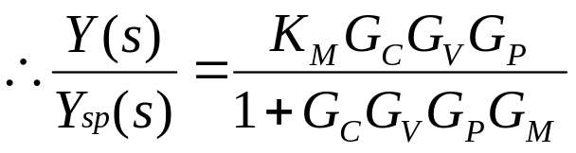
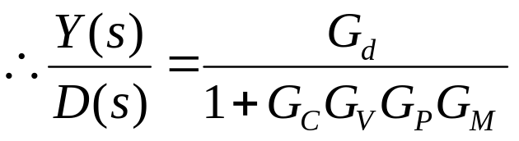
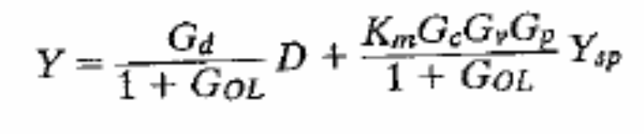
“Closed-Loop” Transfer Functions
Indicate dynamic behavior of the controlled process
(i.e., process plus controller, transmitter, valve etc.)
Set-point Changes (“Servo Problem”)
Assume Ysp ≠ 0 and D = 0 (set-point change while disturbance
change is zero)
Disturbance Changes (“Regulator Problem”)
Assume D ≠ 0 and Y_{sp} = 0 (constant set-point)
*Note same denominator for Y/D, Y/Y_{sp}.
For both D and Y_{sp} change
BITS, PILANI – K. K. BIRLA GOA CAMPUS

Slide 13
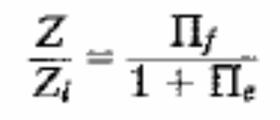
General Expression for feedback control system
Where: Z is the output variable or any internal variable within the control loop
Z_{f} is an input variable (Y_{SP} or D)
BITS, PILANI – K. K. BIRLA GOA CAMPUS

Slide 14
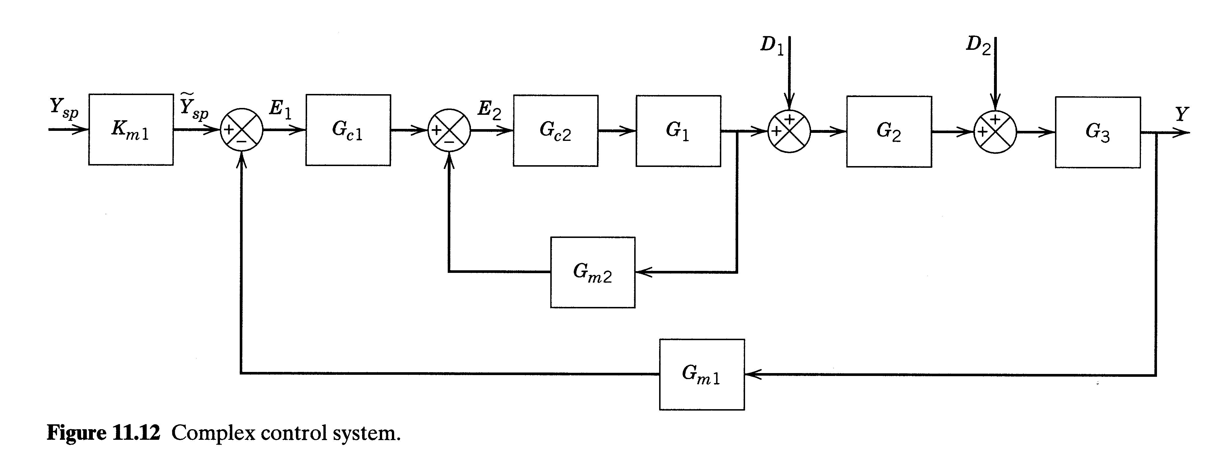
Example 11.1: Find the closed-loop transfer function Y/Y_{sp} for the following complex control system
BITS, PILANI – K. K. BIRLA GOA CAMPUS

Slide 15
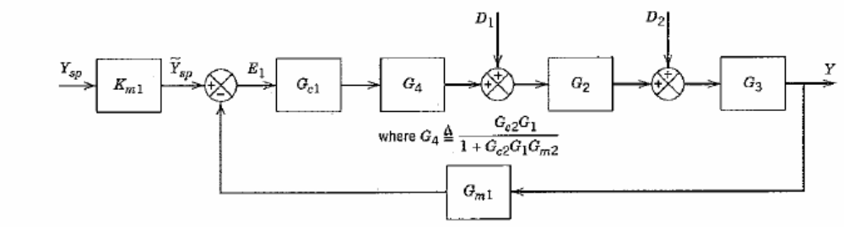
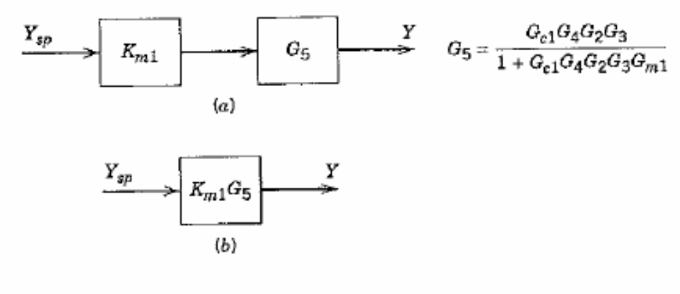
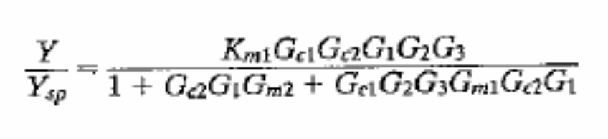
BITS, PILANI – K. K. BIRLA GOA CAMPUS

Slide 16
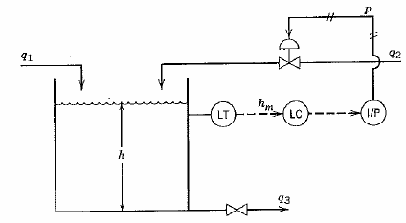
Liquid level control system
Assumptions:
ρ an A are constant
q₃=h/R
3. Negligible dynamics for level transmitter and I/P transducer.
4. Electronic controller with input and output in % is used
BITS, PILANI – K. K. BIRLA GOA CAMPUS

Slide 17

G_{m}(s)=K_{m}
G_{v}(s)=K_{v}
BITS, PILANI – K. K. BIRLA GOA CAMPUS

Slide 18
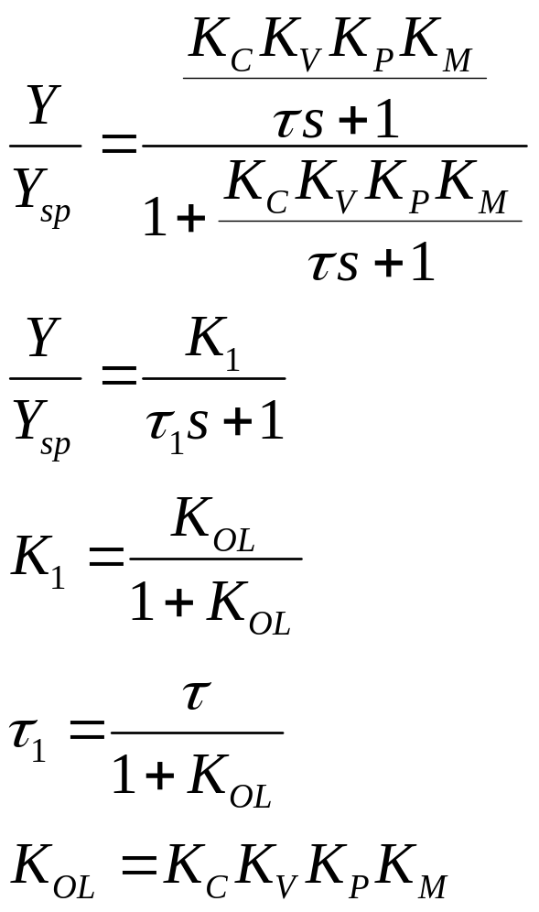
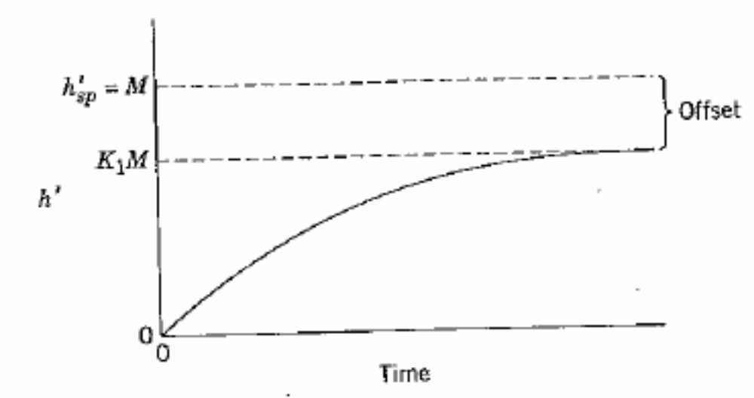
Proportional control and set point change
BITS, PILANI – K. K. BIRLA GOA CAMPUS

Slide 19
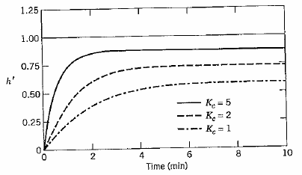
Effect of increased value K_{C}
BITS, PILANI – K. K. BIRLA GOA CAMPUS

Slide 20
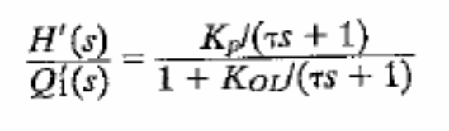



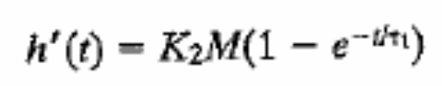
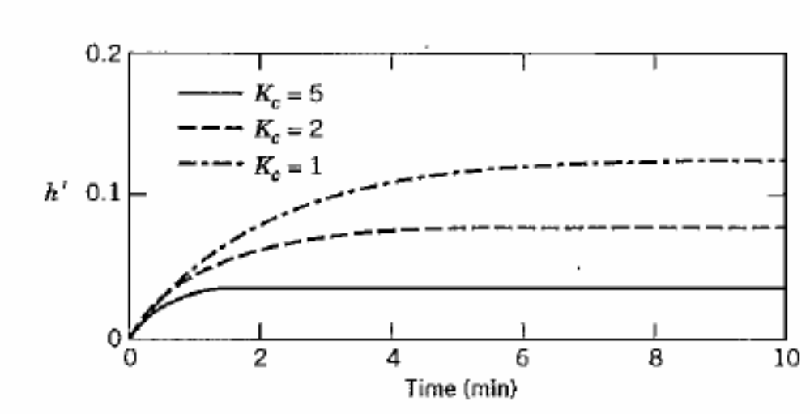
Proportional control and disturbance change
BITS, PILANI – K. K. BIRLA GOA CAMPUS

Slide 21
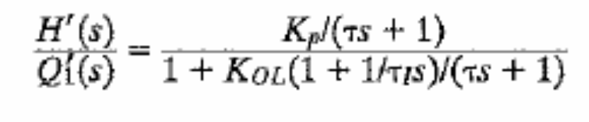
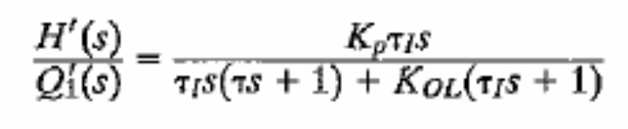
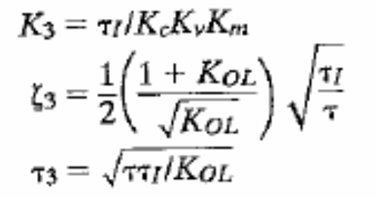
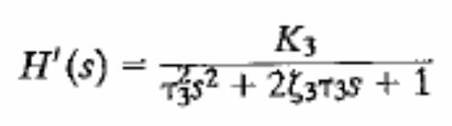
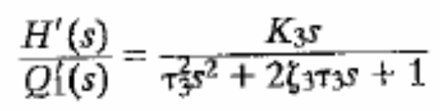
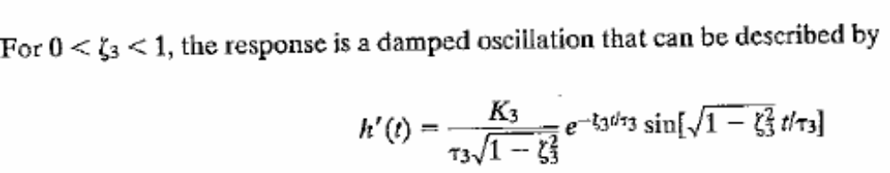
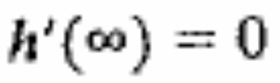
PI control and disturbance change
No offset
BITS, PILANI – K. K. BIRLA GOA CAMPUS

Slide 22
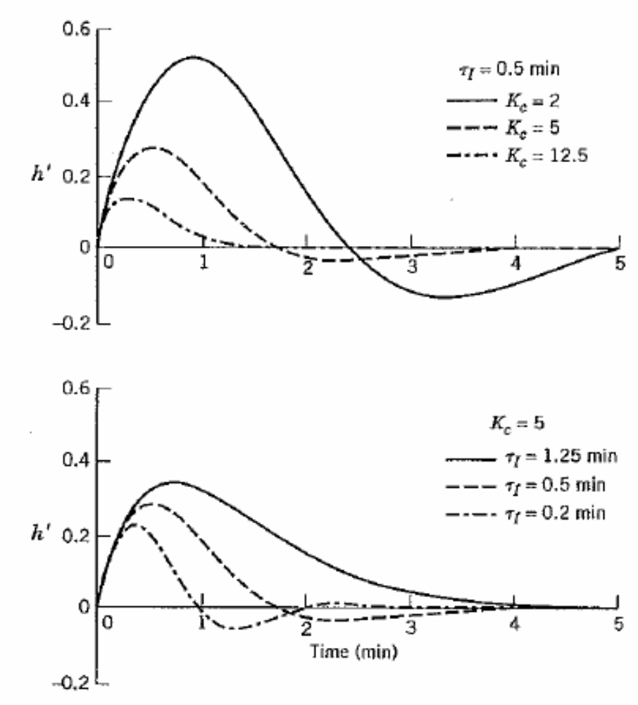
Response is faster when K_{C} increases,
Response is faster when τ decreases
BITS, PILANI – K. K. BIRLA GOA CAMPUS

Slide 23
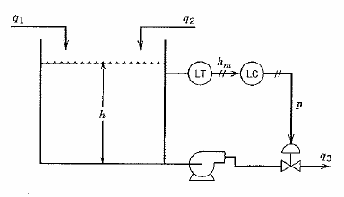

EXAMPLE 1: P.I. control of liquid level
Assumptions
1. q₁, varies with time; q₂ is constant.
2. Constant density and x-sectional area of tank, A.
3. (for uncontrolled process)
4. The transmitter and control valve have negligible dynamics
(compared with dynamics of tank).
5. Ideal PI controller is used (direct-acting).
BITS, PILANI – K. K. BIRLA GOA CAMPUS

Slide 24
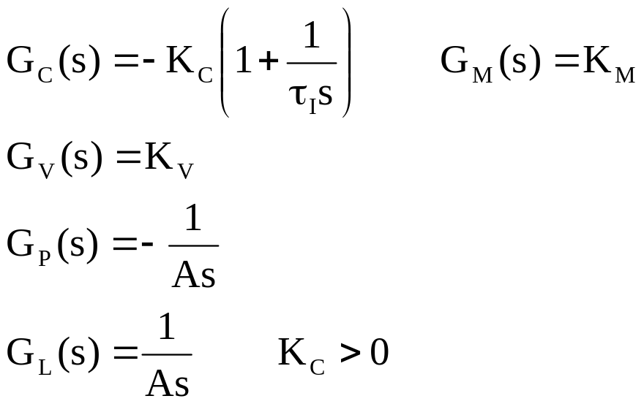
For these assumptions, the transfer functions are:
BITS, PILANI – K. K. BIRLA GOA CAMPUS

Slide 25
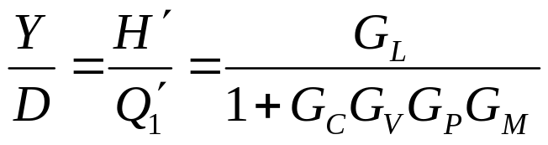
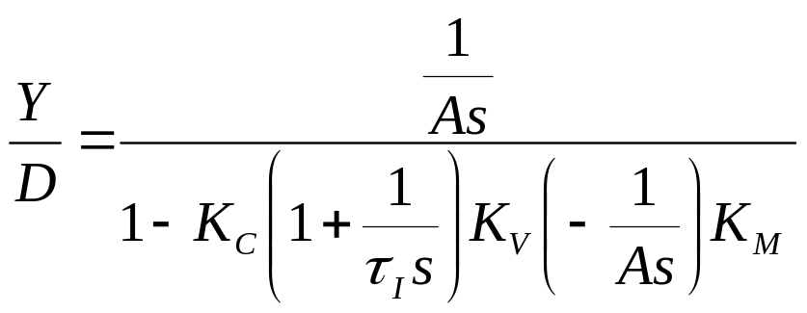
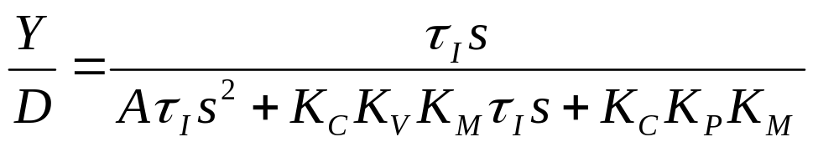
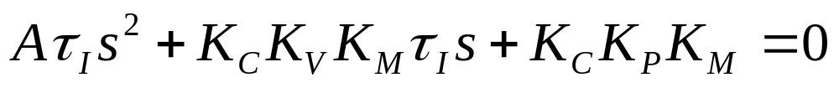
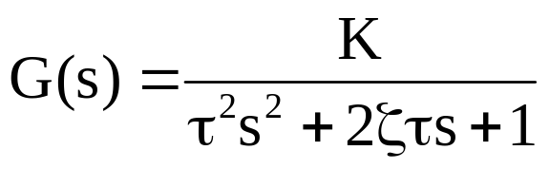
The closed-loop transfer function is:
(11-68)
Substitute,
(2)
Simplify,
(3)
Characteristic Equation:
(4)
Recall the standard 2nd Order Transfer Function:
(5)
BITS, PILANI – K. K. BIRLA GOA CAMPUS

Slide 26
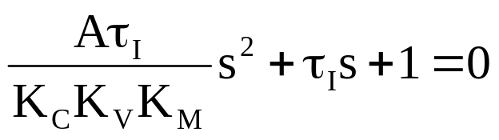
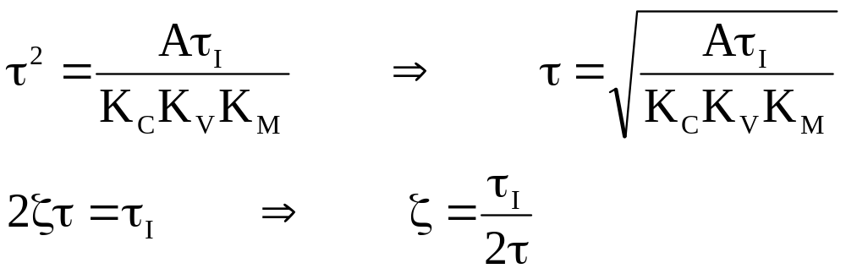
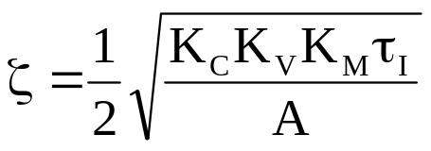
To place Eqn. (4) in the same form as the denominator of the
T.F. in Eqn. (5), divide by K_{c}, K_{V}, K_{M} :
Comparing coefficients (5) and (6) gives:
Substitute,
For 0 < ζ < 1 , closed-loop response is oscillatory. Thus
decreased degree of oscillation by increasing K_{c} or τ_{I} (for constant
K_{v}, K_{M}, and A).
unusual property of PI control of integrating system
better to use P only
BITS, PILANI – K. K. BIRLA GOA CAMPUS

Slide 27

Stability of Closed-Loop Control Systems
BITS, PILANI – K. K. BIRLA GOA CAMPUS

Slide 28
General Stability Criterion
Definition of Stability. An unconstrained linear system is said to be stable if the output response is bounded for all bounded inputs. Otherwise it is said to be unstable.
BITS, PILANI – K. K. BIRLA GOA CAMPUS

Slide 29






For set point change
Where P_{i} is the pole and Z_{i} is the zero
Is the characteristic equation
BITS, PILANI – K. K. BIRLA GOA CAMPUS

Slide 30



For a unit step change in set point
If all the poles are distinct
If any pole p>0 y(t) will unstable
BITS, PILANI – K. K. BIRLA GOA CAMPUS

Slide 31

Routh Stability Criterion
Characteristic equation
Where a_{n} >0 . According to the Routh criterion, if any of the coefficients a₀, a₁, …, a_{n-1} are negative or zero, then at least one root of the characteristic equation lies in the RHP, and thus the system is unstable. On the other hand, if all of the coefficients are positive, then one must construct the Routh Array shown below:
BITS, PILANI – K. K. BIRLA GOA CAMPUS

Slide 32

For stability, all elements in the first column must be positive.
BITS, PILANI – K. K. BIRLA GOA CAMPUS

Slide 33




The first two rows of the Routh Array are comprised of the
coefficients in the characteristic equation. The elements in the
remaining rows are calculated from coefficients by using the
formulas:
(11-94)
(11-95)
(11-96)
(11-97)
(n+1 rows must be constructed; n = order of the characteristic eqn.)
BITS, PILANI – K. K. BIRLA GOA CAMPUS

Slide 34





Application of the Routh Array:
Characteristic Eqn is
We want to know what value of K_{c} causes instability, I.e., at least
one root of the above equation is positive. Using the Routh array,
Conditions for Stability
The important constraint is K_{c}<8. Any K_{c} ≥8 will cause instability.
BITS, PILANI – K. K. BIRLA GOA CAMPUS

Slide 35
Concept of ROOT LOCUS
Root locus is a graphical method for finding the actual values of the roots of the characteristic
equation, from which we can obtain the transient response of the system to an arbitrary forcing function.
Rules for Plotting Root-Locus Diagrams
(Negative Feedback)
RULE 1. The number of loci or branches is equal to the number of open-loop poles, n.
BITS, PILANI – K. K. BIRLA GOA CAMPUS

Slide 36
RULE 2. The root loci begin at open-loop poles and terminate at open-loop zeros. The termination of (n - m) of the loci will occur at the zeros at infinity along
RULE 3. LOCUS ON REAL AXIS. The real axis is part of the root locus when the sum of the number of poles and zeros to the right of a point on the real axis is odd.
RULE 4. ASYMPTOTES. There are (n - m) loci that approach (as K ∞ ) asymptotically (n - m) straight lines, radiating from the center of gravity of the poles and zeros of the open-loop transfer function. The center of gravity is given by
These asymptotic lines make angles of π[(2k + l)/(n - m)] with the real axis and are, therefore, equally spaced at angles 2d(n - m) to each other (k = 0,1,2..., n - m - 1).
BITS, PILANI – K. K. BIRLA GOA CAMPUS

Slide 37
RULE 5. BREAKAWAY POINT. The point at which two root loci, emerging from adjacent poles (or moving toward adjacent zeros) on the real axis, intersect and then leave (or enter) the real axis is determined by the solution of the equation
RULE 6. ANGLE OF DEPARTURE OR APPROACH. There are q loci emerging from each qth-order open-loop pole at angles determined by
BITS, PILANI – K. K. BIRLA GOA CAMPUS

Slide 38


Example: Plot the root-locus diagram for the open-loop transfer function
Solution:
1. Plot the open-loop poles as shown in Figure The poles are indicated by X .There are no open-loop zeros for this example.
2. Since we have three poles, there are three branches.
3. A portion, of the locus is on the real axis between -1 and -2 and another portion is to thk left of -3.
BITS, PILANI – K. K. BIRLA GOA CAMPUS

Slide 39
4. Since n - m = 3, we have three asymptotes and the center of gravity is y = (-3 - 2 - 1)/3 = -2. Angles which the asymptotes make with the real axis are π/3, 3π/3, and 5π/3. These asymptotes are shown in Fig
BITS, PILANI – K. K. BIRLA GOA CAMPUS

Slide 40



BITS, PILANI – K. K. BIRLA GOA CAMPUS

Slide 41



BITS, PILANI – K. K. BIRLA GOA CAMPUS

Slide 42


BITS, PILANI – K. K. BIRLA GOA CAMPUS

Slide 43




BITS, PILANI – K. K. BIRLA GOA CAMPUS

Slide 44




BITS, PILANI – K. K. BIRLA GOA CAMPUS

Slide 45

BITS, PILANI – K. K. BIRLA GOA CAMPUS

Slide 46
Thank you
BITS, PILANI – K. K. BIRLA GOA CAMPUS

