Slide 1

BITS, PILANI – K. K. BIRLA GOA CAMPUS
Process Control- CHE C441
Chapter #2
Theoretical Models of Chemical Processes
Dr. Saroj Sundar Baral
Department of Chemical Engineering
BITS, PILANI – K. K. BIRLA GOA CAMPUS

Slide 2
The purpose of the chapter
1. To understand why we need to develop a mathematical model of a chemical process as an prerequisite to the design of its controller
2. To describe a methodology for the modeling a chemical process.
3. To determine the scope and difficulties of the mathematical modeling for process control
BITS, PILANI – K. K. BIRLA GOA CAMPUS

Slide 3
Why mathematical models are required?
To find the effect of disturbance on the chemical process
1. Experimental approach
This approach is time and effort consuming
Cost involve is high
2. Theoretical approach
BITS, PILANI – K. K. BIRLA GOA CAMPUS
BITS, PILANI – K. K. BIRLA GOA CAMPUS

Slide 4
Use of mathematical models
Improve understanding of the process
Train plant operational personnel
Develop control strategy for a new process
Optimize process operating conditions
BITS, PILANI – K. K. BIRLA GOA CAMPUS
BITS, PILANI – K. K. BIRLA GOA CAMPUS

Slide 5
Different mathematical models
Theoretical (Provide physical insight, applicable to wide ranges of conditions, Time consuming, non availability of model parameter)
Empirical (Easier to develop, applicable to small ranges of conditions, Few operating conditions are included)
Semi-empirical (Incorporate theoretical back ground, applicable to wide ranges of conditions, required less effort)
BITS, PILANI – K. K. BIRLA GOA CAMPUS
BITS, PILANI – K. K. BIRLA GOA CAMPUS

Slide 6
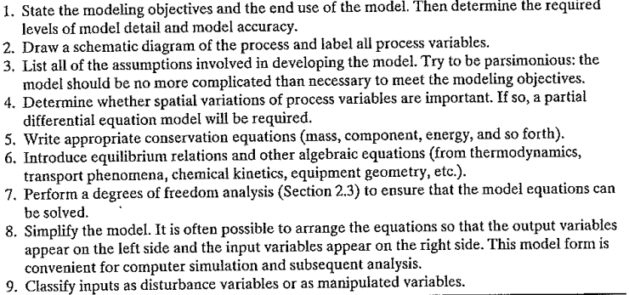
General modeling principles
BITS, PILANI – K. K. BIRLA GOA CAMPUS
BITS, PILANI – K. K. BIRLA GOA CAMPUS

Slide 7

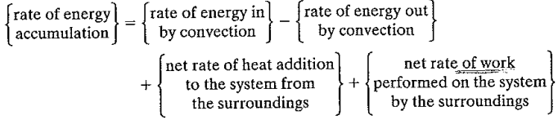
Conservation of mass
Conservation of mass
Conservation of Component i
Conservation of energy
BITS, PILANI – K. K. BIRLA GOA CAMPUS
BITS, PILANI – K. K. BIRLA GOA CAMPUS

Slide 8
For thermodynamic system the Total energy is given by
Assumptions:
Change in potential and kinetic energy is zero
The net rate of work can be neglected because it is small compared to the rate of heat transfer and convection
BITS, PILANI – K. K. BIRLA GOA CAMPUS
BITS, PILANI – K. K. BIRLA GOA CAMPUS

Slide 9
Degrees of freedom analysis
N_{F}=N_{V}-N_{E}
N_{F}- Number of degrees of freedom
N_{V}- The number of process variables
N_{E}- Number of independent equations
N_{F} =0: Exactly specified
N_{F} >0: Under specified
N_{F} <0: Over specified
BITS, PILANI – K. K. BIRLA GOA CAMPUS
BITS, PILANI – K. K. BIRLA GOA CAMPUS

Slide 10
Degrees of freedom analysis
List all parameter that can be specified
Determine the number of equation and number of process variable
Calculate the number of degrees of freedom
Identify the output variable that can be obtain
Identify the input variable that must be specified
BITS, PILANI – K. K. BIRLA GOA CAMPUS
BITS, PILANI – K. K. BIRLA GOA CAMPUS

Slide 11
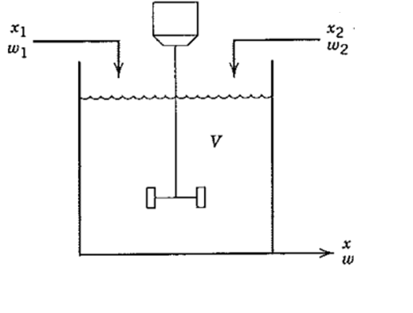
Blending process
Assumption:
Blending tank is perfectly mixing (No concentration gradient in the tank contents and the composition in the exit stream equal to the tank composition)
Density is constant
BITS, PILANI – K. K. BIRLA GOA CAMPUS
BITS, PILANI – K. K. BIRLA GOA CAMPUS

Slide 12



Unsteady state mass balance
Unsteady state component balance
Corresponding steady state equations are
BITS, PILANI – K. K. BIRLA GOA CAMPUS

Slide 13

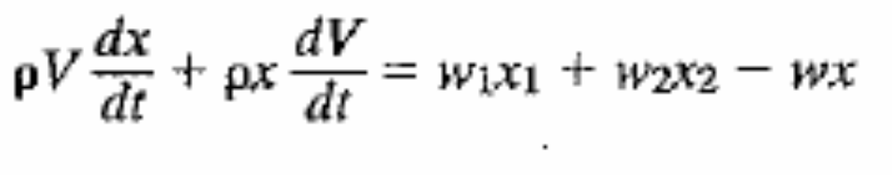
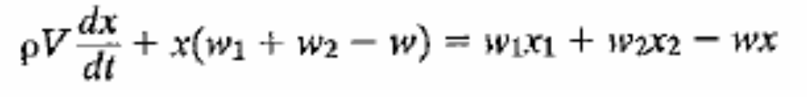

Simplified Overall mass balance equation
Simplified component balance equation
BITS, PILANI – K. K. BIRLA GOA CAMPUS
BITS, PILANI – K. K. BIRLA GOA CAMPUS

Slide 14
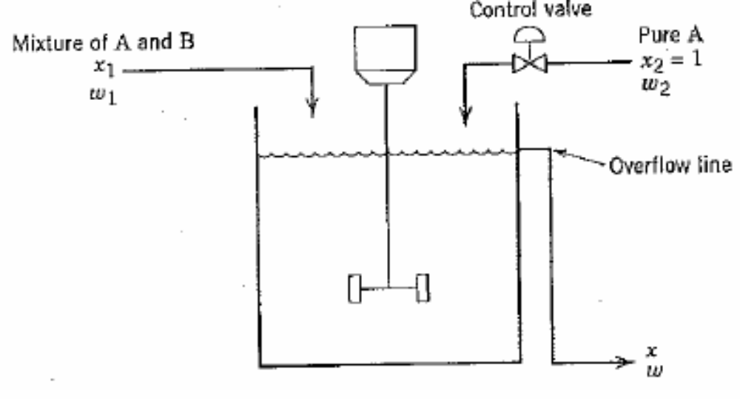
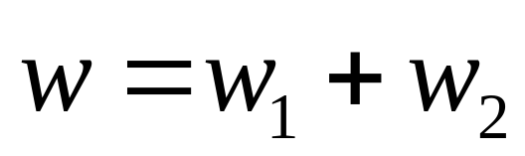

Modified Blending process
Assumption:
Blending tank is perfectly mixing
Density is constant
BITS, PILANI – K. K. BIRLA GOA CAMPUS
BITS, PILANI – K. K. BIRLA GOA CAMPUS

Slide 15
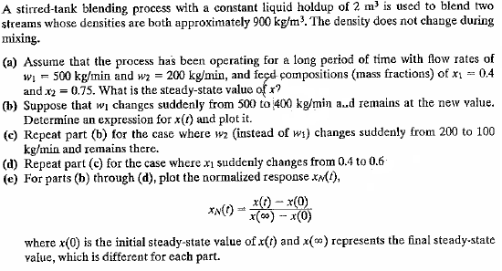
Example:
BITS, PILANI – K. K. BIRLA GOA CAMPUS
BITS, PILANI – K. K. BIRLA GOA CAMPUS

Slide 16
Example
Analyze the degrees of freedom for the blending system as shown in figure.
Assume that the blending tank is perfectly mixing and density is constant
BITS, PILANI – K. K. BIRLA GOA CAMPUS
BITS, PILANI – K. K. BIRLA GOA CAMPUS

Slide 17
Example: Analyze the degrees of freedom for the blending system as shown in figure.
Assume that the blending tank is perfectly mixing and density is constant
BITS, PILANI – K. K. BIRLA GOA CAMPUS
BITS, PILANI – K. K. BIRLA GOA CAMPUS

Slide 18
Mathematical model for mercury thermometer
T- Temperature of the mercury manometer
T_{a}-Ambient temperature
H- is the convective heat transfer coefficient of the fluid
L- is the length of the bulb
D- is the diameter of the bulb
Surface area of the film=Πdl
Mass of mercury=ρπd²l/4
BITS, PILANI – K. K. BIRLA GOA CAMPUS
BITS, PILANI – K. K. BIRLA GOA CAMPUS

Slide 19
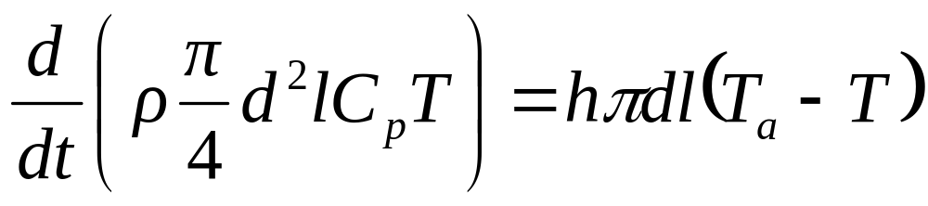
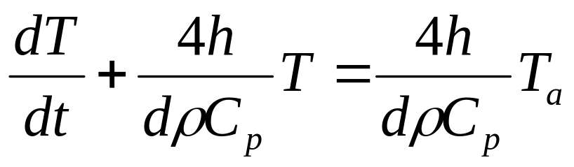
Assumptions:
There is no resistance offered by the bulb
Density of mercury is constant
Parameter: h, ρ, C_{p}, d, t
Variables: T, T_{a} (output T and Disturbance T_{a})
N_{v}=2, N_{E}=1
N_{F}= N_{v}-N_{E}=2-1=1
For given T_{a} the above equation can be used to find out how T changing with time
BITS, PILANI – K. K. BIRLA GOA CAMPUS
BITS, PILANI – K. K. BIRLA GOA CAMPUS

Slide 20
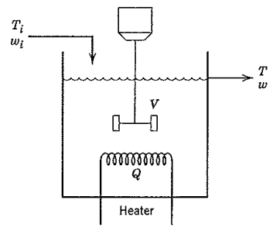
Stirred tank heating process (constant holdup)
Assumptions:
Perfect mixing
Liquid holdup is constant (w_{i}=w)
ρ and C_{p} are constant
Heat losses are negligible
BITS, PILANI – K. K. BIRLA GOA CAMPUS
BITS, PILANI – K. K. BIRLA GOA CAMPUS

Slide 21


Energy balance equation
Parameter: V, ρ, C_{p}
Variables: T, T_{i} , w, Q (output: T, Disturbance: T_{i}, w and Manipulated: Q)
N_{v}=4, N_{E}=1
N_{F}= N_{v}-N_{E}=4-1=3
For given T_{i} , w and Q the above equation can be used to find out how T changing with time
BITS, PILANI – K. K. BIRLA GOA CAMPUS
BITS, PILANI – K. K. BIRLA GOA CAMPUS

Slide 22
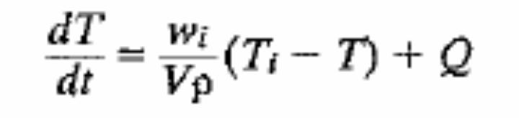
Stirred tank heating process (variable holdup)
BITS, PILANI – K. K. BIRLA GOA CAMPUS
BITS, PILANI – K. K. BIRLA GOA CAMPUS

Slide 23

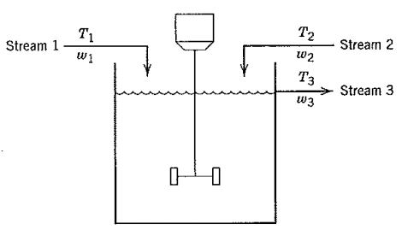
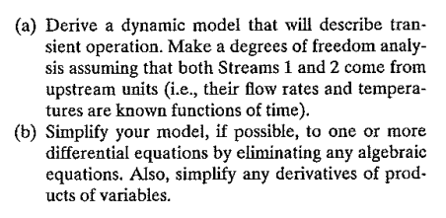
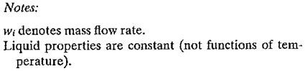
Ex. 2.1
BITS, PILANI – K. K. BIRLA GOA CAMPUS

Slide 24
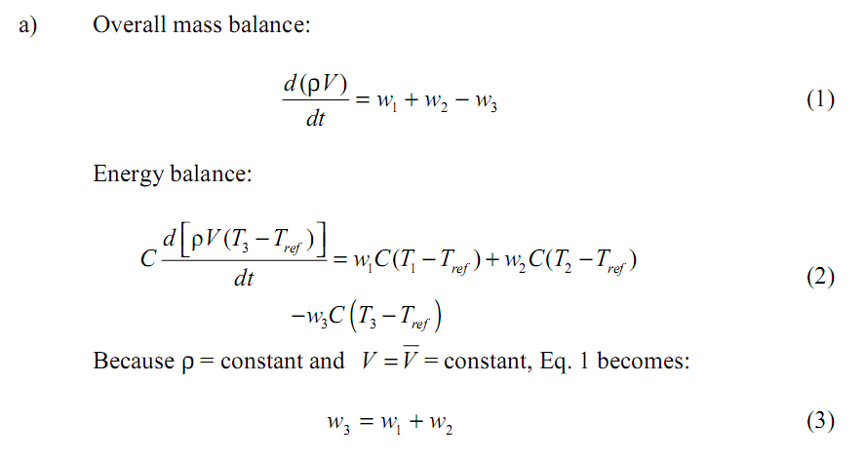
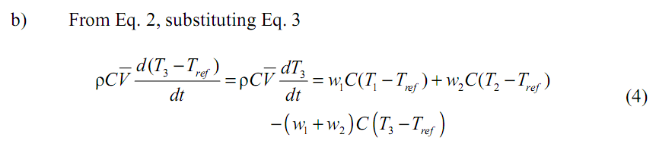
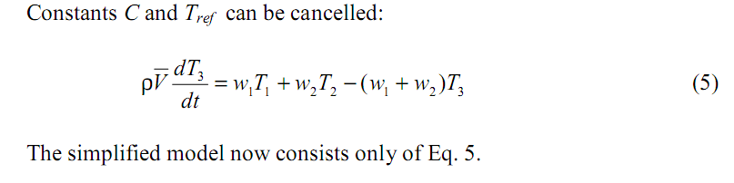
BITS, PILANI – K. K. BIRLA GOA CAMPUS

Slide 25
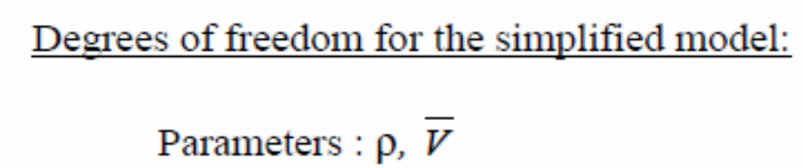
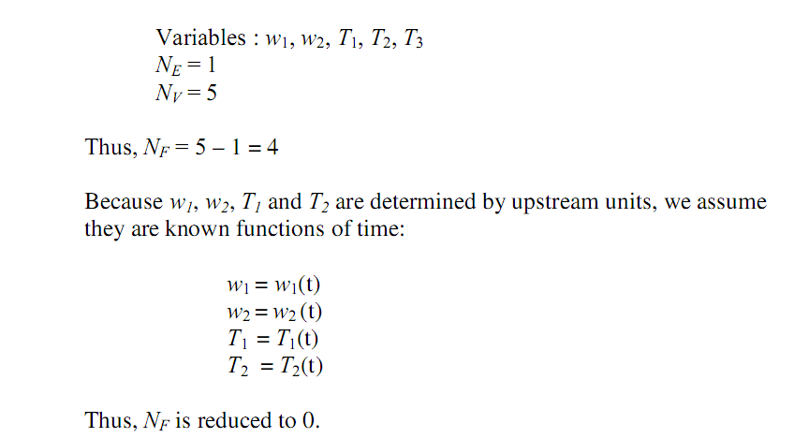
BITS, PILANI – K. K. BIRLA GOA CAMPUS

Slide 26
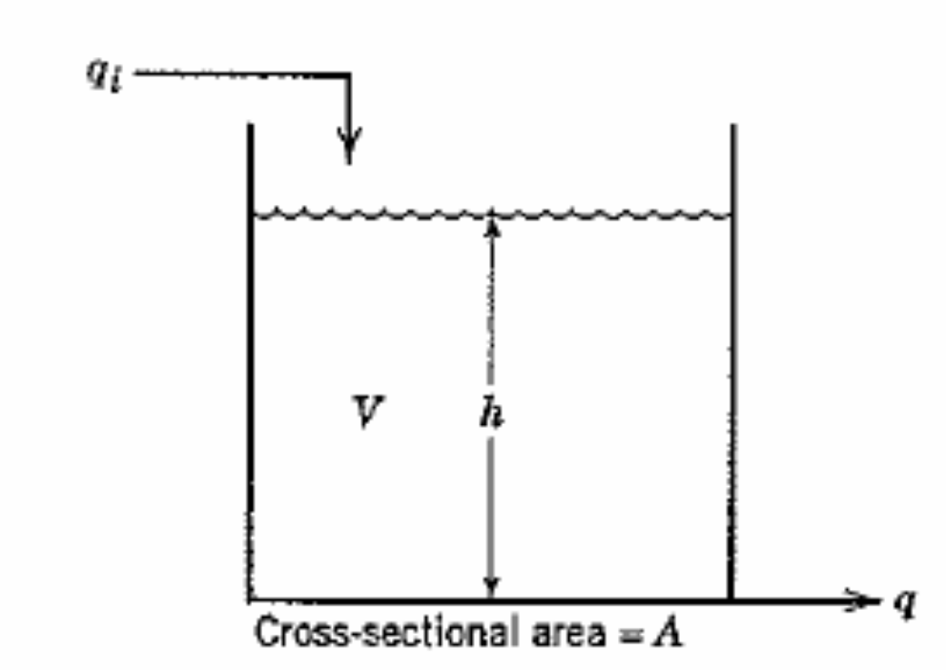
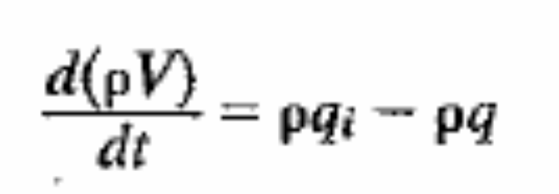
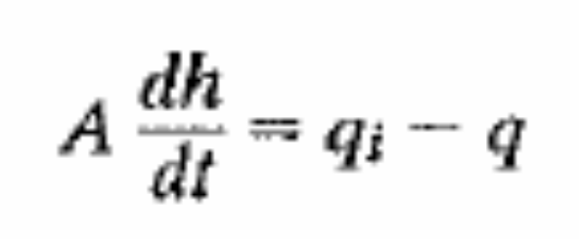
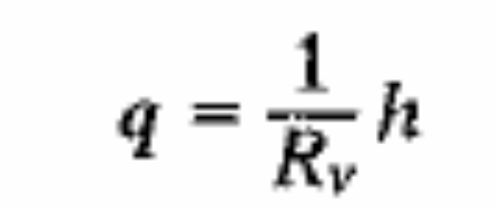
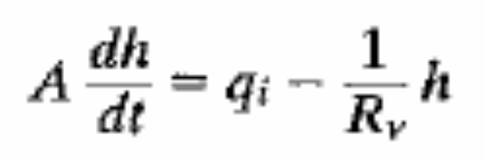
Liquid storage tank
BITS, PILANI – K. K. BIRLA GOA CAMPUS

Slide 27
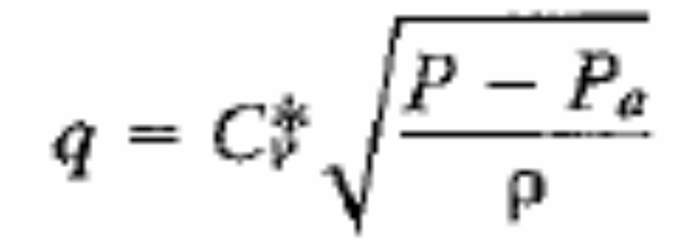
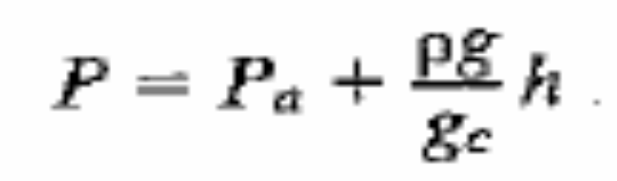

If Valve is there in outlet line
BITS, PILANI – K. K. BIRLA GOA CAMPUS

Slide 28
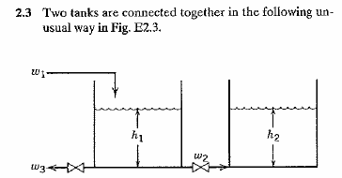
BITS, PILANI – K. K. BIRLA GOA CAMPUS

Slide 29
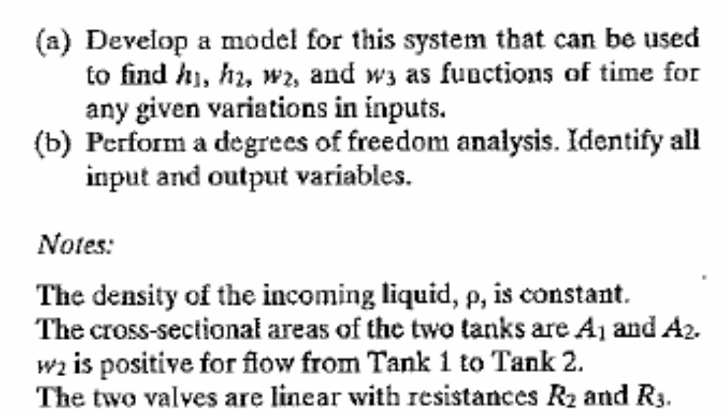
BITS, PILANI – K. K. BIRLA GOA CAMPUS

Slide 30
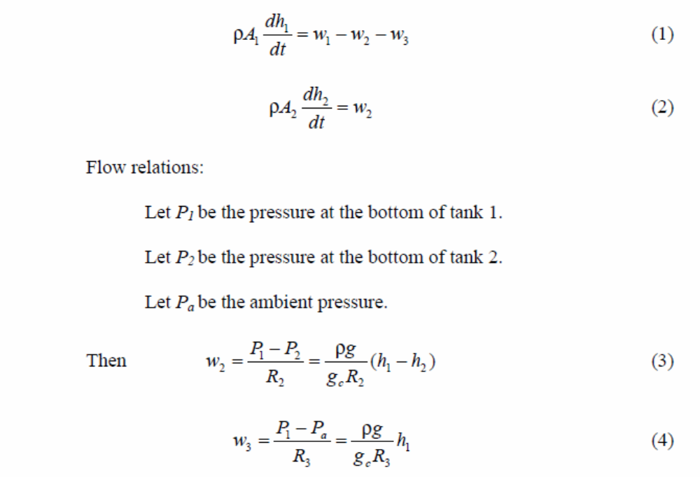
BITS, PILANI – K. K. BIRLA GOA CAMPUS

Slide 31
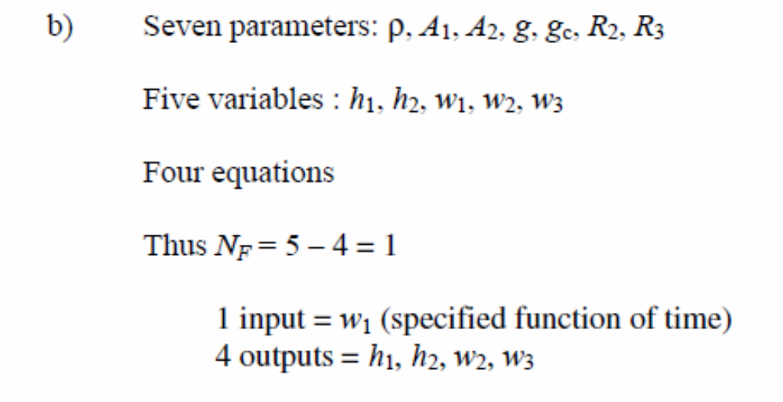
BITS, PILANI – K. K. BIRLA GOA CAMPUS

Slide 32
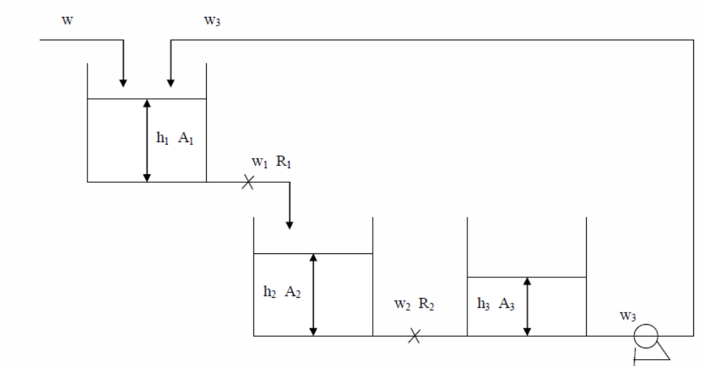
Example
BITS, PILANI – K. K. BIRLA GOA CAMPUS

Slide 33


Steam heated stirred tank
Assumption: The thermal capacitance of liquid condensate is negligible compare to the thermal capacitance of tank liquid and the wall of the coil.
Energy balance in the liquid
Energy balance in the coil
BITS, PILANI – K. K. BIRLA GOA CAMPUS

Slide 34
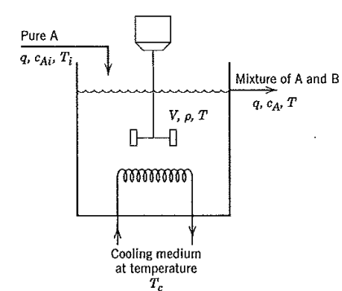
Non Isothermal CSTR
BITS, PILANI – K. K. BIRLA GOA CAMPUS

Slide 35
Assumption:
Perfect mixing
Mass density of product and feed are constant
Constant holdup
The thermal capacitance of coolant and coil wall is negligible
All the coolant is at a uniform temperature T_{C}
The rate of heat transfer from the reactor content to the coolant is
Heat of mixing is negligible to the heat of reaction
Shaft work and heat loss is negligible
BITS, PILANI – K. K. BIRLA GOA CAMPUS

Slide 36




Mass balance
ρ and V are constant
Component balance of A
Energy balance
BITS, PILANI – K. K. BIRLA GOA CAMPUS

Slide 37
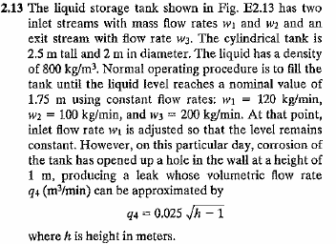

BITS, PILANI – K. K. BIRLA GOA CAMPUS

Slide 38
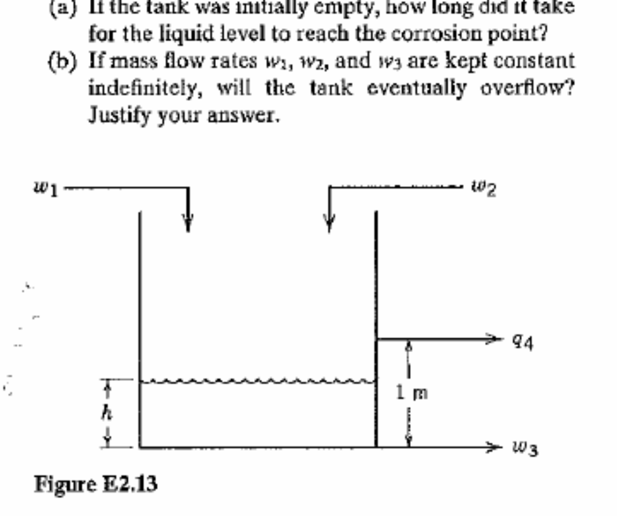
BITS, PILANI – K. K. BIRLA GOA CAMPUS

Slide 39
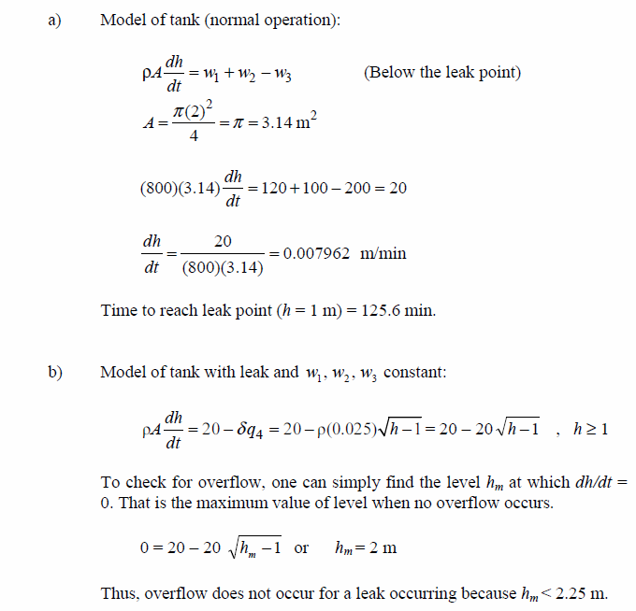
BITS, PILANI – K. K. BIRLA GOA CAMPUS

Slide 40
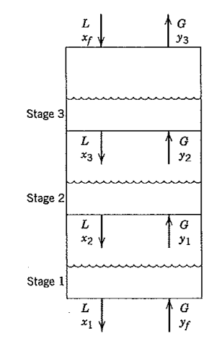
Three stage absorber
Assumptions:
Each stage is an ideal one
Constant liquid holdup
Perfect mixing
Gas holdup is negligible
Molar liquid and gas flow rate are constant
BITS, PILANI – K. K. BIRLA GOA CAMPUS

Slide 41


Equilibrium relation:
Component material balance
Stage liquid residence time
The stripping factor
Gas to liquid ratio
BITS, PILANI – K. K. BIRLA GOA CAMPUS

Slide 42



The models for all the three stages are
BITS, PILANI – K. K. BIRLA GOA CAMPUS

Slide 43
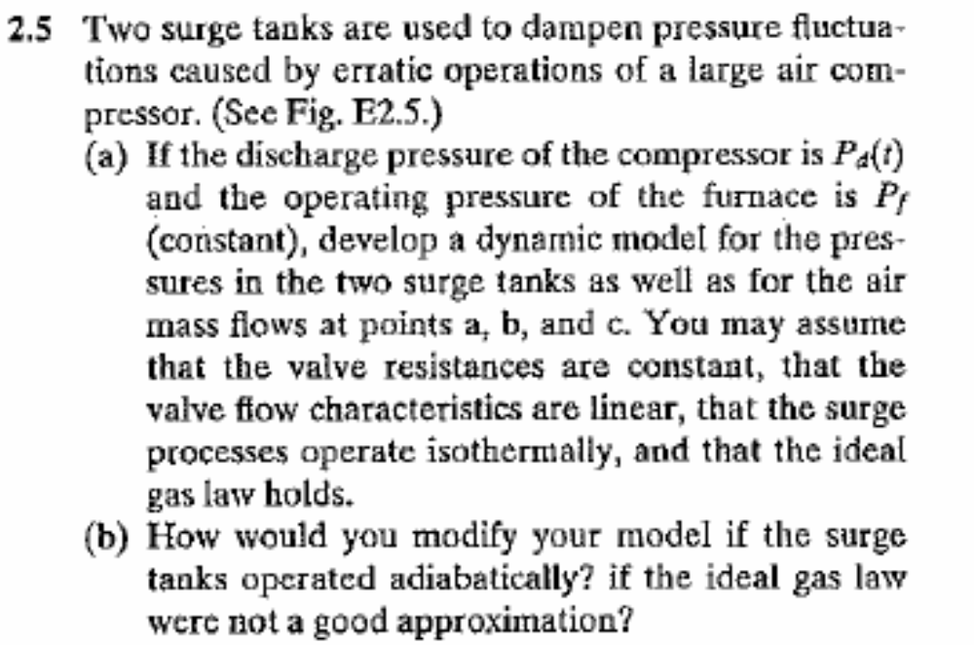

BITS, PILANI – K. K. BIRLA GOA CAMPUS

Slide 44
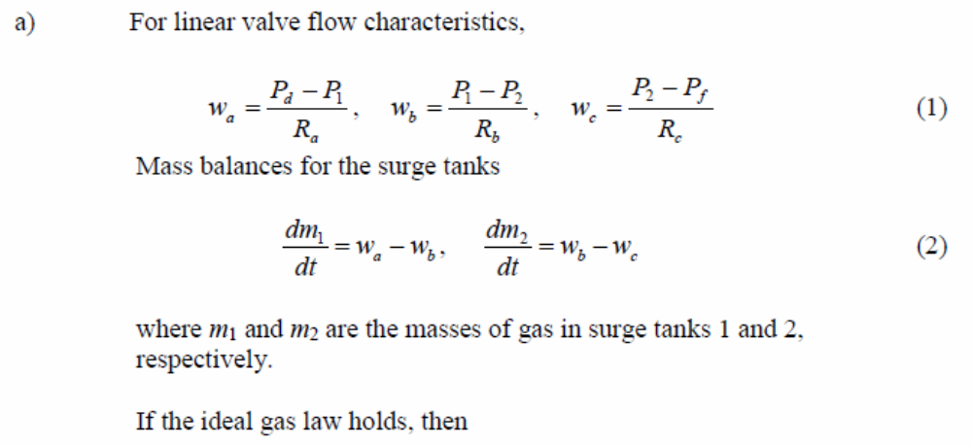
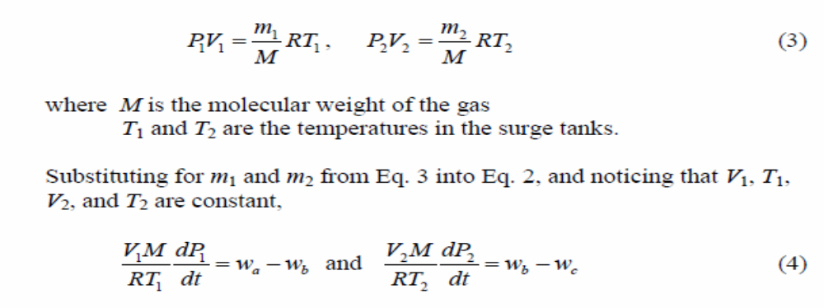
BITS, PILANI – K. K. BIRLA GOA CAMPUS

Slide 45
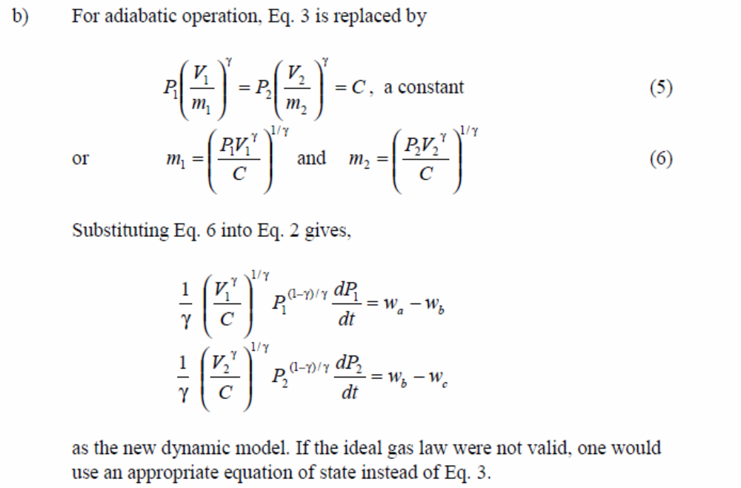
BITS, PILANI – K. K. BIRLA GOA CAMPUS

Slide 46
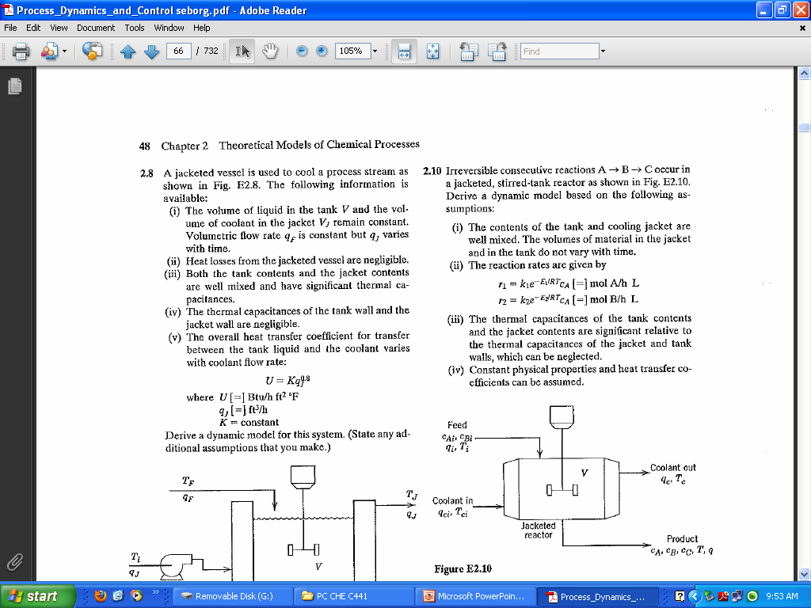
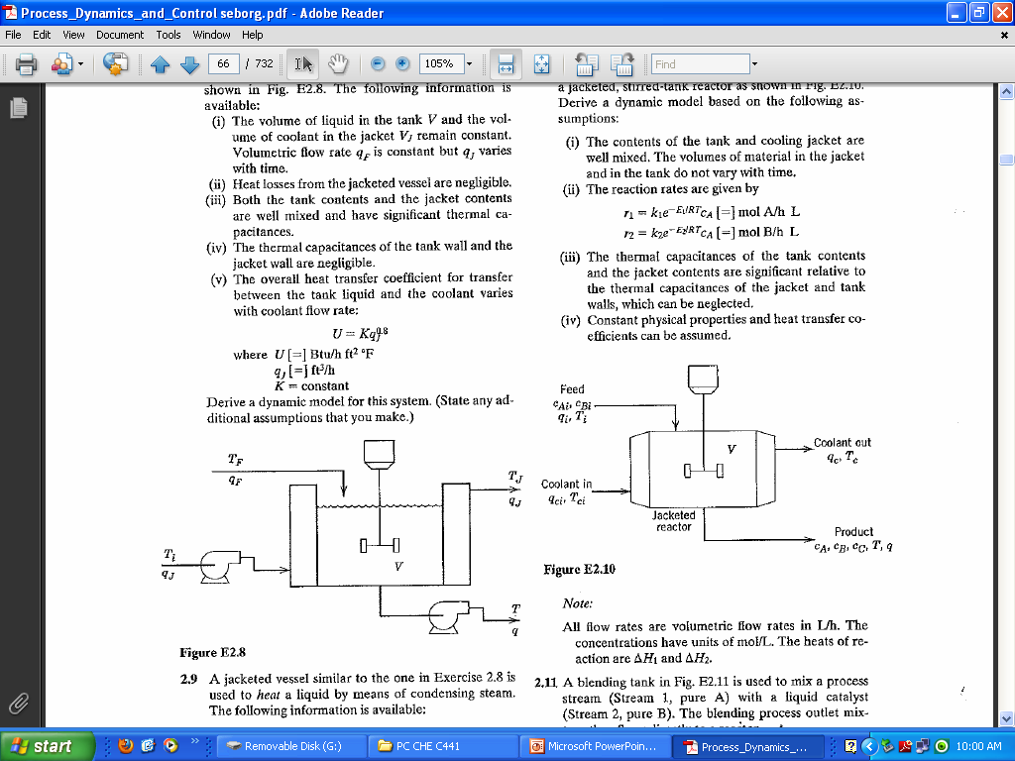
BITS, PILANI – K. K. BIRLA GOA CAMPUS

Slide 47
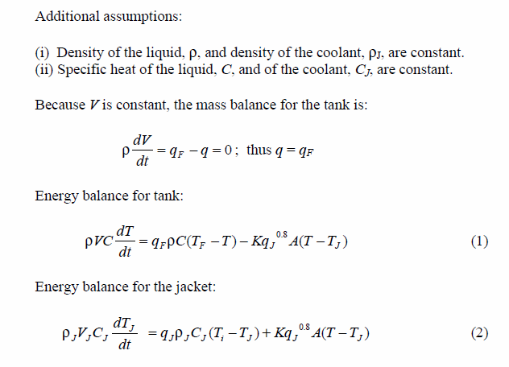
Solution
BITS, PILANI – K. K. BIRLA GOA CAMPUS

Slide 48
Ideal binary distillation column
Assumptions:
Vapor holdup in each tray is negligible
Molar heat of vaporization of both component A and B are approximately constant
Heat loss to the surrounding is negligible
The relative volatility is constant throughout the column
Each tray is assume to be ideal
The 1st three assumption imply that V₁=V₂=……=V_{N} and no energy balance for each tray is required.
The last two assumptions imply that V-L relationship can be used to find y_{i} and x_{i}
Neglect the dynamic of the condenser and reboiler
Neglect the momentum balance for each tray. Also assumed that the liquid flow rate in each tray depends on the liquid holdup L_{i}=f(M_{i})
BITS, PILANI – K. K. BIRLA GOA CAMPUS

Slide 49
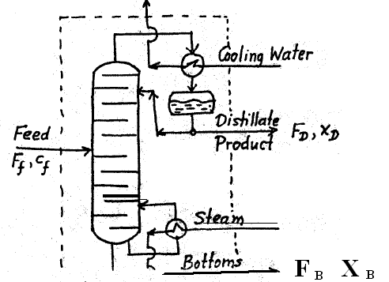
BITS, PILANI – K. K. BIRLA GOA CAMPUS

Slide 50
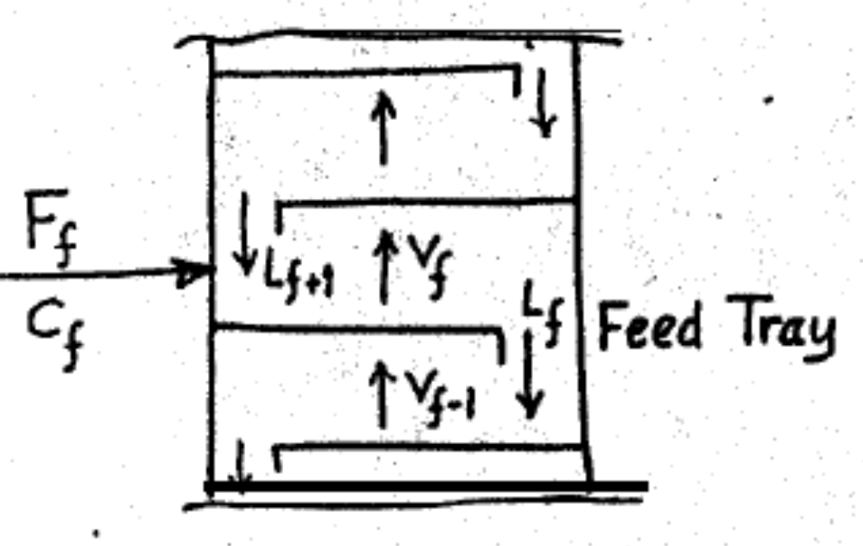
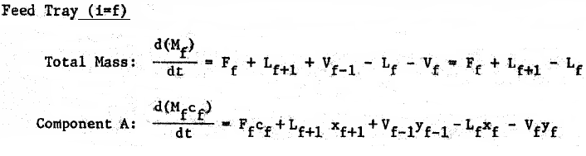
BITS, PILANI – K. K. BIRLA GOA CAMPUS

Slide 51
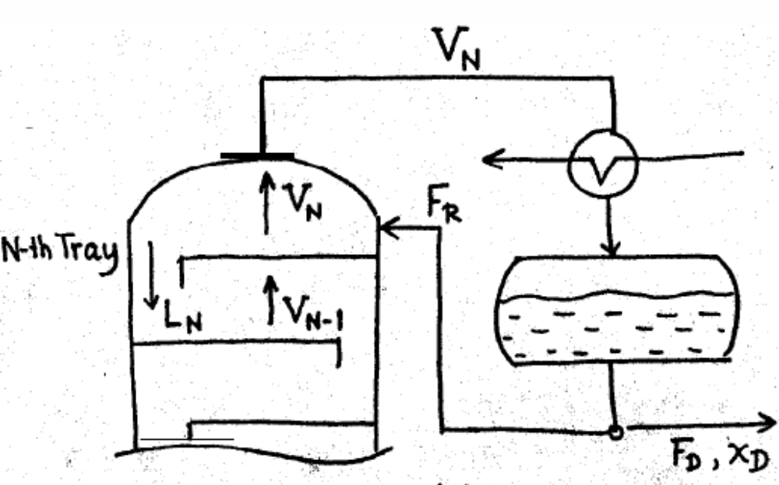
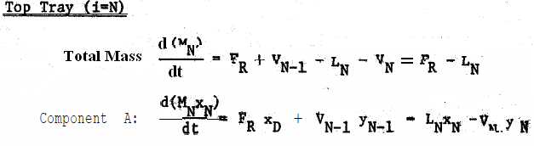
BITS, PILANI – K. K. BIRLA GOA CAMPUS

Slide 52
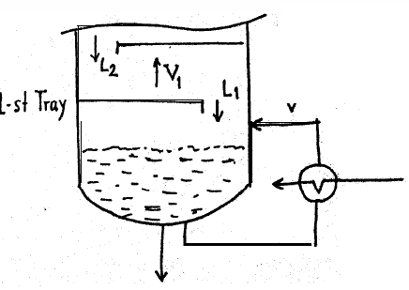

BITS, PILANI – K. K. BIRLA GOA CAMPUS

Slide 53


BITS, PILANI – K. K. BIRLA GOA CAMPUS

Slide 54


BITS, PILANI – K. K. BIRLA GOA CAMPUS

Slide 55

BITS, PILANI – K. K. BIRLA GOA CAMPUS

Slide 56

BITS, PILANI – K. K. BIRLA GOA CAMPUS

Slide 57
Modeling difficulties
Difficulties in modeling of CSTR
Determining the process parameter, k₀, E & U
C_{p} , ρ and –ΔH_{r} is function of Temperature and concentration
U₀ changes with time because of fouling
Reaction rate
BITS, PILANI – K. K. BIRLA GOA CAMPUS

Slide 58
The three type of difficulties in process modeling
Poorly understood process
Imprecise known parameters
Size and complexity of the model
BITS, PILANI – K. K. BIRLA GOA CAMPUS

Slide 59
Poorly understand process
Exa. Fluidized catalytic cracking
The reaction rate of the cracking process
The rate with which carbon and heavy materials deposited on catalyst surface
The dependence of the above two rate on the temperature and quality of feed
The rate of regeneration and its temperature dependancy
BITS, PILANI – K. K. BIRLA GOA CAMPUS

Slide 60
Imprecise known parameters
Accuracy of the process parameter (ρ, ΔHr, U0, Cp, Activity of catalyst, dead time
Even if catalyst activity is known it is time dependant
Experimental values are required
BITS, PILANI – K. K. BIRLA GOA CAMPUS

Slide 61
Size and complexity of the model
Example: Distillation with 20 trays (two component system)
2N+4=2*20+4=44 differential equation
2N+1=2*20+1=41 algebraic equation
Most distillation column deals with multi-component system with large number of trays
BITS, PILANI – K. K. BIRLA GOA CAMPUS

Slide 62
Thank you
BITS, PILANI – K. K. BIRLA GOA CAMPUS

