Slide 1

BITS, PILANI – K. K. BIRLA GOA CAMPUS
Process Control- CHE C441
Chapter #4
Transfer Function and State-space Model
Dr. Saroj Sundar Baral
Department of Chemical Engineering

Slide 2
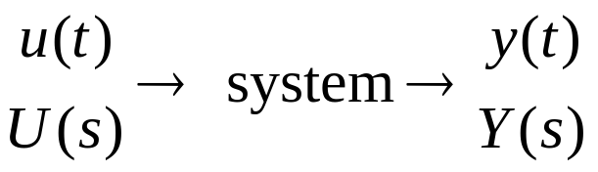
Transfer Functions
Convenient representation of a linear, dynamic model.
A transfer function (TF) relates one input and one output:
The following terminology is used:
u
input
forcing function
“cause”
y
output
response
“effect”

Slide 3
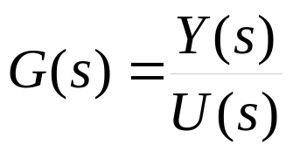
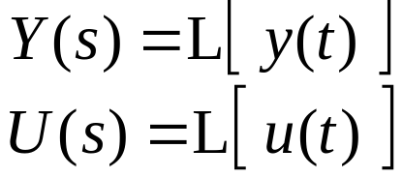
Definition of the transfer function:
Let G(s) denote the transfer function between an input, x, and an output, y. Then, by definition
where:
Development of Transfer Functions
Example: Stirred Tank Heating System

Slide 4
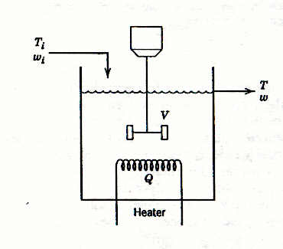
Chapter 4
Figure 2.3 Stirred-tank heating process with constant holdup, V.

Slide 5
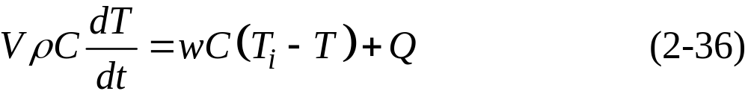
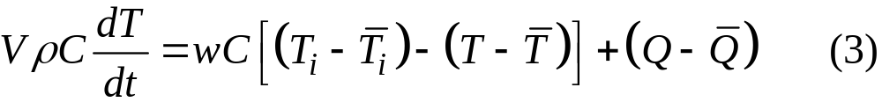
Recall the previous dynamic model, assuming constant liquid holdup and flow rates:
Suppose the process is at steady state:
Chapter 4
Subtract (2) from (2-36):

Slide 6
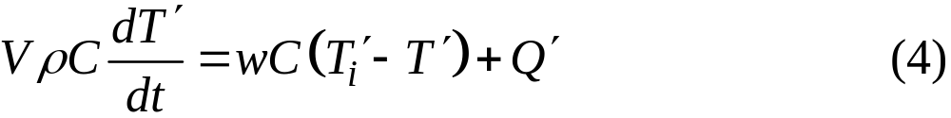
But,
where the “deviation variables” are
Chapter 4
Take L of (4):
At the initial steady state, T′(0) = 0.

Slide 7
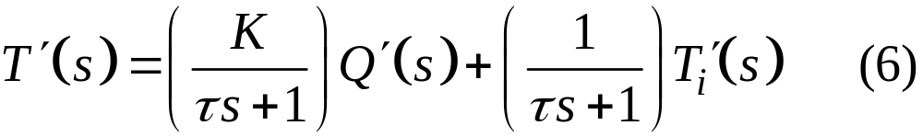
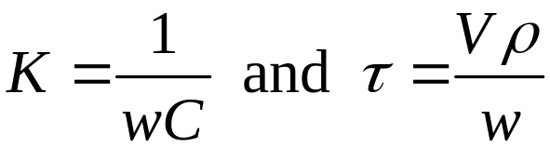
Rearrange (5) to solve for
where
Chapter 4

Slide 8
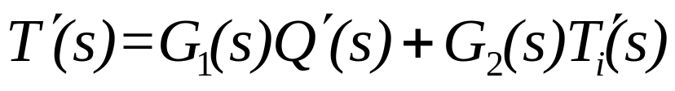
G₁ and G₂ are transfer functions and independent of the
inputs, Q′ and T_{i}′.
Note G₁ (process) has gain K and time constant t.
G₂ (disturbance) has gain=1 and time constant t.
gain = G(s=0). Both are first order processes.
Chapter 4
If there is no change in inlet temperature (T_{i}′= 0),
then T_{i}′(s) = 0.
System can be forced by a change in either T_{i} or Q
(see Example 4.3).

Slide 9

  Conclusions about TFs
  1. Note that (6) shows that the effects of changes in both Q and are additive. This always occurs for linear, dynamic models (like TFs) because the Principle of Superposition is valid.
Chapter 4
The TF model enables us to determine the output response to any change in an input.
Use deviation variables to eliminate initial conditions for TF models.

Slide 10


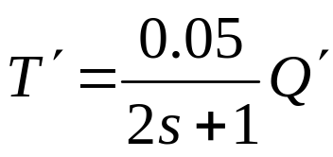
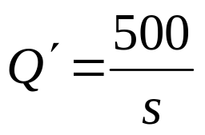
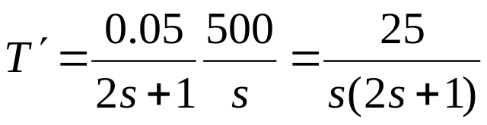
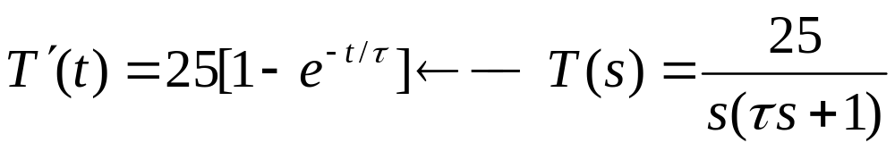
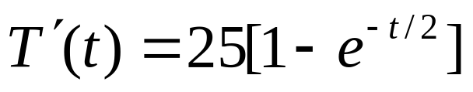
Example: Stirred Tank Heater
No change in T_{i}′
Step change in Q(t): 1500 cal/sec to 2000 cal/sec
Chapter 4
What is T′(t)?
From line 13, Table 3.1

Slide 11
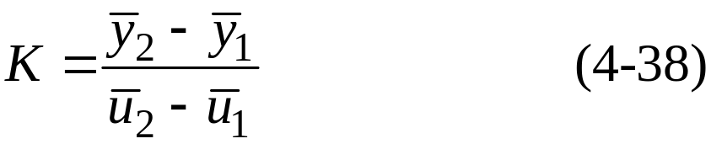

Properties of Transfer Function Models
Steady-State Gain
The steady-state of a TF can be used to calculate the steady-state change in an output due to a steady-state change in the input. For example, suppose we know two steady states for an input, u, and an output, y. Then we can calculate the steady-state gain, K, from:
Chapter 4
For a linear system, K is a constant. But for a nonlinear system, K will depend on the operating condition

Slide 12
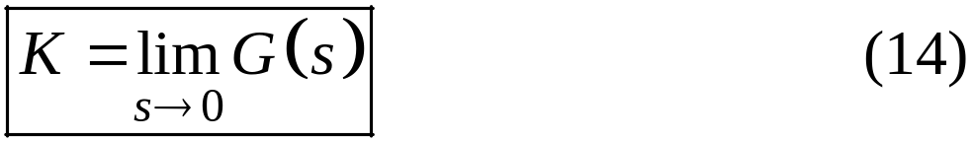
Calculation of K from the TF Model:
If a TF model has a steady-state gain, then:
This important result is a consequence of the Final Value Theorem
Note: Some TF models do not have a steady-state gain (e.g., integrating process in Ch. 5)
Chapter 4

Slide 13
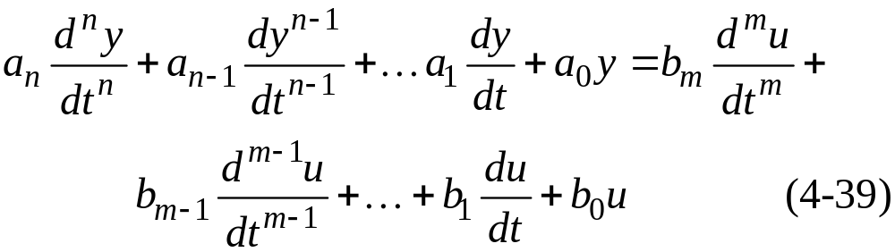
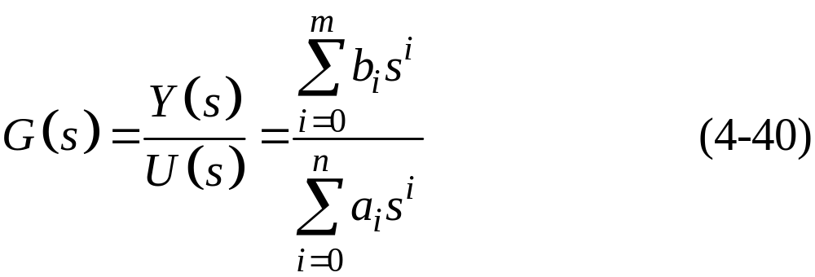
Order of a TF Model
Consider a general n-th order, linear ODE:
Chapter 4
Take L, assuming the initial conditions are all zero. Rearranging gives the TF:

Slide 14

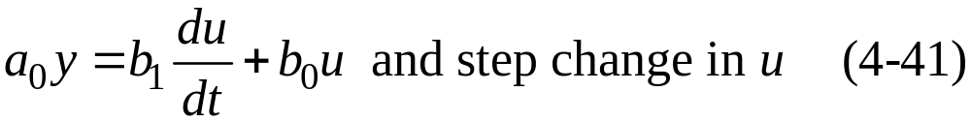
Definition:
The order of the TF is defined to be the order of the denominator polynomial.
Note: The order of the TF is equal to the order of the ODE.
Physical Realizability:
Chapter 4
For any physical system, in (4-38). Otherwise, the system response to a step input will be an impulse. This can’t happen.
Example:

Slide 15
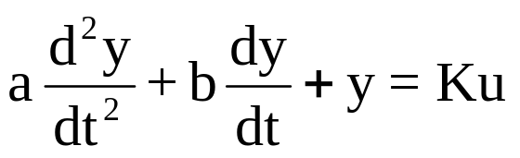
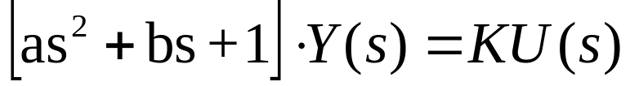
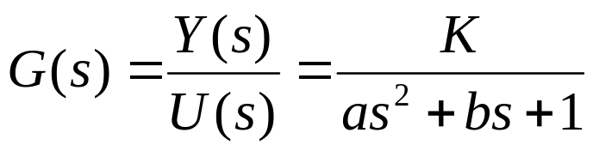
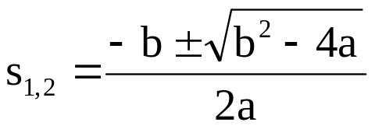
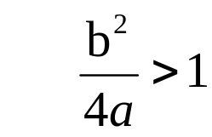
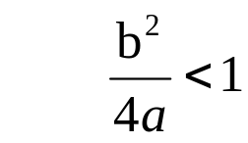
2nd order process
General 2nd order ODE:
Laplace Transform:
Chapter 4
2 roots
: real roots
: imaginary roots

Slide 16
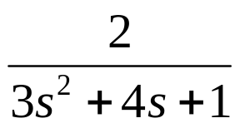
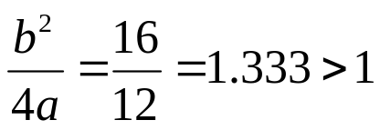
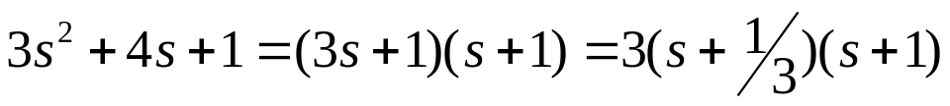
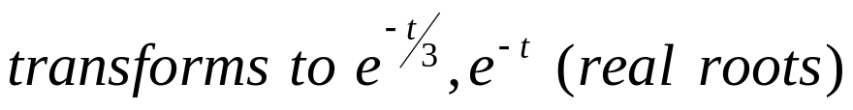
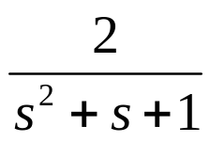
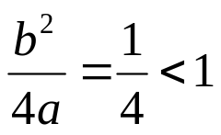
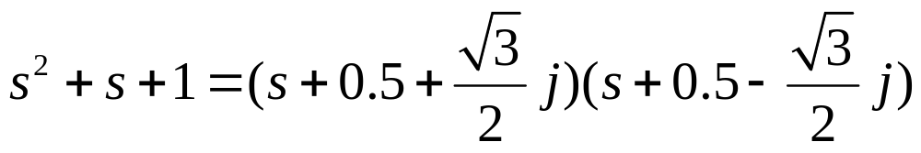
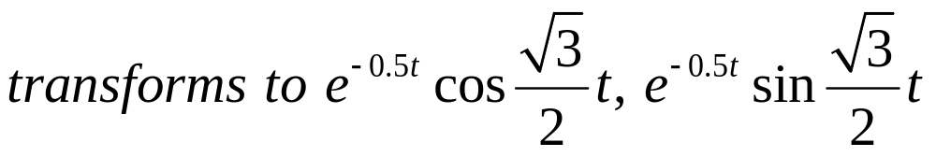
Examples
1.
(no oscillation)
Chapter 4
2.
(oscillation)

Slide 17
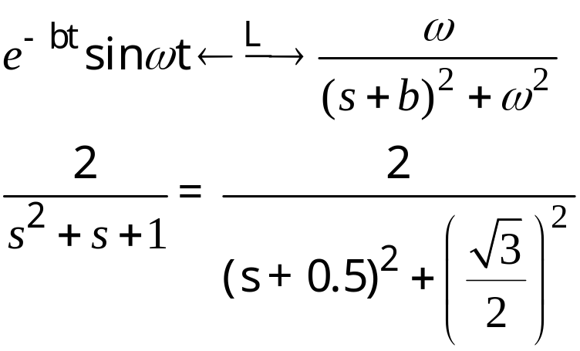
From Table 3.1, line 17
Chapter 4

Slide 18
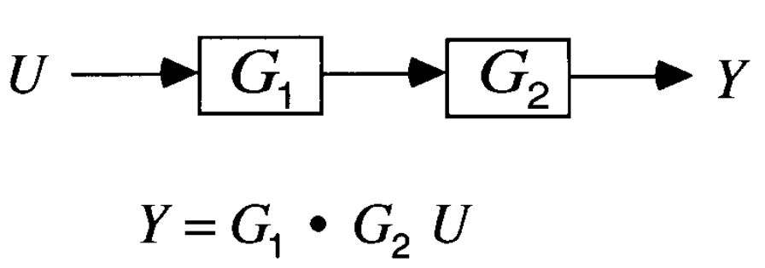
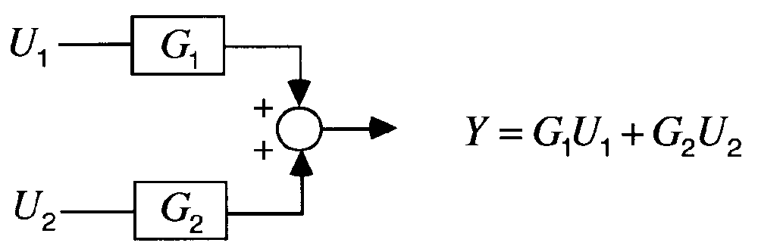
Two IMPORTANT properties (L.T.)
A. Multiplicative Rule
Chapter 4
B. Additive Rule

Slide 19
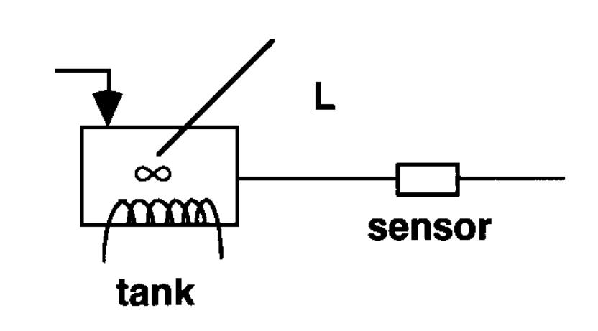
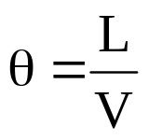
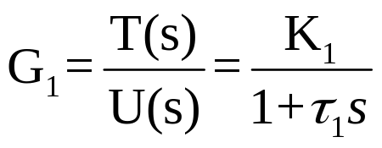
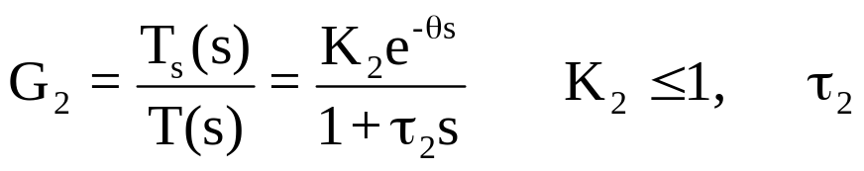
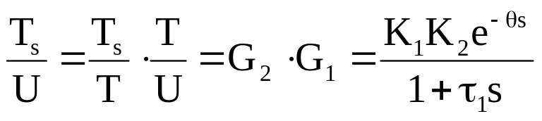
Example 1:
Place sensor for temperature downstream from heated
tank (transport lag)
Distance L for plug flow,
Dead time
Chapter 4
V = fluid velocity
Tank:
Sensor:
is very small
(neglect)
Overall transfer function:

Slide 20
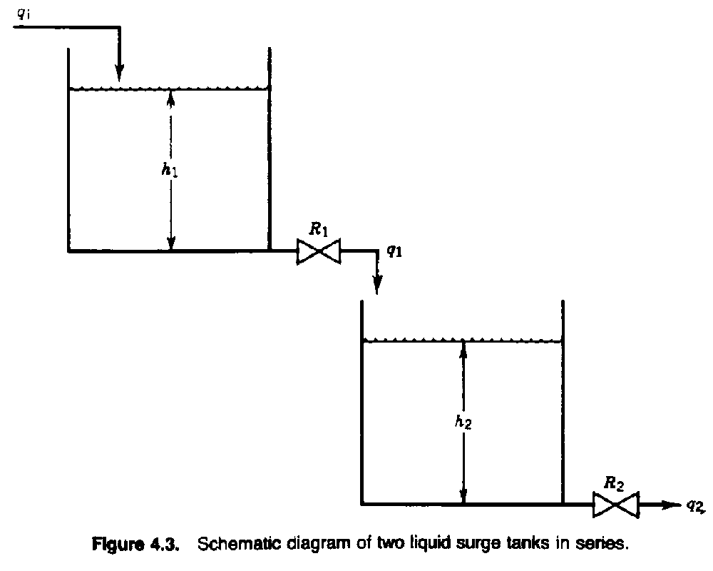
Chapter 4

Slide 21
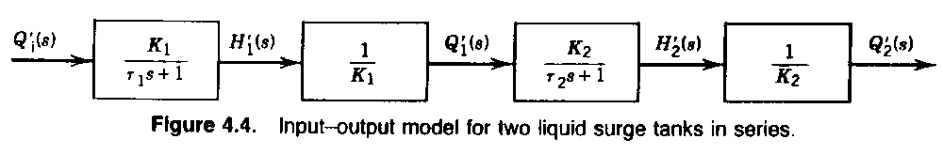
Chapter 4

Slide 22
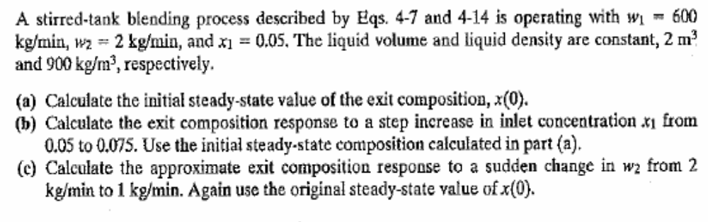
Example:
BITS, PILANI – K. K. BIRLA GOA CAMPUS

Slide 23
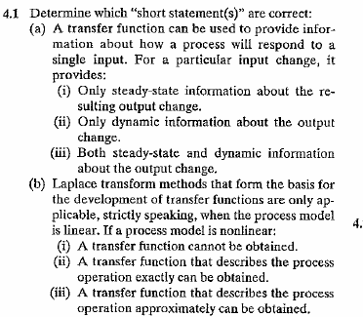
Example:4.1
BITS, PILANI – K. K. BIRLA GOA CAMPUS

Slide 24
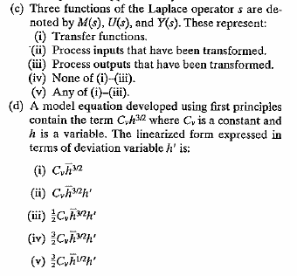
BITS, PILANI – K. K. BIRLA GOA CAMPUS

Slide 25
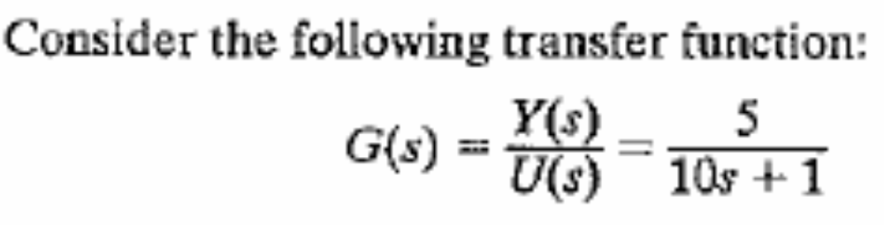
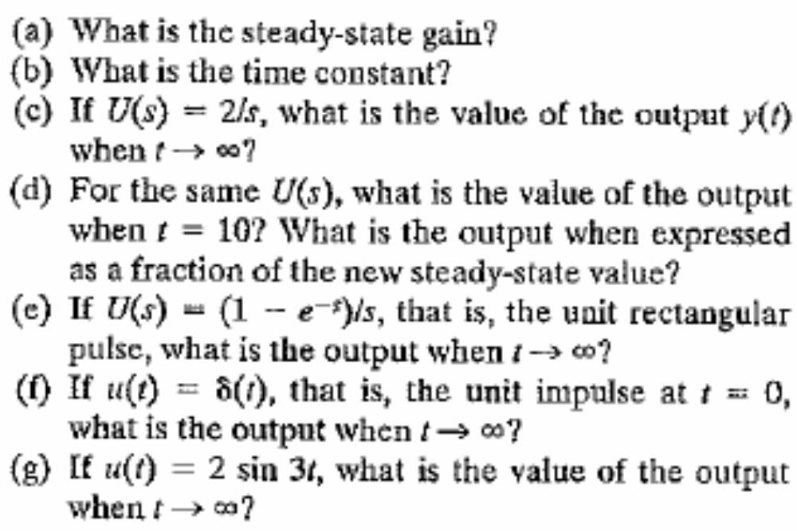
Example:4.2
BITS, PILANI – K. K. BIRLA GOA CAMPUS

Slide 26
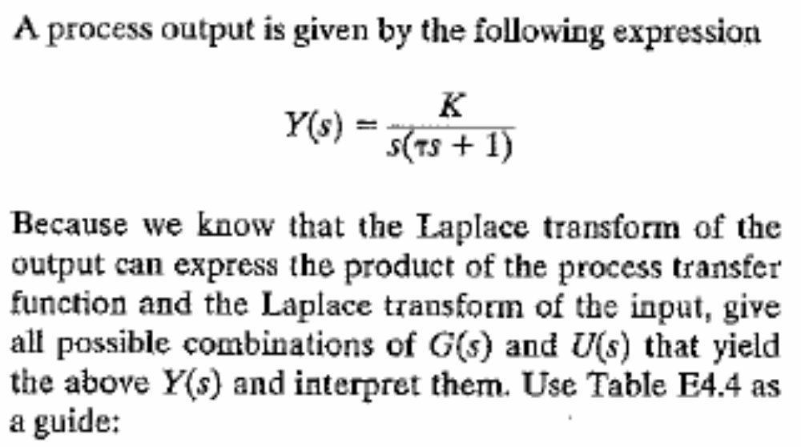

Example:4.4
BITS, PILANI – K. K. BIRLA GOA CAMPUS

Slide 27

Example:4.5
BITS, PILANI – K. K. BIRLA GOA CAMPUS

Slide 28



Linearization of Nonlinear Models
Required to derive transfer function.
Good approximation near a given operating point.
Gain, time constants may change with
operating point.
Use 1st order Taylor series.
Chapter 4
(4-60)
(4-61)
Subtract steady-state equation from dynamic equation
(4-62)

Slide 29






Example 3:
q₀: control,
q_{i}: disturbance
Use L.T.
Chapter 4
(deviation variables)
suppose q₀ is constant
pure integrator (ramp) for step change in q_{i}

Slide 30




q₀ is manipulated by a flow control valve,
nonlinear element
Figure 2.5
Chapter 4
Linear model
R: line and valve resistance
linear ODE : eq. (4-74)

Slide 31





Perform Taylor series of right hand side
Chapter 4

Slide 32

Example:4.13
BITS, PILANI – K. K. BIRLA GOA CAMPUS

Slide 33
Thanks
BITS, PILANI – K. K. BIRLA GOA CAMPUS

