Slide 1

BITS, PILANI – K. K. BIRLA GOA CAMPUS
Process Control- CHE C441
Chapter #5
Dynamic behavior of 1st and 2nd order system
Dr. Saroj Sundar Baral
Department of Chemical Engineering

Slide 2
Dynamic Behavior
In analyzing process dynamic and process control systems, it is important to know how the process responds to changes in the process inputs.
A number of standard types of input changes are widely used for two reasons:
  They are representative of the types of changes that occur in plants.
  They are easy to analyze mathematically.
BITS, PILANI – K. K. BIRLA GOA CAMPUS

Slide 3
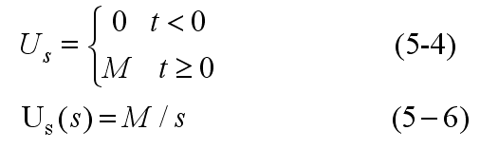
Step Input
A sudden change in a process variable can be approximated by a step change of magnitude, M:
The step change occurs at an arbitrary time denoted as t = 0.
Special Case: If M = 1, we have a “unit step change”. We give it the symbol, S(t).
Example of a step change: A reactor feedstock is suddenly switched from one supply to another, causing sudden changes in feed concentration, flow, etc.
BITS, PILANI – K. K. BIRLA GOA CAMPUS

Slide 4
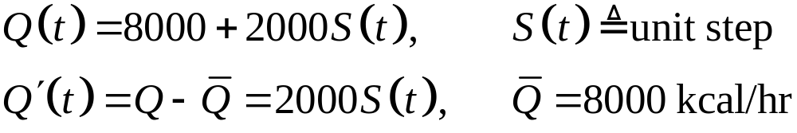
Example:
The heat input to the stirred-tank heating system in Chapter 2 is suddenly changed from 8000 to 10,000 kcal/hr by changing the electrical signal to the heater. Thus,
Ramp Input
Industrial processes often experience “drifting disturbances”, that is, relatively slow changes up or down for some period of time.
The rate of change is approximately constant.
BITS, PILANI – K. K. BIRLA GOA CAMPUS

Slide 5
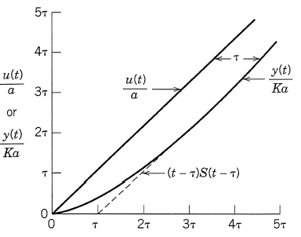
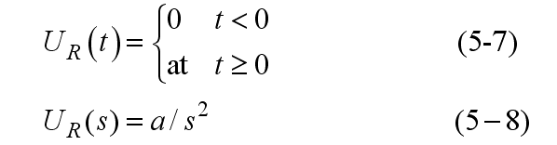
We can approximate a drifting disturbance by a ramp input:
Examples of ramp changes:
  Ramp a setpoint to a new value. (Why not make a step change?)
  Feed composition, heat exchanger fouling, catalyst activity, ambient temperature.
BITS, PILANI – K. K. BIRLA GOA CAMPUS

Slide 6
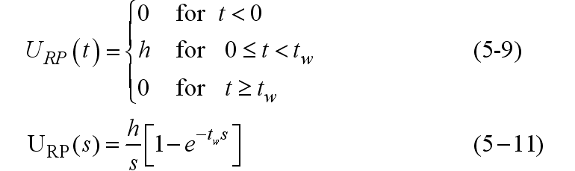
Rectangular Pulse
It represents a brief, sudden change in a process variable:
h
0
Examples:
  Reactor feed is shut off for one hour.
  The fuel gas supply to a furnace is briefly interrupted.
BITS, PILANI – K. K. BIRLA GOA CAMPUS

Slide 7
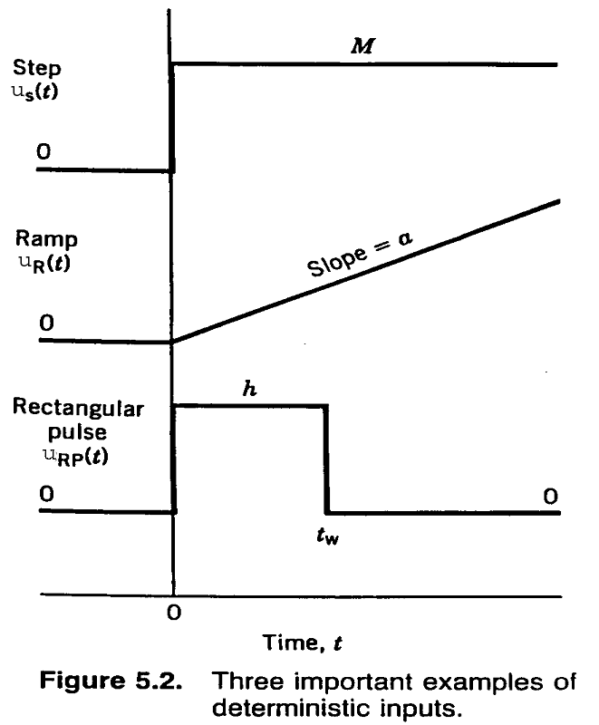
BITS, PILANI – K. K. BIRLA GOA CAMPUS

Slide 8
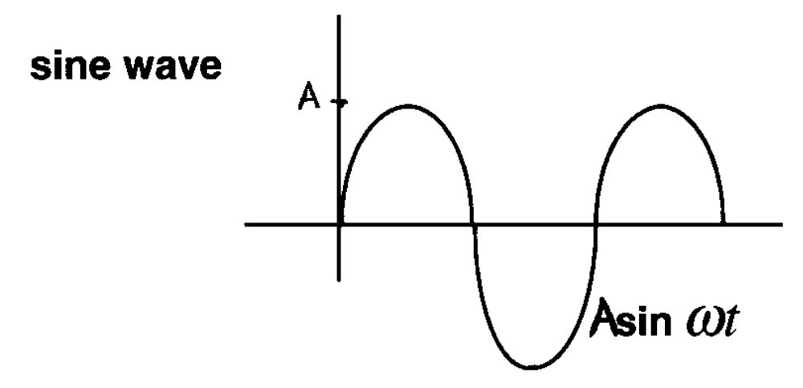
Other Inputs
4. Sinusoidal Input
BITS, PILANI – K. K. BIRLA GOA CAMPUS

Slide 9
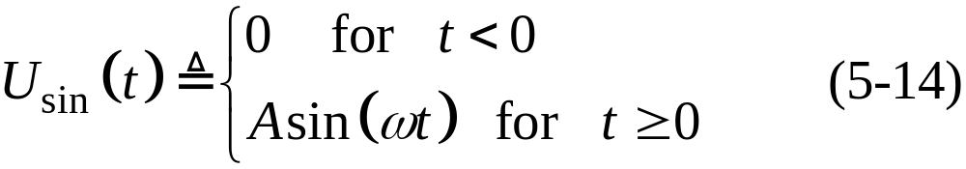
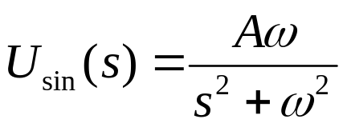
Processes are also subject to periodic, or cyclic, disturbances. They can be approximated by a sinusoidal disturbance:
where: A = amplitude, ω = angular frequency
Examples:
  24 hour variations in cooling water temperature.
  60-Hz electrical noise (in USA!)
BITS, PILANI – K. K. BIRLA GOA CAMPUS

Slide 10
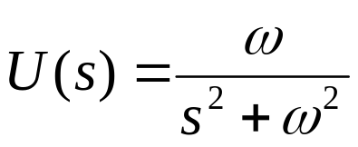
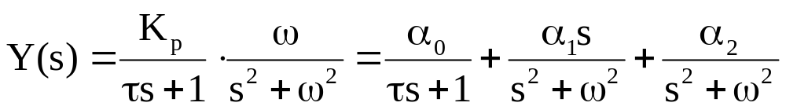
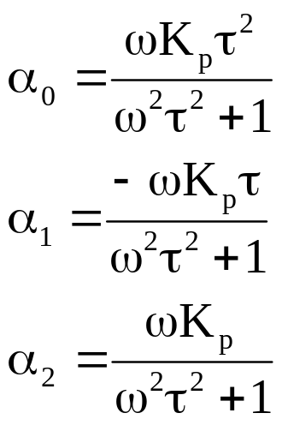
For a sine input (1st order process)
output is...
By partial fraction decomposition,
BITS, PILANI – K. K. BIRLA GOA CAMPUS

Slide 11
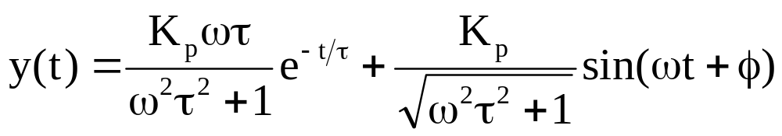

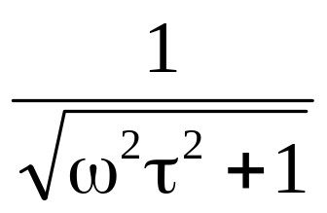
Inverting,
this term dies out for large t
note: f is not a function of t but of t and w.
For large t, y(t) is also sinusoidal,
output sine is attenuated by…
(fast vs. slow w)
BITS, PILANI – K. K. BIRLA GOA CAMPUS

Slide 12


Impulse Input
  Here,
  It represents a short, transient disturbance.
  It is the limit of a rectangular pulse for t_{w}→0 and h = 1/t_{w}
Examples:
  Electrical noise spike in a thermo-couple reading.
  Injection of a tracer dye.
Here,
BITS, PILANI – K. K. BIRLA GOA CAMPUS

Slide 13
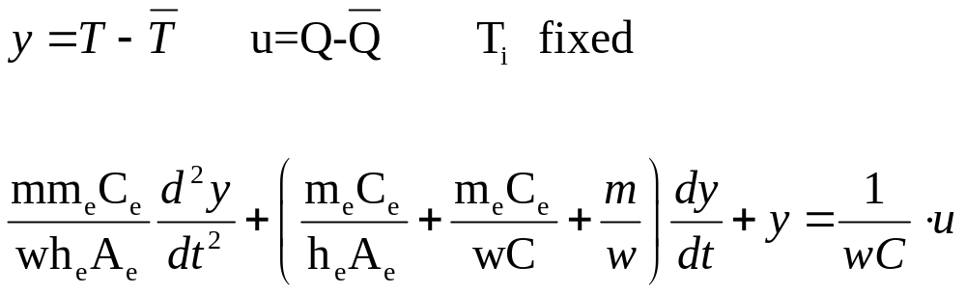
Second order process example, Example 4.2
note when C_{e} → 0, obtain 1st order equation
(simpler model)
BITS, PILANI – K. K. BIRLA GOA CAMPUS

Slide 14
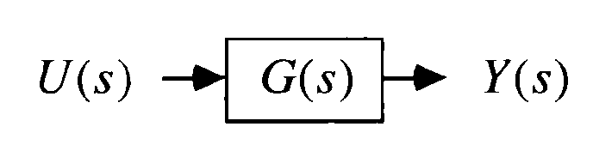
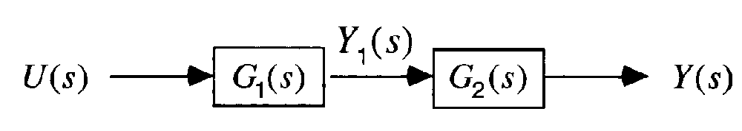
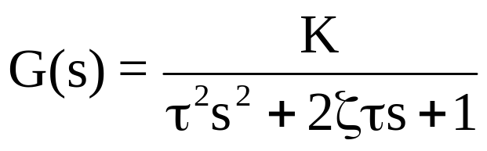
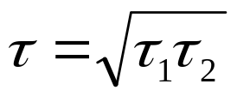
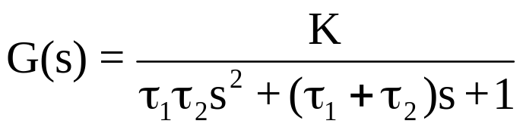
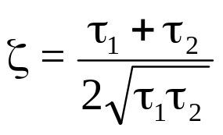

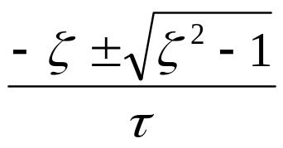
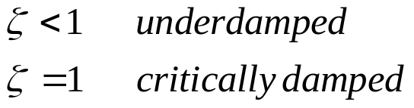
Block Notation:
Composed of two first order subsystems (G₁ and G₂)
2nd order ODE model
(overdamped)
roots:
BITS, PILANI – K. K. BIRLA GOA CAMPUS

Slide 15
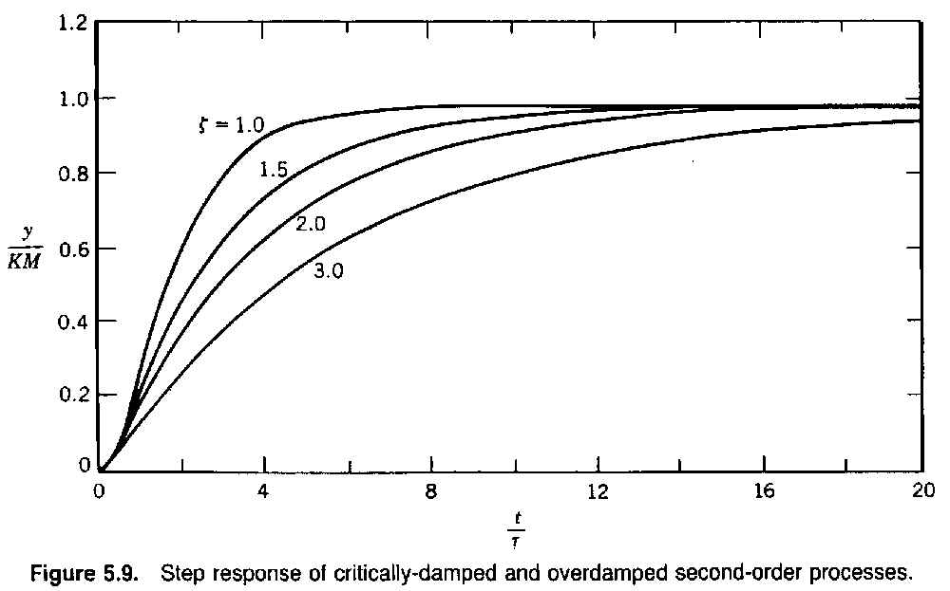
BITS, PILANI – K. K. BIRLA GOA CAMPUS

Slide 16
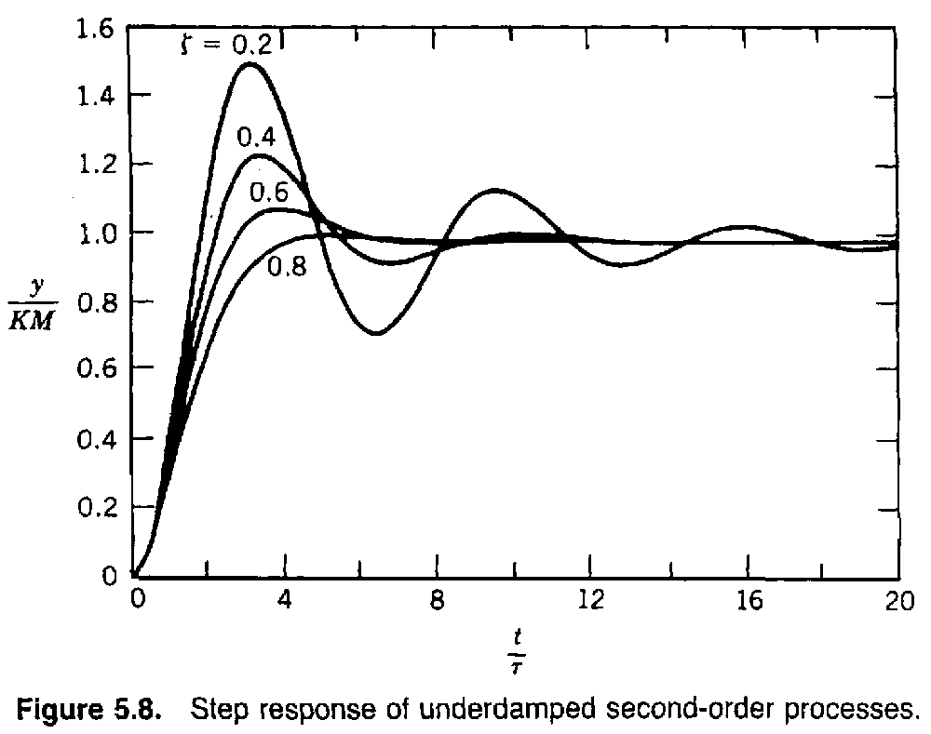
BITS, PILANI – K. K. BIRLA GOA CAMPUS

Slide 17
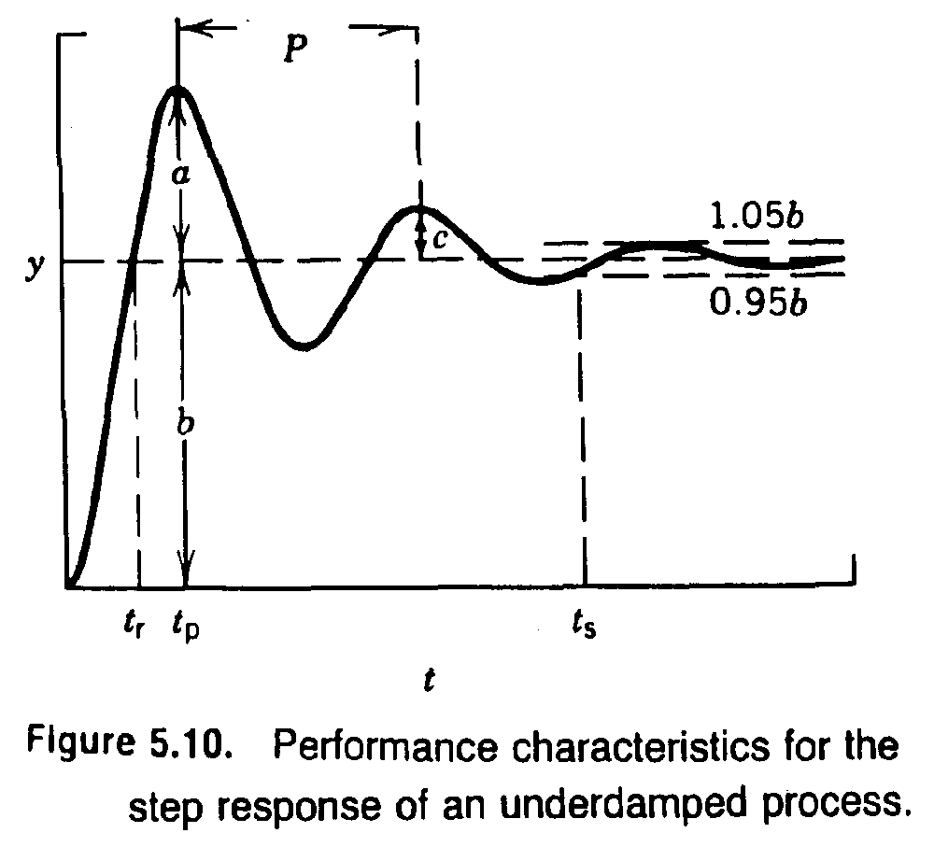
BITS, PILANI – K. K. BIRLA GOA CAMPUS

Slide 18
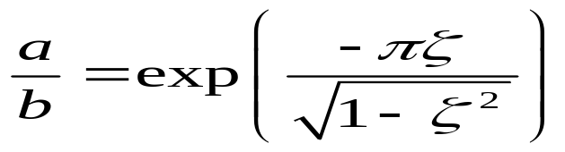
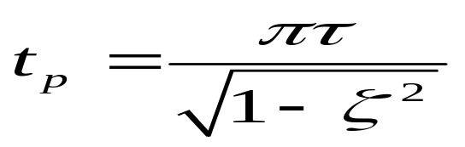
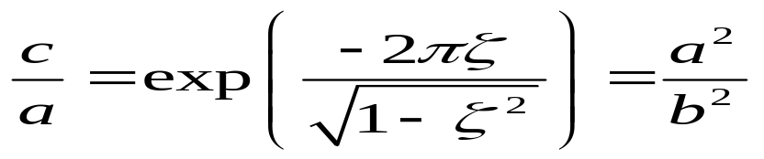
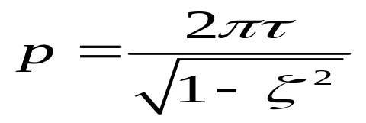
Second Order Step Change
Overshoot
time of first maximum
c. decay ratio (successive maxima – not min.)
d. period of oscillation
BITS, PILANI – K. K. BIRLA GOA CAMPUS

Slide 19
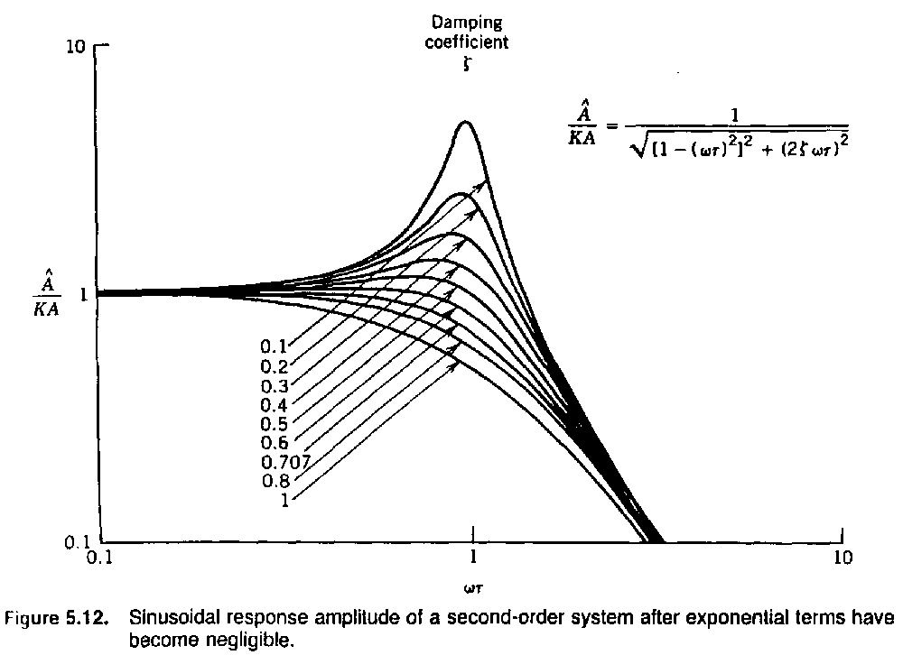
BITS, PILANI – K. K. BIRLA GOA CAMPUS

Slide 20
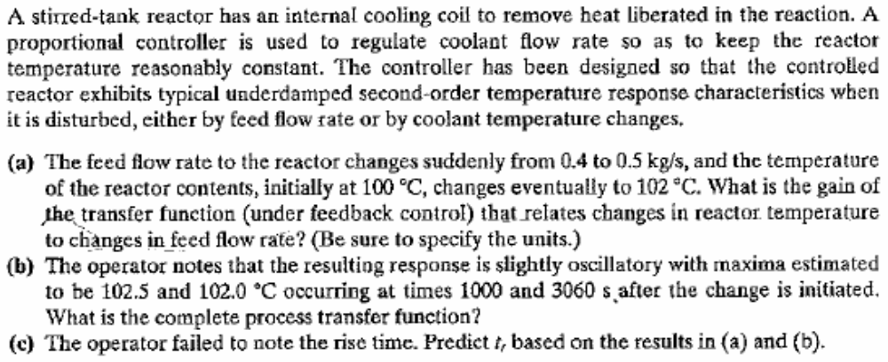
Example 5.5
BITS, PILANI – K. K. BIRLA GOA CAMPUS

Slide 21
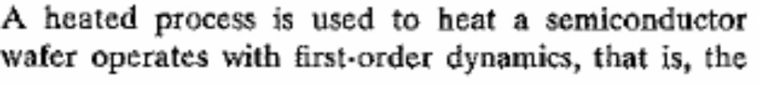
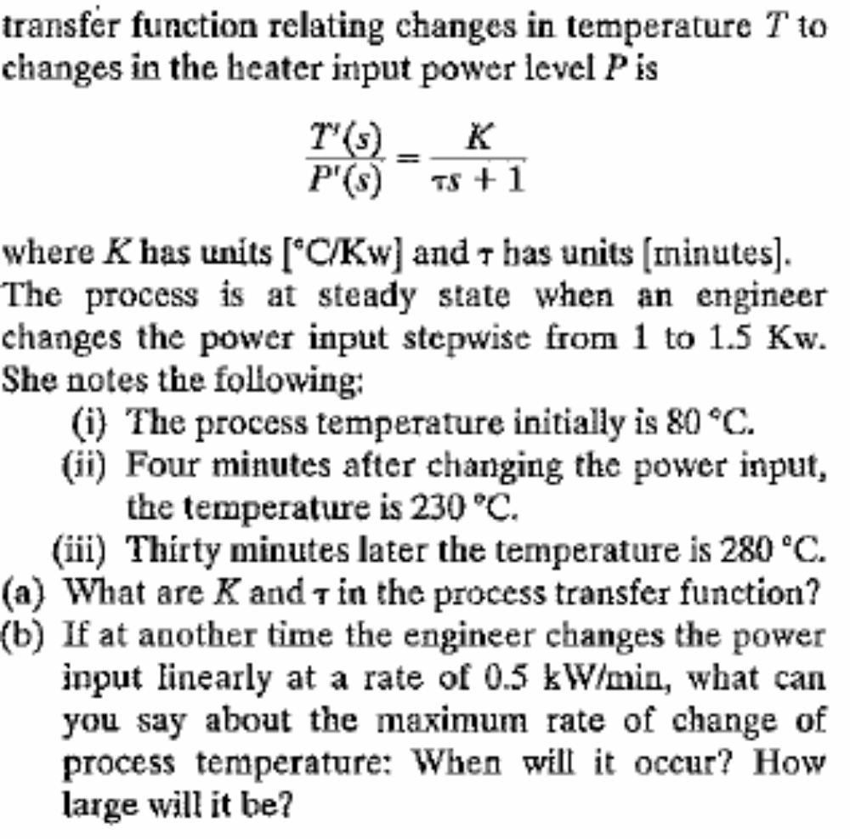
Example: 5.2
BITS, PILANI – K. K. BIRLA GOA CAMPUS

Slide 22
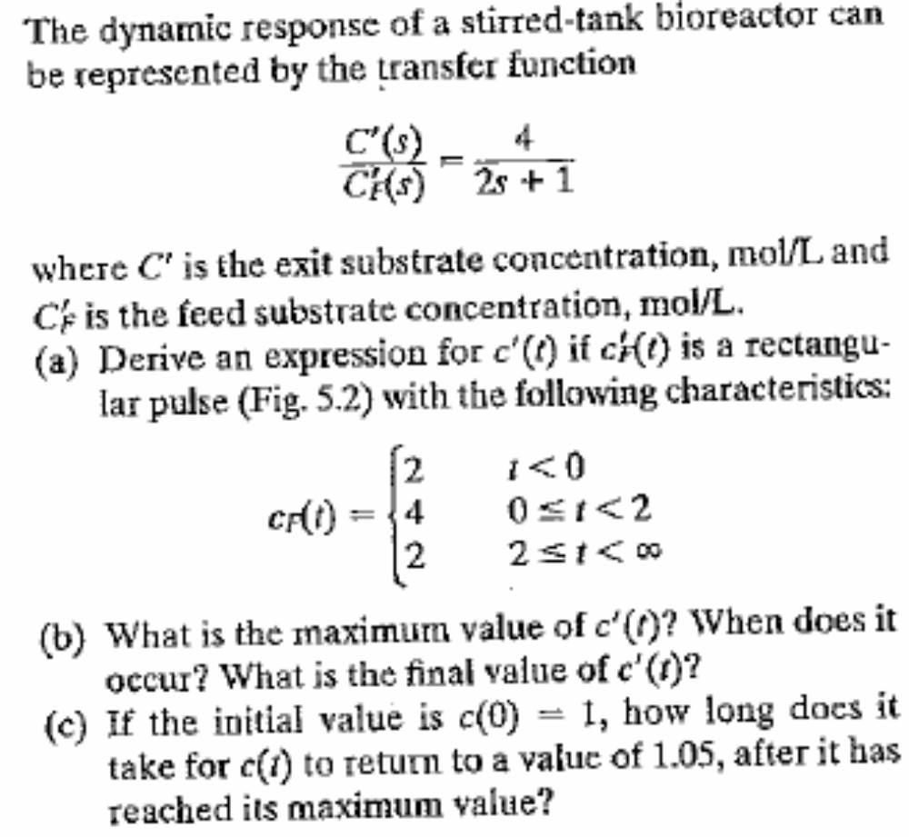
Example: 5.4
BITS, PILANI – K. K. BIRLA GOA CAMPUS

Slide 23
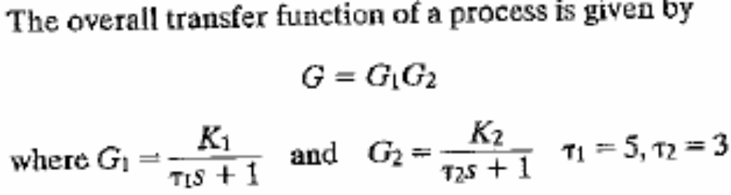
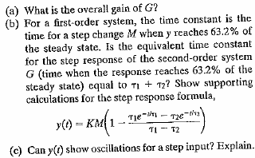
Example: 5.6
BITS, PILANI – K. K. BIRLA GOA CAMPUS

Slide 24

Example: 8.1
A step change of magnitude 4 is introduced into a system having the transfer function
Determine
(a) % overshoot
(b) Rise time
(c) Max value of Y(t)
(d) Ultimate value of Y(t)
(e) Period of Oscillation.
BITS, PILANI – K. K. BIRLA GOA CAMPUS

Slide 25
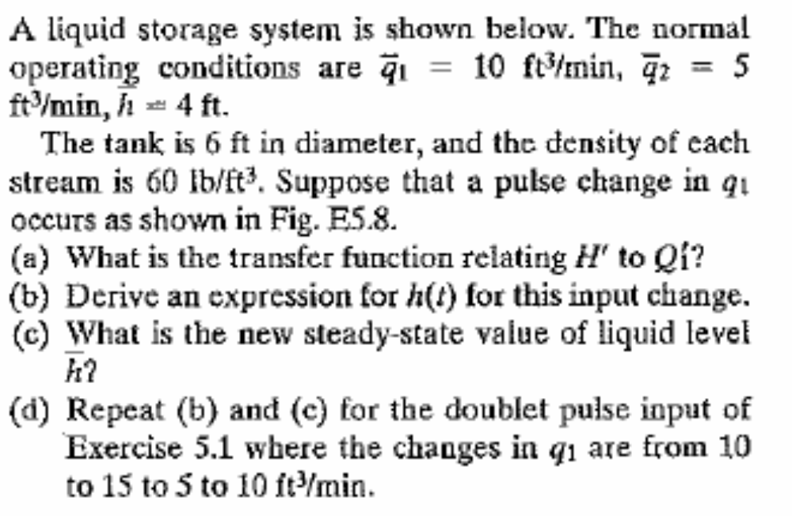
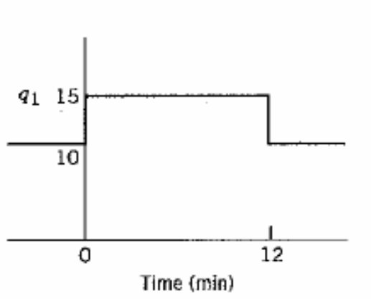
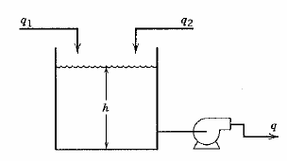
Example:5.8
BITS, PILANI – K. K. BIRLA GOA CAMPUS

Slide 26
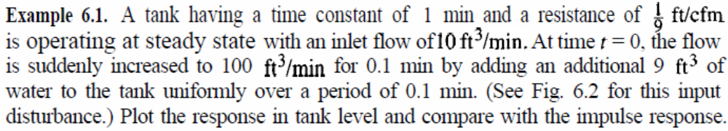
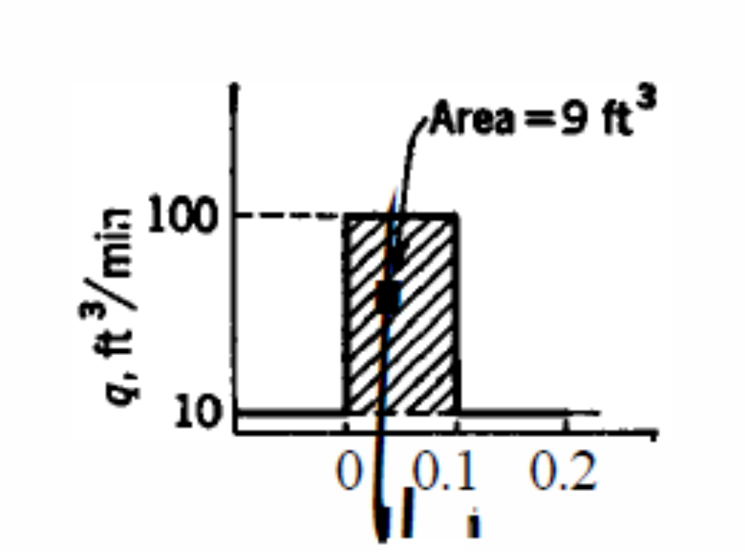
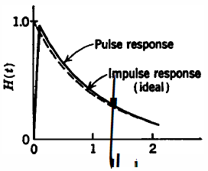
BITS, PILANI – K. K. BIRLA GOA CAMPUS

Slide 27
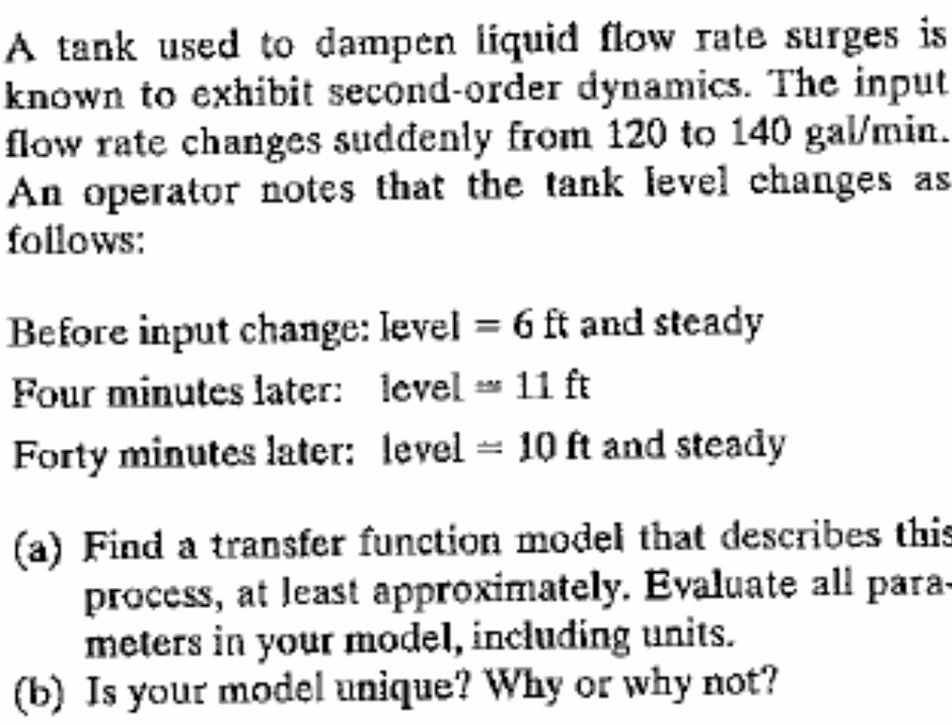
Example: 5.17
BITS, PILANI – K. K. BIRLA GOA CAMPUS

Slide 28
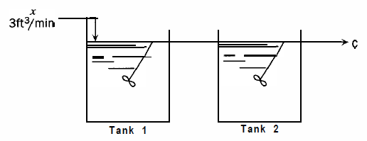
In the two-tank mixing process shown in Fig, x varies from 0 lb salt/ft³ to 1 lb salt/ft³ according to a step function. At what time does the salt concentration in tank 2 reach 0.6 lb salt/ft³? The holdup volume of each tank is 6 ft³.
BITS, PILANI – K. K. BIRLA GOA CAMPUS

Slide 29
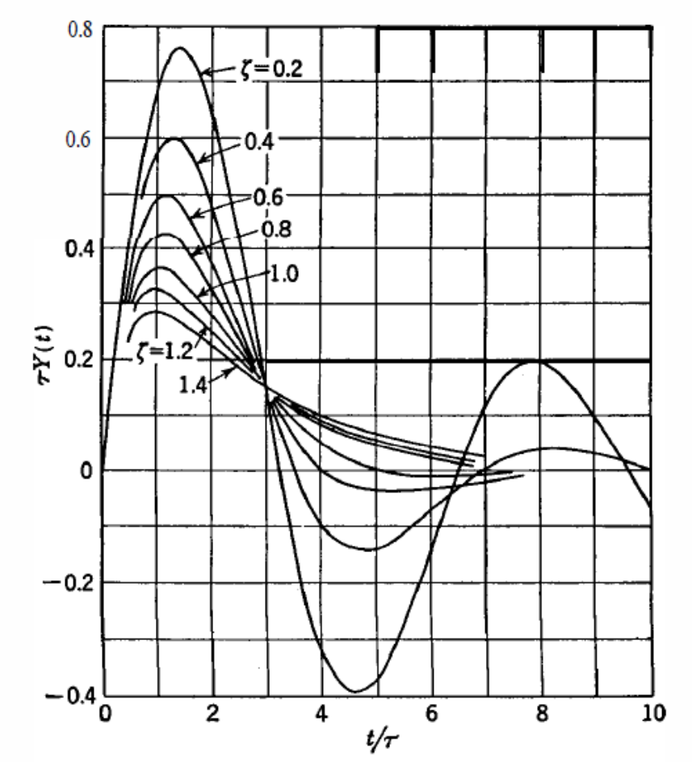
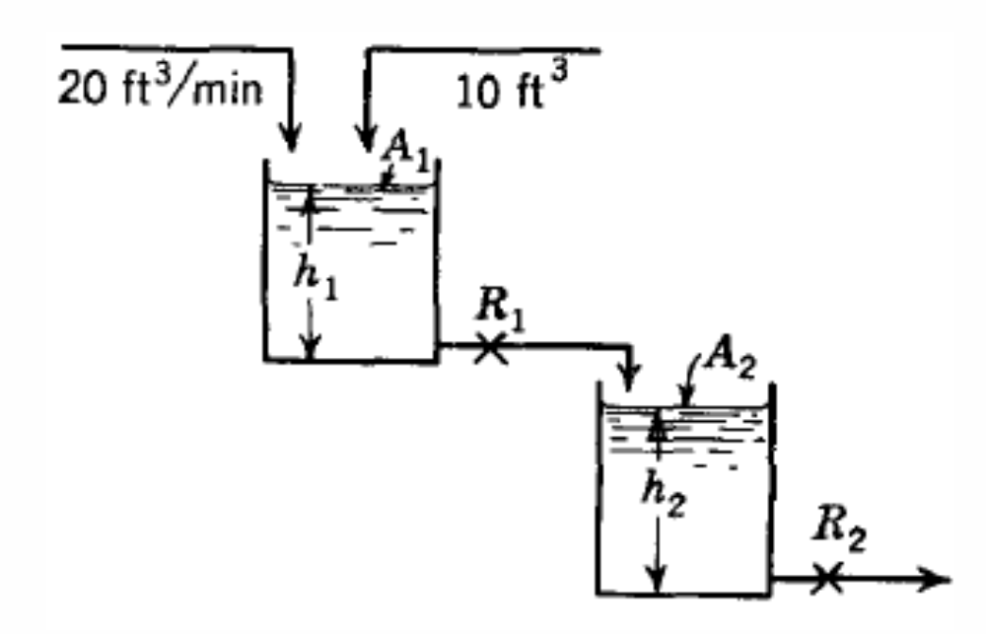
The tank system operates at steady state. At t = 0, 10 ft³ of water is added to tank 1. Determine the maximum deviation in level in both tanks from the ultimate steady state values, and the time at which each maximum occurs.
A1 = A2 = 10 ft3 R1 = 0.1ft/cfm R2 = 0.35ft/cfm.
BITS, PILANI – K. K. BIRLA GOA CAMPUS

Slide 30
Thanks
BITS, PILANI – K. K. BIRLA GOA CAMPUS

