Slide 1

BITS, PILANI – K. K. BIRLA GOA CAMPUS
Process Control- CHE C441
Chapter #6
Dynamic Response Characteristics of More Complicated Systems
Dr. Saroj Sundar Baral
Department of Chemical Engineering

Slide 2
Dynamic Response Characteristics of More Complicated Systems
Topics to be covered:
Example of higher order system
How numerator and denominator affect dynamic response
Time delay in transfer function
Approximation of higher order system
Interacting and Non-interacting process
BITS, PILANI – K. K. BIRLA GOA CAMPUS

Slide 3
Complication can be because of two reason:
Higher order denominator
Numerator is a function of s
Three classes of higher order system:
Multi-capacity process
Process with dead time
Process with inverse response
BITS, PILANI – K. K. BIRLA GOA CAMPUS

Slide 4
Multi capacity process
Under damped response is initially faster than the critically damped or over damped which are characterize as sluggish
Under damped response reaches its ultimate value quickly but it will not stay there rather it will oscillate
The oscillatory behavior becomes more pronounced with smaller value of zeta
The response of over damped multi capacity system to step change is S-type i.e. initially changes slowly and then it picks up speed
As the number of capacities increases the sluggishness becomes more pronounced
BITS, PILANI – K. K. BIRLA GOA CAMPUS

Slide 5
For N capacity in series
N non-interacting in series
  The response has characteristic of over damped system
  Increasing the number of capacities increases the sluggishness
N interacting capacity in series
  Interaction increases the sluggishness of the overall system
Examples:
Jacketed cooler
Distillation column with N trays
BITS, PILANI – K. K. BIRLA GOA CAMPUS

Slide 6
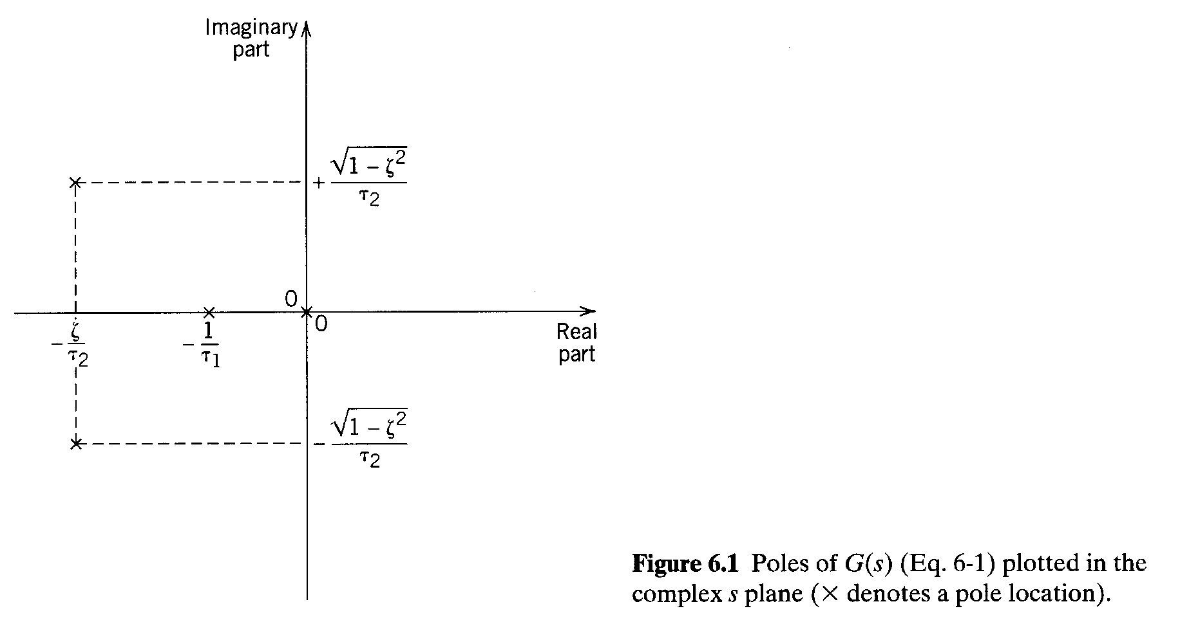
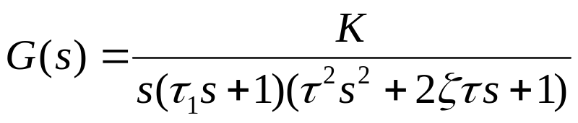
4 poles (denominator is 4th order polynomial)
BITS, PILANI – K. K. BIRLA GOA CAMPUS

Slide 7
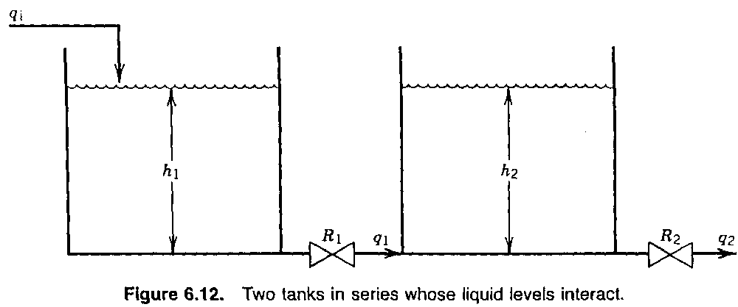
H₁/Q_{i} has numerator dynamics
BITS, PILANI – K. K. BIRLA GOA CAMPUS

Slide 8
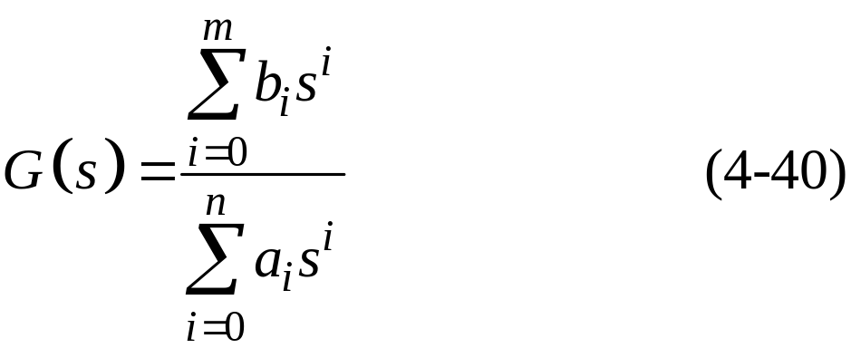
More General Transfer Function Models
Poles and Zeros:
The dynamic behavior of a transfer function model can be characterized by the numerical value of its poles and zeros.
General Representation of a TF:
There are two equivalent representations:
BITS, PILANI – K. K. BIRLA GOA CAMPUS

Slide 9
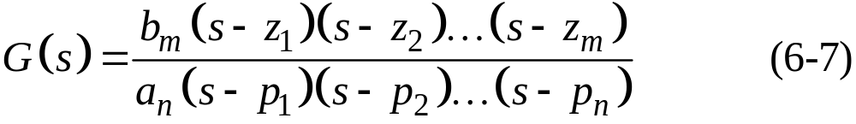
where {z_{i}} are the “zeros” and {p_{i}} are the “poles”.
We will assume that there are no “pole-zero” cancellations. That is, that no pole has the same numerical value as a zero.
Review: n>m in order to have a physically realizable system.
BITS, PILANI – K. K. BIRLA GOA CAMPUS

Slide 10
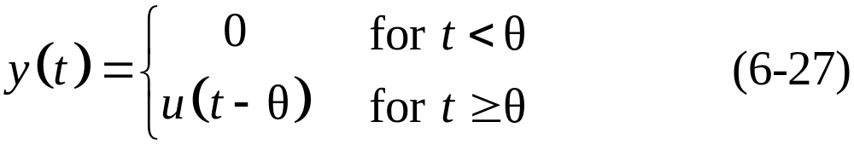
Time Delays
Time delays occur due to:
Fluid flow in a pipe
Transport of solid material (e.g., conveyor belt)
Chemical analysis
  Sampling line delay
  Time required to do the analysis (e.g., on-line gas chromatograph)
Mathematical description:
A time delay, θ, between an input u and an output y results in the following expression:
BITS, PILANI – K. K. BIRLA GOA CAMPUS

Slide 11
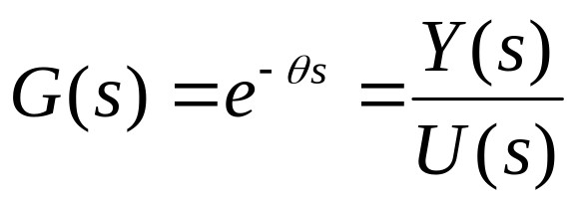
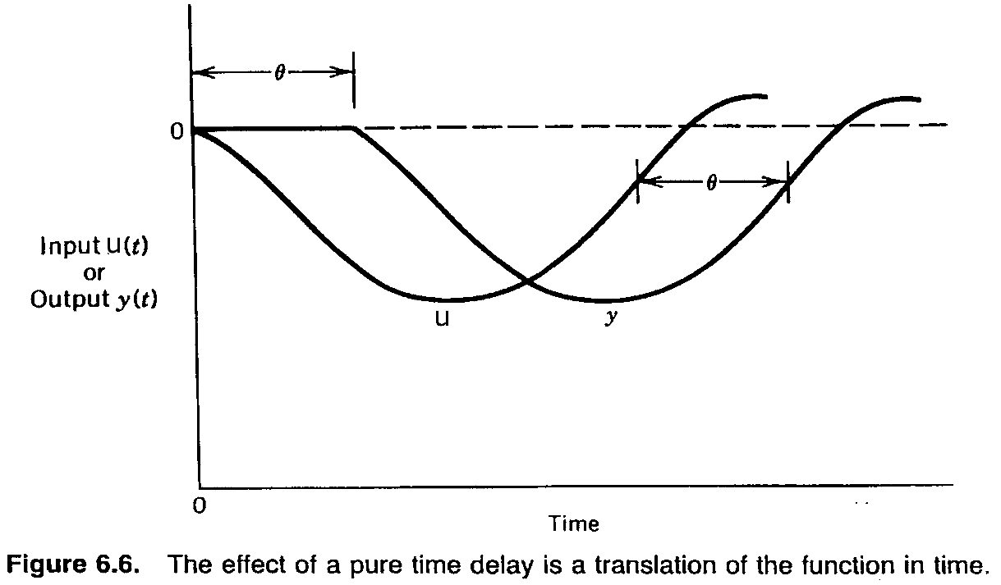
BITS, PILANI – K. K. BIRLA GOA CAMPUS

Slide 12
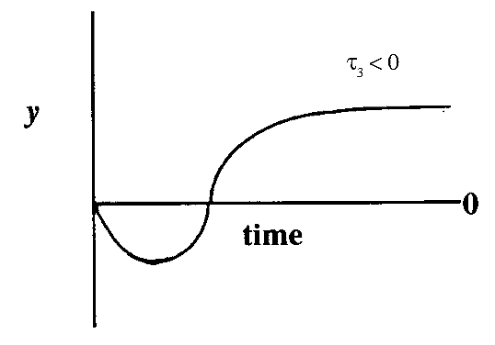
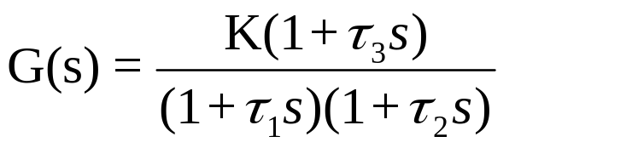


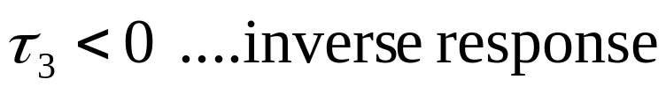

Dynamic Response Characteristics of More Complicated Systems
Inverse Response
slope
If ….fast response
: zero of transfer function
Use nonlinear regression for fitting data
(graphical method not available)
BITS, PILANI – K. K. BIRLA GOA CAMPUS

Slide 13
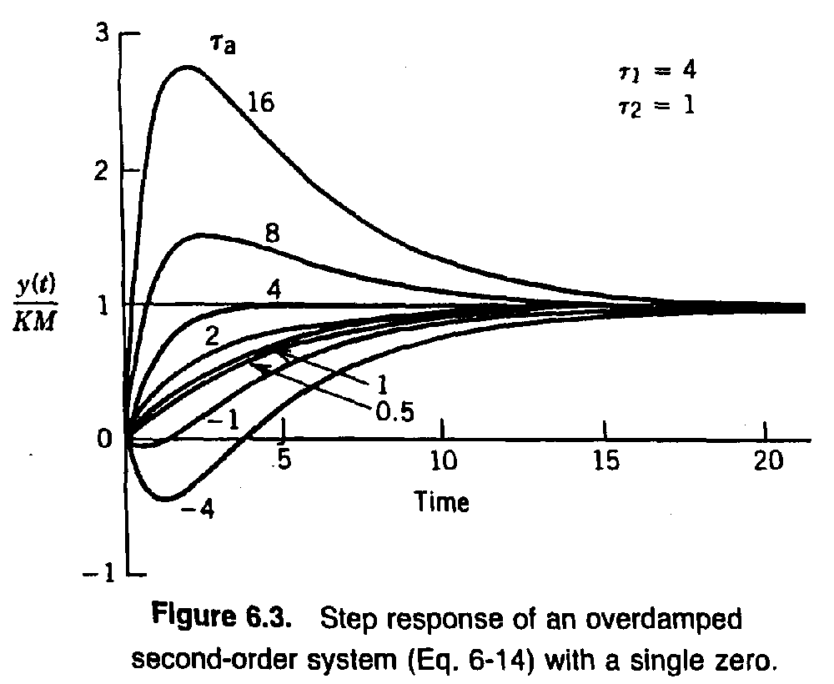
BITS, PILANI – K. K. BIRLA GOA CAMPUS

Slide 14
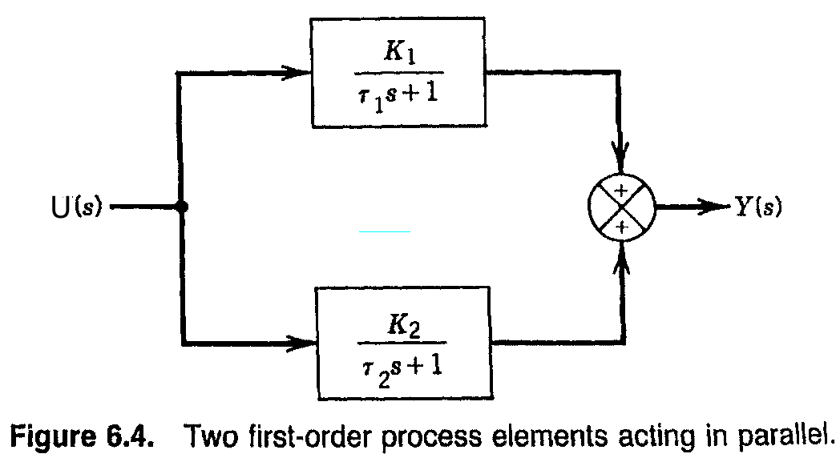
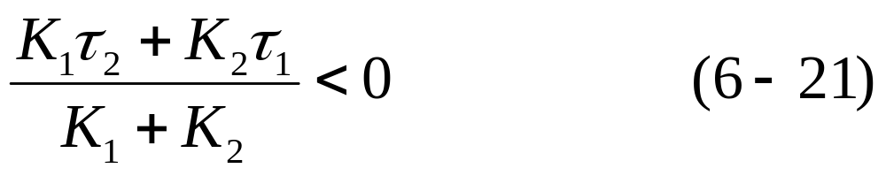
For inverse response
BITS, PILANI – K. K. BIRLA GOA CAMPUS

Slide 15
Approximation of Higher-Order Transfer Functions
In this section, we present a general approach for approximating high-order transfer function models with lower-order models that have similar dynamic and steady-state characteristics.
Taylor series expansion:
Pade approximation
Skogestad’s approximations
BITS, PILANI – K. K. BIRLA GOA CAMPUS

Slide 16
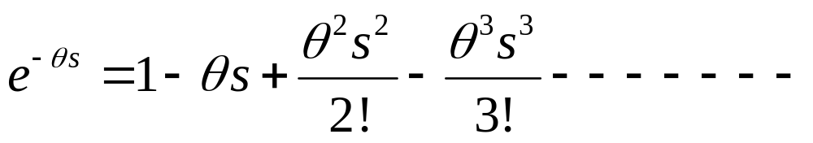
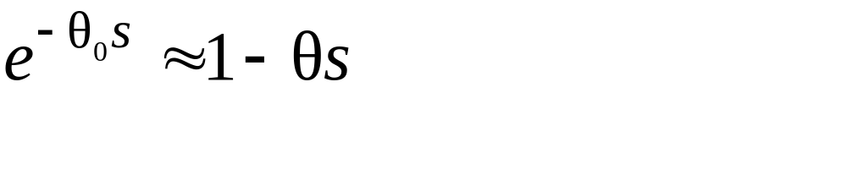
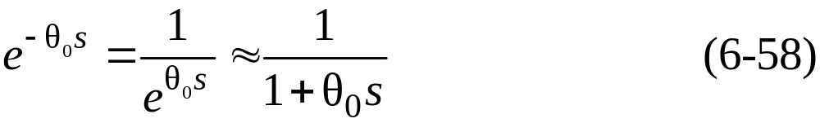
Taylor series expansion:
The transfer function for a time delay can be expressed as a Taylor series expansion.
An alternative first-order approximation consists of the transfer function,
BITS, PILANI – K. K. BIRLA GOA CAMPUS

Slide 17
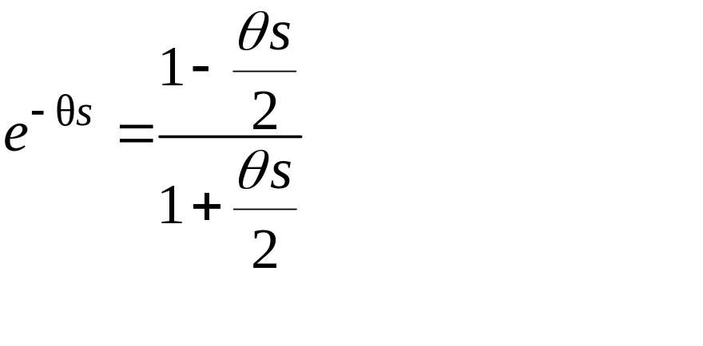
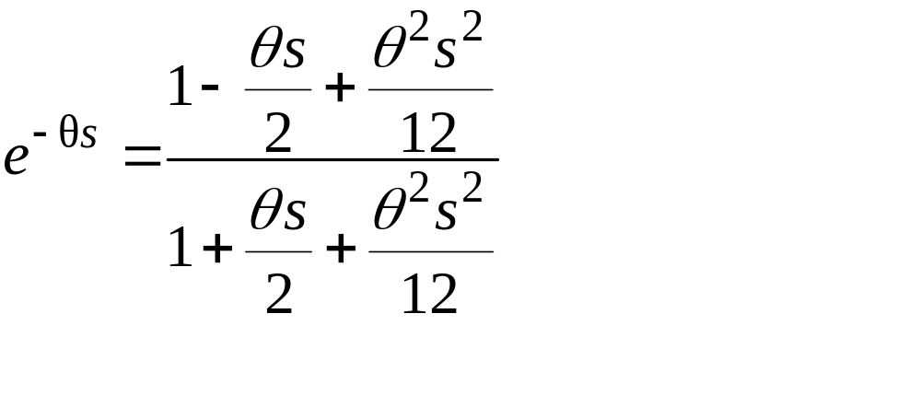
2. Pade approximation
Pade 1/1 approximation:
Pade 2/2 approximation:
BITS, PILANI – K. K. BIRLA GOA CAMPUS

Slide 18
3. Skogestad’s “half rule”
Skogestad (2002) has proposed an approximation method for higher-order models that contain multiple time constants.
The largest time constant/constants in the denominator is/are retain
Identify the largest neglected time constant
One-half of the largest neglected time constant is added to the existing time delay if any
Other one-half of the largest neglected time constant is added to the smallest retain time constant
Time constant which are smaller than the largest neglected time approximated as time delay
BITS, PILANI – K. K. BIRLA GOA CAMPUS

Slide 19
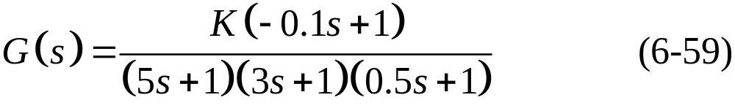
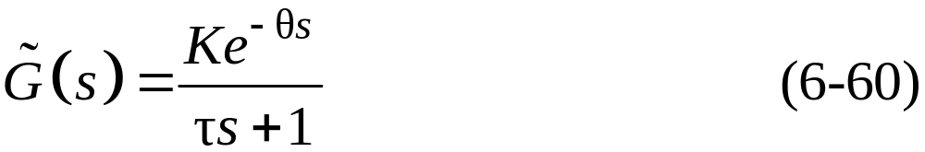
Example 6.4
Consider a transfer function:
Derive an approximate first-order-plus-time-delay model,
using two methods:
The Taylor series expansions
Skogestad’s half rule
Compare the normalized responses of G(s) and the approximate models for a unit step input.
BITS, PILANI – K. K. BIRLA GOA CAMPUS

Slide 20
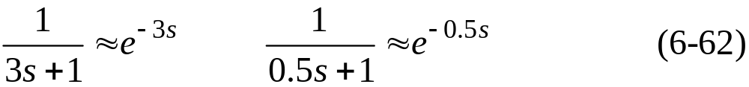

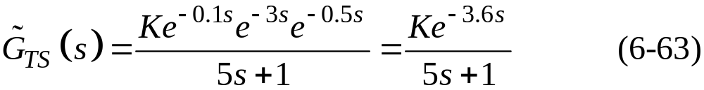
Solution
The dominant time constant (5) is retained. Applying
the approximations in (6-57) and (6-58) gives:
and
Substitution into (6-59) gives the Taylor series approximation,
BITS, PILANI – K. K. BIRLA GOA CAMPUS

Slide 21

(b) To use Skogestad’s method, we note that the largest neglected time constant in (6-59) has a value of three.
According to his “half rule”, half of this value is added to the next largest time constant to generate a new time constant
The other half provides a new time delay of 0.5(3) = 1.5.
The approximation of the RHP zero in (6-61) provides an additional time delay of 0.1.
Approximating the smallest time constant of 0.5 in (6-59) by (6-58) produces an additional time delay of 0.5.
Thus the total time delay in (6-60) is,
BITS, PILANI – K. K. BIRLA GOA CAMPUS

Slide 22
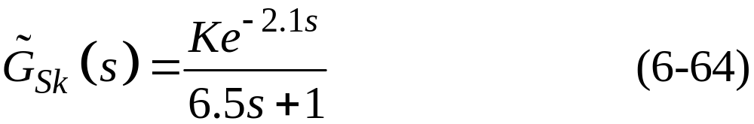
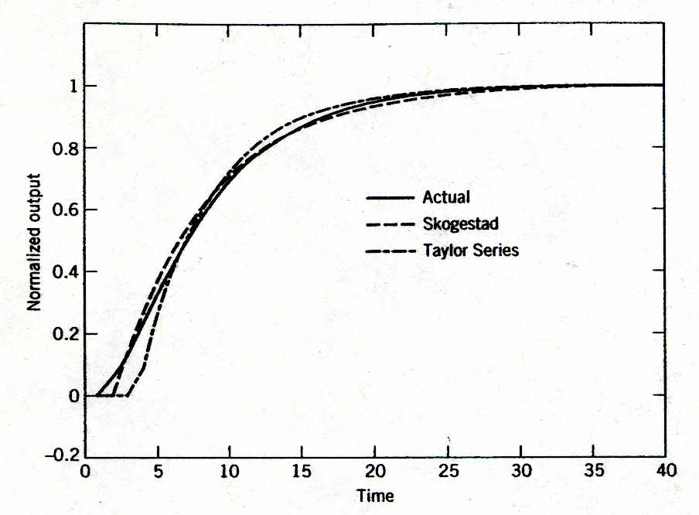
and G(s) can be approximated as:
The normalized step responses for G(s) and the two approximate models are shown in Fig. 6.10. Skogestad’s method provides better agreement with the actual response.
Figure 6.10 Comparison of the actual and approximate models for Example 6.4.
BITS, PILANI – K. K. BIRLA GOA CAMPUS

Slide 23
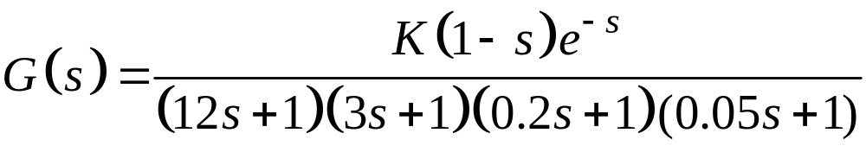
Example 6.5
Consider a transfer function:
Derive an approximate first-order-plus-time-delay model using Skogestad’s half rule
Derive an approximate 2nd-order-plus-time-delay model using Skogestad’s half rule
BITS, PILANI – K. K. BIRLA GOA CAMPUS

Slide 24
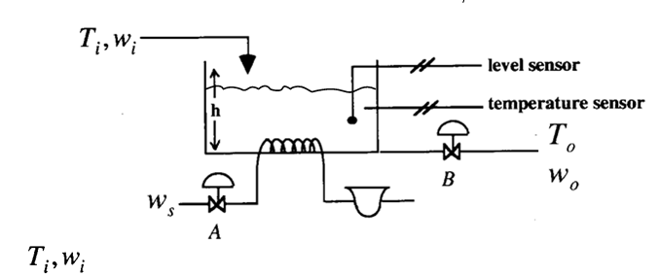
Multivariable Processes
many examples: distillation columns, FCC, boilers, etc.
Consider stirred tank with level controller
2 disturbances (T_{i}, w_{i})
2 control valves (A, B) manipulate w_{s}, w_{o}
2 measurements (T₀, h)
controlled variables (T₀, h)
change in w₀ affects T₀ and h
change in w_{s} only affects T₀
BITS, PILANI – K. K. BIRLA GOA CAMPUS

Slide 25
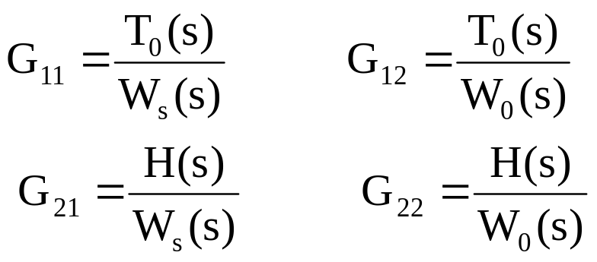
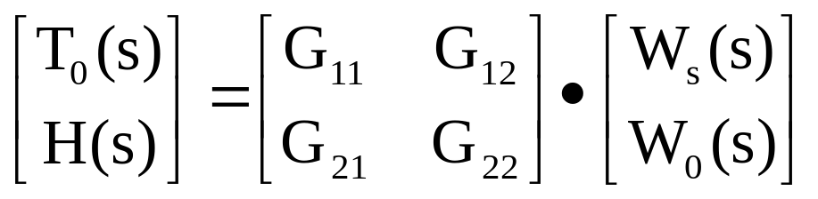
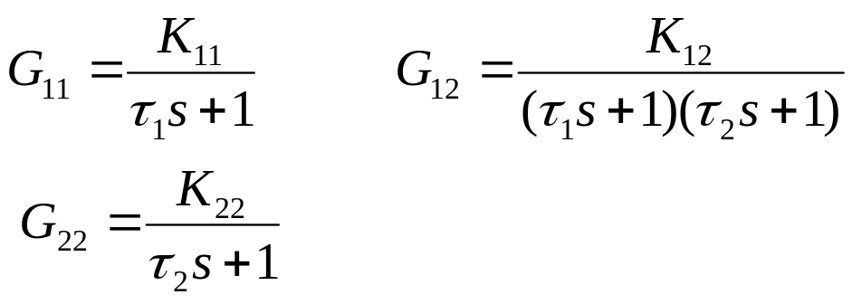
Three non-zero transfer functions
Transfer Function Matrix
From material and energy balances,
BITS, PILANI – K. K. BIRLA GOA CAMPUS

Slide 26
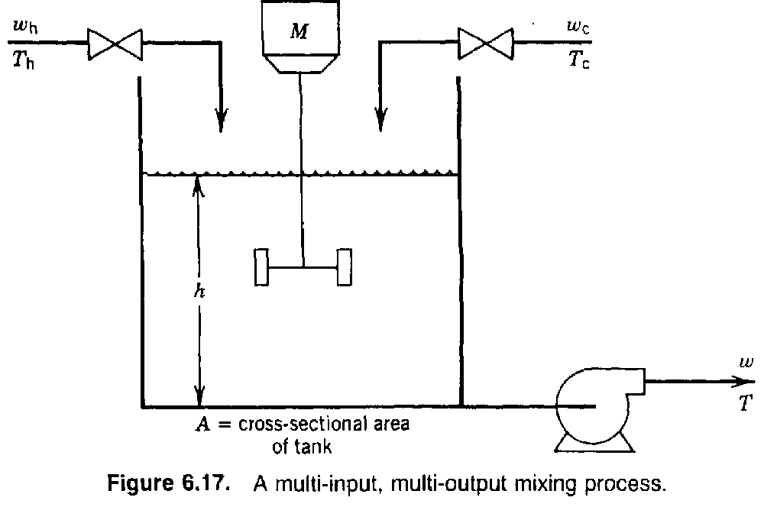
BITS, PILANI – K. K. BIRLA GOA CAMPUS

Slide 27
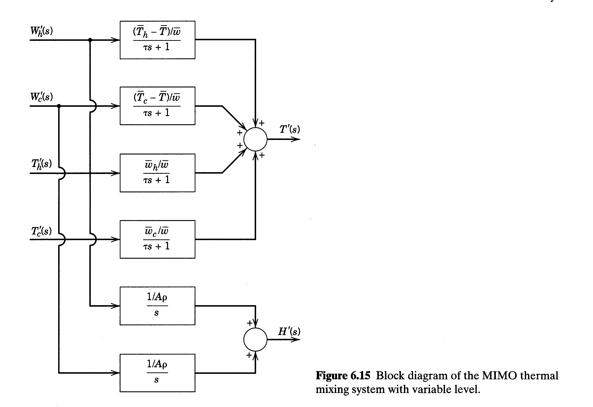
BITS, PILANI – K. K. BIRLA GOA CAMPUS

Slide 28
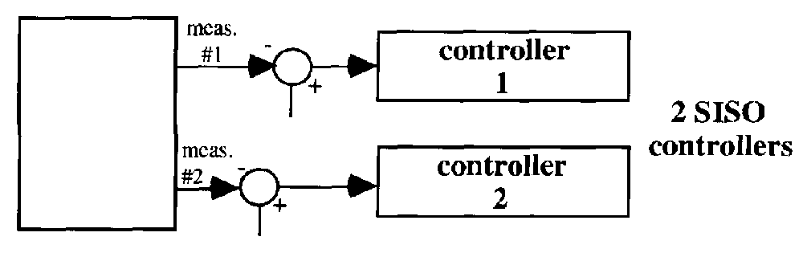
Normal method, but interactions may present
tuning problems.
In multivariable control, interactions are treated,
but controller design is more complicated.
BITS, PILANI – K. K. BIRLA GOA CAMPUS

Slide 29
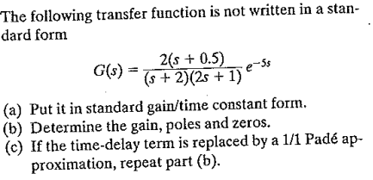
Example: 6.2
BITS, PILANI – K. K. BIRLA GOA CAMPUS

Slide 30
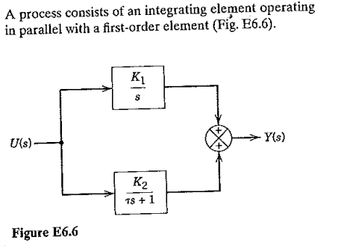
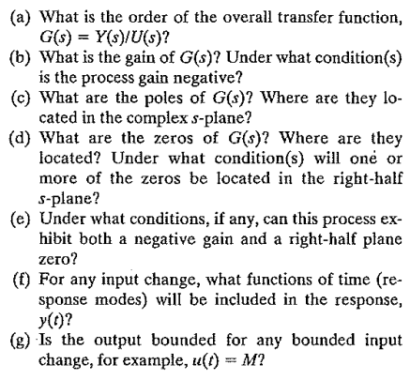
Example: 6.6
BITS, PILANI – K. K. BIRLA GOA CAMPUS

Slide 31
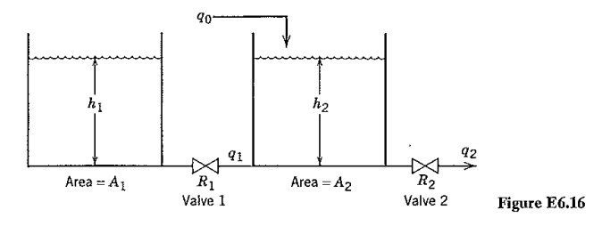

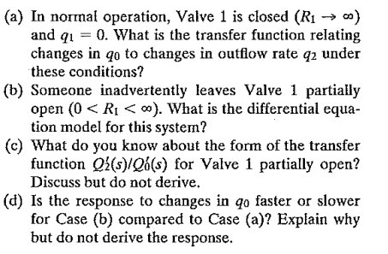
Example: 6.16
BITS, PILANI – K. K. BIRLA GOA CAMPUS

Slide 32
Thanks
BITS, PILANI – K. K. BIRLA GOA CAMPUS

