Slide 1

BITS, PILANI – K. K. BIRLA GOA CAMPUS
Process Control- CHE C441
Chapter #7
Development of Empirical Models
from Process Data
Dr. Saroj Sundar Baral
Department of Chemical Engineering

Slide 2
Development of Empirical Dynamic
Models from Step Response Data
Black box models
      Step response easiest to use but may upset the plant manager (size of input change? move to new steady-state?)
      Other methods
      impulse - dye injection, tracer
      random - PRBS (pseudo random binary sequences)
      sinusoidal - theoretical approach
      frequency response - modest usage (incl. pulse testing)
      on-line (under FB control)
BITS, PILANI – K. K. BIRLA GOA CAMPUS

Slide 3
Some processes too complicated to model using
physical principles
material, energy balances
    flow dynamics
    physical properties (often unknown)
    thermodynamics
Example 1: distillation column
50 plates
  For a 50 plate column, dynamic models have many ODEs that require model simplification; and physical properties must be known; e.g., HYSYS
  black box models (only good for fixed operating conditions) but requires operating plant (actual data)
  theoretical models must be used prior to plant construction or for new process chemistry
BITS, PILANI – K. K. BIRLA GOA CAMPUS

Slide 4
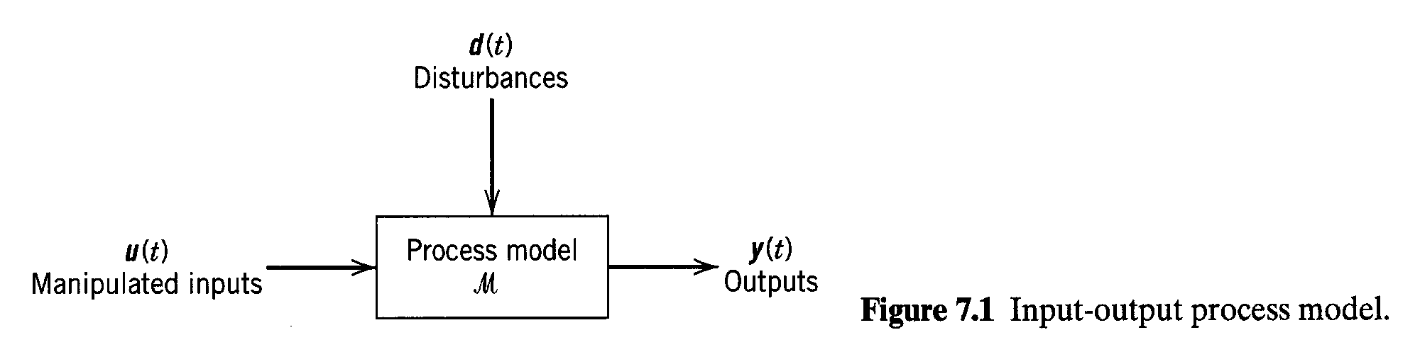
Need to minimize disturbances during a plant test
BITS, PILANI – K. K. BIRLA GOA CAMPUS

Slide 5
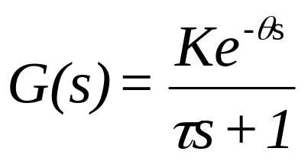
Simple Process Models
1st order system with gain K,
dead time θ and time
constant τ; 3 parameters to
be fitted.
Step response:
BITS, PILANI – K. K. BIRLA GOA CAMPUS

Slide 6
For a 1st order model, we note the following
characteristics (step response)
(1) The response attains 63.2% of its final response
at one time constant (t = τ+θ ).
(2) The line drawn tangent to the response at
maximum slope (t = θ) intersects the 100%
line at (t = τ+θ ). [see Fig. 7.2]
K is found from the steady state response for an input
change magnitude M.
There are 4 generally accepted graphical techniques
for determining first order system parameters τ, θ:
63.2% response
point of inflection
S&K method
semilog plot
BITS, PILANI – K. K. BIRLA GOA CAMPUS

Slide 7
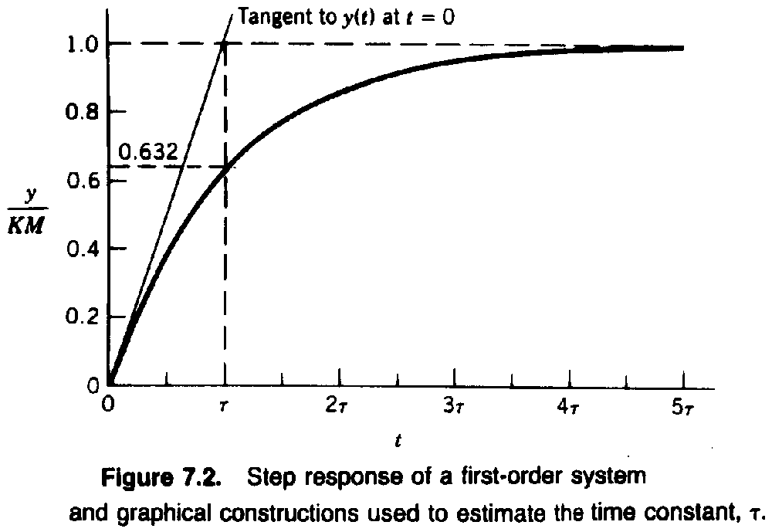

(θ = 0)
BITS, PILANI – K. K. BIRLA GOA CAMPUS

Slide 8
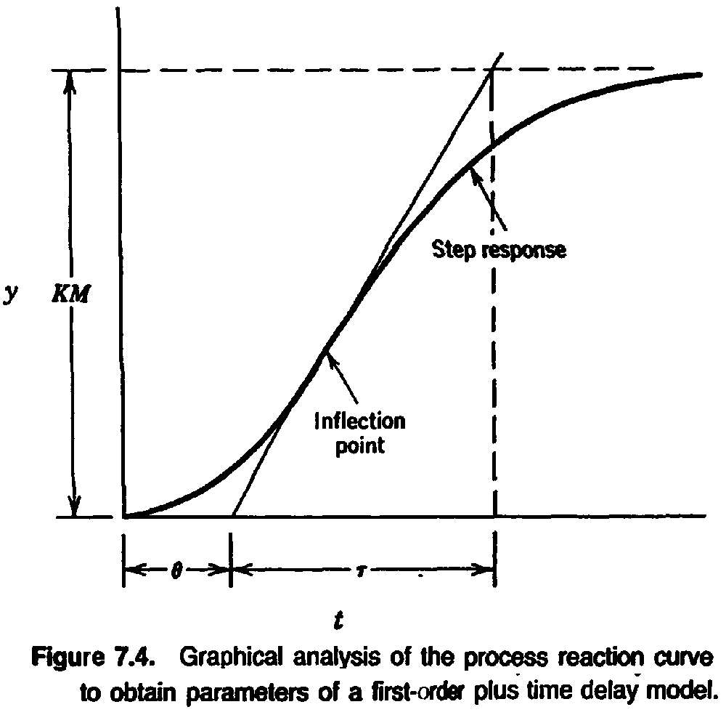
Inflection point hard to find with noisy data.
BITS, PILANI – K. K. BIRLA GOA CAMPUS

Slide 9
S & K Method for Fitting FOPTD Model
Normalize step response
(t = 0, y = 0; t →∞, y = 1)
Use 35 and 85% response times (t₁ and t₂)
θ = 1.3 t₁ – 0.29 t₂
τ = 0.67 (t₂ – t₁)
(based on analyzing many step responses)
K found from steady state response
Alternatively, use Excel Solver to fit θ and τ using y (t) = K [1 – e ^{–(t-θ)/t}] and data of y vs. t
BITS, PILANI – K. K. BIRLA GOA CAMPUS

Slide 10
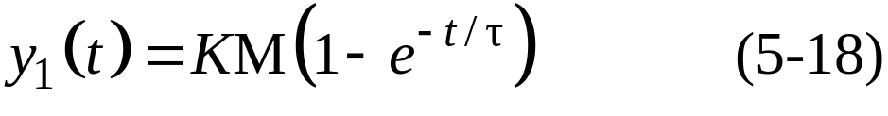
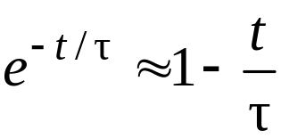
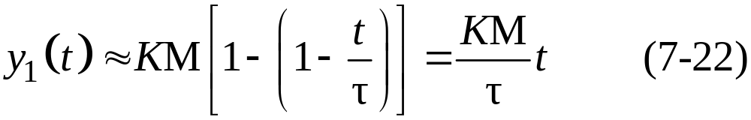
Fitting an Integrator Model
to Step Response Data
In Chapter 5 we considered the response of a first-order process to a step change in input of magnitude M:
For short times, t < τ, the exponential term can be approximated by
so that the approximate response is:
(straight line with slope of y₁(t=0))
BITS, PILANI – K. K. BIRLA GOA CAMPUS

Slide 11
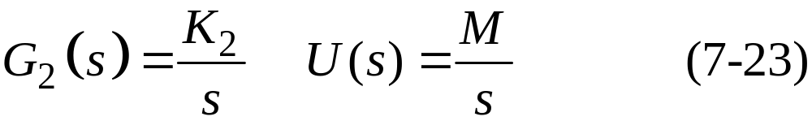
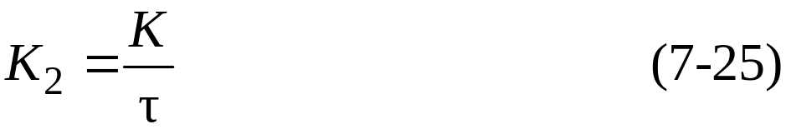
is virtually indistinguishable from the step response of the integrating element
In the time domain, the step response of an integrator is
Comparing with (7-22),
matches the early ramp-like response to a step change in input.
BITS, PILANI – K. K. BIRLA GOA CAMPUS

Slide 12
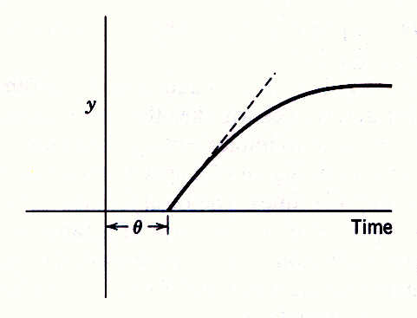
Figure 7.10. Comparison of step responses for a FOPTD model (solid line) and the approximate integrator plus time delay model (dashed line).
BITS, PILANI – K. K. BIRLA GOA CAMPUS

Slide 13
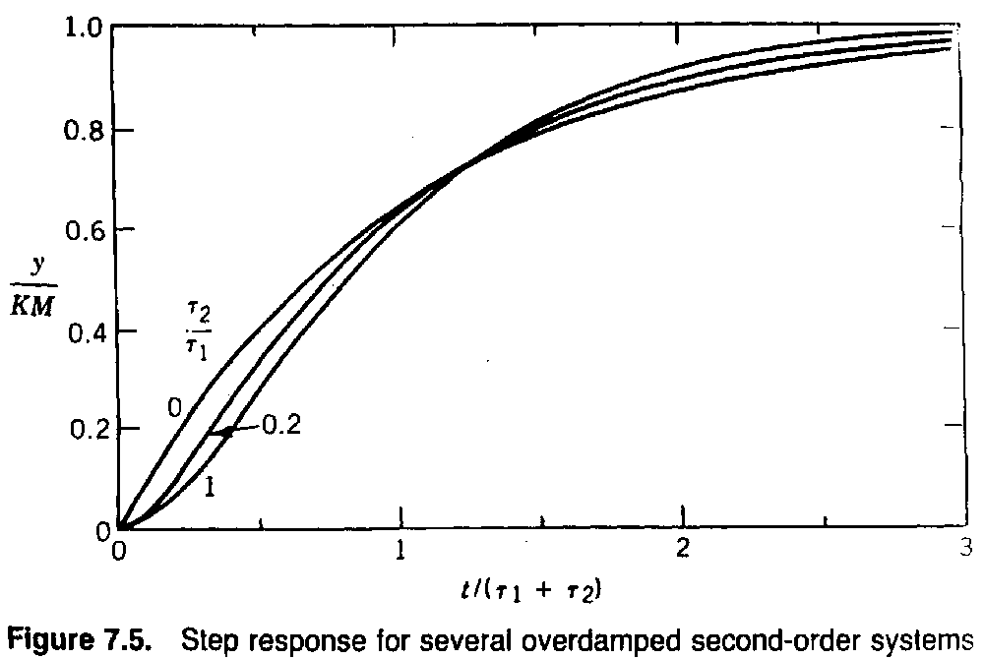

BITS, PILANI – K. K. BIRLA GOA CAMPUS

Slide 14
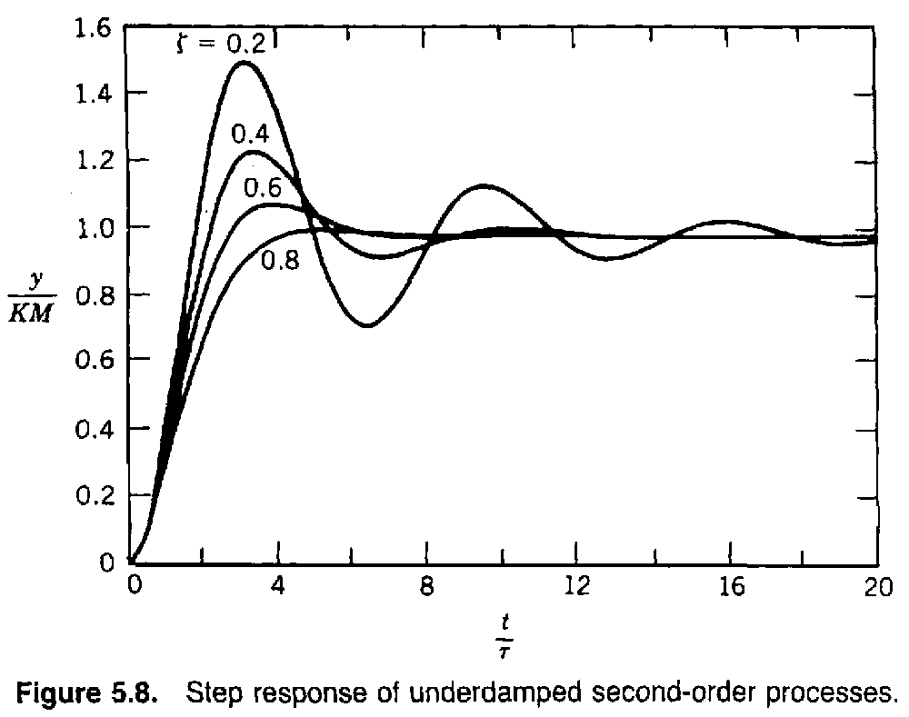
BITS, PILANI – K. K. BIRLA GOA CAMPUS

Slide 15
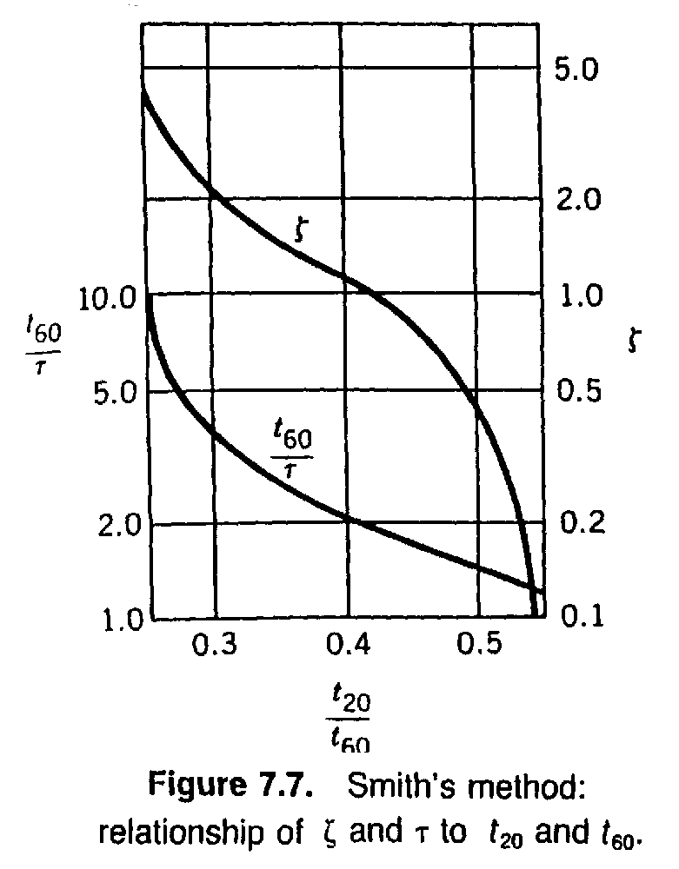
BITS, PILANI – K. K. BIRLA GOA CAMPUS

Slide 16
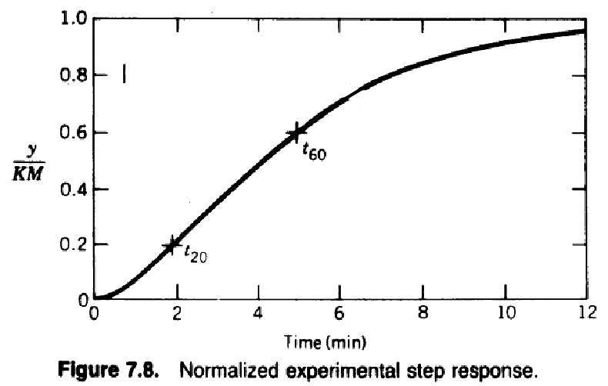
BITS, PILANI – K. K. BIRLA GOA CAMPUS

Slide 17
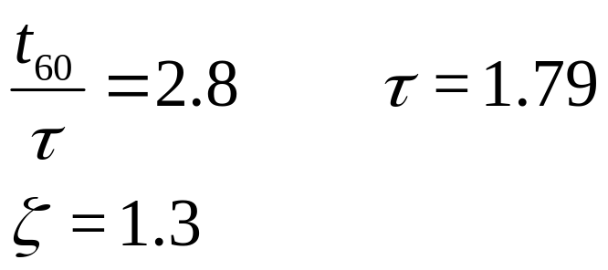
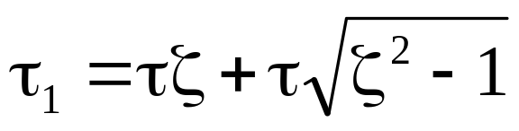
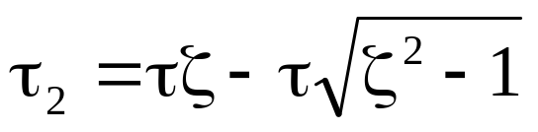
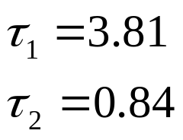
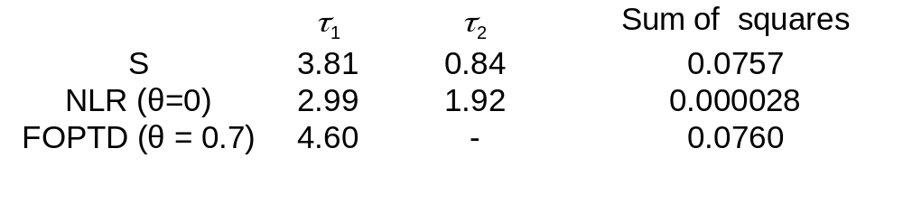
Smith’s Method
20% response: t₂₀ = 1.85
60% response: t₆₀ = 5.0
t₂₀ / t₆₀ = 0.37
from graph
Solving,
BITS, PILANI – K. K. BIRLA GOA CAMPUS

Slide 18
Using Excel Solver to Fit Transfer Function Models
use y (data) vs. y (predicted)
column 1 is data (taken at different times), or y₁
column 2 is model prediction (same time values as above), or y₂
target cell is Σ (y₁ - y₂)² , to be minimized
specify parameters to be changed in reference cells (e.g. τ₁ = 1, τ₂ = 2)
open solver dialog box to check settings
click on < solve > (calls optimization program)
BITS, PILANI – K. K. BIRLA GOA CAMPUS

Slide 19
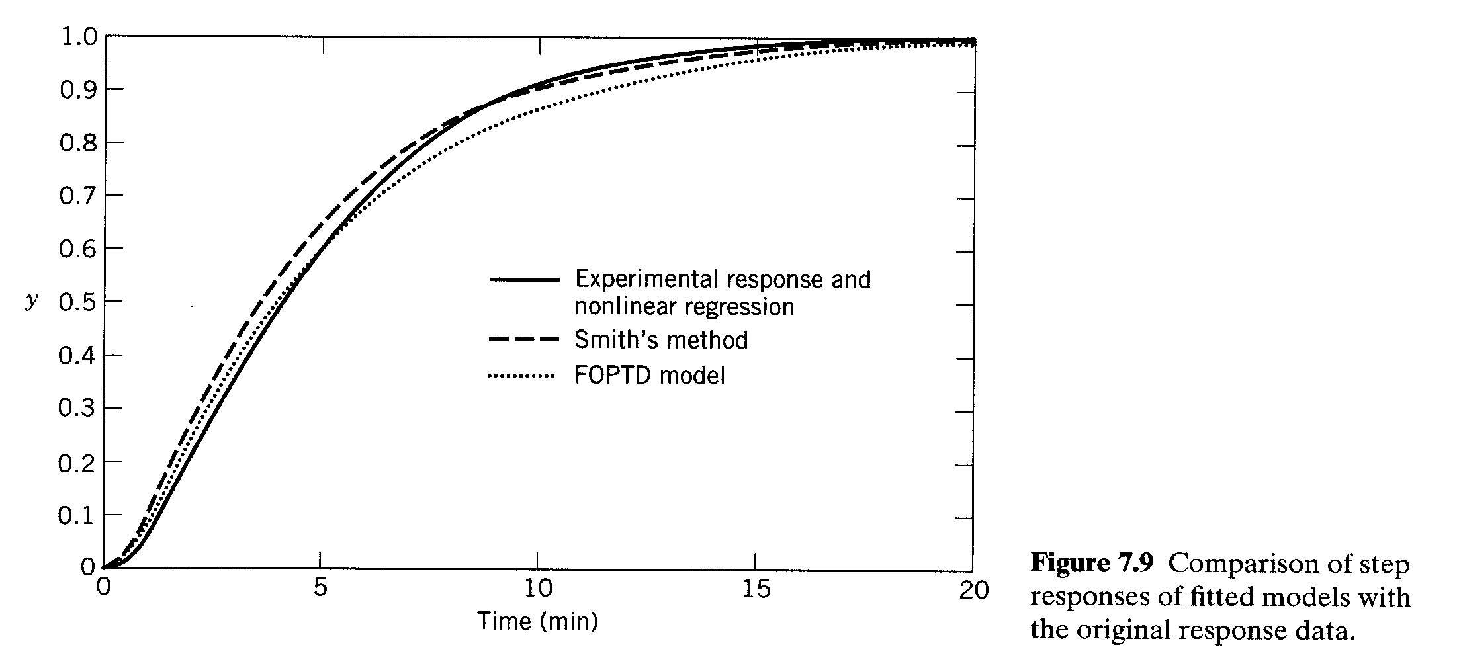
BITS, PILANI – K. K. BIRLA GOA CAMPUS

Slide 20
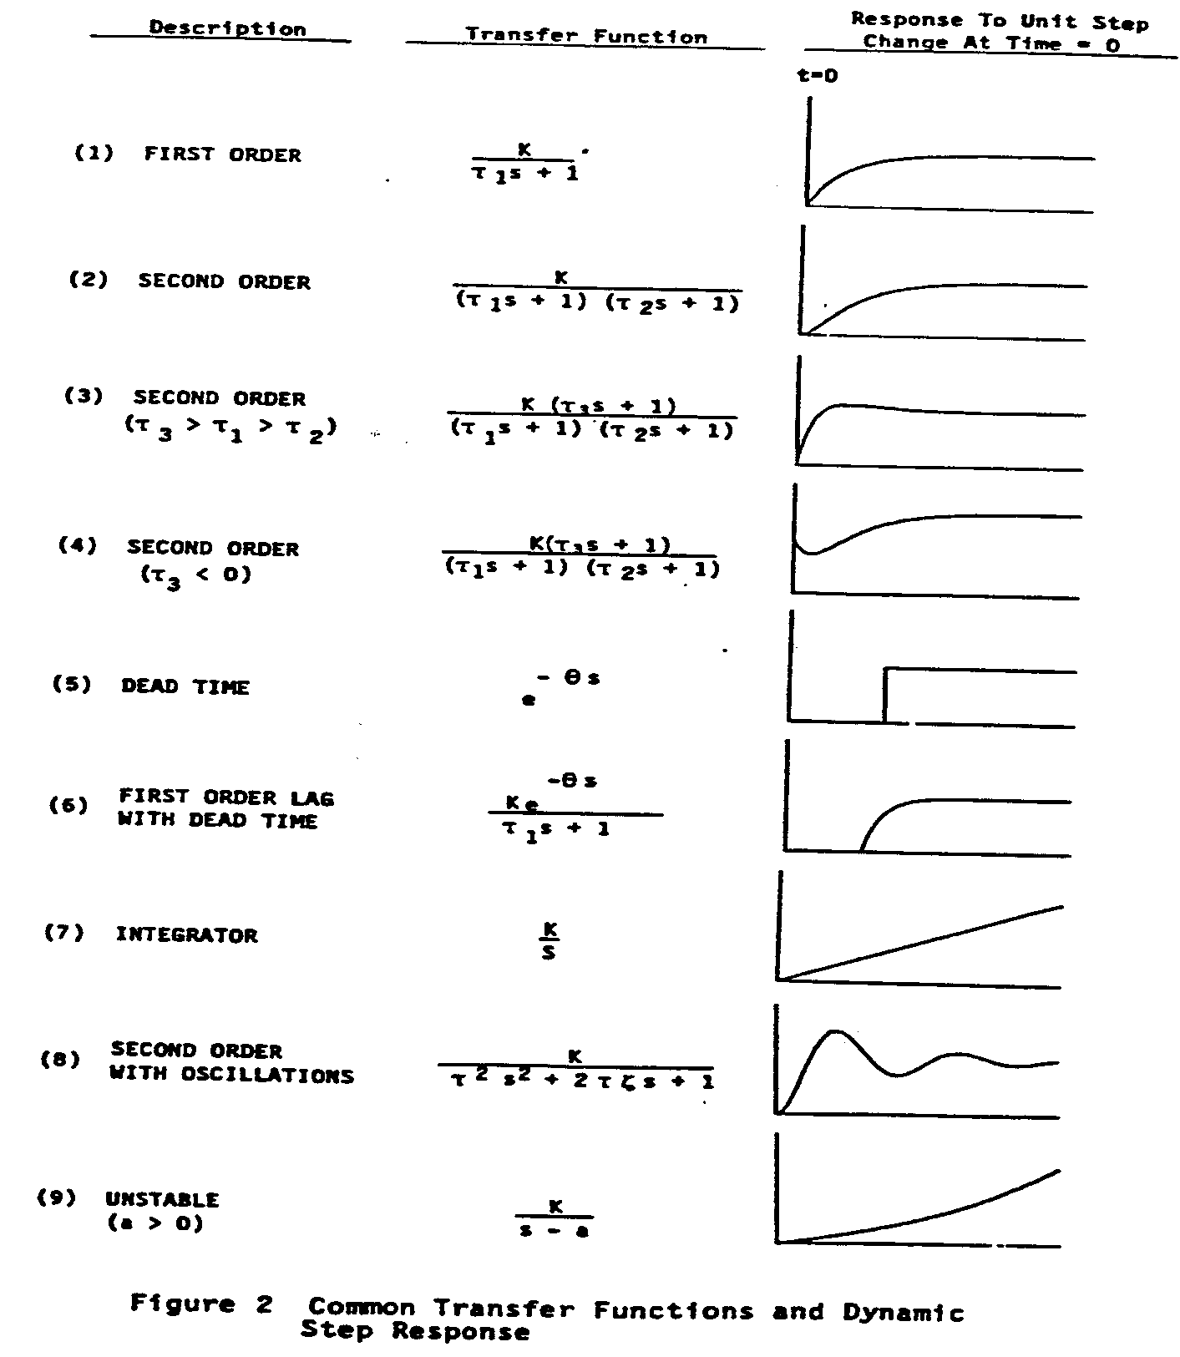
BITS, PILANI – K. K. BIRLA GOA CAMPUS

Slide 21
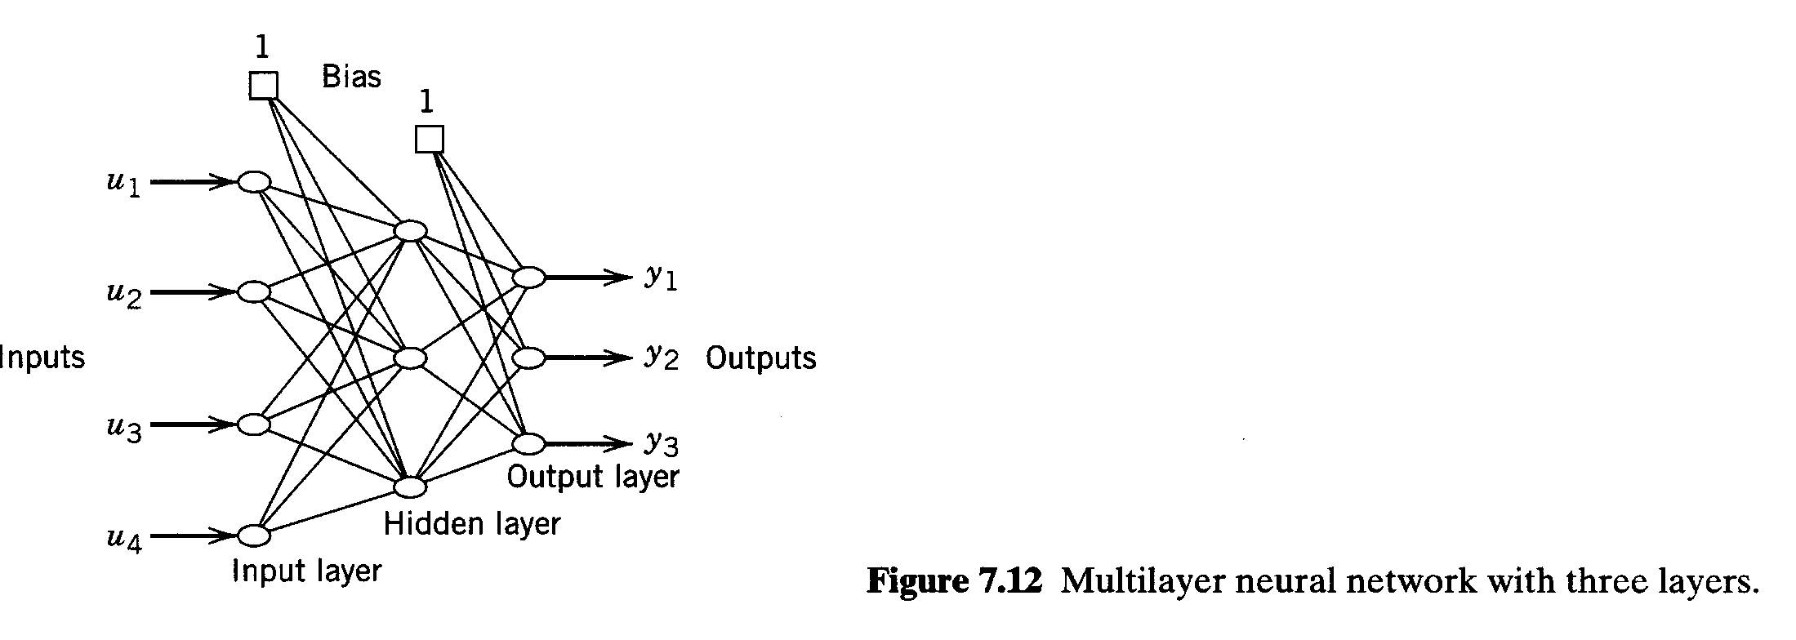
BITS, PILANI – K. K. BIRLA GOA CAMPUS

Slide 22
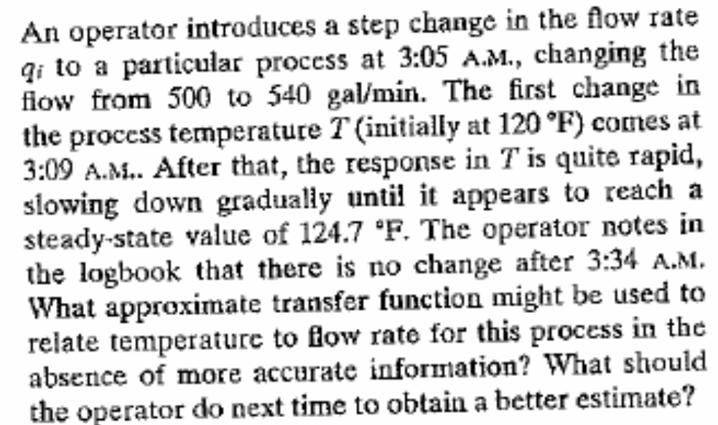
Example: 7.1
BITS, PILANI – K. K. BIRLA GOA CAMPUS

Slide 23
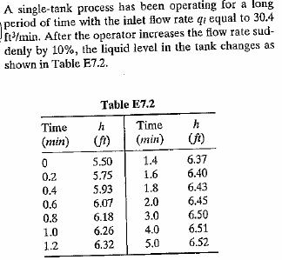
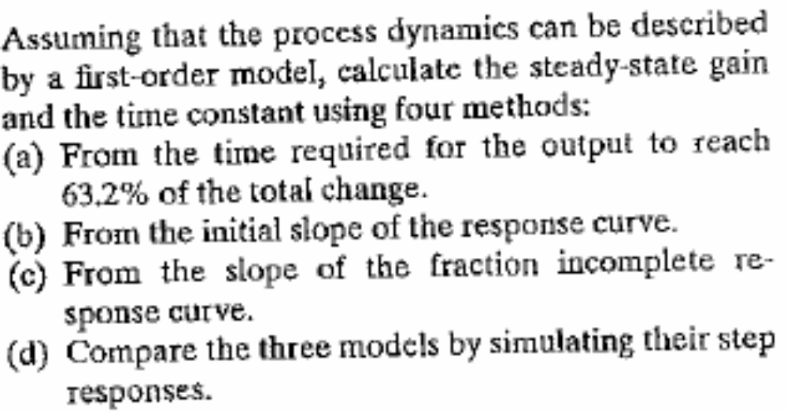
Example: 7.2
BITS, PILANI – K. K. BIRLA GOA CAMPUS

Slide 24
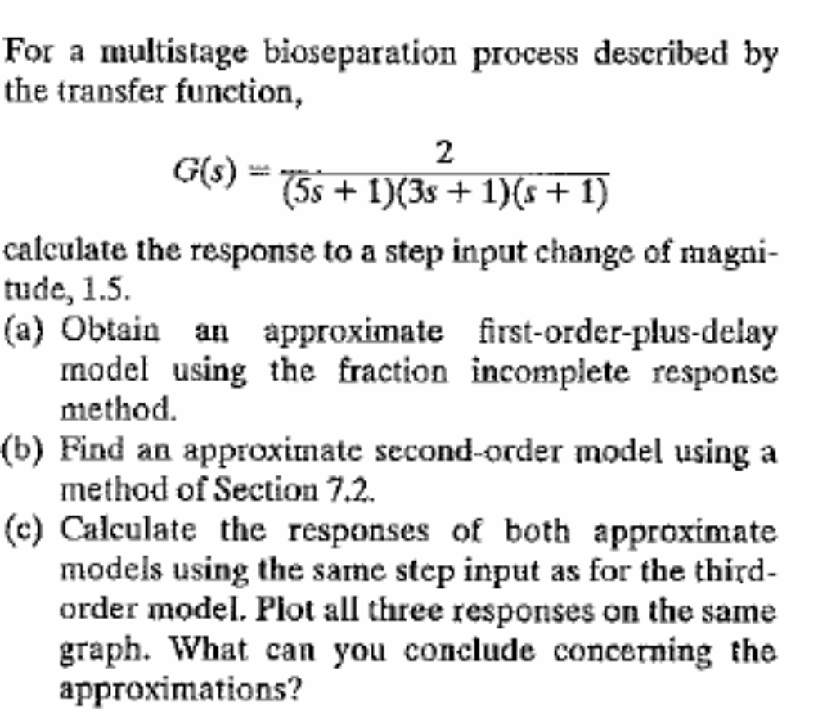
Quiz-3
BITS, PILANI – K. K. BIRLA GOA CAMPUS

Slide 25
Thanks
BITS, PILANI – K. K. BIRLA GOA CAMPUS

