Slide 1

BITS, PILANI – K. K. BIRLA GOA CAMPUS
Process Control- CHE C441
Chapter #8
Feedback Controllers
Dr. Saroj Sundar Baral
Department of Chemical Engineering

Slide 2
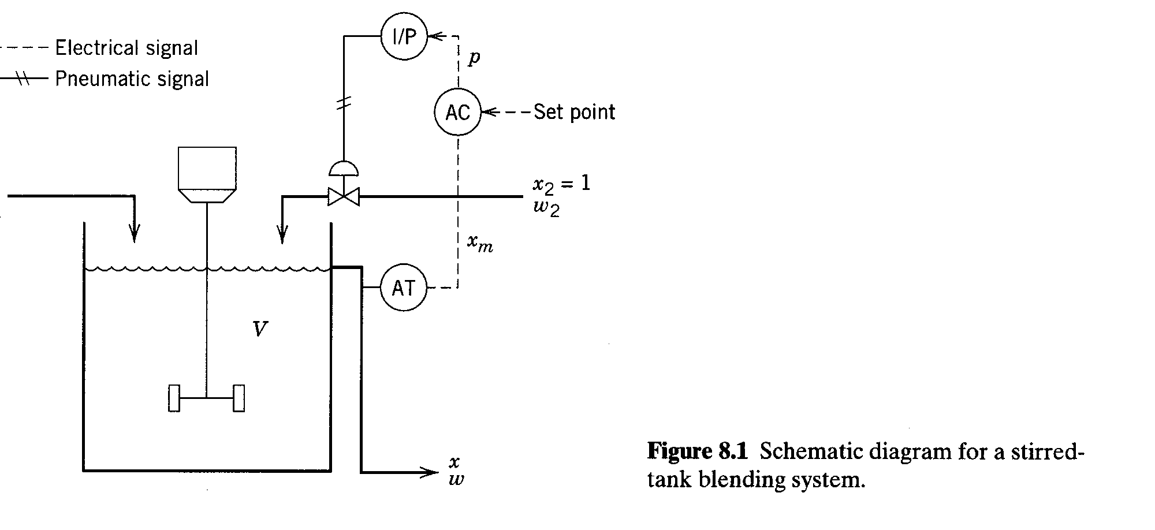
Feedback Controllers
BITS, PILANI – K. K. BIRLA GOA CAMPUS

Slide 3
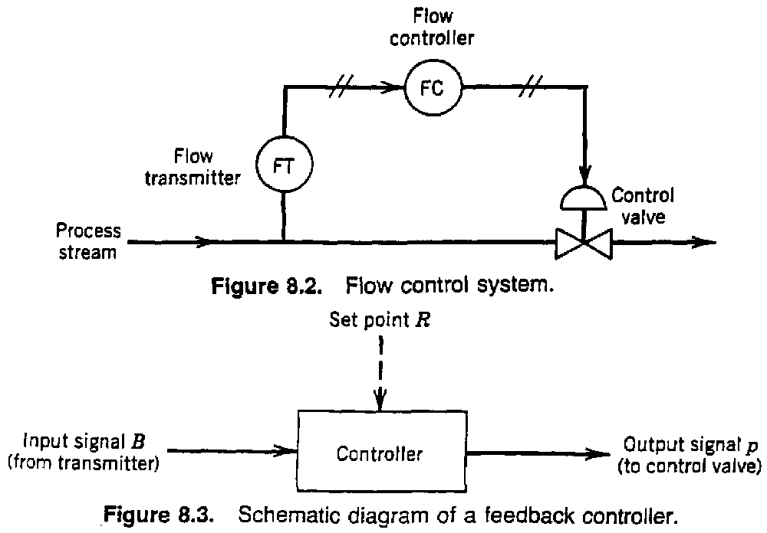
BITS, PILANI – K. K. BIRLA GOA CAMPUS

Slide 4
On-off Controllers
Simple
Cheap
Used In residential heating and domestic refrigerators
Limited use in process control due to continuous
cycling of controlled variable ⇒ excessive wear
on control valve.
Examples
Batch process control (PLC = programmable logic controller)
Solenoid in home heating unit
Sprinkler systems
Cruise control?
BITS, PILANI – K. K. BIRLA GOA CAMPUS

Slide 5
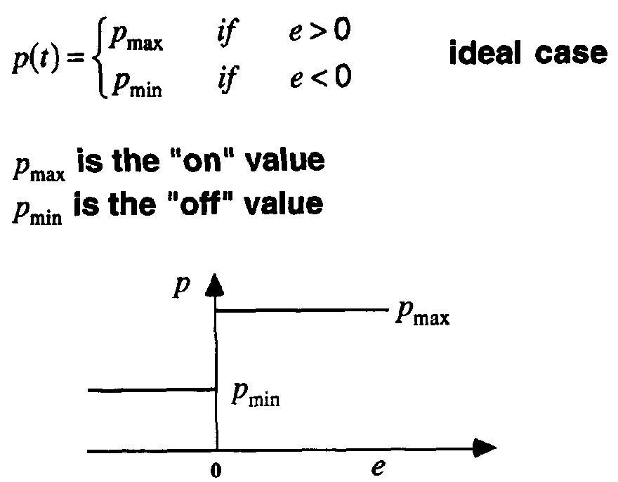
On-Off Controllers
Synonyms:
“two-position” or “bang-bang” controllers.
Controller output has two possible values.
BITS, PILANI – K. K. BIRLA GOA CAMPUS

Slide 6
Three Mode (PID) Controller
  Proportional
  Integral
  Derivative
Proportional Control
  Define an error signal, e, by e = Y_{sp} – Y_{m}
    where
    Y_{sp} = set point
    Y_{m} = measured value of the controlled variable
    (or equivalent signal from transmitter)
BITS, PILANI – K. K. BIRLA GOA CAMPUS

Slide 7
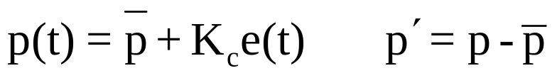

Since signals are time varying,
    e(t) = Y_{sp}(t) - Y_{m} (t)
  For proportional control:
  where,
  p(t) = controller output
  = bias value (adjustable)
  K_{c} = controller gain (dimensionless, adjustable)
BITS, PILANI – K. K. BIRLA GOA CAMPUS

Slide 8
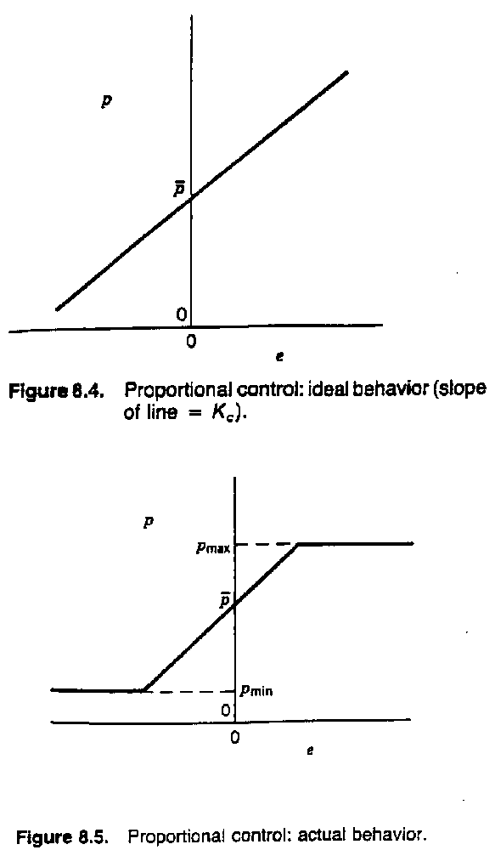
Standards (ISO/ISA)
3 – 15 psi
4 - 20 ma
0 – 5 V (DC)
BITS, PILANI – K. K. BIRLA GOA CAMPUS

Slide 9
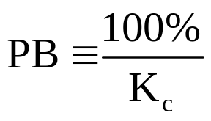


Proportional Band, PB
Reverse or Direct Acting Controller
      K_{c} can be made positive or negative
      Recall for proportional FB control:
    or
Direct-Acting (K_{c} < 0)
“output increases as input increases"
p(t) Y_{m}(t)
Reverse-Acting (K_{c} > 0)
“output increases as input decreases"
BITS, PILANI – K. K. BIRLA GOA CAMPUS

Slide 10
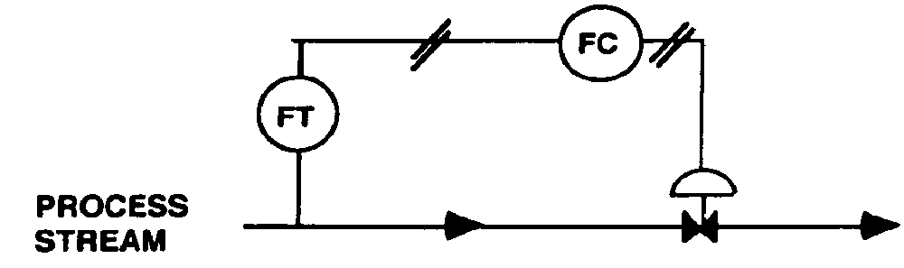
Example 2: Flow Control Loop
Assume FT is direct-acting. Select sign of K_{c} so that K_{c}K_{v} > 0
1.) Air-to-open (fail close) valve ==> ?
2.) Air-to-close (fail open) valve ==> ?
BITS, PILANI – K. K. BIRLA GOA CAMPUS

Slide 11



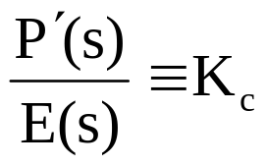
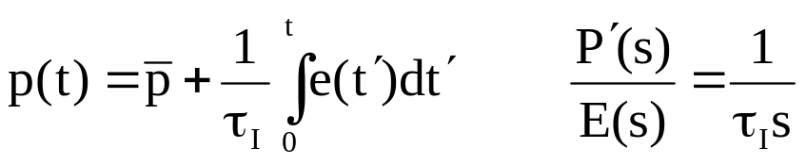
Transfer Function for Proportional Control:
Let
Then controller input/output relation can written as
Take Laplace transform of each side,
or
INTEGRAL CONTROL ACTION
Synonyms: "reset", "floating control"
τ_{I} ≡ reset time (or integral time) - adjustable
BITS, PILANI – K. K. BIRLA GOA CAMPUS

Slide 12
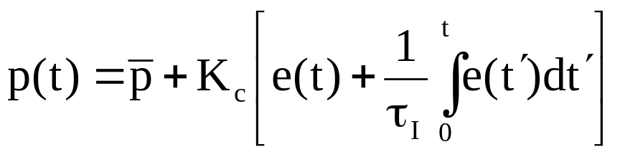
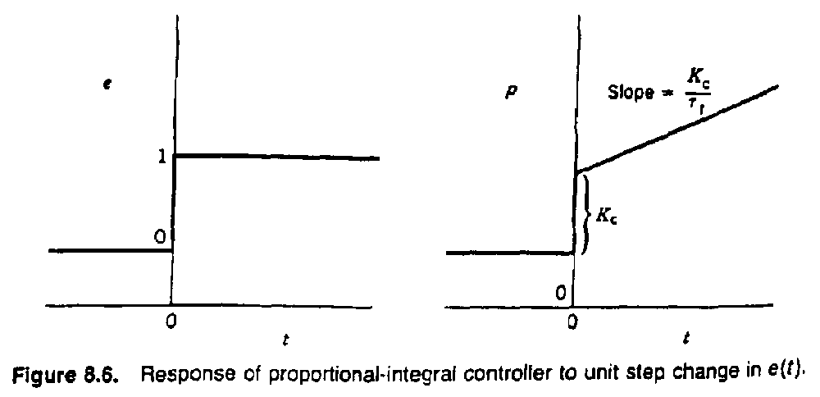
Proportional-Integral (PI) Control
integral provides memory of e
most popular controller
Response to unit step change in e:
BITS, PILANI – K. K. BIRLA GOA CAMPUS

Slide 13
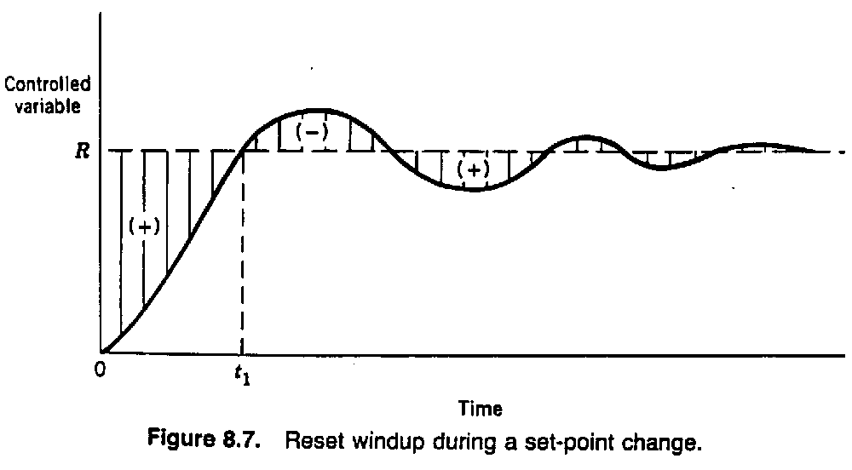
Integral action eliminates steady-state error
(i.e., offset) Why??? e ≠ 0 ⇒ p is changing with
time until e = 0, where p reaches steady state.
BITS, PILANI – K. K. BIRLA GOA CAMPUS

Slide 14

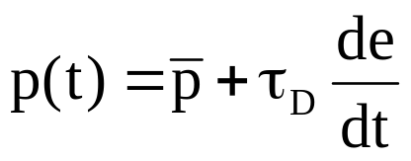
Some controllers are calibrated in 1/τ_{I}
("repeats per minute") instead of τ_{I} .
For PI controllers,
is not adjustable.
Derivative Control Action
Ideal derivative action
Used to improve dynamic response of the
controlled variable
Derivative kick (use -dy_{m}/dt )
Use alone?
BITS, PILANI – K. K. BIRLA GOA CAMPUS

Slide 15
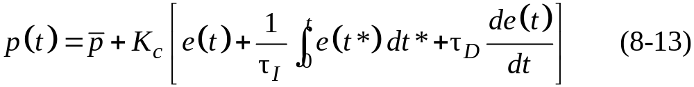
Proportional-Integral-Derivative (PID) Control
Now we consider the combination of the proportional, integral, and derivative control modes as a PID controller.
Many variations of PID control are used in practice.
Next, we consider the three most common forms.
Parallel Form of PID Control
The parallel form of the PID control algorithm (without a derivative filter) is given by
BITS, PILANI – K. K. BIRLA GOA CAMPUS

Slide 16
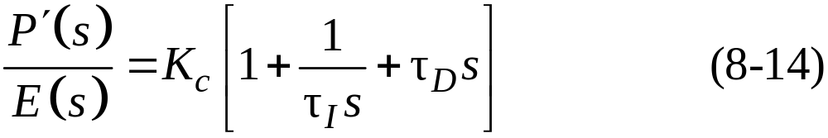
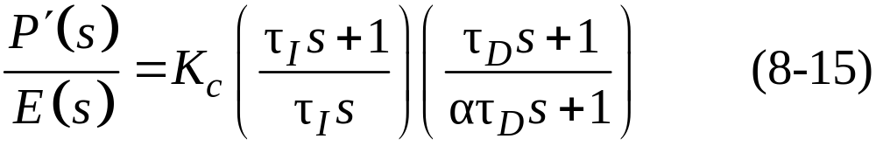
The corresponding transfer function is:
Series Form of PID Control
Historically, it was convenient to construct early analog controllers (both electronic and pneumatic) so that a PI element and a PD element operated in series.
Commercial versions of the series-form controller have a derivative filter that is applied to either the derivative term, as in Eq. 8-12, or to the PD term, as in Eq. 8-15:
BITS, PILANI – K. K. BIRLA GOA CAMPUS

Slide 17
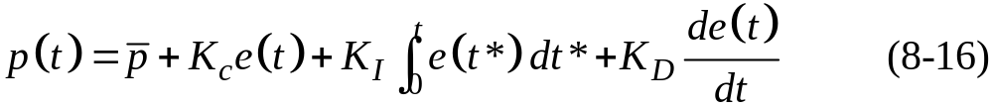
Expanded Form of PID Control
In addition to the well-known series and parallel forms, the expanded form of PID control in Eq. 8-16 is sometimes used:
Features of PID Controllers
Elimination of Derivative and Proportional Kick
One disadvantage of the previous PID controllers is that a sudden change in set point (and hence the error, e) will cause the derivative term momentarily to become very large and thus provide a derivative kick to the final control element.
BITS, PILANI – K. K. BIRLA GOA CAMPUS

Slide 18
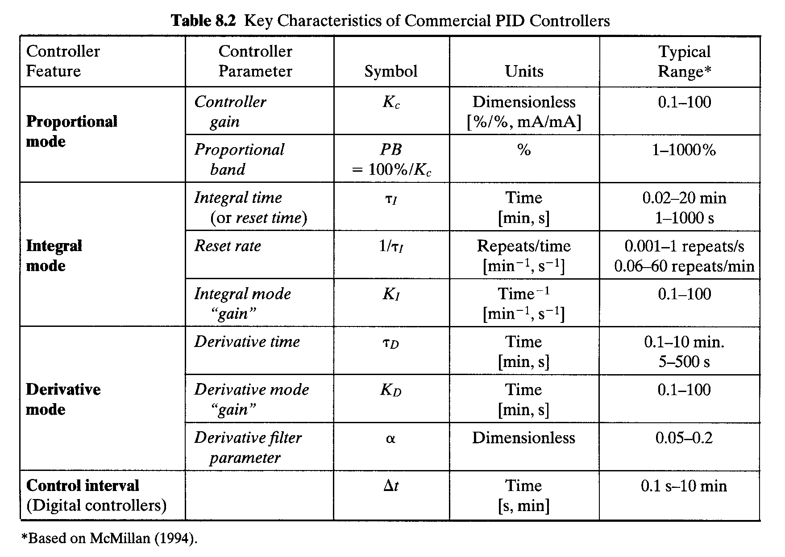
BITS, PILANI – K. K. BIRLA GOA CAMPUS

Slide 19
Automatic and Manual Control Modes
Automatic Mode
  Controller output, p(t), depends on e(t), controller
  constants, and type of controller used.
  ( PI vs. PID etc.)
Manual Mode
Controller output, p(t), is adjusted manually.
Manual Mode is very useful when unusual
conditions exist:
      plant start-up
      plant shut-down
      emergencies
Percentage of controllers "on manual” ??
(30% in 2001, Honeywell survey)
BITS, PILANI – K. K. BIRLA GOA CAMPUS

Slide 20
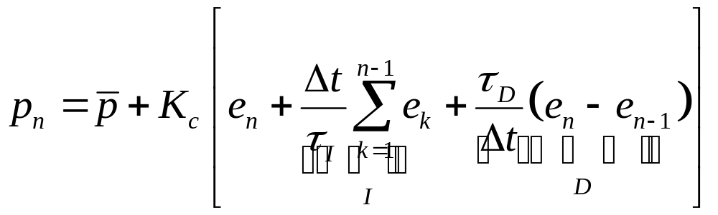
Digital PID Controller
finite difference approximation
where,
    = the sampling period (the time between
    successive samples of the controlled variable)
    = controller output at the nth sampling
    instant, n=1,2,…
    = error at the nth sampling unit
velocity form - see Equation (8-19)
    (Δp_{n})- incremental change
BITS, PILANI – K. K. BIRLA GOA CAMPUS

Slide 21
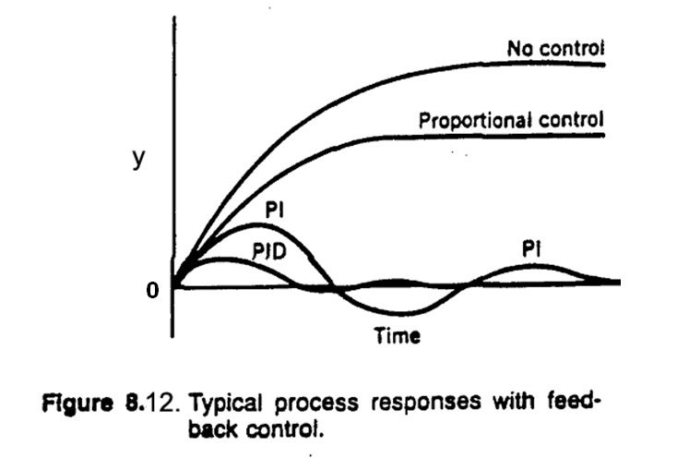
Typical Response of Feedback Control Systems
  Consider response of a controlled system after a
  sustained disturbance occurs (e.g., step change in
  disturbance variable); y > 0 is off-spec.
BITS, PILANI – K. K. BIRLA GOA CAMPUS

Slide 22
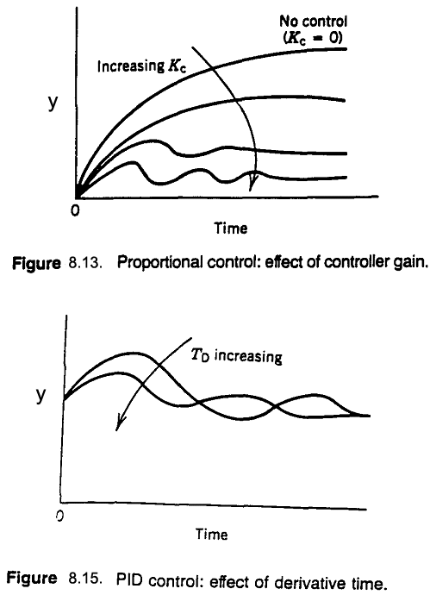
BITS, PILANI – K. K. BIRLA GOA CAMPUS

Slide 23
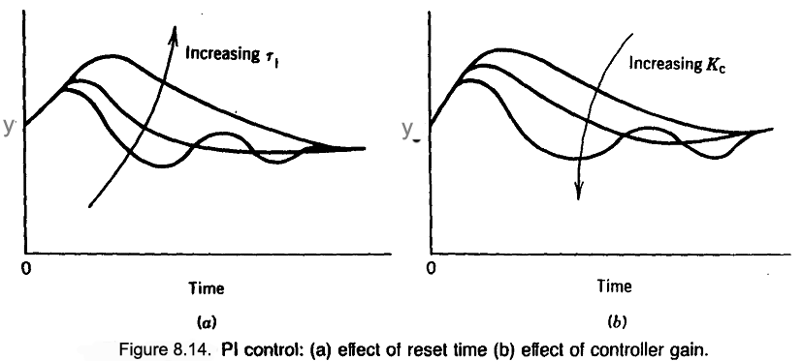
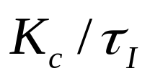
integral action ~
BITS, PILANI – K. K. BIRLA GOA CAMPUS

Slide 24
Summary of the Characteristics of the Most Commonly Used Controller Modes
  1. Two Position:
  Inexpensive.
  Extremely simple.
  2. Proportional:
  Simple.
  Inherently stable when properly tuned.
  Easy to tune.
  Experiences offset at steady state. (OK for level control)
  3. Proportional plus integral:
  No offset.
  Better dynamic response than reset alone.
  Possibilities exist for instability due to lag
  introduced.
BITS, PILANI – K. K. BIRLA GOA CAMPUS

Slide 25
  4. Proportional plus derivative:
  Stable.
  Less offset than proportional alone (use of
  higher gain possible).
  Reduces lags, i.e., more rapid response.
  5. Proportional plus integral plus derivative:
  Most complex
  Rapid response
  No offset.
  Best control if properly tuned.
BITS, PILANI – K. K. BIRLA GOA CAMPUS

Slide 26
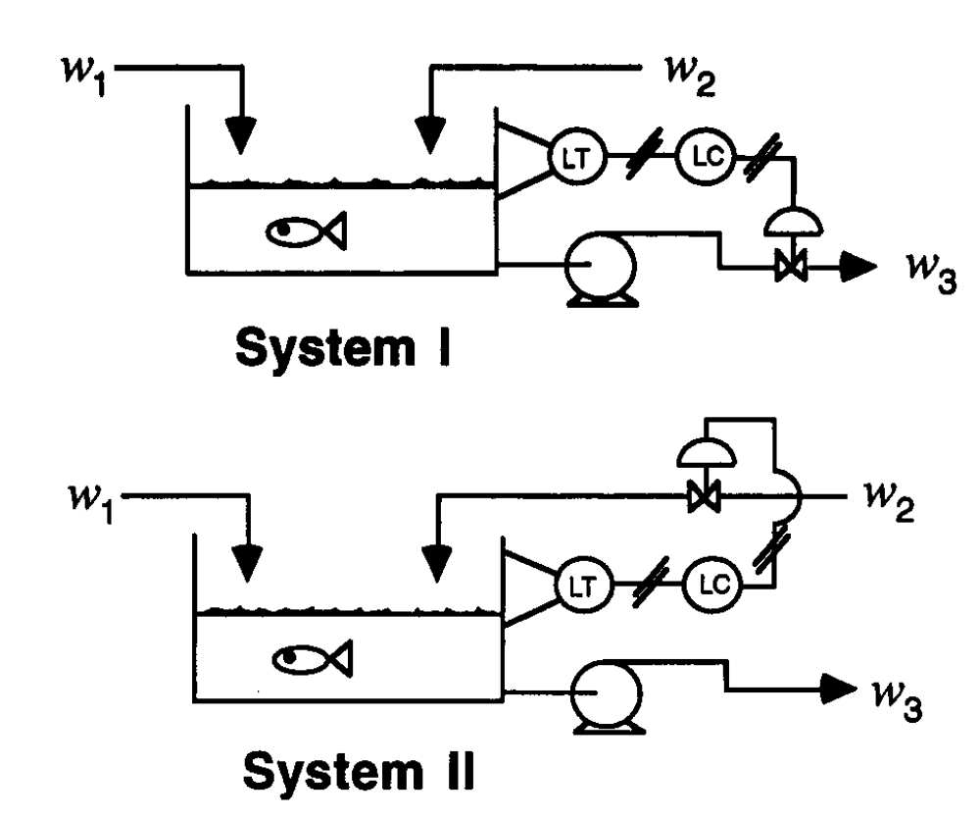
Example 3: Liquid Level Control
  Control valves are air-to-open
  Level transmitters are direct acting
BITS, PILANI – K. K. BIRLA GOA CAMPUS

Slide 27
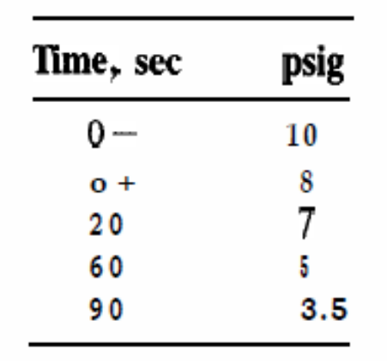
Example: 1
A pneumatic PI controller has an output pressure of 10 psi when the set point and pen point are together. The set point and pen point are suddenly displaced by 0.5 in. (i.e., a step change in error is introduced) and the following data are obtained:
What is the values of the controller parameters of the PI controller?
BITS, PILANI – K. K. BIRLA GOA CAMPUS

Slide 28
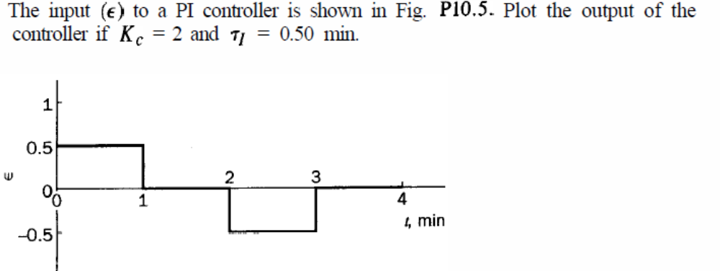
Example:2
BITS, PILANI – K. K. BIRLA GOA CAMPUS

Slide 29
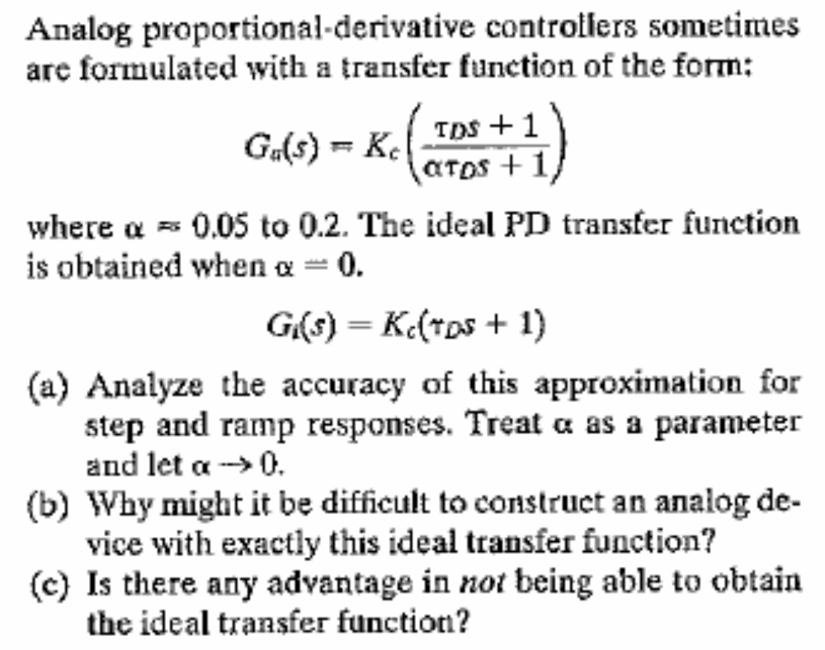
Example:8.1
BITS, PILANI – K. K. BIRLA GOA CAMPUS

Slide 30
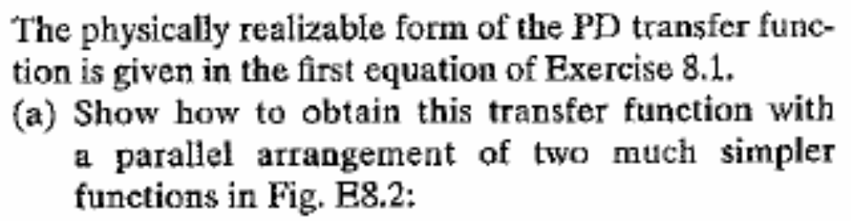
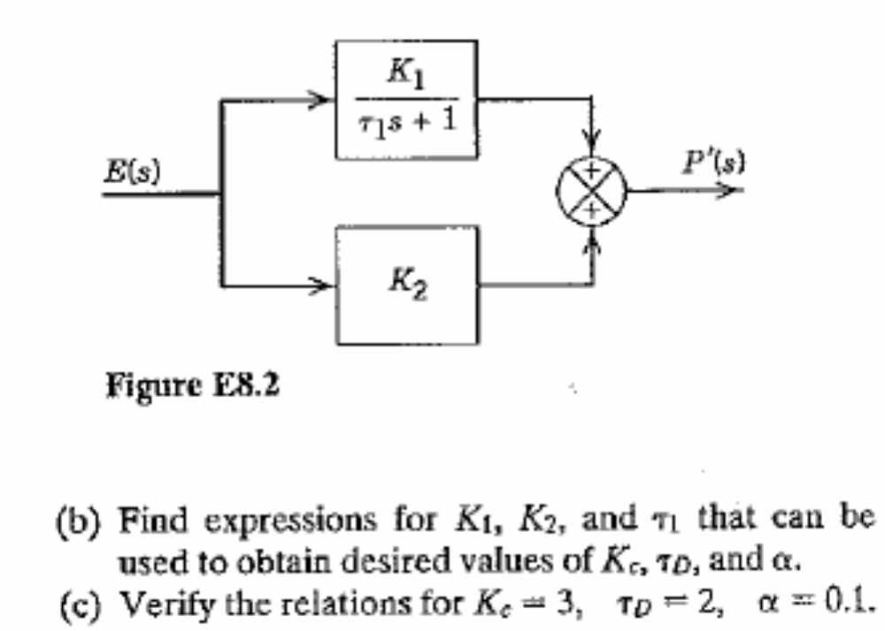
Example:8.2
BITS, PILANI – K. K. BIRLA GOA CAMPUS

Slide 31
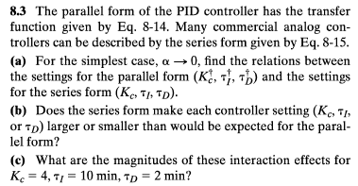

Example:8.3
BITS, PILANI – K. K. BIRLA GOA CAMPUS

Slide 32
Thanks
BITS, PILANI – K. K. BIRLA GOA CAMPUS

