Slide 1
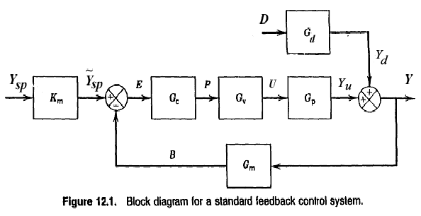
Controller Design Based on Transient Response Criteria
Chapter 12

Slide 2
Desirable Controller Features
0. Stable
1. Quick responding
2. Adequate disturbance rejection
3. Insensitive to model, measurement errors
4. Avoids excessive controller action
5. Suitable over a wide range of operating conditions
Impossible to satisfy all 5 unless self-tuning. Use
“optimum sloppiness"
Chapter 12

Slide 3
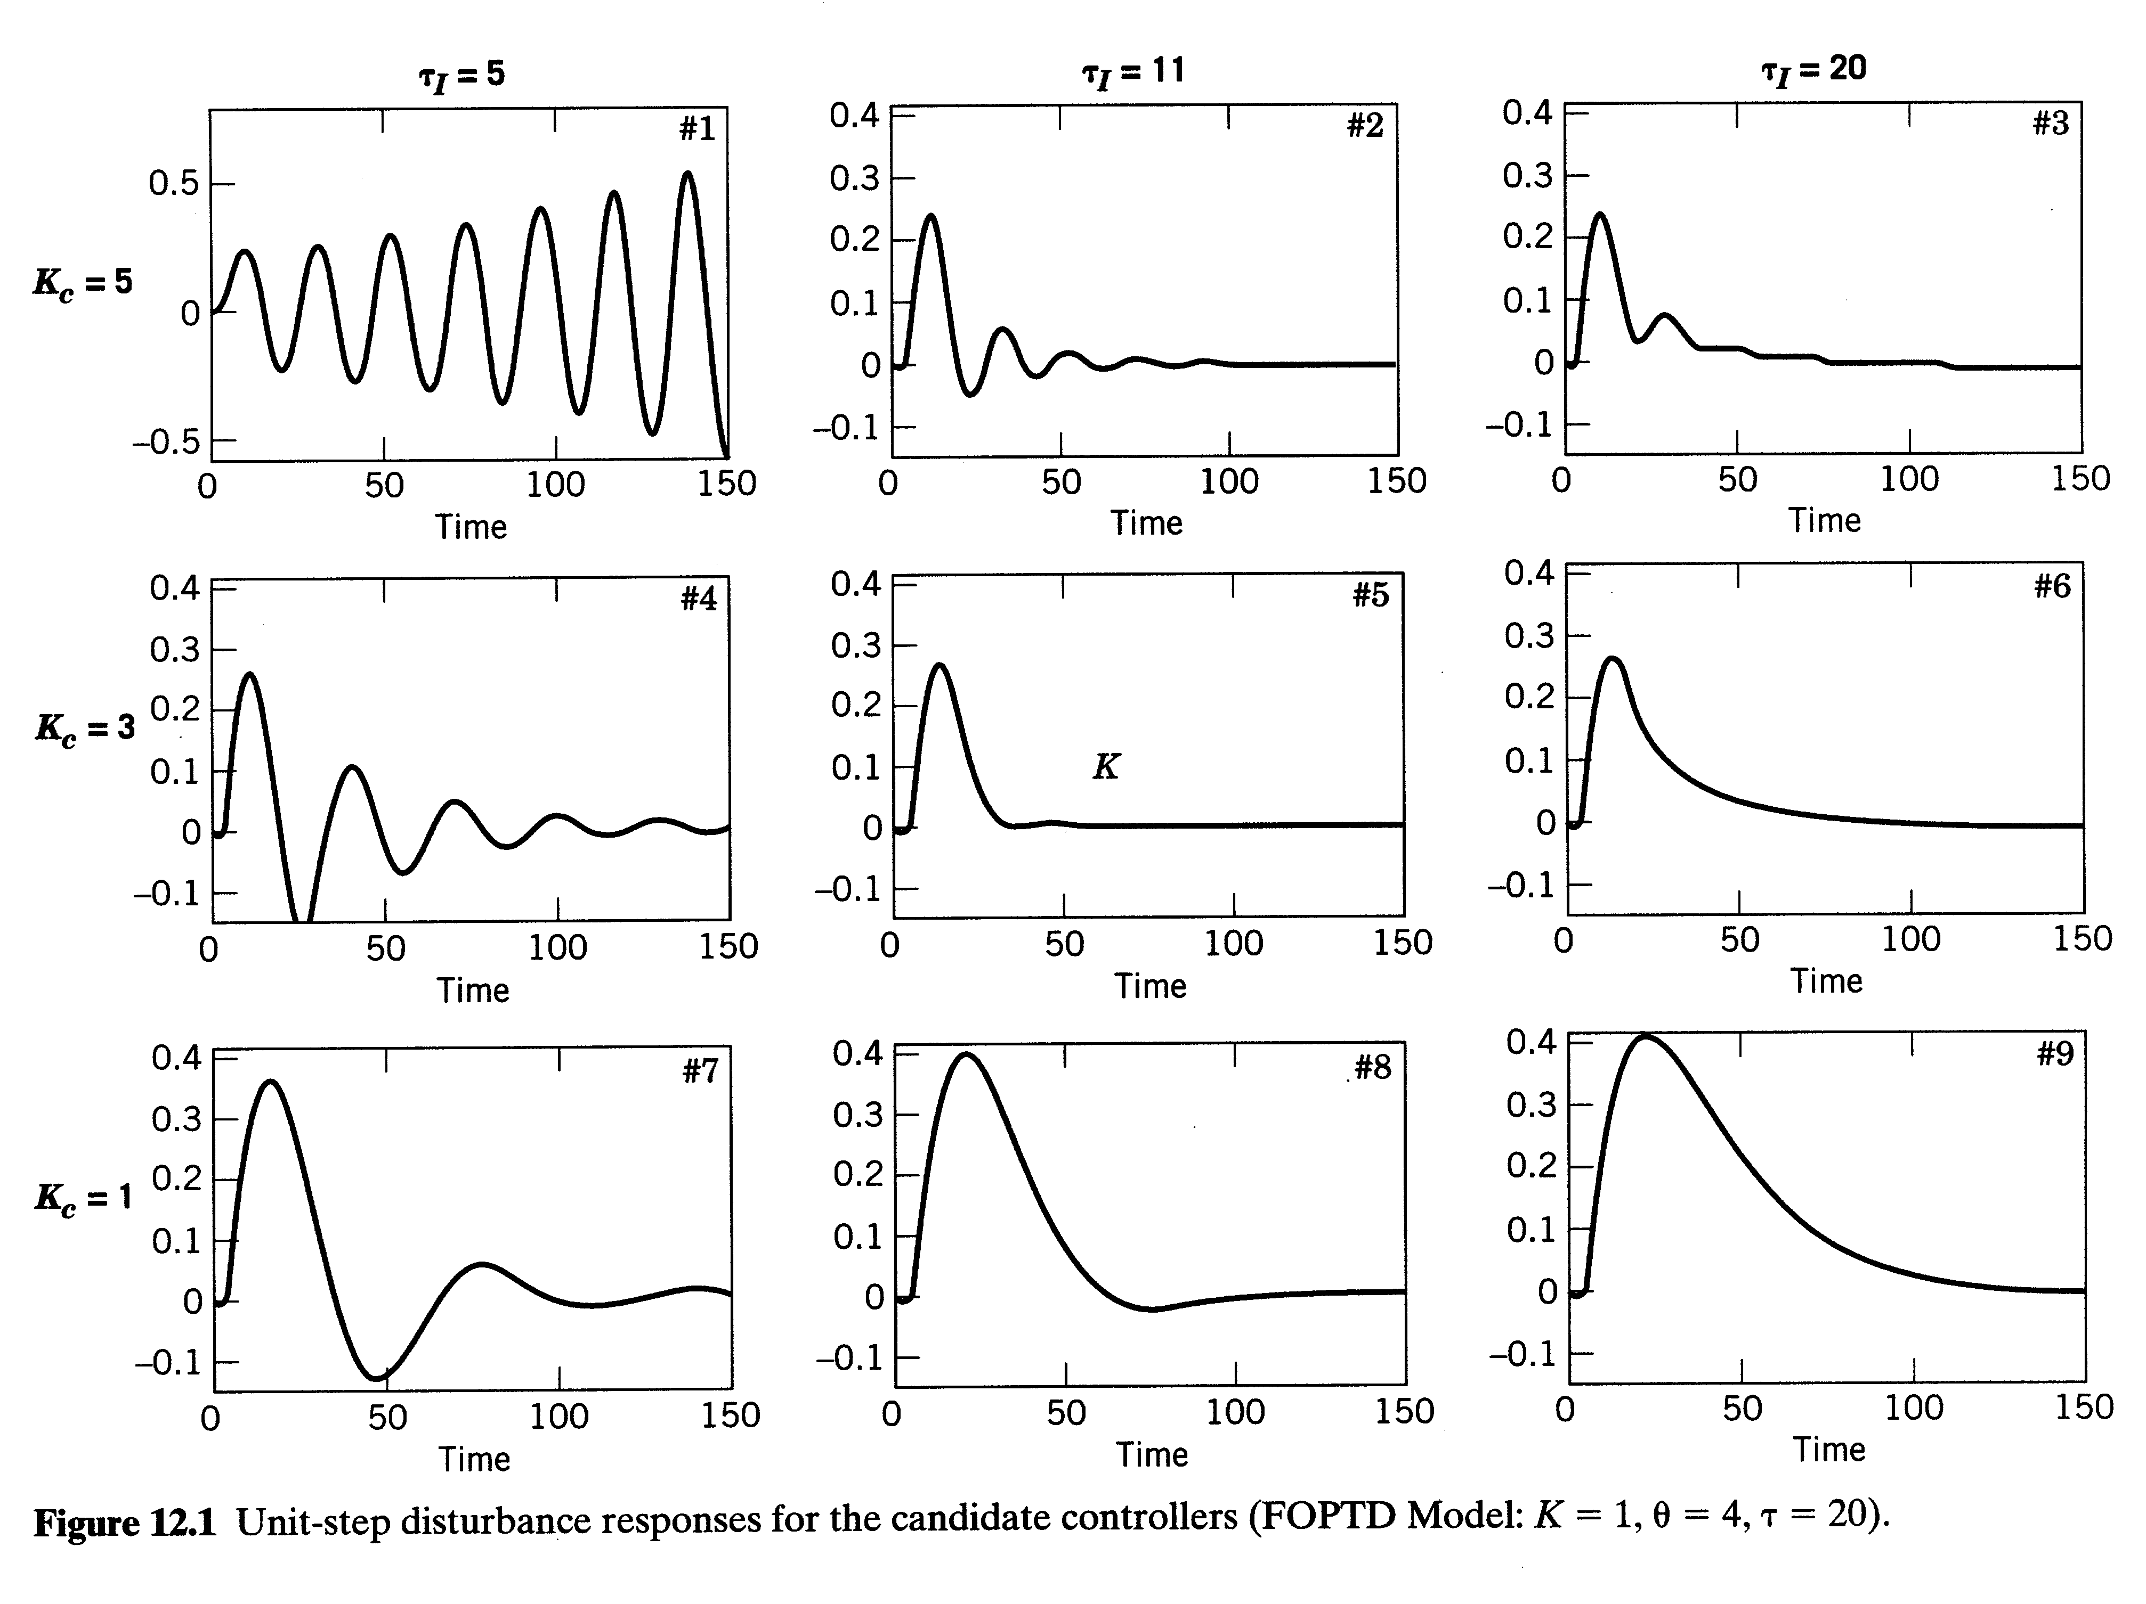
Chapter 12

Slide 4
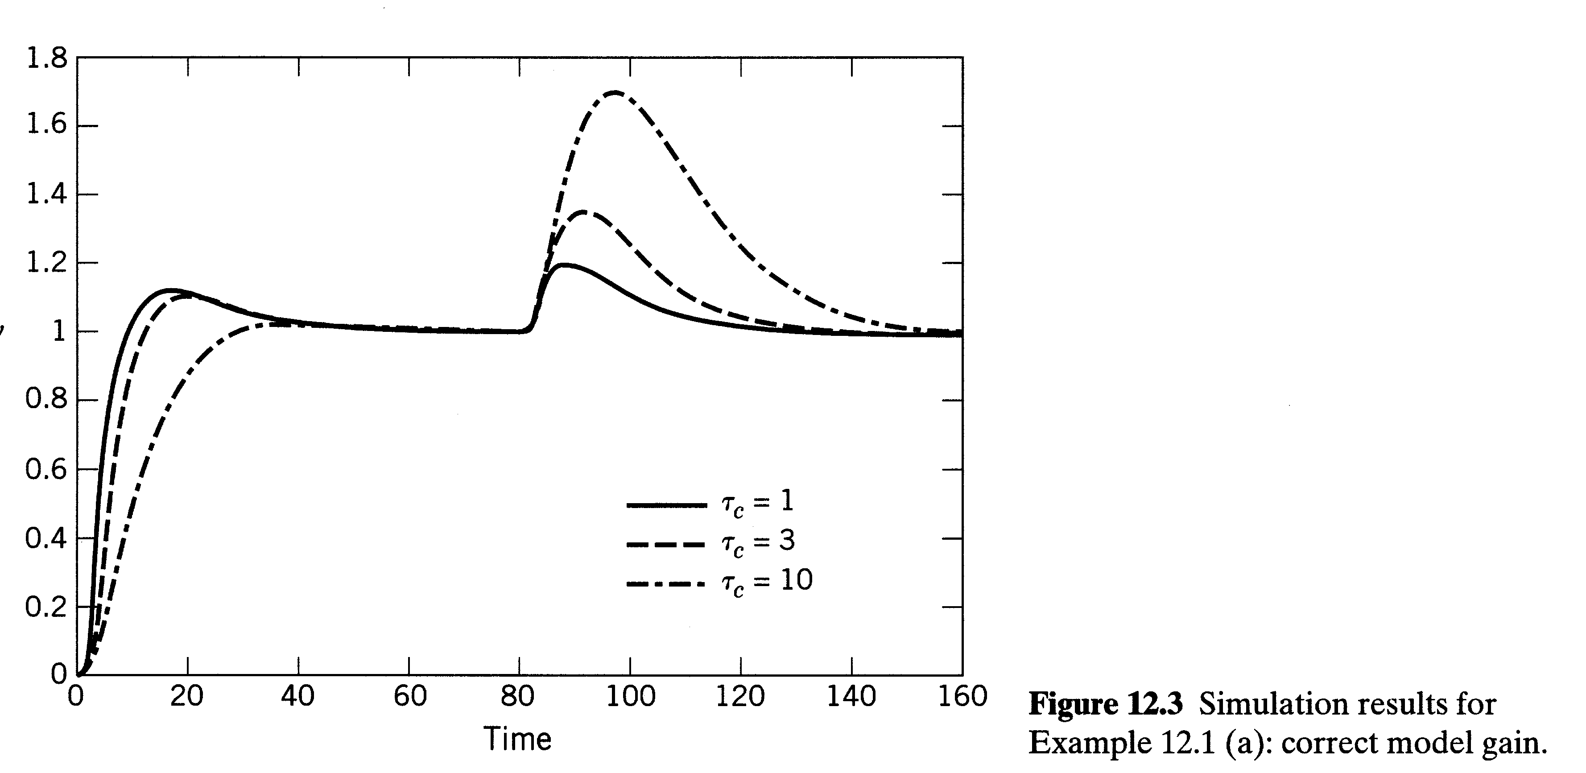
Chapter 12

Slide 5
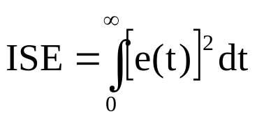
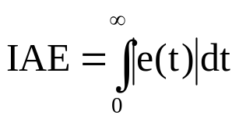
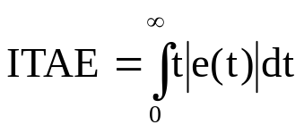
Approach (b)
1. Integral of square error (ISE)
2. Integral of absolute value of error (IAE)
3. Time-weighted IAE
Pick controller parameters to minimize integral.
IAE allows larger deviation than ISE (smaller overshoots)
ISE longer settling time
ITAE weights errors occurring later more heavily
Approximate optimum tuning parameters are correlated
with K, θ, τ (Table 12.3).
Chapter 12

Slide 6
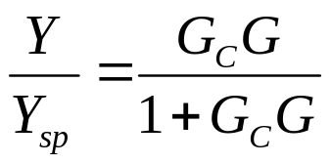
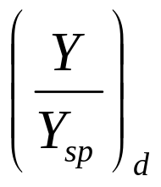
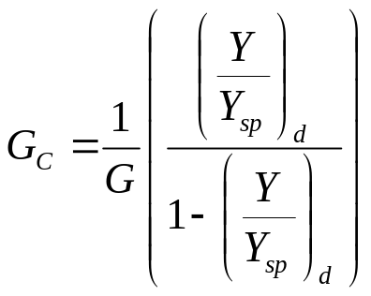
Direct Synthesis
( G includes G_{m}, G_{v})
1. Specify closed-loop response (transfer function)
Chapter 12
2. Need process model, G (= G_{P}G_{M}G_{V})
3. Solve for G_{c},

Slide 7
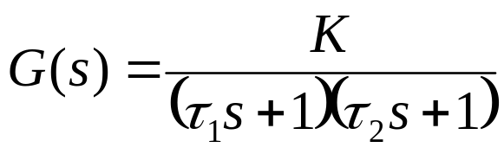
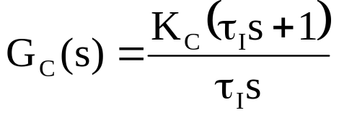
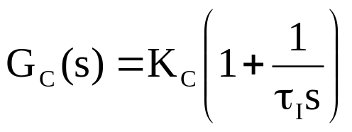
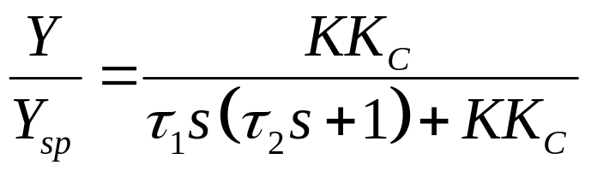
Example: Second Order Process with PI Controller Can Yield Second Order Closed-loop Response
Chapter 12
or
PI:
Let τ_{Ι} = τ₁, where τ₁ > τ₂
Canceling terms,
Check gain (s = 0)

Slide 8
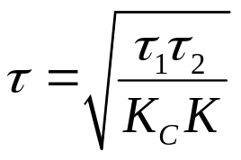
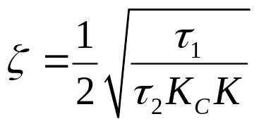

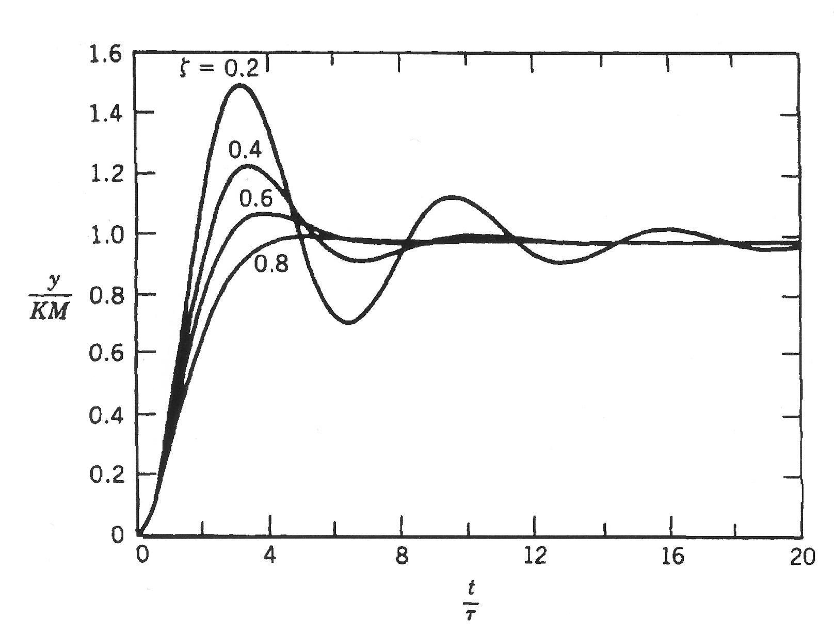
2nd order response with...
and
Select K_{c} to give
(overshoot)
Chapter 12
Figure 5.8. Step response of underdamped second-order processes.

Slide 9
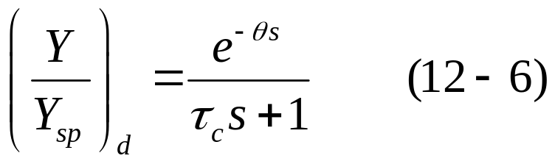
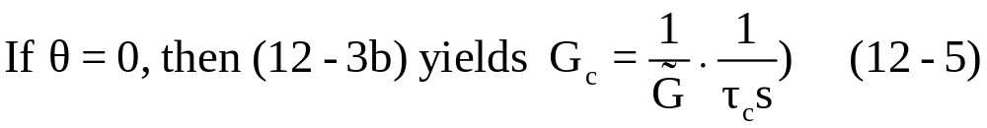
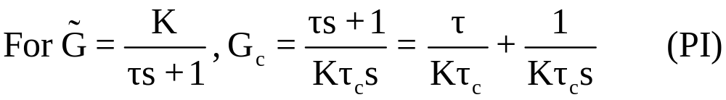
Specify Closed – Loop Transfer Function
(first – order response, no offset)
But other variations of (12-6) can be used (e.g., replace time delay
with polynomial approximation)

Slide 10
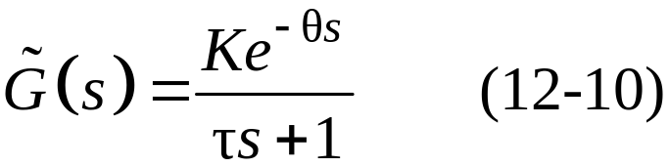


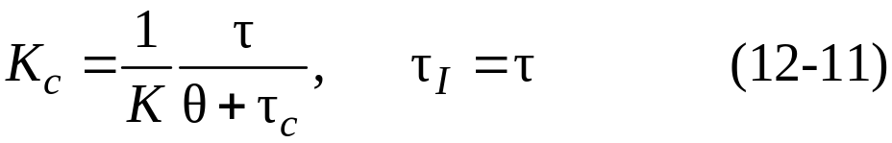
Deviation of PI Controller for FOPTD Process
Consider the standard first-order-plus-time-delay model,
Chapter 12
Specify closed-loop response as FOPTD (12-6), but
approximate
Substituting and rearranging gives a PI controller,
with the following controller settings:

Slide 11
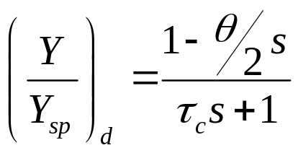
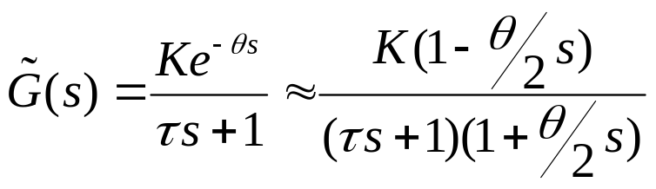
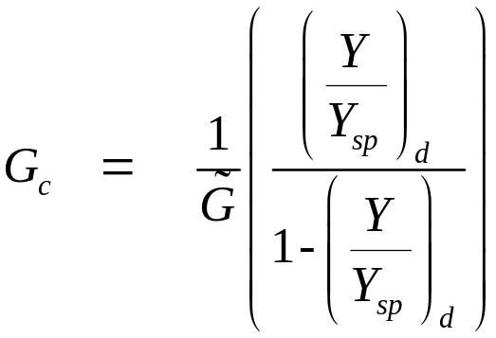
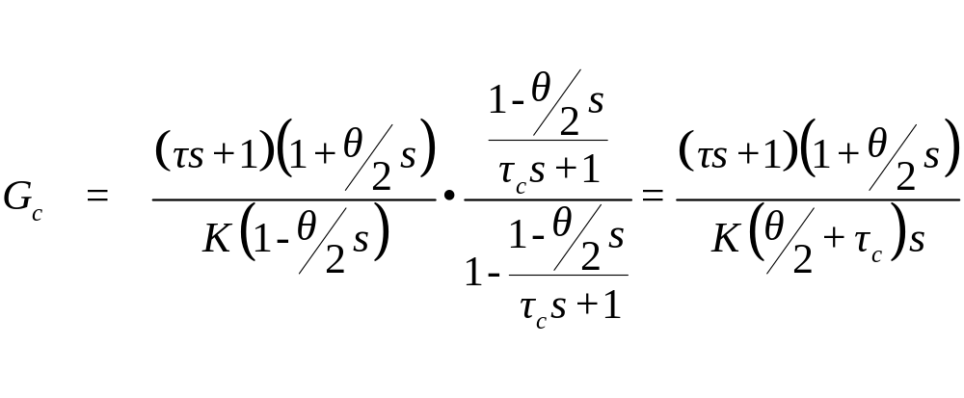
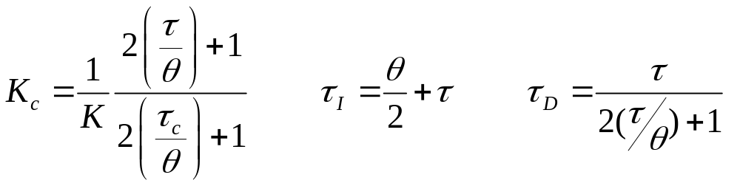
Derivation of PID Controller for FOPTD Process:
let
(12-3b)
Chapter 12
(12-2a)
(12-30)

Slide 12
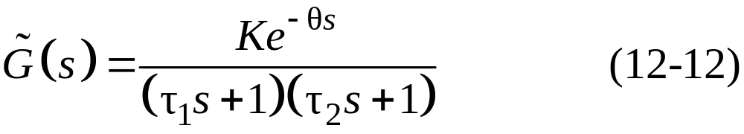
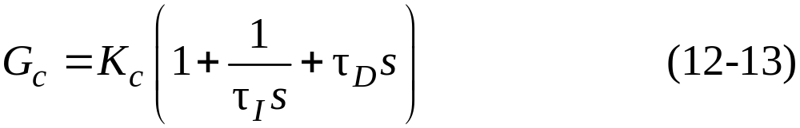
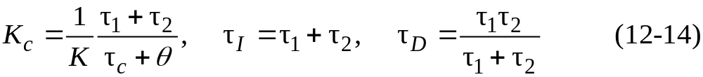
Second-Order-plus-Time-Delay (SOPTD) Model
Consider a second-order-plus-time-delay model,
Use of FOPTD closed-loop response (12-6) and time delay approximation gives a PID controller in parallel form,
Chapter 12
where

Slide 13
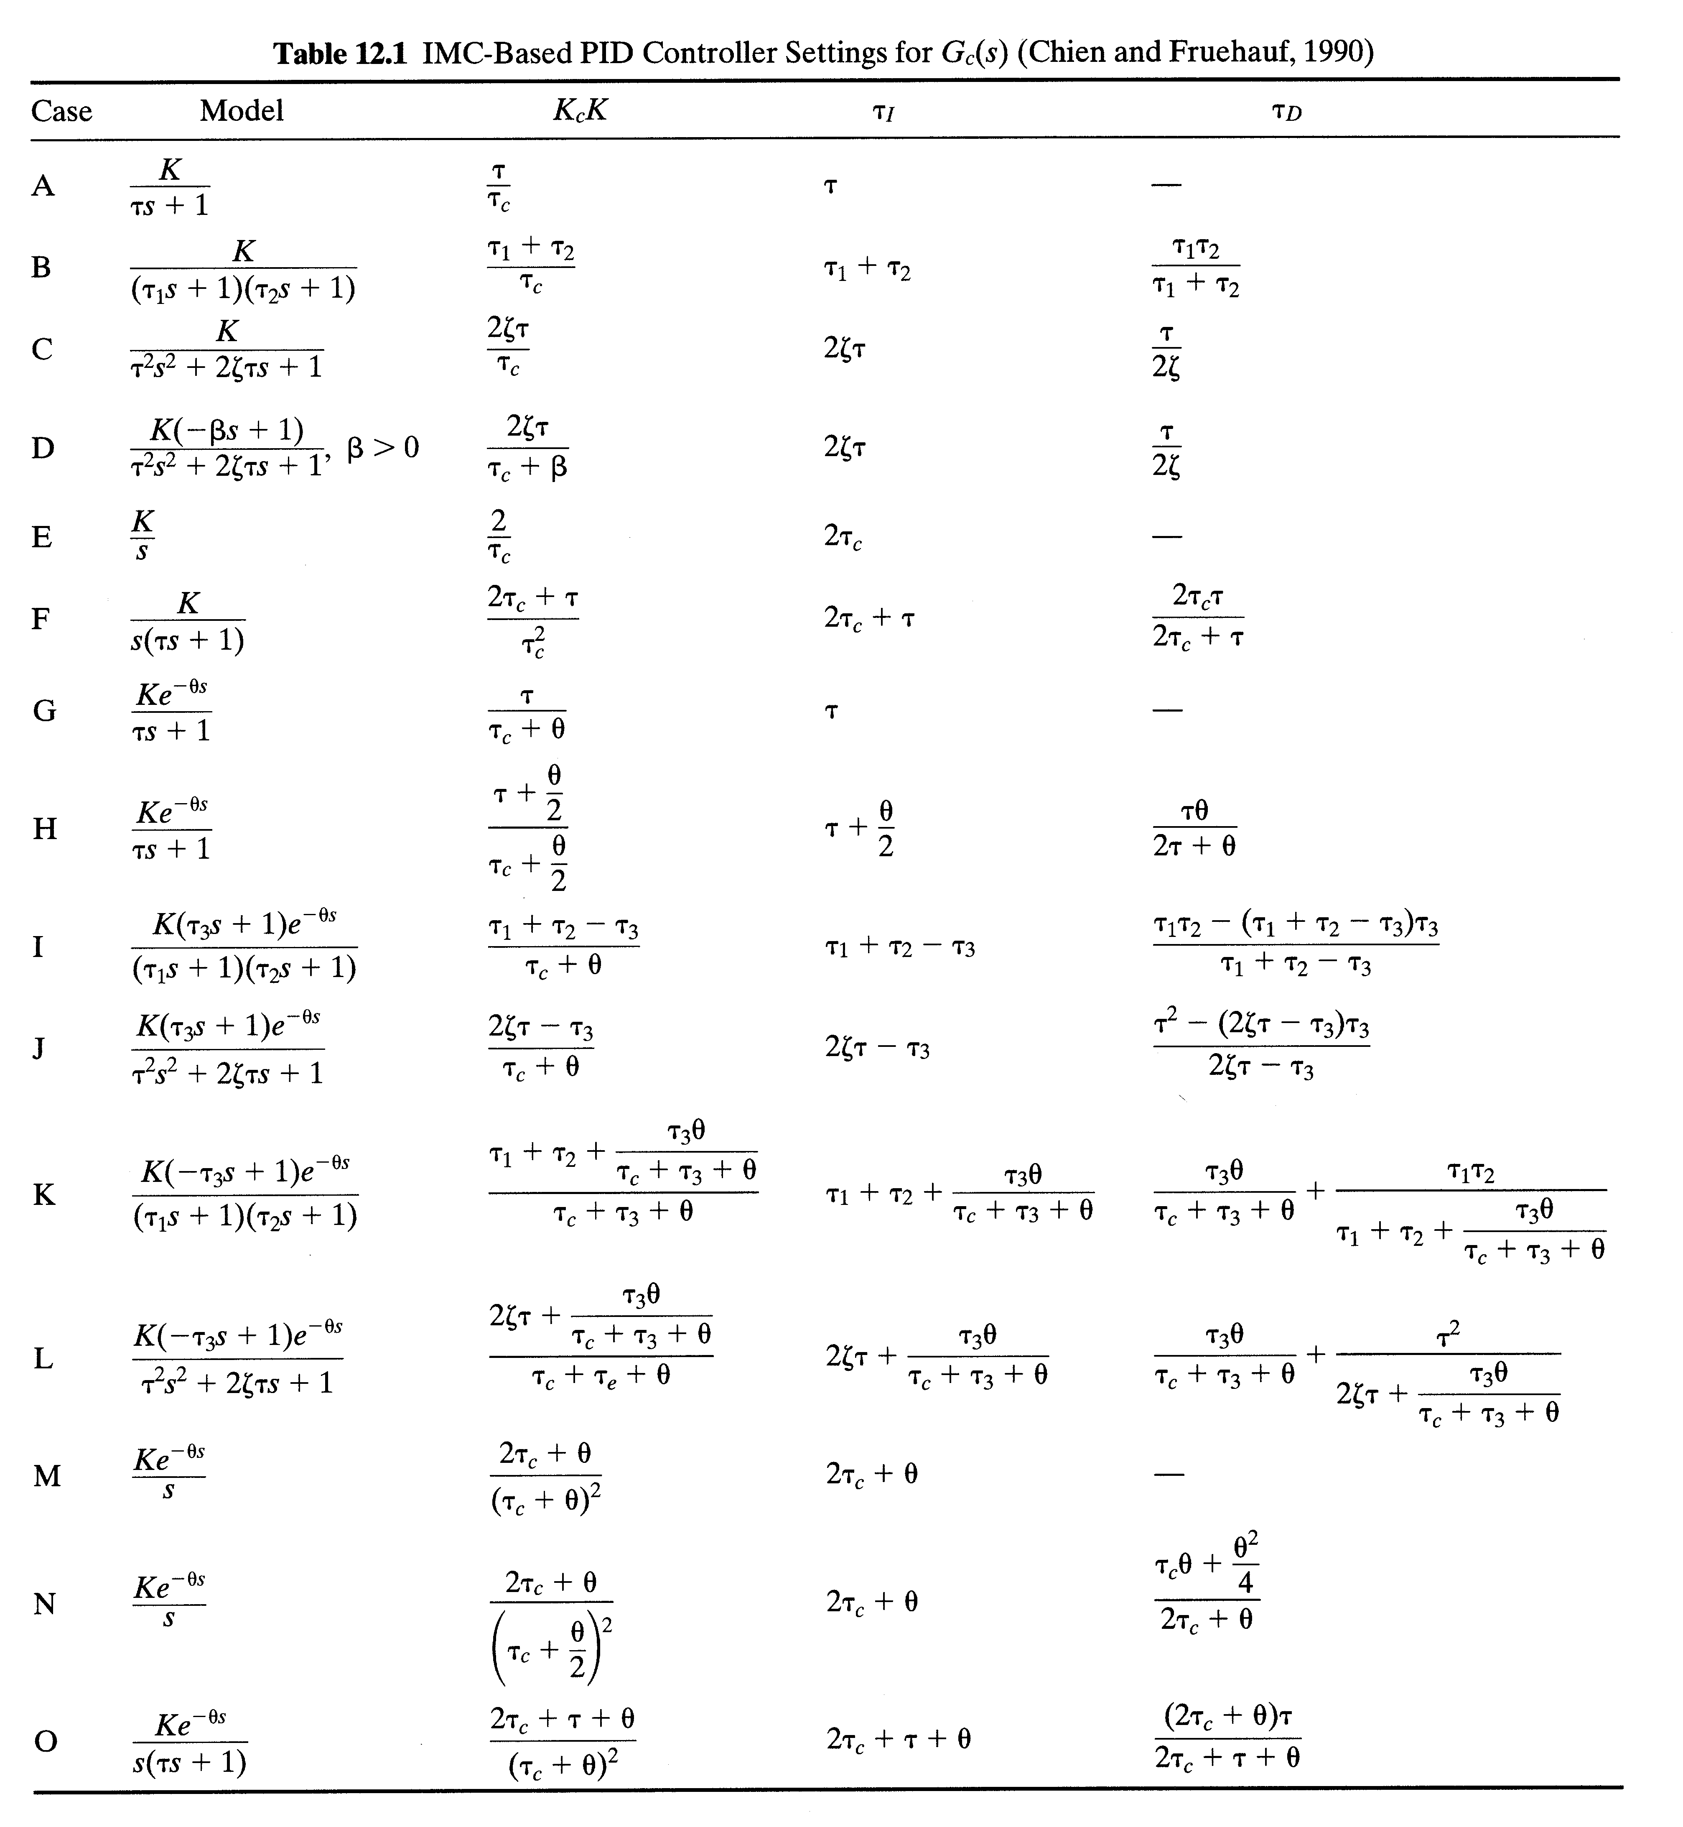
Chapter 12

Slide 14
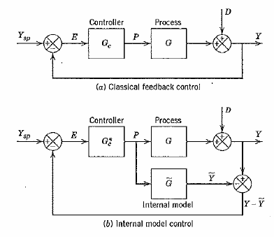
Internal Model Control
Chapter 12

Slide 15
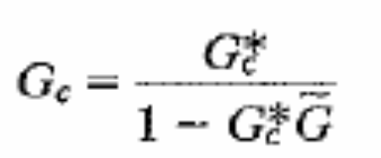
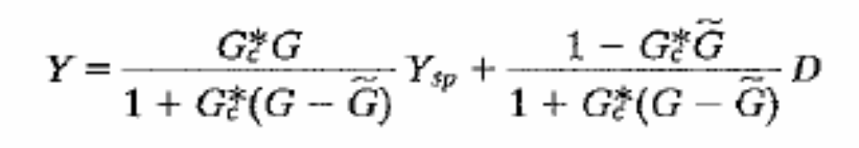
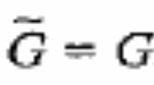
Two block diagram will identical when
The closed loop relation for the feed back controller :
Chapter 12
For special case where

Slide 16
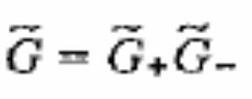

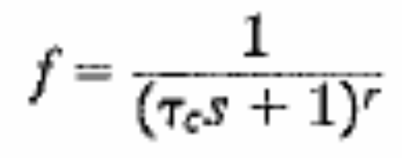
Design Procedures:
STEP 1: The process model is factored
Where represents any time lag and right half plane zero’s
STEP 2: The controller is specified as
Where f is the low pass filter with steady state gain of one and is given by
r is positive integer usually
taken as one
Chapter 12

Slide 17
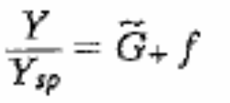
For special case where
Closed loop transfer function for set point change is:
Chapter 12

Slide 18
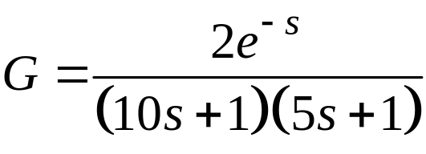



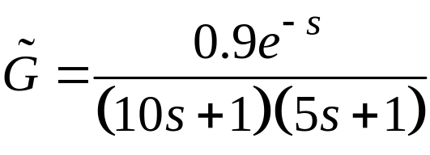
Example 12.1
Use the DS design method to calculate PID controller settings for the process:
Chapter 12
Consider three values of the desired closed-loop time constant: . Evaluate the controllers for unit step changes in both the set point and the disturbance, assuming that G_{d} = G. Perform the evaluation for two cases:
The process model is perfect ( = G).
The model gain is = 0.9, instead of the actual value, K = 2. This model error could cause a robustness problem in the controller for K = 2.

Slide 19



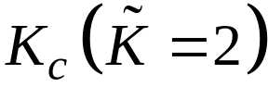
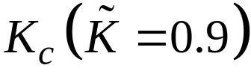


The IMC controller settings for this example are:
 | 3.75 | 1.88 | 0.682
 | 8.33 | 4.17 | 1.51
 | 15 | 15 | 15
 | 3.33 | 3.33 | 3.33
Note only K_{c} is affected by the change in process gain.

Slide 20

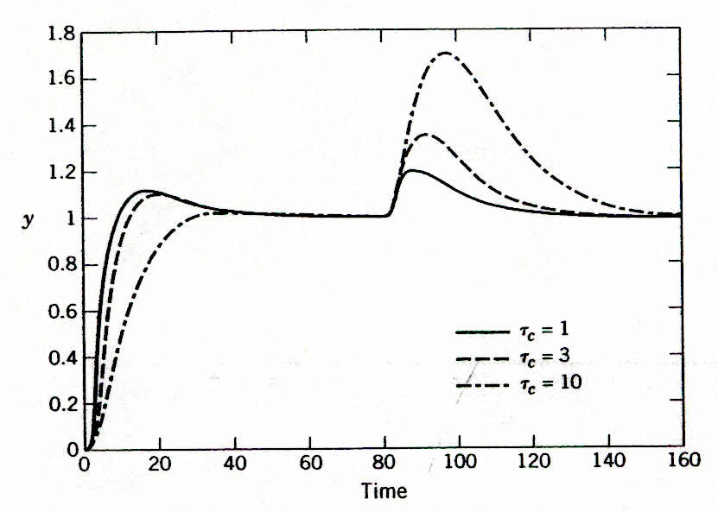
The values of K_{c} decrease as increases, but the values of and do not change, as indicated by Eq. 12-14.
Chapter 12
Figure 12.3 Simulation results for Example 12.1 (a): correct
model gain.

Slide 21
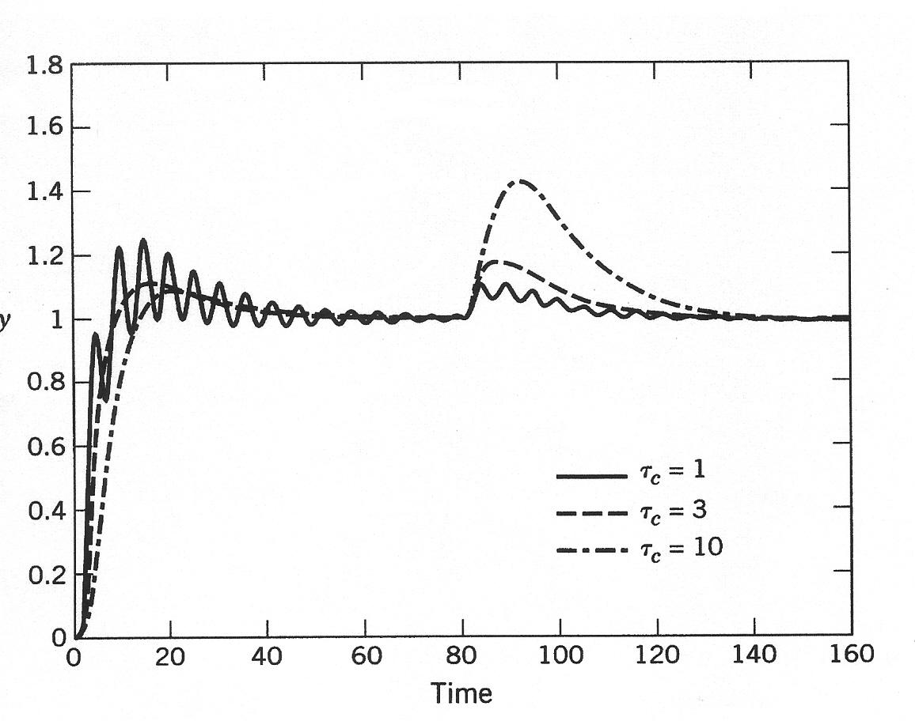
Chapter 12
Figure 12.4 Simulation results for Example 12.1 (b):
incorrect model gain.

Slide 22





Controller Tuning Relations
Model-based design methods such as DS and IMC produce PI or PID controllers for certain classes of process models, with one tuning parameter τ_{c} (see Table 12.1)
How to Select τ_{c}?
Chapter 12
Several IMC guidelines for have been published for the model in Eq. 12-10:
> 0.8 and (Rivera et al., 1986)
(Chien and Fruehauf, 1990)
(Skogestad, 2003)

Slide 23


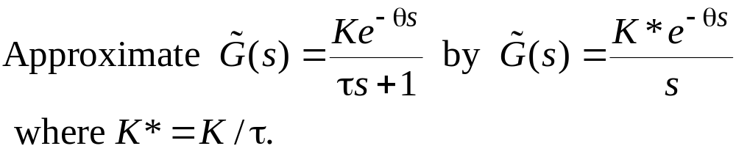
Tuning for Lag-Dominant Models
First- or second-order models with relatively small time delays are referred to as lag-dominant models.
The IMC and DS methods provide satisfactory set-point responses, but very slow disturbance responses, because the value of is very large.
Fortunately, this problem can be solved in three different ways.
Method 1: Integrator Approximation
Chapter 12
Then can use the IMC tuning rules (Rule M or N) to specify the controller settings.

Slide 24
Method 2. Limit the Value of τ_{I}
Skogestad (2003) has proposed limiting the value of :
where τ₁ is the largest time constant (if there are two).
Chapter 12
Method 3. Design the Controller for Disturbances, Rather
Set-point Changes
The desired CLTF is expressed in terms of (Y/D)_{d}, rather than (Y/Y_{sp})_{d}
Reference: Chen & Seborg (2002)

Slide 25

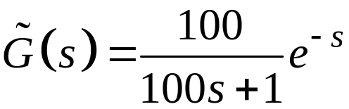


Example 12.4
Consider a lag-dominant model with
Chapter 12
Design three PI controllers:
IMC
IMC based on the integrator approximation in Eq. 12-33
IMC with Skogestad’s modification (Eq. 12-34)

Slide 26

Evaluate the three controllers by comparing their performance for unit step changes in both set point and disturbance. Assume that the model is perfect and that G_{d}(s) = G(s).
Solution
The PI controller settings are:
Chapter 12
Controller | K_{c}
IMC | 0.5 | 100
(b) Integrator approximation | 0.556 | 5
(c) Skogestad | 0.5 | 8

Slide 27
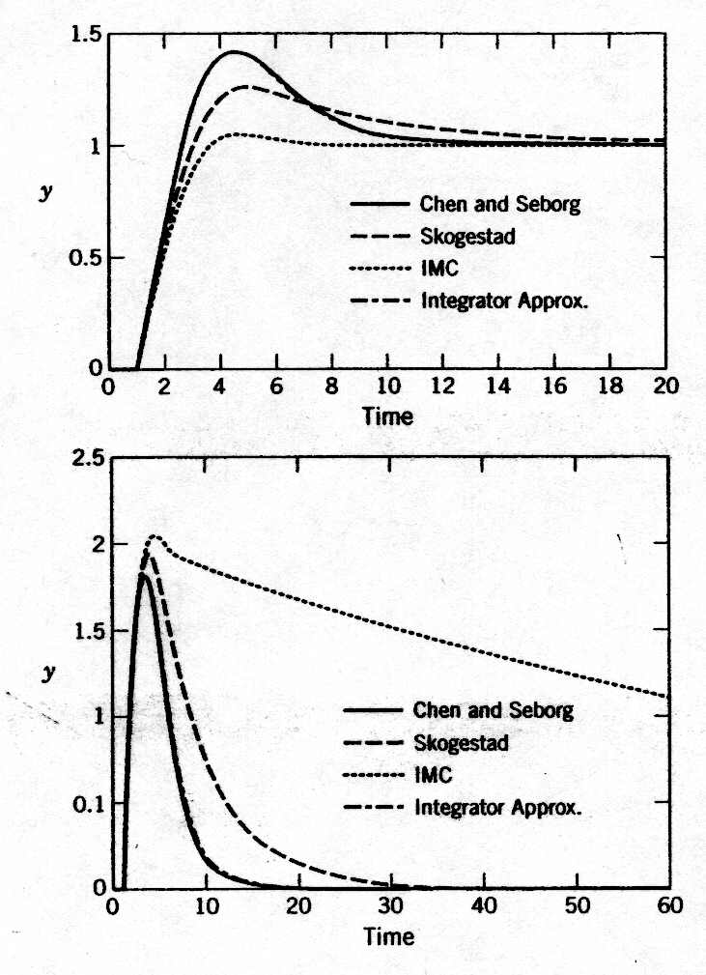
Figure 12.8. Comparison of set-point responses (top) and disturbance responses (bottom) for Example 12.4. The responses for the integrator approximation and Chen and Seborg (discussed in textbook) methods are essentially identical.
Chapter 12

Slide 28
On-Line Controller Tuning
Controller tuning inevitably involves a tradeoff between performance and robustness.
Controller settings do not have to be precisely determined. In general, a small change in a controller setting from its best value (for example, ±10%) has little effect on closed-loop responses.
For most plants, it is not feasible to manually tune each controller. Tuning is usually done by a control specialist (engineer or technician) or by a plant operator. Because each person is typically responsible for 300 to 1000 control loops, it is not feasible to tune every controller.
Diagnostic techniques for monitoring control system performance are available.
Chapter 12

Slide 29
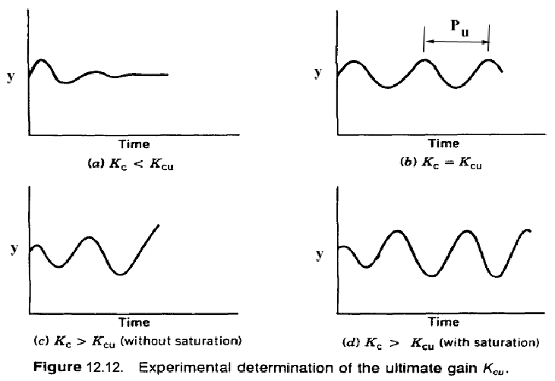
Controller Tuning and Troubleshooting Control Loops
Chapter 12

Slide 30
Ziegler-Nichols Rules:
These well-known tuning rules were published by Z-N in 1942:
controller | K_{c} | τ_{I} | τ_{D}
P PI PID | 0.5 K_{CU} 0.45 K_{CU} 0.6 K_{CU} | - P_{U}/1.2 P_{U}/2 | - - P_{U}/8
Chapter 12
Z-N controller settings are widely considered to be an "industry standard".
Z-N settings were developed to provide 1/4 decay ratio -- too oscillatory?

Slide 31
Modified Z-N settings for PID control
controller | K_{c} | τ_{I} | τ_{D}
original Some overshoot No overshoot | 0.6 K_{CU} 0.33 K_{CU} 0.2 K_{CU} | P_{U}/2 P_{U}/2 P_{U}/3 | P_{U}/8 P_{U}/3 P_{U}/2
Chapter 12

Slide 32
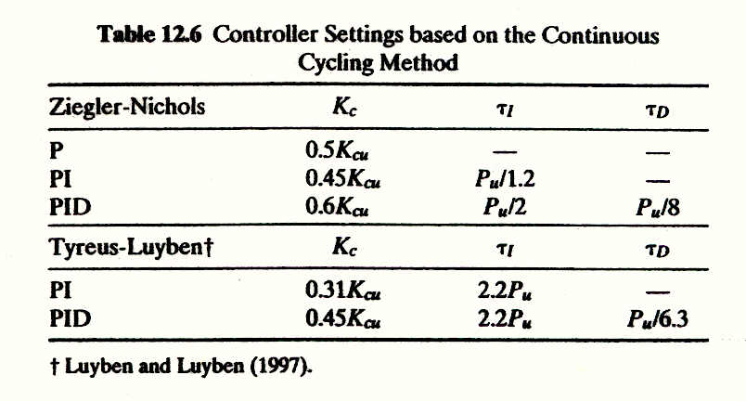
Chapter 12

Slide 33
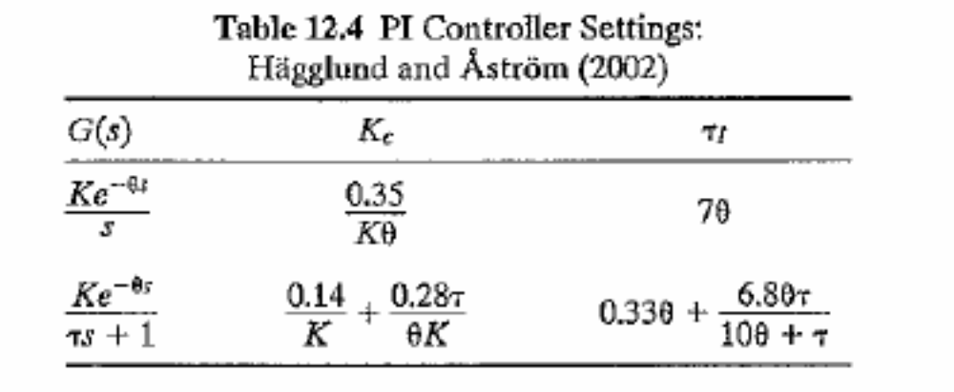
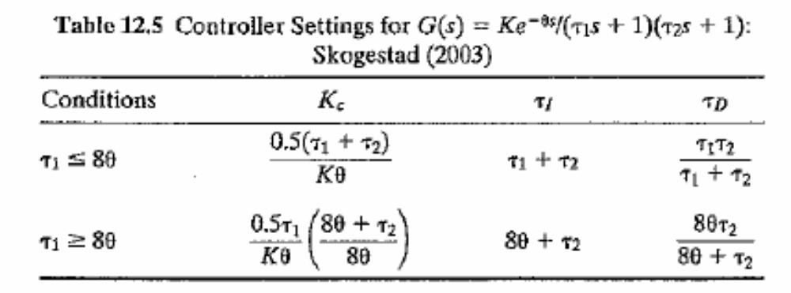
Chapter 12

Slide 34

Chapter 12

Slide 35


Chapter 12

Slide 36

Chapter 12
Figure 12.15 Typical process reaction curves: (a) non-self-regulating process, (b) self-regulating process.

Slide 37

Chapter 12
Figure 12.16 Process reaction curve for Example 12.8.

Slide 38


Chapter 12

Slide 39

Chapter 12
Figure 12.17 Block diagram for Example 12.8.

Slide 40

Example 12.3:
Chapter 12

Slide 41


Slide 42

Example 12.2:
Chapter 12

Slide 43

Chapter 12

Slide 44

Chapter 12

Slide 45

Chapter 12

Slide 46
Chapter 12
Previous chapter
Next chapter

