Slide 1
Controller Design Using Frequency Response Criteria
Advantages of FR Analysis:
1. Applicable to dynamic model of any order
(including non-polynomials).
2. Designer can specify desired closed-loop response
characteristics.
3. Information on stability and sensitivity/robustness is provided.
Disadvantage:
The approach tends to be iterative and hence time-consuming
-- interactive computer graphics desirable (MATLAB)
Chapter 14

Slide 2
Controller Design by Frequency Response
- Stability Margins
Analyze G_{OL}(s) = G_{C}G_{V}G_{P}G_{M} (open loop gain)
Four methods in use:
    (1) Bode plot |G|, φ vs. ω (open loop F.R.)
    (2) Nyquist plot - polar plot of G(j ω)
    (3) Inverse Nyquist plot - polar plot of G⁻¹(j ω)
    (4) Nichols chart |G|, φ vs. G/(1+G) (closed loop F.R.)
Advantages:
    do not need to compute roots of characteristic equation
    can be applied to time delay systems
    can identify stability margin, i.e., how close you are to
    instability.
Chapter 14

Slide 3
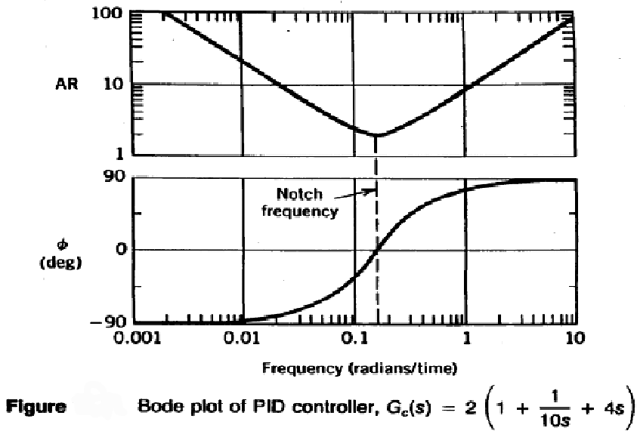
Chapter 14

Slide 4
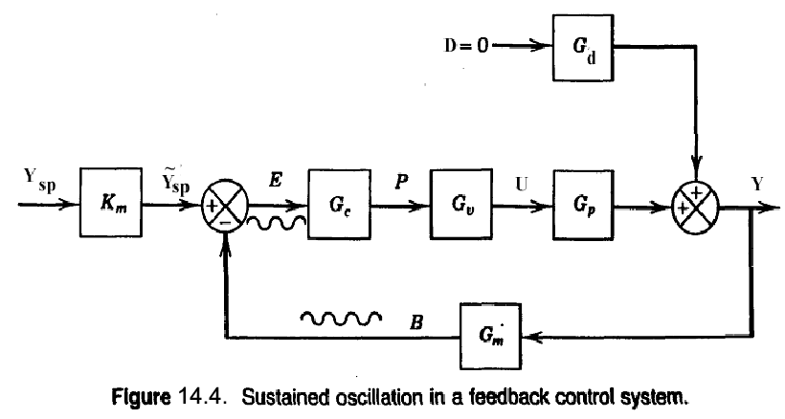
Chapter 14

Slide 5


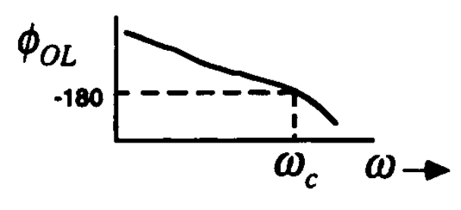
Frequency Response Stability Criteria
Two principal results:
1. Bode Stability Criterion
2. Nyquist Stability Criterion
I) Bode stability criterion
    A closed-loop system is unstable if the FR of the
open-loop T.F. G_{OL}=G_{C}G_{P}G_{V}G_{M}, has an amplitude ratio
greater than one at the critical frequency, . Otherwise
the closed-loop system is stable.
    Note: where the open-loop phase angle
is -180⁰. Thus,
    The Bode Stability Criterion provides info on closed-loop
stability from open-loop FR info.
    Physical Analogy: Pushing a child on a swing or
    bouncing a ball.
Chapter 14

Slide 6
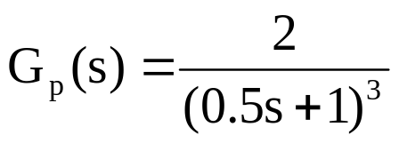
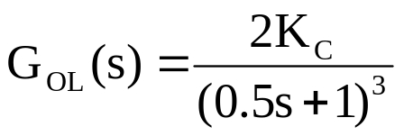
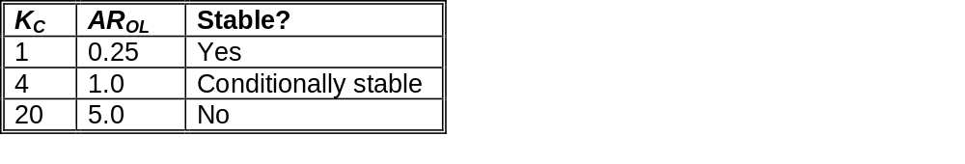
Example 1:
A process has a T.F.,
And G_{V} = 0.1, G_{M} = 10 . If proportional control is used, determine
closed-loop stability for 3 values of K_{c}: 1, 4, and 20.
Solution:
Chapter 14
The OLTF is G_{OL}=G_{C}G_{P}G_{V}G_{M} or...
The Bode plots for the 3 values of K_{c} shown in Fig. 16.6.
Note: the phase angle curves are identical. From the Bode
diagram:

Slide 7
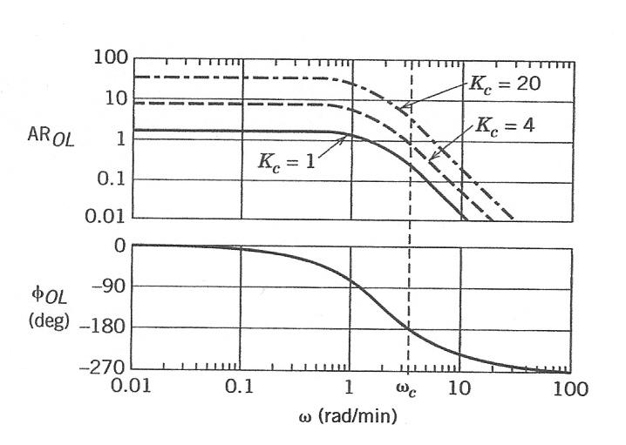
Figure 14.5 Bode plots for G_{OL} = 2K_{c}/(0.5s + 1)³.

Slide 8
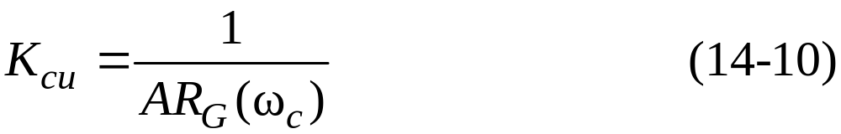
For proportional-only control, the ultimate gain K_{cu} is defined to be the largest value of K_{c} that results in a stable closed-loop system.
For proportional-only control, G_{OL}= K_{c}G and G = G_{v}G_{p}G_{m}.
AR_{OL}(ω)=K_{c} AR_{G}(ω) (14-9)
where AR_{G} denotes the amplitude ratio of G.
At the stability limit, ω = ω_{c}, AR_{OL}(ω_{c}) = 1 and K_{c}= K_{cu}.
Chapter 14

Slide 9
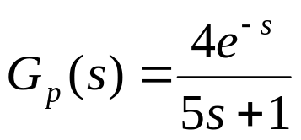
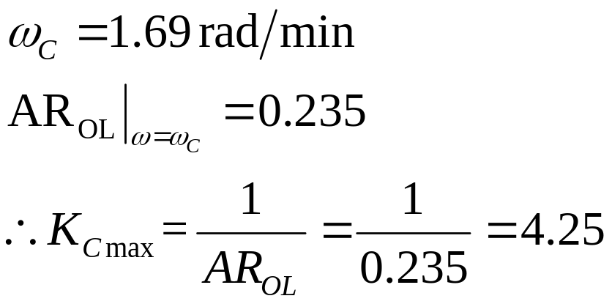
Example 2:
Determine the closed-loop stability of the system,
Where G_{V} = 2.0, G_{M} = 0.25 and G_{C} =K_{C} . Find ω_{C} from the
Bode Diagram. What is the maximum value of K_{c} for a stable
system?
Chapter 14
Solution:
The Bode plot for K_{c}= 1 is shown in Fig. 14.7.
Note that:

Slide 10
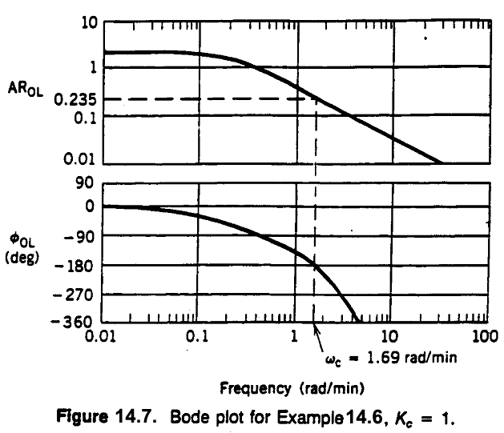
Chapter 14

Slide 11
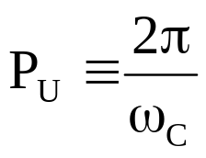
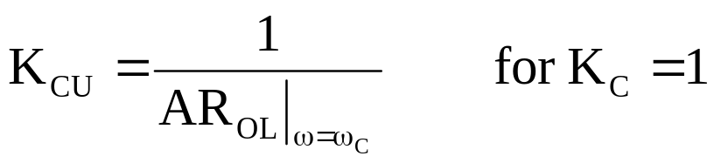
Ultimate Gain and Ultimate Period
Ultimate Gain: K_{CU} = maximum value of |K_{C}| that results in a
    stable closed-loop system when proportional-only
    control Is used.
Ultimate Period:
K_{CU} can be determined from the OLFR when
    proportional-only control is used with K_{C} =1. Thus
Note: First and second-order systems (without time delays)
do not have a K_{CU} value if the PID controller action is correct.
Chapter 14

Slide 12
Gain and Phase Margins
The gain margin (GM) and phase margin (PM) provide
    measures of how close a system is to a stability limit.
Gain Margin:
Let A_{C} = AR_{OL} at ω = ω_{C}. Then the gain margin is
defined as: GM = 1/A_{C}
According to the Bode Stability Criterion, GM >1 ⇔ stability
Phase Margin:
Let ω₁ = frequency at which AR_{α} = 1.0 and the
corresponding phase angle is φ₁ . The phase margin
is defined as: PM = 180° + φ₁
According to the Bode Stability Criterion,
PM >0 ⇔ stability
See Figure 14.9.
Chapter 14

Slide 13
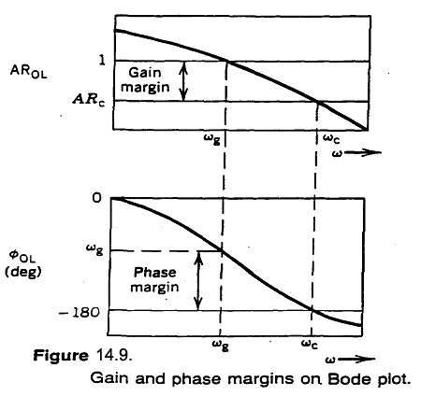
Chapter 14

Slide 14
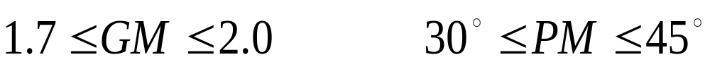
Rules of Thumb:
  A well-designed FB control system will have:
  Closed-Loop FR Characteristics:
  An analysis of CLFR provides useful information about control system performance. Typical desired CLFR for disturbance and setpoint changes and the corresponding step response are shown in Figure 14.14.
Chapter 14

Slide 15
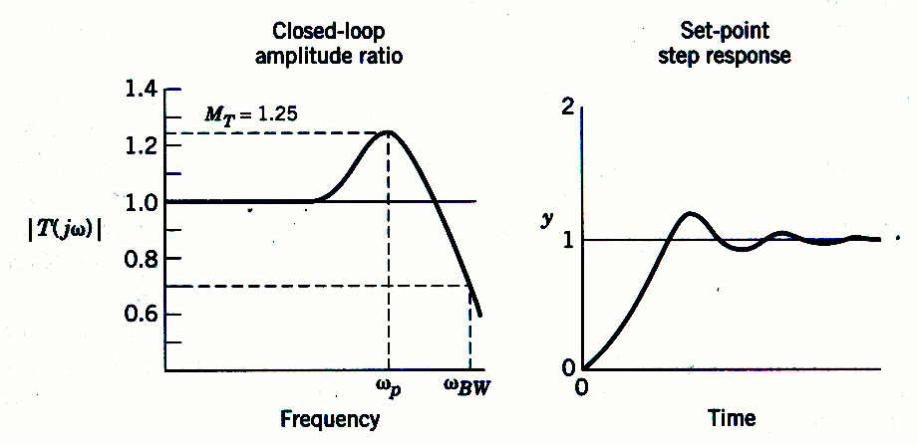
Chapter 14
Figure 14.14 Typical closed-loop amplitude ratio |T(jω)| and set-point response.

Slide 16
Chapter 14
Previous chapter
Next chapter

