Slide 1
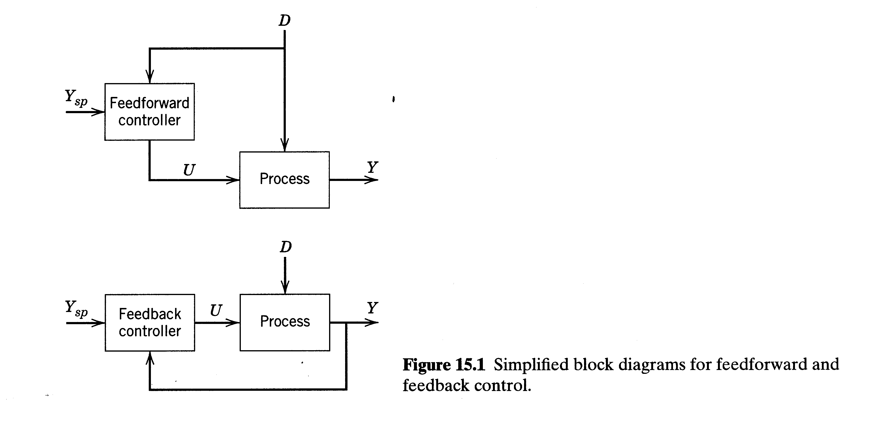
Feedforward and Ratio Control
Chapter 15

Slide 2
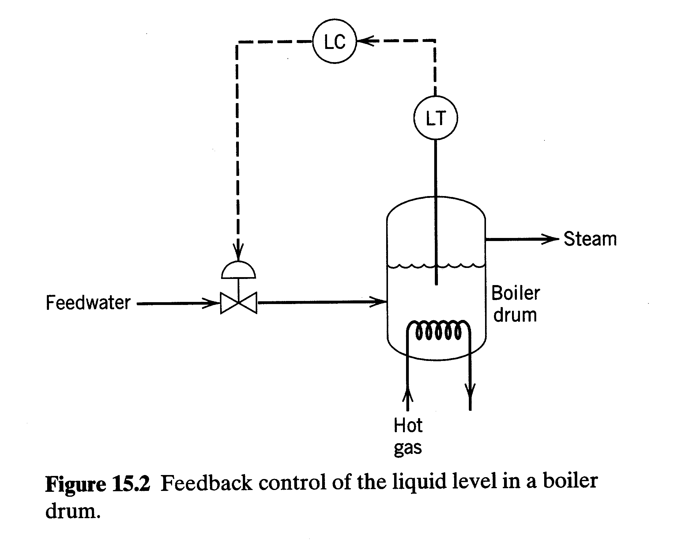
Chapter 15

Slide 3
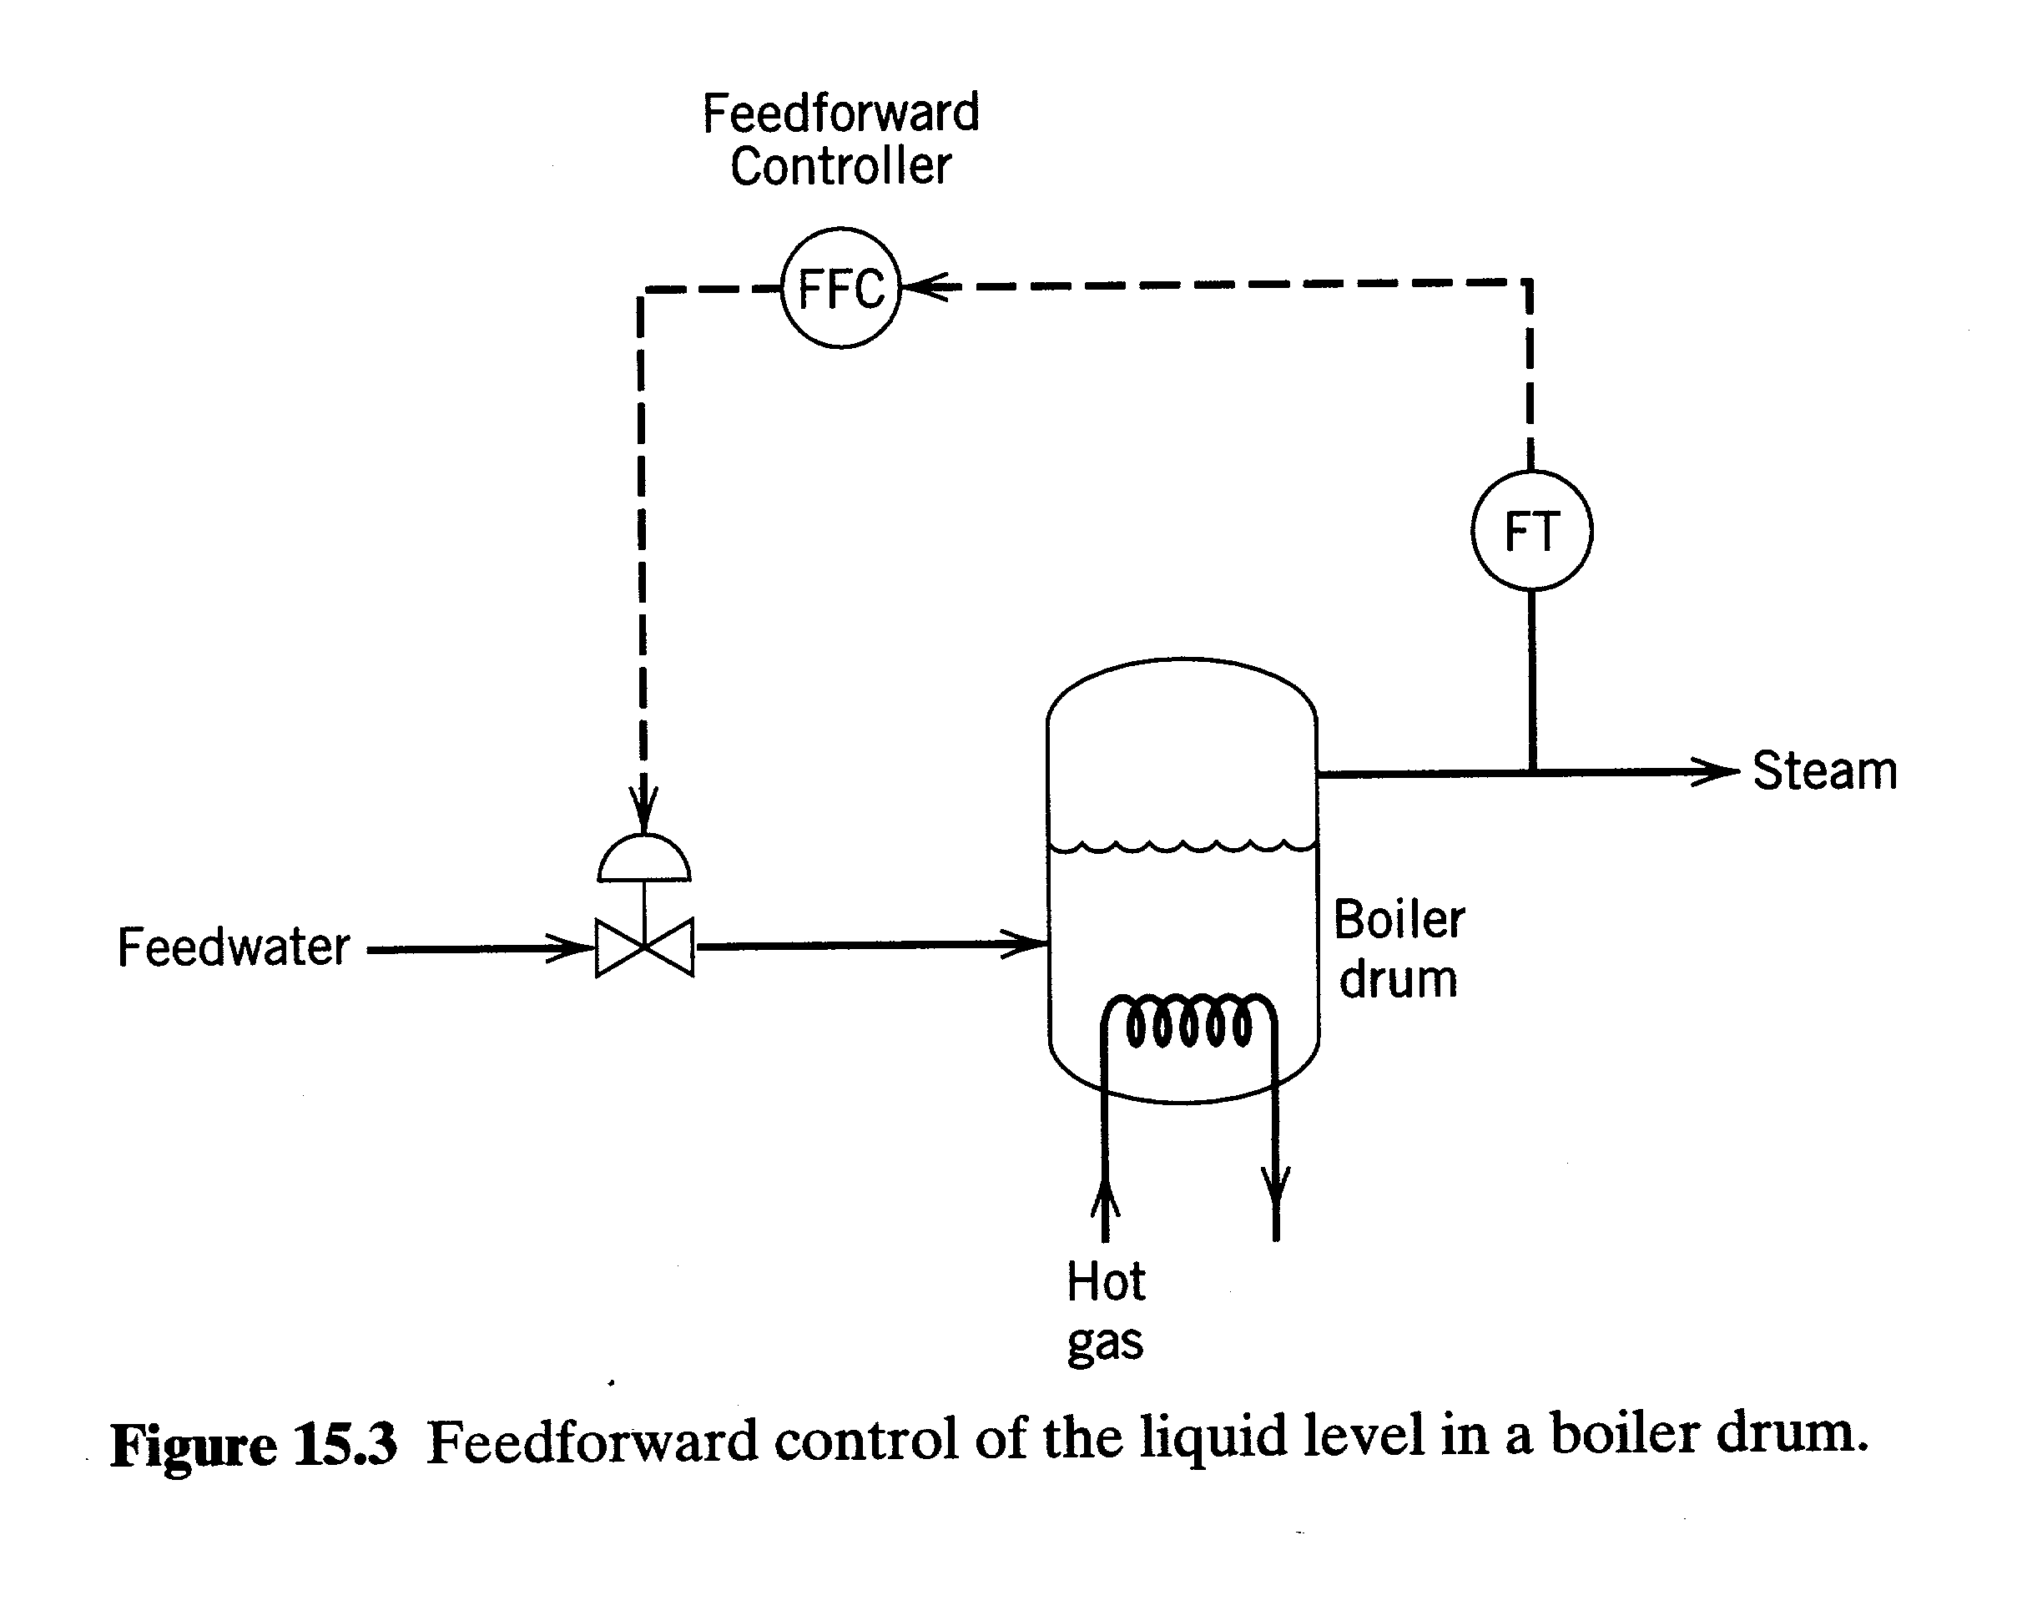
Chapter 15

Slide 4
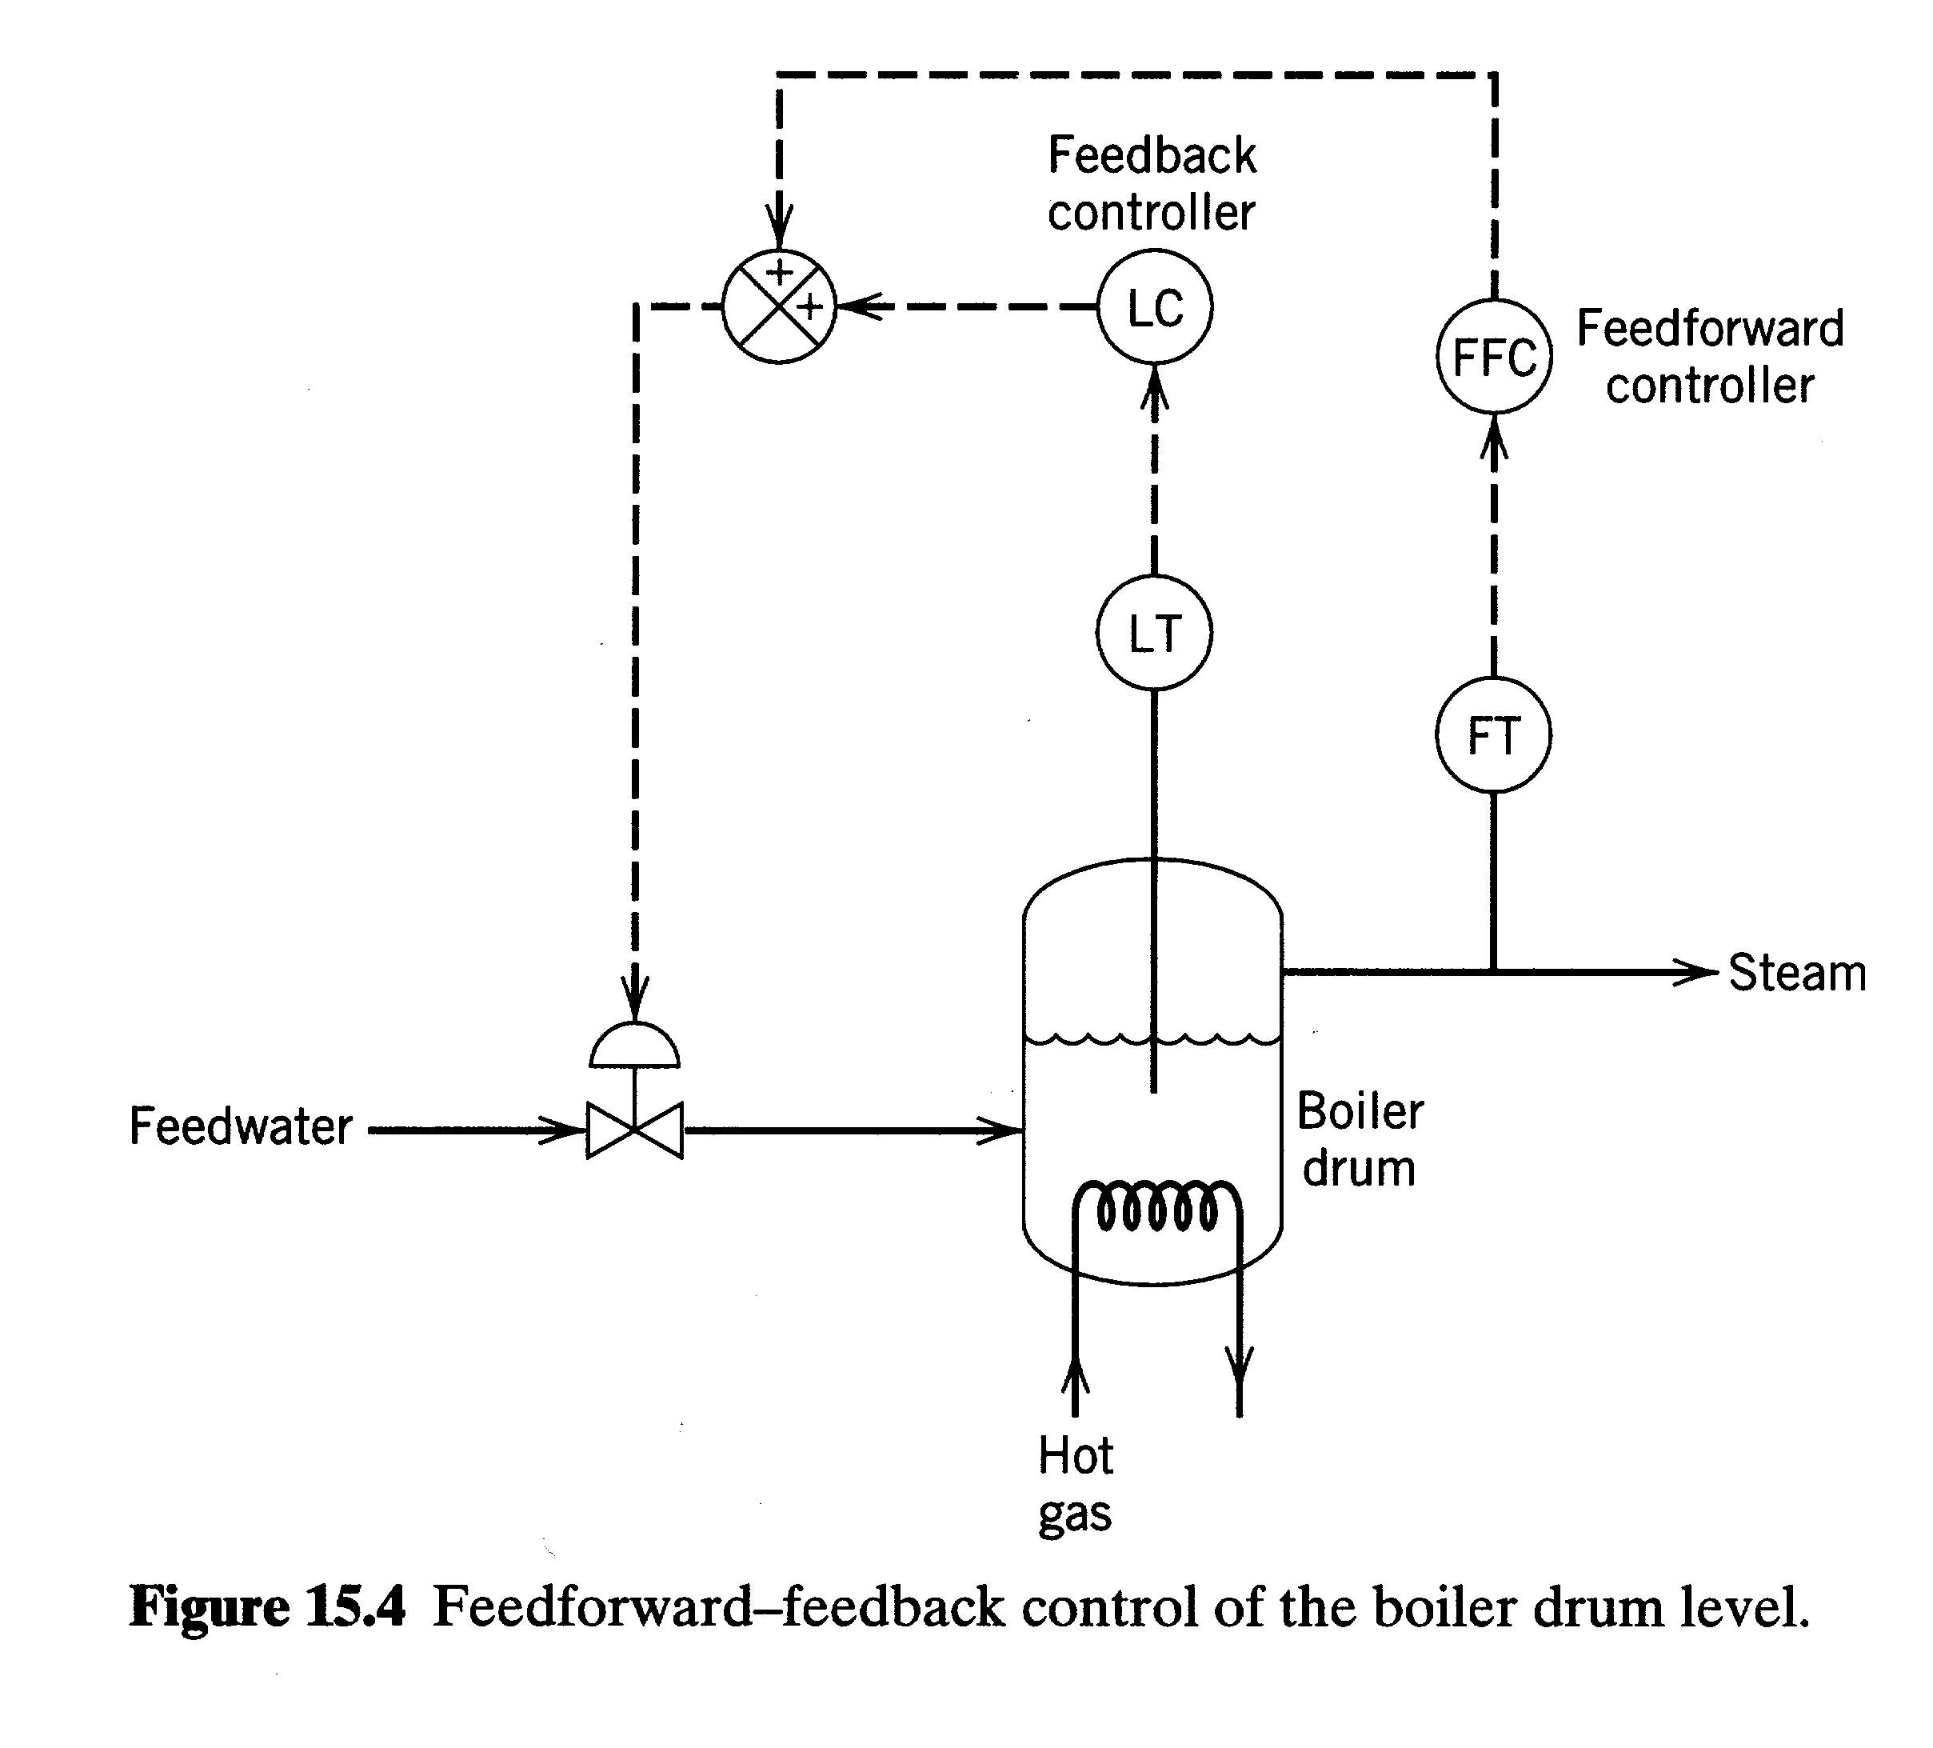
Chapter 15

Slide 5
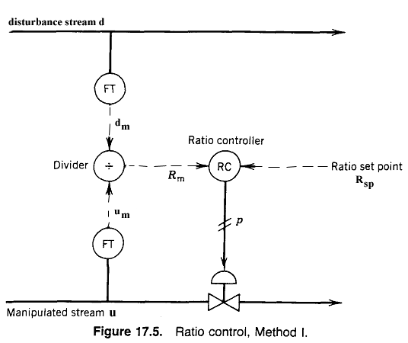
Chapter 15

Slide 6
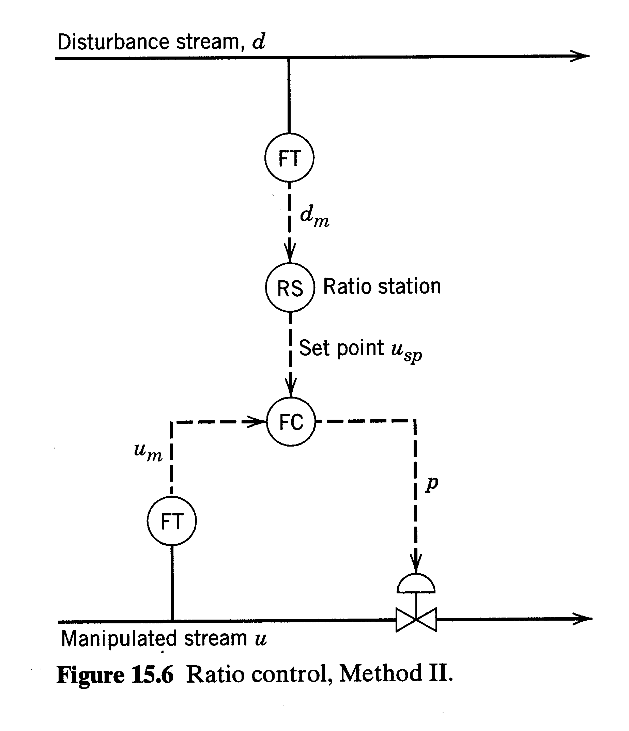
Chapter 15

Slide 7
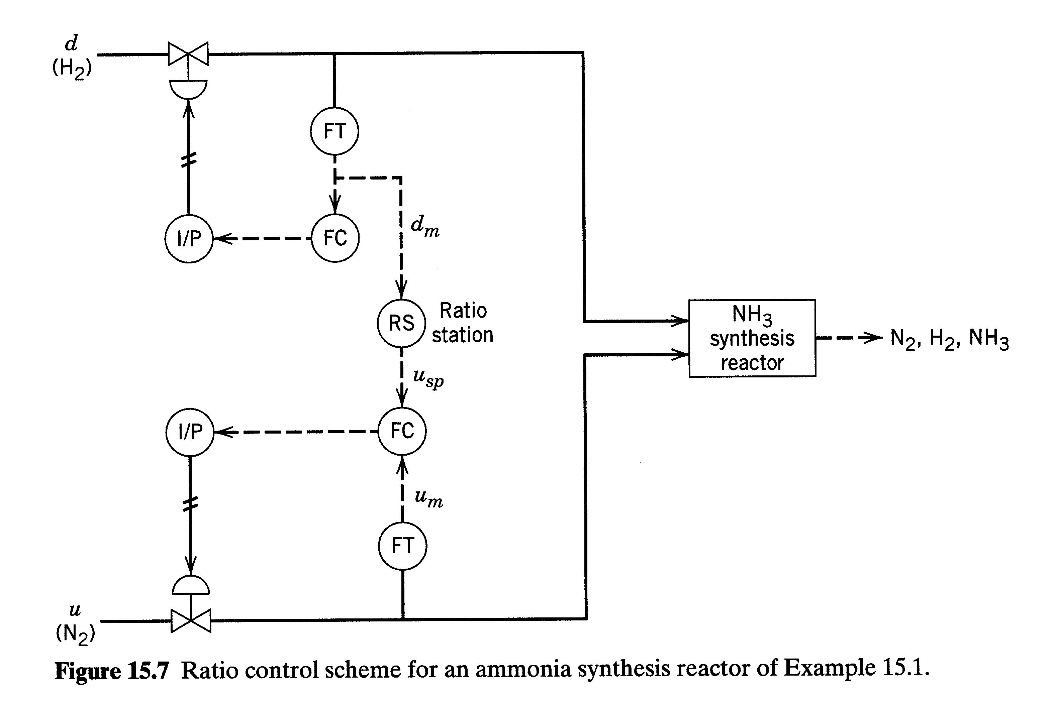
Chapter 15

Slide 8
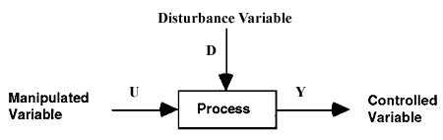
Introduction : Feedforward Control
Control Objective: Maintain Y at its set point, Y_{sp}, despite disturbances.
Feedback Control:
      Measure Y, compare it to Y_{sp}, adjust U so as to maintain Y at Y_{sp}.
      Widely used (e.g., PID controllers)
      Feedback is a fundamental concept
Feedforward Control:
      Measure D, adjust U so as to maintain Y at Y_{sp}.
      Note that the controlled variable Y is not measured.
Chapter 15

Slide 9
Comparison of Feedback and Feedforward Control
1) Feedback (FB) Control
  Advantages:
  Corrective action occurs regardless of the source and type
of disturbances.
  Requires little knowledge about the process (For example,
a process model is not necessary).
  Versatile and robust (Conditions change? May have to
re-tune controller).
  Disadvantages:
  FB control takes no corrective action until a deviation in the controlled variable occurs.
  FB control is incapable of correcting a deviation from set point at the time of its detection.
  Theoretically not capable of achieving “perfect control.”
  For frequent and severe disturbances, process may not settle out.
Chapter 15

Slide 10
2) Feedforward (FF) Control
  Advantages:
  Takes corrective action before the process is upset (cf. FB control.)
  Theoretically capable of "perfect control"
  Does not affect system stability
  Disadvantages:
  Disturbance must be measured (capital, operating costs)
  Requires more knowledge of the process to be controlled (process model)
  Ideal controllers that result in "perfect control”: may be physically unrealizable. Use practical controllers such as lead-lag units
3) Feedforward Plus Feedback Control
  FF Control
  Attempts to eliminate the effects of measurable disturbances.
  FB Control
  Corrects for unmeasurable disturbances, modeling errors, etc.
    (FB trim)
Chapter 15

Slide 11
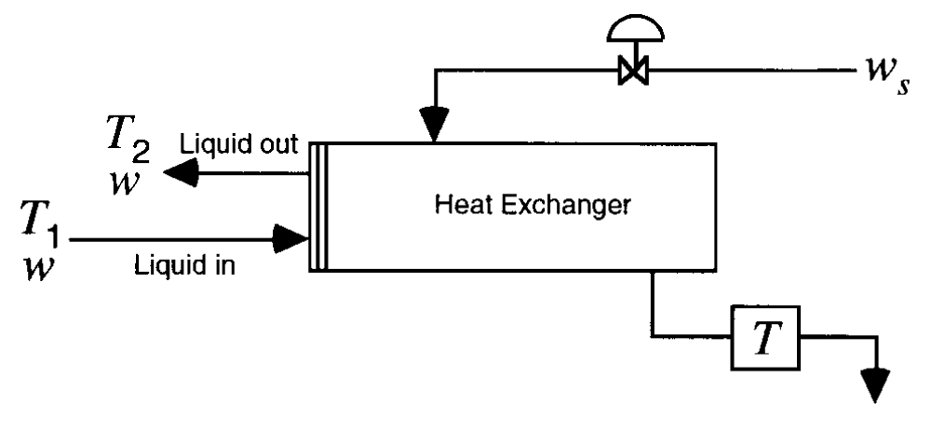
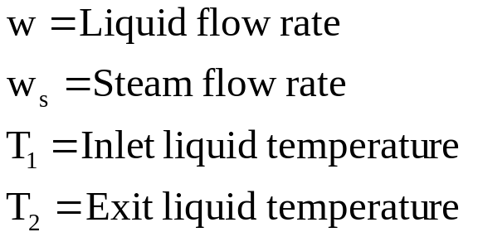
4) Historical Perspective :
    1925: 3 element boiler level control
    1960's: FF control applied to other processes
EXAMPLE 3: Heat Exchanger
Chapter 15

Slide 12
Control Objective:
  Maintain T₂ at the desired value (or set-point), T_{sp}, despite variations in the inlet flow rate, w. Do this by manipulating w_{s}.
Feedback Control Scheme:
  Measure T₂, compare T₂ to T_{sp}, adjust w_{s}.
Feedforward Control Scheme:
  Measure w, adjust w_{s} (knowing T_{sp}), to control exit
  temperature,T₂.
Chapter 15

Slide 13
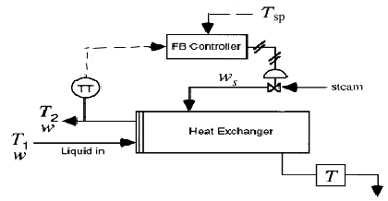
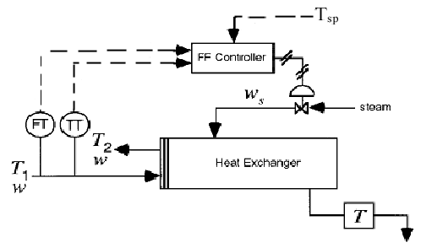
Feedback Control
Chapter 15
Feedforward Control

Slide 14
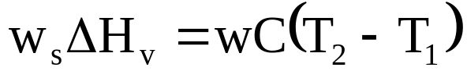
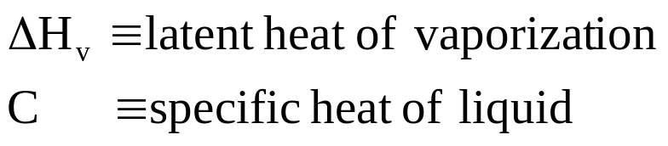
II. Design Procedures for Feedforward Control
Recall that FF control requires some knowledge of the process
(model).
  Material and Energy Balances
  Transfer Functions
Design Procedure
  Here we will use material and energy balances written for SS conditions.
    Example: Heat Exchanger
    Steady-state energy balances
Chapter 15
Heat transferred = Heat added to
from steam process stream
(1)
Where,

Slide 15
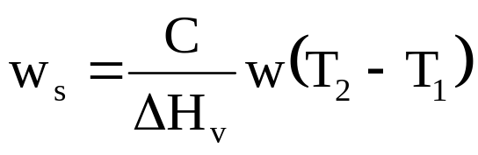

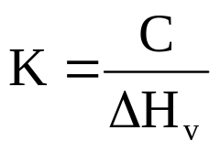

Rearranging Eqn. (1) gives,
(2)
or
(3)
Chapter 15
with
(4)
Replace T₂ by T_{set} since T₂ is not measured:
(5)

Slide 16
Equation (5) can be used in the FF control calculations
  digital computer).
Let K be an adjustable parameter (useful for tuning).
Advantages of this Design Procedure
  Simple calculations
  Control system is stable and self-regulating
Shortcomings of this Design Procedure
  What about unsteady state conditions, upsets etc.?
  Possibility of offset at other load conditions add FB control
Dynamic Compensation
  to improve control during upset conditions, add dynamic
  compensation to above design.
Example: Lead/lag units
Chapter 15

Slide 17
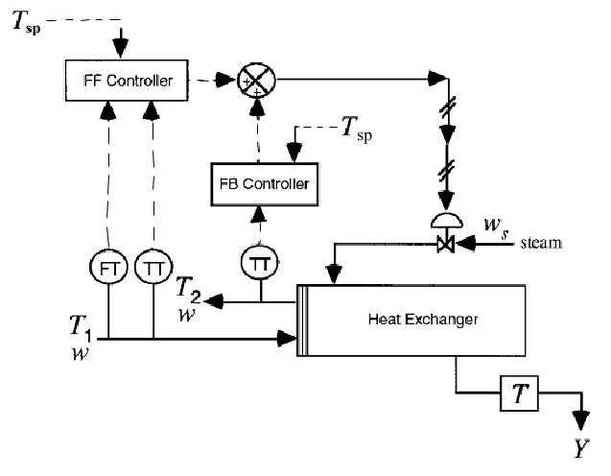
Feedforward/Feedback Control of a Heat Exchanger
Chapter 15

Slide 18
Hardware Required for Heat Exchanger Example
1) Feedback Control
    Temp. transmitter
    Steam control valve
2) FB/FF Control
Additional Equipment
    Two flow transmitters (for w and w_{s})
    I/P or R/I transducers?
    Temperature transmitter for T₁ (optional)
Chapter 15
Blending System Example?

Slide 19
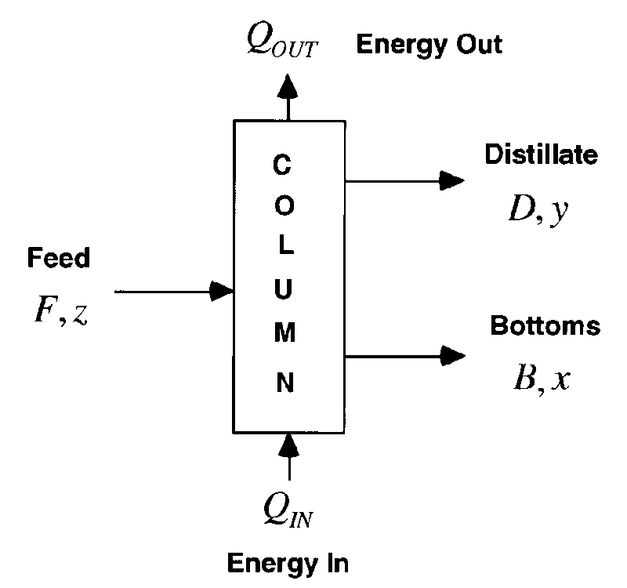
EXAMPLE: Distillation Column
Chapter 15
Symbols
  F, D, B are flow rates
  z, y, x are mole fractions of the light component
Control objective:
  Control y despite disturbances in F and z
  by manipulating D.
Mole balances: F=D+B; Fz=Dy+Bx

Slide 20
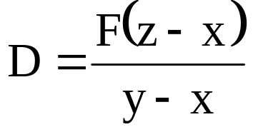
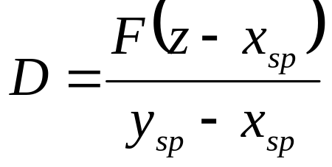
EXAMPLE: cont.
Combine to obtain
Replace y and x by their set point values,
y_{sp} and x_{sp}:
Chapter 15

Slide 21
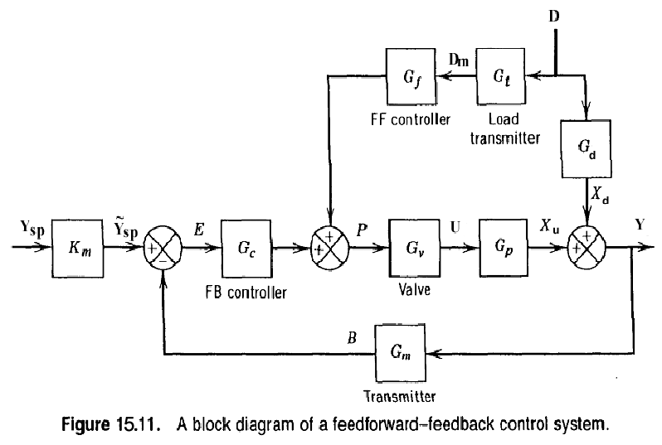
Chapter 15

Slide 22
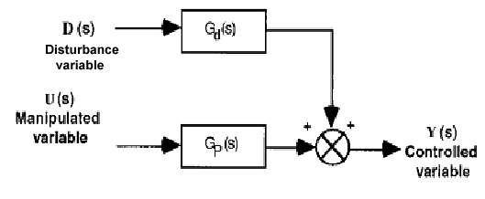
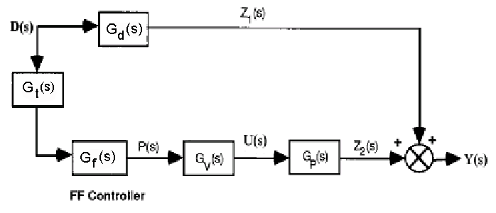
Analysis of Block Diagrams
Process
Chapter 15
Process with FF Control

Slide 23


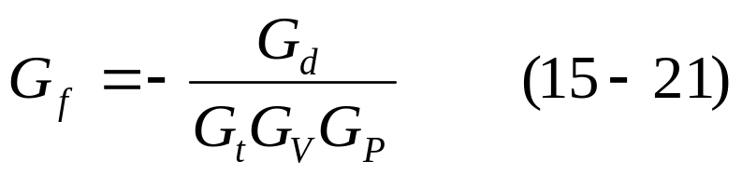
Analysis (drop the “s” for convenience)
For “perfect control” we want Y = 0 even though D ≠ 0. Then rearranging Eq. (3), with Y = 0 , gives a design equation.
Chapter 15

Slide 24
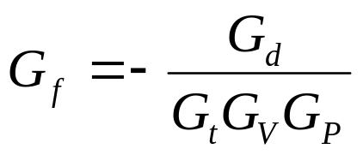
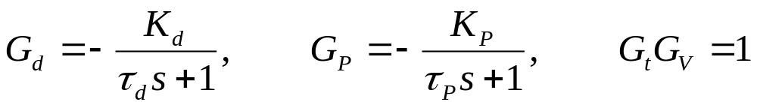
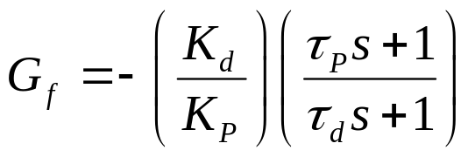
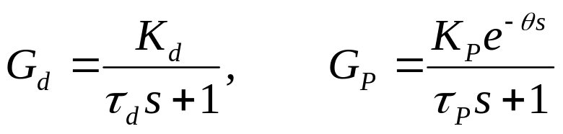
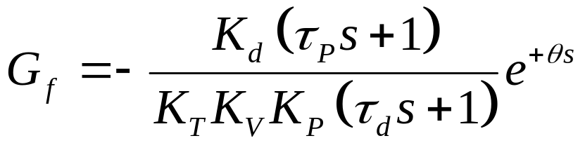

Examples:
For simplicity, consider the design expression in the Eqn. (15-21),
then:
  1) Suppose:
    Then from Equation (15-21),
  2) Let
    Then from Equation (15-21)
Chapter 15
(lead/lag)
- implies prediction
of future
disturbances
(15-25)

Slide 25
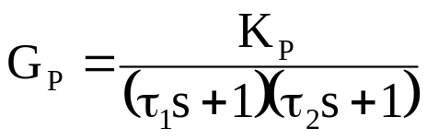
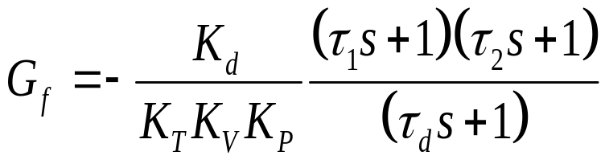
    The ideal controller is physically unrealizable.
3) Suppose , same G_{d}
To implement this controller, we would have to take the
second derivative of the load measurements (not possible).
Then,
This ideal controller is also unrealizable.
However, approximate FF controllers can result in
significantly improved control.
(e.g., set s=0 in unrealizable part)
See Chapter 6 for lead-lag process responses.
Chapter 15
(15-27)

Slide 26
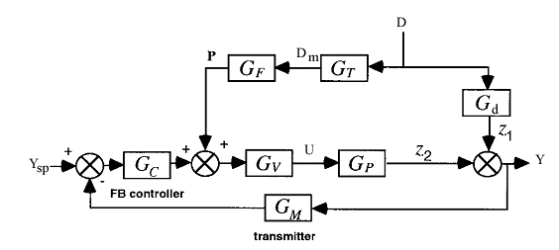
FF/FB Control
Chapter 15

Slide 27
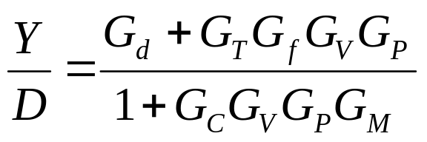
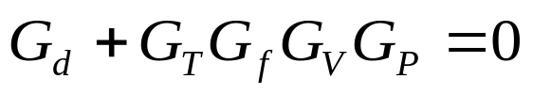
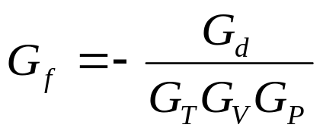

Stability Analysis
Closed-loop transfer function:
Design Eqn. For G_{F}
For Y=0 and D ≠ 0 , then we require
Chapter 15
previous result (15-21)
Characteristic equation
The roots of the characteristic equation determine system
stability. But this equation does not contain G_{f}.
**Therefore, FF control does NOT affect stability of FB system.

Slide 28
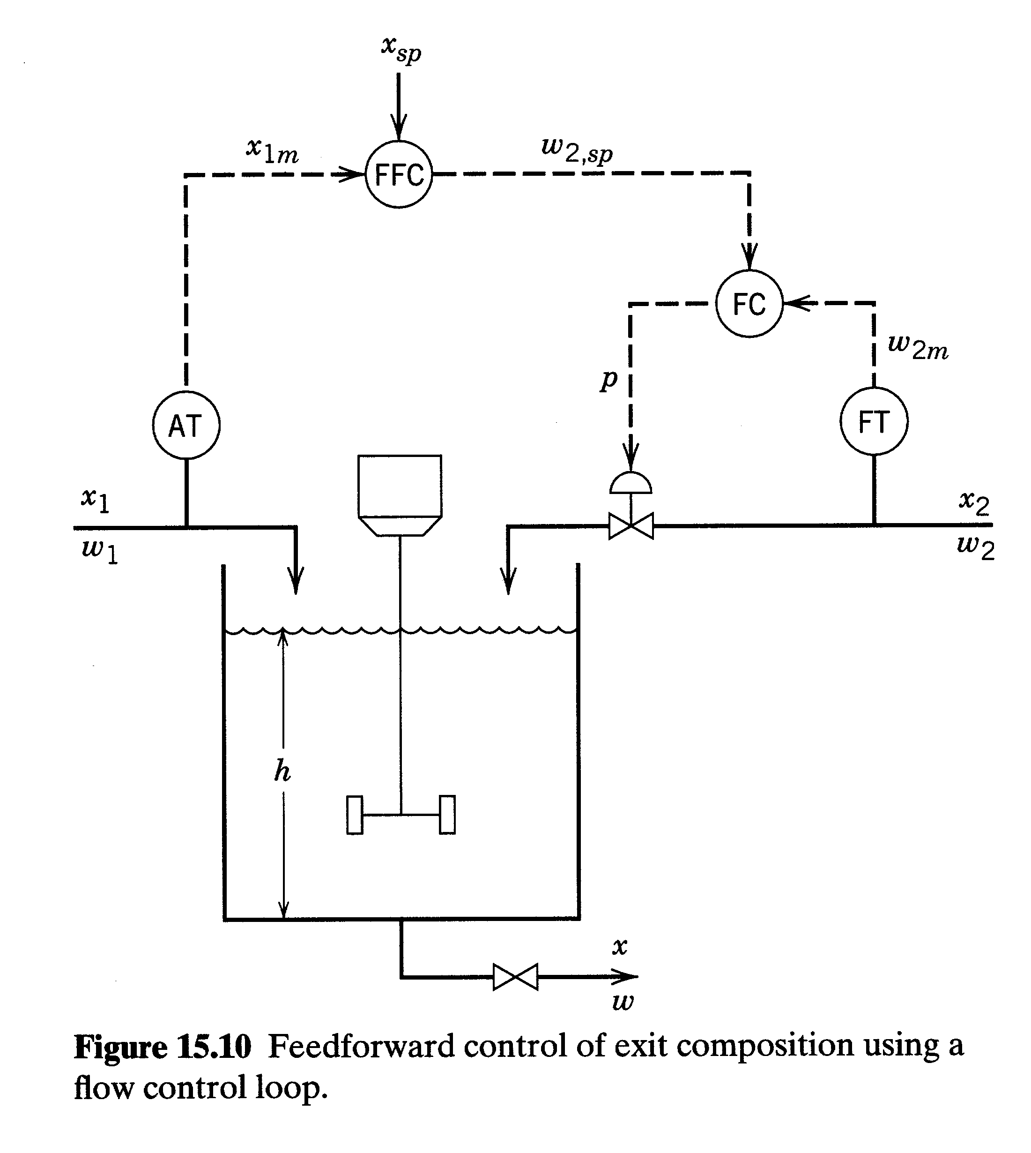
Chapter 15

Slide 29
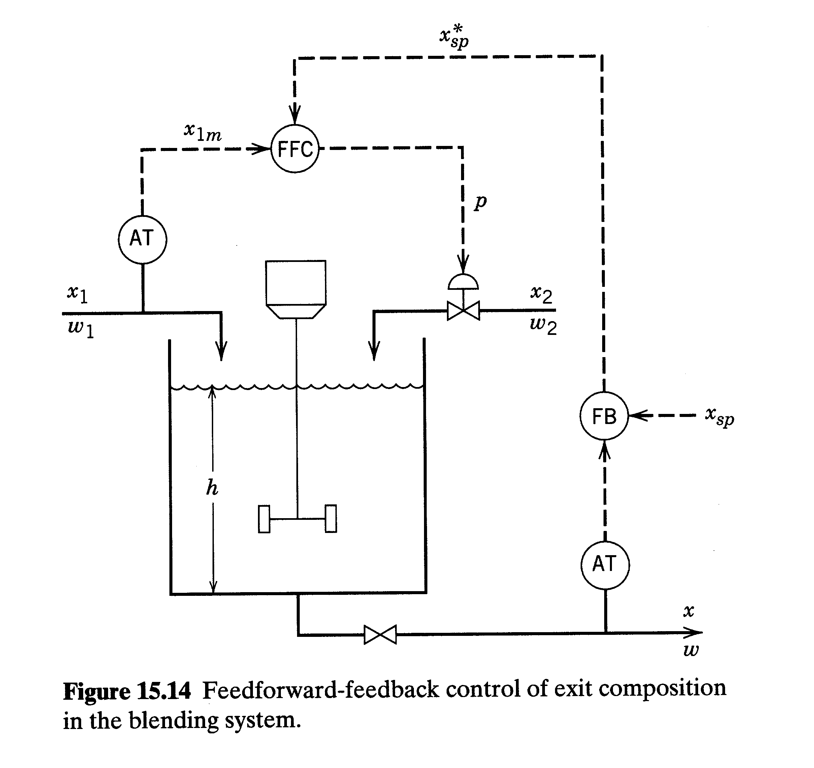
Chapter 15

Slide 30
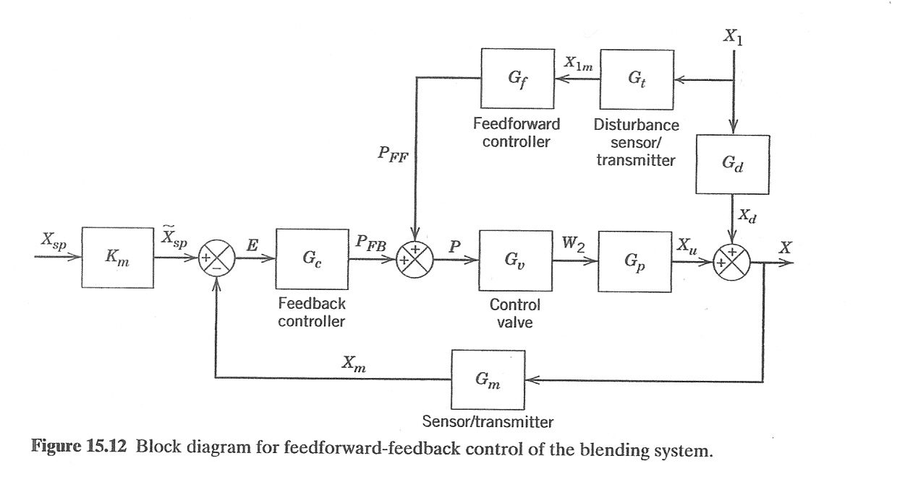

Slide 31
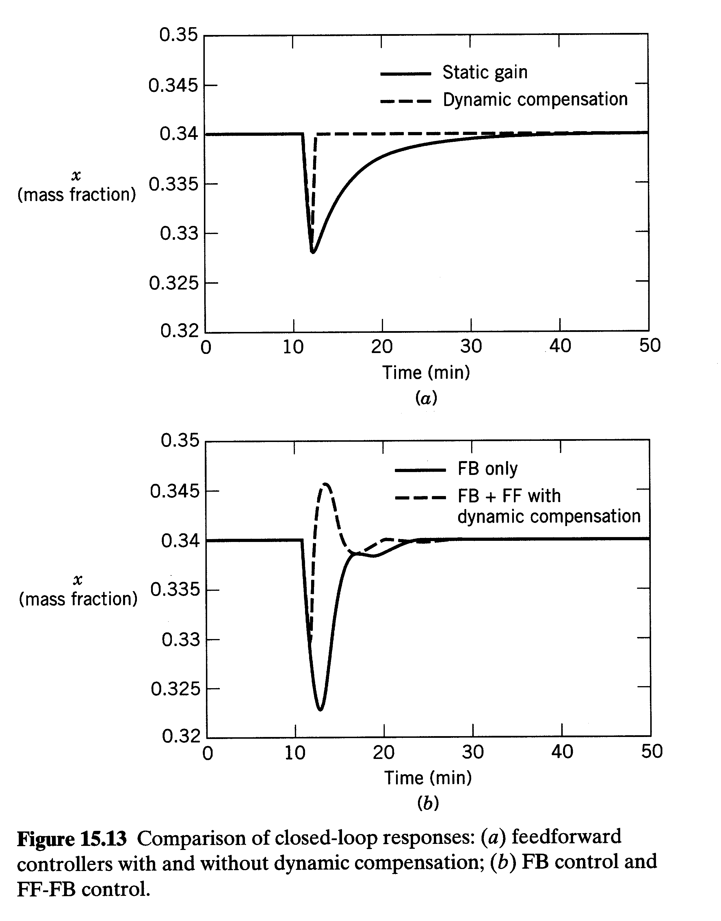
Chapter 15

Slide 32
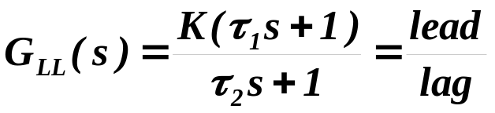
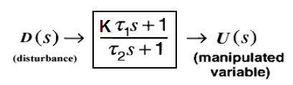
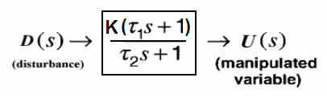
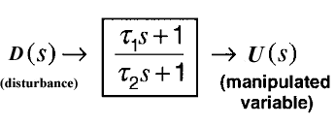
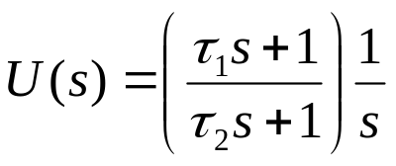
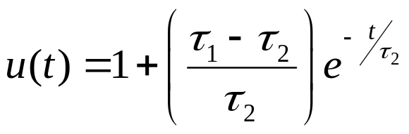
Lead-Lag (LL) Units
Commonly used to provide dynamic compensation in FF control.
Analog or digital implementation (Off the shelf components)
Transfer function:
Tune τ₁, τ_{2,} K
If a LL unit is used as a FF controller,
Chapter 15
K = 1
For a unit step change in load,
Take inverse Laplace Transforms,

Slide 33
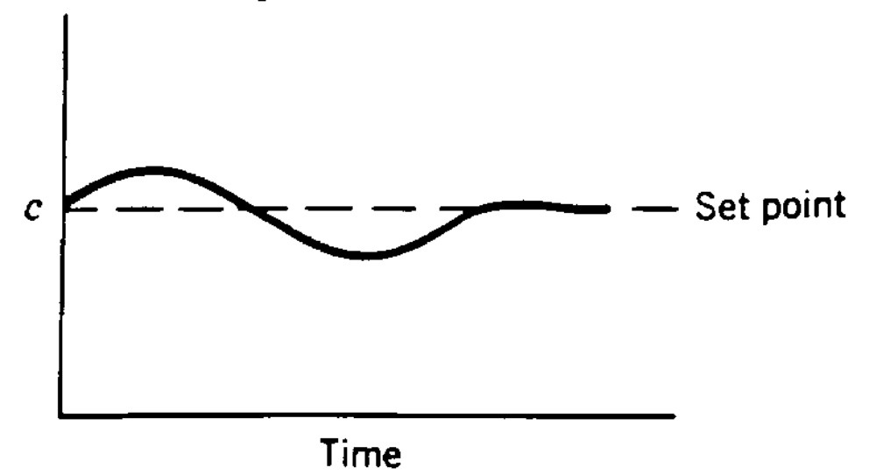
Step 2: Fine tune τ₁ and τ₂ making small steps changes in L.
Desired response
equal areas above and below set-point; small deviations
Chapter 15
According to Shinskey (1996), equal areas imply that the difference
of τ₁ and τ₂ is correct. In subsequent tuning (to reduce the size
  of the areas), τ₁ and τ₂ should be adjusted to keep τ₁ - τ₂
  constant.

Slide 34
Step 4: Tune the FB Controller
  Various FB/FF configurations can be used.
  Examples
  Add outputs of FB and FF controllers (See previous block diagram).
  FB controller can be tuned using conventional techniques (ex. IMC, ITAE).
Chapter 15

Slide 35
Chapter 15
Previous chapter
Next chapter

