Slide 1

BITS, PILANI – K. K. BIRLA GOA CAMPUS
Process Control- CHE F342
Chapter #1 & 3
Prof. Saroj Sundar Baral
Department of Chemical Engineering
BITS, Pilani- K. K. Birla Goa Campus
1/13/2016
BITS, PILANI – K. K. BIRLA GOA CAMPUS

Slide 2
What is the requirement of process control?
Safety
Production specification
Environmental regulation
Operational constraint
Economics
1/13/2016
BITS, PILANI – K. K. BIRLA GOA CAMPUS

Slide 3
A Control system has to satisfy three general needs
Suppressing the influence of external disturbances
Ensuring the stability of a chemical process
Optimizing the performance of a chemical process
1/13/2016
BITS, PILANI – K. K. BIRLA GOA CAMPUS

Slide 4
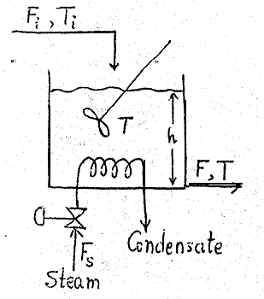
1. Suppressing the influence of external disturbances
Example: Controlling the operation of stirred tank heater
1/13/2016
BITS, PILANI – K. K. BIRLA GOA CAMPUS

Slide 5
Operational objectives
To keep the effluent temperature T at desired value T_{SP}
To keep the volume of the liquid in the tank at a desired value V_{SP}
Assumption:
The tank is consider to be well stirred
1/13/2016
BITS, PILANI – K. K. BIRLA GOA CAMPUS

Slide 6
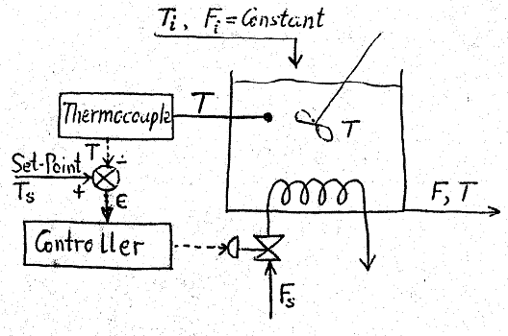
Feedback temperature control
1/13/2016
BITS, PILANI – K. K. BIRLA GOA CAMPUS

Slide 7
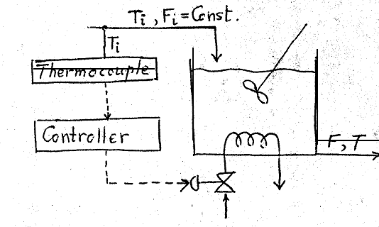
Feedforward temperature control
1/13/2016
BITS, PILANI – K. K. BIRLA GOA CAMPUS

Slide 8
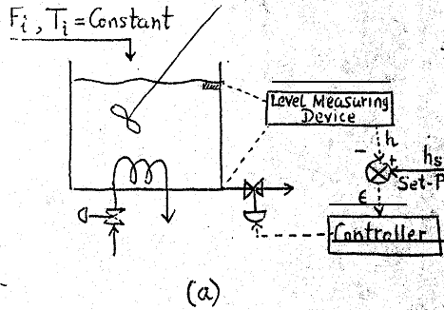
Feedback level control
1/13/2016
BITS, PILANI – K. K. BIRLA GOA CAMPUS

Slide 9
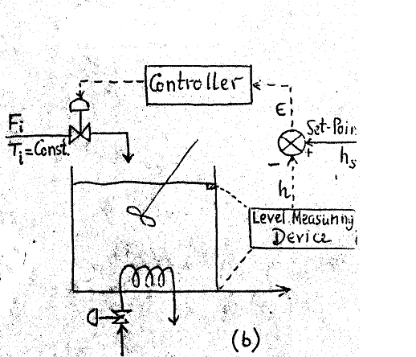
1/13/2016
BITS, PILANI – K. K. BIRLA GOA CAMPUS

Slide 10
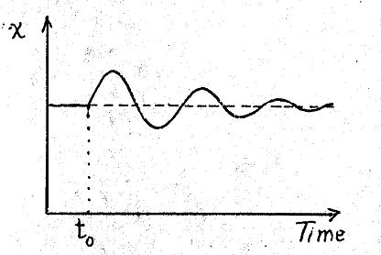
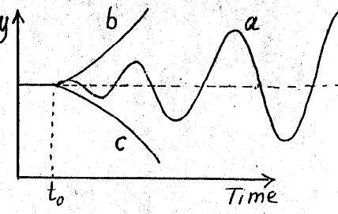
2. Ensuring the stability of a chemical process
Stable system
Unstable system
Example: Explosion of hydrocarbon fuel in air
1/13/2016
BITS, PILANI – K. K. BIRLA GOA CAMPUS

Slide 11
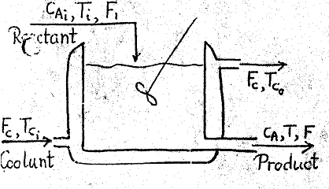
Example: controlling the operation of unstable stirred tank reactor
A
B
Reaction is exothermic
1/13/2016
BITS, PILANI – K. K. BIRLA GOA CAMPUS

Slide 12
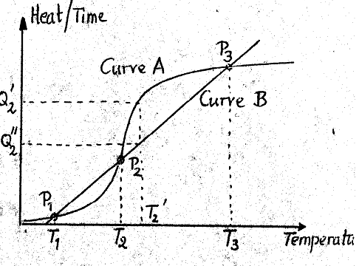
The three steady states of CSTR
1/13/2016
BITS, PILANI – K. K. BIRLA GOA CAMPUS

Slide 13
The reactor is to operate at P₂ because
At P₁ the yield is very less
At P₃ temperature is very high causing unsafe conditions
1/13/2016
BITS, PILANI – K. K. BIRLA GOA CAMPUS

Slide 14
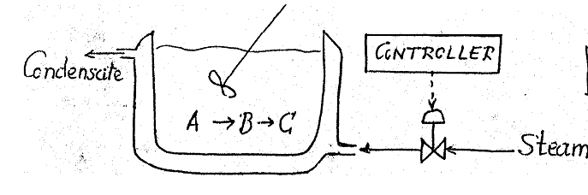
3. Optimize the performance of a chemical process
Example: Optimizing the performance of a batch reactor
B
A
C
1/13/2016
BITS, PILANI – K. K. BIRLA GOA CAMPUS

Slide 15
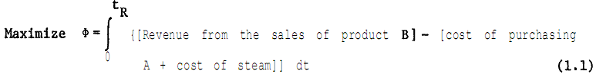
Assumption:
Both the reactions are endothermic
Both are 1st order reaction
Objective: Maximize the profit
1/13/2016
BITS, PILANI – K. K. BIRLA GOA CAMPUS

Slide 16
Design aspect of a process control system
Classification of variable in a chemical process
1. Input variables
Manipulated
Disturbance
2. Output variables
Measured output variables
Unmeasured output variables
1/13/2016
BITS, PILANI – K. K. BIRLA GOA CAMPUS

Slide 17
Design elements of a control system
The basic questions we must ask and try to answer, while attempting to design a control system
What are the operational objectives that a control system is called upon to achieved?
What variable should we measure in order to monitor the operational performance of a plant?
What are the manipulated variables to be used to control a chemical process?
What is the best control configuration for a given chemical process control situation?
How is the information taken from the measurements, used to adjust the values of the manipulated variables?
1/13/2016
BITS, PILANI – K. K. BIRLA GOA CAMPUS

Slide 18
Driving a Car: An Everyday Example of Process Control
Control Objective (Set point): Maintain car in proper lane.
Controlled variable- Location on the road
Manipulated variable- Orientation of the front wheels
Actuator- Driver’s arms/steering wheel
Sensor- Driver’s eyes
Controller- Driver
Disturbance- Curve in road
1/13/2016
BITS, PILANI – K. K. BIRLA GOA CAMPUS

Slide 19
Laplace transforms
Introduction
Laplace transformation
Inverse Laplace transformation
Partial Fraction Solving DEs
1/13/2016
BITS, PILANI – K. K. BIRLA GOA CAMPUS

Slide 20
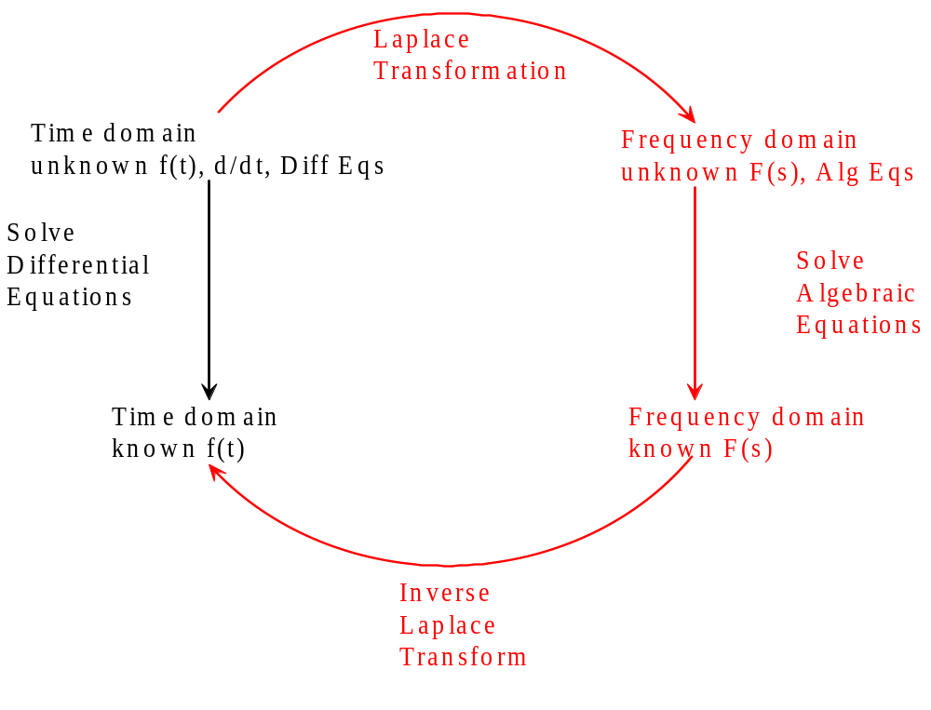
Introduction
1/13/2016
BITS, PILANI – K. K. BIRLA GOA CAMPUS

Slide 21
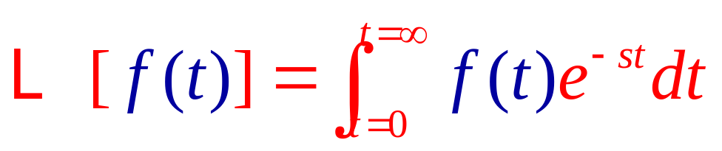
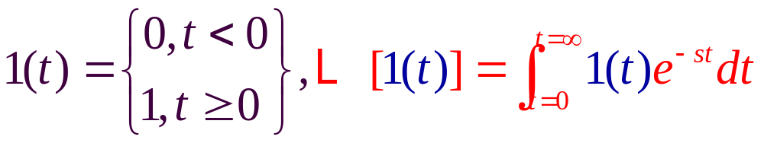
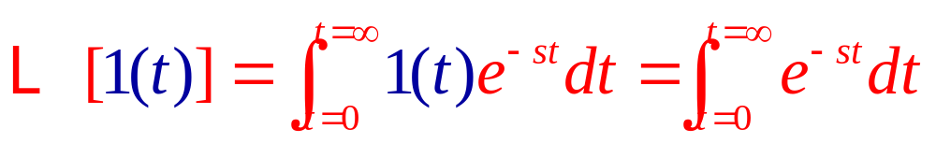
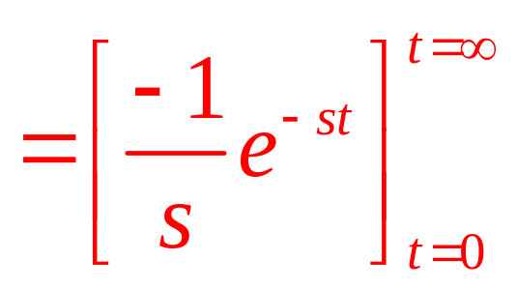
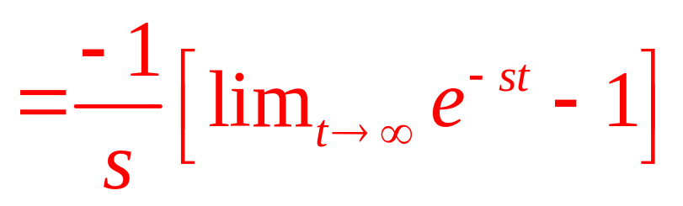
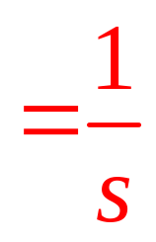
Laplace
Transformation
1/13/2016
BITS, PILANI – K. K. BIRLA GOA CAMPUS

Slide 22
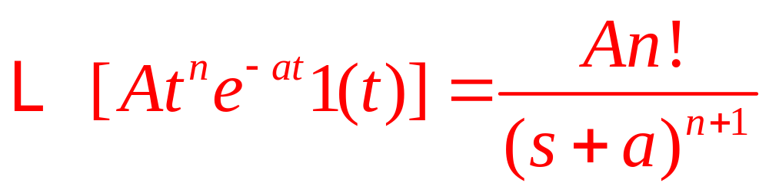
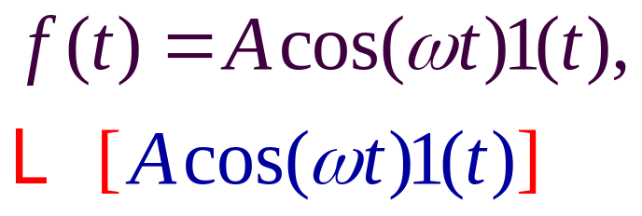
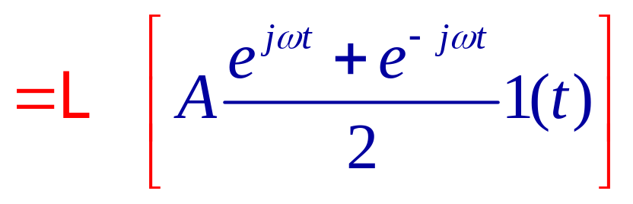
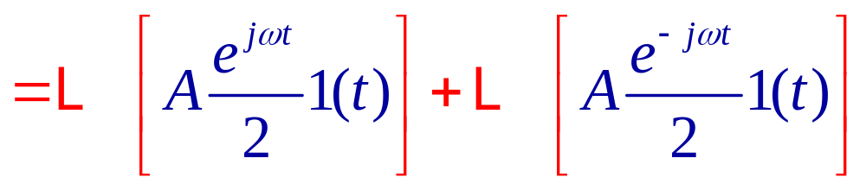
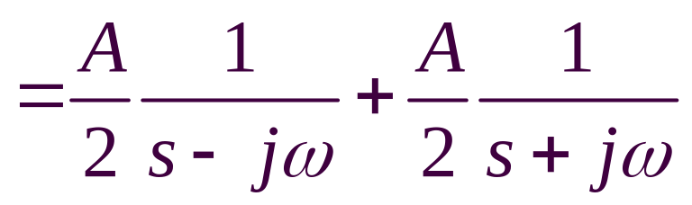
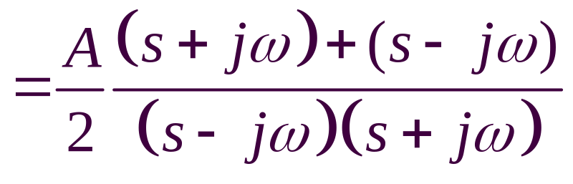
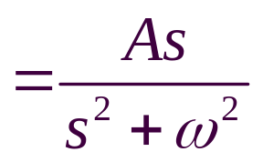
Laplace
Transformation
1/13/2016
BITS, PILANI – K. K. BIRLA GOA CAMPUS

Slide 23
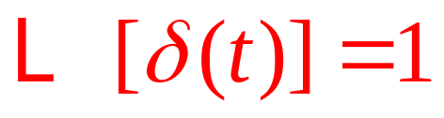
Laplace Transformation
1/13/2016
BITS, PILANI – K. K. BIRLA GOA CAMPUS

Slide 24
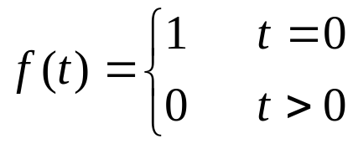





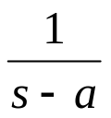

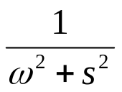
Laplace Transforms of Common Functions
Name
f(t)
F(s)
Impulse
1
Step
Ramp
Exponential
Sine
1/13/2016
BITS, PILANI – K. K. BIRLA GOA CAMPUS
Notes:
Jlh: function for impulse needs to be fixed

Slide 25
Laplace Transforms
Linearity
Constant multiplication
Complex shift
Real shift
Scaling
f₁(t) ± f₂(t)
a f(t)
e^{at} f(t)
f(t - T)
f(t/a)
F₁(s) ± F₂(s)
a F(s)
F(s-a)
e^{-Ts} F(as)
a F(as)
1/13/2016
BITS, PILANI – K. K. BIRLA GOA CAMPUS
4. Laplace transforms

Slide 26
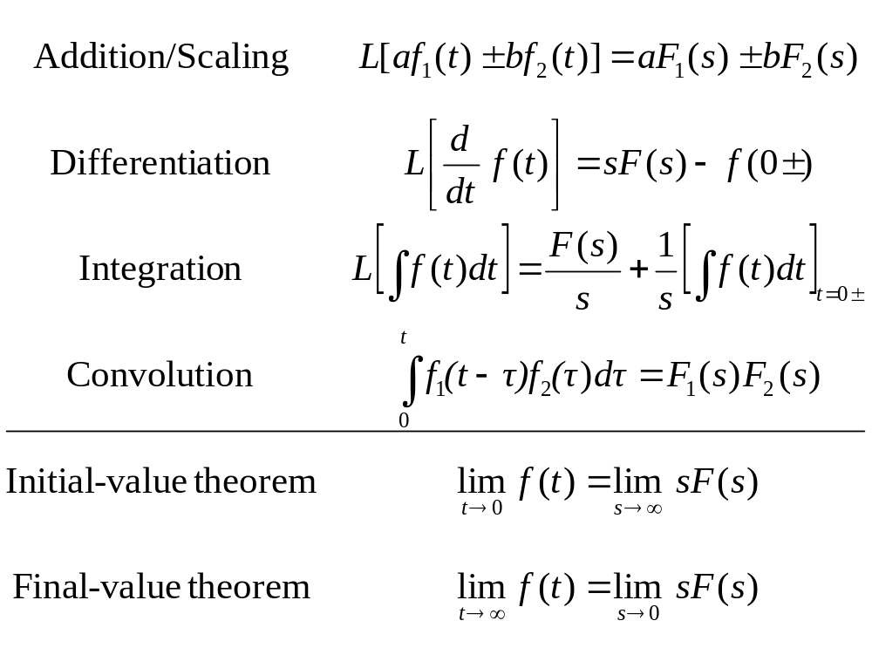
Laplace Transform Properties
1/13/2016
BITS, PILANI – K. K. BIRLA GOA CAMPUS

Slide 27
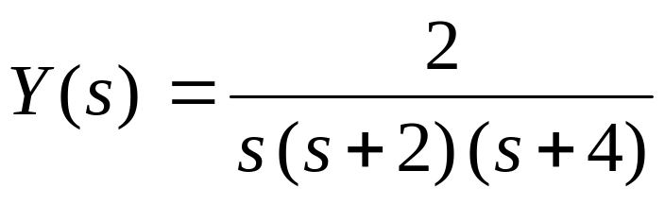
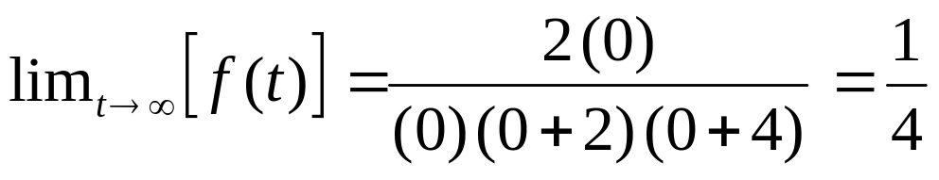
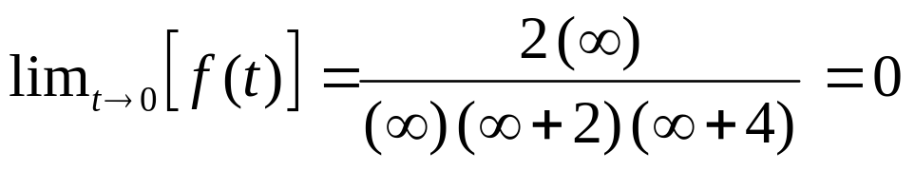
Apply Initial- and Final-Value Theorems to this Example
Laplace transform of the function.
Apply final-value theorem
Apply initial-value theorem
1/13/2016
BITS, PILANI – K. K. BIRLA GOA CAMPUS

Slide 28
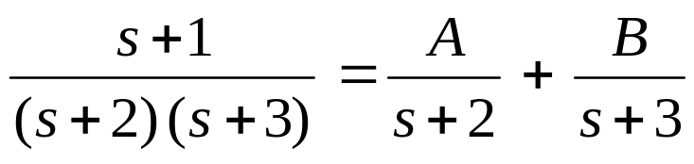
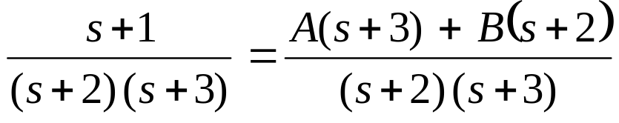


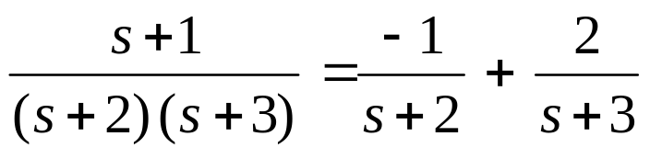
Partial Fraction Expansions
Expand into a term for each factor in the denominator.
Recombine RHS
Equate terms in s and constant terms. Solve.
Each term is in a form so that inverse Laplace transforms can be applied.
1/13/2016
BITS, PILANI – K. K. BIRLA GOA CAMPUS

Slide 29
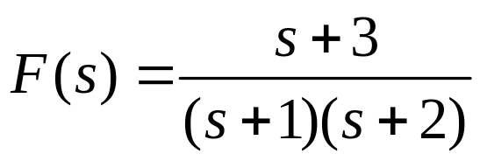
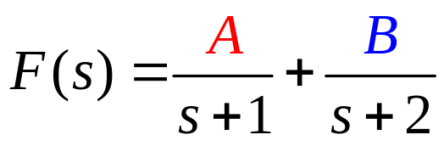
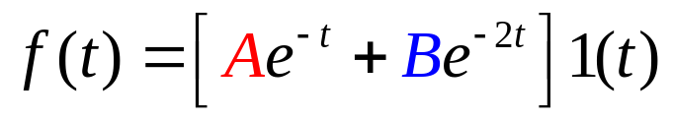
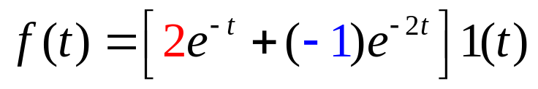
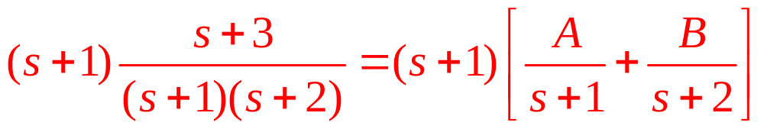
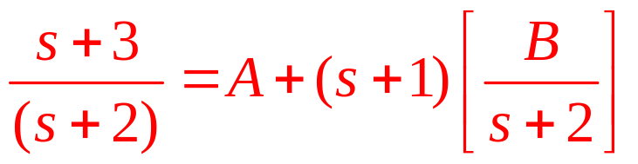
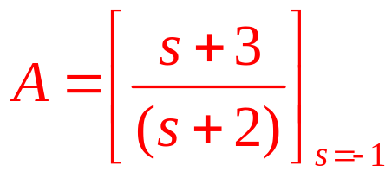

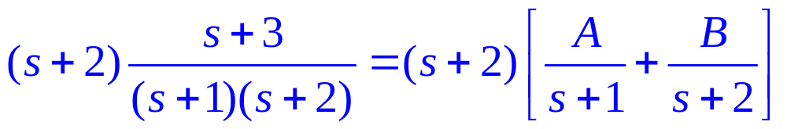

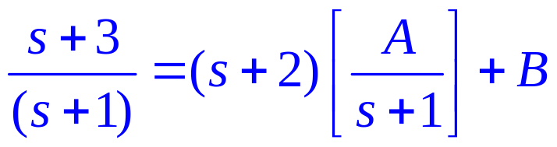
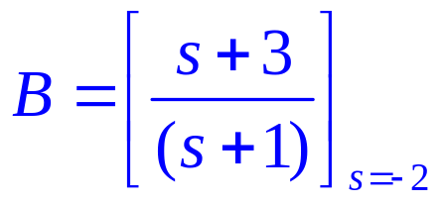
Inverse Laplace Transformation
A:
B:
1/13/2016
BITS, PILANI – K. K. BIRLA GOA CAMPUS

Slide 30
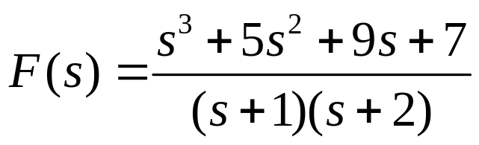
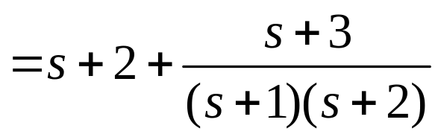
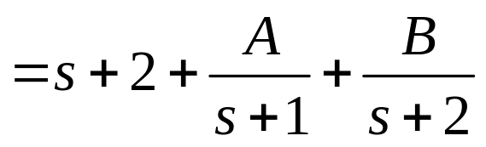
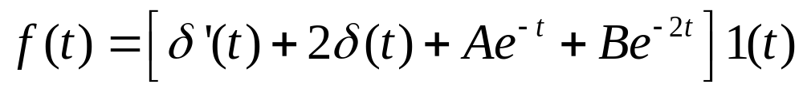

Inverse Laplace Transformation
A and B same as in previous problem.
1/13/2016
BITS, PILANI – K. K. BIRLA GOA CAMPUS

Slide 31











Inverse Laplace Transformation
1/13/2016
BITS, PILANI – K. K. BIRLA GOA CAMPUS

Slide 32












Inverse Laplace Transformation
1/13/2016
BITS, PILANI – K. K. BIRLA GOA CAMPUS

Slide 33

Laplace transform of a derivative
Note:
Lower case f indicates function of time.
Upper case F indicates function of s.
(Multiplication by s) = (differentiation wrt time)
1/13/2016
BITS, PILANI – K. K. BIRLA GOA CAMPUS

Slide 34








Solving DEs
Laplace transforms are the primary tool used to solve DEs in control engineering.
When initial
conditions are zero:
For non zero
initial conditions
1/13/2016
BITS, PILANI – K. K. BIRLA GOA CAMPUS

Slide 35











Solving DEs
1/13/2016
BITS, PILANI – K. K. BIRLA GOA CAMPUS

Slide 36









Solving DEs
No j’s in final answer.
1/13/2016
BITS, PILANI – K. K. BIRLA GOA CAMPUS

Slide 37


Some more example on Laplace Transform
Ex.1: Derive the Laplace transform of the input signal shown in figure
Solution:
1/13/2016
BITS, PILANI – K. K. BIRLA GOA CAMPUS

Slide 38

Ex.2: If a forcing function f(t) has the following Laplace transform, graph the function
1/13/2016
BITS, PILANI – K. K. BIRLA GOA CAMPUS
BITS Pilani - K. K. Birla Goa Campus

Slide 39

Solution of Ex. 2
1/13/2016
BITS, PILANI – K. K. BIRLA GOA CAMPUS

Slide 40

Example 3: The start-up procedure for a batch reactor includes a heating step where the reactor temperature is gradually heated to the nominal operating temperature of 75⁰C. The desired temperature profile T(t) is shown in Figure below. What is T(s)?
1/13/2016
BITS, PILANI – K. K. BIRLA GOA CAMPUS

Slide 41

Solution of Ex.3
1/13/2016
BITS, PILANI – K. K. BIRLA GOA CAMPUS

Slide 42


Example 4:
1/13/2016
BITS, PILANI – K. K. BIRLA GOA CAMPUS

Slide 43


Solution of Ex.4
1/13/2016
BITS, PILANI – K. K. BIRLA GOA CAMPUS

Slide 44

1/13/2016
BITS, PILANI – K. K. BIRLA GOA CAMPUS

Slide 45

Example 5:
1/13/2016
BITS, PILANI – K. K. BIRLA GOA CAMPUS

Slide 46

Solution of Ex.5
1/13/2016
BITS, PILANI – K. K. BIRLA GOA CAMPUS

Slide 47

Solution of Ex.5, Cont…..
1/13/2016
BITS, PILANI – K. K. BIRLA GOA CAMPUS
BITS Pilani- K. K. Birla Goa Campus

Slide 48
Thanks
1/13/2016
BITS, PILANI – K. K. BIRLA GOA CAMPUS

