Slide 1
Introduction to Scikit Flow
A simplified interface for TensorFlow

Slide 2
Installation
Have been moved to /tensorflow /contrib/learn
import tensorflow.contrib.learn as skflow

Slide 3
Features
Sklearn-like
Easily integrated with TensorFlow
Reducing tedious work needed to build models

Slide 4
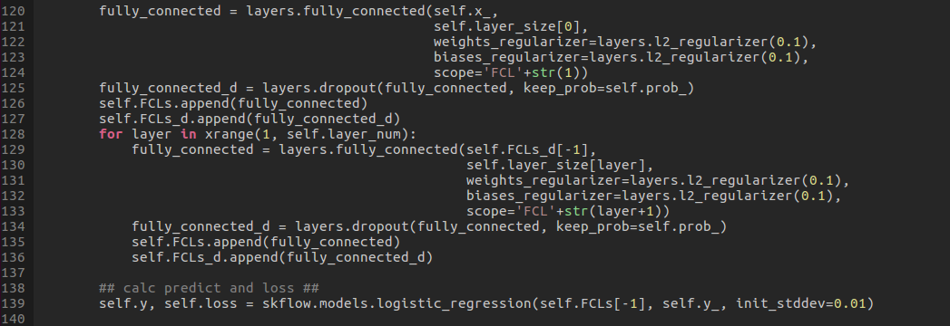
Features

Slide 5
Usages
High-level Operation Function
In /tensorflow/contrib/learn/python/learn/models.py &
/tensorflow/contrib/learn/python/learn/ops
E.g. linear_regression(), logistic_regression(), dnn()…
Some will be deprecated

Slide 6
Usages
A variety of Estimators
In /tensorflow/contrib/learn/python/learn/estimators/ &
/tensorflow/contrib/learn/python/learn/ops
E.g. Estimator(), TensorFlowEstimator(), DNNClassifier()…
DataFrame
An out-of-core input handling
Notes:
Use dask to perform out-of-core input handling

Slide 7
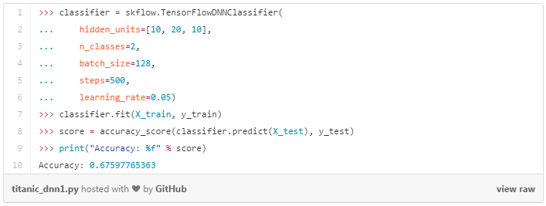
Examples
structure
Training(500 steps)
evaluate

Slide 8
Examples
TensorFlowLinearClassifier()
TensorFlowLinearRegressor()
TensorFlowRNNClassifier()……

Slide 9
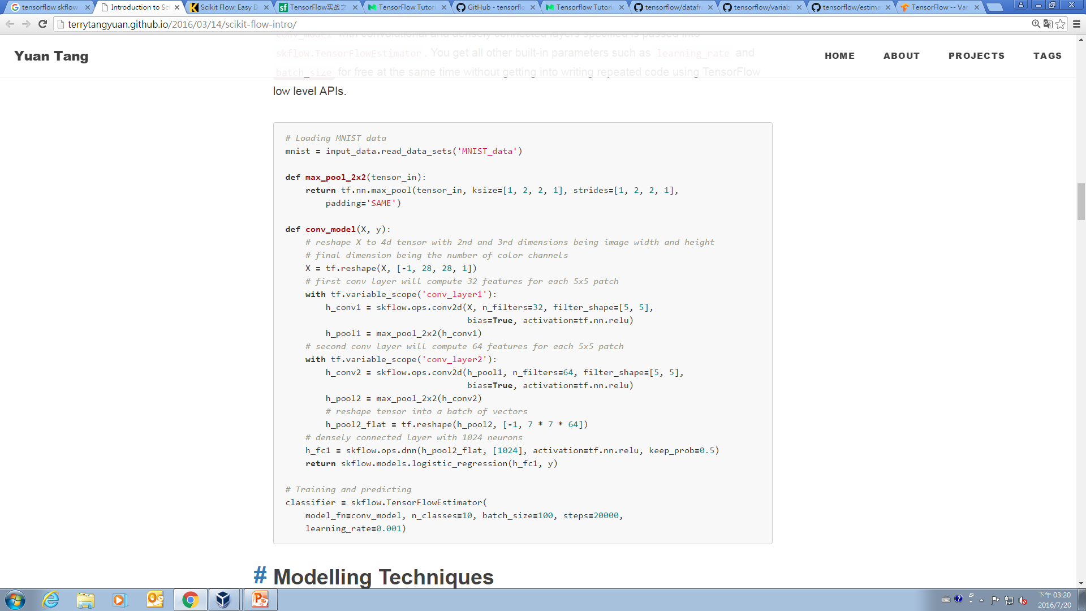
Self-defined Model
Self-defined model
Predict & loss
SkFlow layer

Slide 10
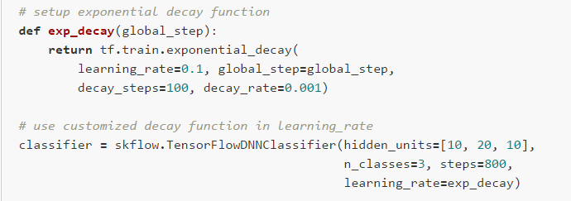
Learning rate decay func

Slide 11
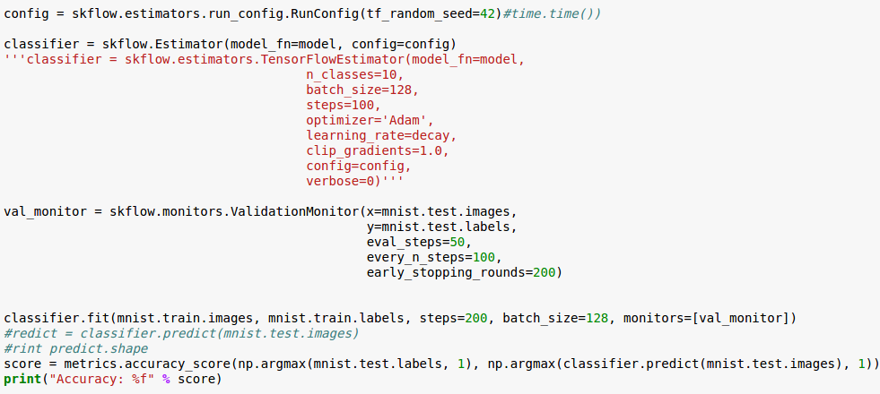
Early Stopping
Monitor

Slide 12
Model Building
tensorflow/Contrib/layers/python/layers
E.g. fully_connected(), dropout(), conv2d()
E.g. optimize_loss()
E.g. xavier_initializer()

