Slide 1
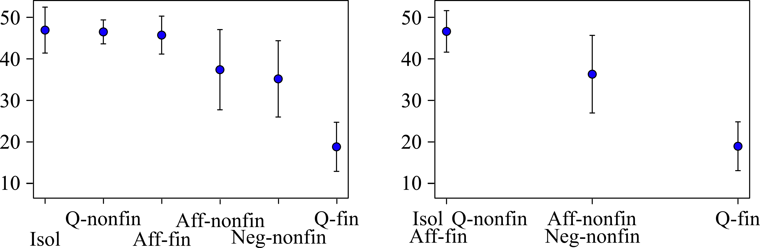
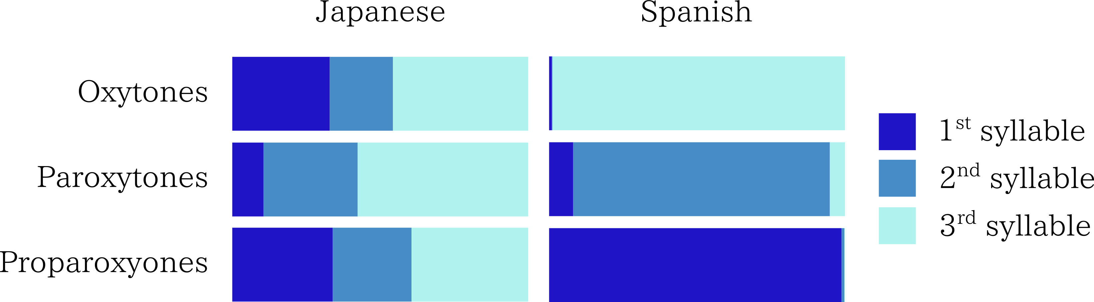
Influence of Sentence Intonation in the Perception of
Spanish Accent Position by Japanese Learners
José Joaquín ATRIA (1), Takuya KIMURA (2), Hirotaka SENSUI (3), Miyuki TAKASAWA (4) and Atsuko TOYOMARU (5)
1. Tokyo University of Foreign Studies; 2. Seisen University; 3. Nanzan University; 4. Waseda University; 5. Takushoku University.
Introduction
Procedure
And here go the conclusions.
Despite the phonological similarities that may be found between Japanese and Spanish, the way in which the accent is defined is still one of their main phonological differences. In Japanese, a “pitch accent” language, an accented mora is characterized by a falling pitch between itself and the unaccented mora which follows, and this is not affected by the intonation pattern of the utterance as a whole [1, 2]. On the other hand, accented syllables in a “stress accent” language like Spanish, while traditionally linked to a rise in pitch, need not be accompanied by it, and this rise is not only influenced by the pitch contour of the rest of the utterance, but it is also commonly found outside the boundaries of the accented syllable itself [3, 4].
This difference causes Japanese learners to incorrectly assess the position of the accent in Spanish utterances. This study aims to identify the contexts in which this difficulty arises, as well as introduce some possible related issues.
A perception experiment was performed in Salamanca (Spain) with native speakers of Spanish (43 subjects) and in Tokyo and Nagoya (Japan) with Japanese learners of Spanish (51 subjects).
We used the same target words that were used in [5]: 8 trios of words which differed only in the position of their accents for a total of 24 target words, 12 of them being meaningful Spanish words, and the remaining 12 being nonce words.
The bolded target words in Table 1 were tested in 6 different contexts, while the unbolded words were tested only in the first one:
Isolated (Isol): “X”
Affirmative-Final (Aff-fin): “Dijo la palabra X” / “He said the word X”
Affirmative non final (Aff-nonfin):
“Dijo la palabra X la semana pasada” / “He said the word X last week”
Negative non-final (Neg-nonfin):
“No dijo la palabra X la semana pasada. La dijo ayer”
“He didn't say the word X last week. He said it yesterday”
Interrogative Final (Q-fin):
“¿Dijo la palabra X?” / “Did he say the word X?”
Interrogative non-final (Q-nonfin):
“¿Dijo la palabra X la semana pasada?”
“Did he say the word X last week?”
 | Isol | Aff-fin | Aff-nonfin | Neg-nonfin | Q-fin | Q-nonfin
Isol | - | 0.81 | <0.05 | <0.01 | <0.01 | 0.9
Aff-fin | 0.81 | - | 0.35 | <0.05 | <0.01 | 1
Aff-nonfin | <0.05 | 0.35 | - | 0.96 | <0.01 | 0.26
Neg-nonfin | <0.01 | <0.05 | 0.96 | - | 0.06 | <0.05
Q-fin | <0.01 | <0.01 | <0.01 | 0.06 | - | <0.01
Q-nonfin | 0.9 | 1 | 0.26 | <0.05 | <0.01 | -
In preparation for the experiments, a native speaker from Cuenca, Spain, read each of the sentences in random order five times for a total of 270 utterances. These were later randomized once more and put into a sound file.
For the experiments, the participants listened to the sound file and were presented with a transcript of the utterance in which the target word was blanked. The task was to fill the blank with one of the three possible words, different only in the position of the accent. They were asked to leave no blanks unfilled.
To prevent fatigue, the experiments had 5-minute breaks every 90 items.
The Spanish speakers were able to correctly recognize the position of the accent with a high degree of certainty, responding correctly in 97.6% of the cases. The Japanese learners, on the other hand, had a much poorer performance, correctly determining the position of the accent in only 81% of them. This difference is statistically significant (t = 11.45, p < 0.01).
However, the performance of the Japanese subjects was not equal for all contexts. Of the six sentence contexts, Isol, Aff-fin and Q-nonfin presented the least difficulty, whereas Q-fin proved to be the most difficult (Figure 1).
As suggested by earlier tests [6], results from contexts Isol, Aff-fin and Q-nonfin can be safely aggregated into a single larger one, as do those for contexts Neg-nonfin and Aff-nonfin, resulting in the three larger clusters shown in Figure 2. Results of Scheffe's multiple comparison, shown in Table 3, support this aggregation.
Results
Table 3: Scheffe's multiple comparison for all contexts. Results support the aggregation of data in Figure 2.
Discussion
Method
The aggregation of data shown in Figure 2 clearly demonstrates that the context has an effect on our Japanese subjects’ perception of the Spanish accent, with a high success rate on Isol, Q-nonfin and Aff-fin contexts, and a remarkably lower rate apparent exclusively in Q-fin.
In the former three, a declining intonation reduces the amount of noise in the perception of the target word’s pitch contour, and makes it much more likely for Japanese learners to identify a rise in pitch as a telling sign that a syllable is stressed. This occurs even in Q-nonfin since a long interrogation like that is broken down into IPs. On the other hand, a sentence like those used in Q-fin places the target word in a rising pitch, making it harder to differentiate information pertaining to the interrogation toneme from that related to the syllable’s stress. Aff-nonfin and Neg-nonfin can also be explained in these terms, since in these contexts the target words are also at the end of an IP, but the pitch contour of the second IP is always falling.
In order to more correctly understand the nature of the influence context has on perception, further analysis is required. However, a comparison between the responses given by Japanese and Spanish subjects to differently accented target words in a Q-fin context seems to indicate that there might be a connection with existing accent types in Japanese, and the way in which these are transported into perception of Spanish utterances.
Materials
 | Spanish speakers | Japanese learners
Number of subjects | 43 | 51
Mean correct responses | 263.51 | 218.57
SD | 9.07 | 23.72
Nonce Words |  |  | Meaningful Words
Núlido | Nulido | Nulidó | Número | Numero | Numeró
Ládebo | Ladebo | Ladebó | Válido | Valido | Validó
Lúguido | Luguido | Luguidó | Médico | Medico | Medicó
Málebo | Malebo | Malebó | Límite | Limite | Limité
Table 2: Correct responses for Spanish and Japanese subjects.
The nature of the influence
Table 1: Target words used in our experiments
Fig.1: Japanese subjects who answered correctly per context. (Mean ± SD)
Fig.2: Aggregated context results for Japanese subjects. (Mean ± SD)
Figure 3: Syllables perceived as stressed for all kinds of target words in Q-fin context for both groups of subjects.
[1] Saito, Y., Nihongo Onseigaku Nyuumon [Kaiteiban] (Introduction to Japanese Phonetics [Revised edition]), Sanseido, Tokyo, 2006. [2] Vance, T. J., The Sounds of Japanese, Cambridge University Press, 2008. [3] Quilis, A., Fonética acústica de la lengua española, Madrid, Gredos, 1981. [4] Hualde, J. I., The Sounds of Spanish, Cambridge University Press, 2005.
[5] Llisterri, J., Machuca, M. J., de la Mota, C., Riera, M., Ríos, A., “The perception of lexical stress in Spanish”, in Solé, M. J., Recasens, D., Romero, J. (Eds.) Proceedings of the 15th International Congress of Phonetic Sciences. Barcelona, 3-9 August 2003. Causal Productions pp. 2023-2026, 2003.
[6]Kimura, T., Sensui, H., Takasawa, M., Toyomaru, A., Atria, J.J., A Pilot Study on Perception of Spanish Stress by Japanese Learners of Spanish, Proceedings of the Interspeech 2010 Satellite Workshop on Second Language Studies, 2010.

