Slide 1
Large Language Models for Generative AI
AIML* ZG536
Dr. Monali Mavani

Slide 2

Large Language Models for Generative AI
Disclaimer and Acknowledgement
The content for these slides has been obtained from books and various other source on the Internet
I here by acknowledge all the contributors for their material and inputs.
I have provided source information wherever necessary
I have added and modified the content to suit the requirements of the course

Slide 3
Handout

Slide 4

Evaluation
Component | Details | Weightage
Assignments | Plan will be shared by second week | 35%
Mid-term Exam | Closed Book | 30%
End Semester Exam | Open Book | 35%

Slide 5
Agenda
Introduction to LLMs and Generative AI
  Probabilistic Language Models
  Conditional generation of text
  LLM and Generative AI
Building blocks of LLM
  Tokenization: BPE, Byte-level BPE
  Token Embeddings and positional encoding
  Language Modelling Head
LLM landscape

Slide 6
Introduction to LLMs and Generative AI

Slide 7
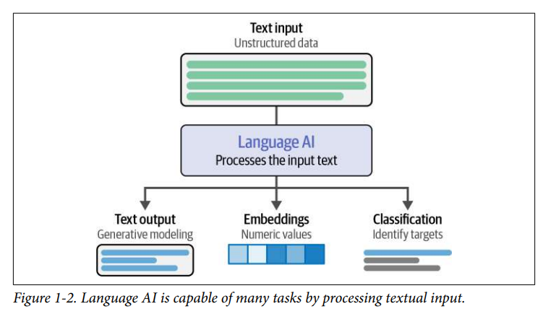
Language AI

Slide 8
Probabilistic Language Models
A language model assigns probabilities to sequences of tokens. It can compute either:
1 Probability of a sentence
P(W) = P(w₁, w₂, …, w_{n})
Probability of the next token
P(w_{n} | w₁, …, w_{n−1})
They are equivalent (chain rule): P(w₁, …, w_{n}) = ∏ P(w_{i} | w₁, …, w_{i−1}) → predict the next token well, and you can score any sentence
Example: P(all of a sudden I notice three guys standing on the sidewalk) high
> P(on guys all I of notice sidewalk three a sudden standing the) low
How LMs evolved
n-gram
count last n−1 words
Neural LM
learned embeddings
RNN / LSTM
sequential memory
Transformer
attention: GPT, Llama, Qwen
Hybrid
attention + Mamba (Jamba)

Slide 9
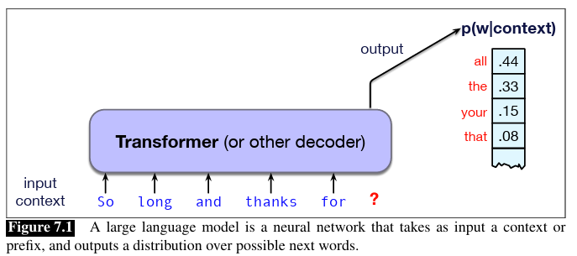
What is a Large Language Model?
LLMs are deep neural networks (Transformers) trained with self-supervised next-token prediction on massive, filtered text corpora: web data, code, books and papers (e.g. ~15T tokens for Llama 3, ~36T for Qwen3).
“Large” refers to:
  Parameters: billions (Llama 3: 8B–405B; DeepSeek-V3: 671B total, ~37B active per token)
  Training data: trillions of tokens
  Context window (often also implied): from 2K tokens (GPT-3) to 128K+ (Llama 3.1, Qwen3)

Slide 10
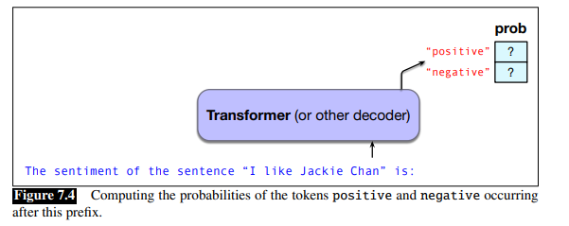
Conditional generation of text
Almost any NLP task can be modeled as word prediction in a large language model
E.g. Sentiment classification:
P(“positive”|“The sentiment of the sentence ‘I like Jackie Chan’ is:”)
P(“negative”|“The sentiment of the sentence ‘I like Jackie Chan’ is:”)
E.g. Question Answering
P(w|Q: Who wrote the book ‘‘The Origin of Species"? A:)
Then vs now: one fine-tuned model per task (e.g. BERT + classifier) → one LLM, many tasks, via the prompt

Slide 11
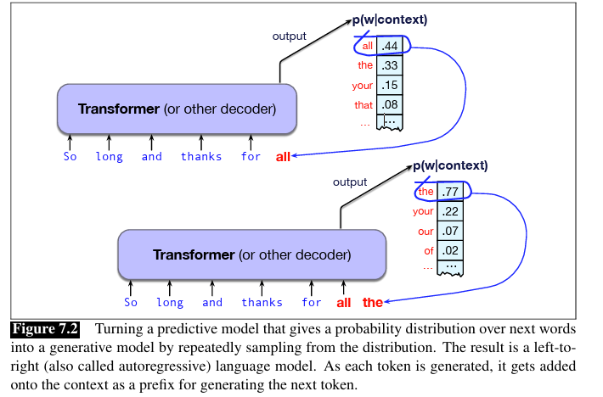
Generative AI
Fundamental intuition of language models
  A model that can predict text (assigning a distribution over following words) can also be used to generate text by sampling from the distribution. (sampling means to choose a word from a distribution)
  Called as autoregressive language model
The process of generating natural language text with LLMs is called decoding.
The idea of using computational models to generate text, code, speech, images, video, audio, constitutes the important new area called Generative AI

Slide 12
Building blocks of LLM
  Tokenization: BPE, Byte-level BPE
  Token Embeddings and positional encoding
  Attention Mechanism & Transformer
  Language Modelling Head

Slide 13
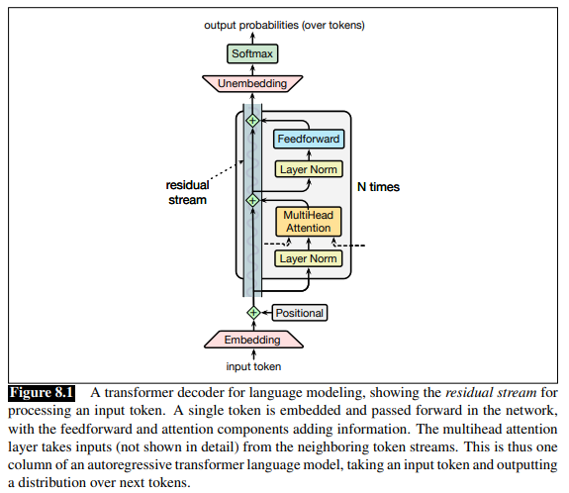
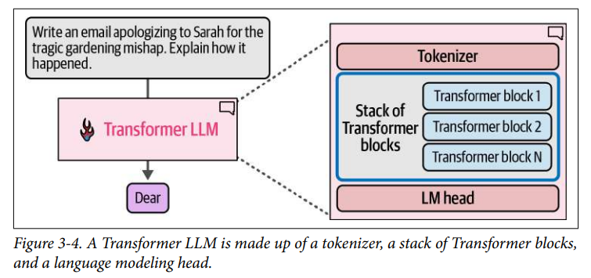

Transformer LLM
We use transformers to create generative models
by using only decoders
Attention = talk between tokens.
FFN = think per token.
Residual stream = each sub-layer adds to X, never replaces it.

Slide 14
Tokenization

Slide 15
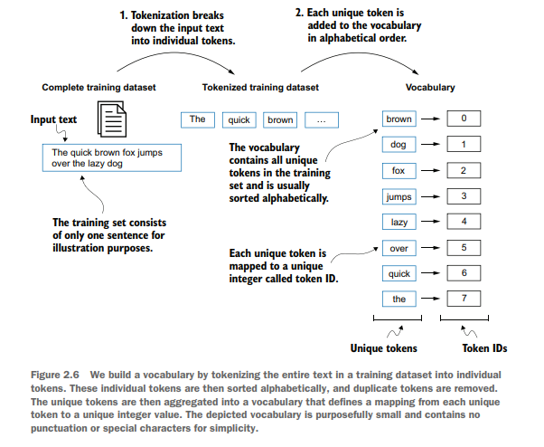
Vocabulary Building

Slide 16
Word structure and subword models
Common words get their own token; rare words are split into (sometimes intuitive, sometimes not) pieces.
Worst case: a word splits into as many tokens as it has characters (or bytes).
Notation note
## marks a continuation in WordPiece (BERT).
Byte-level BPE (GPT, Llama, Qwen) marks a leading space instead: Ġtasty
word
vocab mapping hat
learn
taa## aaa## sty la## ern## Transformer## ify
embedding
hat learn
taaaaasty laern
→
→
→
→
Common
words
Variations
misspellings
novel items
Transformerify →

Slide 17
Types of tokens
Word tokens (e.g. word2vec)
Cannot handle words unseen in training (OOV). Near-duplicates waste vocab: apology, apologize, apologist.
Text: unhappiness!
Word
unhappiness
!
Subword
un
happi
ness
!
Subword tokens
New words split into known pieces. Used by every modern LLM.
Character
u
n
h
a
p
p
i
n
e
s
s
!
Byte
"Apple" → 65 112 112 108 101 (5)
"क" (1 Hindi char) → 224 164 149 (3)
Byte tokens
Vocab = 256 UTF-8 bytes, so nothing is ever OOV, but sequences get much longer. Byte-level model: ByT5. (CANINE is character-level.)
Subword split shown is illustrative; real splits depend on the learned vocabulary.
Byte-level BPE = subword merges built on top of bytes (used by Llama, Qwen, DeepSeek, gpt-oss)

Slide 18
Subword tokenization
Three common algorithms:
  Byte-Pair Encoding (BPE) (Sennrich et al., 2016)
  Unigram language modeling tokenization (Kudo, 2018)
  WordPiece (Schuster and Nakajima, 2012)
Vocabulary is built dynamically
  Frequent words get assigned their own tokens
  Rare words are split into sub-words
Every tokenizer has two parts
Training corpus
hug pug pun bun hugs
→
Token learner
runs BPE
→
Vocabulary + merge rules
Once, at training time
New text
hugs
→
Token segmenter
applies rules
→
Tokens → IDs
[hug, s] → [12, 5]
On every input, at inference

Slide 19
Byte Pair Encoding
Pre-tokenize: split the corpus into words (rule-based)
Construct a word dictionary with frequency counts : ("hug", 10), ("pug", 5), ("pun", 12), ("bun", 4), ("hugs", 5)
Start from single characters; count adjacent pairs
Merge the most frequent pair into a new token
Repeat 3–4 until the target vocab size
Find the most frequent adjacent pair across all words, weighted by word frequency:
(“u”,”g”) → hug 10 + pug 5 + hugs 5 = 20
(“p”,”u”) → pug 5 + pun 12 = 17
(“u”,”n”) → pun 12 + bun 4 = 16
(“h”,”u”) → hug 10 + hugs 5 = 15
Merge the winner: (“u”,”g”) → new token “ug”, added to the vocabulary: [b, g, h, n, p, s, u, ug]
Repeat on the updated corpus until the vocabulary reaches the target size

Slide 20
Byte Pair Encoding
Iteration | Current Vocab | Tokenization of Words
1 | ["b", "g", "h", "n", "p", "s", "u"] | ("h" "u" "g", 10), ("p" "u" "g", 5), ("p" "u" "n", 12), ("b" "u" "n", 4), ("h" "u" "g" "s", 5)
2 | ["b", "g", "h", "n", "p", "s", "u", "ug”] | ("h" "ug", 10), ("p" "ug", 5), ("p" "u" "n", 12), ("b" "u" "n", 4), ("h" "ug" "s", 5)
3 | ["b", "g", "h", "n", "p", "s", "u", "ug” “un”] | ("h" "ug", 10), ("p" "ug", 5), ("p" "un", 12), ("b" "un", 4), ("h" "ug" "s", 5)
4 | ["b", "g", "h", "n", "p", "s", "u", "ug” “un”, “hug”] | ("hug", 10), ("p" "ug", 5), ("p" "un", 12), ("b" "un", 4), ("hug" "s", 5)
Segmenter: apply merges in learned order
bug → b u g → b ug
hugs → h u g s → h ug s → hug s
But what about mug?
"m" is not in the vocabulary → [UNK].
Fix: start from 256 bytes, not characters → byte-level BPE

Slide 21
Byte-level BPE
Byte-level BPE is a subtype of BPE that uses bytes instead of characters as basic token component.
Vocabulary is not created based on characters, but based on bytes.
Characters are decomposed as the associated sequence of bytes in the unicode representation
E.g.
  “u” = 117
  “g” =103
  After first merge "ug"”= bytes [117 103]
  vocabulary simply records “ID 256 = bytes [117 103] = "ug"”
This removes completely the possibility of unseen characters and saves space when representing individual elements (i.e. bytes) in the vocabulary.

Slide 22
Byte Pair Encoding
Advantages:
Efficient handling of rare words and subword units.
Reduces the vocabulary size, making the model more efficient.
Helps in better generalization by breaking down words into subword units.
Limitations:
Can produce fragmented tokens for some languages, especially those with complex morphology.
May not capture semantic meaning as effectively as other tokenization methods.

Slide 23
SentencePiece
Open-Source Framework: Developed by Google, SentencePiece is a subword tokenization library implementing both BPE and Unigram Language Model algorithms.
Language-Agnostic (No Pre-Tokenizer Needed): Operates directly on raw text streams without relying on language-specific word splitters, making it effective for unsegmented languages such as Chinese, Japanese, and Thai.
Architectural Legacy: Served as the core tokenization backend for foundational models including Google's T5 and Gemma, as well as Meta's Llama 1 and 2.
Subword case · "Tokenization matters"
Input: Tokenization matters
Whitespace-marked: ▁Tokenization▁matters
Pieces:
▁Token
ization
▁matters

Slide 24
Which tokenizer framework should I use?
Claude & Gemini: no full local library, so count tokens via their API.
What are you trying to do?
Train a new tokenizer
(or extend one)
Build an open-source
model pipeline
Work with OpenAI
API models
Hugging Face tokenizers
Hugging Face tokenizers
OpenAI tiktoken
Custom BPE / Unigram training
Normalisation & pre-tokenisation rules
Choose your own vocab size
Loads any HF Hub model's tokenizer
Chat templates + special tokens
Llama 3, Qwen3, DeepSeek, gpt-oss, Gemma
Fast, exact token counting
API cost estimation
Encode/decode only, cannot train
HF: you tokenize, then the model runs. API: the server tokenizes, and you use tiktoken only to count and trim.

Slide 25
Token Embeddings and positional encoding

Slide 26
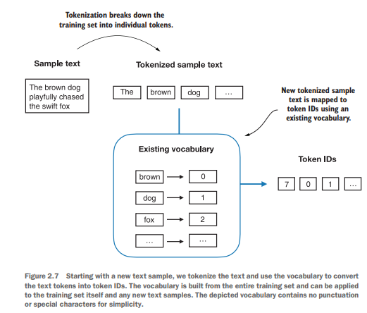
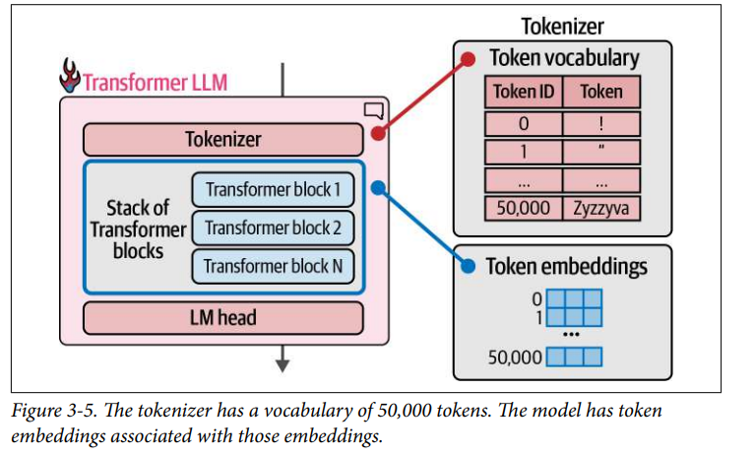
Tokens to token IDs

Slide 27
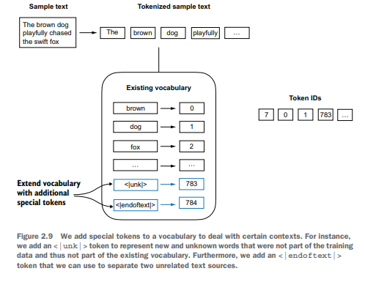
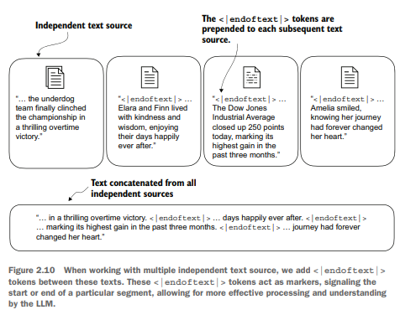
Adding special context tokens

Slide 28
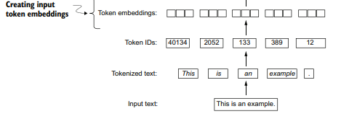
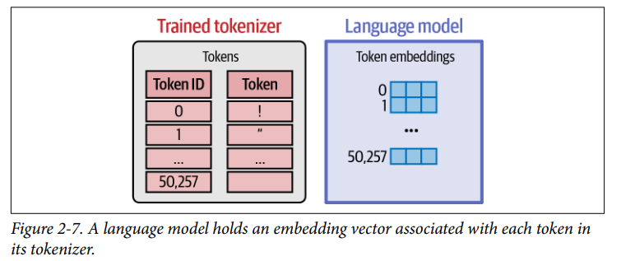
Token IDs to Token Embeddings

Slide 29
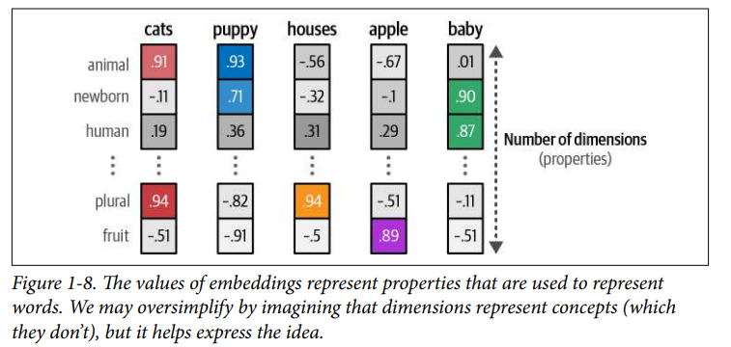
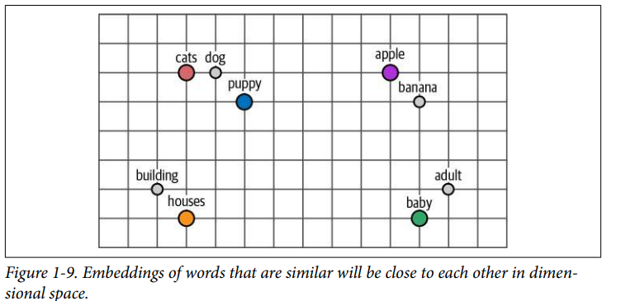
Embeddings

Slide 30
Embedding layer: look up a row
E (|V| × d) has one row per vocabulary token. Values start random and are learned during training.
1 Text → token IDs
fox jumps over dog
↓
[ 2, 3, 5, 1 ]
2 Pick row ID from E (here 6 × 3)
3 Stack rows in input order → X (n × d)
ID | token | dim 1 | dim 2 | dim 3
0 | brown | 0.34 | −0.18 | −0.17
1 | dog | 0.92 | 1.58 | 1.30
2 | fox | 1.28 | −0.20 | −0.16
3 | jumps | −0.40 | 0.97 | −1.15
4 | lazy | −1.16 | 0.33 | −0.63
5 | over | −2.84 | −0.78 | −1.41
token | dim 1 | dim 2 | dim 3
fox | 1.28 | −0.20 | −0.16
jumps | −0.40 | 0.97 | −1.15
over | −2.84 | −0.78 | −1.41
dog | 0.92 | 1.58 | 1.30
n = 4 tokens, d = 3
Same token → same vector, wherever it appears. Position is added separately (positional encoding).
Real scale: Llama 3 8B: E is 128,256 × 4096 ≈ 525M parameters.

Slide 31
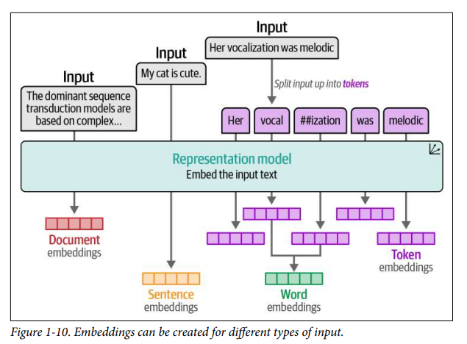
Types of text embeddings

Slide 32
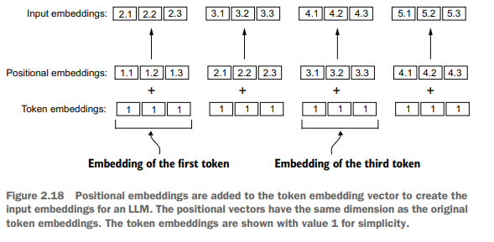
Positional embeddings

Slide 33
Positional Encoding
Attention has no inherent sense of order, so position information must be injected for the model to infer sequence structure
Learned positional embeddings (GPT-2, BERT): a trainable lookup table with one vector per position, added to the token embeddings
Sinusoidal encodings (original Transformer): fixed sine/cosine functions at multiple frequencies, added to the token embeddings
Rotary Positional Embeddings, RoPE (Llama, Qwen, DeepSeek): not added to the input; rotates Q and K inside every attention layer so scores depend on relative position (covered in the Advanced Architectures session)

Slide 34
Language Modelling Head : Unembedding layer + Softmax layer

Slide 35
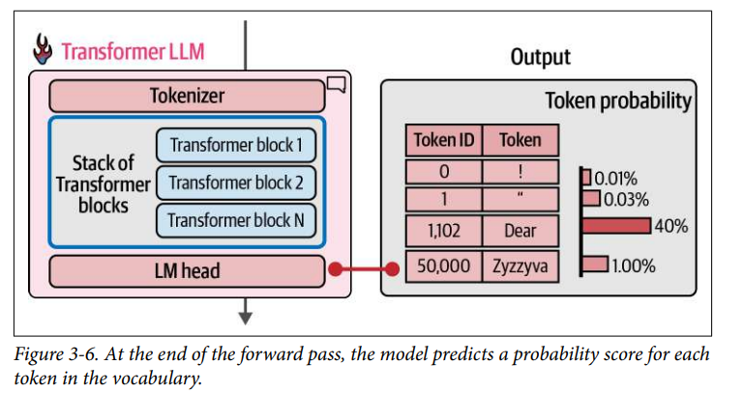
Language Modelling Head
LM maps the final hidden state at each position to vocabulary logits; during training, each position predicts the next token, while during inference the last position is used to generate the next token.

Slide 36

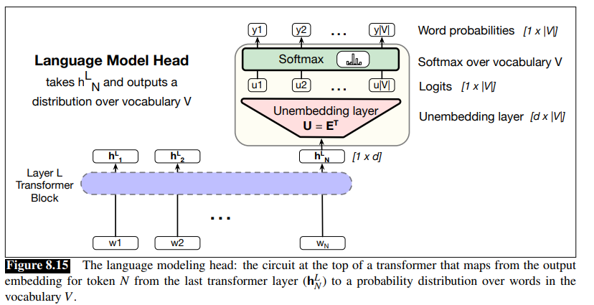
Language Modeling Head
h^{L}_{N} = output token embedding at position N from the final block L (shape of [1×d)
U= (1 × |V|), logits, one score per token
Unembedding matrix (E^{T}) can be tied to Embedding matrix (E)
A softmax layer turns the logits u into
the probabilities y over the vocabulary
Training: logits at all n positions in parallel (n predictions)
Inference: only the last position
Size: d × |V| = 4096 × 128K ≈ 525M params in Llama 3 8B, so a bigger vocab = bigger head.
Softmax probabilities (y) can be used
  To help assign a probability to a given text
  To generate text, (By sampling a word from these probabilities y)

Slide 37
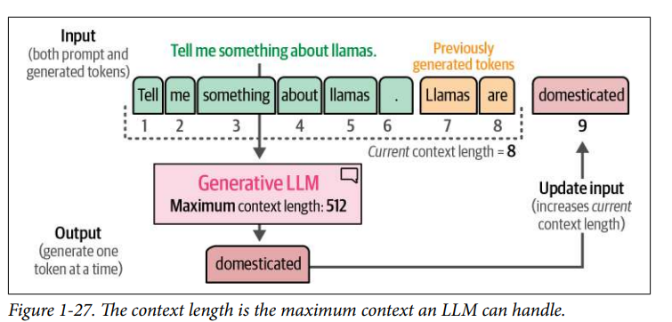
Context length
Context length represents the maximum number of tokens the model can process
Due to the autoregressive nature of these models, the current context length will increase as new tokens are generated

Slide 38
Language models landscape
Early foundation models (late 2010s)
ELMo: pretraining with LSTMs, fine-tuning helps tasks
BERT: pretraining with Transformer, fine-tuning helps tasks
Google's T5 (11B): cast everything as text-to-text
Embracing scaling, more closed
OpenAI's GPT-2 (1.5B): fluent text, first signs of zero-shot, staged release
Scaling laws: provide hope / predictability for scaling, Kaplan law
OpenAI's GPT-3 (175B): in-context learning, closed
Google's PaLM (540B): massive scale, undertrained
DeepMind's Chinchilla (70B): compute-optimal scaling laws
Open models
EleutherAI's open datasets (The Pile) and models (GPT-J)
Meta's OPT (175B): GPT-3 replication, lots of hardware issues
Hugging Face / BigScience's BLOOM: focused on data sourcing
Meta's Llama models
Alibaba's Qwen models
DeepSeek's models
AI2's OLMo 2

Slide 39
Language models landscape
Levels of openness
  Closed models (e.g., GPT, Gemini, Claude): API access only
  Open-weight models (e.g., Llama, DeepSeek, Qwen): weights available, paper with architecture details, some training details, no data details
  Open-source models (e.g., OLMo): weights and data available, paper with most details (but not necessarily the rationale, failed experiments)

Slide 40
Recent models
Model Family | Key Release | Primary Strength
OpenAI | GPT-6 | Deep reasoning, tool use, and long-horizon research tasks
Google | Gemini 4 | Complex problem-solving, multimodal understanding, and tool-based workflows
Google | Gemma 4 | Open-weight reasoning, multimodal understanding, and agentic workflows
Anthropic | Claude Opus 5.5 | Long-context reasoning, coding, and sustained agentic work
Alibaba | Qwen3.x series | Open-weight dense and MoE models across sizes; a common base for fine-tuning
DeepSeek | DeepSeek V4.1 | Open-weight models; RL-driven reasoning lineage from DeepSeek-R1
Mistral | Mistral Large 4 | Efficient sparse MoE design (public preview)
xAI | Grok 4.7 | Parallel multi-agent research and collaborative task execution

Slide 41
References
Speech and Language Processing (3rd ed. draft) Dan Jurafsky Jan 2026 - Ch- 2, 7, 8
Hands-On Large Language Models – Jay Alamar : Ch-1,2,3
Build a Large Language Model (From Scratch) SEBASTIAN RASCHKA : Ch-1,2
https://huggingface.co/learn/llm-course/en/chapter6/5
Research Papers
Neural Machine Translation with Byte-Level Subwords

Slide 42
Addidtional Review slides

Slide 43
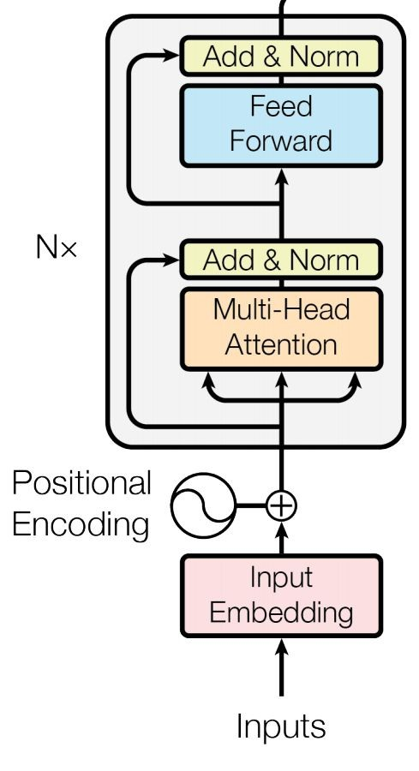
Encoder-Only Models (e.g., BERT, RoBERTa)
Encoder-based LLMs learn contextual understanding rather than free-form generation.
Architecture: Transformer encoder stacks with bidirectional self-attention
Training Objective: MLM, where you randomly mask tokens and predict them using both left and right context.
Context: Bidirectional
Strengths: Excels at comprehension tasks such as classification, NER, and sentiment analysis because it builds dense semantic representations.
Weaknesses: Not naturally generative; requires adapter heads or fine-tuning for sequence output
Example: BERT remains a reference model for tasks that require deep bidirectional context.

Slide 44
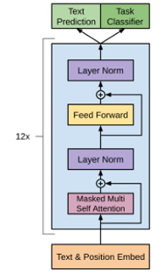
Decoder-Only Models (e.g., GPT, LLaMA)
GPT 1
Decoder-based LLMs are trained to predict the next token given all previous ones, capturing temporal dependency through autoregression (progressively generating sequence of outputs).
Architecture: Transformer decoder stacks with causal masking that blocks access to future tokens
Training Objective: CLM, where you minimize cross-entropy over next-token predictions
Context: Unidirectional (left-to-right) to maintain causal structure
Strengths: Outstanding at open-ended text generation, dialogue, code completion, and story synthesis
Weaknesses: Less efficient for classification or bidirectional reasoning
Example: GPT models, Meta’s LLaMA series etc.

Slide 45
Encoder-Decoder Models (e.g., T5, BART)
These models bridge the understanding and generation paradigms by pairing an encoder (MLM-like) with a decoder (CLM-like)
Architecture: An encoder transforms the input sequence into contextual representations; a decoder generates outputs via cross-attention
Training Objective: Sequence-to-sequence learning-often formulated as translation or summarization-and sometimes a span-corruption variant of MLM as in T5
Strengths: Effective for translation, summarization, and multimodal pipelines where the input and output domains differ
Weaknesses: Dual stacks increase training complexity and inference latency.
Example: T5 and BART use span-corruption pre-training and autoregressive decoding; multimodal systems (speech-text, vision-language) extend the same blueprint

Slide 46
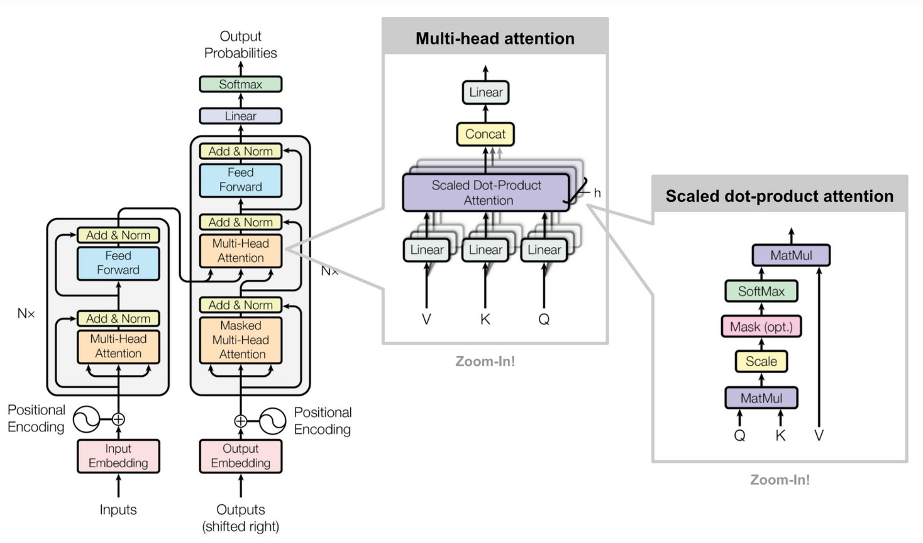
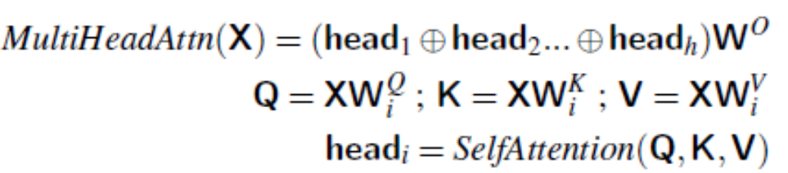
Transformer Encoder-Decoder

