Slide 1
Large Language Models for Generative AI
AIML* ZG536
Dr. Monali Mavani

Slide 2

Large Language Models for Generative AI
Disclaimer and Acknowledgement
The content for these slides has been obtained from books and various other source on the Internet
I here by acknowledge all the contributors for their material and inputs.
I have provided source information wherever necessary
I have added and modified the content to suit the requirements of the course

Slide 3
Agenda
LLM Pre-training
Pre-training Objectives
Pre-training Data
Scaling Laws
Domain Adaptation
Pretraining of popular frontier models

Slide 4
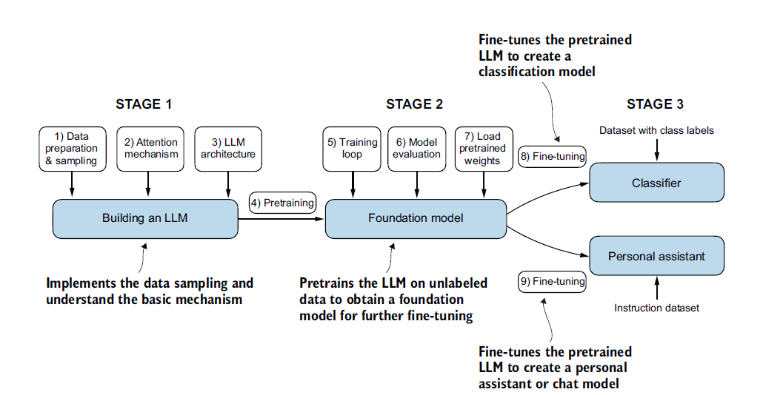
Building a large language model

Slide 5
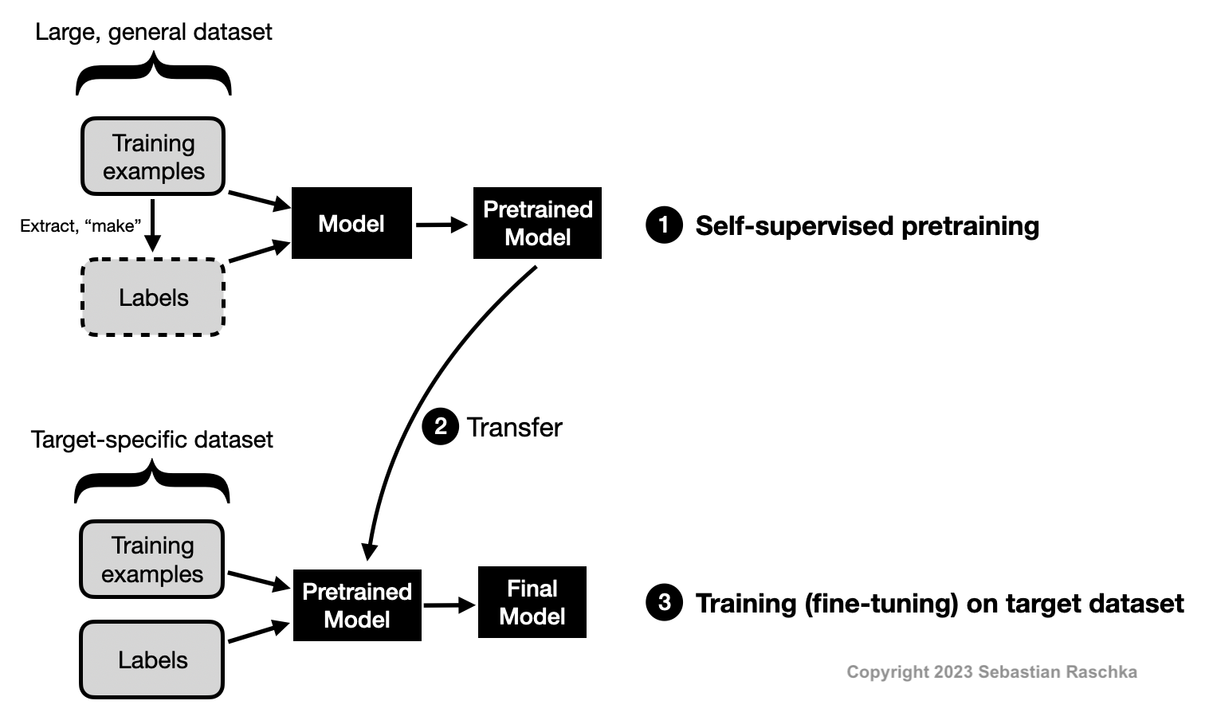
Self-Supervised Learning
The model learns language by reading vast amounts of text and predicting hidden parts of it
No human labels: the label is taken from the text itself (GPT: the next token; BERT: a masked token)
These made-up prediction tasks are called pretext tasks: not the goal, but they force the model to learn grammar, facts and meaning
Every token in the corpus is a free training example, so it scales to trillions of tokens
https://sebastianraschka.com/faq/docs/self-supervised.html

Slide 6
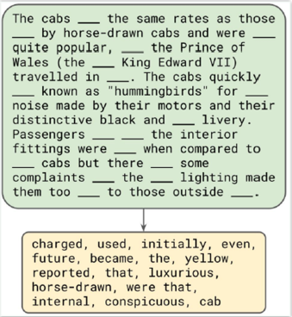
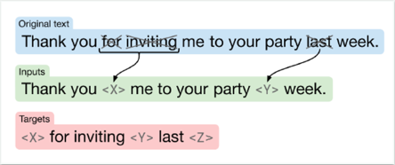
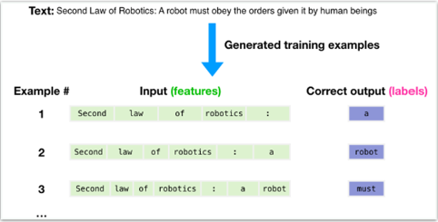
Pre-training objectives
Encoder-only
BERT (Devlin et al., 2018)
Encoder-decoder
T5 (Raffel et al., 2019)
Decoder-only
GPT-2/3, Llama 3, Qwen3, DeepSeek-V3
Masked language modeling (MLM)
Hide ~15% of tokens; predict them using context on both sides
Span corruption (denoising)
Replace spans with sentinels <X>, <Y>; decoder generates the missing spans
Causal language modeling (CLM)
Predict the next token from the previous ones only (left to right)
Modern LLMs use CLM: next-token prediction trains generation directly, which MLM does not.
Figures: taoyds.github.io/courses/comp3361

Slide 7
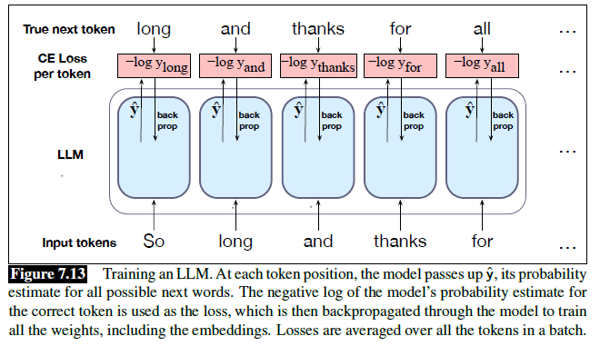
LLM training
Teacher forcing
The input at each position is the true previous token, not the model's own guess (unlike generation).
All positions in parallel
One forward pass computes every position's loss at once; the causal mask stops each token seeing the future.
Updates everything
The loss is backpropagated through all weights, including the embeddings.
Cross-entropy loss over a sequence of T tokens: L = −(1/T) Σ_{t} log P(w_{t+1} | w_{≤t}) Perplexity = exp(L)
Lower perplexity = better next-token prediction.
Scale: Llama 3 was pre-trained on ~15T tokens. Each token position is a training example, so no labelling is needed.

Slide 8
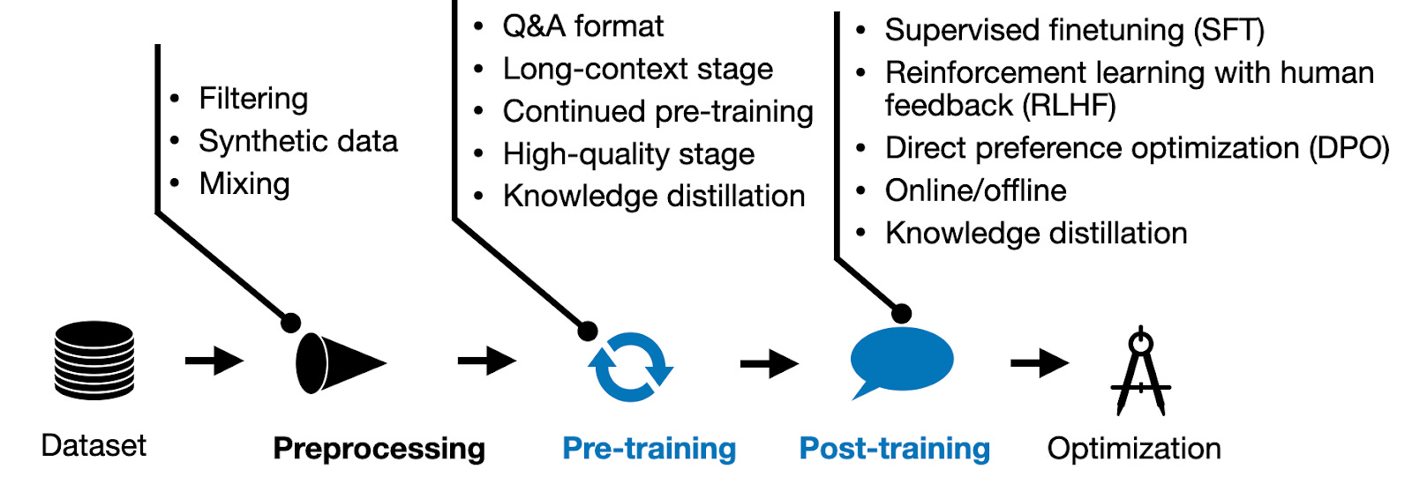
Modern LLM development and training pipeline
Credits: https://magazine.sebastianraschka.com/p/new-llm-pre-training-and-post-training

Slide 9
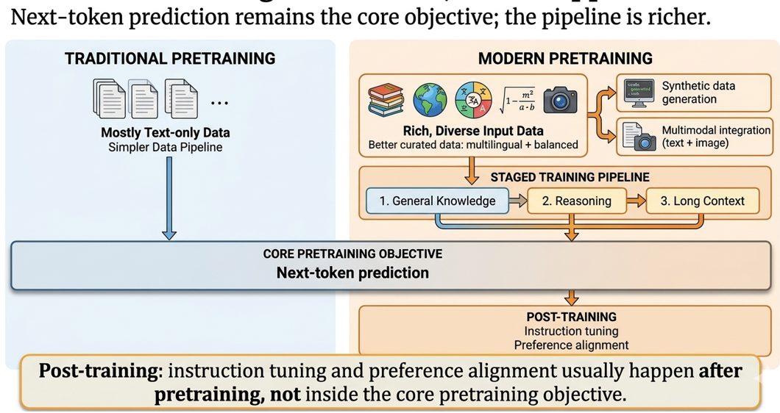
Modern pre-training

Slide 10
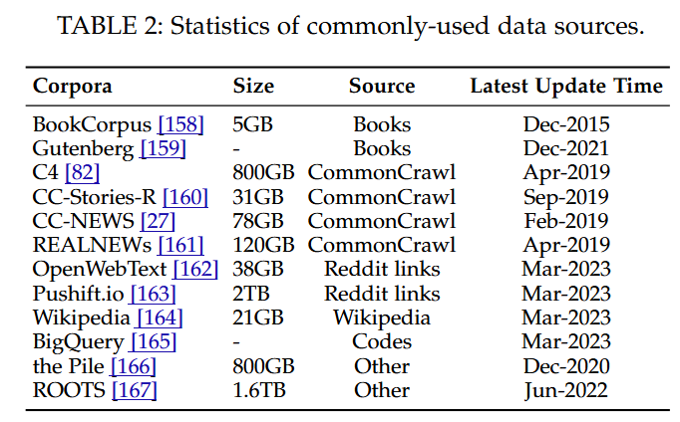
Commonly Used Corpora for Pre-training
Today’s open corpora: FineWeb (15T tokens), RedPajama-V2 (30T), Dolma (3T, OLMo), The Stack v2 (code).

Slide 11
Pre-training data pipeline
Raw web text is mostly noise. Each stage removes something before the model sees it.
Raw corpus
1 Filter
2 De-duplicate
3 Remove PII
4 Tokenize + pack
Web crawl, books, code, papers
Drop low-quality, spam, wrong-language text
Drop repeated sentences and near-copy documents
Mask names, emails, phone numbers
Byte-level BPE, then pack docs into full context windows
Common Crawl, GitHub, arXiv, Wikipedia
Alice is writing a paper. #$^&
→ "#$^&" removed
same paragraph on 50 sites
→ keep 1
Alice → [Somebody]
abc@x.com → [EMAIL]
doc1 <eos> doc2 <eos> doc3
→ no wasted padding
Why de-duplicate?
Repeated text is memorised
Wastes compute on the same tokens
Prevents test-set contamination: benchmark text in training inflates scores
How: n-gram / MinHash overlap between documents
How filtering is done
Heuristics (cheap): language ID, length, block lists etc.
Classifier: train a small model on high-quality text, keep what scores well

Slide 12
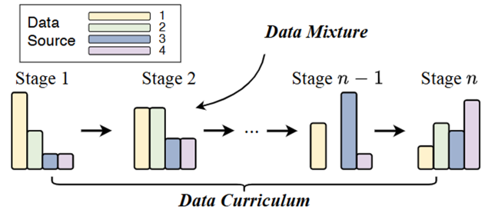
Data mixture and curriculum
Pre-training data is not fed in randomly from one pool. Sources (web, code, math, books…) are mixed in chosen proportions, and the mix changes over training.
Data mixture: what proportion of each source to use, e.g. more code to improve coding ability.
Data curriculum: how the mixture changes across stages: start with easy, general data, then add harder or specialised data (math, code, long documents).
In practice: Llama 3
Annealing: in the final stage, the learning rate is lowered to zero while high-quality data (math, code) is upsampled.
Result: Llama 3 8B improved notably on math benchmarks (GSM8K, MATH); gains on 405B were negligible, since larger models already learn well from the general mix.
Long context is also a curriculum: context length was raised gradually from 8K to 128K tokens in stages.

Slide 13
Why scaling laws?
The problem
Training a large LLM costs millions of dollars and runs once. You must decide before you start:
  How big should the model be? (N = number of parameters)
  How much text should it read? (D = number of training tokens)
  Both cost compute: C ≈ 6 × N × D FLOPs for a conventional dense Transformer, as a rough estimate.
  A fixed budget means a bigger model gets less data, and vice versa.
The solution – scaling laws
Researchers found that loss (prediction error) drops in a smooth, predictable way as N, D or C grows. This rule is a scaling law.
Test cheap on small models: Fit the curve, then extrapolate to the big one
Lock the recipe before the big run: Set model size, data mix, token budget with confidence
Scaling laws turn large-scale pre-training from largely empirical trial and error into a more systematic, data-driven optimization process—but predictions remain estimates, not guarantees.
Meta trained smaller models on different data mixtures and used scaling laws to identify promising mixtures and predict downstream performance.

Slide 14
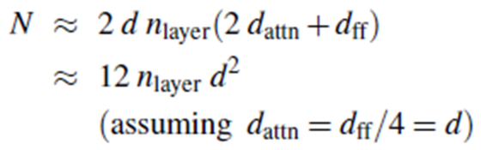
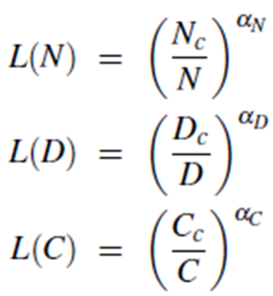
Scaling Laws: Kaplan et al., 2020
How to read these
L = loss (lower is better). N = parameters, D = training tokens, C = compute.
Bigger N, D or C → smaller fraction → lower loss.
α (alpha) is the exponent fitted from experiments: it measures how fast loss falls as you scale up (bigger α = faster improvement).
Here α is small (≈ 0.05–0.1), so returns diminish:
Each gain needs much more scale, but the gains are predictable.
Counting parameters
Each layer holds about 12 × d² weights (attention 4d² + FFN 8d²), so multiply by the number of layers.
GPT-3: 96 layers, d = 12,288
12 × 96 × 12,288² ≈ 175B
What Kaplan concluded
Model size matters most; depth vs width barely matters
With 10× more compute, make the model ~5× bigger but give it only ~2× more data
So industry built huge models on little data. GPT-3: 175B parameters but only 300B tokens (~1.7 tokens per parameter)

Slide 15
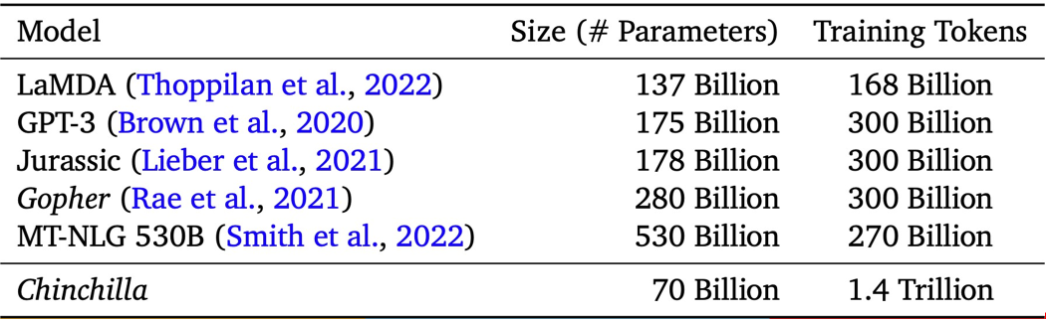
Chinchilla scaling (Hoffmann et al., 2022)
Kaplan: 10× compute → 5× model, 2× data. Chinchilla: scale both equally → ~3.2× each
Rule of thumb: ~20 training tokens per parameter is compute-optimal (cheapest route to a given loss, not a minimum)
Existing large models were undertrained: Chinchilla 70B used the same compute as Gopher 280B and beat it, GPT-3 and MT-NLG
Table adapted from UMass CS685 slides (Hoffmann et al., 2022). Tokens per parameter: GPT-3 ≈ 1.7, Gopher ≈ 1.1, MT-NLG ≈ 0.5, Chinchilla = 20.

Slide 16
Scaling laws today
A scaling law: spend more of X → Y improves smoothly and predictably, usually a straight line on a log scale.
Axis | Spend more of… | …and this improves | Real example
Pre-training (overtraining) | Training tokens, well beyond ~20 tokens per parameter (Chinchilla-optimal) | Loss keeps falling with diminishing returns, and the smaller model is cheaper to serve | Llama 3 8B was trained on ~15T tokens, about 1,900 tokens per parameter
Test-time compute | Thinking tokens or repeated attempts at inference | Accuracy on reasoning tasks rises roughly with log(compute) | o1 and DeepSeek-R1 improve as they are allowed to think longer
RL training compute (emerging) | RL steps on verifiable tasks such as math and code | Reasoning accuracy; responses also grow longer | DeepSeek-R1-Zero's response length grew steadily during RL
Why it matters: the same small-scale-experiments-then-extrapolate method now plans how much to spend on thinking and RL, not just on model size

Slide 17
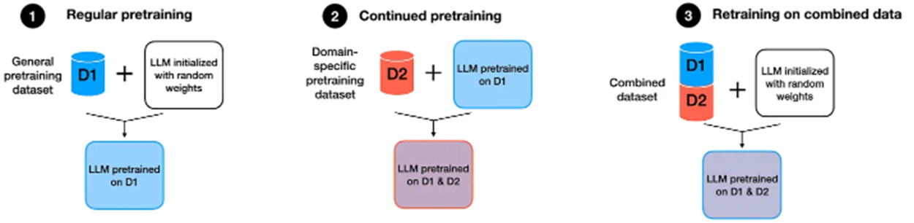
Three ways to get a domain LLM
D1 = general pre-training data, D2 = domain data (finance, medicine, law, code…)
1 Regular pre-training
Random weights, trained on D1 only. General model with no domain depth.
2 Continued pre-training (CPT)
Take a model pre-trained on D1 and keep pre-training on D2 (mixed with some D1).
Low cost; most common choice
3 Domain pre-training from scratch
Random weights, trained on D1 + D2 together from the start.
Very expensive; needs a huge domain corpus
Figure: Sebastian Raschka, magazine.sebastianraschka.com/p/tips-for-llm-pretraining-and-evaluating-rms

Slide 18
Domain adaptation in practice: finance
Model size chosen with Chinchilla scaling laws to fit the available finance data
Mixes general data so the model stays good at general language tasks
Requires a large proprietary corpus and a big training budget
BloombergGPT
Domain pre-training from scratch (Wu et al., 2023)
Starts from Llama 3 8B, so it inherits its general knowledge and reasoning
Finance : general ≈ 3 : 1, mixed to prevent catastrophic forgetting
Far fewer tokens than training from scratch
FinLLaMA
Continued pre-training (Open-FinLLMs, 2024)
50B
parameters
363B
finance tokens
345B
general tokens
8B
Llama 3 base
52B
finance tokens
18B
general tokens
Takeaway: both mix general data with domain data so general skills are not lost. CPT is the practical default; from scratch only pays off with a huge domain corpus and budget.

Slide 19
Catastrophic forgetting
When a trained network learns new data, the weight updates can overwrite what it learned before. The risk is highest when training continues on a different distribution (new domain, new task).
LLM example: continue pre-training Llama 3 only on finance text → finance improves, but general knowledge, coding and instruction-following drop.
How to mitigate
Replay (data mixing)
Used in practice
Mix a share of original general data into the new data.
Most effective, standard. ~5% replay often enough; FinLLaMA used ~25%.
Learning-rate schedule
Used in practice
Re-warm to the peak LR, then decay. Higher LR learns faster but forgets more.
Pair with replay to get both.
LoRA / PEFT
Used in fine-tuning
Freeze base weights; train only small adapter matrices.
Forgets less, but also learns less new knowledge. Best for fine-tuning.

Slide 20
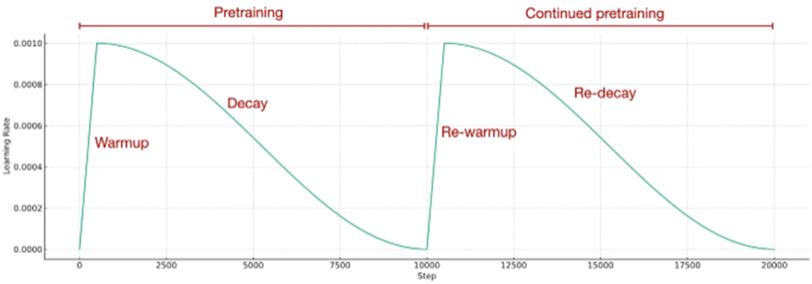
LR schedule for continued pre-training
Recipe: repeat the original schedule. Re-warm the LR back up to its peak, then re-decay it, and add replay of general data.
Warmup
Start small and ramp up, so the first updates (fresh optimizer stats) don't destabilise training.
Decay (cosine)
Lower the LR gradually so the model settles into a good solution.
Why re-warm?
At the end of pre-training the LR is ~0, so the model can barely learn the new domain without raising it again.
Figure: Sebastian Raschka, magazine.sebastianraschka.com/p/tips-for-llm-pretraining-and-evaluating-rms
Trade-off: a higher peak LR learns the new domain faster but forgets more. Replay of general data offsets the forgetting, so re-warm + re-decay + replay together can match retraining from scratch at a fraction of the cost.

Slide 21
Modern pre-training recipes at a glance
Next-token prediction everywhere (DeepSeek-V3 adds multi-token prediction). The differences are in data, staging and efficiency.
Gemma 2: distillation
27B from scratch; 2B and 9B learn from a larger teacher
DeepSeek-V3: efficiency
MoE 671B (37B active), 14.8T tokens; MTP + FP8 ≈ 2.8M H800 GPU-hours
Fully open recipe to explore: OLMo 2 (AI2) publishes its pre-training data, code and checkpoints.
 | Llama 3.1 | Qwen3 | Gemma 2 | DeepSeek-V3
Filtering heuristics + model-based quality scoring | ✓ | ✓ | ✓ | ✓
Synthetic data text generated by earlier models | ✓ | ✓ | ✗ | in post-training
Data mixing tuned proportions of sources | ✓ | ✓ | ✓ | ✓
Long-context stage extend context near the end | ✓ | ✓ | ✗ | ✓
High-quality final stage annealing on math / code / reasoning | ✓ | ✓ | ✗ | —
Knowledge distillation small model learns from a big teacher | ✗ | in post-training | ✓ | in post-training
Training efficiency MoE, multi-token prediction, FP8 | — | — | — | ✓
Checklist adapted from S. Raschka.

Slide 22
Case study: Llama 3 (405B) pre-training
Three stages
Model-as-judge data filtering
1 Initial pre-training
~15.6T tokens at 8K context. Batch grows 4M → 8M → 16M tokens: small batches early for stability, large later for efficiency.
Web data → clean, de-duplicate, safety filter
Llama 2 labels a sample of documents as high / low quality
2 Long-context pre-training
Context raised 8K → 128K in six steps, using ~800B tokens.
Train cheap classifiers on those labels: fastText (fast) and DistilRoBERTa (better)
3 Annealing
Final 40M tokens: learning rate decayed to 0 while upsampling top-quality data (math, code). The last data seen at low LR shapes the final weights.
Classifiers score the full web corpus → keep high-quality data
Why a judge model? Running Llama 2 on trillions of tokens is too costly, so it labels a sample and small classifiers do the bulk scoring.

Slide 23
Case study: Qwen3 pre-training
Broad language ability → stronger reasoning → longer context
S1 General
S2 Reasoning
S3 Long context
30T+ tokens
4K context
119 languages
~5T more tokens
more STEM, code, synthetic data
context → 32K
75% of docs 16K–32K tokens, 25% 4K–16K
Where the 36T tokens came from
2× the data
36T tokens vs 18T in Qwen2.5; 119 languages vs 29
PDF extraction
Qwen2.5-VL reads PDFs; Qwen2.5 cleans the text
Synthetic data
Qwen2.5-Math / Coder write textbooks, Q&A, code
Labelled mixing
Every document tagged (domain, educational value, safety) to tune the mix
Takeaway: earlier models build the data for the next generation: extracting, writing and labelling it.

Slide 24
What pre-training costs
Using C ≈ 6 · N · D (N = active parameters, D = training tokens), real runs need thousands of GPUs for months.
Model | Size | Tokens | Compute (6·N·D) | Hardware | GPU-hours (GPUs × hours) | Precision
Llama 3.1 405B | 405B dense | 15.6T | ~3.8 × 10²⁵ FLOPs | up to 16K H100 | ~30.8M H100-hours | BF16
DeepSeek-V3 | 671B MoE (37B active) | 14.8T | ~3.3 × 10²⁴ FLOPs | 2,048 H800 | ~2.8M H800-hours (2,048 GPUs × ~57 days) | FP8 mixed
Splitting the work across GPUs
Data parallel: each GPU group trains on different batches
Tensor parallel: each matrix multiply is split across GPUs
Pipeline parallel: the layers are split across GPUs
Context parallel: one long sequence is split across GPUs
Expert parallel: MoE experts are placed on different GPUs
In practice
Llama 3 combined tensor, context, pipeline and data parallelism to use 16K GPUs at once.
DeepSeek-V3 used pipeline, expert and data parallelism, with no tensor parallelism.
Why DeepSeek-V3 was compute-efficient: Its Mixture-of-Experts architecture activates only about 37B of its 671B parameters per token, reducing per-token computation compared with a dense model of similar total size. FP8 mixed-precision training further improves hardware efficiency.

Slide 25

Emergent abilities of LLMs
“An ability is emergent if it is not present in smaller models but is present in larger models.”
Emergent abilities cannot be predicted simply by extrapolating the performance of smaller models
Ability is emergent when a model has random performance until a certain scale, after which performance increases to well-above random.
Schaeffer et.al.. 2023
Sharpness: Transitioning seemingly instantaneously from not present to present
Unpredictability: Appearing at seemingly unforeseeable model scales
Alleged emergent abilities evaporate with different metrics or with better statistics, and may not be a fundamental property of scaling AI models

Slide 26
Emergent Abilities and Evolving Capabilities of LLMs
1. In-context learning (GPT-3, 2020)
  Given an instruction and/or a few examples in the prompt, the model performs the task by generating a continuation.
  No gradient updates occur during inference; the model's weights remain unchanged.
2. Instruction following (instruction tuning)
  Fine-tuning on diverse instruction–response examples enables models to follow new instructions, often without requiring examples in the prompt.
  This capability depends on training data and post-training methods, not model size alone.
3. Step-by-step reasoning (chain-of-thought prompting)
  Prompting models to generate intermediate reasoning steps can improve performance on multi-step tasks, such as mathematical word problems.
  Early studies found strong scale dependence, with substantial gains on some tasks appearing around 60–100B parameters. However, this is not a universal threshold.
  Modern smaller reasoning models, such as Qwen3-4B and Qwen3-8B, demonstrate that reasoning performance can be improved through targeted training, reinforcement learning and distillation.

Slide 27
What pre-training produces: the base model
Base model learns language, facts and patterns through next-token prediction. Its default behavior is to continue text, rather than reliably behave like a conversational assistant.
A base model may follow instructions or produce a complete answer in some cases, but it is not specifically optimized for reliable instruction following, conversational behavior or appropriate stopping.
On Hugging Face, base and instruction-tuned versions are often released separately:
  Llama 3.1: Meta-Llama-3.1-8B vs. Meta-Llama-3.1-8B-Instruct
  Qwen3: Qwen3-8B-Base vs. Qwen3-8B. The standard Qwen3-8B is the post-trained instruction/reasoning model; Qwen3-8B-Base is the pretrained model.
Prompt: "What is the capital of France?" | Typical output
Base model | "What is the capital of Germany? What is the capital of Italy? …" (continues a list of quiz questions)
Instruct model (after post-training) | "The capital of France is Paris."

Slide 28
References
Speech and Language Processing (3rd ed. draft) Dan Jurafsky Jan 2026 - Ch- 7, 8
Build a Large Language Model (From Scratch) SEBASTIAN RASCHKA : Ch-2,5
https://aws.amazon.com/blogs/machine-learning/an-introduction-to-preparing-your-own-dataset-for-llm-training/
https://huggingface.co/spaces/HuggingFaceTB/smol-training-playbook#introduction
Research Papers
  Scaling Laws for Neural Language Models (Kaplan law)
  Training Compute-Optimal Large Language Models (Chinchilla)
  Emergent Abilities of Large Language Models
  Are Emergent Abilities of Large Language Models a Mirage?
  BloombergGPT:A Large Language Model for Finance
  The Llama 3 Herd of Models
  Qwen3 Technical Report
  A Survey of Large Language Models (https://arxiv.org/pdf/2303.18223)

