Slide 1
Transforming Knowledge Access
A Vision for Intelligent Knowledge Management
The Challenge
Our Vision
Inefficient knowledge discovery for users (employees, customers).
Build a scalable, multi-geographic, vector embeddings for the Knowledge Management System built by HPE
Difficulty in maintaining up-to-date and consistent knowledge.
Lack of a centralized, intelligent system for diverse data.
Enable intuitive natural language querying for users.
Need for global accessibility and performance.
Provide robust tools for administrators to create and manage KB articles.
Leverage existing valuable data from your SFDC databases.
Knowledge Management System
Confidential

Slide 2
Agenda / Table of Contents
Introduction: The Challenge & Our Vision
Solution Overview: FAISS Vector DB for Cognate AI
System Architecture: FAISS Integration Pipeline
Data Model: SFDC Case Data & CFIs
RAG Implementation: Vector Search & Retrieval
Pipeline Development: Scheduled Updates
7
Testing & Accuracy Measurement
Technology Stack: FAISS & Integration Tools Milestone-Based Development Roadmap
Team & Resource Allocation
Benefits & Next Steps
8
9
12 Q&A
FAISS Vector DB for Cognate AI
Confidential

Slide 3



FAISS Vector Database for Cognate AI
Project Overview
Primary Objective
Build a vector database of case issues and resolutions for 2 years' worth of Pan-HPE SFDC case data, enabling Cognate AI to replace Coveo for similar case and resolution search.
Key Deliverables
FAISS Vector DB: Facebook AI similarity search file usable directly inside Cognate AI
Scheduled Pipeline: Automated vector DB updates via Jenkins job
Similar Case Search: Accurate resolution search verified by GSR
Coveo Replacement: API2 lexical search replaced with vector search
Comprehensive Data: Includes SFDC case data, CFIs, and engineer sources
Compliance: Meets SRE, Security, and NFR requirements including monitoring
Scope Definition
Inclusions
Exclusions
2 years of Pan-HPE SFDC case data
All case text fields (issue, subject, resolution, notes) CFIs (Customer Facing Information)
Other sources currently used by engineers
KM articles which are already in Coveo
FAISS Vector DB for Cognate AI
Confidential

Slide 4
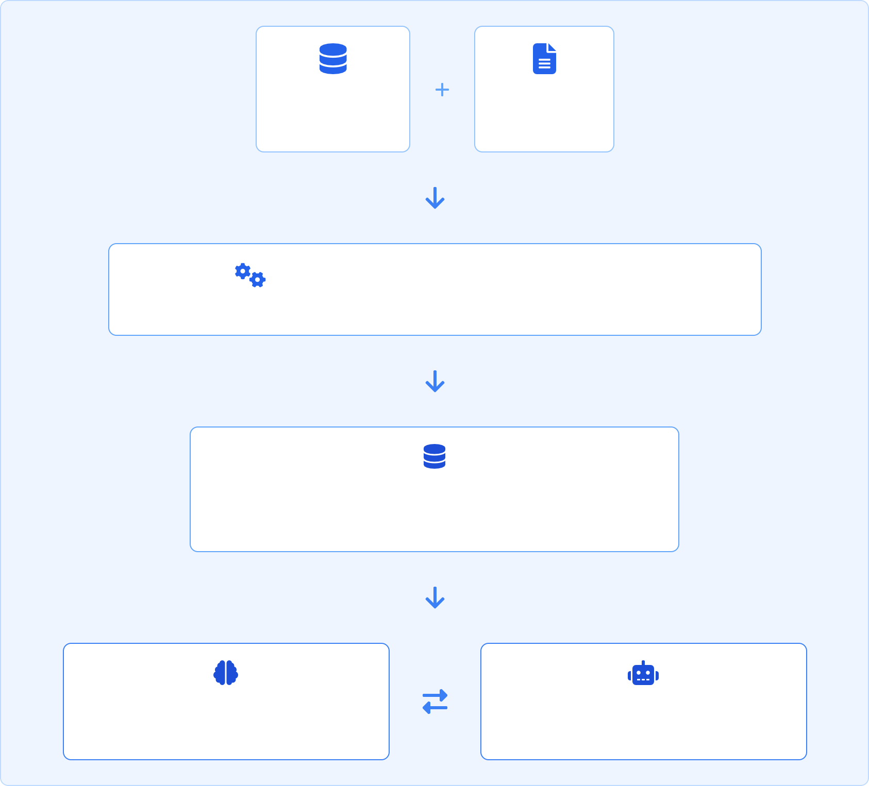



FAISS Vector DB Pipeline
Cognate AI Integration with Nomic Embeddings
Key Components
SFDC Data Source: 2 years of Pan-HPE case data
CFI Sources: Customer Facing Information
Nomic Embeddings: High-quality text vectorization
FAISS Vector DB: Facebook AI Similarity Search
Cognate AI: Case similarity search engine
KM Generation Agent: Interfaces with vector DB
Ingestion Pipeline: Scheduled via Jenkins Monitoring: Performance & accuracy metrics
SFDC Case Data
(2 Years)
CFIs & Other Sources
Vectorization Pipeline (Jenkins Scheduled)
Text extraction → Field processing → Nomic embeddings → FAISS indexing
FAISS Vector DB
Nomic-powered similarity search index
Cognate AI
Replacing Coveo API2
KM Generation Agent
Case similarity search
Data Flow: SFDC case data and CFIs are processed with Nomic embeddings via scheduled Jenkins pipeline into a FAISS index
Knowledge Management System
Integration: Cognate AI uses Nomic-powered FAISS for semantic search, replacing Coveo API2's lexical search
Confidential

Slide 5
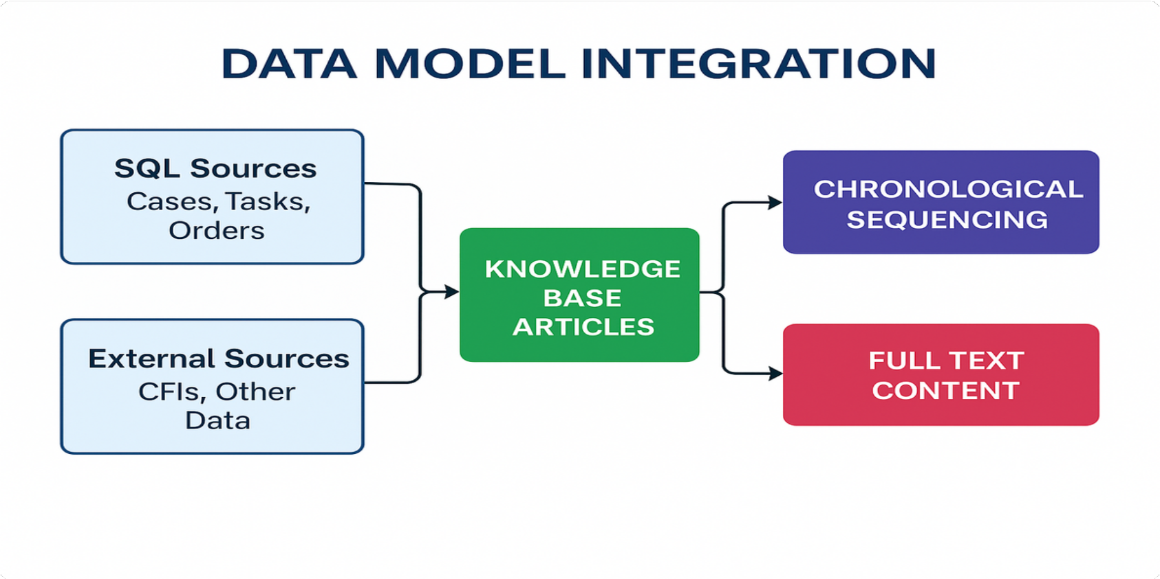


FAISS Vector Database: Data Model & Sources
Building the Knowledge Foundation
Data Scope & Inclusions
2 Years of Pan-HPE SFDC case data
Critical Case Fields
Subject_Description - Case headline Issue_Plain_Text - Problem description Resolution_Plain_Text - Solution details Notes - Additional troubleshooting
Additional Engineer Resources
CFIs (Customer Facing Information)
Other sources currently used by engineers
* Specific sources to be defined with GSR guidance
Explicit Exclusions
KM articles already managed in Coveo
Vectorization Process
Data Collection: Extract text fields (issue, subject, resolution, notes) from 2 years of SFDC cases
Data Processing: Combine with CFIs and engineer resources (as defined by GSR)
Vector Generation: Convert to FAISS-compatible format for Cognate AI integration
Knowledge Management System
4. Delivery: Replace Coveo case lexical search (API2) in Cognate AI
Confidential

Slide 6
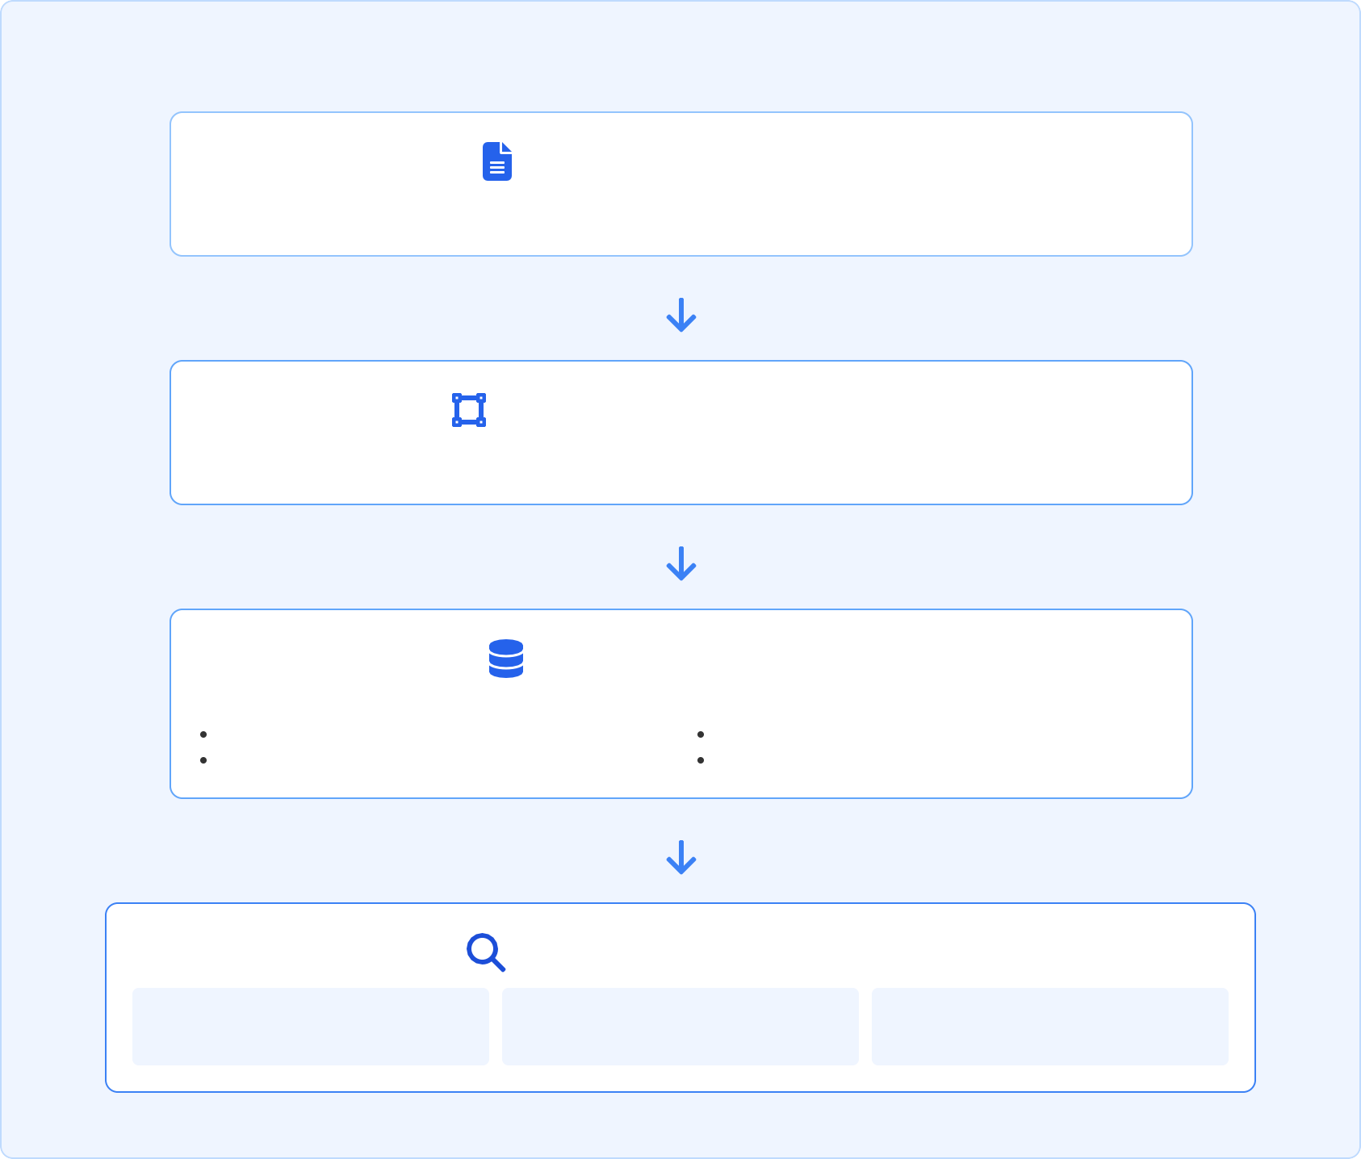






FAISS Vector DB Technical Implementation
With Nomic Embeddings Integration
FAISS Core Features
High-Speed Search: Optimized for similarity search in high dimensions
Efficient Indexing: Multiple index types for different data volumes
Clustering: k-means clustering for vector organization
Vector Compression: Reduces memory footprint while preserving similarity
GPU Acceleration: CUDA support for performance boost
Nomic Embeddings: High-quality text embeddings with semantic preservation
FAISS Indexing Process with Nomic Embeddings
Case Data Text Processing
SFDC case fields, issue details, resolution notes, CFIs extracted and normalized
Nomic Embeddings Generation
Text converted to high-dimensional vector embeddings with semantic meaning preserved
FAISS Index Construction
Vector Processing: Dimensionality reduction Vector quantization
Index Types:
IVF (Inverted File Index) PQ (Product Quantization)
Similarity Search Mechanics
1. Query Embedding Convert query to Nomic vector
2. ANN Search Approximate nearest neighbor search
3. K-Nearest Results Return top-k similar cases
Vector Storage Optimization for Case Data
Scalar Quantization
Reduces precision to save memory
Hierarchical Indexing
Multi-tier search for faster retrieval
Memory Mapping
Efficient access to large indexes _{Confidential}
Knowledge Management System

Slide 7













Vector DB Pipeline & Monitoring
Automated Vectorization & Quality Assurance
Jenkins Pipeline Automation
Automated CI/CD pipeline for FAISS vector DB updates Source data extraction from SFDC, CFIs, and other sources
Scheduled job execution based on GSR-approved frequency
Pipeline version control and execution history
Scheduled Vectorization Process
Nomic Embeddings
Extract Data
FAISS Index
Deploy
Monitoring & Compliance
Real-time monitoring of vectorization process health Data quality checks for vectorization accuracy Comprehensive logs for auditing and troubleshooting
FAISS Vector DB for Cognate AI
Alerts for pipeline failures or data quality issues
SRE & Security compliance with approved standards Performance metrics for FAISS index size and query speed
Confidential

Slide 8
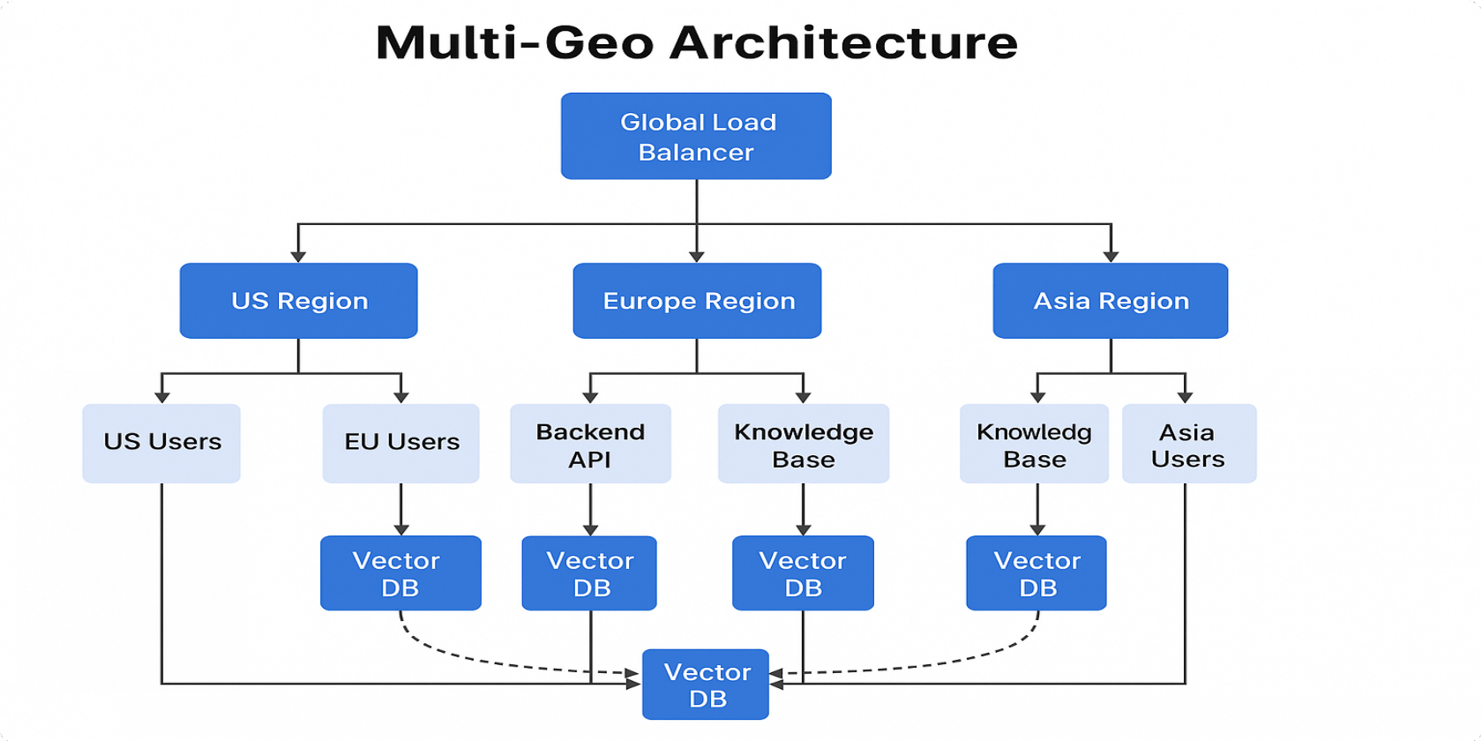


Global Reach & High Performance
Scalability and Multi-Geo Deployment
Scalability
Managed Cloud Services: Auto-scaling databases & serverless backend
Vector Database: FAISS file sync or managed Pinecone/Milvus
Caching: Redis for frequently accessed data
Async Processing: Message queues for ingestion
Multi-Geo Strategy
Regional Instances: Core components in target regions
Vector DB Distribution: Cross-region synchronization
Global Load Balancing: Route to nearest region Data Replication: Consistency across regions
Data Residency: Compliance with local requirements
Multi-Geo Architecture with Global Load Balancer routing to regional components and cross-region Vector DB synchronization
Global Synchronization: Vector indices remain synchronized across all regions
Local Access: Users are directed to their nearest region for optimal performance and data residency compliance
Knowledge Management System
Confidential

Slide 9



FAISS Vector DB Project
Technology Stack
Vector Database
FAISS (Facebook AI Similarity Search)
High-performance vector similarity search library optimized for large datasets
Binary FAISS Index Format
Optimized for direct integration with Cognate AI
Embedding Technology
Nomic Embeddings
High-quality vector representations for case data with superior semantic search capabilities
Vector Dimension Optimization
Configured for optimal balance between search quality and performance
Data Processing
Python Data Pipeline
SQL Server (SFDC Case Data)
CFI & Supplementary Data Processing
Automation & Scheduling
Jenkins Pipeline
Scheduled Vectorization Jobs Version-Controlled Deployment
Integration
Cognate AI Integration KM Generation Agent API
Coveo Replacement (API2)
FAISS Vector DB for Cognate AI
Monitoring & Operations
Cloud-native Monitoring Alerting & Metrics
SRE & Security Compliance
Confidential

Slide 10

Project Milestones
FAISS Vector DB & Cognate AI Integration
Field Finalization
Determine which fields from case data will be vectorized
1
Initial Vectorization
Vectorize 2 years of Pan-HPE SFDC case data and save as FAISS file
2
AC: GSR sign-off on the selected fields
AC: Showcase randomly selected vectorized case details
Test Data Creation
Create test data for accuracy verification in collaboration with GSR/DE
3
Accuracy Measurement
Measure accuracy using test data and iterate on vectorization approach
4
AC: GSR sign-off on the test data
AC: GSR sign-off on accepted accuracy level
Cognate AI Integration
Update vector DB in Cognate AI while maintaining current functionalities
5
Scheduled Pipeline Creation
Create automated pipeline for scheduled vectorization updates
6
AC: Unit/fitness/regression tests with build success
AC: SRE/Security sign-off, demo update, Jenkins job creation
ITG/PRO Deployment
Deploy solution to production environments
7
Project Scope
2 years of Pan-HPE SFDC case data CFIs and other engineer-used sources
All text fields (issue, subject, resolution, notes)
Existing KM articles already in Coveo
AC: KM Generation Agent calls updated vectorDB, replacing API2: Coveo
Knowledge Management System
Confidential

Slide 11







Our Dedicated Team
Expertise for Success
Core Team (8-10 individuals)
Project Manager:
Overall coordination, timeline, communication
2-3x Backend Devs: API logic, cloud services, LLM integration
2x Frontend Devs: User & Admin UI, responsive design
Data Engineer:
Data pipelines, embeddings, vector management
DBA / Data Modeler: SQL expertise, database optimization
DevOps Engineer:
Infrastructure, CI/CD, multi-geo deployment
QA Engineer:
Testing, LLM validation, test data creation
Supporting Roles (as needed)
Subject Matter Experts (SMEs) / GSR / DE: Knowledge validation, field finalization, test data, accuracy sign-off Security Specialist: Security audits and alignment with organizational requirements
SMART involvement: Non-functional requirements, performance monitoring, and optimization
Knowledge Management System
Confidential

Slide 12




Realizing the Value
Benefits and Next Steps
Key Benefits
Improved Efficiency: Faster access to accurate information for users through Cognate AI
Enhanced Customer/Employee Experience: Self-service capabilities, reduced wait times
Data-Driven Insights: Understand knowledge gaps and usage patterns
Future-Proof: Scalable architecture ready for growth and evolving AI
Global Consistency: Unified knowledge base across all regions
Modernized Search: Replacement of legacy Coveo search with advanced semantic capabilities
Next Steps
Detailed requirements gathering and scope finalization, focusing on the new questions Deep dive into existing data (CFIs, other sources) and Cognate AI specifics
Kick-off Phase 1: Foundation & Initial Vectorization
Knowledge Management System
Confidential

Slide 13

Effort Estimation: FAISS Vector DB Project
Resource allocation for 7 milestone-driven implementation (14-week timeline)
Effort Estimation By Milestone (Person-Weeks)
Key Assumptions
Core team of 6 specialists focused on FAISS vector DB integration
Timely GSR/DE sign-offs for fields, test data, and accuracy Cognate AI environment ready for vector DB integration SRE and Security resources available for approvals SMART involvement for NFR alignment and monitoring
Role / Milestone
Field Initial Finalization Vectorization
Test
Accuracy
Data
Measurement
Creation
1 0.5
Cognate AI
Integration
Pipeline ITG/P Creation Deploy
Project Manager
1
0.5
1
1
1
Data/ML Engineer
2
4
2
4
4
2
1
Backend Developer
1
2
1
2
4
2
2
Milestone Distribution
Milestone 1 & 2
Field finalization & Initial vectorization
14 Person-Weeks (24%)
Milestone 3 & 4
Test data creation & Accuracy measurement
15 Person-Weeks (25.5%)
Milestone 5
Cognate AI integration
11.5 Person-Weeks (19.5%)
Milestone 6 & 7
Pipeline creation & ITG/PRO deployment
18 Person-Weeks (31%)
DBA /
Data 2 Modeler | 1 | 1 | 0.5 | 0.5 | 1 | 0
DevOps 0 | 0 | 0 | 0 | 1 | 3 | 2
Engineer
QA
Engineer
0
0.5
1
2
1
1
2
Total Per Milestone
6
8
6
9
11.5
10
8
* Estimates based on core team of 6 individuals over a 14-week period, structured by key milestones with specific acceptance criteria.
FAISS Vector DB for Cognate AI
Confidential

Slide 14
Project Timeline
FAISS Vector DB & Cognate AI Integration Milestones
Project Overview
Duration: 14 Weeks (3.5 Months) Primary Scope: FAISS Vector DB Creation
Integration: Cognate AI (Replace Coveo API2)
7 Key Milestones with AC: Week 2: Field Finalization
AC: GSR sign-off on vectorization fields
Week 4: Initial Vectorization
AC: Showcase random case details vectorization
Week 6: Test Data Creation
AC: GSR sign-off on test data
Week 8: Accuracy Measurement
AC: GSR sign-off on accepted accuracy level
Week 10: Cognate AI Integration
AC: Unit/fitness/regression tests success
Week 12: Pipeline Creation
AC: SRE/Security signoff, demo update
Week 14: ITG/PRO Deployment
AC: KM Generation Agent using updated vectorDB
Phase Legend: Analysis & Setup
Development & Testing Integration & Deployment
Knowledge Management System
Development & Analysis & Setup Integration & Deployment ▼ ▼ Testing ▼ ▼ ▼ ▼ ▼
1 | 2 | 3 | 4 | 5 | 6 | 7 | 8 | 9 | 10 | 11 | 12 | 13 | 14
Field Analysis & Finalization
Data Extraction & Preparation
Initial FAISS Vectorization
Test Data Preparation
Vector Search Testing
Accuracy Measurement & Iteration
Cognate AI Development
Integration Testing & Validation
Jenkins Pipeline Development
SRE & Security Review
ITG Environment Deployment
Production Deployment
KM Generation Agent integration with updated vectorDB, replacing API2: Coveo case lexical search
Confidential

Slide 15

Questions & Discussion
Key Discussion Points
Vector Database Choice & Multi-Geo
Primary criteria for selecting FAISS, Pinecone, or Milvus? (cost, scalability, expertise)
Multi-region deployment preferences and data residency requirements?
Cognate AI Integration
Exact mechanism for Cognate AI to consume the vector index? Current functionalities that must be preserved during integration?
Data & Operational Requirements
Acceptable data freshness latency? (real-time, hourly, daily) Security, compliance, and ongoing maintenance plans?
Open Discussion
We welcome your questions and insights about our Knowledge Management System solution.
Your feedback is valuable to refine our approach.
Knowledge Management System
Confidential

