Slide 1


Health Care
Block
Go To the Moon
March 4, 2021
Patient Care Success Team

Slide 2





Team
Jungjoo Kim
Hyeonseok Lee
Minho Lee
Jason Jun
Frontend & Backend Developer
Frontend & Backend Developer
UX Designer
Project Manager

Slide 3

Introduction
Patients want to manage their own medical history
Problems with personal healthcare records application system
To solve these problems, Blockchain can be used
Make Blockchain to contain both hospital and patients’ own data

Slide 4

Vision / Solution
Business Opportunities
Patients’ Priorities
Insurance companies hold hand with patients
Insurance companies gain more customers
Medical data analysis companies will receive all the data
Use blockchain to make sure all the data are kept within it
Provided with insurance plan
Claim their hospital bill easier and quicker (through Blockchain)
Able to choose which medical history they don’t want to show

Slide 5

Alex has a chemical abuse history and wants it to be kept hidden.
At the same time, he doesn’t have enough money to go to hospital and get treated.
Scenario

Slide 6

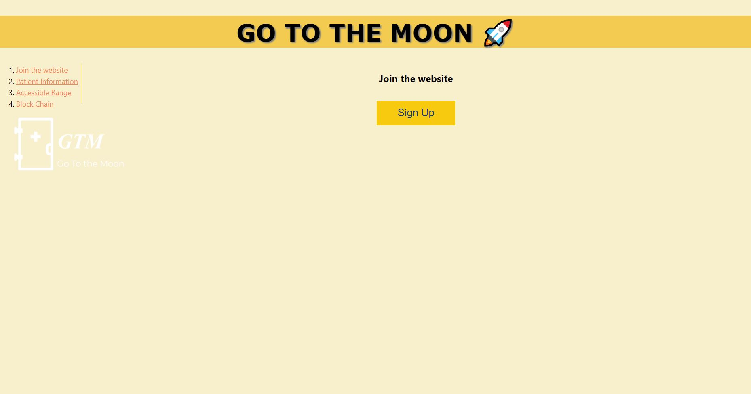
Template

Slide 7
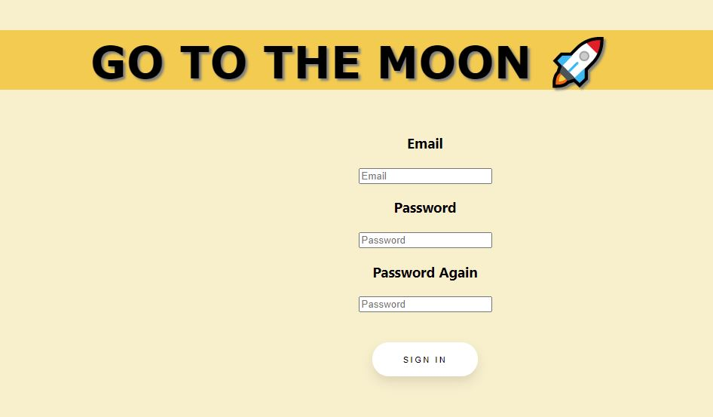

Template

Slide 8
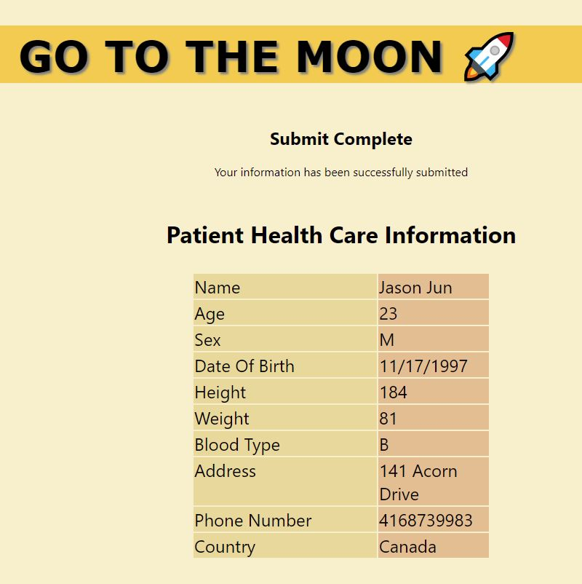
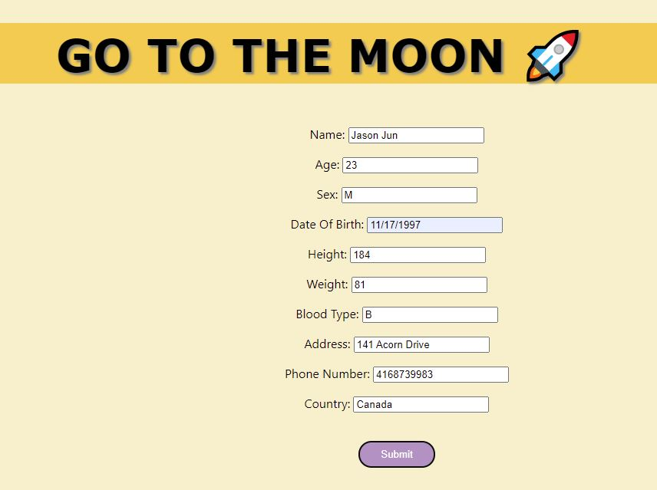
Template

Slide 9
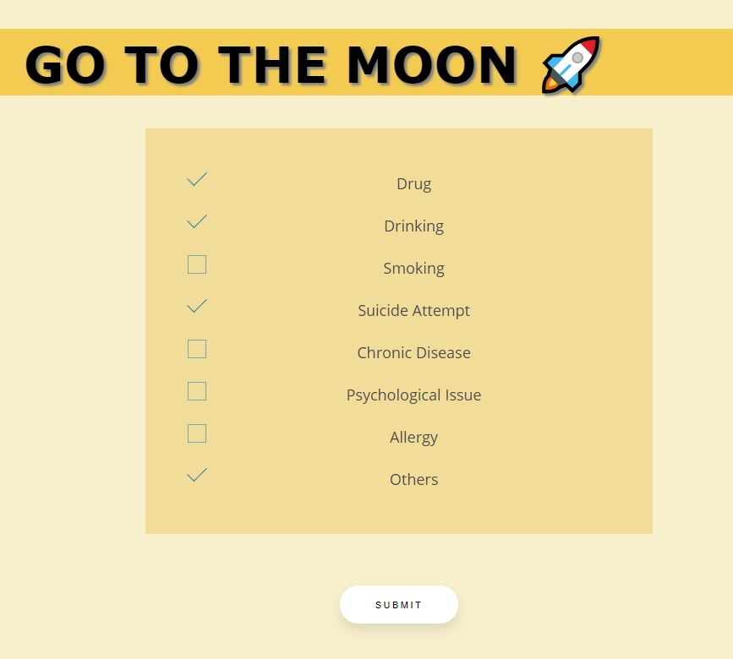
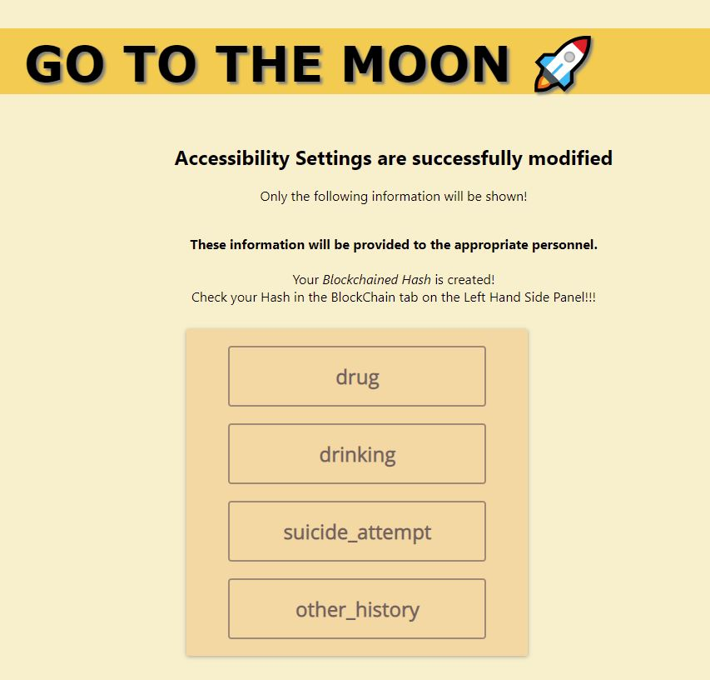
Template

Slide 10

Template

Slide 11

Conclusion
Thank you for listening and we hope you enjoyed the presentation of our idea

