Slide 1
Database stimuli selection
Criteria
  Phonetically dense
  Small enough to read in time
  Covers the language

Slide 2
Text corpus
PAISA text corpus www.corpusitaliano.it
  Web texts (blogs, newspapers, Wikipedia)
  Automatically cleaned and annotated, some non-Italian texts present
  About 250 million words
Step 1: Phonetically transcribe using Festival

Slide 3
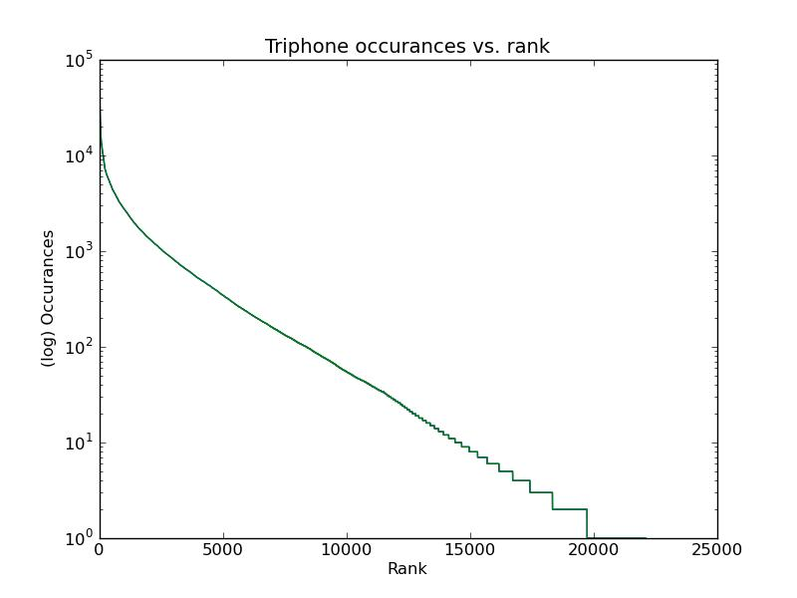
Scoring the sentences
Scores are based on triphones (sequences of 3 phonemes)

Slide 4

Scoring the sentences
Scores should favor sentences with lower-frequency triphones, and more unique triphones
T – number of triphones in the sentence
c – number of occurances of triphone t in the corpus
N – total number of triphones in the corpus
u – number of unique triphones in the sentence

Slide 5
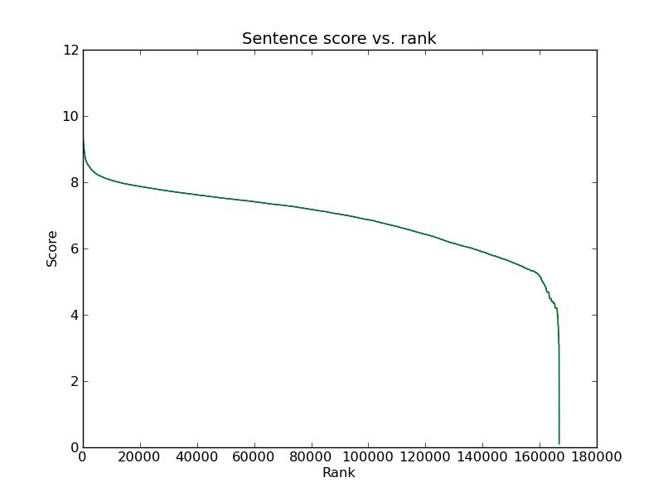
Scoring the sentences
On the raw corpus, English and Russian sentences have the highest scores

Slide 6
Selecting a set of sentences
Start with highest ranked triphone that hasn't been used yet
Find the highest ranked sentence with that triphone that hasn't already been chosen
Manually inspect the sentence
Repeat until desired number of sentences has been chosen

