Slide 1
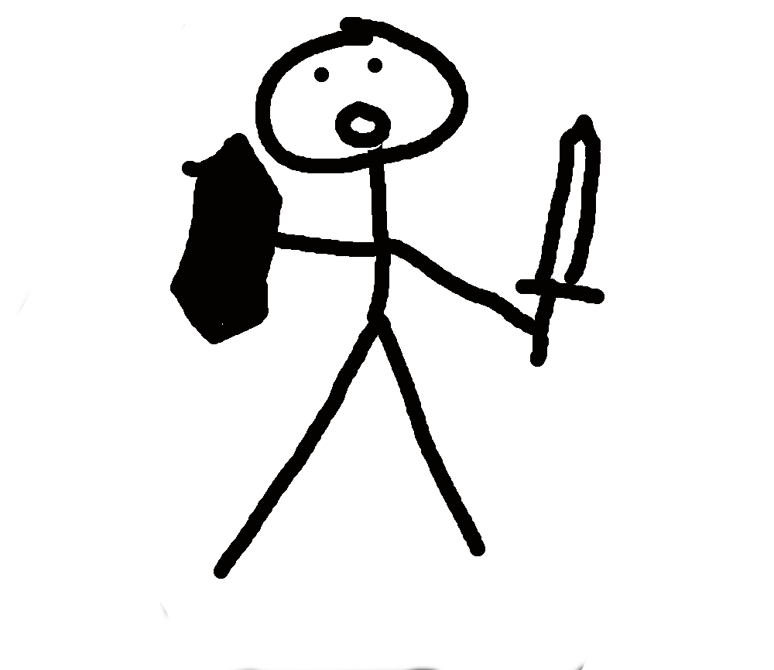
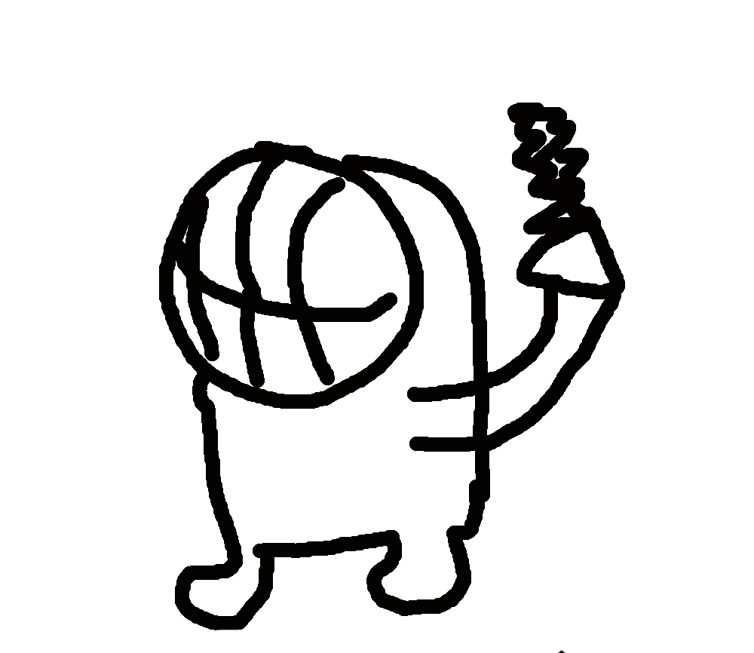
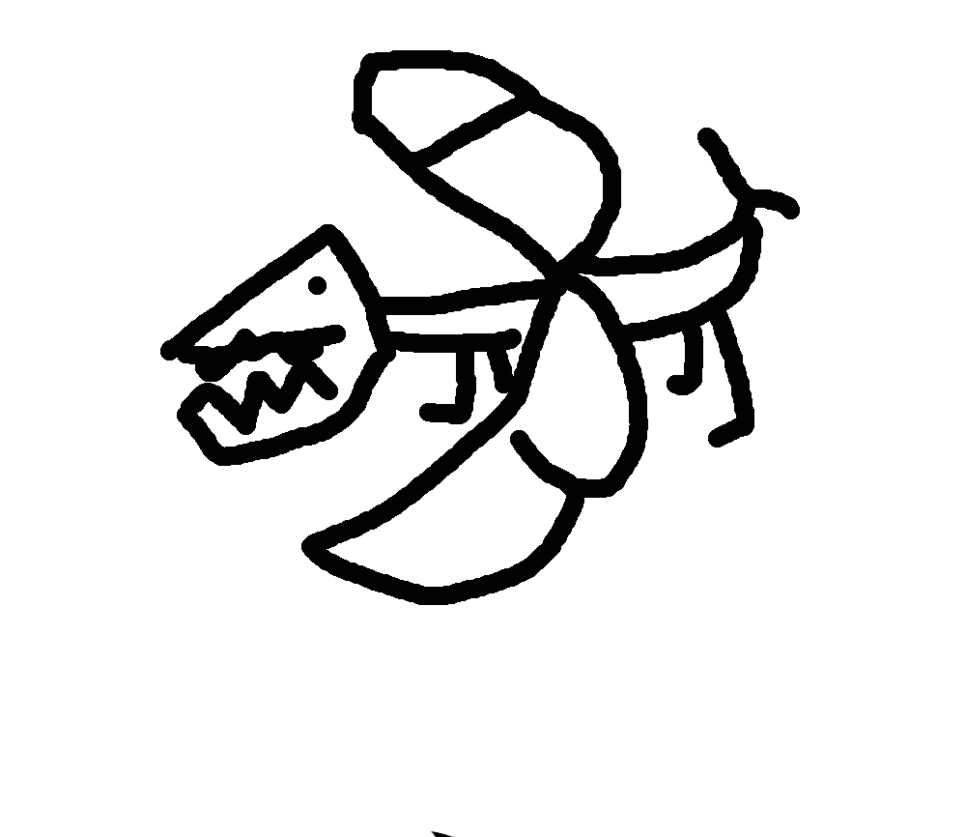
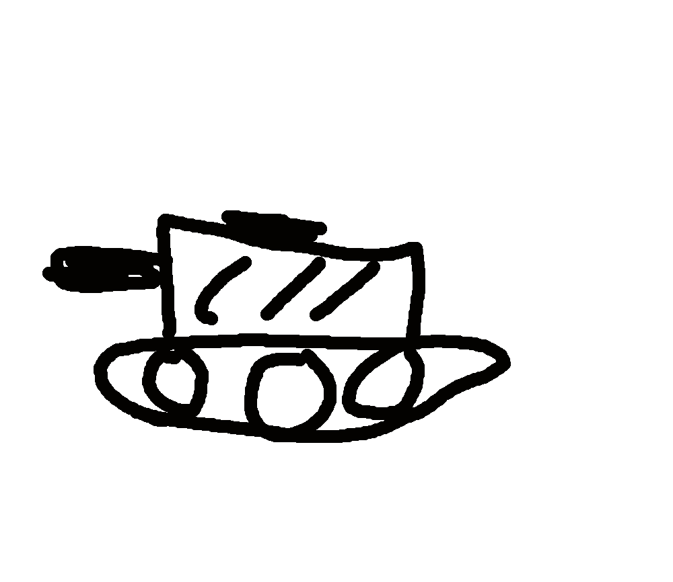
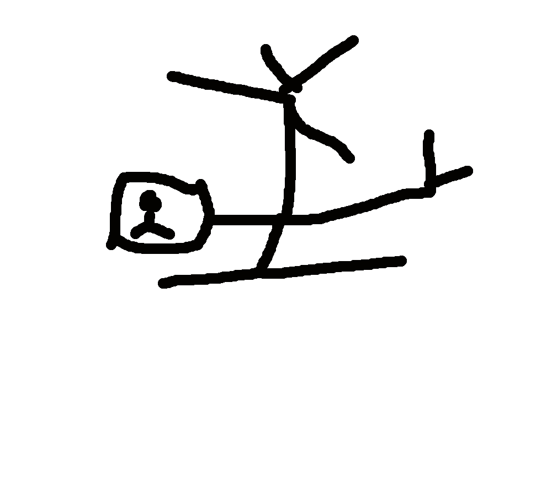
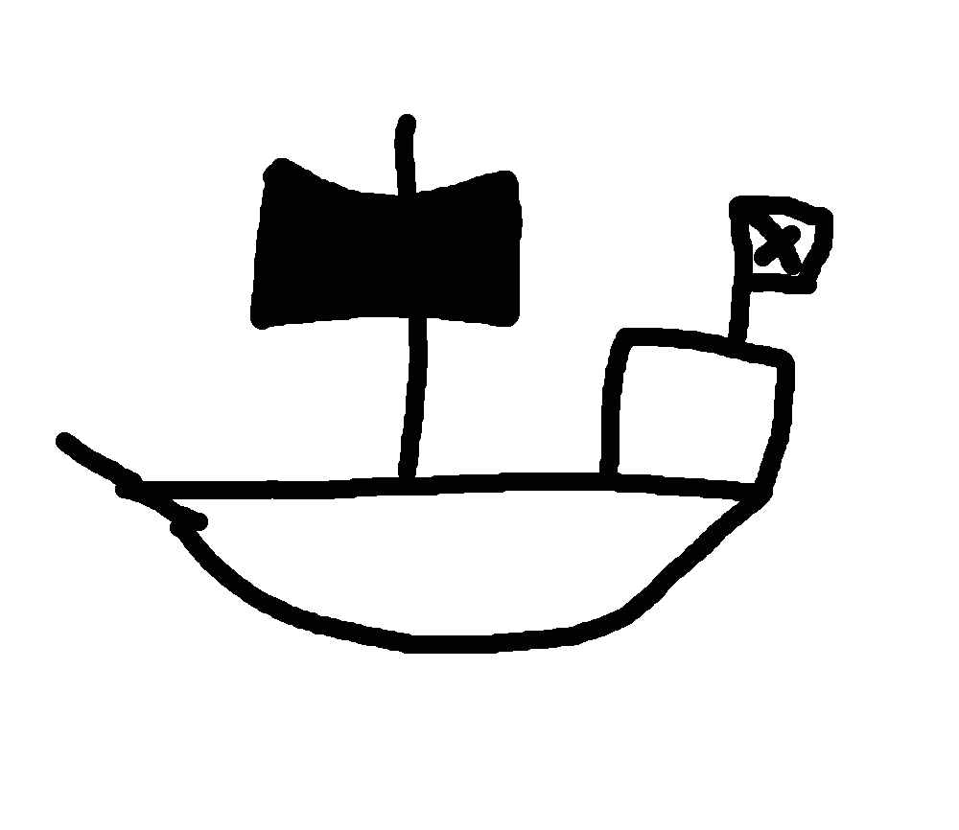
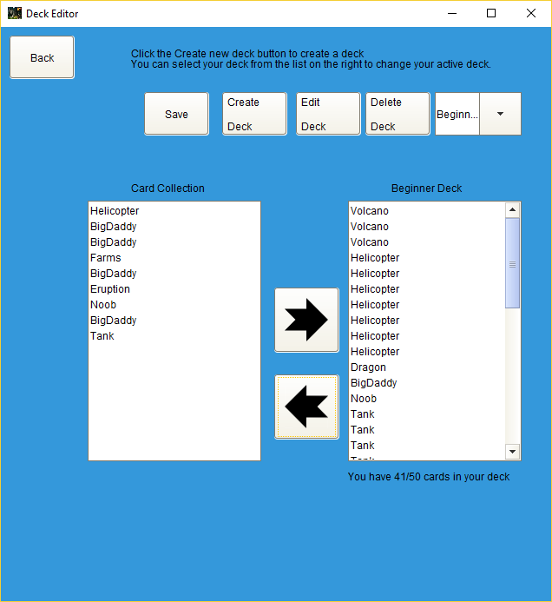
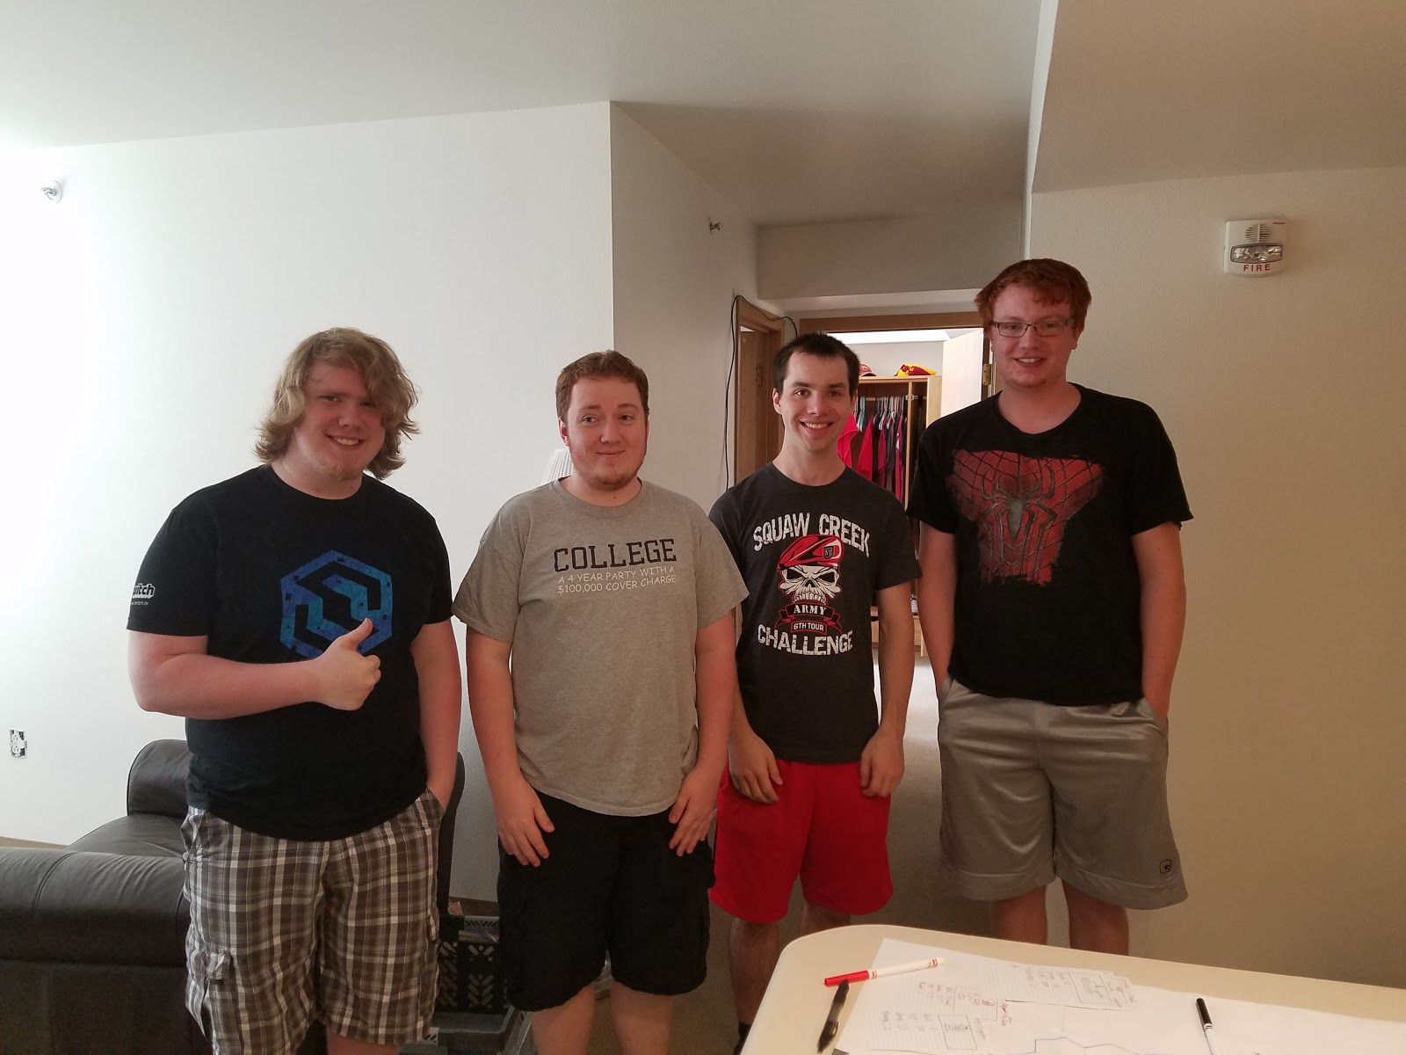
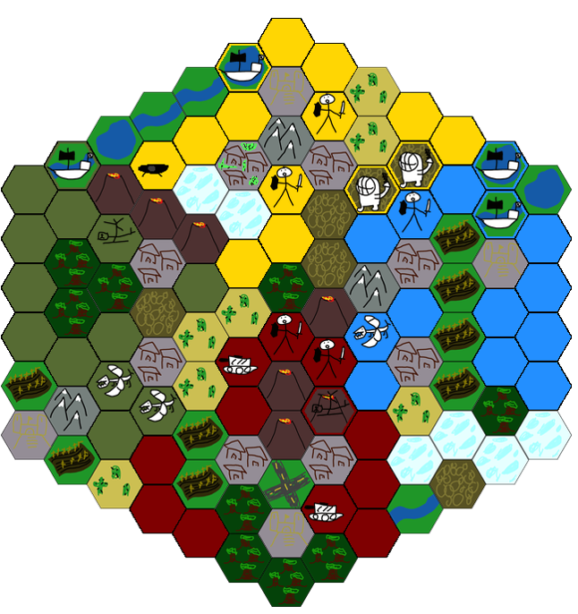
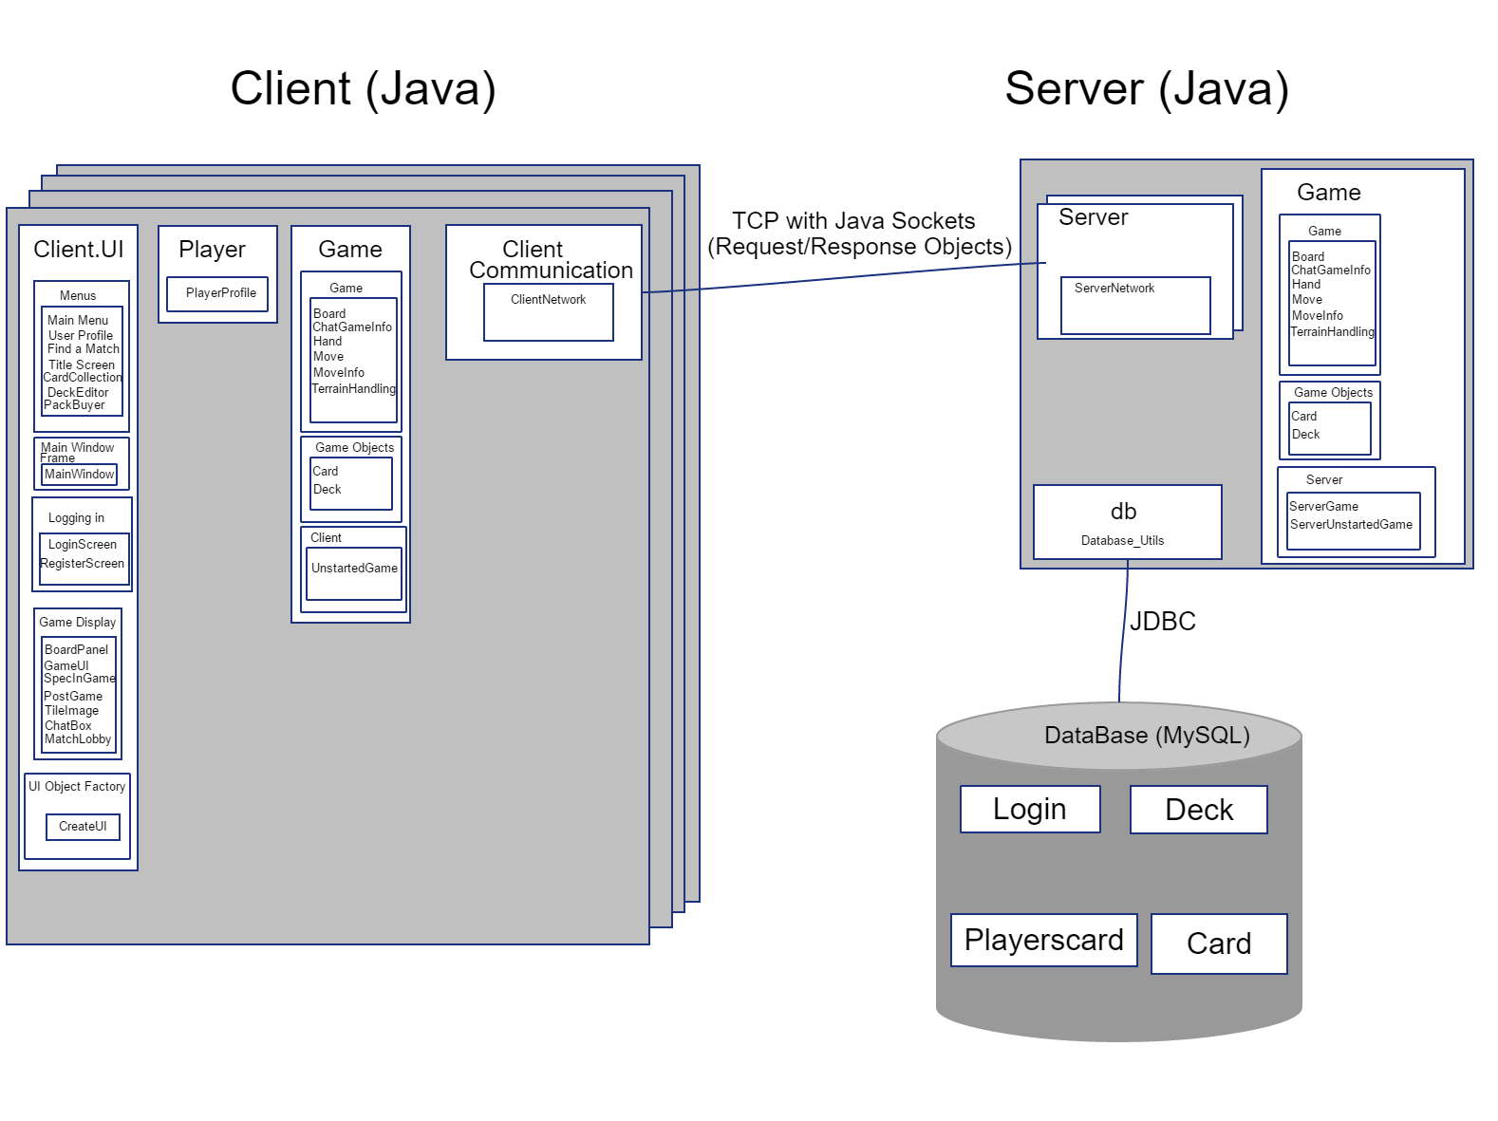
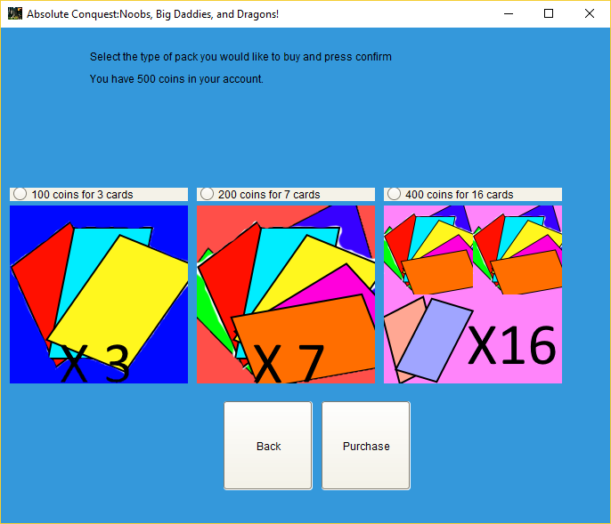
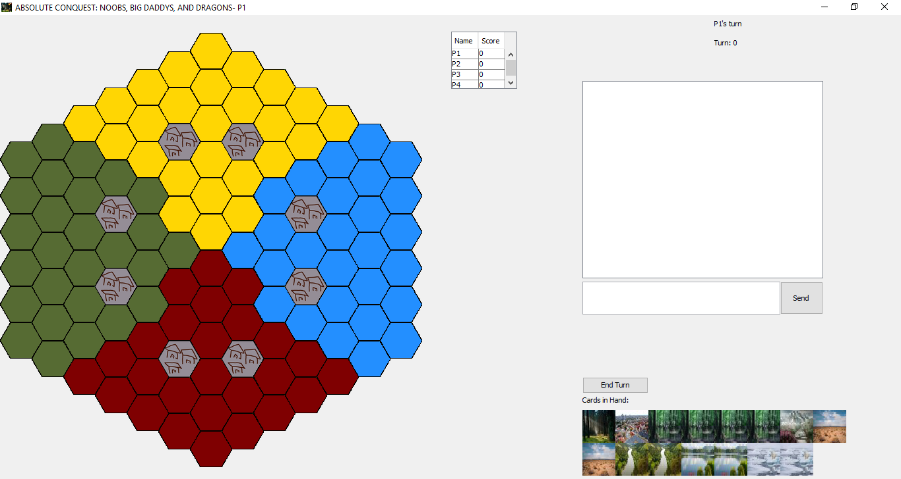
Absolute Conquest
Noobs, Big Daddies and Dragons
COM S 309 Fall 2017
Project Description:
Next generation turn-based-strategy. Create a deck of cards out of the most treacherous terrain, deadly traps and battle hardened warriors. Fight to the death with 3 other players and conquer the world.
Users:
Players
Spectators
Administrators
Use Cases:
Playing games
Creating custom
decks
Purchase card packs
Spectate games
User Interfaces
Game Window
Deck Editor
User views their generated schedule
Login and Register
Pack Buyer
Player Profile
Deck Editor
Pack Buyer
Selected Module Interface Descriptions
Module Interfaces
Team Info:
Team RB_C_3
Jacob Aspinall– CPRE (Jr)
Joshua Brenneman– COM S (Sr)
Jeremiah Brusegaard – SE (Jr)
Harry Mitchell– COM S (Sr)
What went wrong:
Networking code took a while to get working
Aggressive team member
What went right:
Focusing on network/database functionality first
Teamwork
Lessons Learned:
Java Swing
Game-UI Interface:
-makeMove(PlayerProfile p, MoveInfo moveInfo)
When a player selects a move on the board, a MoveInfo object is created which contains all the move information. That is then fed into makeMove(), which updates the game board array.
Server-Database Interface
register(String username, String password)
The server calls this function to register a user and puts their info on the Database
Client-Server Interface
getCardLibrary()
This method(called from the client) grabs the Card Library from the server.
joinGameAsSpectator(String userId, String gameId)
This method adds the client as a spectator to the requested Game.
Design Decisions
Compute game logic locally
Storing a copy of the game on the server for spectators
SQL Injection avoidance
4 players required
No API’s other than JDBC
Main Game Window

