Slide 1
“Synthetic Aperture Radar image generation using Generative Adversarial Networks”
Joshua Coon/5448
Mark Louie/5448
Daniel Moser/1516
Mary Moya/5448
Darren Rodriguez/5448
Alex Schwing/UIUC
Theodore Stangebye/5448
Derrek Yager/5448
Notes:
SAND2018-8249 C

Slide 2
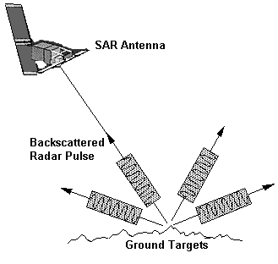
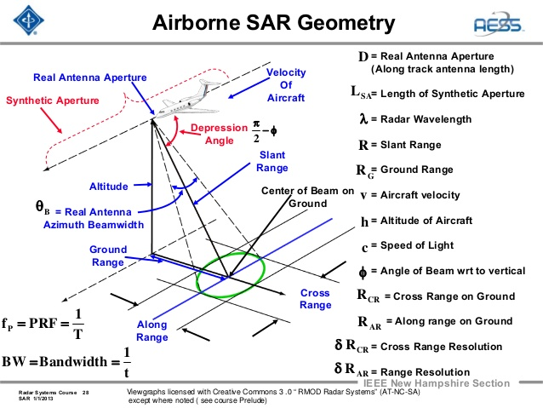
Synthetic Aperture Radar (SAR) overview

Slide 3
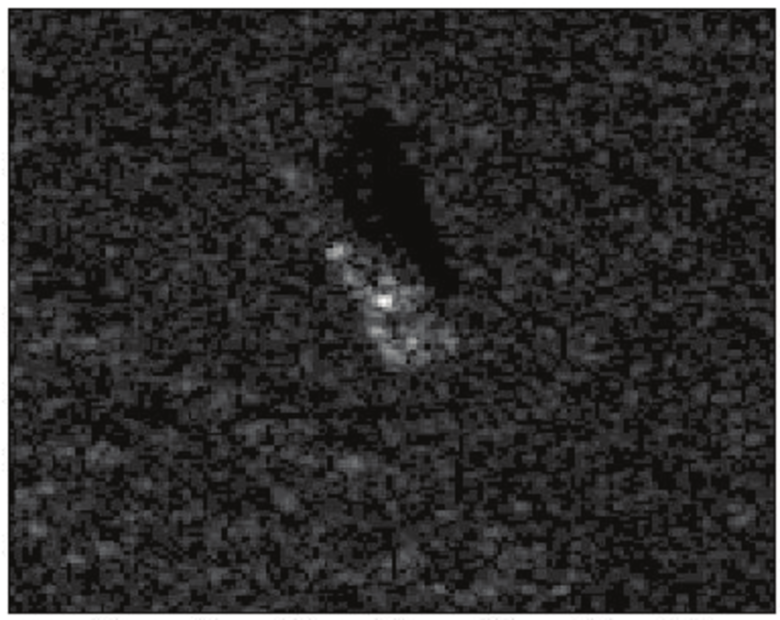
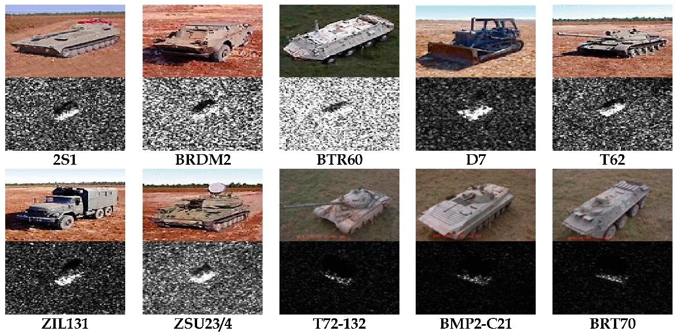
Generating SAR Images with GANs
Example image from MSTAR dataset
Examples of SAR images on left
SAR images have different statistics from optical images
Patches of bright and dark spots called “speckle”
Convolutional Neural Networks (CNNs) that work for optical images need adaptation to work for SAR images
Loss function of CNNs

Slide 4
Research questions
Style transfer: Can we make synthetic images look more like real images without human intervention?
Change elevation: Can we train a GAN on a set of 30 degree elevation images and generate a 15 degree elevation image (for example)?
Denied target: Can we generate SAR image for denied target by only training on group of similar images and a few images of the target?
Other parameters: Can we generate images that account for changes in other variables, such as squint angle?

Slide 5
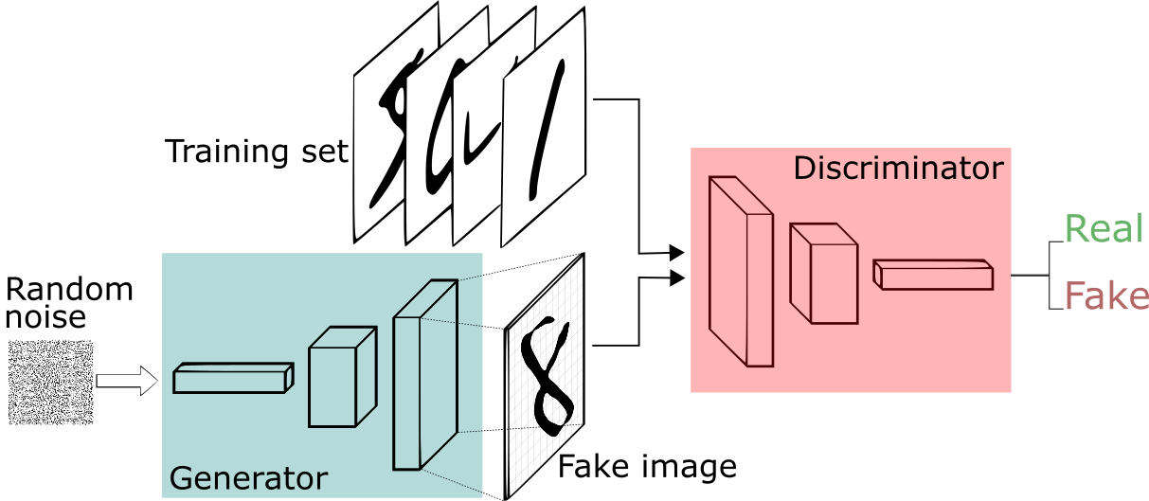
Algorithmic approach of your solution
Generative Adversarial Networks (GANs) train two neural networks in a “game” against each other
The generator is equivalent to a forger
The discriminator is equivalent to an expert trying to decide if the generators work is real or fake
Nash equilibrium when 50/50 chance that generated images are labelled real by discriminator
Discussed in https://arxiv.org/abs/1710.08446

Slide 6
GAN Architectures
Generator
Discriminator
https://github.com/vdumoulin/conv_arithmetic
for some cool illustrations of convolutional filters
32x1 vector is noise input
Conditional GANs (cGANs) concatenate additional
tunable variables onto the end of noise vector

Slide 7
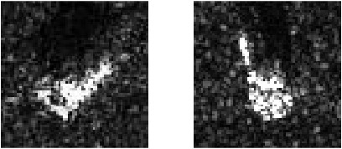
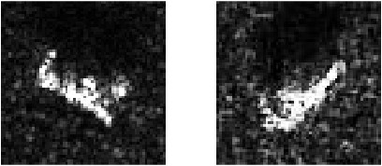
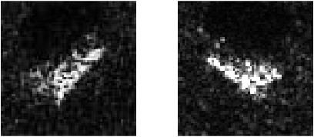
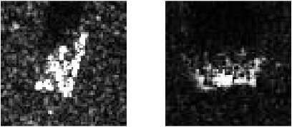
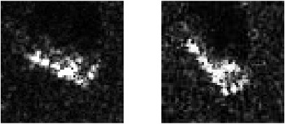
SAR Turing Test
Which one is real/fake?
1.
4.
2.
5.
3.
Answers: 1. R/F 2. F/R 3. R/F 4. R/F 5.R/F

Slide 8
Lessons Learned
Example of Lesson Learned:
Lessons Learned:
The quality of images is sensitive to network architecture and hyperparameter tuning.
Off-the-shelf solutions don’t produce good results without modifications
Using a sliced Wasserstein loss function seems superior to L2 loss function
SME feedback on images critical for improving data
Fixed generated images (above) to make them more “blocky” by changing activation function on generator network from sigmoid to RELU
SAR SMEs say blocky images more realistic
Example of changes in network architecture producing better images

Slide 9
Additional Results and Future Directions
Additional results from using Pix2Pix and CycleGAN on improving synthetic SAR images
Can show examples later if interested
Dan Moser
Examining several improvements on ‘vanilla” GANs
Sliced Wasserstein GAN: Replace loss function with Sliced Wasserstein loss function
Cost to transform one pile of dirt into a different pile of dirt
Mathematical arguments support Wasserstein being a better loss function
Derrek Yager
Data Augmentation: Expand data set by translating pictures, adding noise, etc.
Theo Stangebye
Network Architecture: More layers? Pooling -> Capsule Network?
Alex Schwing and Dan Moser
Examine Automatic Target Recognition (ATR) properties of generated images
Mary Moya
Other staff members developing statistical tests for comparing SAR images
Michelle Hummel

