Slide 1
Digital Geometry - Introduction to OpenFlipper ( & Tips for Exercise 1)
Junjie Cao @ DLUT
Spring 2017
http://jjcao.github.io/digital-geometry/
Notes:
Based on MIT6_837F12_Lec07.pdf, finished.

Slide 2
The minimal C++ knowledge
http://jjcao.github.io/cPlusPlus/
lab01_ConsoleApplication;
01_1_Your1stProgram;

Slide 3
Building OpenMesh
Exercises will be simple after finishing this

Slide 4
Building OpenMesh - Dependencies
Install glut 3.7.6 (machine type 'X86‘)
Rearrange the files in the glut-3.7 directory such that:
all *.lib and *.dll files are in a c:\libs\glut-3.7\lib subdirectory
the glut.h file is moved to the subdirectory c:\libs\glut-3.7\include\gl\glut.h
Or just extract glut-3.7.6.zip we provided
Install Visual Studio Community 2015
Install CMake (>=3.4)
Install binary version (VC2015+'X86') of Qt5
qt-opensource-windows-x86-msvc2015-5.7.0.exe
Extract OpenMesh source code (>=6.3)

Slide 5
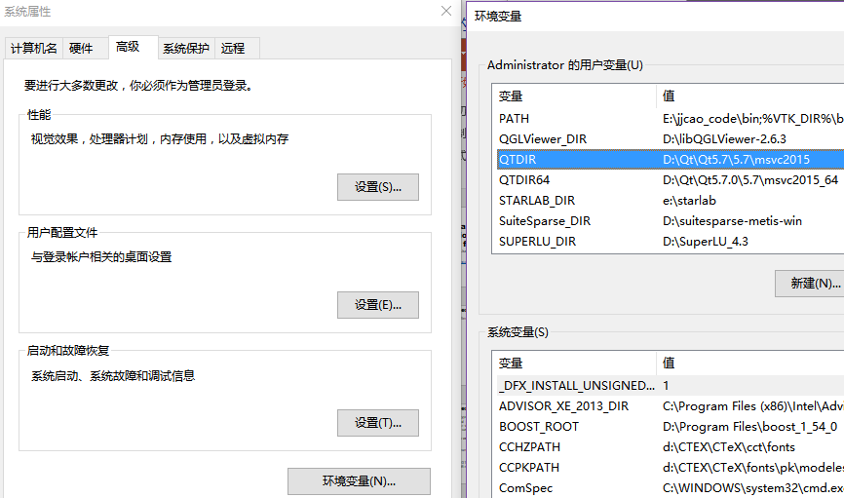
Make sure that

Slide 6
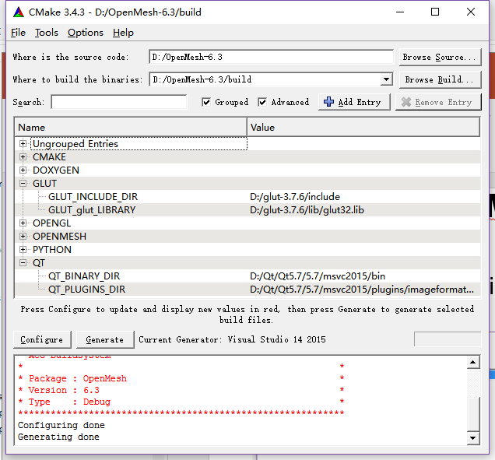
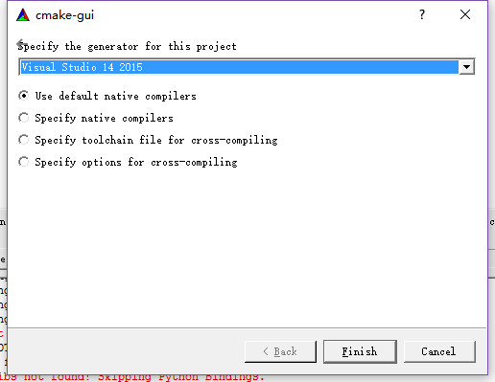
Building OpenMesh - CMake
Run cmake-gui
Build OpenMesh (machine type 'X86‘)
Configure
Generate

Slide 7
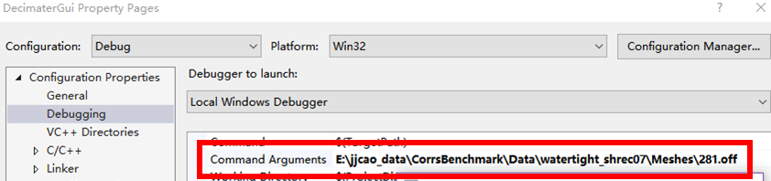
Build 1st example - DecimaterGui
D:\OpenMesh-6.3\build/OpenMesh.sln
Build project: DecimaterGui
Set it as “Set as Startup Project”
Specify a mesh
Run it with F5
Success until you see the mesh
http://jjcao.github.io/links.html

Slide 8
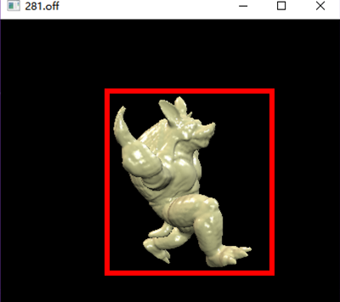
Congratulations!

Slide 9
Assume you are Sherlock Holmes
Where is the entrance?
int main(int argc, char **argv) in decimaterviewer.cc
What are input?
while ( (c=getopt(argc,argv,"s"))!=-1 )
if ( ! w.open_mesh(argv[optind], opt) )
What is the core?
DecimaterViewerWidget
void DecimaterViewerWidget::keyPressEvent(QKeyEvent* _event)

Slide 10
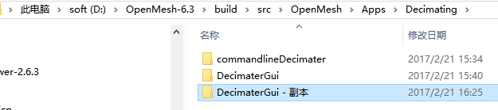
Copy it as a start point of your journey
Copy it, keep it at the same path
Name it as ex1
Open ex1\DecimaterGui.vcxproj with VC2015
Run it and start with it!

Slide 11
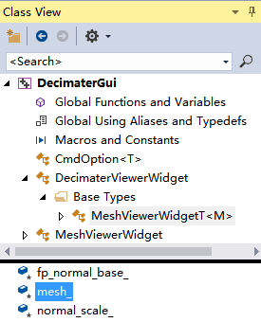
Step 1 - Vertex valence of a triangle mesh
ValenceViewer::calc_valences() called once before render loop starts
=> DecimaterViewerWidget::calc_valences()
After load the mesh or add a keyPressEvent or …
Add code to this method to compute valence of each vertex in mesh “mesh_” (member of superclass “MeshViewer”)
=> MeshViewerWidgetT
Store valences in custom attribute you must define for each vertex

Slide 12
Step 2 - Color visualization
Define function mapping of each valence number to RGB value used as vertex color
Implement mapping in ValenceViewer::color_coding()(called right after calc_valences())
=> where & how?
Describe your mapping in readme.txt submitted with assignment
Use predefined attributes for color (don’t define your own)
Notes:
1 => Mesh::Color(0, 0, 255)
2 => Mesh::Color(2, 4, 44)
…

Slide 13
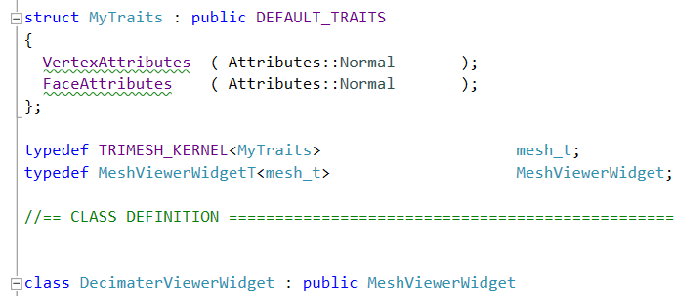
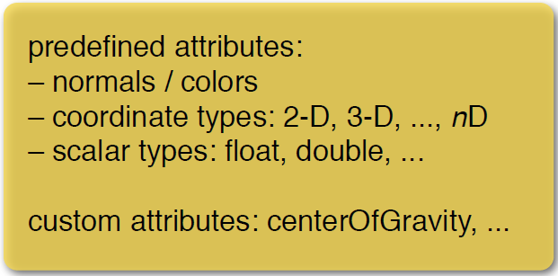
Customizing the Mesh
Kernel & traits
# define TRIMESH_KERNEL TriMesh_ArrayKernelT
Traits
Attributes: 2 different ways to use them
see exercise1.pdf & Using (custom) properties in Tutorials of OpenMesh document

Slide 14
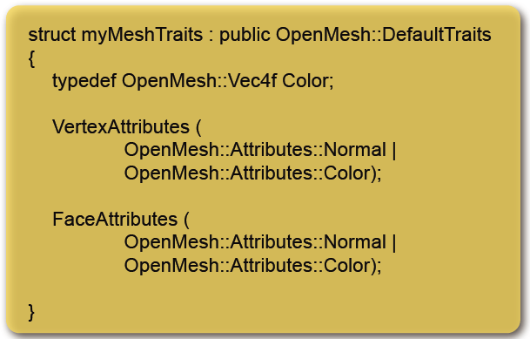
custom attribute / Traits – static customization
VertexAttributes ( Attributes::Normal | Attributes::Color );

Slide 15
mesh_->set_color(currentVH, Mesh::Color(0, 0, 255));
MeshViewerWidgetT<M>::open_mesh(const char* _filename, IO::Options _opt){
…
// check for possible color information
if ( opt_.check( IO::Options::VertexColor ) )
{
std::cout << "File provides vertex colors\n";
add_draw_mode("Colored Vertices");
}
else
mesh_.release_vertex_colors();
…
Notes:
void set_color (VertexHandle _vh, const Color &_c)

Slide 16
Where to display the color?
MeshViewerWidgetT<M>::draw_openmesh(const std::string& _draw_mode)
else if (_draw_mode == "Colored Vertices")
How to make this true?
Click menu item named "Colored Vertices"
Have to add the item before clicking
w.add_draw_mode("Colored Vertices");

Slide 17
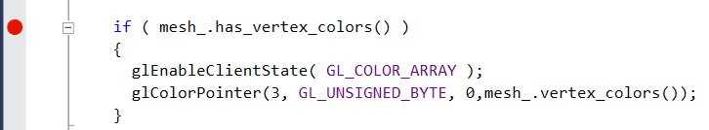
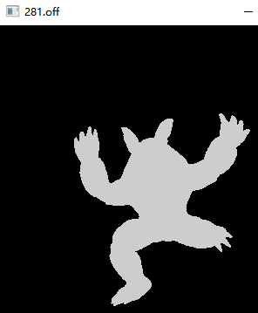
Debug your code!

