Slide 1
C++ Program Design -- IDE_VC_Win32ConsoleApplication
Junjie Cao @ DLUT
Summer 2016
http://jjcao.github.io/cPlusPlus

Slide 2
1. Setting up a Console Application in VC 10
Create a Console Project
Solution Explorer
Add New Source File
Add Code
Class View
Setup Intermediate Directory (Optional)
Build Project
Run the Program

Slide 3
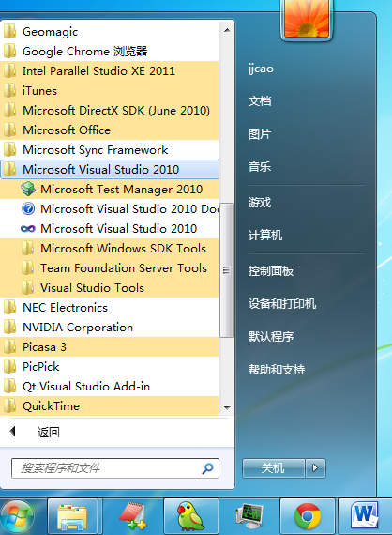

Start VC IDE

Slide 4
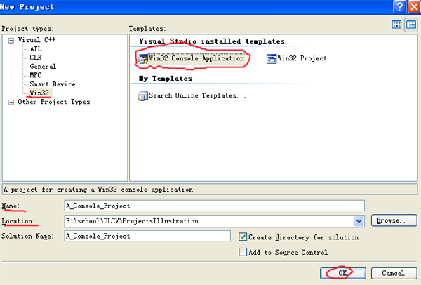
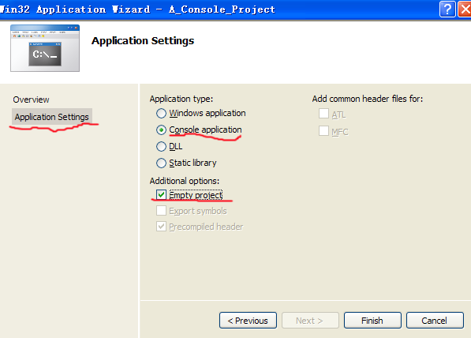
Step 1: Create a Console Project
Choose File -> New -> Project from the VS210 menus => Win32 Console Application (chosen from the templates on the right side).
Set the location to someplace on your drive and give the project a name, such as A_Console_Project.
Click OK.
Go to the Application Settings tab. Make sure Console application and Empty project are selected.
Click Finished.

Slide 5
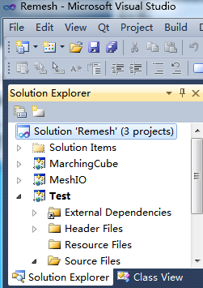
Step 2: Solution Explorer
Choose View- Solution Explorer from the VS menus
It shows you a tree representing your current solution.
Solutions are made of one or more projects, which in turn are composed of one or more files. We currently have one project in our solution, namely A_Console_Project

Slide 6
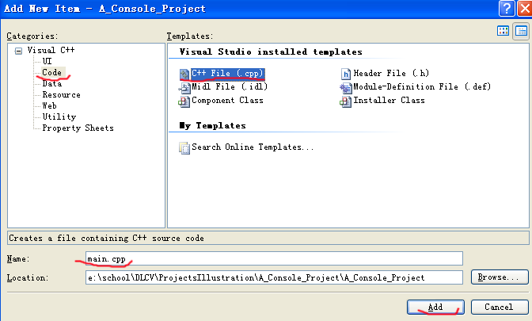
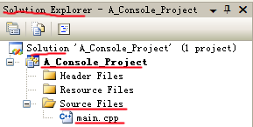
Step 3: Add New Source File
Right click on our project A_Console_Project at solution explorer and choose Add->Add New Item.
We want a C++ source file so choose the Code category and C++ File (.cpp) from the Templates.
Enter a name for our source file, main.cpp in our case. The location should already be under the project you’ve created.
Click Add.
You should now see a blank source file in the editor titled main.cpp.
Solution Explorer shows that A_Console_Project has currently a single file main.cpp under Source Files.
Notes:
solution explorer : Let’s add a window to VS2010 to make navigating our project easier. From the View menu choose Solution Explorer. All windows in VS2010 can be docked or hidden as you’d like, so feel free to drag this new window to a location that is accessible but does not block your view of the main source window.

Slide 7
Step 4: Add Code
Enter the following code into main.cpp which should already be open in the main source window.
#include <iostream>
using namespace std;
int main(int argc, char** args){
cout << "Hello world" << endl;
return 0;
}

Slide 8
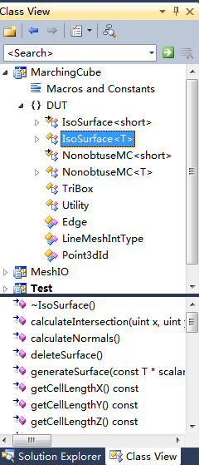
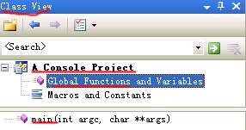
Step 5: Class View
We have a single function: main() currently, so it is easy to locate the code. However, the project can become rather large and finding the function you want to modify may not be so easy.
Choose View -> Class View => Class View window, which is similar to Solution Explorer. Hence you'll probably want to place them together.
It breaks the project up by class and function rather than by file. Right now we have only a single function main but later your projects will grow to multiply classes each containing many functions. The Class View window will prove invaluable when navigating such projects later in the course.

Slide 9
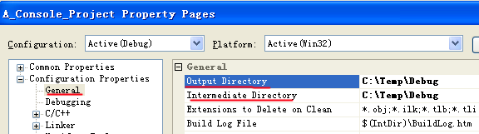
Step 6: Setup Intermediate Directory (Optional)
Open the Class View window, right click on our project A_Console_Project and choose Properties. Select General from the left hand pane and set the Output Directory and Intermediate Directory both to C:\Temp\Debug.
Click OK and we’re all set to compile our project.

Slide 10
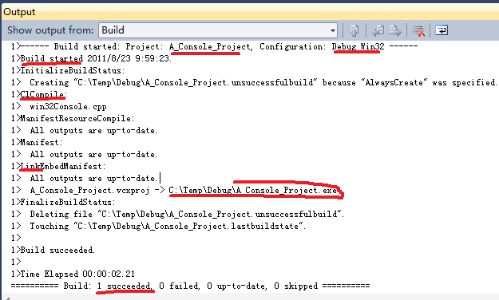
Step 7: Build (compile+link) Project
View->Other Windows->Output from VS2010 menus. The Output window shows the output from the compile and linking process.
Chose Build->Build Solution (F7) from the VS2010 menus.
If you've copied the code correctly, you should see the following output to the right.
If the build failed you should see some text explaining why it failed. If the error is a compiling error, you should be able to double click on the error and the source window should update to show you the line on which the error occurred.
Notes:
Before building our project we need to open another window so we can see the results of our build attempt.

Slide 11
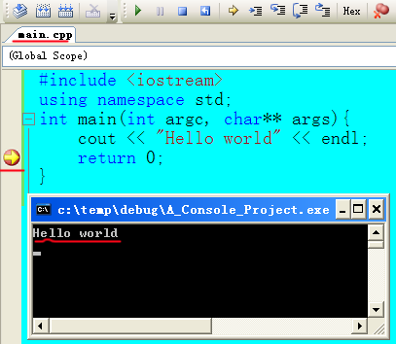
Step 8: Run the Program
Place a breakpoint on the line “return 0” by left clicking on the position of the big red point (left click again, it will disappear) and press F5.
A console window appears and the program will break at the line “return 0”.
Press F5 again to continue the execution of the program, and the program will exist successfully.
Congratulations!
Notes:
Refer to “How to: Create a Standard C++ Program” in MSDN.

Slide 12
Questions?

Slide 13
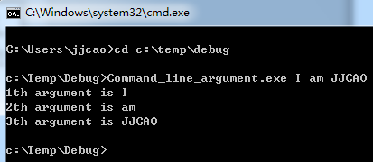
2. Command Line Argument
In Windows, the GUI will be used to communicate with the user.
In DOS, command line arguments are used to parse in users' specified parameters.
In the following figure, "Command_line_argument.exe" is the command and I am JJCAO is the command line arguments being parsed in.
Modify Main
Modify Project's Command Arguments
Build Project
Run the program

Slide 14
Step 1: Modify Main
#include <iostream>
using namespace std;
int main(int argc, char** args)
{
// Notice I start from i=1 not 0 because the args[0] is reserved
// for the name of this program.
for(int i = 1; i < argc; i++)
{
cerr << i << "th argument is " << args[i] << "\n";
}
}
Note: The relationship of argc and args:
args is an array of char*
argc is the size of the array: args, which is determined when command line arguments are passed to the main() function. So after you change the size of args, argc is not updated automatically.

Slide 15
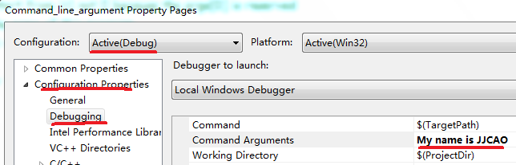
Step 2: Modify Project's Command Arguments Setting
Open the Class View window, right click on our project (Command_line_argument), and choose Properties. Choose Debugging from the left hand pane. Add My name is JJCAO to the Command Arguments. Click OK

Slide 16
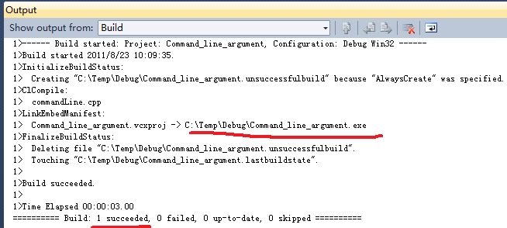
Step 3: Build Project
Press F7 to build the solution.

Slide 17

Step 4: Run the Program
Press F5 to run the program..
Congratulations! You've got your 2nd successful VS2010 project
Note: When debugging a c++ program from the IDE (F5), the current path is the path where the project file (*.vcproj) is located. When running a c++ program from the IDE (Ctrl+F5), the current path is the path where the excutable file (*.exe) is located (commonly is the path Debug).

Slide 18
Questions

Slide 19
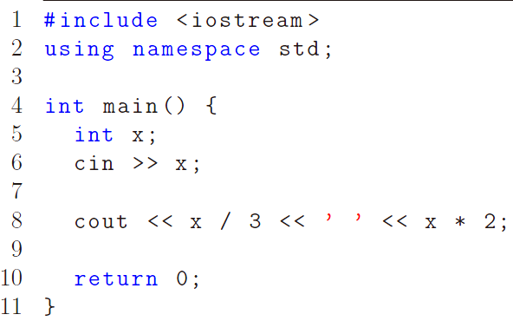
Input
Let user input values to the program (line 6)
ctrl+z: cancel input from cin
Notes:
Now that we know how to give names to values, we can also have the user of the program input values. This is demonstrated in line 6 below.

Slide 20
iostream
cin
cout
cerr
clog
Ordinarily, sys associates them with the console window.
They can be redirected to files.

Slide 21
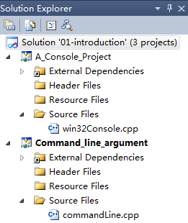

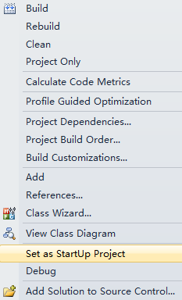
Default current directory of VC
Solution: 01-Introduction
Project: A_Console_Project
Project: Command_line_argument
Current Project: Command_line_argument
The current directory of the current project
The dir where the Command_line_argument.vcxproj is
Where is win32Console.cpp? ../ A_Console_Project/

Slide 22
Debugging
Compilation error
Violations of the syntax rules
Misuse of types
Runtime error
Need debugging

Slide 23
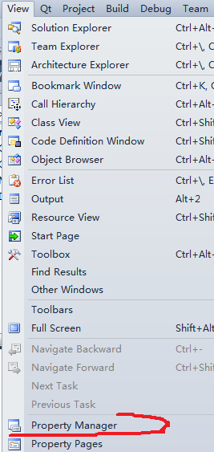
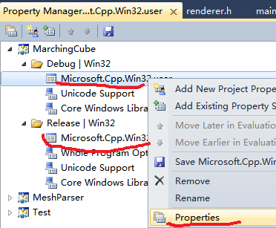
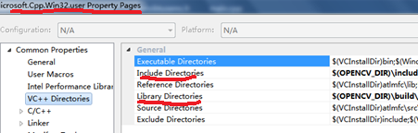
Set include & lib path independent with solutions
Set it in Property Manager (You have to open a project first.) If you set it in the Context Menu of a solution or project, it will be dependent on specified projections.

Slide 24
Build configurations
Switching between debug and release in Visual Studio

Slide 25
Pack Your Solution -- before sending it to others
Delete *.ncb || *.sdf
Delete debug, release && ipch directories
Compress all into a *.rar or *.zip
Sent it by email || …
Notes:
Packing.bat
@Echo Off
del *.ncb /s
del *.sdf /s
@Echo Find debug
@For /r . %%a In (.) Do @If Exist "%%a\debug" @Echo "%%a\debug"
@Echo Find debug Dir....OK
@For /r . %%a In (.) Do @If Exist "%%a\debug" rd /s /q "%%a\debug"
@Echo Clear debug Dir Mission Completed
@Echo Find release
@For /r . %%a In (.) Do @If Exist "%%a\release" @Echo "%%a\release"
@Echo Find debug Dir....OK
@For /r . %%a In (.) Do @If Exist "%%a\release" rd /s /q "%%a\release"
@Echo Clear debug Dir Mission Completed
@echo on

