Slide 1

James Choi
6/22/17

Slide 2
About Me
Background in MIS
Started career as a C# and .NET web developer
Business Analyst at IBM Global Financing
Software Engineer at IBM Advanced Cloud Solutions
Data Science Program at Metis

Slide 3
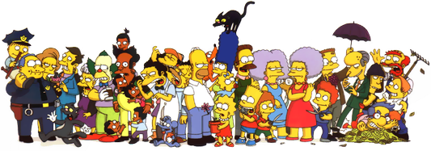
About The Simpsons
The longest running American sitcom and animated program
Started in 1989 and in 28th season now
Won dozens of awards -31 Primetime Emmy Awards, 30 Annie Awards, and a Peabody Award

Slide 4
Interesting and unique dataset
Relatively new on Kaggle with not many contributions
Interested in working in a media / TV / gaming company
Exploring the data to for fun!
Motivation

Slide 5
Four CSV files
  Characters (id, character name, gender) – 6722 rows
  Locations (id, location name) – 4459 rows
  Episodes (id, title, original air date, production code, season, number in season, imdb rating, us viewers in million,) – 596 rows
  Script Lines (id, episode id, character id number, script text, timestamp, speaking line, word count) – 158,247 rows
Additional Data Gathered- scraped from Wikipedia
  Directors (production code, director name) – 610 rows
  Writers (production code, writer name) – 746 rows
Data Source

Slide 6
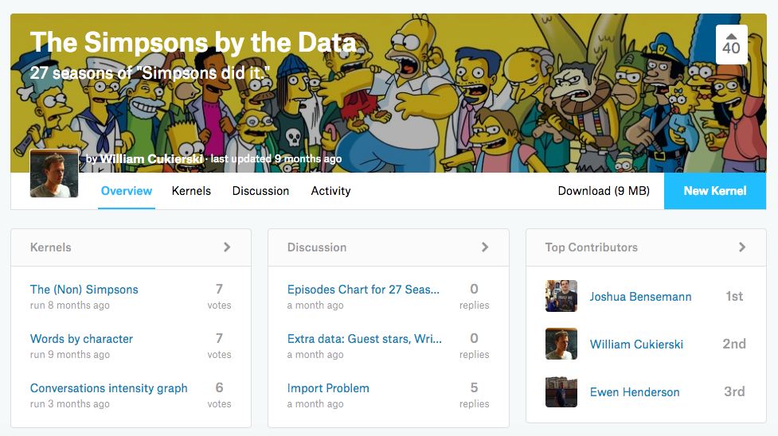
Data Source
https://www.kaggle.com/wcukierski/the-simpsons-by-the-data

Slide 7
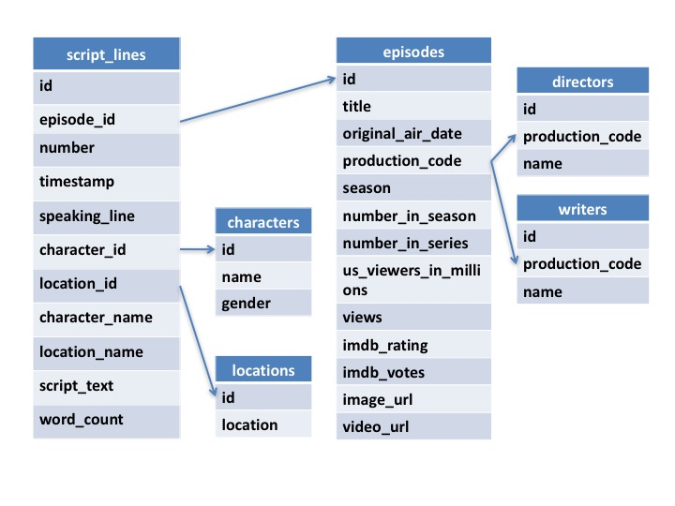
Table Relationship

Slide 8



Tools Used

Slide 9
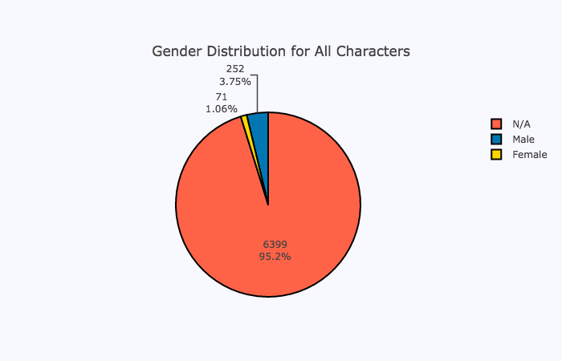
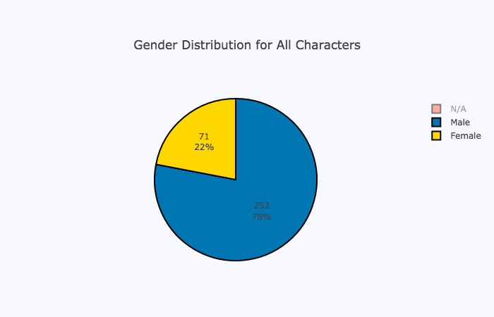
Exploratory Analysis - Characters
Of 6722 characters…

Slide 10
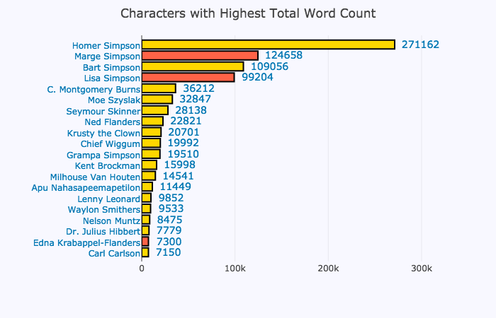
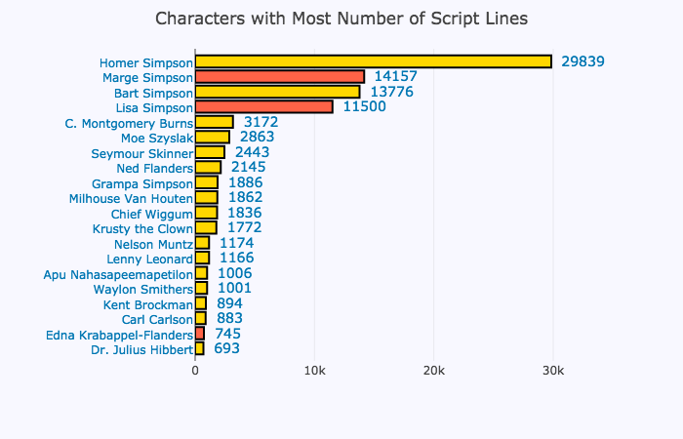
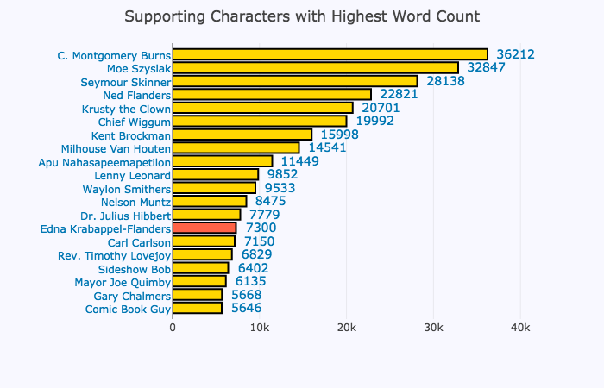
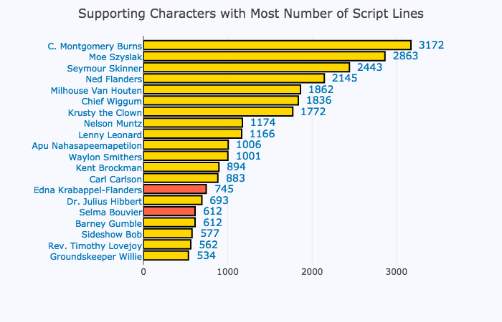
Exploratory Analysis – Characters & Script

Slide 11
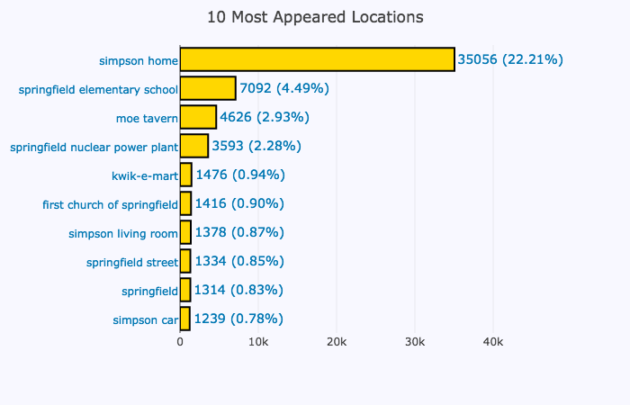
Exploratory Analysis – Locations & Script

Slide 12
Exploratory Analysis – Episodes
Excluded 28th Seasons
Total 596 Episodes for 27 Seasons
US Viewers in Million, IMDB Rating, Directors, Writers

Slide 13
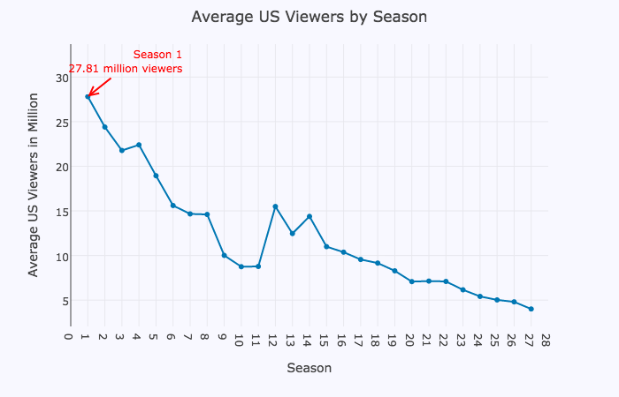
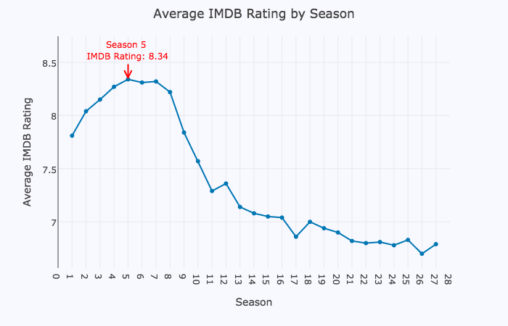
Exploratory Analysis – Episodes

Slide 14
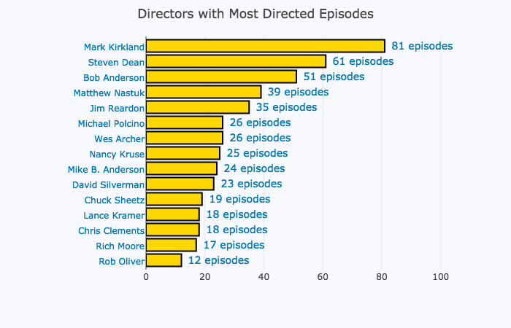
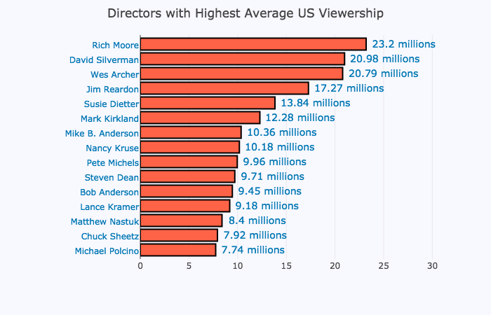
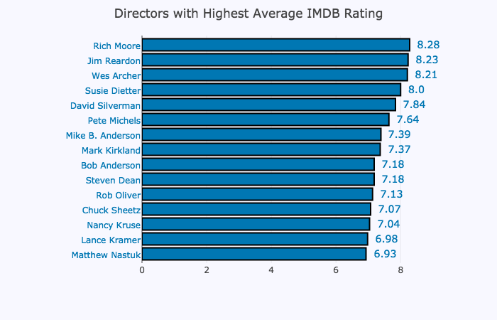
Exploratory Analysis – Directors

Slide 15
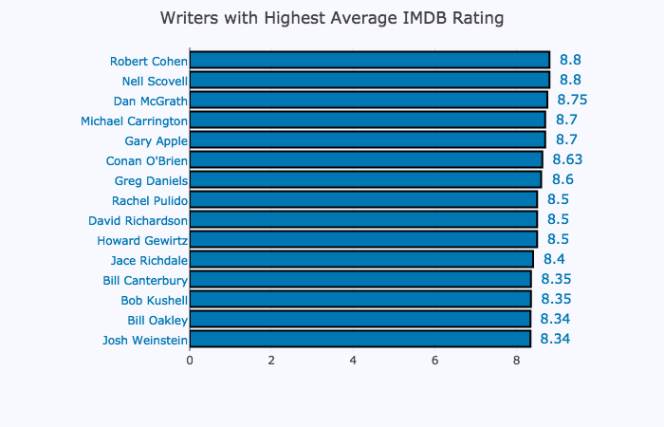
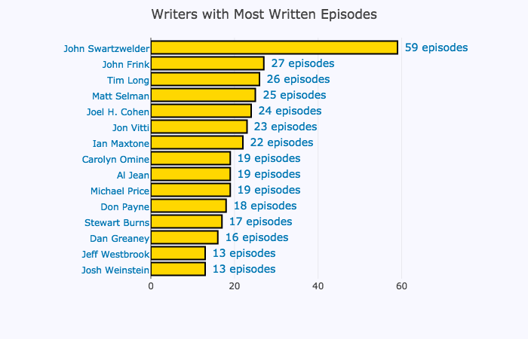
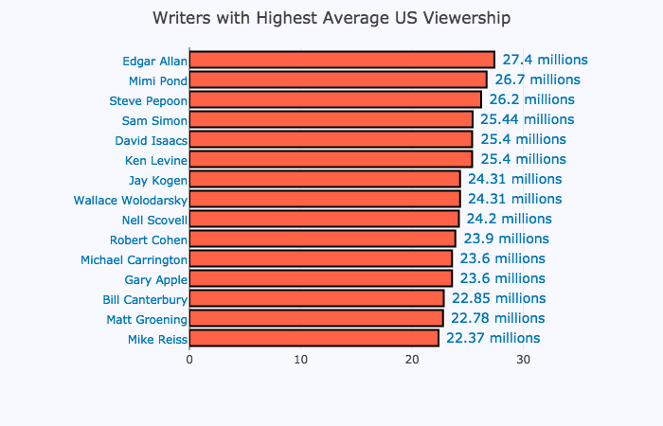
Exploratory Analysis – Writers

Slide 16
Visualization
Putting it all together…
Which episodes to watch?
https://jjchoi08.github.io/simpson/

Slide 17
Text Learning
Utilizing 160,000 rows of text data
Extracting Most Relevant Words in Corpus
Topic Modeling
  Tf-Idf
  Non-Negative Matrix Factorization

Slide 18
Normalize Texts & Group Script Lines by Episode
‘script line 1’, ‘script line 2’, ‘script line 3’, ‘script line 4’, …..
TextBlob tag=‘NN’
‘noun only script line 1’, ‘noun only script line 2’, ……..
TF-IDF Transformation
Topic Words

Slide 19
Text Learning
Interpretable
  Simpsons Roasting on an Open Fire – christmas, homer, dad, christmas bonus
  The Call of the Simpsons – dad, man, something, bigfoot, homer
  Lisa’s Substitute – mr, bergstorm, mr bergstorm, lisa, think
  Bart’s Frend Falls in Love – milhouse, bart, school, samantha, listen
  Lisa’s First Word – bart, baby, lisa, word, daddy
  Bart’s Girlfriend – bart, jessica, simpson, think, school
  Two Bad Neighbors – george, bush, president, george bush, mr
  Beyond Blunderdome - mel, gibson, mel gibson, movie, mr
  Covercraft - music, band, apu, singer, rock
  The Musk Who Fell to Earth - musk, elon, elon musk, mr, homer
  Sky Police - casino, counting, money, cards, counting cards

Slide 20
Text Learning
Difficult to Interpret
  Simson and Delilah – homer, simpson, homer simpson, mr, mr simpson
  One Fish, Two Fish, Blowfish, Blue Fish - want, dad, homer, please, please dad
  Homer Defined – sir, homer, simpson, time, homer simpson
  Homer Badman - homer, simpson, homer simpson, mr, mr simpson
  Marge Be Not Proud - mom, gon, want, wait, man
  The Fool Monty - burns, mr, mr burns, people, man
  Simpson Tide - homer, simpson, homer simpson, time, man

Slide 21
Limitations
Using same NMF / TF-IDF parameters for all episodes
Nouns + Pronouns sometimes returns meaningless words
Homer’s vocabulary
Limited time to cover broad topic as a novice data science student 😭

Slide 22
Conclusion
Next Steps
  Fine Tune Topic Modeling:
    n-grams
    Tokenization
    Add more stopwords
  Non-English word analysis for Homer
  Enhance D3 for Zoom in and out
  Gain more experiences with NLP techniques

Slide 23
Thank You
jungsangjameschoi@gmail.com
jjchoi08.github.io

