Slide 1

Chapter I Introduction

Slide 2
Session I Introduction
Oracle 12c Database Training

Slide 3
Brief History of Oracle Database
The concept of a relational database was originally developed back in 1970 by Dr. E.F. Codd. He laid down the theory of relational databases in his seminal paper entitled “A Relational Model of Data for Large Shared Data Banks,” published in Communications of the ACM (Association for Computing Machinery), Vol. 13, No. 6, June 1970.
In 1970 Larry Ellison and Bob miner founded software development
After reading a paper by cod in IBM journal of research and development they create oracle .
Version 2.0 of oracle was released in 1979 and the company change it’s name relational software
In 1982 the company renamed to oracle corporation
In 1983 oracle release version 3.0 which was written in C
In 2003 oracle 10g was released where g stands for Grid computing dfasnfdsm
In 2007 oracle has released oracle 11g.

Slide 4
Basic concepts of a relational database
The basic concepts of a relational database are fairly easy to understand. A relational database is a collection of related information that has been organized into tables. Each table stores data in rows; the data is arranged into columns. The tables are stored in database schemas, which are areas where users may store their own tables. A user may grant permissions to other users so they can access their tables. An important point to remember is that the information that makes up a database is different from the system used to access that information. The software used to access database is known as a database management system(DBMS).
DBMS controls the storage organization, and retrieval of data.
The Oracle database is one such piece of software; other examples include SQL Server, DB2, and MySQL.

Slide 5


Definition of a Relational Database
A relational database is a collection of relations or two-dimensional tables.
Dr. E. F. Cod proposed the relational model for database systems in 1979.
It is the basis for the relational database management system (RDBMS).
The relational model consists of the following:
Collection of objects or relations
Set of operators to act on the relations
Data integrity for accuracy and consistency
Oracle
server
Table name: EMPLOYEES
Table name: DEPARTMENTS
…

Slide 6
Relational DBMS
Each row of data in a table is uniquely identified by a primary key. You can logically relate data from multiple tables using foreign keys. Database management systems evolved from hierarchical network to relational database management systems (RDBMS). A relational database management system is an organized model of subjects and characteristics that have relationships among the subjects. Also RDBMS is a type of database management software which is built based on the relational model.
RDBMS is the most widely used database system, and the object structures are related.
We see relationships everywhere in our daily lives: parents and children, team and players, doctor and patient, to name a few. The main advantages of RDBMS include the way it stores
and retrieves information and how the data integrity is maintained.

Slide 7
Relational DBMS Characteristics
RDBMS structures are easy to understand and build. These structures are logically represented using the entity-relationship (ER) model.
Relational databases have the following three major characteristics. Structures: are objects that store or access data from the database. Tables, views, and indexes are examples of structures in Oracle. Operations: are the actions that are used to define the structures or to manipulate data between the structures. SELECT statements and CREATE statements are examples of operations in Oracle.
Integrity rules: govern what kinds of actions are allowed on data and the database structure.
These rules protect the data and the structure of the database. The primary keys and foreign keys are examples of integrity rules in Oracle.

Slide 8
Entity-relationship (ER) model.
A logical model of an RDBMS is typically a block diagram of entities and relationships, referred to as an entity-relationship (ER) model or ER diagram. An ER model has entity, relationship, and attributes.
An ER model is visual, showing the structure, characteristics, and interactions within and around the data being modeled.
Entities and Attributes An entity in a logical model is much like a noun in grammar—a person, place, or thing.
The characteristics of an entity are known as its attributes. Attributes are detailed information about an entity that serves to qualify, identify, classify, or quantify it. For example: ABC Inc. has many offices in the United States; each office has many departments, and each department may have many employees.

Slide 9
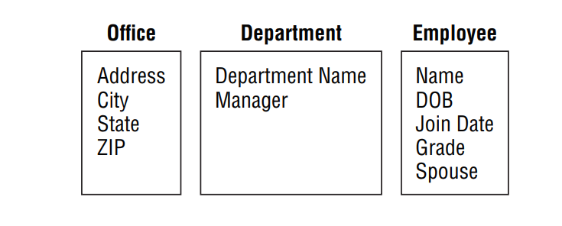
Entity-relationship (ER) model.
Placing the organization of ABC Inc. in terms of the ER model, you could identify OFFICE, DEPARTMENT, and EMPLOYEE as entities. Each entity will also have its own characteristics.
For instance, when you say “office,” you might want to know the address and city where the office is located, the state, and how many employees work there.

Slide 10
Types of Relationships
One-to-One A one-to-one relationship is one in which each occurrence of one entity is represented by a single occurrence in another entity.
For example, product and patent—one product might have a patent, and one patent corresponds to only one product.
One-to-Many A one-to-many relationship is one in which an occurrence of one entity can be represented by many occurrences in another entity.
For example, department and employees—one department has one or more employees, and an employee belongs to only one department.

Slide 11
Types of Relationships
Many-to-Many A many-to-many relationship is one in which an occurrence from one entity can be represented by one or more occurrences in another entity, and an occurrence from the second entity may be represented by one or many occurrences in the first entity. Many-to-many relationships should not exist in RDBMS because they cannot be properly joined to represent a single row correctly.
To solve this, create another entity that has an one-to-many relationship with the first entity and an one-to-many relationship with the second entity. For example, doctor and patient—a patient can visit many doctors, and a doctor can have many patients.

Slide 12
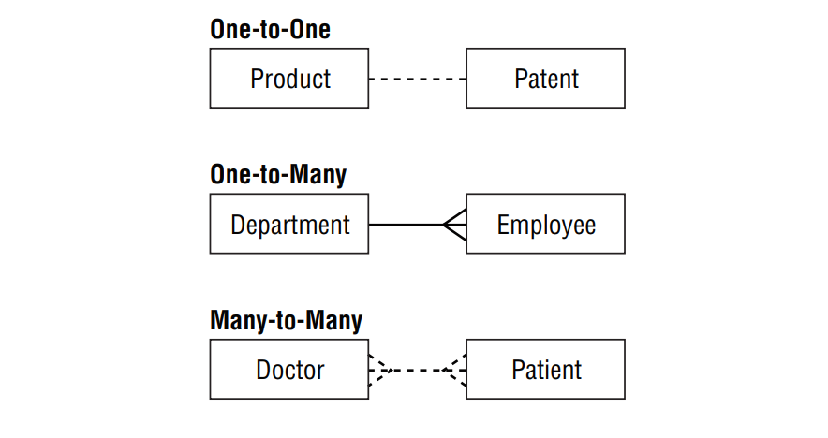
Types of Relationships

Slide 13
Implementing the RDBMS characteristics
Oracle implements the RDBMS characteristics using the following set of structures:
Tables are used for data storage.
Views and synonyms are created for data access.
Indexes are used to speed up data retrieval.
Primary keys, foreign keys, and unique keys are called constraints and are created to enforce data integrity
Triggers are created to satisfy the business rules.
Roles and privileges are used for security.
Procedures, functions, and packages are used to code the application.

Slide 14
Introducing the SQL
There is metadata in the DBMS that keeps track of all the components of the database, also known as the Data dictionary. The code or language used to retrieve data from the database is known as SQL, which stands for Structured Query Language.
“ S-Q-L” is the correct way to pronounce SQL according to the American National Standards Institute. However, the single word “sequel” is frequently used instead.
SQL is the basic language used to manipulate and retrieve data from Oracle Databases. SQL is a nonprocedural language, meaning it does not have programmatic constructs such as loop structures.
PL/SQL is Oracle’s procedural extension of SQL, and SQLJ allows embedded SQL operations in Java code.

Slide 15
Introducing the SQL
There is metadata in the DBMS that keeps track of all the components of the database, also known as the Data dictionary. The code or language used to retrieve data from the database is known as SQL, which stands for Structured Query Language.
“ S-Q-L” is the correct way to pronounce SQL according to the American National Standards Institute. However, the single word “sequel” is frequently used instead.
SQL is the basic language used to manipulate and retrieve data from Oracle Databases. SQL is a nonprocedural language, meaning it does not have programmatic constructs such as loop structures.
PL/SQL is Oracle’s procedural extension of SQL, and SQLJ allows embedded SQL operations in Java code.

Slide 16
SQL Commands
SQL uses a simple syntax that is easy to learn and use. Of course, every database must have some way to get data in and out of it, preferably using a common language understood by all databases. Database management systems implement a standard language known as Structured Query Language, or SQL.
There are five types of SQL statements or sub languages.
1. Query statements retrieve rows stored in database tables. You write a query using the SQL SELECT statement.
2. Data Manipulation Language (DML) statements modify the contents of tables. There are three DML statements:
INSERT adds rows to a table.
UPDATE changes rows.
DELETE removes rows.
Merge combines Insert update and delete statements

Slide 17
SQL Commands
SQL uses a simple syntax that is easy to learn and use. Of course, every database must have some way to get data in and out of it, preferably using a common language understood by all databases.
Database management systems implement a standard language known as Structured Query Language, or SQL.
There are five types of SQL statements or sub languages.
1. Data Query statements retrieve rows stored in database tables. You write a query using the SQL SELECT statement.
2. Data Manipulation Language (DML) statements modify the contents of tables. There are three DML statements:
INSERT adds rows to a table.
UPDATE changes rows.
DELETE removes rows.
Merge combines Insert update and delete statements

Slide 18
SQL Commands
Data Definition Language (DDL) statements define the data structures of the tables. There are five basic types of DDL statements:
CREATE creates a database structure. For example, CREATE TABLE is used to create a table; another example is CREATE USER, which is used to create a database user.
ALTER modifies a database structure. For example, ALTER TABLE is used to modify a table.
DROP removes a database structure. For example, DROP TABLE is used to remove a table.
RENAME changes the name of a table.
TRUNCATE deletes all the rows from a table

Slide 19
SQL Commands
Transaction Control (TC) statements either permanently record any changes made to rows, or undo those changes. There are three TC statements:
COMMIT permanently records changes made to rows.
ROLLBACK undoes changes made to rows.
SAVEPOINT sets a “save point” to which you can roll back changes.
Data Control Language (DCL) statements change the permissions on database structures. There are two DCL statements:
GRANT gives another user access to your database structures.
REVOKE prevents another user from accessing your database structures.

Slide 20
Tools will be used to Run SQL query
There are many ways to run SQL statements and get results back from the database, some of which include programs written using Oracle Forms and Reports.
There are two development environments for this course:
Primary tool is Oracle SQL Developer.
SQL*Plus command line interface may also be used.
Sometimes Oracle Enterprise Manager OEM.

Slide 21
Overview of Licensing and Installation Options
Types of installations you can perform are the same. Although these may change with product releases, they generally include the following:
Enterprise Edition This is the most feature rich and extensible version of the Oracle database.
Standard Edition This edition provides a good subset of the features of the Enterprise Edition, generally including the features that a small business will need.
Personal Edition This edition allows for development of applications that will run on either the Standard or Enterprise Edition. This edition cannot be used in a production environment.
Use the Oracle Universal Installer (OUI) to install and manage all Oracle components for both the server-side and client-side components. You can also deinstall any Oracle products from the initial OUI screens.

Slide 22
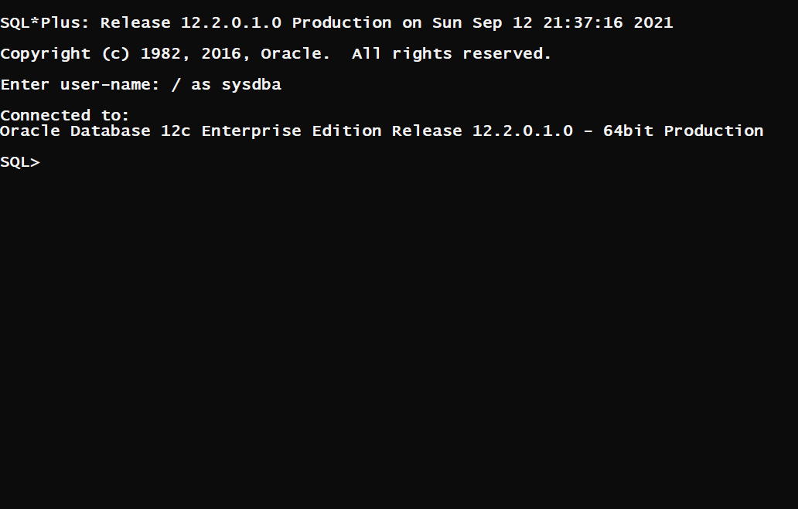
SQL*Plus Screen

Slide 23
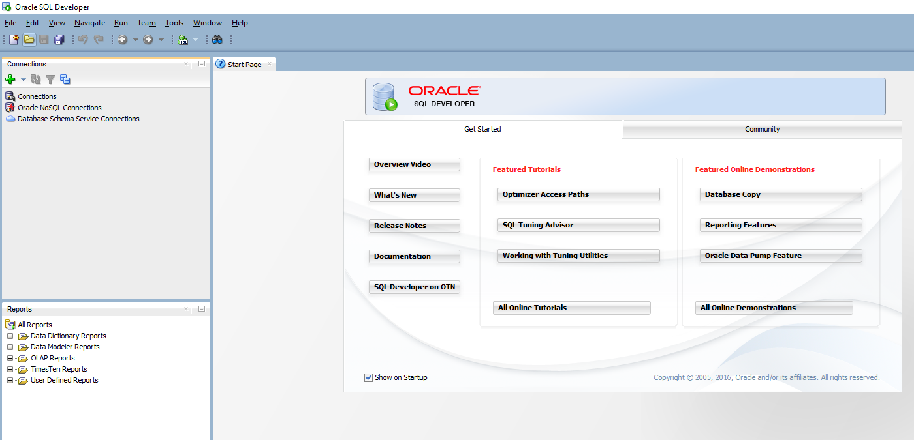
SQL Developer Screen

Slide 24
THANK YOU

