Slide 1
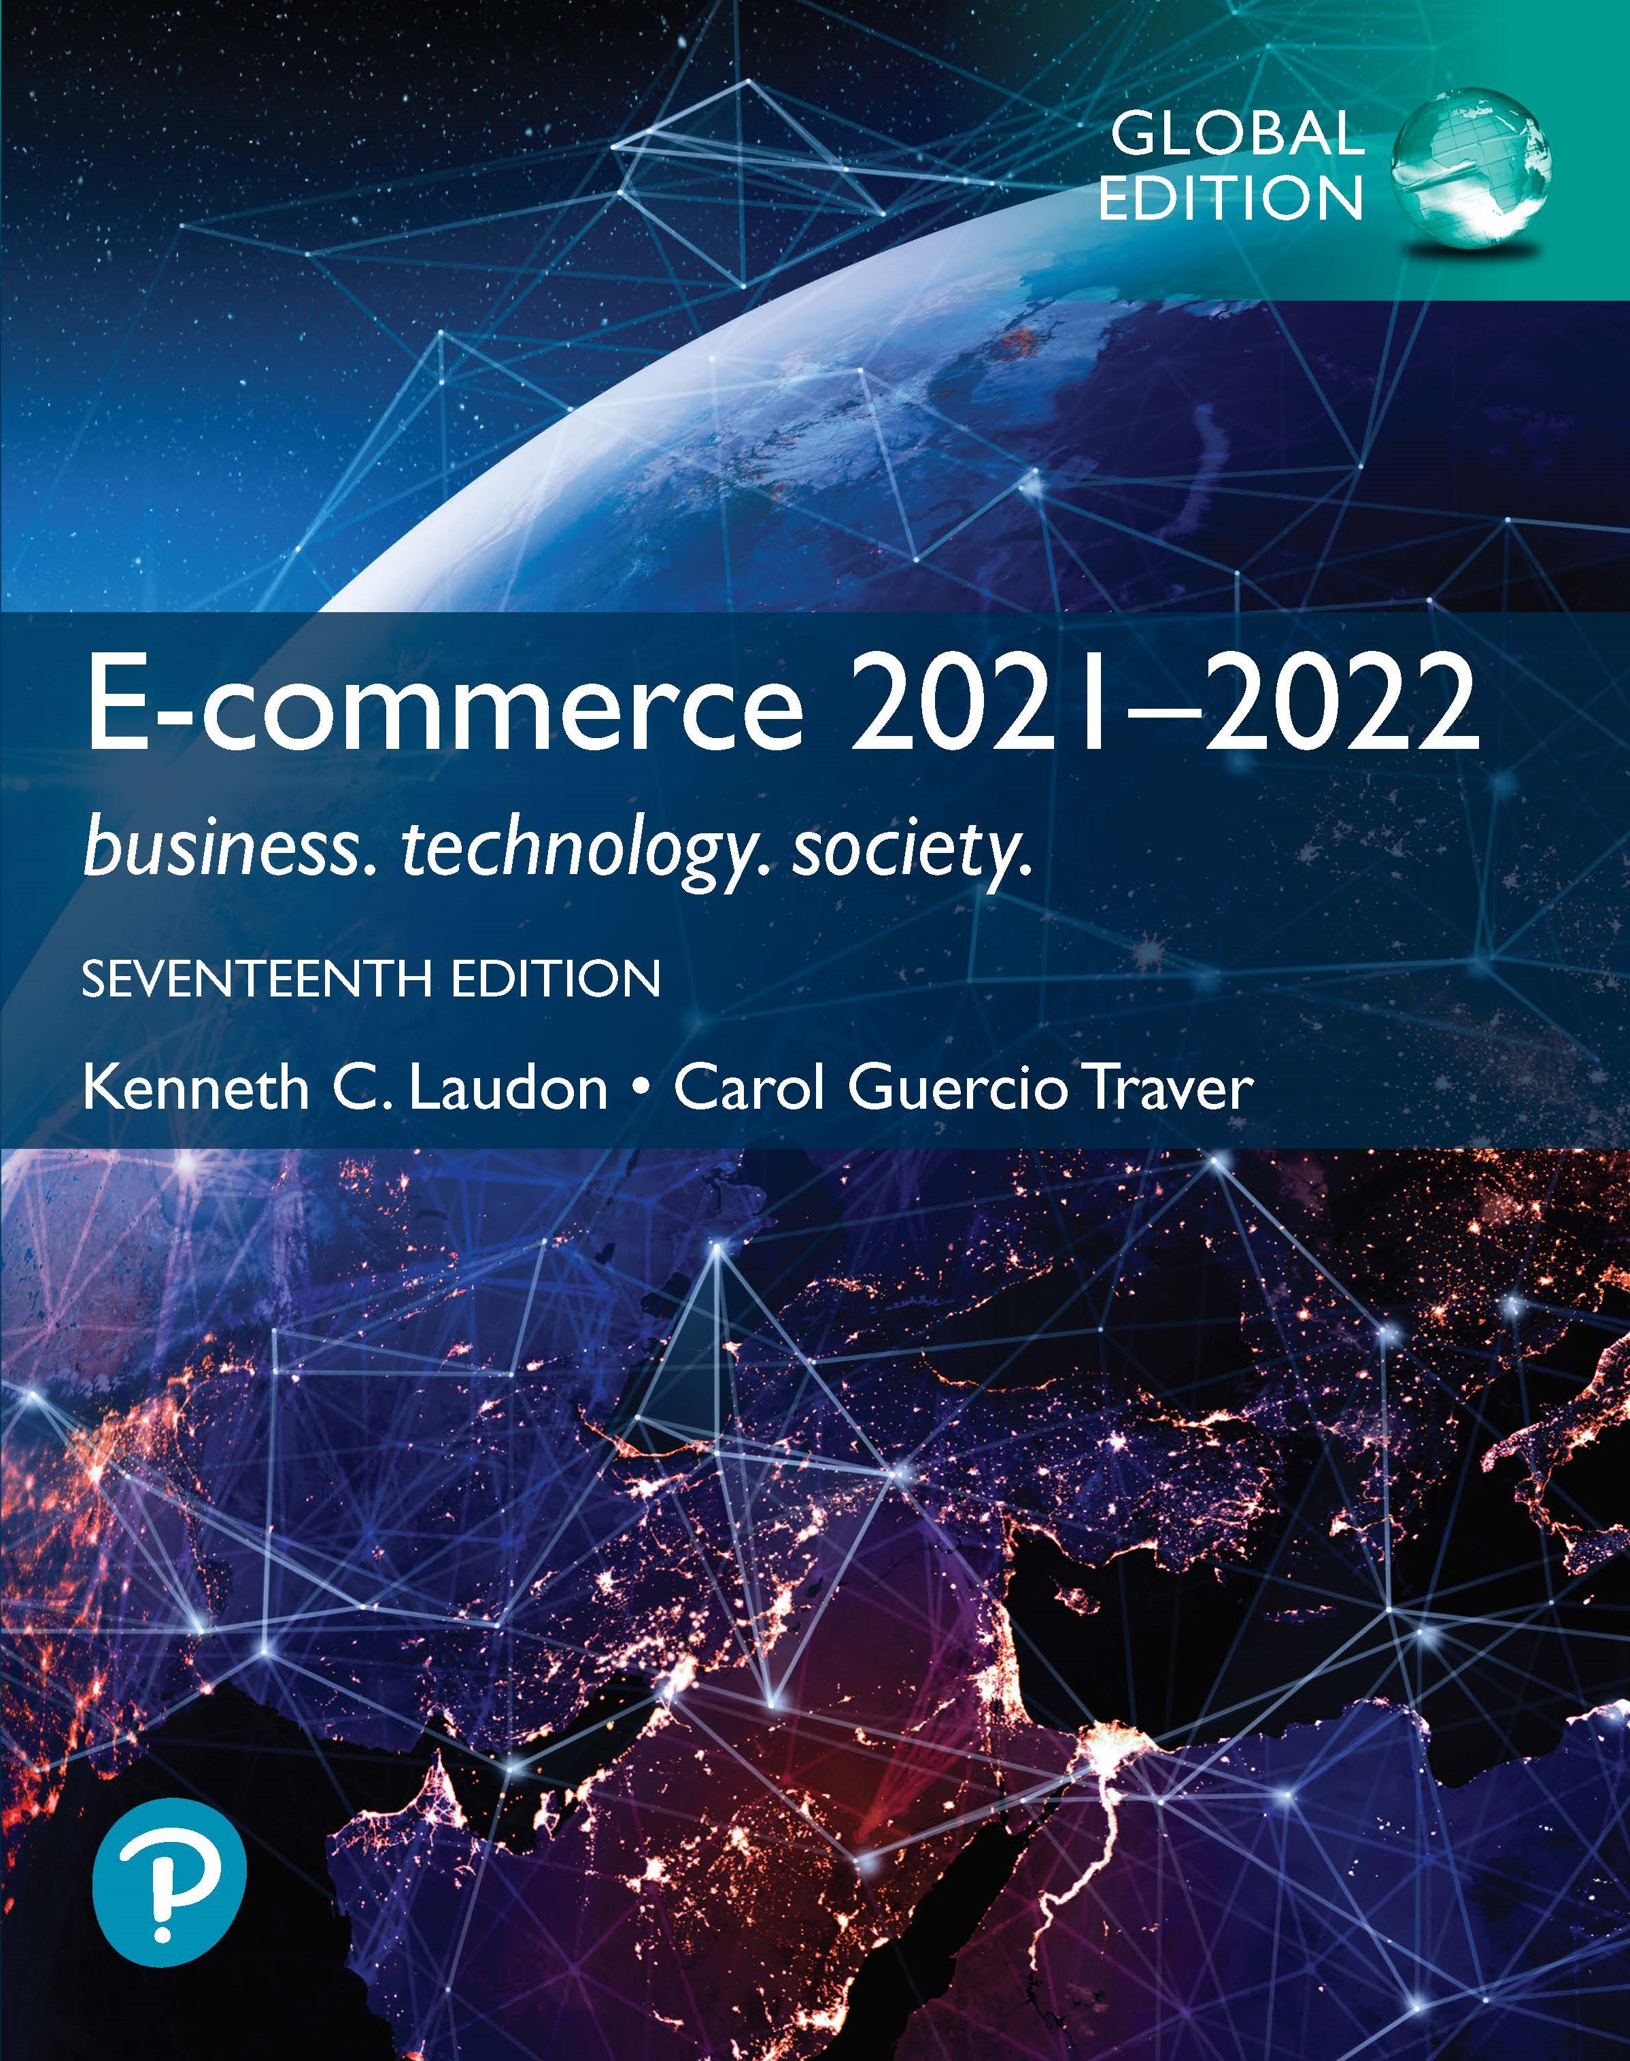

E-commerce 2021–2022: Business. Technology. Society.
Seventeenth Edition, Global Edition
Chapter 3
E-commerce Infrastructure
Copyright © 2022, 2019, 2018 Pearson Education, Ltd. All Rights Reserved
Notes:
If this PowerPoint presentation contains mathematical equations, you may need to check that your computer has the following installed:
1) MathType Plugin
2) Math Player (free versions available)
3) NVDA Reader (free versions available)
Slides in this presentation contain hyperlinks. JAWS users should be able to get a list of links by using INSERT+F7

Slide 2
Learning Objectives
3.1 Discuss the origins of, and the key technology concepts behind, the Internet.
3.2 Explain the current structure of the Internet.
3.3 Understand how the Web works.
3.4 Describe how Internet and web features and services support e-commerce.
3.5 Understand the impact of mobile applications.

Slide 3
The Internet: Technology Background
Internet
Interconnected network of thousands of networks and millions of computers
Links businesses, educational institutions, government agencies, and individuals
World Wide Web (Web)
One of the Internet’s most popular services
Provides access to billions, possibly trillions, of web pages

Slide 4
The Evolution of the Internet 1961–Present
Innovation Phase, 1961–1974
Creation of fundamental building blocks
Institutionalization Phase, 1975–1995
Large institutions provide funding and legitimization
Commercialization Phase, 1995–present
Private corporations take over, expand Internet backbone and local service

Slide 5
Domain Names, D N S, and U R L s
Domain name
I P address expressed in natural language
Domain name system (D N S)
Allows numeric I P addresses to be expressed in natural language
Uniform resource locator (U R L)
Address used by web browser to identify location of content on the Web
For example:
http://www.azimuth-interactive.com/

Slide 6
Client/Server Computing
Powerful desktop computers (clients) connected in network with one or more servers
Servers perform common functions for the clients
Storing files
Software applications
Access to printers, and so on

Slide 7
The Mobile Platform
Primary Internet access is now through smartphones and tablets
Smartphones are a disruptive technology
New processors and operating systems
Over 245 million in US. access Internet with mobile phone
Tablets supplement P C s for mobile situations
Over 170 million in U S. use Internet with tablets

Slide 8
Mobile Internet Access
Two basic types of wireless Internet access:
Telephone-based (mobile phones, smartphones)
Computer network-based (wireless local area network-based)
Telephone-based wireless Internet access
Currently based on 3G and 4G technologies
5G will provide higher bandwidth with speeds reaching 10 G b p s or more

Slide 9
Wireless Local Area Network (W L A N) -Based Internet Access
Wi-Fi (various 802.11 standards)
High-speed, fixed broadband wireless L A N (W L A N)
Wireless access point (“hot spots”)
Limited range but inexpensive

Slide 10
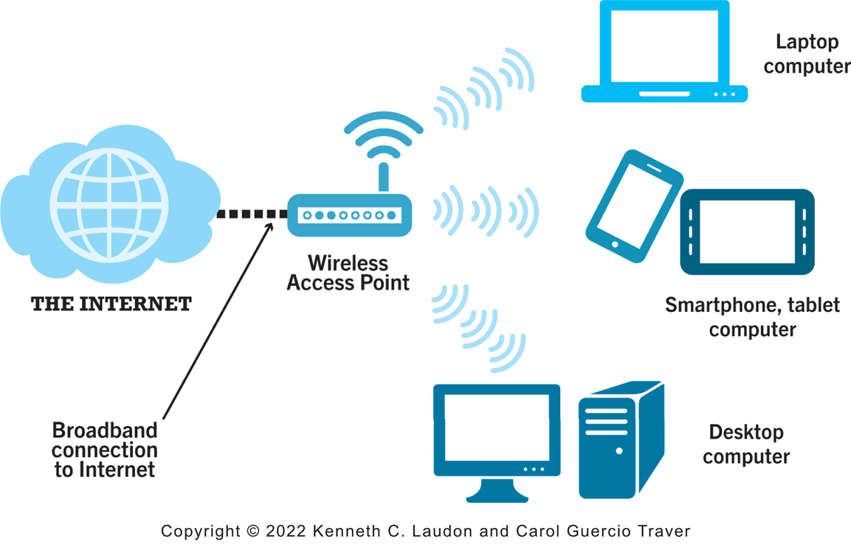
Figure 3.13 Wi-Fi Networks
Notes:
Figure 3.13, page 141.
In a Wi-Fi network, wireless access points connect to the Internet using a land-based broadband connection. Clients, which could be desktops, laptops, tablet computers, or smartphones, connect to the access point using radio signals.
Alt Text
Long description: An illustration depicts WI FI networks, as follows: A wireless access point is connected to the internet by a broadband connection. The access point provides internet access to devices such as a laptop and desktop computer and a smartphone or tablet computer.

Slide 11
The Web
1989–1991: Web invented
Tim Berners-Lee at C E R N
H T M L, H T T P, web server, web browser
1993: Mosaic web browser w/G U I
Andreessen and others at N C S A
Runs on Windows, Macintosh, or Unix
1994: Netscape Navigator, first commercial web browser
1995: Microsoft Internet Explorer

Slide 12
Hypertext
Text formatted with embedded links
Links connect documents to one another, and to other objects such as sound, video, or animation files
Uses Hypertext Transfer Protocol (H T T P) and U R L s to locate resources on the Web
Example U R L:
http://megacorp.com/content/features/082602.html
Notes:
Note: Example URL is not an actual URL.

Slide 13
Markup Languages
Hypertext Markup Language (H T M L)
Fixed set of pre-defined markup “tags” used to format text
Controls look and feel of web pages
Used in conjunction with C S S (Cascading Style Sheets)
H T M L5 the newest version
eXtensible Markup Language (X M L)
Designed to describe data and information
Tags used are defined by user

Slide 14
Web Servers and Web Clients
Web server software
Enables a computer to deliver web pages to clients on a network that request this service by sending an H T T P request
Basic capabilities: Security services, F T P, search engine, data capture
Web server
May refer to either web server software or physical server
Specialized servers: Database servers, ad servers, and so on
Web client
Any computing device attached to the Internet that is capable of making H T T P requests and displaying H T M L pages

Slide 15
Web Browsers
Primary purpose is to display web page, but may include added features
Google’s Chrome: almost 70% of desktop market and about 65% of mobile market
Open source
Mozilla Firefox: 8% desktop, >1% mobile
Open source
Microsoft Edge: 7% desktop
Internet Explorer: 6% desktop
Apple’s Safari: 4% desktop, 27% mobile

Slide 16
The Internet and Web: Features
Features on which the foundations of e-commerce are built:
Communication tools
Search engines
Downloadable and streaming media
Virtual reality
Intelligent digital assistants

Slide 17
Communication Tools
E-mail
Most used application of the Internet
Messaging Applications
Instant messaging
Videoconferencing, video chatting

Slide 18
Insight on Technology: Zoom in the Midst of the Pandemic
Class Discussion
What has your experience using Zoom and other videoconferencing services during the pandemic been like?
What challenges does Zoom face?
How has Zoom responded to those challenges?

Slide 19
Search Engines
Identify web pages that match queries based on one or more techniques
Keyword indexes
Page ranking
Also serve as:
Shopping tools
Advertising vehicles (search engine marketing)
Tool within e-commerce sites
Top three providers: Google, Microsoft’s Bing, Verizon Media (Yahoo)

Slide 20
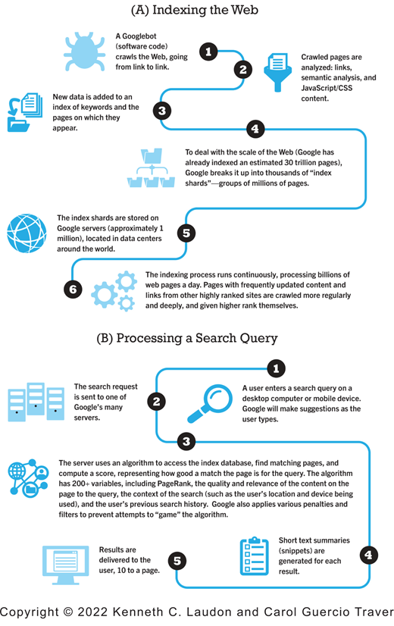
Figure 3.17 How Google Works
Notes:
Figure 3.17, page 167.
Alt Text
Long description: A flow chart depicts how Google works, as follows: A, Indexing the web. Step 1, a Googlebot, which is a form of software code, crawls the web, going from link to link. Step 2, crawled pages are analyzed: links semantic analysis and JavaScript or C S S content. Step 3, new data is added to an index of keywords and the pages on which they appear. Step 4, to deal with the scale of the Web, Google has already indexed an estimated 30 trillion pages, Google breaks it up into thousands of index shards, groups of millions of pages. Step 5, the index shards are stored on Google servers, approximately 1 million, located in data centers around the world. Step 6, the indexing process runs continuously, processing billions of web pages a day. Pages with frequently updated content and links from other highly ranked sites are crawled more regularly and deeply and given higher rank themselves. B, Processing a Search Query. Step 1, a user enters a search query on a desktop computer or mobile device. Google will make suggestions as the user types. Step 2, the search request is sent to one of Google’s many servers. Step 3, the server uses an algorithm to access the index database, find matching pages, and compute a score, representing how good a match the page is for the query. The algorithm has 200 plus variables, including page rank, the quality and relevance of the content on the page to the query, the context of the search such as the user’s location and device being used, and the user’s previous search history. Google also applies various penalties and filters to prevent attempts to game the algorithm. Step 4, short text summaries or snippets are generated for each result. Step 5, results are delivered to the user, 10 to a page.

Slide 21
Downloadable and Streaming Media
Downloads:
Growth in broadband connections enables large media file downloads
Streaming technologies
Enables music, video, and other large files to be sent to users in chunks so that the file can play uninterrupted

Slide 22
Web 2.0 Features and Services
Online Social Networks
Services that support communication among networks of friends, peers
Blogs
Personal web page of chronological entries
Enables web page publishing with no knowledge of H T M L
Wikis
Enables documents to be written collectively and collaboratively
E.g., Wikipedia

Slide 23
Virtual Reality
Virtual reality (V R)
Immersing users within virtual world
Oculus Rift, Vive, PlayStation V R

Slide 24
Mobile Apps
Use of mobile apps has exploded
Most popular entertainment media, over T V
Always present shopping tool
Almost all top 100 brands have an app
Platforms
iPhone/iPad (i O S), Android
App marketplaces
Google Play, Apple’s App Store, Amazon’s Appstore

Slide 25
Careers in E-commerce
Position: E-commerce Specialist
Qualification/Skills
Preparing for the Interview
Possible Interview Questions

Slide 26

Copyright
This work is protected by United States copyright laws and is provided solely for the use of instructors in teaching their courses and assessing student learning. Dissemination or sale of any part of this work (including on the World Wide Web) will destroy the integrity of the work and is not permitted. The work and materials from it should never be made available to students except by instructors using the accompanying text in their classes. All recipients of this work are expected to abide by these restrictions and to honor the intended pedagogical purposes and the needs of other instructors who rely on these materials.

