Slide 1
Chapter 1: Introduction

Slide 2
Outline
The Need for Databases
Data Models
Relational Databases
Database Design
Storage Manager
Query Processing
Transaction Manager

Slide 3
Database Management System (DBMS)
DBMS contains information about a particular enterprise
  Collection of interrelated data
  Set of programs to access the data
  An environment that is both convenient and efficient to use
Database Applications:
  Banking: transactions
  Airlines: reservations, schedules
  Universities: registration, grades
  Sales: customers, products, purchases
  Online retailers: order tracking, customized recommendations
  Manufacturing: production, inventory, orders, supply chain
  Human resources: employee records, salaries, tax deductions
Databases can be very large.
Databases touch all aspects of our lives

Slide 4
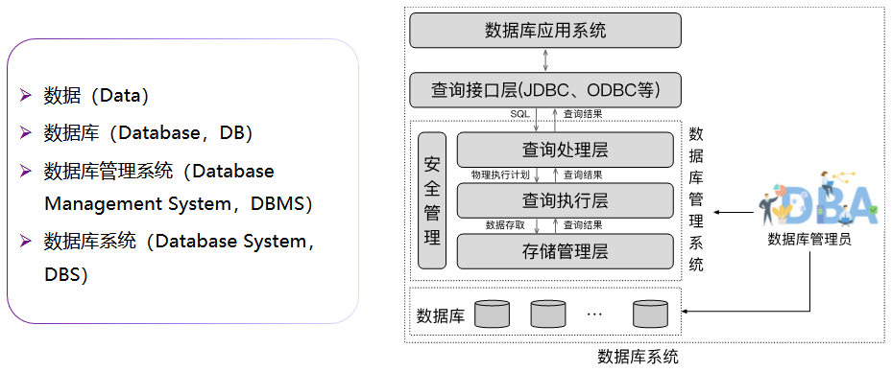
数据库的基本概念

Slide 5
University Database Example
Application program examples
  Add new students, instructors, and courses
  Register students for courses, and generate class rosters
  Assign grades to students, compute grade point averages (GPA) and generate transcripts
In the early days, database applications were built directly on top of file systems

Slide 6
Drawbacks of using file systems to store data
Data redundancy and inconsistency
  Multiple file formats, duplication of information in different files
Difficulty in accessing data
  Need to write a new program to carry out each new task
Data isolation
  Multiple files and formats
Integrity problems
  Integrity constraints (e.g., account balance > 0) become “buried” in program code rather than being stated explicitly
  Hard to add new constraints or change existing ones

Slide 7
Drawbacks of using file systems to store data (Cont.)
Atomicity of updates
  Failures may leave database in an inconsistent state with partial updates carried out
  Example: Transfer of funds from one account to another should either complete or not happen at all
Concurrent access by multiple users
  Concurrent access needed for performance
  Uncontrolled concurrent accesses can lead to inconsistencies
    Example: Two people reading a balance (say 100) and updating it by withdrawing money (say 50 each) at the same time
Security problems
  Hard to provide user access to some, but not all, data
Database systems offer solutions to all the above problems

Slide 8
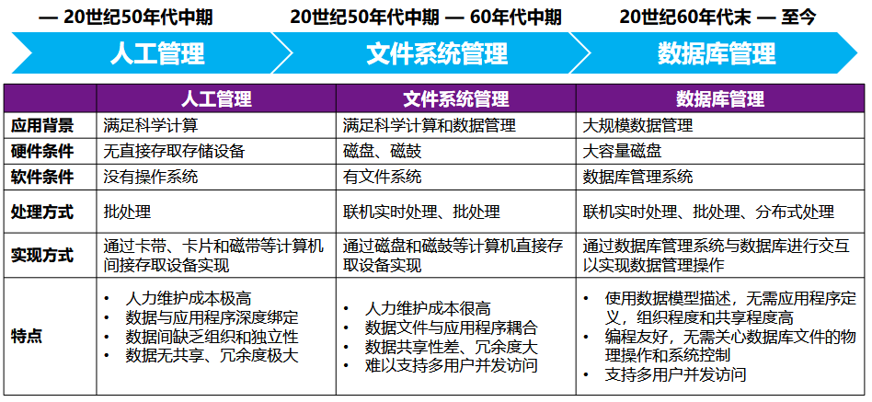
数据管理的三个阶段

Slide 9

文件系统阶段
劳资科
学号
姓名
系别
补贴
学籍科
学号
姓名
系别
学分
学位
房产科
学号
姓名
系别
性别
住址
人事科
学号
姓名
系别
性别
学位
年龄
出身

Slide 10
数据库系统的特点
人事科
劳资科
系别
年龄
补贴
学位
学号
姓名
住址
学分
学籍科
性别
出身
房产科

Slide 11
Levels of Abstraction
Physical level: describes how a record (e.g., instructor) is stored.
Logical level: describes data stored in database, and the relationships among the data.
  type instructor = record
  ID : string;
  name : string;
  dept_name : string;
  salary : integer;
        end;
View level: application programs hide details of data types. Views can also hide information (such as an employee’s salary) for security purposes.

Slide 12
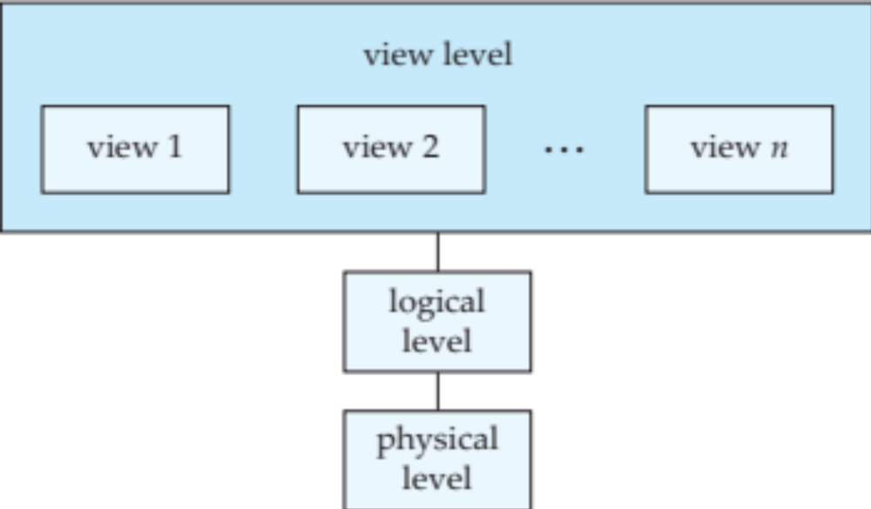
View of Data
An architecture for a database system

Slide 13
Instances and Schemas
Similar to types and variables in programming languages
Logical Schema – the overall logical structure of the database
  Example: The database consists of information about a set of customers and accounts in a bank and the relationship between them
    Analogous to type information of a variable in a program
Physical schema– the overall physical structure of the database
Instance – the actual content of the database at a particular point in time
  Analogous to the value of a variable
Physical Data Independence – the ability to modify the physical schema without changing the logical schema
  Applications depend on the logical schema
  In general, the interfaces between the various levels and components should be well defined so that changes in some parts do not seriously influence others.

Slide 14
Data Models
A collection of tools for describing
  Data
  Data relationships
  Data semantics
  Data constraints
Relational model
Entity-Relationship data model (mainly for database design)
Object-based data models (Object-oriented and Object-relational)
Semistructured data model (XML)
Other older models:
  Network model
  Hierarchical model

Slide 15
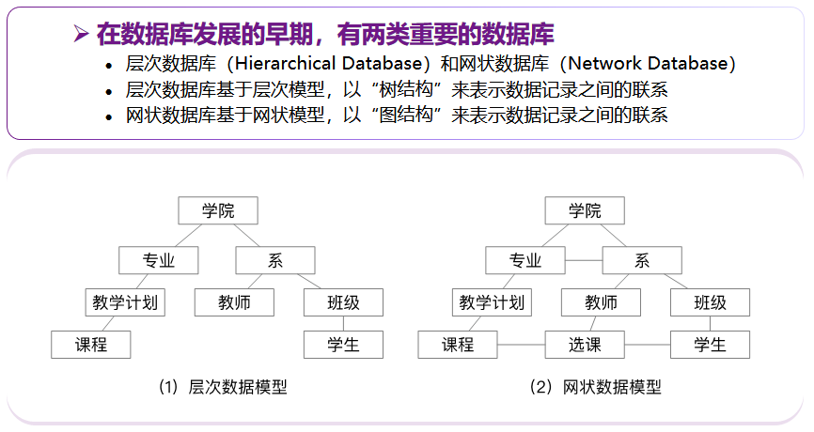
数据库模型：层次数据库和网状数据库

Slide 16
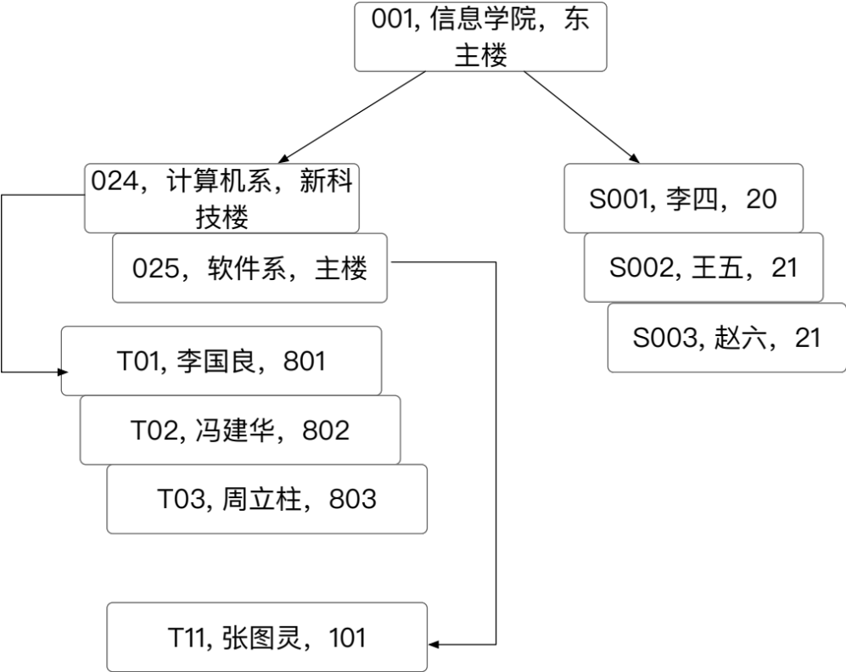
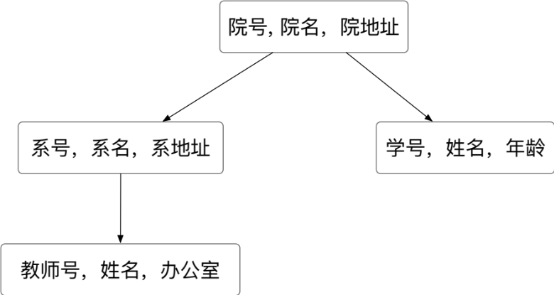
数据库模型：层次模型与层次数据库
层次模型用树形结构来表示各类实体以及实体间的联系
  除根节点以外，其他结点有且只有一个父亲结点
典型代表是IBM公司的IMS （Information Management System，IMS）数据库

Slide 17
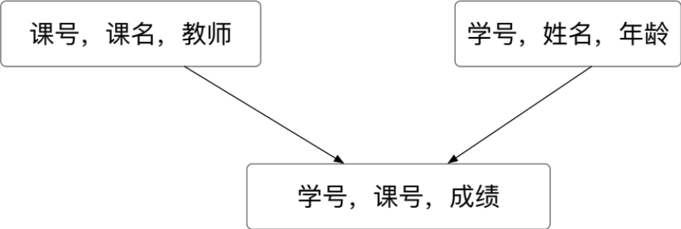
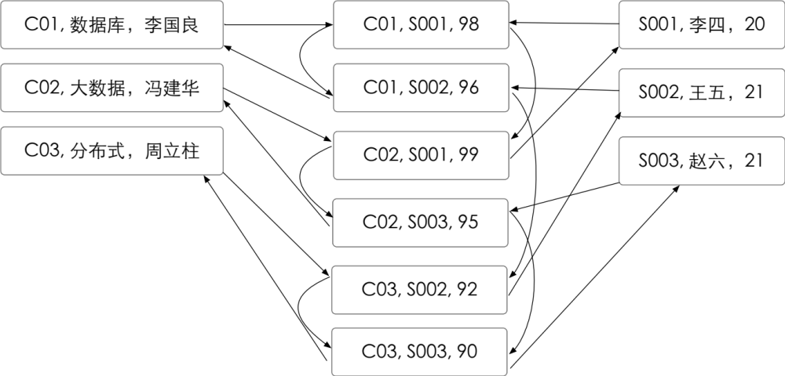
数据库模型：网状模型和网状数据库
美国通用电气公司发布了世界上第一个网状数据库系统——IDS（Integrated Data Storage，集成数据存储）
  允许一个以上的结点无父亲
  一个结点可以有多于一个的父亲

Slide 18
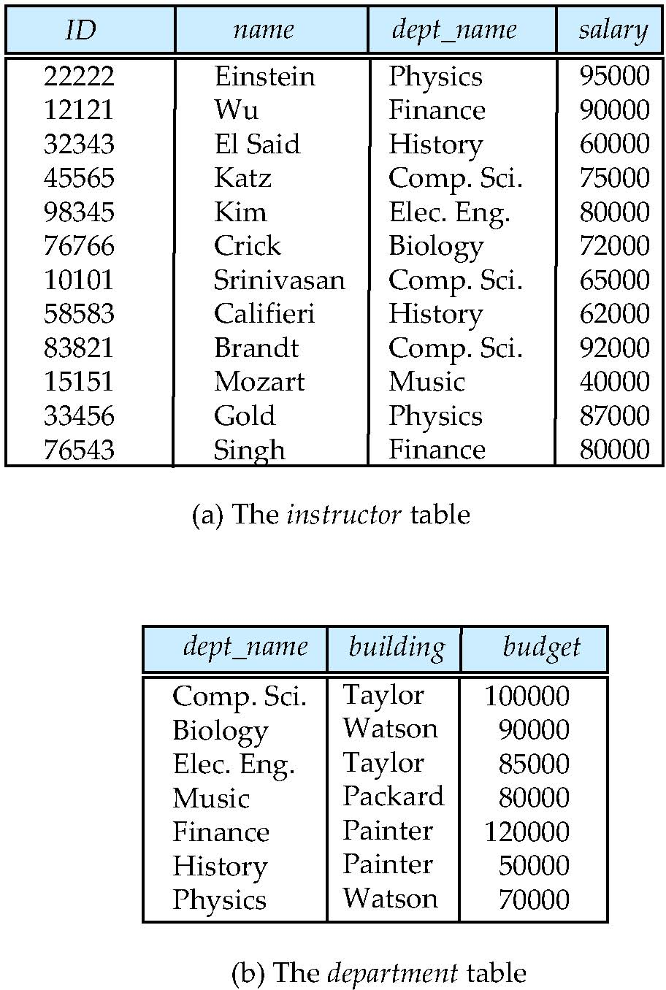
Relational Model
All the data is stored in various tables.
Example of tabular data in the relational model
Columns
Rows

Slide 19
A Sample Relational Database

Slide 20
Data Definition Language (DDL)
Specification notation for defining the database schema
  Example: create table instructor (
  ID char(5),
  name varchar(20),
  dept_name varchar(20),
  salary numeric(8,2))
DDL compiler generates a set of table templates stored in a data dictionary
Data dictionary contains metadata (i.e., data about data)
  Database schema
  Integrity constraints
    Primary key (ID uniquely identifies instructors)
  Authorization
    Who can access what

Slide 21
Data Manipulation Language (DML)
Language for accessing and manipulating the data organized by the appropriate data model
  DML also known as query language
Two classes of languages
  Pure – used for proving properties about computational power and for optimization
    Relational Algebra
    Tuple relational calculus
    Domain relational calculus
  Commercial – used in commercial systems
    SQL is the most widely used commercial language

Slide 22
SQL
The most widely used commercial language
SQL is NOT a Turing machine equivalent language
To be able to compute complex functions SQL is usually embedded in some higher-level language
Application programs generally access databases through one of
  Language extensions to allow embedded SQL
  Application program interface (e.g., ODBC/JDBC) which allow SQL queries to be sent to a database
Notes:
SQL is NOT a Turing machine equivalent language
SQL不像一个通用的图灵机那么强大，即有一些计算可以用通用的程序设计语言来表达，但无法通过SQL来表达

Slide 23
Database Design
The process of designing the general structure of the database:
Logical Design – Deciding on the database schema. Database design requires that we find a “good” collection of relation schemas.
  Business decision – What attributes should we record in the database?
  Computer Science decision – What relation schemas should we have and how should the attributes be distributed among the various relation schemas?
Physical Design – Deciding on the physical layout of the database

Slide 24
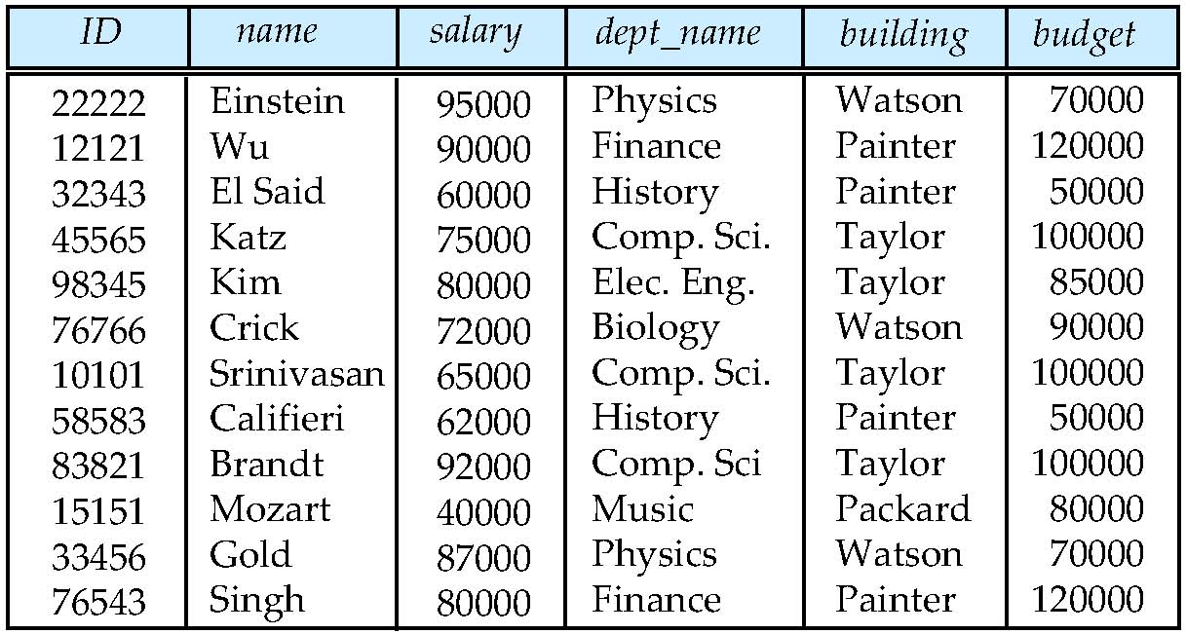
Database Design (Cont.)
Is there any problem with this relation?

Slide 25
Design Approaches
Need to come up with a methodology to ensure that each of the relations in the database is “good”
Two ways of doing so:
  Entity Relationship Model (Chapter 6)
    Models an enterprise as a collection of entities and relationships
    Represented diagrammatically by an entity-relationship diagram:
  Normalization Theory (Chapter 7)
    Formalize what designs are bad, and test for them

Slide 26
Object-Relational Data Models
Relational model: flat, “atomic” values
Object Relational Data Models
  Extend the relational data model by including object orientation and constructs to deal with added data types.
  Allow attributes of tuples to have complex types, including non-atomic values such as nested relations.
  Preserve relational foundations, in particular the declarative access to data, while extending modeling power.
  Provide upward compatibility with existing relational languages.

Slide 27
XML: Extensible Markup Language
Defined by the WWW Consortium (W3C)
Originally intended as a document markup language not a database language
The ability to specify new tags, and to create nested tag structures made XML a great way to exchange data, not just documents
XML has become the basis for all new generation data interchange formats.
A wide variety of tools is available for parsing, browsing and querying XML documents/data

Slide 28
Database Engine
Storage manager
Query processing
Transaction manager

Slide 29
Storage Management
Storage manager is a program module that provides the interface between the low-level data stored in the database and the application programs and queries submitted to the system.
The storage manager is responsible to the following tasks:
  Interaction with the OS file manager
  Efficient storing, retrieving and updating of data
Issues:
  Storage access
  File organization
  Indexing and hashing

Slide 30
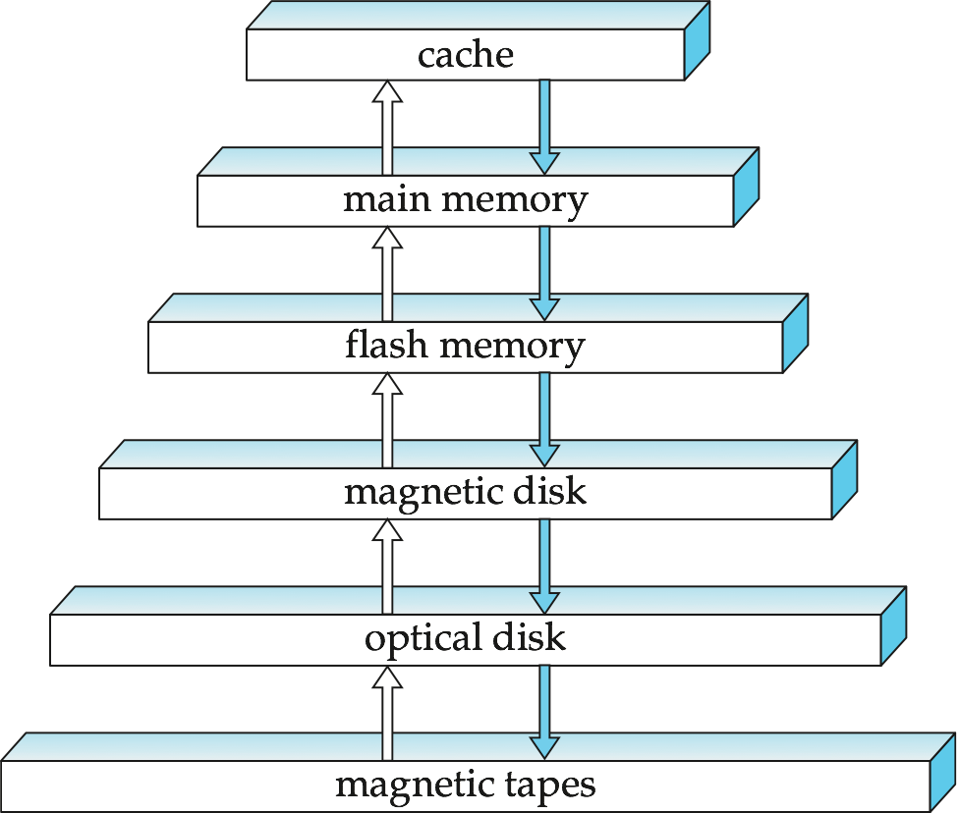




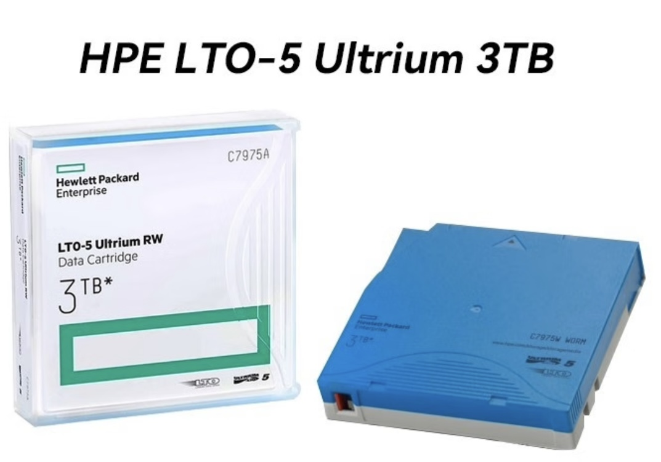

Storage Hierarchy
高速缓冲存储器：
与数据库无关
快闪存储器：
USB口存取，
与数据库无关
Notes:
cache：高速缓冲存储器：与数据库无关
flash memory：快闪存储器：USB口存取，与数据库无关
Optical disk：光盘

Slide 31

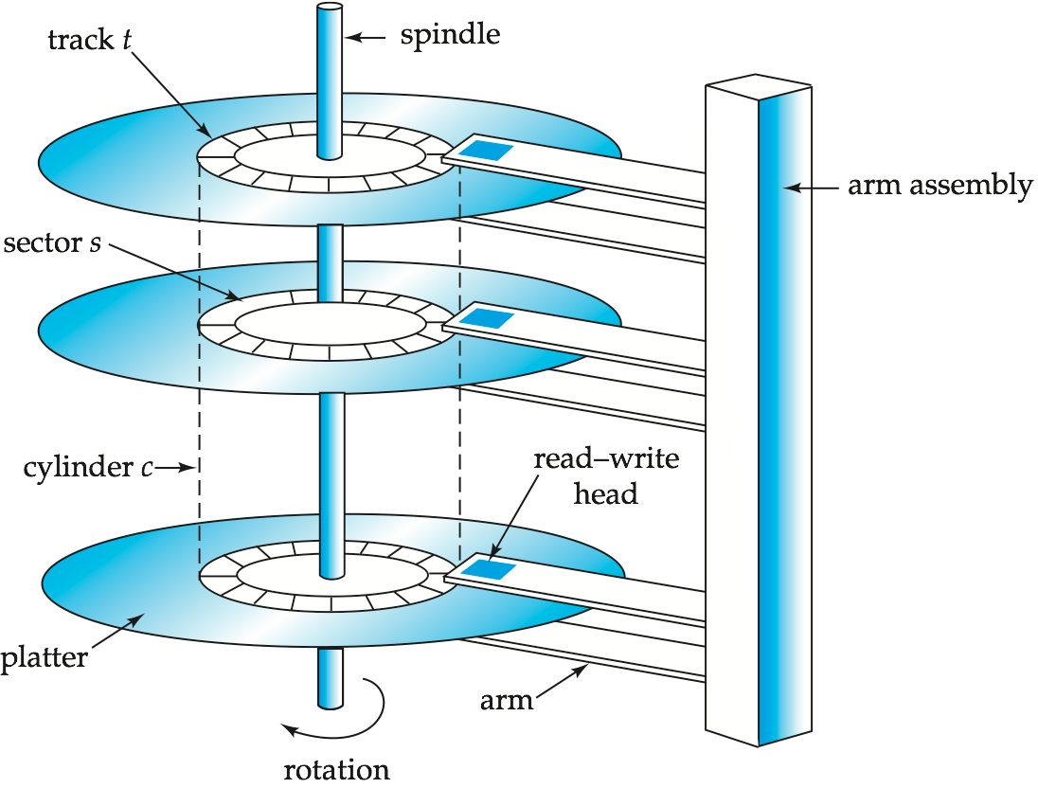
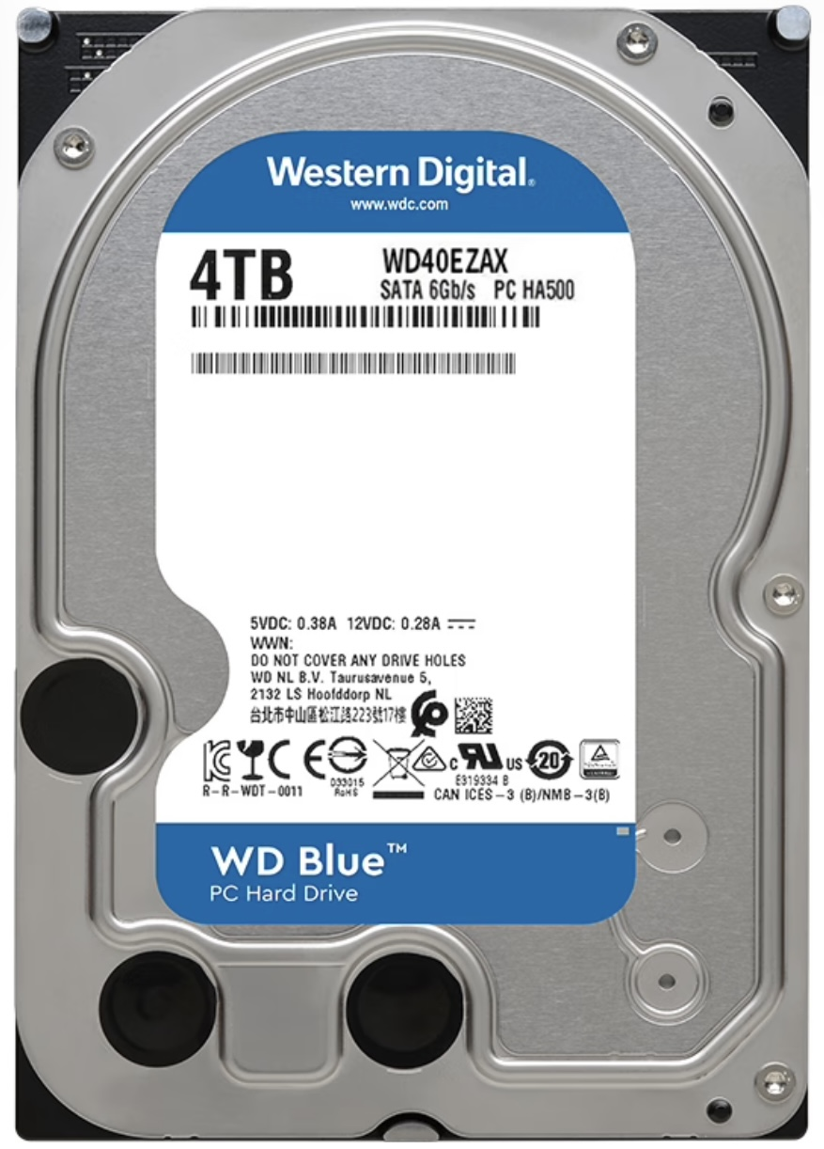
Magnetic Hard Disk Mechanism
Notes:
磁盘驱动器两个主要的移动部件：磁盘组合与磁头组合

Slide 32
Overview of Primary Components
User
process
Instance
SGA
Shared pool
Library
cache
Database
buffer cache
Redo log
buffer cache
Server
process
Data Dict.
cache
PGA
PMON
SMON
DBWR
LGWR
CKPT
Others
Parameter
file
Data files
Control files
Redo log files
Archived
log files
Password
file
Database
Notes:
Overview of Primary Components
The Oracle architecture includes a number of primary components, which are discussed further in this lesson.
Oracle server: There are several files, processes, and memory structures in an Oracle server; however, not all of them are used when processing a SQL statement. Some are used to improve the performance of the database, ensure that the database can be recovered in the event of a software or hardware error, or perform other tasks necessary to maintain the database. The Oracle server consists of an Oracle instance and an Oracle database.
Oracle instance: An Oracle instance is the combination of the background processes and memory structures. The instance must be started to access the data in the database. Every time an instance is started, a System Global Area (SGA) is allocated and Oracle background processes are started. Background processes perform functions on behalf of the invoking process. They consolidate functions that would otherwise be handled by multiple Oracle programs running for each user. The background processes perform input/output (I/O) and monitor other Oracle processes to provide increased parallelism for better performance and reliability.
Oracle database: An Oracle database consists of operating system files, also known as database files, that provide the actual physical storage for database information. The database files are used to ensure that the data is kept consistent and can be recovered in the event of a failure of the instance.
Other key files: Nondatabase files are used to configure the instance, authenticate privileged users, and recover the database in the event of a disk failure.
User and server processes: The user and server processes are the primary processes involved when a SQL statement is executed; however, other processes may help the server complete the processing of the SQL statement.
Other processes: Many other processes exist that are used by other options within Oracle, such as Advanced Queuing, Real Application Clusters, Shared Server, Advanced Replication, and so on. These processes are discussed within their respective courses.

Slide 33
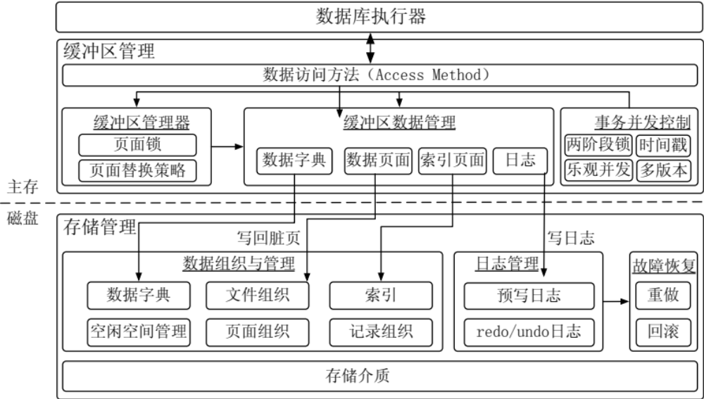
存储结构

Slide 34
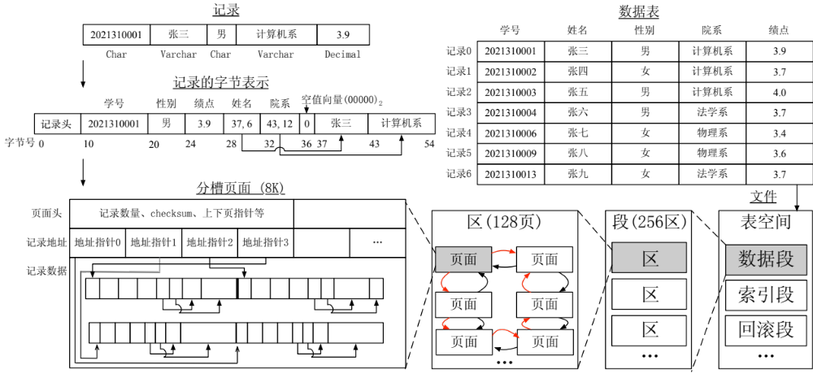
存储结构
数据块
  存储介质上的数据最小存储单位
页面
  统一大小来管理数据
  一般为8KB、16KB

Slide 35
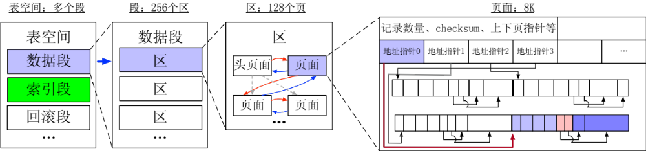
数据表空间管理
数据表空间由段（segment）、区（extent）、页（page）组成。
  数据段、索引段、回滚段分别存储
  一次申请一个区（多个连续页），让相邻页的物理位置也相邻，方便实现顺序I/O。

Slide 36
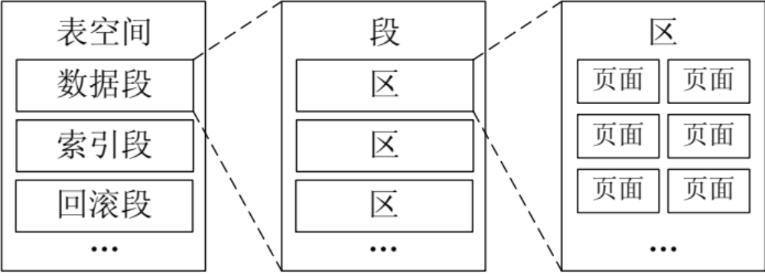
申请新页面
假设所有的页面都满时，要继续插入记录的话就需要申请新的页面
每次申请固定数量的区（extent）
  为了页面尽量连续

Slide 37
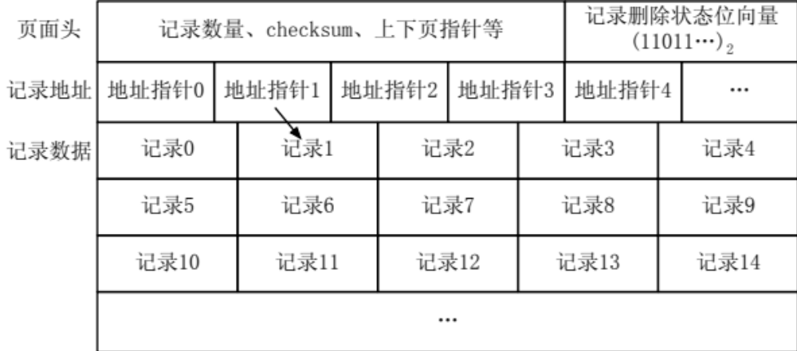
页面组织
页面大小为8KB或者16KB，一般为2的整数次幂
一个页面往往包含了多条记录

Slide 38
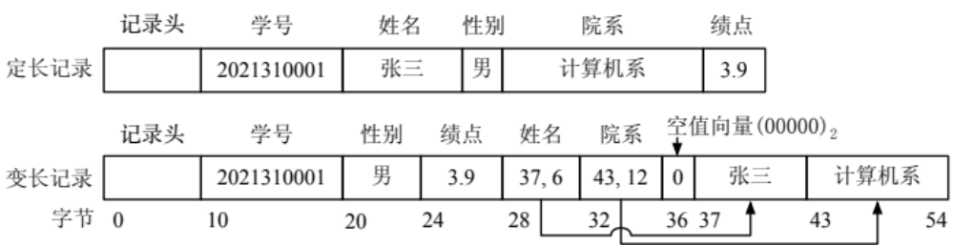
页面组织： 定长记录 vs 变长记录
定长记录：长度固定，页面中记录数目固定，易于定位一个页面的记录位置
  例如年龄short，学号char（10）
变长记录：长度可变，页面中记录数目不固定，难以直接计算并定位记录位置
  例如姓名varchar，院系varchar

Slide 39
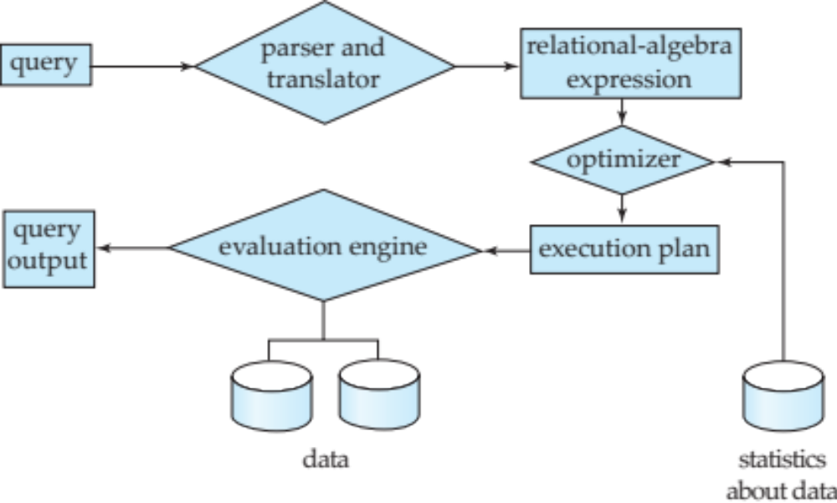
Query Processing
1. Parsing and translation
2. Optimization
3. Evaluation

Slide 40
Query Processing (Cont.)
Alternative ways of evaluating a given query
  Equivalent expressions
  Different algorithms for each operation
Cost difference between a good and a bad way of evaluating a query can be enormous
Need to estimate the cost of operations
  Depends critically on statistical information about relations which the database must maintain
  Need to estimate statistics for intermediate results to compute cost of complex expressions

Slide 41
Transaction Management
What if the system fails?
What if more than one user is concurrently updating the same data?
A transaction is a collection of operations that performs a single logical function in a database application
Transaction-management component ensures that the database remains in a consistent (correct) state despite system failures (e.g., power failures and operating system crashes) and transaction failures.
Concurrency-control manager controls the interaction among the concurrent transactions, to ensure the consistency of the database.

Slide 42
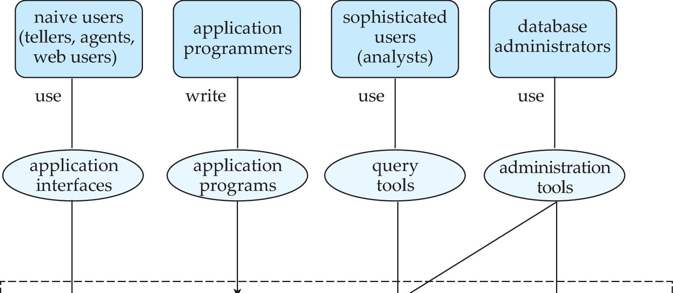
Database Users and Administrators
Database

Slide 43
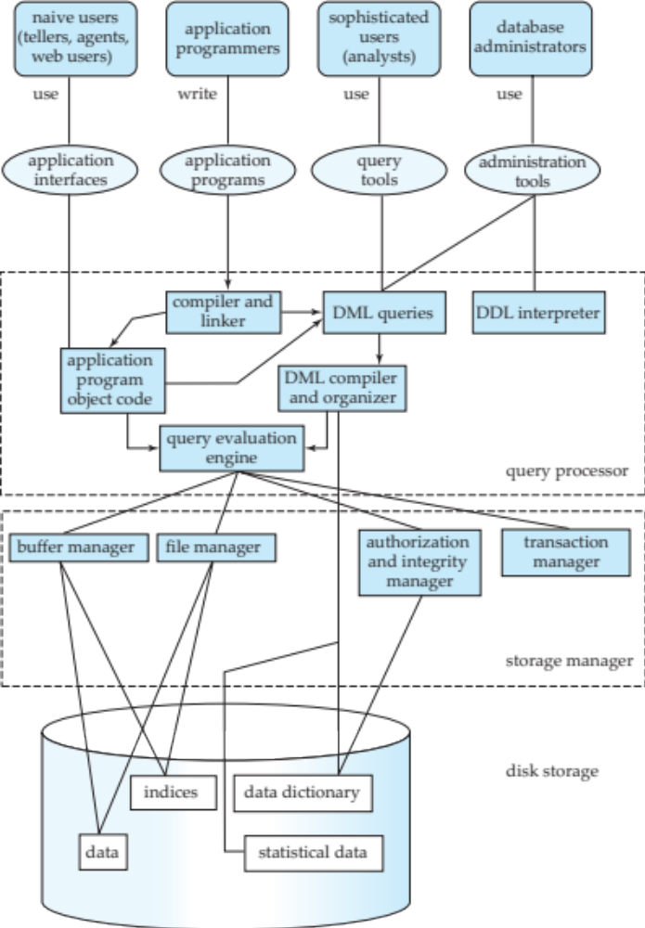
Database System Internals

Slide 44
Database Architecture
The architecture of a database systems is greatly influenced by
the underlying computer system on which the database is running:
Centralized
Client-server
Parallel (multi-processor)
Distributed

Slide 45
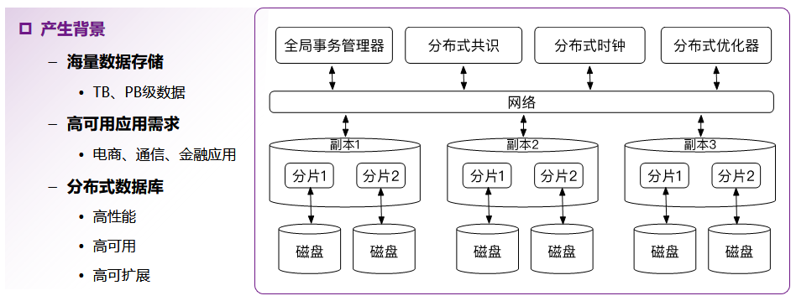
数据库架构：分布式数据库

Slide 46
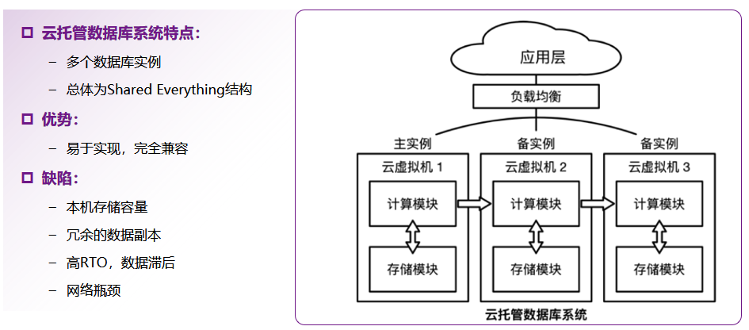
数据库架构：云托管数据库

Slide 47
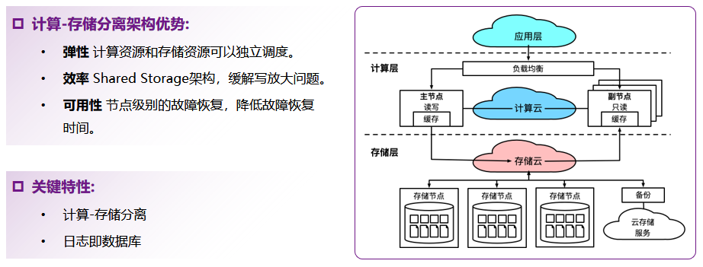
数据库架构：云原生数据库

Slide 48
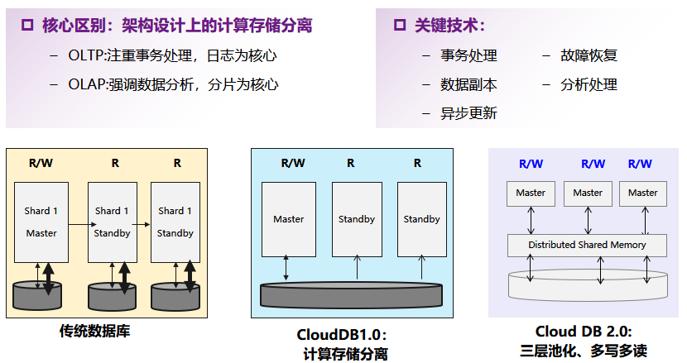
数据库架构：云原生数据库

Slide 49
History of Database Systems
1950s and early 1960s:
  Data processing using magnetic tapes for storage
    Tapes provided only sequential access
  Punched cards for input
Late 1960s and 1970s:
  Hard disks allowed direct access to data
  Network and hierarchical data models in widespread use
  Ted Codd defines the relational data model
    Would win the ACM Turing Award for this work
    IBM Research begins System R prototype
    UC Berkeley begins Ingres prototype
  High-performance (for the era) transaction processing

Slide 50
History (cont.)
1980s:
  Research relational prototypes evolve into commercial systems
    SQL becomes industrial standard
  Parallel and distributed database systems
  Object-oriented database systems
1990s:
  Large decision support and data-mining applications
  Large multi-terabyte data warehouses
  Emergence of Web commerce
Early 2000s:
  XML and XQuery standards
  Automated database administration
Later 2000s:
  Giant data storage systems
    Google BigTable, Yahoo PNuts, Amazon, ..

Slide 51
数据库模型： NoSQL数据库类型
键值数据库
  以键值对格式存储数据的数据库，数据访问简单高效
列族数据库
  数据列按访问关联性划分成不同族，一个族可视为关系表
文档数据库
  以JSON等文档格式存取数据，避免应用中数据转换的代价
图数据库
  以包含边、节点及属性的图结构来存储数据和建模关联信息
向量数据库
  非结构化数据（文本、图片）转换的向量数据（embedding、vector）

Slide 52
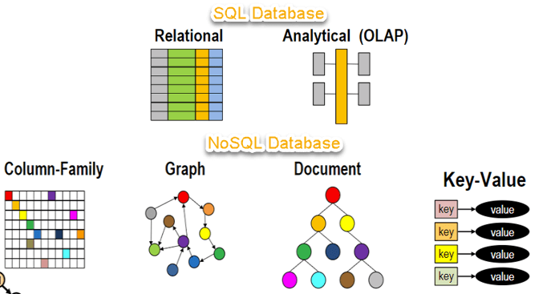
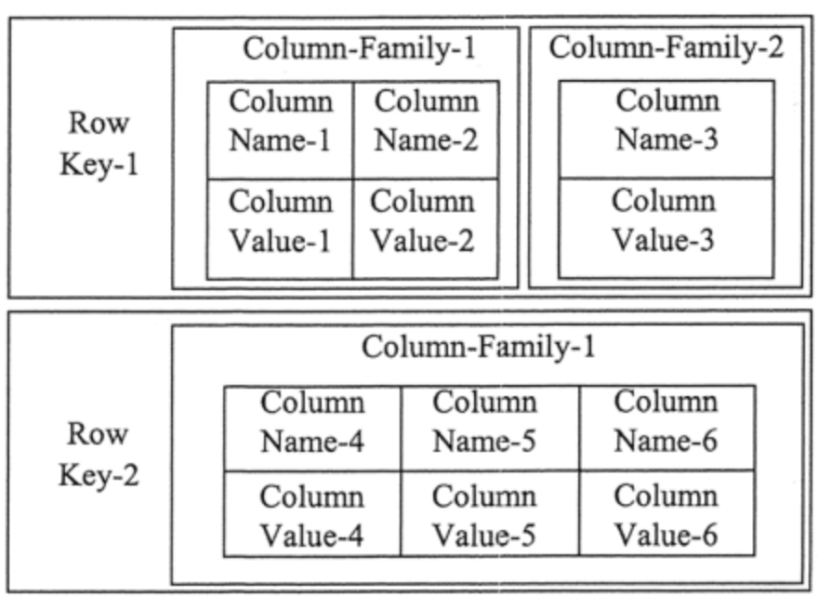
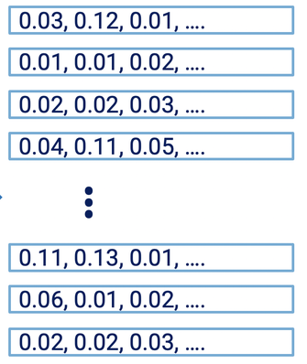
适合大规模分布式存储和高效查询
常见应用：缓存、会话存储、配置存储等（如 Redis）
vector
特征向量
图神经网络
用于自然语言处理或语义搜索

Slide 53
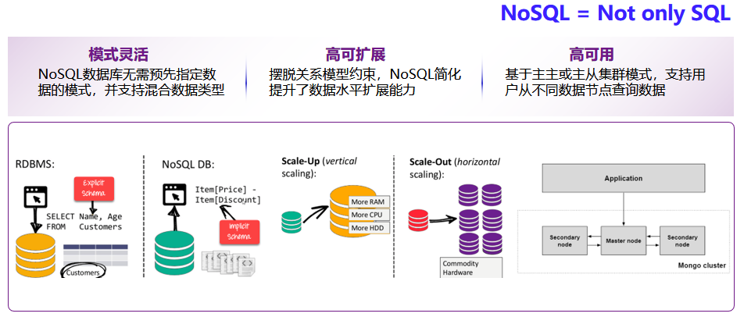
数据库模型： NoSQL数据库主要特点

Slide 54
数据库模型：常见的NoSQL数据库
主要类型 |  | NoSQL数据库产品（示例）
键值数据库 | 内存键值存储 | Redis, Memcached
 | 最终一致性键值存储 | Dynamo
 | 持久化键值存储 | LevelDB、RocksDB
列族数据库 |  | Cassandra, Hbase, Google BigTable
文档数据库 |  | MongoDB
图数据库 |  | Neo4J
向量数据库 |  | Milvus

Slide 55
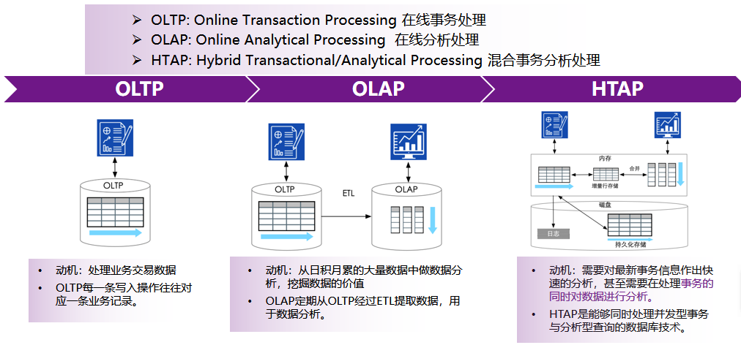
数据库各类应用： OLTP、OLAP与
HTAP数据库

Slide 56
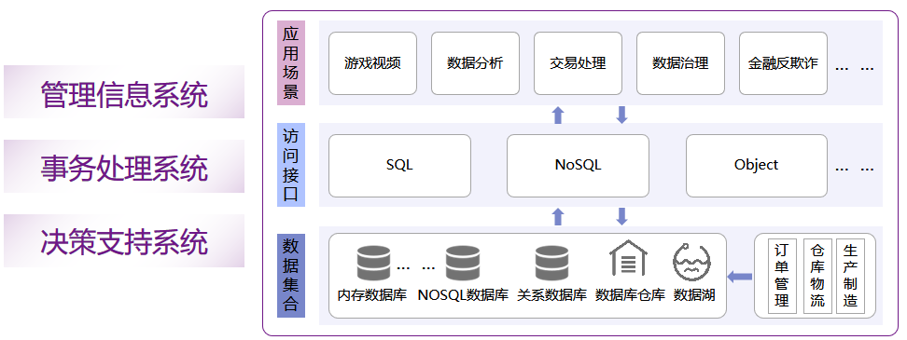
数据库各类应用

Slide 57
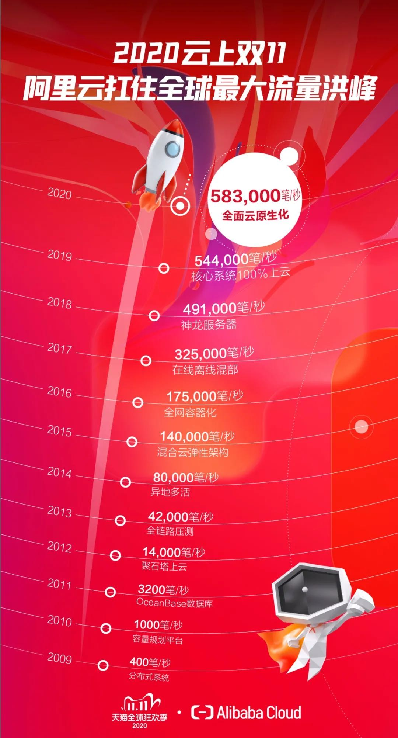

Slide 59
End of Chapter 1

