Slide 1
Chapter 18 : Concurrency Control

Slide 2
Outline
Lock-Based Protocols
Timestamp-Based Protocols
Validation-Based Protocols
Multiple Granularity
Multiversion Schemes
Insert and Delete Operations
Concurrency in Index Structures

Slide 3
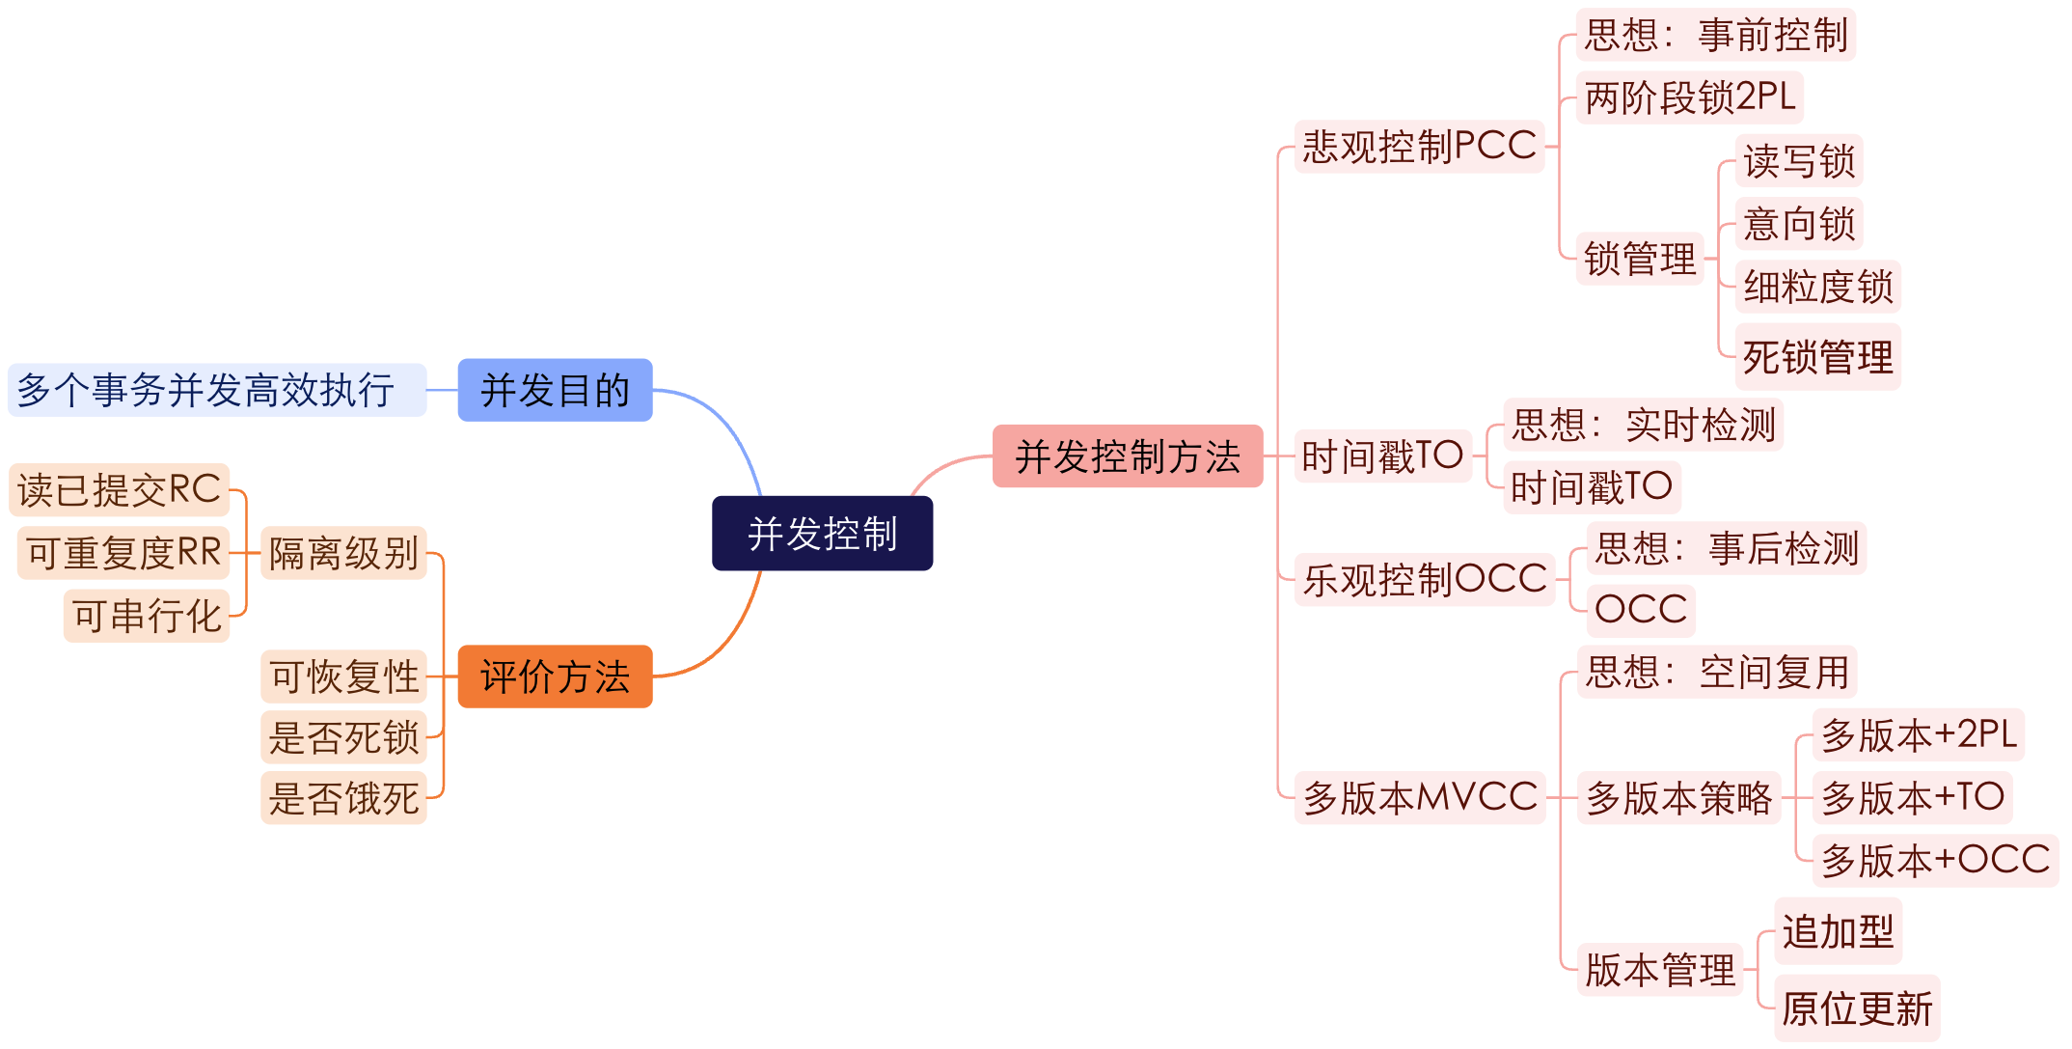
并发控制 概览

Slide 4
并发控制 概览
并发：在同一时间间隔内有多个事件或活动发生
多个事务相继到来：
  数量少，间隔久 --> 依次执行
  数量多，间隔短 --> 并发控制
考虑要素
  事务、语句的执行顺序
  数据对象的共享和保护

Slide 5
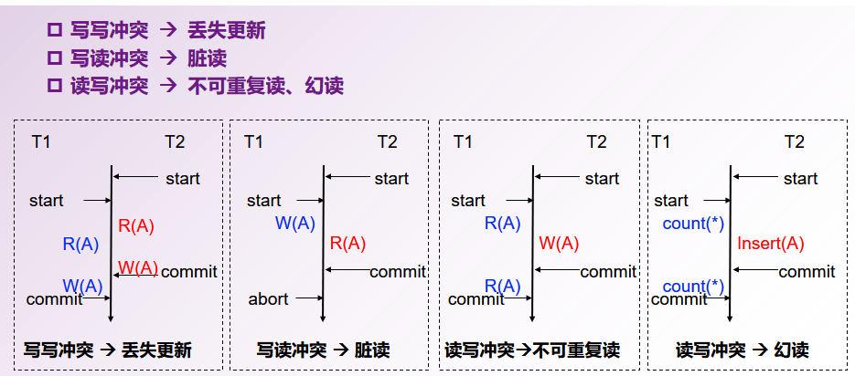
并发控制 概览

Slide 6
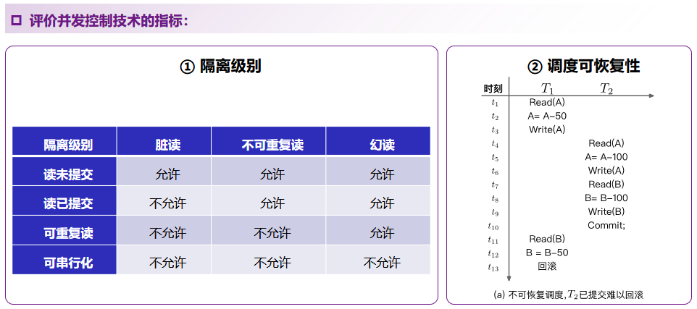
并发控制 概览

Slide 7
并发控制 概览
解决冲突的思想
  悲观并发控制技术：事前控制，避免冲突发生
    两阶段锁
    基于图的协议
  乐观并发控制技术：事后控制，冲突发生后再处理
    时间戳排序协议
    乐观并发控制协议
多版本机制
  保存数据项的多个版本，通过空间复用提升并发度
  与悲观、乐观并发控制技术相结合
    多版本两阶段锁协议
    多版本时间戳排序协议
    多版本乐观并发控制协议

Slide 8
Lock-Based Protocols
A lock is a mechanism to control concurrent access to a data item
Data items can be locked in two modes :
1. exclusive (X) mode. Data item can be both read as well as written.
  X-lock is requested using lock-X instruction.
2. shared (S) mode. Data item can only be read.
  S-lock is requested using lock-S instruction.
Lock requests are made to concurrency-control manager.
  Transaction can proceed only after request is granted.

Slide 9
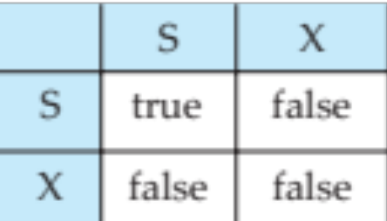
Lock-Based Protocols (Cont.)
Lock-compatibility matrix
  A transaction may be granted a lock on an item if the requested lock is compatible with locks already held on the item by other transactions
  Any number of transactions can hold shared locks on an item, but if any transaction holds an exclusive on the item no other transaction may hold any lock on the item.
  If a lock cannot be granted, the requesting transaction is made to wait till all incompatible locks held by other transactions have been released.
    The lock is then granted.

Slide 10
Lock-Based Protocols (Cont.)
Example of a transaction performing locking:
T₂: lock-S(A);
read (A);
unlock(A);
lock-S(B);
read (B);
unlock(B);
display(A+B)
  Locking as above is not sufficient to guarantee serializability
  if A and B get updated in-between the read of A and B, the displayed sum would be wrong.
A locking protocol is a set of rules followed by all transactions while requesting and releasing locks.
  Locking protocols restrict the set of possible schedules.
T1:
lock-X(A);
READ(A);
A=A-50;
unlock(A);

Slide 11
T₁ | T₂ | Concurrency-control manager
lock-X(B) read(B) B:=B-50 write(B) unlock(B) |  | grant-x(B,T₁)
 | lock-S(A); read (A); unlock(A); lock-S(B); read (B); unlock(B); display(A+B) | grant-s(A,T₂) grant-s(B,T₂)
lock-X(A) read(A) A:=A+50 write(A) unlock(A) |  | grant-x(A,T₂)
100
50
B=50
200
50
该封锁不足以保证可串行化: T₁过早释放锁，导致T₂的显示的总和出现错误
250
200
250
A=250

Slide 12
普通锁不能解决可串行化调度问题
事务
T1: R(A) W(A) R(B) W(B)
T2: R(A) R(B)
调度
T1: R(A) W(A) R(B) W(B)
T2: R(A) R(B)
 | T₁ | T₂
1 | Read(A)
2 |  | Read(A)
3 | A=A+1
4 | Write(A)
5 |  | Read(B)
6 | Read(B)
7 |  | A+B
8 |  | Commit
9 | B=B-1
10 | Write(B)
11 | Commit
 | T₁ | T₂
1 | X-Lock(A)
2 | Read(A)
3 |  | S-Lock(A)
4 | Write(A)
5 | Unlock(A)
6 |  | Read(A)
7 |  | S-Lock(B)
8 | X-Lock(B)
9 |  | Read(B)
10 |  | Unlock(A)
11 |  | Unlock(B)
12 | Read(B) | Commit
13 | Write(B)
14 | Unlock(B)
15 | Commit
不可串行化

Slide 13
The Two-Phase Locking Protocol
This is a protocol which ensures conflict-serializable schedules.
Phase 1: Growing Phase
  transaction may obtain locks
  transaction may not release locks
Phase 2: Shrinking Phase
  transaction may release locks
  transaction may not obtain locks
The protocol assures serializability.
  It can be proved that the transactions can be serialized in the order of their lock points (i.e. the point where a transaction acquired its final lock).
Notes:
本协议确保可串行化. 可以证明事务可按它们的lock points (即事务获得最后一个锁的点)的次序串行化.

Slide 14
The Two-Phase Locking Protocol (Cont.)
There can be conflict serializable schedules that cannot be obtained if two-phase locking is used.
However, in the absence of extra information (e.g., ordering of access to data), two-phase locking is needed for conflict serializability in the following sense:
  Given a transaction T_{i} that does not follow two-phase locking, we can find a transaction T_{j} that uses two-phase locking, and a schedule for T_{i} and T_{j} that is not conflict serializable.

Slide 15
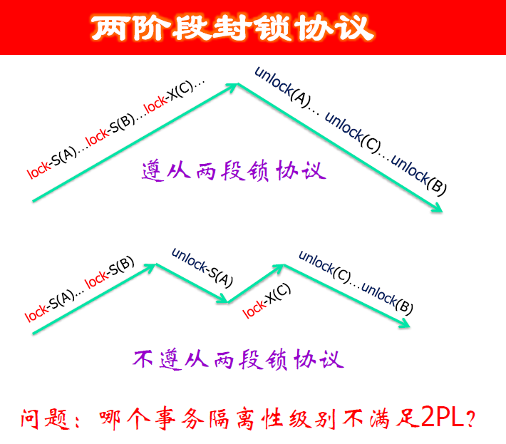

Slide 16
Lock Conversions
T1 :
read(a₁);
read(a₂);
……
read(a_{n} );
write(a₁).
T2:
read(a₁);
……
Two-phase locking with lock conversions:
– First Phase: can take place in only the growing phase
  can acquire a lock-S on item
  can acquire a lock-X on item
  can convert a lock-S to a lock-X (upgrade)
– Second Phase: can take place in only the shrinking phase
  can release a lock-S
  can release a lock-X
  can convert a lock-X to a lock-S (downgrade)
This protocol assures serializability.
  But still relies on the programmer to insert the various locking instructions.
T1 | T2
lock-S(a₁)
 | lock-S(a₁)
lock-S(a₂)
… | …
lock-S(a_{n})
 | unlock(a₁)
upgrade(a₁)

Slide 17
两阶段锁能解决可串行化调度问题
事务
T1: R(A) W(A) R(B) W(B)
T2: R(A) R(B)
调度
T1: R(A) W(A) R(B) W(B)
T2: R(A) R(B)
 | T₁ | T₂
1 | Read(A)
2 |  | Read(A)
3 | A=A+1
4 | Write(A)
5 |  | Read(B)
6 | Read(B)
7 |  | A+B
8 |  | Commit
9 | B=B-1
10 | Write(B)
11 | Commit
 | T₁ | T₂
1 | X-Lock(A)
2 | Read(A)
3 |  | S-Lock(A)
4 | Write(A)
5 | X-Lock(B)
6 | Unlock(A)
7 |  | Read(A)
8 |  | S-Lock(B)
9 | Read(B)
10 | Write(B)
11 | Unlock(B)
12 | Commit | Read(B)
13 |  | Unlock(A)
14 |  | Unlock(B)
15 |  | Commit
可串行化
但可能
不可恢复

Slide 18
严格两阶段锁能解决可串行化调度问题
The potential for deadlock exists in most locking protocols. Deadlocks are a necessary evil.
When a deadlock occurs there is a possibility of cascading roll-backs.
Cascading roll-back is possible under two-phase locking. To avoid this, follow a modified protocol called strict two-phase locking -- a transaction must hold all its exclusive locks till it commits/aborts.
Rigorous two-phase locking is even stricter. Here, all locks are held till commit/abort. In this protocol transactions can be serialized in the order in which they commit.

Slide 19
严格两阶段锁能解决可串行化调度问题
事务
T1: R(A) W(A) R(B) W(B)
T2: R(A) R(B)
调度
T1: R(A) W(A) R(B) W(B)
T2: R(A) R(B)
 | T₁ | T₂
1 | Read(A)
2 |  | Read(A)
3 | A=A+1
4 | Write(A)
5 |  | Read(B)
6 | Read(B)
7 |  | A+B
8 |  | Commit
9 | B=B-1
10 | Write(B)
11 | Commit
 | T₁ | T₂
1 | X-Lock(A)
2 | Read(A)
3 |  | S-Lock(A)
4 | Write(A)
5 | X-Lock(B)
6 | Read(B)
7 | Write(B)
8 | Commit
9 | Unlock(A)
10 | Unlock(B) | Read(A)
11 |  | S-Lock(B)
12 |  | Read(B)
13 |  | Commit
14 |  | Unlock(A)
15 |  | Unlock(B)
可串行化
也可恢复

Slide 20
两阶段锁的隔离级别
隔离级别 | 技术 | 脏写 | 脏读 | 不可重复读 | 幻读
无隔离要求 | 不加锁 | 是 | 是 | 是 | 是
读未提交 | 仅写加锁，写完释放锁 | 否 | 是 | 是 | 是
读已提交 | 写加行锁，事务提交完释放锁；读加读行锁，读完一次释放 | 否 | 否 | 是 | 是
可重复读 | 写加行锁，事务提交完释放锁；读加读行锁，所有读完释放 | 否 | 否 | 否 | 是
可串行化 | 写加表锁，提交完释放锁；读加读锁，读完释放 写加行锁，提交完释放锁；读加谓词锁，读完释放 | 否 | 否 | 否 | 否
脏写 | 不加任何锁
脏读

Slide 21
Automatic Acquisition of Locks
A transaction T_{i} issues the standard read/write instruction, without explicit locking calls.
The operation read(D) is processed as:
if T_{i} has a lock on D
then
read(D)
else begin
if necessary wait until no other
transaction has a lock-X on D
grant T_{i} a lock-S on D;
read(D)
end

Slide 22
Automatic Acquisition of Locks (Cont.)
write(D) is processed as:
if T_{i} has a lock-X on D
then
write(D)
else begin
if necessary wait until no other transaction has any lock on D,
if T_{i} has a lock-S on D
then
upgrade lock on D to lock-X
else
grant T_{i} a lock-X on D
write(D)
end;
All locks are released after commit or abort

Slide 23
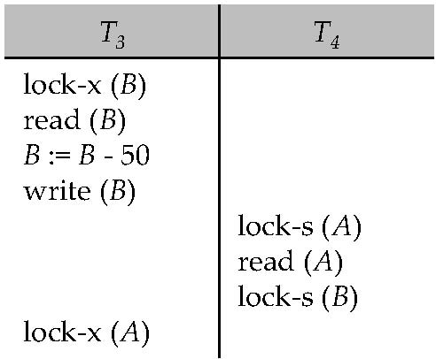
Deadlocks
Consider the partial schedule
Neither T₃ nor T₄ can make progress — executing lock-S(B) causes T₄ to wait for T₃ to release its lock on B, while executing lock-X(A) causes T₃ to wait for T₄ to release its lock on A.
Such a situation is called a deadlock.
  To handle a deadlock one of T₃ or T₄ must be rolled back
  and its locks released.

Slide 24
Deadlocks (Cont.)
Two-phase locking does not ensure freedom from deadlocks.
In addition to deadlocks, there is a possibility of starvation.
Starvation occurs if the concurrency control manager is badly designed. For example:
  A transaction may be waiting for an X-lock on an item, while a sequence of other transactions request and are granted an S-lock on the same item.
  The same transaction is repeatedly rolled back due to deadlocks.
Concurrency control manager can be designed to prevent starvation.

Slide 25
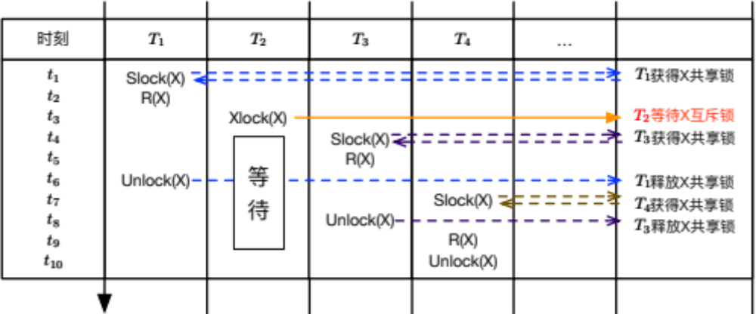

锁带来的问题
饿死现象
  不考虑已在等待的事务，$T_{2}$一直等待无法获得锁

Slide 26
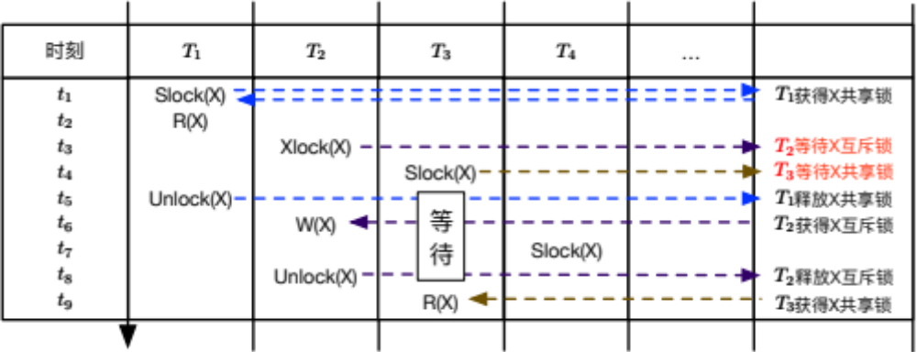
锁带来的问题
避免饿死
  同时考虑相容性和事务到来顺序
  先来先服务：优先满足先来的事务

Slide 27
Implementation of Locking
A lock manager can be implemented as a separate process to which transactions send lock and unlock requests
The lock manager replies to a lock request by sending a lock grant messages (or a message asking the transaction to roll back, in case of a deadlock)
The requesting transaction waits until its request is answered
The lock manager maintains a data-structure called a lock table to record granted locks and pending requests
The lock table is usually implemented as an in-memory hash table indexed on the name of the data item being locked

Slide 28
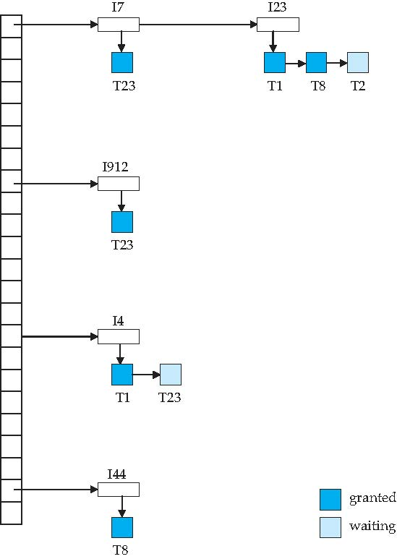
Lock Table
Dark blue rectangles indicate granted locks; light blue indicate waiting requests
Lock table also records the type of lock granted or requested
New request is added to the end of the queue of requests for the data item, and granted if it is compatible with all earlier locks
Unlock requests result in the request being deleted, and later requests are checked to see if they can now be granted
If transaction aborts, all waiting or granted requests of the transaction are deleted
  lock manager may keep a list of locks held by each transaction, to implement this efficiently

Slide 29
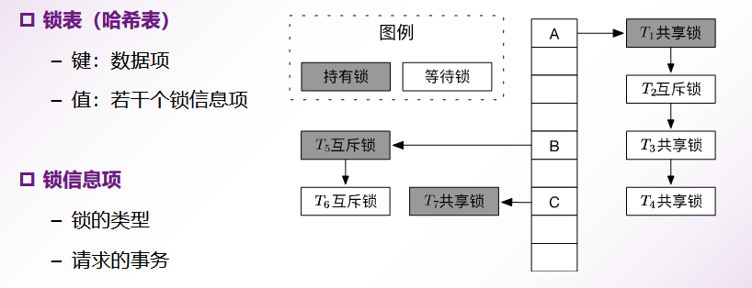
锁的数据结构

Slide 30
Deadlock Handling
System is deadlocked if there is a set of transactions such that every transaction in the set is waiting for another transaction in the set.
Deadlock prevention protocols ensure that the system will never enter into a deadlock state. Some prevention strategies :
  Require that each transaction locks all its data items before it begins execution (predeclaration).
  Impose partial ordering of all data items and require that a transaction can lock data items only in the order specified by the partial order.

Slide 31
死 锁
处理方法
  死锁预防
    在协议设计上保证数据库不会进入死锁状态
  死锁检测与恢复
    允许死锁的发生，但能够及时地意识到死锁的发生并进行处理
  锁超时重启
    设置事务最长等待时间

Slide 32
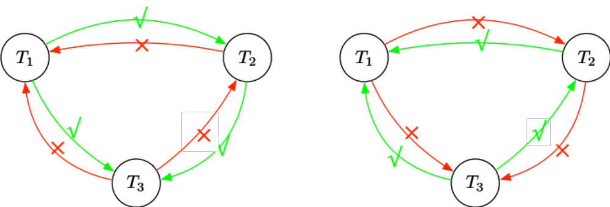
死锁预防
事务时间戳：确定事务顺序
两种算法：
  等待死亡 Wait-Die（旧事务等待新事务）
  伤害等待 Wound-Wait（新事务等待旧事务）
Wait-Die | Wound-Wait

Slide 33
More Deadlock Prevention Strategies
Following schemes use transaction timestamps for the sake of deadlock prevention alone.
wait-die scheme — non-preemptive
  older transaction may wait for younger one to release data item. (older means smaller timestamp) Younger transactions never Younger transactions never wait for older ones; they are rolled back instead.
  a transaction may die several times before acquiring needed data item
wound-wait scheme — preemptive
  older transaction wounds (forces rollback) of younger transaction instead of waiting for it. Younger transactions may wait for older ones.
  may be fewer rollbacks than wait-die scheme.

Slide 34
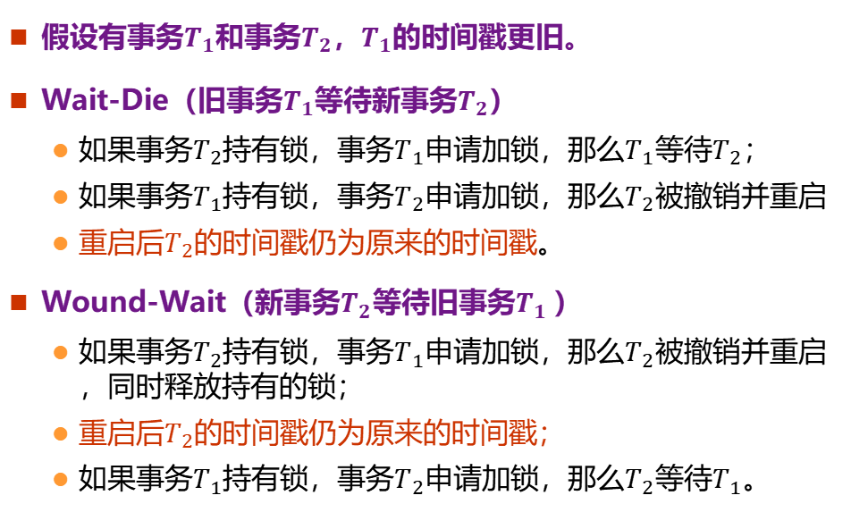
死锁预防
假设有事务$T_{1}$和事务$T_{2}$，$T_{1}$的时间戳更旧。
Wait-Die（旧事务$T_{1}$等待新事务$T_{2}$）
  如果事务$T_{2}$持有锁，事务$T_{1}$申请加锁，那么$T_{1}$等待$T_{2}$；
  如果事务$T_{1}$持有锁，事务$T_{2}$申请加锁，那么$T_{2}$被撤销并重启
  重启后$T_{2}$的时间戳仍为原来的时间戳。
Wound-Wait（新事务$T_{2}$等待旧事务$T_{1}$）
  如果事务$T_{2}$持有锁，事务$T_{1}$申请加锁，那么$T_{2}$被撤销并重启，同时释放持有的锁；
  重启后$T_{2}$的时间戳仍为原来的时间戳；
  如果事务$T_{1}$持有锁，事务$T_{2}$申请加锁，那么$T_{2}$等待$T_{1}$。

Slide 35
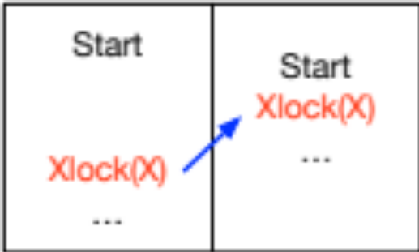
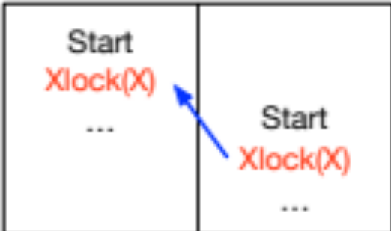
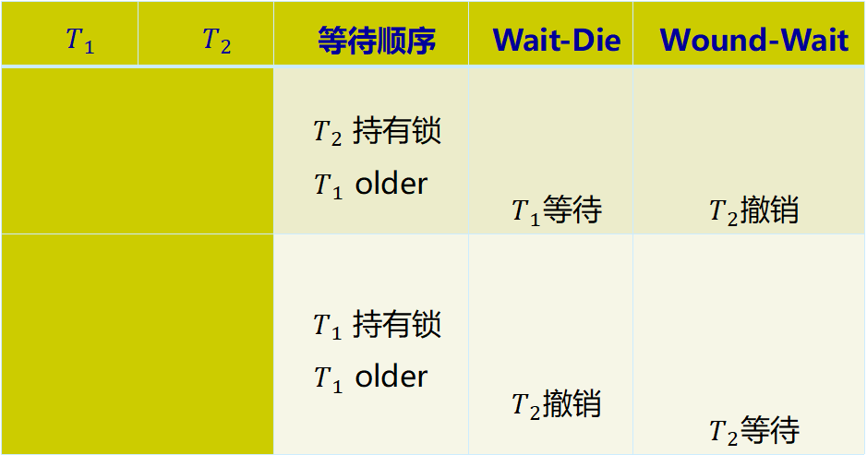
死锁预防
$$T_{1}$$ | $$T_{2}$$ | 等待顺序 | Wait-Die | Wound-Wait
 |  | $T_{2}$ 持有锁 $T_{1}$ older | $T_{1}$等待 | $T_{2}$撤销
 |  | $T_{1}$ 持有锁 $T_{1}$ older | $T_{2}$撤销 | $T_{2}$等待
Wait

Slide 36
死锁预防
等待关系
  两个算法都只允许一种类型的等待存在
    Wait-Die 旧事务等待新事务
    Wound-Wait 新事务等待旧事务
  事务间的等待关系不会构成环，因此可以防止死锁的发生。
Wait-Die | Wound-Wait

Slide 37
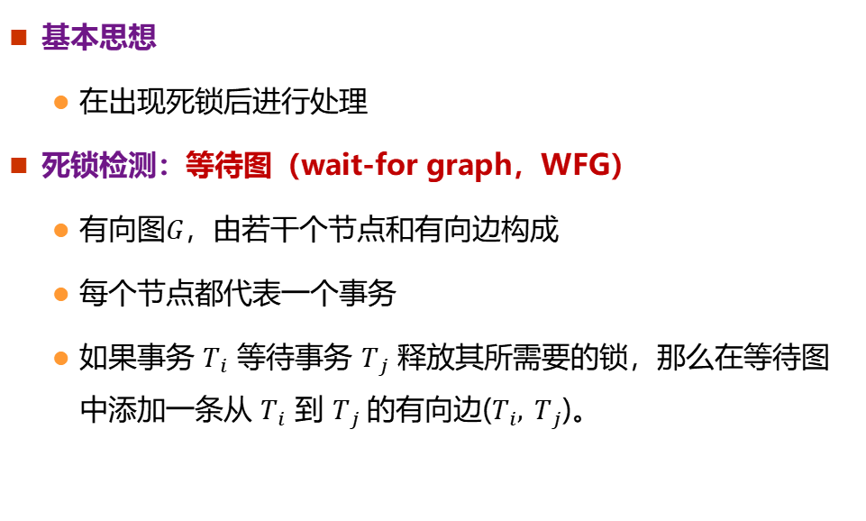
死锁检测与恢复
基本思想
  在出现死锁后进行处理
死锁检测：等待图（wait-for graph，WFG）
  有向图$G$，由若干个节点和有向边构成
  每个节点都代表一个事务
  如果事务 $T_{i}$ 等待事务 $T_{j}$ 释放其所需要的锁，那么在等待图中添加一条从 $T_{i}$ 到 $T_{j}$的有向边($T_{i}, T_{j}$)。

Slide 38
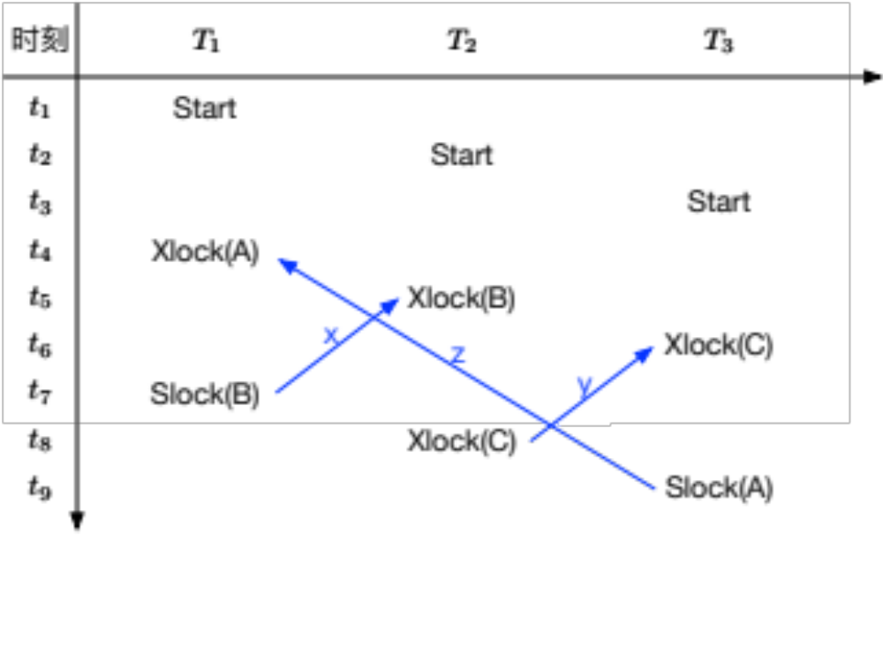
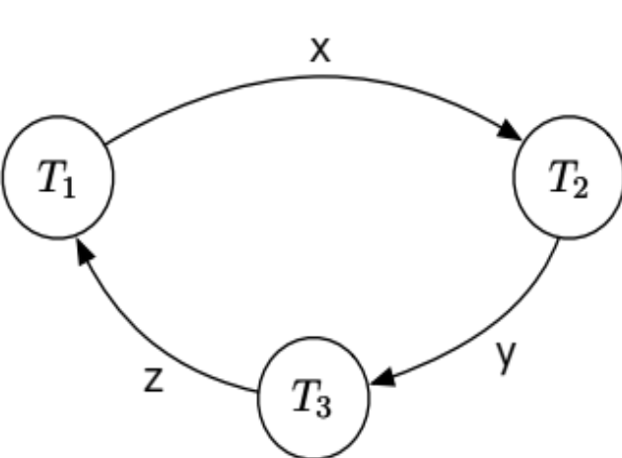
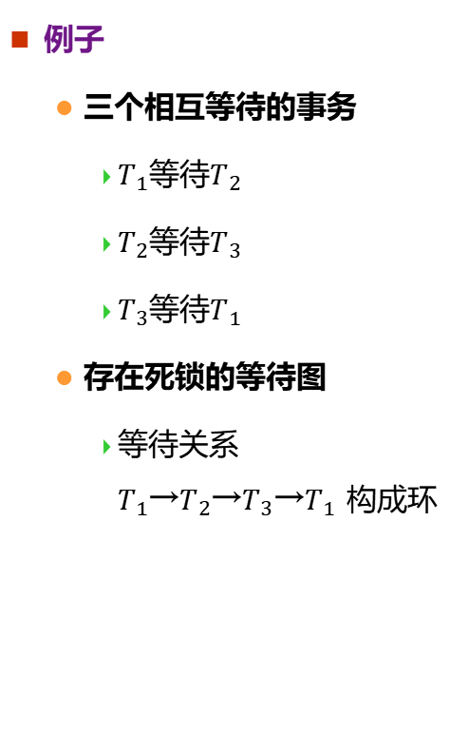
死锁检测与恢复
例子
  三个相互等待的事务
    $T_{1}$等待$T_{2}$
    $T_{2}$等待$T_{3}$
    $T_{3}$等待$T_{1}$
  存在死锁的等待图
    等待关系$T_{1}$→$T_{2}$→$T_{3}$→$T_{1}$ 构成环

Slide 39
死锁检测与恢复
检测频率
  间隔太短，死锁又不经常发生，则会造成资源浪费
  间隔太久，出现死锁较长时间才被检测到，影响数据库效率
  动态改变检测间隔
死锁恢复：撤销一个或多个事务以打破死锁
  合理选择“牺牲者”，即需要撤销的事务：
    事务开始运行的时间戳
    事务已经执行的SQL语句数量
    事务已经加锁的数据项的数量
  事务回滚的程度：全部回滚/部分回滚
  避免事务饿死

Slide 40
锁超时重启
设置事务最长等待时间
  如果申请加锁的事务在该时间结束时仍未获得锁，即事务超时，那么此时将该事务回滚并重启
  当事务之间确实存在死锁时，让死锁中的一个或者多个事务回滚并重启，而其他事务继续执行，解决了死锁问题
适用场景
  事务执行时间都比较短
  事务长时间的等待大多都是死锁造成的
问题：难以合理设置等待时间
Notes:
设置等待时间
太短：未发生死锁但引起了事务回滚，降低系统性能
太长：死锁确实发生时，导致一个或者多个事务不必要的等待

Slide 41
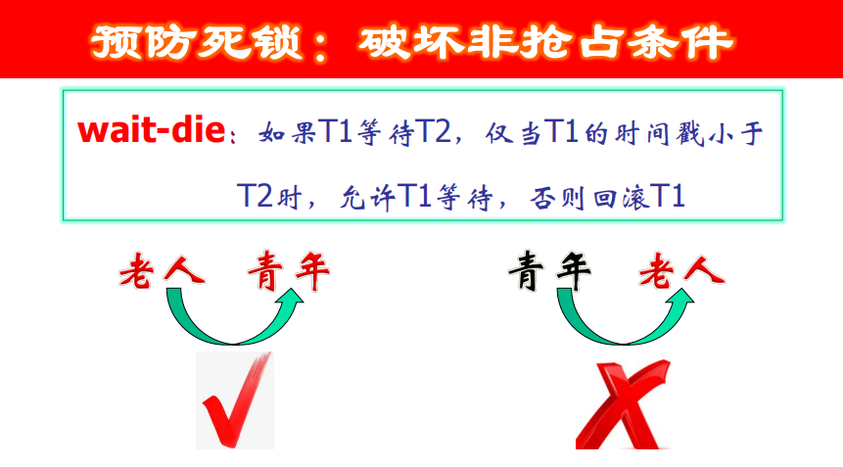

Slide 42
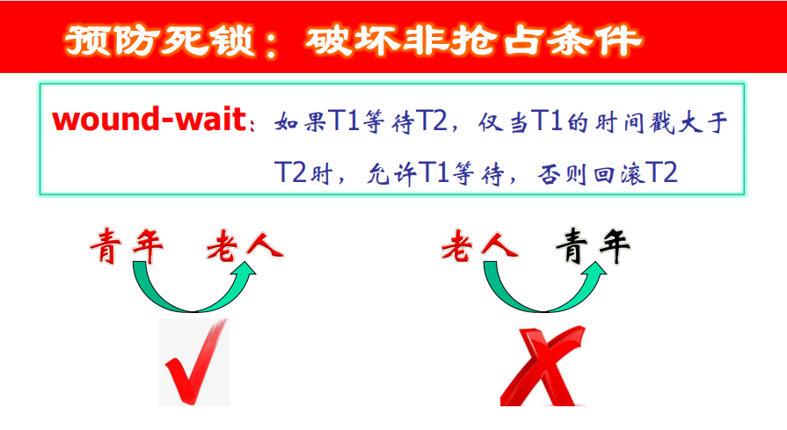

Slide 43
Deadlock prevention (Cont.)
Both in wait-die and in wound-wait schemes, a rolled back transactions is restarted with its original timestamp.
  Older transactions thus have precedence over newer ones, and starvation is hence avoided.
Timeout-Based Schemes:
  a transaction waits for a lock only for a specified amount of time.
    If the lock has not been granted within that time, the transaction is rolled back and restarted,
  Thus, deadlocks are not possible
  simple to implement; but starvation is possible.
    Also difficult to determine good value of the timeout interval.

Slide 44
Deadlock Detection
Deadlocks can be described as a wait-for graph, which consists of a pair G = (V,E),
  V is a set of vertices (all the transactions in the system)
  E is a set of edges; each element is an ordered pair T_{i} →T_{j}.
If T_{i} → T_{j} is in E, then there is a directed edge from T_{i} to T_{j}, implying that T_{i} is waiting for T_{j} to release a data item.
When T_{i} requests a data item currently being held by T_{j}, then the edge T_{i} → T_{j} is inserted in the wait-for graph.
  This edge is removed only when T_{j} is no longer holding a data item needed by T_{i}.
The system is in a deadlock state if and only if the wait-for graph has a cycle.
  Must invoke a deadlock-detection algorithm periodically to look for cycles.

Slide 45
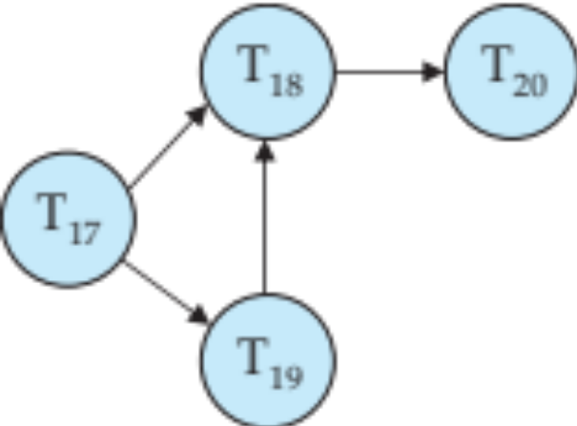
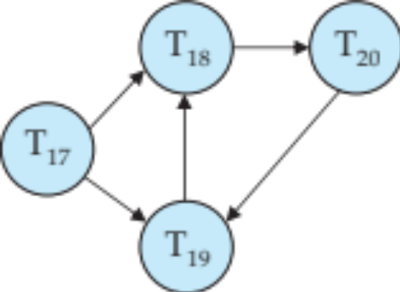
Deadlock Detection (Cont.)
Wait-for graph without a cycle
Wait-for graph with a cycle

Slide 46
Deadlock Recovery
When deadlock is detected :
  Some transaction will have to rolled back (made a victim) to break deadlock.
    Select that transaction as victim that will incur minimum cost.
  Rollback -- determine how far to roll back transaction
    Total rollback: Abort the transaction and then restart it.
    More effective to roll back transaction only as far as necessary to break deadlock.
  Starvation happens if same transaction is always chosen as victim.
    Include the number of rollbacks in the cost factor to avoid starvation

Slide 47
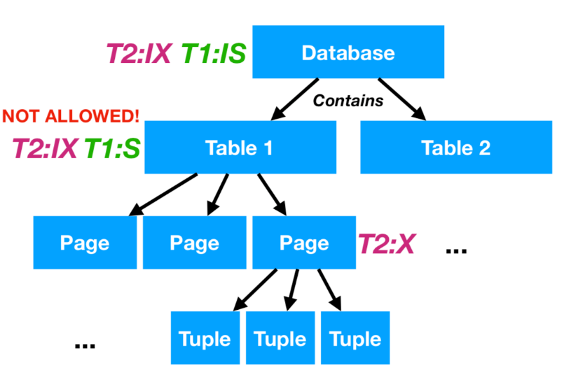
Multiple Granularity
Allow data items to be of various sizes and define a hierarchy of data granularities, where the small granularities are nested within larger ones
Can be represented graphically as a tree.
When a transaction locks a node in the tree explicitly, it implicitly locks all the node's descendents in the same mode.
Granularity of locking (level in tree where locking is done):
  fine granularity (lower in tree): high concurrency, high locking overhead
  coarse granularity (higher in tree): low locking overhead, low concurrency

Slide 48
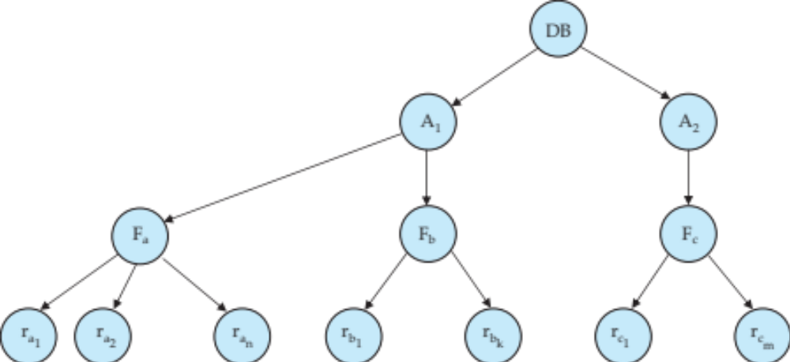
Example of Granularity Hierarchy
域(Area)
文件(File)
记录
(Record)
The levels, starting from the coarsest (top) level are
  database
  area
  file
  record

Slide 49
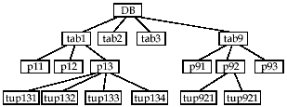
18.4 Multiple Granularity
问题：当一个事务申请对某数据项加锁时，系统如何判断是否有锁冲突存在。
  例1 事务T_{i}已显式S封锁了tab1，事务T_{j}申请对tup132加X锁。
  例2 事务T_{i}已显式X封锁了p93 ，事务T_{j}申请对tab9加S锁。

Slide 50
Intention Lock Modes
In addition to S and X lock modes, there are three additional lock modes with multiple granularity:
  intention-shared (IS): indicates explicit locking at a lower level of the tree but only with shared locks.
  intention-exclusive (IX): indicates explicit locking at a lower level with exclusive or shared locks
  shared and intention-exclusive (SIX): the subtree rooted by that node is locked explicitly in shared mode and explicit locking is being done at a lower level with exclusive-mode locks.
intention locks allow a higher level node to be locked in S or X mode without having to check all descendent nodes.

Slide 51
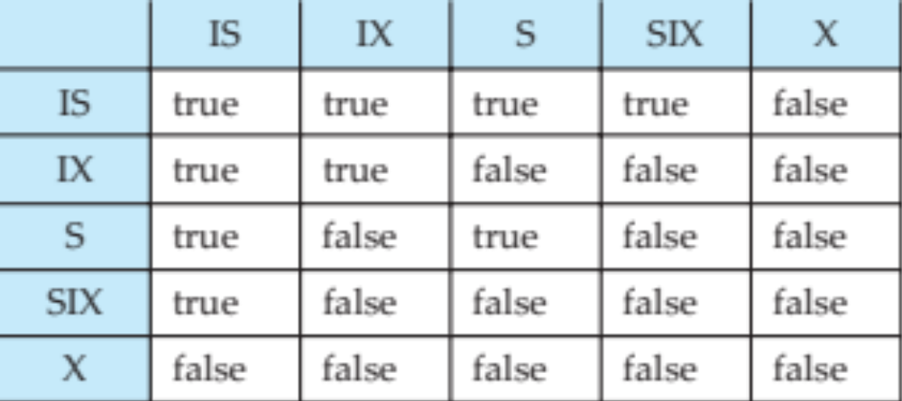
Compatibility Matrix with Intention Lock Modes
The compatibility matrix for all lock modes is:

Slide 52
Multiple Granularity Locking Scheme
Transaction T_{i} can lock a node Q, using the following rules:
  The lock compatibility matrix must be observed.
  The root of the tree must be locked first, and may be locked in any mode.
  A node Q can be locked by T_{i} in S or IS mode only if the parent of Q is currently locked by T_{i} in either IX or IS mode.
  A node Q can be locked by T_{i} in X, SIX, or IX mode only if the parent of Q is currently locked by T_{i} in either IX or SIX mode.
  T_{i} can lock a node only if it has not previously unlocked any node (that is, T_{i} is two-phase).
  T_{i} can unlock a node Q only if none of the children of Q are currently locked by T_{i}.
Observe that locks are acquired in root-to-leaf order, whereas they are released in leaf-to-root order.
Lock granularity escalation: in case there are too many locks at a particular level, switch to higher granularity S or X lock

Slide 53
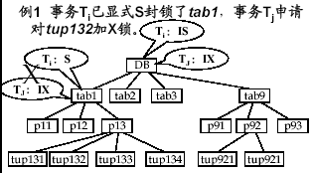
Multiple Granularity Locking Scheme

Slide 54
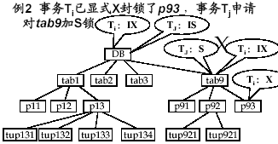
Multiple Granularity Locking Scheme

Slide 55
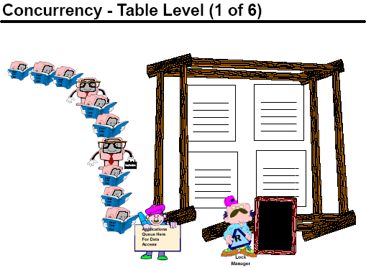

Slide 56
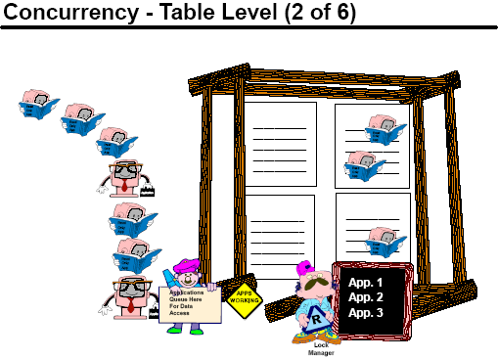

Slide 57
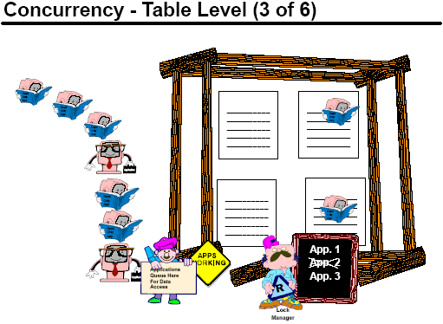

Slide 58
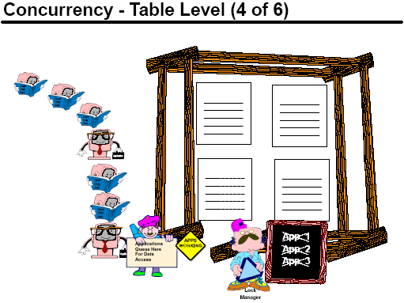

Slide 59
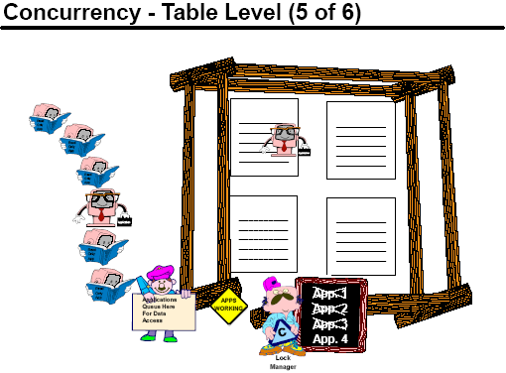

Slide 60
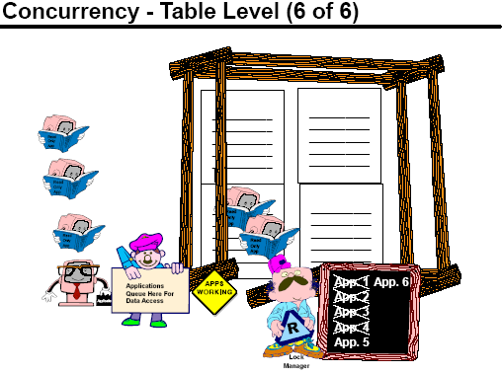

Slide 61
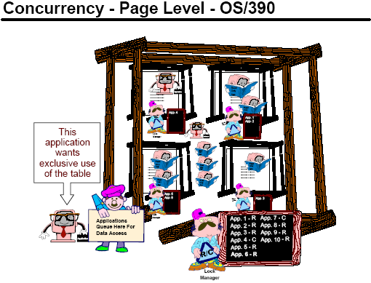

Slide 62
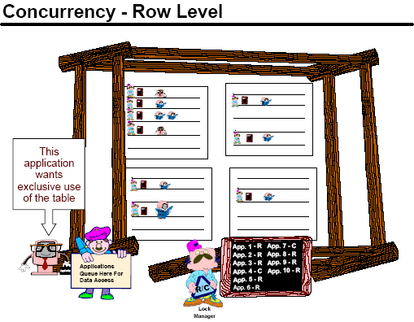

Slide 63
意向锁
使用意向锁后，对数据项加锁情况的检查
  检查数据项自身的锁是否相容
  检查数据项的祖先节点的锁是否相容
  不需要检查后代节点

Slide 64
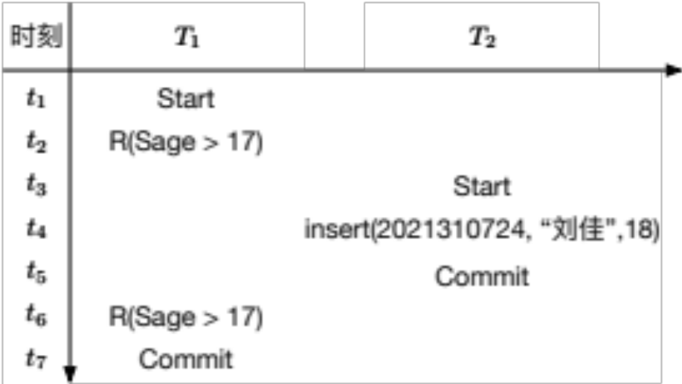
隔离级别的支持
为了提升系统性能，尽量给较小的数据粒度上锁
涉及插入、更新、删除数据的操作时，使用多粒度锁会引发幻读问题
Sno | Sname | Sage
2021310721 | 李博 | 17
2021310722 | 赵宇 | 19
2021310723 | 张敏 | 18

Slide 65
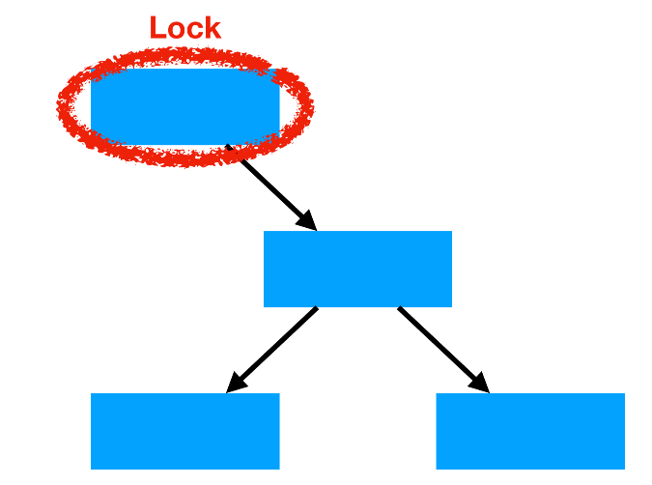
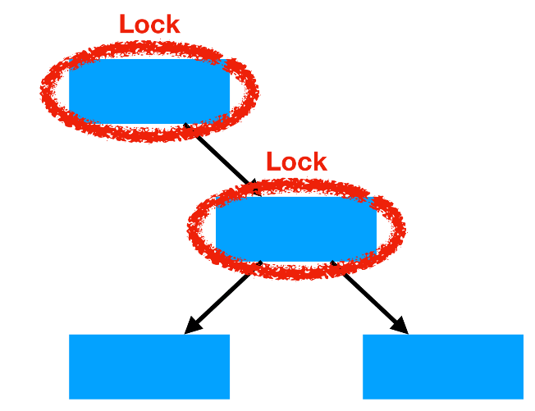
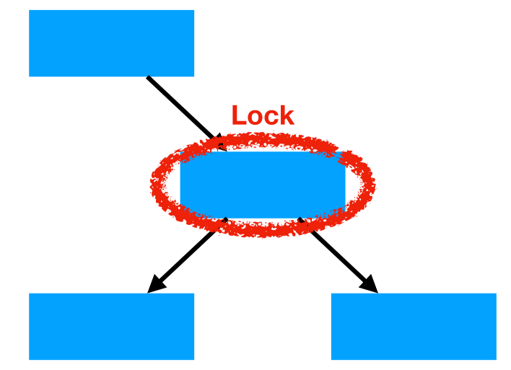
隔离级别的支持
幻读问题主要有两种解决方法
  谓词锁
    SELECT * FROM <table>
    WHERE <qualification>
    FOR UPDATE;
  索引区间锁
  Postgres: FOR SHARE
  MySQL: LOCK IN SHARE MODE

Slide 66
Timestamp-Based Protocols
Each transaction is issued a timestamp when it enters the system. If an old transaction T_{i} has time-stamp TS(T_{i}), a new transaction T_{j} is assigned time-stamp TS(T_{j}) such that TS(T_{i}) <TS(T_{j}).
The protocol manages concurrent execution such that the time-stamps determine the serializability order.
In order to assure such behavior, the protocol maintains for each data Q two timestamp values:
  W-timestamp(Q) is the largest time-stamp of any transaction that executed write(Q) successfully.
  R-timestamp(Q) is the largest time-stamp of any transaction that executed read(Q) successfully.

Slide 67
Timestamp-Based Protocols (Cont.)
The timestamp ordering protocol ensures that any conflicting read and write operations are executed in timestamp order.
Suppose a transaction T_{i} issues a read(Q)
  If TS(T_{i}) ≤ W-timestamp(Q), then T_{i} needs to read a value of Q that was already overwritten.
    Hence, the read operation is rejected, and T_{i} is rolled back.
  If TS(T_{i}) ≥ W-timestamp(Q), then the read operation is executed, and R-timestamp(Q) is set to max(R-timestamp(Q), TS(T_{i})).

Slide 68
Timestamp-Based Protocols (Cont.)
Suppose that transaction T_{i} issues write(Q).
  If TS(T_{i}) < R-timestamp(Q), then the value of Q that T_{i} is producing was needed previously, and the system assumed that that value would never be produced.
    Hence, the write operation is rejected, and T_{i} is rolled back.
  If TS(T_{i}) < W-timestamp(Q), then T_{i} is attempting to write an obsolete value of Q.
    Hence, this write operation is rejected, and T_{i} is rolled back.
  Otherwise, the write operation is executed, and W-timestamp(Q) is set to TS(T_{i}).

Slide 69
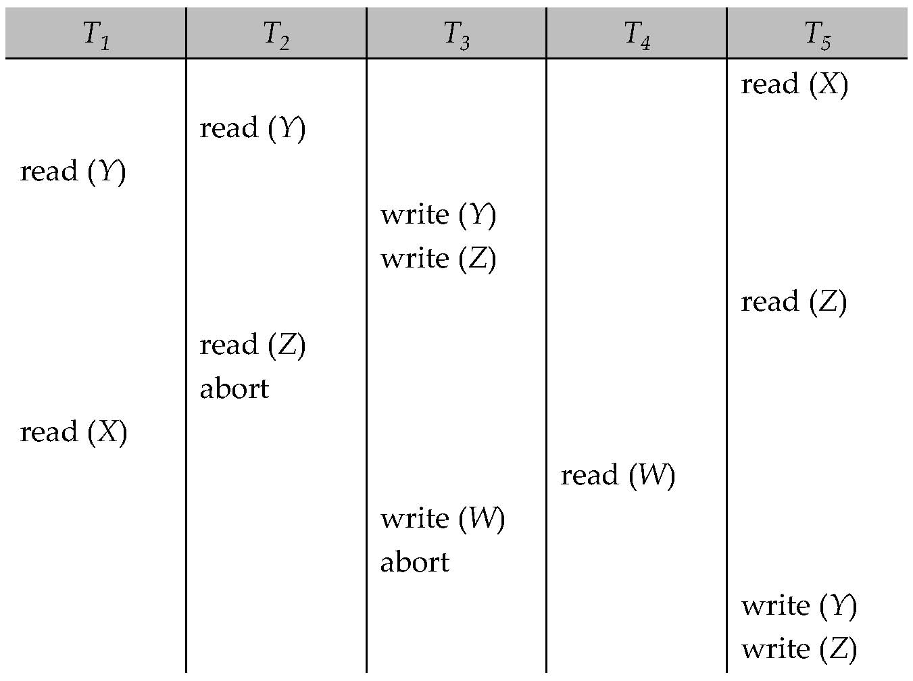
Example Use of the Protocol
A partial schedule for several data items for transactions with
timestamps 1, 2, 3, 4, 5

Slide 70
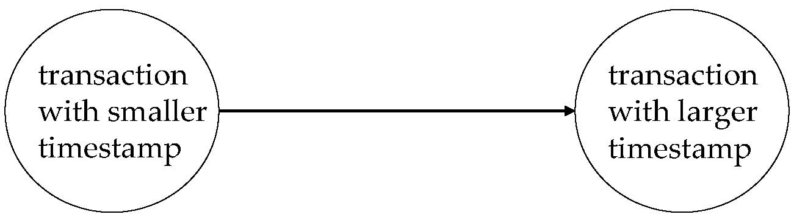
Correctness of Timestamp-Ordering Protocol
The timestamp-ordering protocol guarantees serializability since all the arcs in the precedence graph are of the form:
Thus, there will be no cycles in the precedence graph
Timestamp protocol ensures freedom from deadlock as no transaction ever waits.
But the schedule may not be cascade-free, and may not even be recoverable.

Slide 71
Recoverability and Cascade Freedom
Problem with timestamp-ordering protocol:
  Suppose T_{i} aborts, but T_{j} has read a data item written by T_{i}
  Then T_{j} must abort; if T_{j} had been allowed to commit earlier, the schedule is not recoverable.
  Further, any transaction that has read a data item written by T_{j} must abort
  This can lead to cascading rollback --- that is, a chain of rollbacks
Solution 1:
  A transaction is structured such that its writes are all performed at the end of its processing
  All writes of a transaction form an atomic action; no transaction may execute while a transaction is being written
  A transaction that aborts is restarted with a new timestamp
Solution 2: Limited form of locking: wait for data to be committed before reading it
Solution 3: Use commit dependencies to ensure recoverability

Slide 72
Thomas’ Write Rule
Modified version of the timestamp-ordering protocol in which obsolete write operations may be ignored under certain circumstances.
When T_{i} attempts to write data item Q, if TS(T_{i}) < W-timestamp(Q), then T_{i} is attempting to write an obsolete value of {Q}.
  Rather than rolling back T_{i} as the timestamp ordering protocol would have done, this {write} operation can be ignored.
Otherwise this protocol is the same as the timestamp ordering protocol.
Thomas' Write Rule allows greater potential concurrency.
  Allows some view-serializable schedules that are not conflict-serializable.

Slide 73
Validation-Based Protocol
Execution of transaction T_{i} is done in three phases.
1. Read and execution phase: Transaction T_{i} writes only to
temporary local variables
2. Validation phase: Transaction T_{i} performs a ''validation test''
to determine if local variables can be written without violating
serializability.
3. Write phase: If T_{i} is validated, the updates are applied to the
database; otherwise, T_{i} is rolled back.
The three phases of concurrently executing transactions can be interleaved, but each transaction must go through the three phases in that order.
  Assume for simplicity that the validation and write phase occur together, atomically and serially
    I.e., only one transaction executes validation/write at a time.
Also called as optimistic concurrency control since transaction executes fully in the hope that all will go well during validation

Slide 74
Validation-Based Protocol (Cont.)
Each transaction T_{i} has 3 timestamps
  Start(T_{i}) : the time when T_{i} started its execution
  Validation(T_{i}): the time when T_{i} entered its validation phase
  Finish(T_{i}) : the time when T_{i} finished its write phase
Serializability order is determined by timestamp given at validation time; this is done to increase concurrency.
  Thus, TS(T_{i}) is given the value of Validation(T_{i}).
This protocol is useful and gives greater degree of concurrency if probability of conflicts is low.
  because the serializability order is not pre-decided, and
  relatively few transactions will have to be rolled back.

Slide 75
Validation Test for Transaction T_{j}
If for all T_{i} with TS (T_{i}) < TS (T_{j}) either one of the following condition holds:
  finish(T_{i}) < start(T_{j})
  start(T_{j}) < finish(T_{i}) < validation(T_{j}) and the set of data items written by T_{i} does not intersect with the set of data items read by T_{j}.
then validation succeeds and T_{j} can be committed. Otherwise, validation fails and T_{j} is aborted.
Justification: Either the first condition is satisfied, and there is no overlapped execution, or the second condition is satisfied and
  the writes of T_{j} do not affect reads of T_{i} since they occur after T_{i} has finished its reads.
  the writes of T_{i} do not affect reads of T_{j} since T_{j} does not read any item written by T_{i}.

Slide 76
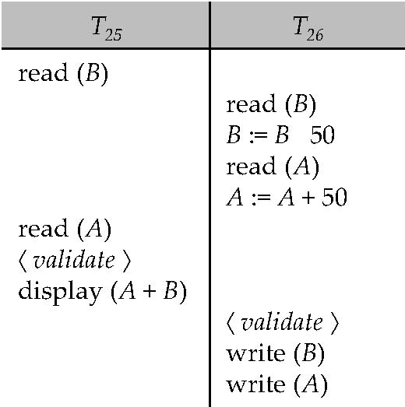
Schedule Produced by Validation
Example of schedule produced using validation

Slide 77
Multiversion Schemes
Multiversion schemes keep old versions of data item to increase concurrency.
  Multiversion Timestamp Ordering
  Multiversion Two-Phase Locking
Each successful write results in the creation of a new version of the data item written.
Use timestamps to label versions.
When a read(Q) operation is issued, select an appropriate version of Q based on the timestamp of the transaction, and return the value of the selected version.
reads never have to wait as an appropriate version is returned immediately.

Slide 78
Multiversion Timestamp Ordering
Each data item Q has a sequence of versions <Q₁, Q₂,...., Q_{m}>. Each version Q_{k} contains three data fields:
  Content -- the value of version Q_{k}.
  W-timestamp(Q_{k}) -- timestamp of the transaction that created (wrote) version Q_{k}
  R-timestamp(Q_{k}) -- largest timestamp of a transaction that successfully read version Q_{k}
When a transaction T_{i} creates a new version Q_{k} of Q, Q_{k}'s W-timestamp and R-timestamp are initialized to TS(T_{i}).
R-timestamp of Q_{k} is updated whenever a transaction T_{j} reads Q_{k}, and TS(T_{j}) > R-timestamp(Q_{k}).

Slide 79
Multiversion Timestamp Ordering (Cont)
Suppose that transaction T_{i} issues a read(Q) or write(Q) operation. Let Q_{k} denote the version of Q whose write timestamp is the largest write timestamp less than or equal to TS(T_{i}).
  If transaction T_{i} issues a read(Q), then the value returned is the content of version Q_{k}.
  If transaction T_{i} issues a write(Q)
    if TS(T_{i}) < R-timestamp(Q_{k}), then transaction T_{i} is rolled back.
    if TS(T_{i}) = W-timestamp(Q_{k}), the contents of Q_{k} are overwritten
    else a new version of Q is created.
Observe that
  Reads always succeed
  A write by T_{i} is rejected if some other transaction T_{j} that (in the serialization order defined by the timestamp values) should read
  T_{i}'s write, has already read a version created by a transaction older than T_{i}.
Protocol guarantees serializability

Slide 80
Multiversion Two-Phase Locking
Differentiates between read-only transactions and update transactions
Update transactions acquire read and write locks, and hold all locks up to the end of the transaction. That is, update transactions follow rigorous two-phase locking.
  Each successful write results in the creation of a new version of the data item written.
  Each version of a data item has a single timestamp whose value is obtained from a counter ts-counter that is incremented during commit processing.
Read-only transactions are assigned a timestamp by reading the current value of ts-counter before they start execution; they follow the multiversion timestamp-ordering protocol for performing reads.

Slide 81
Multiversion Two-Phase Locking (Cont.)
When an update transaction wants to read a data item:
  it obtains a shared lock on it, and reads the latest version.
When it wants to write an item
  it obtains X lock on; it then creates a new version of the item and sets this version's timestamp to ∞.
When update transaction T_{i} completes, commit processing occurs:
  T_{i} sets timestamp on the versions it has created to ts-counter + 1
  T_{i} increments ts-counter by 1
Read-only transactions that start after T_{i} increments ts-counter will see the values updated by T_{i}.
Read-only transactions that start before T_{i} increments the
ts-counter will see the value before the updates by T_{i}.
Only serializable schedules are produced.

Slide 82
MVCC: Implementation Issues
Creation of multiple versions increases storage overhead
  Extra tuples
  Extra space in each tuple for storing version information
Versions can, however, be garbage collected
  E.g. if Q has two versions Q5 and Q9, and the oldest active transaction has timestamp > 9, than Q5 will never be required again

Slide 83
Snapshot Isolation
Motivation: Decision support queries that read large amounts of data have concurrency conflicts with OLTP transactions that update a few rows
  Poor performance results
Solution 1: Give logical “snapshot” of database state to read only transactions, read-write transactions use normal locking
  Multiversion 2-phase locking
  Works well, but how does system know a transaction is read only?
Solution 2: Give snapshot of database state to every transaction, updates alone use 2-phase locking to guard against concurrent updates
  Problem: variety of anomalies such as lost update can result
  Partial solution: snapshot isolation level (next slide)
    Proposed by Berenson et al, SIGMOD 1995
    Variants implemented in many database systems
      E.g. Oracle, PostgreSQL, SQL Server 2005

Slide 84
Snapshot Isolation
A transaction T1 executing with Snapshot Isolation
  takes snapshot of committed data at start
  always reads/modifies data in its own snapshot
  updates of concurrent transactions are not visible to T1
  writes of T1 complete when it commits
  First-committer-wins rule:
    Commits only if no other concurrent transaction has already written data that T1 intends to write.
T1 | T2 | T3
W(Y := 1) Commit
 | Start R(X) → 0 R(Y)→ 1
 |  | W(X:=2) W(Z:=3) Commit
 | R(Z) → 0 R(Y) → 1 W(X:=3) Commit-Req Abort
Concurrent updates not visible
Own updates are visible
Not first-committer of X
Serialization error, T2 is rolled back

Slide 85
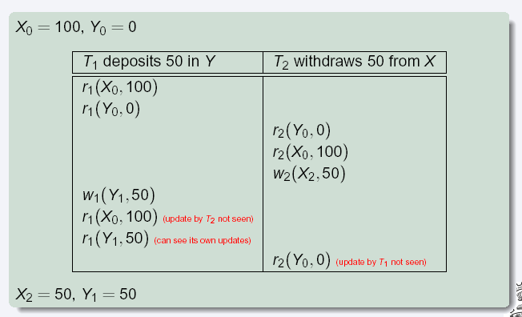
Snapshot Read
Concurrent updates invisible to snapshot read
Notes:
85

Slide 86
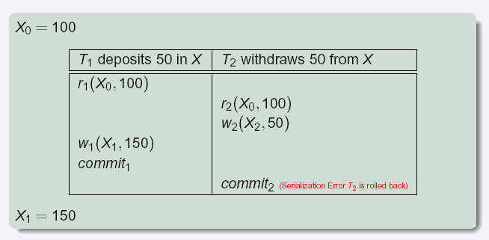
Snapshot Write: First Committer Wins
  Variant: “First-updater-wins”
    Check for concurrent updates when write occurs by locking item
      But lock should be held till all concurrent transactions have finished
    (Oracle uses this plus some extra features)
    Differs only in when abort occurs, otherwise equivalent
Notes:
86

Slide 87
Benefits of SI
Reading is never blocked,
  and also doesn’t block other txns activities
Performance similar to Read Committed
Avoids the usual anomalies
  No dirty read
  No lost update
  No non-repeatable read
  Predicate based selects are repeatable (no phantoms)
Problems with SI
  SI does not always give serializable executions
    Serializable: among two concurrent txns, one sees the effects of the other
    In SI: neither sees the effects of the other
  Result: Integrity constraints can be violated

Slide 88
Snapshot Isolation
E.g. of problem with SI
  T1: x:=y
  T2: y:= x
  Initially x = 3 and y = 17
    Serial execution: x = ??, y = ??
    if both transactions start at the same time, with snapshot isolation: x = ?? , y = ??
Called skew write
Skew also occurs with inserts
  E.g:
    Find max order number among all orders
    Create a new order with order number = previous max + 1

Slide 89
Snapshot Isolation Anomalies
SI breaks serializability when txns modify different items, each based on a previous state of the item the other modified
  Not very common in practice
    E.g., the TPC-C benchmark runs correctly under SI
    when txns conflict due to modifying different data, there is usually also a shared item they both modify too (like a total quantity) so SI will abort one of them
  But does occur
    Application developers should be careful about write skew
SI can also cause a read-only transaction anomaly, where read-only transaction may see an inconsistent state even if updaters are serializable
  We omit details
Using snapshots to verify primary/foreign key integrity can lead to inconsistency
  Integrity constraint checking usually done outside of snapshot

Slide 90
SI In Oracle and PostgreSQL
Warning: SI used when isolation level is set to serializable, by Oracle, and PostgreSQL versions prior to 9.1
  PostgreSQL’s implementation of SI (versions prior to 9.1) described in Section 26.4.1.3
  Oracle implements “first updater wins” rule (variant of “first committer wins”)
    concurrent writer check is done at time of write, not at commit time
    Allows transactions to be rolled back earlier
    Oracle and PostgreSQL < 9.1 do not support true serializable execution
  PostgreSQL 9.1 introduced new protocol called “Serializable Snapshot Isolation” (SSI)
    Which guarantees true serializabilty including handling predicate reads (coming up)

Slide 91
SI In Oracle and PostgreSQL
Can sidestep SI for specific queries by using select .. for update in Oracle and PostgreSQL
  E.g.,
    select max(orderno) from orders for update
    read value into local variable maxorder
    insert into orders (maxorder+1, …)
  Select for update (SFU) treats all data read by the query as if it were also updated, preventing concurrent updates
  Does not always ensure serializability since phantom phenomena can occur (coming up)
In PostgreSQL versions < 9.1, SFU locks the data item, but releases locks when the transaction completes, even if other concurrent transactions are active
  Not quite same as SFU in Oracle, which keeps locks until all
  concurrent transactions have completed
Notes:
91

Slide 92
Insert and Delete Operations
If two-phase locking is used :
  A delete operation may be performed only if the transaction deleting the tuple has an exclusive lock on the tuple to be deleted.
  A transaction that inserts a new tuple into the database is given an X-mode lock on the tuple
Insertions and deletions can lead to the phantom phenomenon.
  A transaction that scans a relation
    (e.g., find sum of balances of all accounts in Perryridge)
    and a transaction that inserts a tuple in the relation
    (e.g., insert a new account at Perryridge)
    (conceptually) conflict in spite of not accessing any tuple in common.
  If only tuple locks are used, non-serializable schedules can result
    E.g. the scan transaction does not see the new account, but reads some other tuple written by the update transaction

Slide 93
Insert and Delete Operations (Cont.)
The transaction scanning the relation is reading information that indicates what tuples the relation contains, while a transaction inserting a tuple updates the same information.
  The conflict should be detected, e.g. by locking the information.
One solution:
  Associate a data item with the relation, to represent the information about what tuples the relation contains.
  Transactions scanning the relation acquire a shared lock in the data item,
  Transactions inserting or deleting a tuple acquire an exclusive lock on the data item. (Note: locks on the data item do not conflict with locks on individual tuples.)
Above protocol provides very low concurrency for insertions/deletions.
Index locking protocols provide higher concurrency while
preventing the phantom phenomenon, by requiring locks
on certain index buckets.

Slide 94
Index Locking Protocol
Index locking protocol:
  Every relation must have at least one index.
  A transaction can access tuples only after finding them through one or more indices on the relation
  A transaction T_{i} that performs a lookup must lock all the index leaf nodes that it accesses, in S-mode
    Even if the leaf node does not contain any tuple satisfying the index lookup (e.g. for a range query, no tuple in a leaf is in the range)
  A transaction T_{i} that inserts, updates or deletes a tuple t_{i} in a relation r
    must update all indices to r
    must obtain exclusive locks on all index leaf nodes affected by the insert/update/delete
  The rules of the two-phase locking protocol must be observed
Guarantees that phantom phenomenon won’t occur

Slide 95
Next-Key Locking
Index-locking protocol to prevent phantoms required locking entire leaf
  Can result in poor concurrency if there are many inserts
Alternative: for an index lookup
  Lock all values that satisfy index lookup (match lookup value, or fall in lookup range)
  Also lock next key value in index
  Lock mode: S for lookups, X for insert/delete/update
Ensures that range queries will conflict with inserts/deletes/updates
  Regardless of which happens first, as long as both are concurrent

Slide 96
Concurrency in Index Structures
Indices are unlike other database items in that their only job is to help in accessing data.
Index-structures are typically accessed very often, much more than other database items.
  Treating index-structures like other database items, e.g. by 2-phase locking of index nodes can lead to low concurrency.
There are several index concurrency protocols where locks on internal nodes are released early, and not in a two-phase fashion.
  It is acceptable to have nonserializable concurrent access to an index as long as the accuracy of the index is maintained.
    In particular, the exact values read in an internal node of a
    B⁺-tree are irrelevant so long as we land up in the correct leaf node.

Slide 97
Concurrency in Index Structures (Cont.)
Example of index concurrency protocol:
Use crabbing instead of two-phase locking on the nodes of the B⁺-tree, as follows. During search/insertion/deletion:
  First lock the root node in shared mode.
  After locking all required children of a node in shared mode, release the lock on the node.
  During insertion/deletion, upgrade leaf node locks to exclusive mode.
  When splitting or coalescing requires changes to a parent, lock the parent in exclusive mode.
Above protocol can cause excessive deadlocks
  Searches coming down the tree deadlock with updates going up the tree
  Can abort and restart search, without affecting transaction
Better protocols are available; see Section 16.9 for one such protocol, the B-link tree protocol
  Intuition: release lock on parent before acquiring lock on child
    And deal with changes that may have happened between lock release and acquire

Slide 98
Weak Levels of Consistency
Degree-two consistency: differs from two-phase locking in that S-locks may be released at any time, and locks may be acquired at any time
  X-locks must be held till end of transaction
  Serializability is not guaranteed, programmer must ensure that no erroneous database state will occur]
Cursor stability:
  For reads, each tuple is locked, read, and lock is immediately released
  X-locks are held till end of transaction
  Special case of degree-two consistency

Slide 99
Weak Levels of Consistency in SQL
SQL allows non-serializable executions
  Serializable: is the default
  Repeatable read: allows only committed records to be read, and repeating a read should return the same value (so read locks should be retained)
    However, the phantom phenomenon need not be prevented
      T1 may see some records inserted by T2, but may not see others inserted by T2
  Read committed: same as degree two consistency, but most systems implement it as cursor-stability
  Read uncommitted: allows even uncommitted data to be read
In many database systems, read committed is the default consistency level
  has to be explicitly changed to serializable when required
    set isolation level serializable

Slide 100
Transactions across User Interaction
Many applications need transaction support across user interactions
  Can’t use locking
  Don’t want to reserve database connection per user
Application level concurrency control
  Each tuple has a version number
  Transaction notes version number when reading tuple
    select r.balance, r.version into :A, :version
    from r where acctId =23
  When writing tuple, check that current version number is same as the version when tuple was read
    update r set r.balance = r.balance + :deposit
    where acctId = 23 and r.version = :version
Equivalent to optimistic concurrency control without validating read set
Used internally in Hibernate ORM system, and manually in many applications
Version numbering can also be used to support first committer wins check of snapshot isolation
  Unlike SI, reads are not guaranteed to be from a single snapshot

Slide 101
End of Module 16
Notes:
101

Slide 102
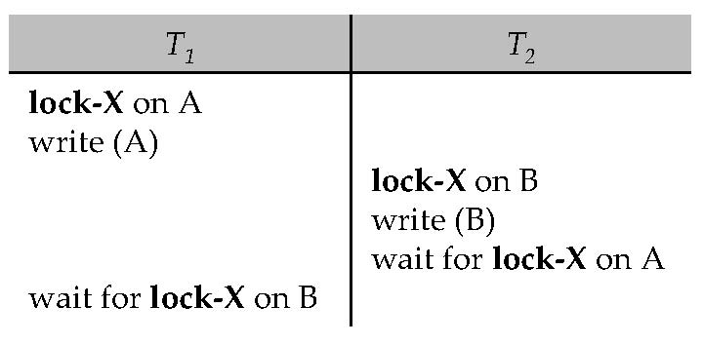
Deadlocks
Consider the following two transactions:
T₁: write (X) T₂: write(Y)
write(Y) write(X)
Schedule with deadlock

