Slide 1

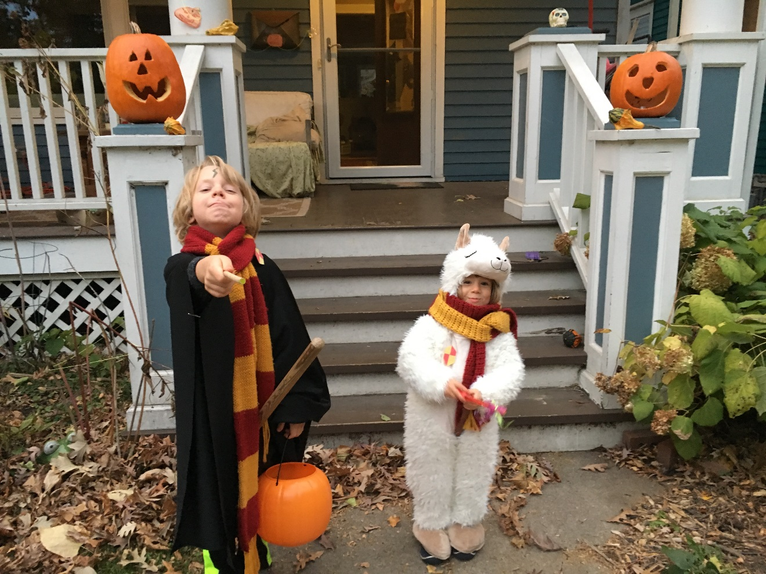
Unit 14: Repeated Measures GLM

Slide 2
Repeated Measures Designs: A Detailed Review
What are the cardinal feature(s) of a repeated measures (within-subject) design?
You have more than one observation per unit of analysis. Most typically, you have more than one observation per participant (as participant is our typical unit of analysis).
You have the same units (e.g., participants) in all conditions associated with a within-subject independent variable in your experiment.
Give two examples: Fully within subject and mixed designs?
What are the advantages of a repeated measures design?
In most instances, you will have more power than the comparable between subjects design with the same N
It is more efficient use of N when subjects are difficult to find
Allows you to examine change over time within participants

Slide 3
Repeated Measures Designs: A Detailed Review
What problems or barriers exist with repeated measures designs?
Can’t manipulate IV (e.g., Sex, Alcohol Dependence)
Contamination of IV conditions
Order effects (e.g., practice, fatigue)
Cannot counterbalance conditions (e.g., cant take away treatment once given)
Can counterbalance but Order effects are large- Why is this a problem?
What are the consequences of each of these problems?
Can’t manipulate- Can’t do it!
Contamination- decrease internal validity, decrease statistical validity (power)
Order effects- decrease internal validity (not counterbalanced) or decrease statistical power (counterbalanced but large, unmodeled order effects)

Slide 4
Repeated Measures Designs: A Detailed Review
How do you control for Order effects?
Counterbalance: Describe how? Fully balanced within subjects vs. across subjects
Include ‘Task Order’ in the regression model (why not perfect solution?)
Clear instructions
Pre-task practice
Short tasks
Compensation
Include “Block” in the model

Slide 5
Repeated Measures Designs: The Analytic Problem
What is the problem with analyzing repeated measures data in “long” format (1 row per DV observation) directly with a regression model in lm?
SubID Cond DV
1 1 Con 180
2 2 Con 190
3 3 Con 200
4 4 Con 220
5 5 Con 240
6 6 Con 200
7 7 Con 300
8 1 Txt 170
9 2 Txt 190
10 3 Txt 180
11 4 Txt 220
12 5 Txt 220
13 6 Txt 200
14 7 Txt 280

Slide 6
Repeated Measures Designs: The Analytic Problem
What is the problem with analyzing repeated measures data in “long” format (1 row per DV observation) directly with a regression model in lm?
Regression models make an assumption that all observations are independent. If you have multiple observations per unit (Subject), these observations will potentially be more alike than observations from other units.
Parameter estimate is still unbiased but SE is VERY inaccurate. As such, significance test will not be correct

Slide 7
Repeated Measures Designs: The Analytic Problem
We fix this problem of independence in the following way
Reformat the data frame to wide format
Calculate the difference between the two measurements for each subject.
Calculate the average of the two measurements for each subject.
Estimate two regression models. One of these models will have the differences as the DV. The second will have the averages as the DV.
All relevant effects (and some “irrelevant” effects) will be provided by the tests of the regression coefficients across these two models

Slide 8
Repeated Measures Designs: The Analytic Problem
How does this fix the independence problem?
SubID DVCon DVTxt DVDiff DVAvg
1 1 180 170 -10 175
2 2 190 190 0 190
3 3 200 180 -20 190
4 4 220 220 0 200
5 5 240 220 -20 230
6 6 200 200 0 200
7 7 300 280 -20 290
Each regression model only has 1 observation per unit (participant) so all observations are now independent

Slide 9
Repeated Measures Designs: The Analytic Problem
The use of difference and average methods to remove the dependence was intentional because each has a meaningful interpretation.
The difference method indexes change in original dependent measure across levels of the within subject variable
The average method indexes the overall level of original dependent measure across within subject conditions/measurements

Slide 10
Repeated Measures Designs: An Example
Blood doping is the practice of boosting the number of red blood cells in the bloodstream in order to enhance athletic performance. Because such blood cells carry oxygen from the lungs to the muscles, a higher concentration in the blood may improve an athlete’s aerobic capacity (VO₂ max) and endurance.
Does blood doping work for marathon runners?
Sketch the important design features of the experiment briefly
At a minimum, consider issues related to the treatment/control groups (between/within, blinding, length/dose of txt, multiple doses), characteristics of the population to study, selection of DV, N

Slide 11
Repeated Measures Designs: An Example
SubID Cond Time
1 1 Con 180
2 2 Con 190
3 3 Con 200
4 4 Con 220
5 5 Con 240
6 6 Con 200
7 7 Con 300
8 8 Txt 170
9 9 Txt 190
10 10 Txt 180
11 11 Txt 220
12 12 Txt 220
13 13 Txt 200
14 14 Txt 280
Sample between subjects data
Does it look like there is a treatment effect?
How do you formally test for a treatment effect?

Slide 12
Repeated Measures Designs: An Example
Coefficients:
Estimate Std. Error t value Pr(>|t|)
(Intercept) 213.6 10.4 20.535 1.02e-10 ***
Txt_v_Con -10.0 20.8 -0.481 0.639
---
Sum of squared errors (SSE): 18171.4, Error df: 12
R-squared: 0.0189
How can you increase power to test the Txt effect? Are there “costs” to each method
Within subject design (see earlier slides)
Increase N (money, time, access)
Increase Treatment effect (how?) (treatment may be pre-defined)
Decrease unexplained variance (IDs, error; s_{y}, R²) (external validity)
Add covariate that predicts DV (cost to measure; skepticism)

Slide 13
Repeated Measures Designs: An Example
Coefficients:
Estimate Std. Error t value Pr(>|t|)
(Intercept) 213.6 10.4 20.535 1.02e-10 ***
Txt_v_Con -10.0 20.8 -0.481 0.639
---
Sum of squared errors (SSE): 18171.4, Error df: 12
R-squared: 0.0189
t = b_{j} / SE_{bj}
SE_{bj} = s_{y} √(1-R²_{Y}) 1
— * ———— * ———
s_{j} √(N-P) √(1-R²_{j})

Slide 14
Repeated Measures Designs: An Example
Decreasing individual differences (data on right)
SubID Txt Time
1 1 Con 180
2 2 Con 190
3 3 Con 200
4 4 Con 220
5 5 Con 240
6 6 Con 200
7 7 Con 300
8 8 Txt 170
9 9 Txt 190
10 10 Txt 180
11 11 Txt 220
12 12 Txt 220
13 13 Txt 200
14 14 Txt 280
SubID Txt Time
1 1 Con 200
2 2 Con 210
3 3 Con 220
4 4 Con 220
5 5 Con 220
6 6 Con 220
7 7 Con 280
8 8 Txt 190
9 9 Txt 210
10 10 Txt 200
11 11 Txt 220
12 12 Txt 220
13 13 Txt 200
14 14 Txt 220
Coefficients:
Estimate Std. Error t value Pr(>|t|)
(Intercept) 213.571 3.247 65.77 <2e-16 ***
Txt_v_Con -10.000 6.494 -1.54 0.15

Slide 15
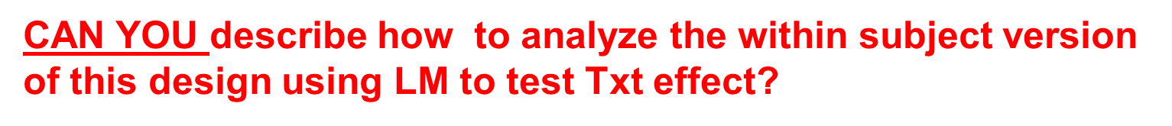
Repeated Measures Designs: An Example
Now pretend the original data were from same subjects
SubID Cond Time
1 1 Con 180
2 2 Con 190
3 3 Con 200
4 4 Con 220
5 5 Con 240
6 6 Con 200
7 7 Con 300
8 1 Exp 170
9 2 Exp 190
10 3 Exp 180
11 4 Exp 220
12 5 Exp 220
13 6 Exp 200
14 7 Exp 280

Slide 16
Repeated Measures Designs: An Example
SubID TimeCon TimeTxt Diff
1 1 180 170 -10
2 2 190 190 0
3 3 200 180 -20
4 4 220 220 0
5 5 240 220 -20
6 6 200 200 0
7 7 300 280 -20
#FIRST CONVERT TO WIDE FORMAT (LAB)
dW$Diff = (dW$TimeTxt - dW$TimeCon)
mDiff = lm(Diff ~ 1, data=dW)
modelSummary(mDiff)
Coefficients:
Estimate Std. Error t value Pr(>|t|)
(Intercept) -10.00 3.78 -2.646 0.0382 *
-----------
Sum of squared errors (SSE): 600.0, Error df: 6
R-squared: 0.0000
On average, the marathon times are 10 minutes faster (lower) in the Txt condition vs. the Con condition

Slide 17
Repeated Measures Designs: An Example
SubID TimeCon TimeTxt Diff Avg
1 1 180 170 -10 175
2 2 190 190 0 190
3 3 200 180 -20 190
4 4 220 220 0 220
5 5 240 220 -20 230
6 6 200 200 0 200
7 7 300 280 -20 290
dW$Avg = (dW$TimeTxt + dW$TimeCon)/2
mAvg = lm(Avg ~ 1, data=dW)
modelSummary(mAvg)
Coefficients:
Estimate Std. Error t value Pr(>|t|)
(Intercept) 213.57 14.59 14.64 6.37e-06 ***
-----
Sum of squared errors (SSE): 8935.7, Error df: 6
R-squared: 0.0000
The intercept of this model tests if the average marathon time is 0. Not an interesting question in this instance.

Slide 18
Repeated Measures Designs: An Example
SubID TimeCon TimeTxt Diff Avg
1 1 180 170 -10 175
2 2 190 190 0 190
3 3 200 180 -20 190
4 4 220 220 0 220
5 5 240 220 -20 230
6 6 200 200 0 200
7 7 300 280 -20 290
Coefficients:
Estimate Std. Error t value Pr(>|t|)
(Intercept) -10.00 3.78 -2.646 0.0382 *
How can you increase power to test the Txt effect in the Difference model?
Increase N
Increase effect of Txt
Decrease variance in the DIFFERENCE (How?)
Add covariate that explains variance in the DIFFERENCE (what would you call this effect in statistical terms)

Slide 19
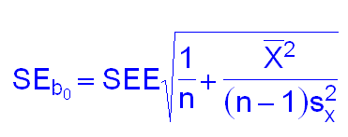
Repeated Measures Designs: A Detailed Review
SubID TimeCon TimeTxt Diff Avg
1 1 180 170 -10 175
2 2 190 190 0 190
3 3 200 180 -20 190
4 4 220 220 0 220
5 5 240 220 -20 230
6 6 200 200 0 200
7 7 300 280 -20 290
Coefficients:
Estimate Std. Error t value Pr(>|t|)
(Intercept) -10.00 3.78 -2.646 0.0382 *
--------
Sum of squared errors (SSE): 600.0, Error df: 6
R-squared: 0.0000
t = b₀ / SE_{b0}
= S_{DIFF}
√N
SEE = sqrt(SSE/(N-P))

Slide 20
Repeated Measures Designs: A Detailed Review
Reducing variance in the difference score….
SubID TimeCon TimeTxt Diff
1 1 180 170 -10
2 2 190 185 -5
3 3 200 185 -15
4 4 220 215 -5
5 5 240 225 -15
6 6 200 195 -5
7 7 300 285 -15
Coefficients:
Estimate Std. Error t value Pr(>|t|)
(Intercept) -10.00 1.89 -5.292 0.00184 **
Sum of squared errors (SSE): 150.0, Error df: 6
R-squared: 0.0000

Slide 21
Repeated Measures Designs: A Detailed Review
One between and one within subject variable
SubID Group Txt Time
1 1 College TimeCon 130
2 2 College TimeCon 135
3 3 College TimeCon 140
4 4 College TimeCon 135
5 5 College TimeCon 135
6 6 Recreation TimeCon 180
7 7 Recreation TimeCon 200
8 8 Recreation TimeCon 240
9 9 Recreation TimeCon 220
10 10 Recreation TimeCon 260
11 1 College TimeTxt 130
12 2 College TimeTxt 130
13 3 College TimeTxt 130
14 4 College TimeTxt 125
15 5 College TimeTxt 135
16 6 Recreation TimeTxt 170
17 7 Recreation TimeTxt 190
18 8 Recreation TimeTxt 225
19 9 Recreation TimeTxt 200
20 10 Recreation TimeTxt 240

Slide 22
Repeated Measures Designs: A Detailed Review
CAN YOU describe how to test if there was a treatment effect using LM if you ignored Group
SubID Group Txt Time
1 1 College TimeCon 130
2 2 College TimeCon 135
3 3 College TimeCon 140
4 4 College TimeCon 135
5 5 College TimeCon 135
6 6 Recreation TimeCon 180
7 7 Recreation TimeCon 200
8 8 Recreation TimeCon 240
9 9 Recreation TimeCon 220
10 10 Recreation TimeCon 260
11 1 College TimeTxt 130
12 2 College TimeTxt 130
13 3 College TimeTxt 130
14 4 College TimeTxt 125
15 5 College TimeTxt 135
16 6 Recreation TimeTxt 170
17 7 Recreation TimeTxt 190
18 8 Recreation TimeTxt 225
19 9 Recreation TimeTxt 200
20 10 Recreation TimeTxt 240

Slide 23
Repeated Measures Designs: A Detailed Review
SubID Group TimeCon TimeTxt Diff
1 1 College 130 130 0
2 2 College 135 130 -5
3 3 College 140 130 -10
4 4 College 135 125 -10
5 5 College 135 135 0
6 6 Recreation 180 170 -10
7 7 Recreation 200 190 -10
8 8 Recreation 240 225 -15
9 9 Recreation 220 200 -20
10 10 Recreation 260 240 -20
Convert data to wide format
Calculate the difference scores
Regress the difference scores on 1 (intercept only model)
Test if intercept in this difference score model is non-zero

Slide 24
Repeated Measures Designs: A Detailed Review
SubID Group TimeCon TimeTxt Diff
1 1 College 130 130 0
2 2 College 135 130 -5
3 3 College 140 130 -10
4 4 College 135 125 -10
5 5 College 135 135 0
6 6 Recreation 180 170 -10
7 7 Recreation 200 190 -10
8 8 Recreation 240 225 -15
9 9 Recreation 220 200 -20
10 10 Recreation 260 240 -20
mDiff = lm(Diff ~ 1, data = dw3)
summary(mDiff)
Coefficients:
Estimate Std. Error t value Pr(>|t|)
(Intercept) -10.000 2.236 -4.472 0.00155 **

Slide 25
Repeated Measures Designs: A Detailed Review
SubID Group TimeCon TimeTxt Diff
1 1 College 130 130 0
2 2 College 135 130 -5
3 3 College 140 130 -10
4 4 College 135 125 -10
5 5 College 135 135 0
6 6 Recreation 180 170 -10
7 7 Recreation 200 190 -10
8 8 Recreation 240 225 -15
9 9 Recreation 220 200 -20
10 10 Recreation 260 240 -20
What additional benefits are obtained by knowing Group membership
Can test if Group moderates treatment effect
Can test for Group main effect
Including (controlling for) Group will provide more powerful test of treatment effect (why?)

Slide 26
Repeated Measures Designs: A Detailed Review
mDiff = lm(Diff ~ 1, data = dW)
modelSummary(mDiff)
Coefficients:
Estimate Std. Error t value Pr(>|t|)
(Intercept) -10.000 2.236 -4.472 0.00155 **
--------
Sum of squared errors (SSE): 450.0, Error df: 9
R-squared: 0.0000
mDiff = lm(Diff ~ cGroup, data = dW)
modelSummary(mDiff)
Coefficients:
Estimate Std. Error t value Pr(>|t|)
(Intercept) -10.000 1.581 -6.325 0.000227 ***
cGroup -10.000 3.162 -3.162 0.013349 *
-----
Sum of squared errors (SSE): 200.0, Error df: 8
R-squared: 0.5556

Slide 27
And now on to new approach…..
An Alternative Approach to Repeated Measures (in some cases)

Slide 28
Group X Pre- Post Design
Examine the effects of CBT on psychosocial functioning among alcoholics.
Measure functioning pre-treatment.
Randomly assign to CBT vs. Social Support (control txt)
Measure functioning post-treatment
There are two relevant variables: Treatment group (CBT vs. Control) and time (Pre-treatment vs. post-treatment)
What do you expect to see if Treatment is effective? What other relationships (or lack thereof) do you expect among the IVs and the DV?

Slide 29
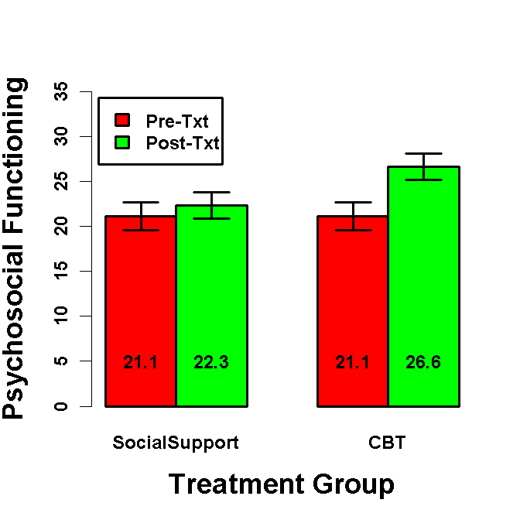
Group X Pre- Post Design
We might predict that improvement (post – pre) in functioning would be greater in the CBT group than the control.
An alternative (conceptually but not statistically equivalent) is that the Treatment groups differ in functioning at post-treatment after controlling for (spurious?) pre-treatment differences
The treatment groups should not differ systematically on pre-treatment scores because participants are randomly assigned to treatment group.

Slide 30
Group X Pre- Post Design
How would you test the Treatment Group X Time interaction in LM?
Regress the post-txt vs. pre-txt difference score on Group. Test of Group coefficient indicates if the two groups differ on the pre-test to post-test change.
mDiff = lm(Post - Pre ~ cGroup,data=dCBT)
Coefficients:
Estimate Std. Error t value Pr(>|t|)
(Intercept) 3.353 1.366 2.454 0.0159
cGroup 4.290 2.733 1.570 0.1197

Slide 31
Repeated Measures vs. Difference score
ANCOVA analysis provides an alternative approach to analyzing this design. How do you conduct this ANCOVA in regression?
Regress Post scores on Group and Pre scores. Test for Group effect. What is the interpretation of each coefficient?
mCBT = lm(Post ~ cGroup + Pre, data=dCBT)
Coefficients:
Estimate Std. Error t value Pr(>|t|)
(Intercept) 19.01619 2.46595 7.711 1.10e-11
cGroup 4.29000 2.03795 2.105 0.0379
Pre 0.15656 0.09478 1.652 0.1018
Residual standard error: 10.19 on 97 degrees of freedom
Multiple R-squared: 0.06874, Adjusted R-squared: 0.04954
F-statistic: 3.58 on 2 and 97 DF, p-value: 0.03162

Slide 32
Repeated Measures vs. Difference score
Is “ANCOVA” approach to Group X Pre/Post design statistically equivalent to the Repeated Measures (LM) approach?
No. What is similar/same vs. what is different?
mCBT = lm(Post ~ cGroup + Pre, data=dCBT)
Coefficients:
Estimate Std. Error t value Pr(>|t|)
(Intercept) 19.01619 2.46595 7.711 1.10e-11
cGroup 4.29000 2.03795 2.105 0.0379
Pre 0.15656 0.09478 1.652 0.1018
mDiffSS = lm(Post-Pre ~ cGroup, data=dCBT)
Coefficients:
Estimate Std. Error t value Pr(>|t|)
(Intercept) 3.353 1.366 2.454 0.0159
cGroup 4.290 2.733 1.570 0.120

Slide 33
Difference score vs. ANCOVA
Regress Post-Pre Difference on Group
(Post - Pre) = b₀ + b₁cGroup
Post = b₀ + b₁cGroup + 1*Pre
Coefficients:
Estimate Std. Error t value Pr(>|t|)
(Intercept) 1.208 1.932 0.625 33
cGroup 4.290 2.733 1.570 0.120
Regress Post on Group and Pre
Post = b₀ + b₁cGroup + b₂Pre
Coefficients:
Estimate Std. Error t value Pr(>|t|)
(Intercept) 19.01619 2.46595 7.711 1.10e-11
cGroup 4.29000 2.03795 2.105 0.0379
Pre 0.15656 0.09478 1.652 0.1018
Why is ANCOVA approach more powerful?
These two models are equivalent except for b₂ vs. the implied coefficient of 1.0 for difference score approach. Regression determines coefficients that minimize SSE relative to any other values. SSE affects the standard error of the group effect.

Slide 34
Difference score vs. ANCOVA
Post = b₀ + b₁Group + b₂Pre
When there are no Group systematic differences on Pre (as expected if participants are randomly assigned to Group and Pre is measured before assignment), ANCOVA approach will be more powerful on average than repeated measures/difference approach.
Why is this not true if there are Group differences on Pre?
If Group and Pre are correlated (i.e., group difference on Pre), controlling Pre will (incorrectly) reduce the group effect. The estimate of the Group effect will be biased (e.g., underestimated).
How does the relationship between Pre and Post affect the relative power advantage of ANCOVA?
The relative advantage of ANCOVA increases as the pre-post correlation decreases (because b₂ will be substantially lower than 1)
If pretest and posttest have the same within-group variance and r_{XY} denotes the pretest–posttest correlation within groups, then ANCOVA needs a sample size only (1 + r_{XY})/2 as large as that for repeated measures/difference score approach assuming no Group effect on pretest.

Slide 35
Difference score vs. ANCOVA
In situations where:
1: Participants are randomly assigned to a between group variable and
2: You have repeated measures (typically pre-test & post-test or similar) and
3: Pre-test is obtained before group assignment
USE ANCOVA approach
In situations where either:
All measurements are obtained after group assignment or
You are using non-manipulated IV/Groups
Use traditional repeated measures (LM) approach
YOU SHOULD KNOW THIS BEFORE YOU RUN THE EXPERIMENT!!

Slide 36
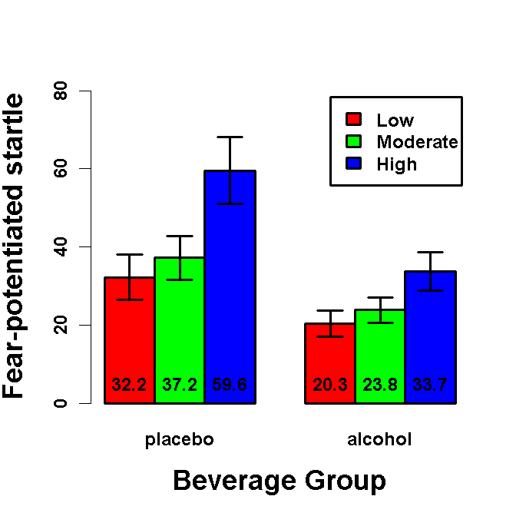
Repeated Measures GLM> 2 levels
Effect of Alcohol and Threat Intensity on Fear:
Two* Beverage Groups: Alcohol vs. Placebo
FPS measured across 3 Threat Intensities (within subjects)
Beverage Group is focal IV.

Slide 37
Repeated Measures GLM
What are all the tests you MIGHT conduct in a Beverage Group X Threat Intensity GLM
Beverage Group contrast (i.e. 1df main effect)
1df main effect contrasts for Threat Intensity
Beverage Group X Threat Intensity interaction contrasts
Simple effects of Beverage Group at each threat intensity
Simple effects of 1df contrasts for Threat Intensity in each Bev. Group

Slide 38
Repeated Measures GLM: Between Subjects Model
How do you test the main effect of Beverage Group?
Calculate mean FPS across the three within-subject levels of threat intensity. Regress mean FPS on BG2. Test of coefficient for BG2 is main effect of Beverage Group.
dDose$FPS_Mean = rowMeans(dDose[c('FPS_Low','FPS_Mod', 'FPS_Hi')])
mMean = lm(FPS_Mean ~ BG2,data=dDose)
Coefficients:
Estimate Std. Error t value Pr(>|t|)
(Intercept) 34.468 3.532 9.758 9.09e-16
BG2Alc vs. Pla -17.055 7.064 -2.414 0.0178

Slide 39
Repeated Measures GLM: Between Subjects Model
How do you test the simple effects of Beverage Group at each threat intensity (and when are you permitted to do this)?
Regress FPS_Low, FPS_Mod, FPS_Hi on BG2 in separate models. BG2 coefficient is test of simple effect of Beverage Group at each threat intensity. Only can test if relevant interaction contrasts are significant. May want to correct for alpha inflation. May not need.
mLow = lm(FPS_Low ~ BG2,data=dDose)
Coefficients:
Estimate Std. Error t value Pr(>|t|)
(Intercept) 26.28 3.36 7.822 9.5e-12
BG2Alc vs. Pla -11.90 6.72 -1.771 0.08
mMod = lm(FPS_Mod ~ BG2,data=dDose)
Coefficients:
Estimate Std. Error t value Pr(>|t|)
(Intercept) 30.516 3.265 9.345 6.59e-15
BG2Alc vs. Pla -13.367 6.531 -2.047 0.0436
mHi = lm(FPS_Hi ~ BG2,data=dDose)
Coefficients:
Estimate Std. Error t value Pr(>|t|)
(Intercept) 46.610 4.895 9.522 2.82e-15
BG2Alc vs. Pla -25.900 9.790 -2.646 0.00963

Slide 40
Repeated Measures GLM: 1df Within Subject Models
How do you test within subject 1df threat contrasts and BG x Threat interaction contrasts? For instance, low vs. mod and low/mod vs. hi threat contrasts
Create difference scores for each contrast. Regress each difference score on BG2 (centered). Test of intercept is 1df contrast for threat. Test of BG2 is BG2 X 1df threat interaction contrast.

Slide 41
Repeated Measures GLM: 1df Within Subject Models
Threat: Mod vs. Low
dDose$FPS_MvL = dDose$FPS_Mod - dDose$FPS_Low
mMvL = lm(FPS_MvL ~ BG2,data=dDose)
Coefficients:
Estimate Std. Error t value Pr(>|t|)
(Intercept) 4.237 2.252 1.881 0.0632
BG2Alc vs. Pla -1.467 4.505 -0.326 0.7454
1df threat contrast
FPS is 4.2µV greater during moderate vs. low intensity shock threat
1df BG2 X Threat interaction contrast
Alcohol reduces FPS 1.5µV more during moderate vs. low intensity shock. [Remember the simple effect of alcohol was -13.4 during moderate shock and -11.9 during low shock

Slide 42
Repeated Measures GLM: 1df Within Subject Models
Threat: Hi vs. Mod/Low
dDose$FPS_HvML = dDose$FPS_Hi - (dDose$FPS_Mod + dDose$FPS_Low)/2
mHvML = lm(FPS_HvML ~ BG2,data=dDose)
Coefficients:
Estimate Std. Error t value Pr(>|t|)
(Intercept) 18.213 2.987 6.098 2.63e-08
BG2Alc vs. Pla -13.267 5.973 -2.221 0.0289
1df threat contrast
FPS is 18.2µV greater during High vs. the mean of moderate & low intensity shock threat
1df BG2 X Threat interaction contrast
Alcohol reduces FPS 13.3µV more during High vs. moderate/low intensity shock.

Slide 43
Repeated Measures GLM: 1df Within Subject Models
How do you test the simple 1df threat effects, separately in alcohol vs. placebo groups. When can you do this?
Recode BG2 using dummy codes. Intercept is simple 1df threat effect in group coded as reference level. For example, the simple Mod vs. Low 1df threat effect in placebo group is tested by intercept below. Only justified again if the relevant interaction contrasts are significant. May need to correct for alpha inflation. May not want
contrasts(dDose$BG2) = lm.setContrasts(dDose$BG2, Type='DUMMY', RefLevel=1)
alcohol_v_placebo
placebo 0
alcohol 1
mMvL = lm(FPS_MvL ~ BG2,data=dDose)
Coefficients:
Estimate Std. Error t value Pr(>|t|)
(Intercept) 4.970 3.901 1.274 0.206
BG2alcohol_v_placebo -1.467 4.505 -0.326 0.745

Slide 44
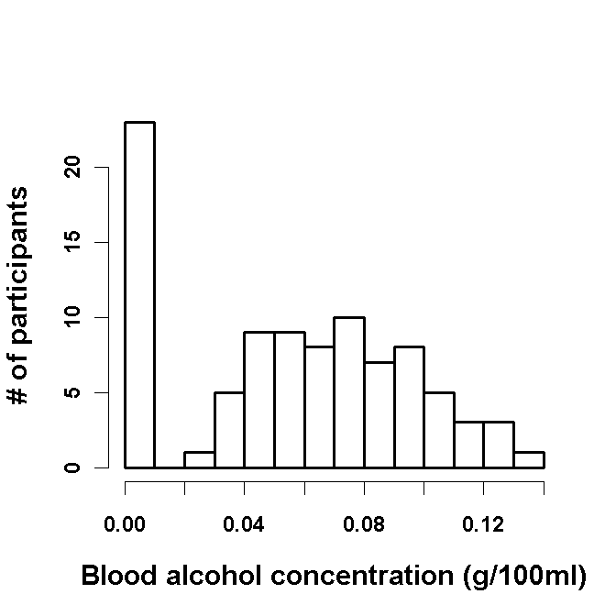
Quantitative Beverage Group

Slide 45
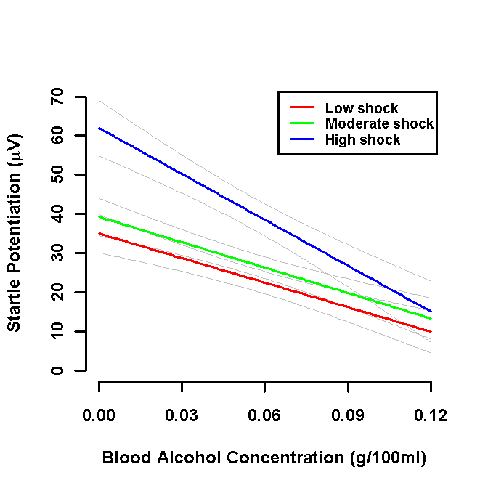
Quantitative Beverage Group

Slide 46
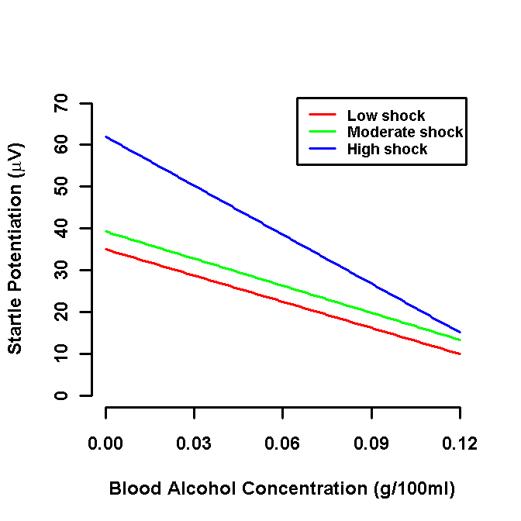
Quantitative IV: Between Subjects Main Effect
dDose$FPS_Mean = rowMeans(dDose[c('FPS_Low','FPS_Mod', 'FPS_Hi')])
mMean = lm(FPS_Mean ~ BAC,data=dDose)
Coefficients:
Estimate Std. Error t value Pr(>|t|)
(Intercept) 45.394 5.112 8.880 6.12e-14 ***
BAC -271.981 74.789 -3.637 0.00046 ***

Slide 47
Quantitative IV: Between Subjects Simple Effects
mLow = lm(FPS_Low ~ BAC,data=dDose)
Coefficients:
Estimate Std. Error t value Pr(>|t|)
(Intercept) 34.973 4.908 7.126 2.48e-10 ***
BAC -208.943 71.806 -2.910 0.00456 **
mMod = lm(FPS_Mod ~ BAC,data=dDose)
Coefficients:
Estimate Std. Error t value Pr(>|t|)
(Intercept) 39.24 4.77 8.227 1.38e-12 ***
BAC -216.14 69.78 -3.097 0.00261 **
mHi = lm(FPS_Hi ~ BAC,data=dDose)
Coefficients:
Estimate Std. Error t value Pr(>|t|)
(Intercept) 61.964 7.095 8.734 1.23e-13 ***
BAC -390.857 103.795 -3.766 0.000296 ***

Slide 48
Quantitative IV: 1DF Threat Effects
Moderate vs. Low shock:
1df Threat contrast (at BAC=0) and 1df BAC x Threat contrast
dDose$FPS_MvL = dDose$FPS_Mod - dDose$FPS_Low
mMvL = lm(FPS_MvL ~ BAC,data=dDose)
Coefficients:
Estimate Std. Error t value Pr(>|t|)
(Intercept) 4.272 3.385 1.262 0.210
BAC -7.199 49.519 -0.145 0.885

Slide 49
Quantitative IV: 1DF Threat Effects
High vs. Moderate/Low shock:
1df Threat contrast (at BAC=0) and 1df BAC x Threat contrast
dDose$FPS_HvML = dDose$FPS_Hi - (dDose$FPS_Mod + dDose$FPS_Low)/2
mHvML = lm(FPS_HvML ~ BAC,data=dDose)
Coefficients:
Estimate Std. Error t value Pr(>|t|)
(Intercept) 24.855 4.424 5.618 2.14e-07 ***
BAC -178.314 64.730 -2.755 0.00711 **

Slide 50
Quantitative IV: 1DF Threat Effects
High vs. Moderate/Low shock:
1df Threat contrast (at mean BAC) and 1df BAC x Threat contrast
dDose$cBAC = dDose$BAC - mean(dDose$BAC)
mHvML = lm(FPS_HvML ~ cBAC,data=dDose)
Coefficients:
Estimate Std. Error t value Pr(>|t|)
(Intercept) 14.896 2.551 5.840 8.2e-08 ***
cBAC -178.314 64.730 -2.755 0.00711 **

