Slide 1
Unit 21 – The Analysis of within-subject variables (Part 3)
Today: Let's formalize the approach

Slide 2
Let's formalize the approach
Reminder of simple regression:
Y = b₀ + b₁X ;
Y = b₀ + b₁X + e ;
Y_{i} = b₀ + b₁X_{i} + e_{i} ;
i = 1, 2, 3, …, N (one number per participant)
Note: b₀ and b₁ do not have subscript i
Y_{i} = β₀ + β₁X_{i} + e_{i} ;
Note: β₀ and β₁ refer to population parameters. Sometimes, standardized regression coefficients are called "betas". Not here!

Slide 3
Formalization
Prestige
Liking
Neighborhood

Slide 4
d$prestigeC <- varRecode(d$prestige, c(1,2), c(-.5,.5))
d$neighbC <- d$neighb - mean(d$neighb)
d$id <- as.factor(d$id)
mod2 <- lmer(like ~ prestigeC * neighbC + (1 + prestigeC|id), data=d)
summary(mod2)
Anova(mod2, type = 3, test = "F")
Fixed effects:
Estimate Std. Error t value
(Intercept) 5.62500 0.41126 13.677
prestigeC 1.15000 0.43508 2.643
neighbC 0.02415 0.20212 0.120
prestigeC:neighbC 0.62560 0.21383 2.926
Response: like
F Df Df.res Pr(>F)
(Intercept) 187.0715 1 18 5.977e-11 ***
prestigeC 6.9866 1 18 0.016524 *
neighbC 0.0143 1 18 0.906200
prestigeC:neighbC 8.5599 1 18 0.009029 **

Slide 5
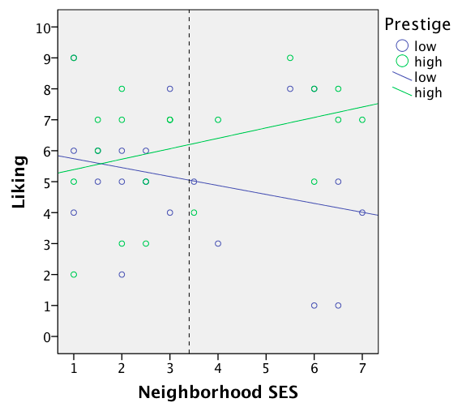

Slide 6
Formalization
How did we get these values?
A three-step process:
1) We ran 20 regression analyses (one per participant) in which we regressed liking on prestige centered (each analysis had an N of 2).
2) We then ran one regression analysis in which we regressed the 20 prestige slopes (b_{1j}) on neighborhood centered (N = 20).
3) Finally, we ran another regression analysis in which we regressed the 20 prestige intercepts (b_{0j}) on neighborhood centered (N = 20).

Slide 7
Formalization
There are two levels:
Level 1: Stimuli (cars)
Level 2: Participants (subjects)
Stimuli are said to be crossed with participants.
Participants are sometimes referred to as the "grouping variable" (the variable that causes the non-independence).

Slide 8
Formalization
We first ran a series of level-1 models (one per participant):
like = b₀ + b₁prestigeC ;
We end up with 20 intercepts (b_{0j}) and 20 slopes (b_{1j}).
Y = b₀ + b₁X ;
Y_{i} = b₀ + b₁X_{i} + e_{i} ;
Y_{ij} = b_{0j} + b_{1j}X_{ij} + e_{ij} ;
i = 1, 2 (one number per stimulus)
j = 1, 2, 3, …, 20 (one number per participant)
Y_{ij} = β_{0j} + β_{1j}X_{ij} + e_{ij} ;

Slide 9
Formalization
We then ran two level-2 models, one with the slopes and one with the intercepts as DV.
We then ran one level-2 model with the slopes as DV (with N = # of level-2 units):
slopes = b₀ + b₁neighbC ;
slopes_{j} =
b₀ + b₁neighbC + e_{j} ;
intercepts_{j} =
b₀ + b₁neighbC + e_{j} ;
b_{1j} = b₀ + b₁Z_{j} + e_{j} ;
b_{0j} = b₀ + b₁Z_{j} + e_{j} ;
b_{1j} = g₀ + g₁Z_{j} + u_{j} ;
b_{0j} = g₀ + g₁Z_{j} + u_{j} ;
b_{1j} = g₁₀ + g₁₁Z_{j} + u_{1j} ;
b_{0j} = g₀₀ + g₀₁Z_{j} + u_{0j} ;
β_{1j} = γ₁₀ + γ₁₁Z_{j} + u_{1j} ;
β_{0j} = γ₀₀ + γ₀₁Z_{j} + u_{0j} ;

Slide 10
Formalization
slopes_{j} =
b₀ + b₁neighbC + e_{j} =
1.15 + .626*neighbC
+ e_{j} ;
intercepts_{j} =
b₀ + b₁neighbC + e_{j} =
5.625 + .024*neighbC
+ e_{j} ;

Slide 11
d$prestigeC <- varRecode(d$prestige, c(1,2), c(-.5,.5))
d$neighbC <- d$neighb - mean(d$neighb)
d$id <- as.factor(d$id)
mod2 <- lmer(like ~ prestigeC * neighbC + (1 + prestigeC|id), data=d)
summary(mod2)
Anova(mod2, type = 3, test = "F")
Fixed effects:
Estimate Std. Error t value
(Intercept) 5.62500 0.41126 13.677
prestigeC 1.15000 0.43508 2.643
neighbC 0.02415 0.20212 0.120
prestigeC:neighbC 0.62560 0.21383 2.926
Response: like
F Df Df.res Pr(>F)
(Intercept) 187.0715 1 18 5.977e-11 ***
prestigeC 6.9866 1 18 0.016524 *
neighbC 0.0143 1 18 0.906200
prestigeC:neighbC 8.5599 1 18 0.009029 **

Slide 12
Formalization
slopes_{j} =
b₀ + b₁neighbC + e_{j} =
1.15 + .626*neighbC
+ e_{j} ;
intercepts_{j} =
b₀ + b₁neighbC + e_{j} =
5.625 + .024*neighbC
+ e_{j} ;
β_{1j} = γ₁₀ + γ₁₁Z_{j} + u_{1j} =
1.15 + .626*Z_{j} + u_{1j} ;
β_{0j} = γ₀₀ + γ₀₁Z_{j} + u_{0j} =
5.625 + .024*Z_{j} + u_{0j} ;
Participant #1 (j = 1):
Participant #1 (j = 1):
-1 = 1.15 + .626(–2.4)
– .649 ;
5.5 = 5.625 + .024(–2.4) – .067 ;

Slide 13
Formalization
Our level-1 model (one per participant):
Y_{ij} = β_{0j} + β_{1j}X_{ij} + e_{ij} ;
Our level-2 models:
β_{1j} = γ₁₀ + γ₁₁Z_{j} + u_{1j} ;
β_{0j} = γ₀₀ + γ₀₁Z_{j} + u_{0j} ;
Y_{ij} = β_{0j} + β_{1j}X_{ij} + e_{ij} =
= (γ₀₀ + γ₀₁Z_{j} + u_{0j}) + (γ₁₀ + γ₁₁Z_{j} + u_{1j})X_{ij} + e_{ij} =
= γ₀₀ + γ₀₁Z_{j} + u_{0j} + γ₁₀X_{ij} + γ₁₁X_{ij}Z_{j} + u_{1j}X_{ij} + e_{ij} =
= γ₀₀ + γ₁₀X_{ij} + γ₀₁Z_{j} + γ₁₁X_{ij}Z_{j} + u_{0j} + u_{1j}X_{ij} + e_{ij} ;

Slide 14
Formalization
Our level-1 model (one per participant):
like_{ij} = β_{0j} + β_{1j}prestigeC_{ij} + e_{ij} ;
Our level-2 models:
β_{1j} = γ₁₀ + γ₁₁neighbC_{j}
+ u_{1j} ;
β_{0j} = γ₀₀ + γ₀₁neighbC_{j}
+ u_{0j} ;
like_{ij} = β_{0j} + β_{1j}prestigeC_{ij} + e_{ij} =
= γ₀₀ + γ₁₀prestigeC_{ij} + γ₀₁neighbC_{j} +
γ₁₁(prestigeC_{ij}*neighbC_{j}) + u_{0j} +
u_{1j}prestigeC_{ij} + e_{ij} ;

Slide 15
Formalization
like_{ij} = γ₀₀ + γ₁₀prestigeC_{ij} + γ₀₁neighbC_{j} +
γ₁₁(prestigeC_{ij}*neighbC_{j}) + u_{0j} +
u_{1j}prestigeC_{ij} + e_{ij} ;
Participant #1, low prestige car (j = 1, i = 1):
6 = 5.625 + 1.15(–.5) + .024(-2.4) +
.626(–.5)(–2.4) + (–.067) +
(–.649)(–.5) + 0 ;

Slide 16
Formalization
like_{ij} =
γ₀₀ +
γ₁₀prestigeC_{ij} +
γ₀₁neighbC_{j} +
γ₁₁(prestigeC_{ij}*neighbC_{j}) +
u_{0j} +
u_{1j}prestigeC_{ij} +
e_{ij} ;
intercept
effect of prestige
effect of neighborh.
interaction
random intercept
random slope
error (residual)
fixed
effects
random
effects
mod2 <- lmer(like ~ prestigeC * neighbC + (1 + prestigeC|id), data=d)
fixed effects
random effects

Slide 17
Formalization
slopes_{j} =
b₀ + b₁neighbC + e_{j} =
1.15 + .626*neighbC
+ e_{j} ;
intercepts_{j} =
b₀ + b₁neighbC + e_{j} =
5.625 + .024*neighbC
+ e_{j} ;
β_{1j} = γ₁₀ + γ₁₁Z_{j} + u_{1j} =
1.15 + .626*Z_{j} + u_{1j} ;
β_{0j} = γ₀₀ + γ₀₁Z_{j} + u_{0j} =
5.625 + .024*Z_{j} + u_{0j} ;
Participant #1 (j = 1):
Participant #1 (j = 1):
-1 = 1.15 + .626(–2.4)
– .649 ;
5.5 = 5.625 + .024(–2.4) – .067 ;

Slide 18
Formalization
Questions?

Slide 19
Two within-subject variables
Prestige
Liking
Context
Prestige and context are both dichotomous within-subject variables (coded 1 and 2)

Slide 20
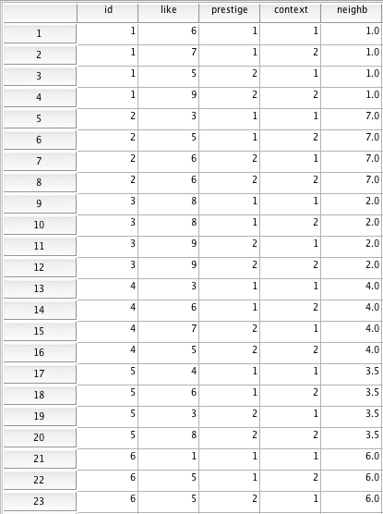
80 observations
20 participants
Observations
are non-
independent!

Slide 21
> d <- dfReadDat ("data cars 3 long.dat")
> varDescribe(d)
var n mean sd median min max skew kurtosis
id 1 80 10.5 5.80 10.50 1 20 0.00 -1.25
like 2 80 6.3 1.97 6.00 1 9 -0.51 -0.26
prestige 3 80 1.5 0.50 1.50 1 2 0.00 -2.02
context 4 80 1.5 0.50 1.50 1 2 0.00 -2.02
neighb 5 80 3.4 2.05 2.75 1 7 0.50 -1.29
80 observations
20 participants

Slide 22
R script for 2 within-subject variables:
d$prestigeC <- varRecode(d$prestige, c(1,2), c(-.5,.5))
d$contextC <- varRecode(d$context, c(1,2), c(-.5,.5))
d$id <- as.factor(d$id)
mod4 <- lmer(like ~ prestigeC * contextC + (1 + prestigeC * contextC|id), data=d)
summary(mod4)
Anova(mod4, type = 3, test = "F")
R script for 1 within- and 1 between subject variable:
d$prestigeC <- varRecode(d$prestige, c(1,2), c(-.5,.5))
d$contextC <- varRecode(d$context, c(1,2), c(-.5,.5))
d$id <- as.factor(d$id)
mod3 <- lmer(like ~ prestigeC * contextC + (1 + prestigeC|id), data=d)
summary(mod3)
Anova(mod3, type = 3, test = "F")

Slide 23
> summary(mod3)
Linear mixed model fit by REML
Formula: like ~ prestigeC * contextC + (1 + prestigeC * contextC | id)
Data: d
AIC BIC logLik deviance REMLdev
306.1 341.8 -138 273.9 276.1
Random effects:
Groups Name Variance Std.Dev. Corr
id (Intercept) 1.82031 1.34919
prestigeC 2.07863 1.44174 -0.398
contextC 1.54442 1.24275 -0.593 0.320
prestigeC:contextC 4.65137 2.15670 0.403 -0.445 0.322
Residual 0.26085 0.51073
Number of obs: 80, groups: id, 20
Fixed effects:
Estimate Std. Error t value
(Intercept) 6.3000 0.3070 20.518
prestigeC 0.9500 0.3420 2.778
contextC 1.4000 0.3004 4.660
prestigeC:contextC -0.3000 0.5336 -0.562
Correlation of Fixed Effects:
(Intr) prstgC cntxtC
prestigeC -0.368
contextC -0.539 0.279
prstgC:cntC 0.358 -0.379 0.269

Slide 24
> Anova(mod3, type = 3, test = "F")
Analysis of Deviance Table (Type III Wald F tests with Kenward-Roger df)
Response: like
F Df Df.res Pr(>F)
(Intercept) 420.9958 1 19.000 1.999e-14 ***
prestigeC 7.7154 1 19.000 0.0119927 *
contextC 21.7142 1 19.000 0.0001707 ***
prestigeC:contextC 0.3161 1 19.002 0.5805379
---
Signif. codes: 0 ‘***’ 0.001 ‘**’ 0.01 ‘*’ 0.05 ‘.’ 0.1 ‘ ’ 1

Slide 25
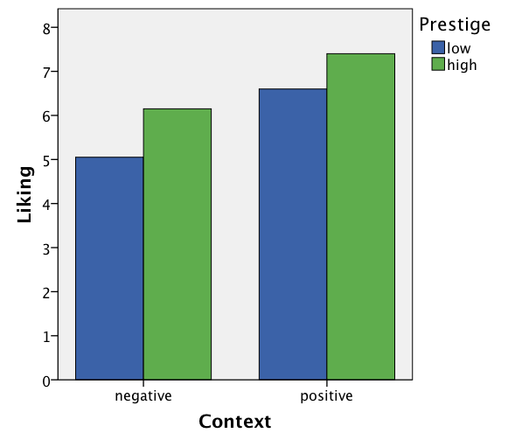

Slide 26
Conclusion
The effect of prestige is statistically significant. So is the effect of context. The interaction is not.
Our interaction hypothesis is not confirmed.
Participants like the high-prestige car significantly more than the low-prestige car, and they like the two cars significantly more when they are presented in a positive context than in a negative context.

Slide 27
The underlying math
The F-values are 7.72, 21.71, and .32. How did R compute these F-values?
Overview:
R estimates a series of regression models (one per participant)
It uses the regression coefficients in a new analysis as the dependent variable.

Slide 28
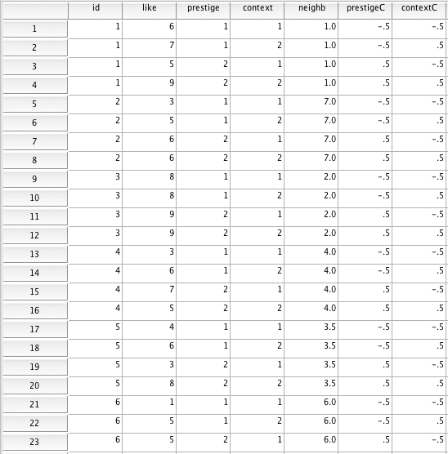

Slide 29
id = 1
id
b₀
b₁
b₂
b₃
9
9
positive
context
7
8
1
6.75
.5
2.5
3
7
6
5
6
5
negative
context
4
3
2
1
-.5
.5
low
high
Prestige
like = b₀ + b₁prestigeC + b₂contextC +
b₃(prestigeC*contextC) =
= 6.75 + .5*prestigeC + 2.5*contectC +
3(prestigeC*contextC) ;

Slide 31
id = 2
id
b₀
b₁
b₂
b₃
9
positive
context
8
1
6.75
.5
2.5
3
7
6
5
6
6
2
5
2
1
1
5
negative
context
3
4
3
…
3
2
1
-.5
.5
low
high
Prestige
like = b₀ + b₁prestigeC + b₂contextC +
b₃(prestigeC*contextC) =
= 5 + 2*prestigeC + 1*contectC –
2(prestigeC*contextC) ;

Slide 32
inter- inter-
liking liking liking liking cepts prestige context action
lo_prest lo_prest hi_prest hi_prest (ave.) effects effects effects
id neg_con pos_con neg_con pos_con b_{0j} b_{1j} b_{2j} b_{3j}
1 6 7 5 9 6.75 1 5 3 2 3 5 6 6 5 4 2 -2 3 8 8 9 9 8.5 2 0 0
4 3 6 7 5 5.25 3 1 -5 5 4 6 3 8 5.25 1 7 3
6 1 5 5 6 4.25 5 5 -3
7 7 7 7 5 6.5 -2 -2 -2
8 8 9 9 8 8.5 0 0 -2
9 4 5 6 8 5.75 5 3 1
10 6 8 6 9 7.25 1 5 1
11 4 6 5 9 6 4 6 2
12 3 5 5 6 4.75 3 3 -1
13 9 8 9 8 8.5 0 -2 0
14 3 6 6 9 6 6 6 0
15 6 8 3 6 5.75 -5 5 1
16 1 6 7 7 5.25 7 5 -5
17 8 8 7 9 8 0 2 2
18 8 7 8 9 8 2 0 2 19 3 5 6 6 5 4 2 -2
20 6 7 4 6 5.75 -3 3 1

Slide 33
Main effect of prestige?
Do a one-sample t-test to test if the 20 prestige effect scores (the b_{1j}'s) are reliably different from zero.
M = .95, F(1,19) = 7.72, t(19) = 2.78, p < .02 ;
Main effect of context?
Do a one-sample t-test to test if the 20 context effect scores (the b_{2j}'s) are reliably different from zero.
M = 1.40, F(1,19) = 21.71, t(19) = 4.66, p < .001 ;

Slide 34
The prestige by context interaction?
Do a one-sample t-test to test if the 20 interaction scores (the b_{3j}'s) are reliably different from zero.
M = –.30, F(1,19) = .32, t(19) = .56, p = .58 ;
All these tests have 1 and 19 degrees of freedom!

Slide 35
The underlying math
Summary. Two-step process:
We ran a series of within-subject regression models to get one prestige effect score, one context effect score, and one interaction score for each participant
We then tested whether each of these scores were reliably different from zero across participants (N = 20)
Questions?

Slide 36
Within-subject variables
Prestige
Liking
Neighborhood
Context
Prestige and context vary within subjects, neighborhood varies between subjects.

Slide 37
R script for 2 within- and 1 between-subject variables:
d <- dfReadDat ("data cars 3 long.dat")
varDescribe(d)
d$id <- as.factor(d$id)
d$neighbC <- scale(d$neighb, scale=F)
d$prestigeC <- varRecode(d$prestige, c(1,2), c(-.5,.5))
d$contextC <- varRecode(d$context, c(1,2), c(-.5,.5))
mod5 <- lmer(like ~ prestigeC * contextC * neighbC + (1 + prestigeC *
contextC|id), data=d)
summary(mod5)
Anova(mod5, type = 3, test = "F")
R script for 1 within- and 2 between-subject variables:
mod3 <- lmer(like ~ prestigeC * contextC * neighbC + (1 + prestigeC|id),
data=d)

Slide 38
Fixed effects:
Estimate Std. Error t value
(Intercept) 6.300000 0.300356 20.975
prestigeC 0.950000 0.321712 2.953
contextC 1.400000 0.308669 4.536
neighbC -0.201087 0.147617 -1.362
prestigeC:contextC -0.300000 0.470427 -0.638
prestigeC:neighbC 0.294686 0.158113 1.864
contextC:neighbC -0.002415 0.151703 -0.016
prestigeC:contextC:neighbC -0.586957 0.231202 -2.539
Response: like
F Df Df.res Pr(>F)
(Intercept) 439.9542 1 18.000 4.228e-14 ***
prestigeC 8.7199 1 18.000 0.0085122 **
contextC 20.5716 1 18.000 0.0002561 ***
neighbC 1.8556 1 18.000 0.1899328
prestigeC:contextC 0.4067 1 18.002 0.5316873
prestigeC:neighbC 3.4736 1 18.000 0.0787512 .
contextC:neighbC 0.0003 1 18.000 0.9874715
prestigeC:contextC:neighbC 6.4450 1 18.002 0.0205786 *
All tests have 1 and 18 degrees of freedom ; F(1,18) = …

Slide 39
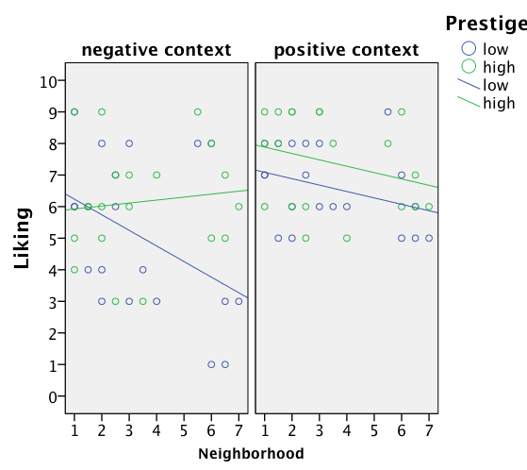

Slide 40
Conclusion
The effect of prestige and context are statistically significant. These effects are qualified by a significant three-way interaction between prestige, context, and neighborhood.

Slide 41
Comparison of R scripts
R script for centering all IVs:
d$neighbC <- scale(d$neighb, scale=F)
d$prestigeC <- varRecode(d$prestige, c(1,2), c(-.5,.5))
d$contextC <- varRecode(d$context, c(1,2), c(-.5,.5))
R script for 3 between-subject variables:
mod3prep <- lm(like ~ prestigeC * neighbC * contextC, data=d)
modelSummary(mod3prep)
modelEffectSizes(mod3prep)
R script for 1 within- and 2 between-subject variables:
d$id <- as.factor(d$id)
mod3 <- lmer(like ~ prestigeC * contextC * neighbC + (1 + prestigeC|id),
data=d)
summary(mod3)
Anova(mod3, type = 3, test = "F")
R script for 2 within- and 1 between-subject variables:
d$id <- as.factor(d$id)
mod5 <- lmer(like ~ prestigeC * contextC * neighbC + (1 + prestigeC *
contextC|id), data=d)
summary(mod5)
Anova(mod5, type = 3, test = "F")

Slide 42
The underlying math
Overview:
R estimates a series of within-subject regression models (one per participant) and uses the regression coefficients from these models in a series of between-subject regression analyses.

Slide 43
id = 1
id
b₀
b₁
b₂
b₃
9
9
positive
context
7
8
1
6.75
.5
2.5
3
7
6
5
2
5
2
1
1
6
5
negative
context
4
3
…
3
2
1
-.5
.5
low
high
Prestige
like = b₀ + b₁prestigeC + b₂contextC +
b₃(prestigeC*contextC) ;

Slide 44
inter- inter-
liking liking liking liking cepts prestige context action
lo_prest lo_prest hi_prest hi_prest (ave.) effects effects effects
id neg_con pos_con neg_con pos_con b_{0j} b_{1j} b_{2j} b_{3j} neighb
1 6 7 5 9 6.75 1 5 3 1
2 3 5 6 6 5 4 2 -2 7
3 8 8 9 9 8.5 2 0 0 2
4 3 6 7 5 5.25 3 1 -5 4
5 4 6 3 8 5.25 1 7 3 3.5
6 1 5 5 6 4.25 5 5 -3 6
7 7 7 7 5 6.5 -2 -2 -2 2.5
8 8 9 9 8 8.5 0 0 -2 5.5
9 4 5 6 8 5.75 5 3 1 1.5
10 6 8 6 9 7.25 1 5 1 1.5
11 4 6 5 9 6 4 6 2 2
12 3 5 5 6 4.75 3 3 -1 6.5
13 9 8 9 8 8.5 0 -2 0 1
14 3 6 6 9 6 6 6 0 3
15 6 8 3 6 5.75 -5 5 1 2.5
16 1 6 7 7 5.25 7 5 -5 6.5
17 8 8 7 9 8 0 2 2 3
18 8 7 8 9 8 2 0 2 6
19 3 5 6 6 5 4 2 -2 2
20 6 7 4 6 5.75 -3 3 1 1

Slide 45
averages (= intercepts = b_{0j}) = g₀₀ + g₀₁*neighbC = 6.30 – .20*neighbC ;
g₀₀: Not a theoretically meaningful test!
g₀₁: The effect of neighborhood.
F(1,18) = 1.86, t(18) = 1.36, p = .19 ;
prestige effects (= b_{1j}) = g₁₀ + g₁₁*neighbC =
.95 + .29*neighbC ;
g₁₀: The effect of prestige.
F(1,18) = 8.72, t(18) = 2.95, p < .009 ;
g₁₁: The prestige by neighborhood interaction.
F(1,18) = 3.47, t(18) = 1.86, p = .08 ;

Slide 46
context effects (= b_{2j}) = g₂₀ + g₂₁*neighbC =
1.40 – .002*neighbC ;
The effect of context.
g₂₀:
F(1,18) = 20.57, t(18) = 4.54, p < .001 ;
The context by neighborhood interaction.
g₂₁:
F(1,18) = .00, t(18) = .02, p = .99 ;
interaction effects (= b_{3j}) = g₃₀ + g₃₁*neighbC =
–.30 – .59*neighbC ;
The prestige by context interaction
g₃₀:
F(1,18) = .41, t(18) = .64, p = .53 ;
The three-way interaction.
g₃₁:
F(1,18) = 6.45, t(18) = 2.54, p < .03 ;

Slide 47
Fixed effects:
Estimate Std. Error t value
(Intercept) 6.300000 0.300356 20.975
prestigeC 0.950000 0.321712 2.953
contextC 1.400000 0.308669 4.536
neighbC -0.201087 0.147617 -1.362
prestigeC:contextC -0.300000 0.470427 -0.638
prestigeC:neighbC 0.294686 0.158113 1.864
contextC:neighbC -0.002415 0.151703 -0.016
prestigeC:contextC:neighbC -0.586957 0.231202 -2.539
Response: like
F Df Df.res Pr(>F)
(Intercept) 439.9542 1 18.000 4.228e-14 ***
prestigeC 8.7199 1 18.000 0.0085122 **
contextC 20.5716 1 18.000 0.0002561 ***
neighbC 1.8556 1 18.000 0.1899328
prestigeC:contextC 0.4067 1 18.002 0.5316873
prestigeC:neighbC 3.4736 1 18.000 0.0787512 .
contextC:neighbC 0.0003 1 18.000 0.9874715
prestigeC:contextC:neighbC 6.4450 1 18.002 0.0205786 *
Questions?

Slide 48
Comparison of R scripts
R script for 3 between-subject variables:
mod3prep <- lm(like ~ prestigeC * neighbC * contextC, data=d)
modelSummary(mod3prep)
modelEffectSizes(mod3prep)
R script for 1 within- and 2 between-subject variables:
d$id <- as.factor(d$id)
mod3 <- lmer(like ~ prestigeC * contextC * neighbC + (1 + prestigeC|id),
data=d)
summary(mod3)
Anova(mod3, type = 3, test = "F")
R script for 2 within- and 1 between-subject variables:
d$id <- as.factor(d$id)
mod5 <- lmer(like ~ prestigeC * contextC * neighbC + (1 + prestigeC *
contextC|id), data=d)
summary(mod5)
Anova(mod5, type = 3, test = "F")
R script for 3 within-subject variables:
d$id <- as.factor(d$id)
mod6 <- lmer(like ~ prestigeC * contextC * neighbC + (1 + prestigeC *
contextC*neighbC|id), data=d)
summary(mod6)
Anova(mod6, type = 3, test = "F")

