Slide 1
Unit 9: Repeated Measures GLM

Slide 2
Repeated Measures GLM
How to handle repeated measures factors in linear models using difference scores
ANCOVA vs. Repeated Measures for Group X Pre-Post Designs
Multivariate and Univariate approaches to multi-df repeated measures factors in linear models
Generalizing repeated measures to include quantitative between subjects factors

Slide 3
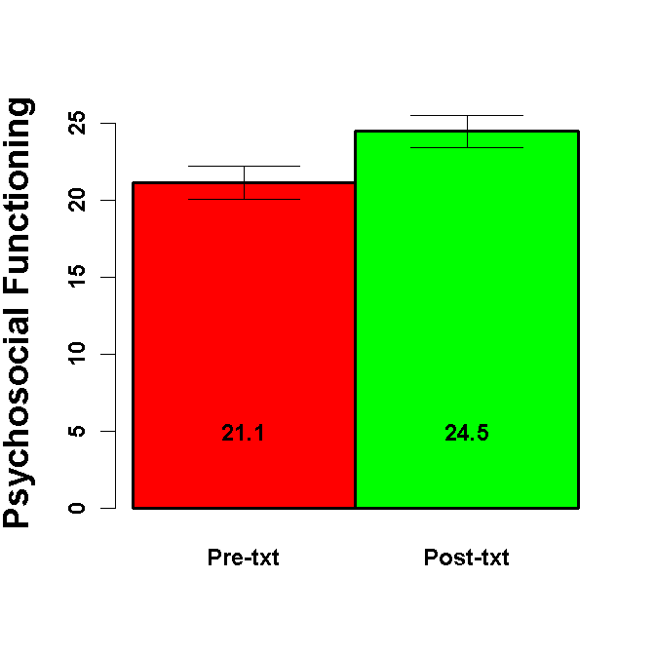
Pre- Post Design
Examine the effects of treatment on psychosocial functioning among alcoholics.
Measure functioning pre-treatment.
Measure functioning post-treatment
var n mean sd median trimmed mad min max range skew kurtosis
Group* 1 100 1.50 0.50 1.50 1.50 0.74 1.00 2.00 1.00 0.00 -2.02
Pre 2 100 21.11 10.81 20.88 21.16 12.65 1.91 41.00 39.09 -0.08 -1.17
Post 3 100 24.47 10.45 24.44 24.17 10.54 0.63 49.67 49.04 0.19 -0.47
se
Group* 0.05
Pre 1.08
Post 1.05
Pearson's product-moment correlation
data: dCBT$Pre and dCBT$Post
t = 1.6236, df = 98, p-value = 0.1077
sample estimates:
cor
0.1618478

Slide 4
Pre- Post Design
What analysis do you conduct to determine if treatment had an effect?
Paired samples t-test to determine if the post-treatment mean of the sample differed from the pre-treatment mean
t.test(dCBT$Post, dCBT$Pre, paired=TRUE)
Paired t-test
data: dCBT$Post and dCBT$Pre
t = 2.4365, df = 99, p-value = 0.01662
alternative hypothesis: true difference in means is not equal to 0
95 percent confidence interval:
0.6224791 6.0845136
sample estimates:
mean of the differences
3.353496

Slide 5
Pre- Post Design
How could you reproduce this analysis in a linear model?
Test if the mean of the difference score (post-txt – pret-txt) was different from zero. Fit a simple linear model with NO predictors. The intercept is the mean of the difference score
dCBT$TxtDiff = dCBT$Post - dCBT$Pre
mIntercept = lm(TxtDiff ~ 1,data=dCBT)
Coefficients:
Estimate Std. Error t value Pr(>|t|)
(Intercept) 3.353 1.376 2.436 0.0166
Residual standard error: 13.76 on 99 degrees of freedom

Slide 6
Pre- Post Design
head(dCBT[2:4])
Pre Post TxtDiff
1 26.27470 40.69262 14.417915
2 29.54202 26.59559 -2.946429
3 34.41847 22.00907 -12.409397
4 41.00000 26.27160 -14.728398
5 19.32441 34.64872 15.324314
6 24.53015 21.65757 -2.872579

Slide 7
Pre- Post Design
Summary(mIntercept)
Coefficients:
Estimate Std. Error t value Pr(>|t|)
(Intercept) 3.353 1.376 2.436 0.0166
Residual standard error: 13.76 on 99 degrees of freedom
confint(mIntercept)
2.5 % 97.5 %
(Intercept) 0.6224791 6.084514
t.test(dCBT$Post, dCBT$Pre, paired=TRUE)
Paired t-test
data: dCBT$Post and dCBT$Pre
t = 2.4365, df = 99, p-value = 0.01662
alternative hypothesis: true difference in means is not equal to 0
95 percent confidence interval:
0.6224791 6.0845136
sample estimates:
mean of the differences
3.353496

Slide 8
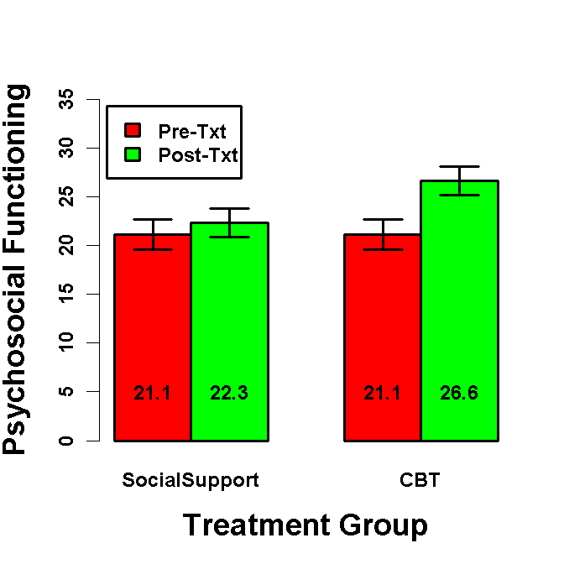
Group X Pre- Post Design
Examine the effects of CBT on psychosocial functioning among alcoholics.
Measure functioning pre-treatment.
Randomly assign to CBT vs. Social Support (control txt)
Measure functioning post-treatment

Slide 9
Group X Pre- Post Design
How would you test the Group X Txt interaction?
Regress the post-txt vs. pre-txt difference score on Group. Test of Group coefficient indicates if the two groups differ on the pre-test to post-test change.
dCBT$TxtDiff = dCBT$Post - dCBT$Pre
mDiff = lm(TxtDiff ~ Group,data=dCBT)
Coefficients:
Estimate Std. Error t value Pr(>|t|)
(Intercept) 3.353 1.366 2.454 0.0159
GroupCBT vs. SS 4.290 2.733 1.570 0.1197
Residual standard error: 13.66 on 98 degrees of freedom
Multiple R-squared: 0.02453, Adjusted R-squared: 0.01458
F-statistic: 2.465 on 1 and 98 DF, p-value: 0.1197

Slide 10
Group X Pre- Post Design
What does the intercept test in this model?
The main effect of txt, unweighted across Group
dCBT$TxtDiff = dCBT$Post - dCBT$Pre
mDiff = lm(TxtDiff ~ Group,data=dCBT)
Coefficients:
Estimate Std. Error t value Pr(>|t|)
(Intercept) 3.353 1.366 2.454 0.0159
GroupCBT vs. SS 4.290 2.733 1.570 0.1197
Residual standard error: 13.66 on 98 degrees of freedom
Multiple R-squared: 0.02453, Adjusted R-squared: 0.01458
F-statistic: 2.465 on 1 and 98 DF, p-value: 0.1197

Slide 11
Group X Pre- Post Design
How would you test the simple effect of Txt in the CBT group?
Recode Group using Dummy codes with CBT as reference level.
Fit the same model as before.
Intercept is now test of Txt in CBT
Group.
Of course, you can also test simple
effect of Txt in SS this way as well
mDiffCBT = lm(TxtDiff ~ Group,data=dCBT)
summary(mDiffCBT)
Coefficients:
Estimate Std. Error t value Pr(>|t|)
(Intercept) 5.498 1.932 2.846 0.0054
GroupSocialSupport_v_CBT -4.290 2.733 -1.570 0.1197
Residual standard error: 13.66 on 98 degrees of freedom
Multiple R-squared: 0.02453, Adjusted R-squared: 0.01458
F-statistic: 2.465 on 1 and 98 DF, p-value: 0.1197

Slide 12
Group X Pre- Post Design
How would you test the main effect of Group?
Regress the mean of pre-test and post-test on Group. Test of Group coefficient indicates if the two groups differ on the mean of pre-test and post-test.
Probably not of interest in this case.
dCBT$Mean = rowMeans(dCBT[c('Pre','Post')])
mMean = lm(Mean ~ Group, data=dCBT)
Coefficients:
Estimate Std. Error t value Pr(>|t|)
(Intercept) 22.7898 0.8071 28.238 <2e-16
GroupCBT vs. SS 2.1450 1.6141 1.329 0.187
Residual standard error: 8.071 on 98 degrees of freedom
Multiple R-squared: 0.0177, Adjusted R-squared: 0.007678
F-statistic: 1.766 on 1 and 98 DF, p-value: 0.1870

Slide 13
Group X Pre- Post Design
What does the intercept test in this model?
It tests if the average psychosocial functioning score (unweighted across Group and Txt) is different from 0. Probably not of interest in this
case.
dCBT$Mean = rowMeans(dCBT[c('Pre','Post')])
mMean = lm(Mean ~ Group, data=dCBT)
Coefficients:
Estimate Std. Error t value Pr(>|t|)
(Intercept) 22.7898 0.8071 28.238 <2e-16
GroupCBT vs. SS 2.1450 1.6141 1.329 0.187
Residual standard error: 8.071 on 98 degrees of freedom
Multiple R-squared: 0.0177, Adjusted R-squared: 0.007678
F-statistic: 1.766 on 1 and 98 DF, p-value: 0.1870

Slide 14
Group X Pre- Post Design
How would you test the simple effect of Group during
Post-txt?
Regress Post-txt scores on Group. Group coefficient tests if green bars differ.
Of course, you could test the simple
effect of Group on Pre-txt in a similar
way.
mPost = lm(Post ~ Group, data=dCBT) #Test Group simple effect on Post-txt
Coefficients:
Estimate Std. Error t value Pr(>|t|)
(Intercept) 24.467 1.028 23.802 <2e-16
GroupCBT vs. SS 4.290 2.056 2.087 0.0395
Residual standard error: 10.28 on 98 degrees of freedom
Multiple R-squared: 0.04254, Adjusted R-squared: 0.03277
F-statistic: 4.354 on 1 and 98 DF, p-value: 0.03951

Slide 15
Group X Pre- Post Design
What does the intercept test in this model?
It tests the mean post-Txt scores (unweighted across Group) against 0.
Probably not of interest in this case.
mPost = lm(Post ~ Group, data=dCBT) #Test Group simple effect on Post-txt
Coefficients:
Estimate Std. Error t value Pr(>|t|)
(Intercept) 24.467 1.028 23.802 <2e-16
GroupCBT vs. SS 4.290 2.056 2.087 0.0395
Residual standard error: 10.28 on 98 degrees of freedom
Multiple R-squared: 0.04254, Adjusted R-squared: 0.03277
F-statistic: 4.354 on 1 and 98 DF, p-value: 0.03951

Slide 16
Group X Pre- Post Design: Summary
Congratulations. You just fully analyzed a mixed model design (i.e., One between subject factor X one within subjects/repeated factor)
You tested:
Between IV X Within IV interaction
Main effect of Between IV
Main effect of Within IV
Simple effects of Between IV
Simple effects of Within IV

Slide 17
Repeated Measures vs. Difference score
ANCOVA analysis provides an alternative approach to analyzing this design. How do you conduct this ANCOVA in regression?
Regress Post scores on Group and Pre scores. Test for Group effect. What is the interpretation of each coefficient?
mCBT = lm(Post ~ Pre + Group, data=dCBT)
Coefficients:
Estimate Std. Error t value Pr(>|t|)
(Intercept) 19.01619 2.46595 7.711 1.10e-11
Pre 0.15656 0.09478 1.652 0.1018
GroupCBT_v_SocialSupport 4.29000 2.03795 2.105 0.0379
Residual standard error: 10.19 on 97 degrees of freedom
Multiple R-squared: 0.06874, Adjusted R-squared: 0.04954
F-statistic: 3.58 on 2 and 97 DF, p-value: 0.03162

Slide 18
Repeated Measures vs. Difference score
Is “ANCOVA” approach to Group X Pre/Post design statistically equivalent to the ANOVA difference/Repeated Measures approach?
No. And in certain circumstances, ANCOVA approach is more powerful!
WHY?????
mCBT = lm(Post ~ Pre + Group, data=dCBT)
Coefficients:
Estimate Std. Error t value Pr(>|t|)
(Intercept) 19.01619 2.46595 7.711 1.10e-11
Pre 0.15656 0.09478 1.652 0.1018
GroupCBT_v_SocialSupport 4.29000 2.03795 2.105 0.0379
mDiffSS = lm(TxtDiff ~ Group,data=dCBT)
Coefficients:
Estimate Std. Error t value Pr(>|t|)
(Intercept) 1.208 1.932 0.625 0.533
GroupCBT_v_SocialSupport 4.290 2.733 1.570 0.120

Slide 19
Difference score vs. ANCOVA
Regress Post-Pre Difference on Group
(Post - Pre) = b₀ + b₁Group
Coefficients:
Estimate Std. Error t value Pr(>|t|)
(Intercept) 1.208 1.932 0.625 0.533
GroupCBT_v_SocialSupport 4.290 2.733 1.570 0.120
Regress Post on Group and Pre
Post = b₀ + b₁Group + b₂Pre
(Post – b₂Pre) = b₀ + b₁Group
Coefficients:
Estimate Std. Error t value Pr(>|t|)
(Intercept) 19.01619 2.46595 7.711 1.10e-11
Pre 0.15656 0.09478 1.652 0.1018
GroupCBT_v_SocialSupport 4.29000 2.03795 2.105 0.0379
Why is ANCOVA approach more powerful?
These two models are equivalent except for b2 vs. the implied coefficient of 1.0 for difference score approach. Regression determines coefficients that minimize SSE relative to any other values. SSE affects the standard error of the group effect.

Slide 20
Difference score vs. ANCOVA
Post = b₀ + b₁Group + b₂Pre
When there are no Group differences on Pre (as expected if participants are randomly assigned to Group and Pre is measured before assignment), ANCOVA approach will be more powerful than repeated measures/difference approach.
Why is this not true if there are Group differences on Pre?
If Group and Pre are correlated (i.e., group difference on Pre), controlling Pre will (incorrectly) reduce the group effect. The estimate of the Group effect will be biased (i.e., underestimated).
How does the relationship between Pre and Post affect the relative power advantage of ANCOVA?
The relative advantage of ANCOVA increases as the pre-post correlation decreases (because b₂ will be substantially lower than 1)
If pretest and posttest have the same within-group variance and r_{XY} denotes the pretest–posttest correlation within groups, then ANCOVA needs a sample size only (1 + r_{XY})/2 as large as that for repeated measures/difference score approach.

Slide 21
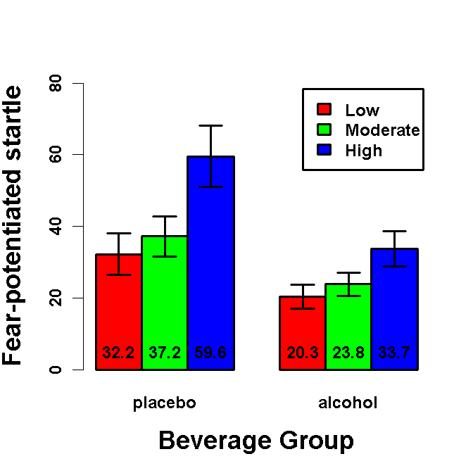
Repeated Measures GLM
Effect of Alcohol and Threat Intensity on Fear:
Two* Beverage Groups: Alcohol vs. Placebo
FPS measured across 3 Threat Intensities (within subjects)
Beverage Group is focal IV.

Slide 22
Repeated Measures GLM
What are all the tests you MIGHT conduct in a Beverage Group X Threat Intensity GLM
Main effect of Beverage Group
[Main effect of Threat Intensity (2df)]
[1df main effect contrasts for Threat Intensity]
Beverage Group X Threat Intensity interaction (2df)
1df interaction contrasts
Simple effects of Beverage Group at each threat intensity
[Simple effects of Threat Intensity in each Beverage Group]
[Simple 1df contrasts for Threat Intensity in each Bev. Group]

Slide 23
Repeated Measures GLM: Between Subjects Model
How do you test the main effect of Beverage Group?
Calculate mean FPS across the three within-subject levels of threat intensity. Regress mean FPS on BG2. Test of coefficient for BG2 is main effect of Beverage Group.
dDose$FPS_Mean = rowMeans(dDose[c('FPS_Low','FPS_Mod', 'FPS_Hi')])
mMean = lm(FPS_Mean ~ BG2,data=dDose)
Coefficients:
Estimate Std. Error t value Pr(>|t|)
(Intercept) 34.468 3.532 9.758 9.09e-16
BG2Alc vs. Pla -17.055 7.064 -2.414 0.0178
Residual standard error: 29.34 on 90 degrees of freedom
Multiple R-squared: 0.06082, Adjusted R-squared: 0.05039
F-statistic: 5.829 on 1 and 90 DF, p-value: 0.01779

Slide 24
Repeated Measures GLM: Between Subjects Model
How do you test the simple effects of Beverage Group at each threat intensity?
Regress FPS_Low, FPS_Mod, FPS_Hi on BG2 in separate models. BG2 coefficient is test of simple effect of Beverage Group at each threat intensity. Average of these coefficients is main effect of BG2. Only test if interaction (or interaction contrasts) are significant
mLow = lm(FPS_Low ~ BG2,data=dDose)
Coefficients:
Estimate Std. Error t value Pr(>|t|)
(Intercept) 26.28 3.36 7.822 9.5e-12
BG2Alc vs. Pla -11.90 6.72 -1.771 0.08
mMod = lm(FPS_Mod ~ BG2,data=dDose)
Coefficients:
Estimate Std. Error t value Pr(>|t|)
(Intercept) 30.516 3.265 9.345 6.59e-15
BG2Alc vs. Pla -13.367 6.531 -2.047 0.0436
mHi = lm(FPS_Hi ~ BG2,data=dDose)
Coefficients:
Estimate Std. Error t value Pr(>|t|)
(Intercept) 46.610 4.895 9.522 2.82e-15
BG2Alc vs. Pla -25.900 9.790 -2.646 0.00963

Slide 25
Repeated Measures GLM: 1df Within Subject Models
How do you test within subject 1df threat contrasts and BG x Threat interaction contrasts? For instance, low vs. mod and low/mod vs. hi threat contrasts
Create difference scores for each contrast. Regress each difference score on BG2 (centered). Test of intercept is 1df contrast for threat. Test of BG2 is BG2 X 1df threat interaction contrast.

Slide 26
Repeated Measures GLM: 1df Within Subject Models
Threat: Mod vs. Low
dDose$FPS_MvL = dDose$FPS_Mod - dDose$FPS_Low
mMvL = lm(FPS_MvL ~ BG2,data=dDose)
Coefficients:
Estimate Std. Error t value Pr(>|t|)
(Intercept) 4.237 2.252 1.881 0.0632
BG2Alc vs. Pla -1.467 4.505 -0.326 0.7454
1df threat contrast
FPS is 4.2µV greater during moderate vs. low intensity shock threat
1df BG2 X Threat interaction contrast
Alcohol reduces FPS 1.5µV more during moderate vs. low intensity shock. [Remember the simple effect of alcohol was -13.4 during moderate shock and -11.9 during low shock

Slide 27
Repeated Measures GLM: 1df Within Subject Models
Threat: Hi vs. Mod/Low
dDose$FPS_HvML = dDose$FPS_Hi - (dDose$FPS_Mod + dDose$FPS_Low)/2
mHvML = lm(FPS_HvML ~ BG2,data=dDose)
Coefficients:
Estimate Std. Error t value Pr(>|t|)
(Intercept) 18.213 2.987 6.098 2.63e-08
BG2Alc vs. Pla -13.267 5.973 -2.221 0.0289
1df threat contrast
FPS is 18.2µV greater during High vs. the mean of moderate & low intensity shock threat
1df BG2 X Threat interaction contrast
Alcohol reduces FPS 13.3µV more during High vs. moderate/low intensity shock.

Slide 28
Repeated Measures GLM: 1df Within Subject Models
How do you test the simple 1df threat effects, separately in alcohol vs. placebo groups
Recode BG2 using dummy codes. Intercept is simple 1df threat effect in group coded as reference level. For example, the simple Mod vs. Low 1df threat effect in placebo group is tested by intercept below.
contrasts(dDose$BG2) = lm.setContrasts(dDose$BG2, Type='DUMMY', RefLevel=1)
alcohol_v_placebo
placebo 0
alcohol 1
mMvL = lm(FPS_MvL ~ BG2,data=dDose)
Coefficients:
Estimate Std. Error t value Pr(>|t|)
(Intercept) 4.970 3.901 1.274 0.206
BG2alcohol_v_placebo -1.467 4.505 -0.326 0.745

Slide 29
Repeated Measures GLM: Omnibus Threat Effects
How do you get the omnibus Threat and BG2 X Threat effects?
These are no longer single df on the DV side. You need to aggregate across the three DV models.
There are two methods, multivariate and univariate, that make different assumptions.
The Anova() function provides all tests, along with various “corrections” for assumptions violations.
?Anova for more complicated example (2 within subject factors and 2 between subject factors)

Slide 30
Repeated Measures GLM: Omnibus Threat Effects
mOmni = lm(cbind(FPS_Low,FPS_Mod,FPS_Hi) ~ BG2, data=dDose)
Threat = factor(c('Low', 'Mod', 'Hi'),levels=c('Low', 'Mod', 'Hi'))
idata <- data.frame(Threat)
mAnova = Anova(mOmni, idata=idata, idesign=~Threat, type=3)
summary(mAnova)
idata
Threat
1 Low
2 Mod
3 Hi

Slide 31
Repeated Measures GLM: Multivariate
Type III Repeated Measures MANOVA Tests:
------------------------------------------
Term: (Intercept)
Response transformation matrix:
(Intercept)
FPS_Low 1
FPS_Mod 1
FPS_Hi 1
Sum of squares and products for the hypothesis:
(Intercept)
(Intercept) 382668.9
Sum of squares and products for error:
(Intercept)
(Intercept) 697312.2
Multivariate Tests: (Intercept)
Df test stat approx F num Df den Df Pr(>F)
Pillai 1 0.3543292 49.38993 1 90 3.9011e-10
Wilks 1 0.6456708 49.38993 1 90 3.9011e-10
Hotelling-Lawley 1 0.5487770 49.38993 1 90 3.9011e-10
Roy 1 0.5487770 49.38993 1 90 3.9011e-10

Slide 32
Repeated Measures GLM: Multivariate
Type III Repeated Measures MANOVA Tests:
------------------------------------------
Term: BG2
Response transformation matrix:
(Intercept)
FPS_Low 1
FPS_Mod 1
FPS_Hi 1
Sum of squares and products for the hypothesis:
(Intercept)
(Intercept) 45159.54
Sum of squares and products for error:
(Intercept)
(Intercept) 697312.2
Multivariate Tests: BG2
Df test stat approx F num Df den Df Pr(>F)
Pillai 1 0.0608232 5.828607 1 90 0.017792
Wilks 1 0.9391768 5.828607 1 90 0.017792
Hotelling-Lawley 1 0.0647623 5.828607 1 90 0.017792
Roy 1 0.0647623 5.828607 1 90 0.017792

Slide 33
Repeated Measures GLM: Multivariate
Type III Repeated Measures MANOVA Tests:
------------------------------------------
Term: Threat
Response transformation matrix:
Threat1 Threat2
FPS_Low 1 0
FPS_Mod 0 1
FPS_Hi -1 -1
Sum of squares and products for the hypothesis:
Threat1 Threat2
Threat1 17181.32 14056.89
Threat2 14056.89 11500.63
Sum of squares and products for error:
Threat1 Threat2
Threat1 55222.82 47512.37
Threat2 47512.37 71305.21
Multivariate Tests: Threat
Df test stat approx F num Df den Df Pr(>F)
Pillai 1 0.2378827 13.88997 2 89 5.623e-06
Wilks 1 0.7621173 13.88997 2 89 5.623e-06
Hotelling-Lawley 1 0.3121341 13.88997 2 89 5.623e-06
Roy 1 0.3121341 13.88997 2 89 5.623e-06

Slide 34
Repeated Measures GLM: Multivariate
Type III Repeated Measures MANOVA Tests:
------------------------------------------
Term: BG2:Threat
Response transformation matrix:
Threat1 Threat2
FPS_Low 1 0
FPS_Mod 0 1
FPS_Hi -1 -1
Sum of squares and products for the hypothesis:
Threat1 Threat2
Threat1 3381.056 3026.783
Threat2 3026.783 2709.631
Sum of squares and products for error:
Threat1 Threat2
Threat1 55222.82 47512.37
Threat2 47512.37 71305.21
Multivariate Tests: BG2:Threat
Df test stat approx F num Df den Df Pr(>F)
Pillai 1 0.0578132 2.730547 2 89 0.070648
Wilks 1 0.9421868 2.730547 2 89 0.070648
Hotelling-Lawley 1 0.0613606 2.730547 2 89 0.070648
Roy 1 0.0613606 2.730547 2 89 0.070648

Slide 35
Repeated Measures GLM: Univariate
Univariate Type III Repeated-Measures ANOVA Assuming Sphericity
SS num Df Error SS den Df F Pr(>F)
(Intercept) 127556 1 232437 90 49.3899 3.901e-10
BG2 15053 1 232437 90 5.8286 0.01779
Threat 9750 2 52677 180 16.6582 2.303e-07
BG2:Threat 2043 2 52677 180 3.4898 0.03259
Mauchly Tests for Sphericity
Test statistic p-value
Threat 0.80736 7.3208e-05
BG2:Threat 0.80736 7.3208e-05
Greenhouse-Geisser and Huynh-Feldt Corrections
for Departure from Sphericity
GG eps Pr(>F[GG])
Threat 0.83848 1.606e-06
BG2:Threat 0.83848 0.04085
HF eps Pr(>F[HF])
Threat 0.85257 1.355e-06
BG2:Threat 0.85257 0.04005

Slide 36
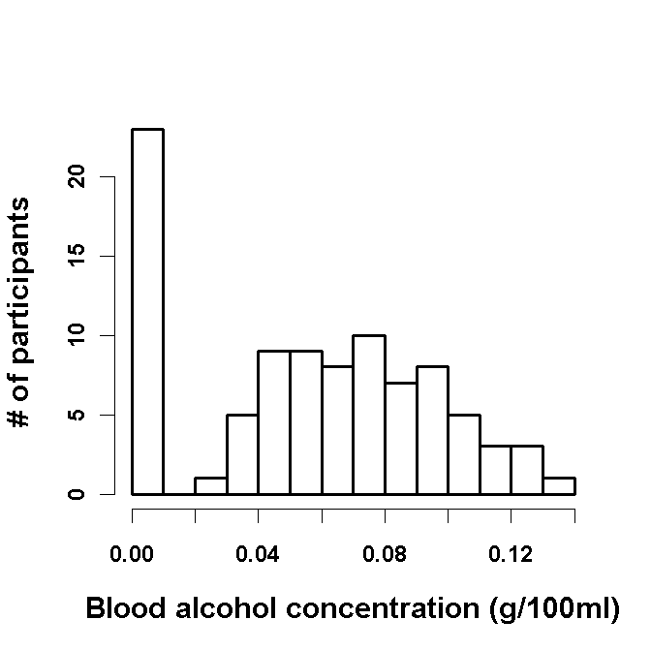
Quantitative Beverage Group

Slide 37
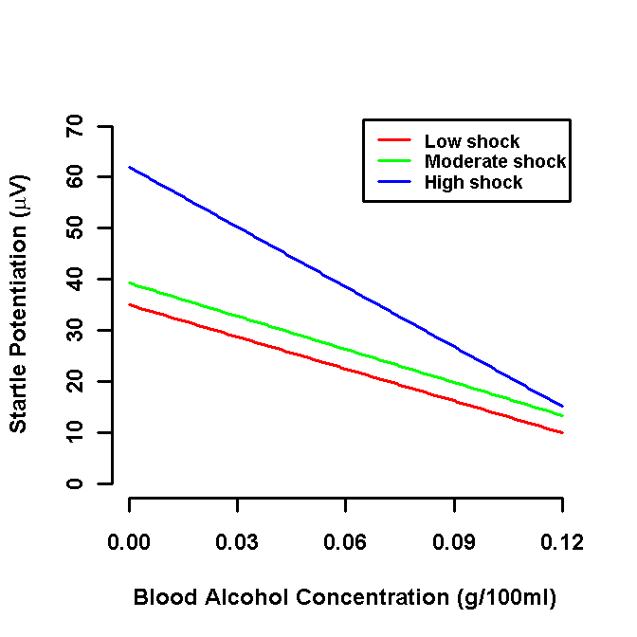
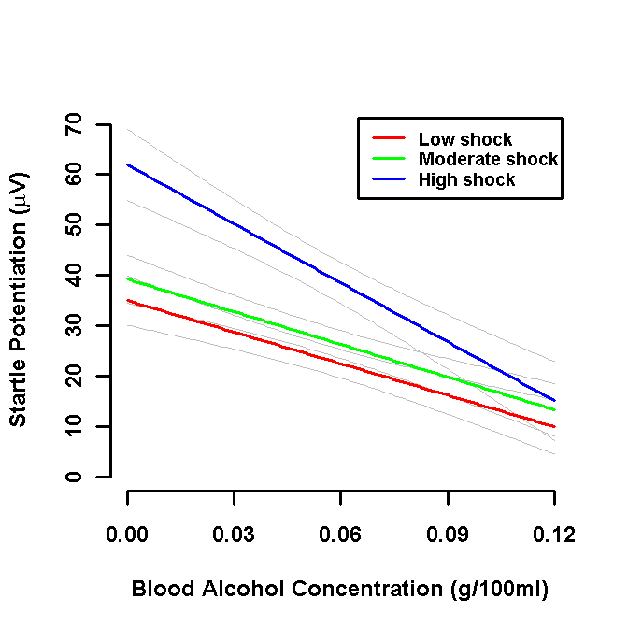
Quantitative Beverage Group

Slide 38
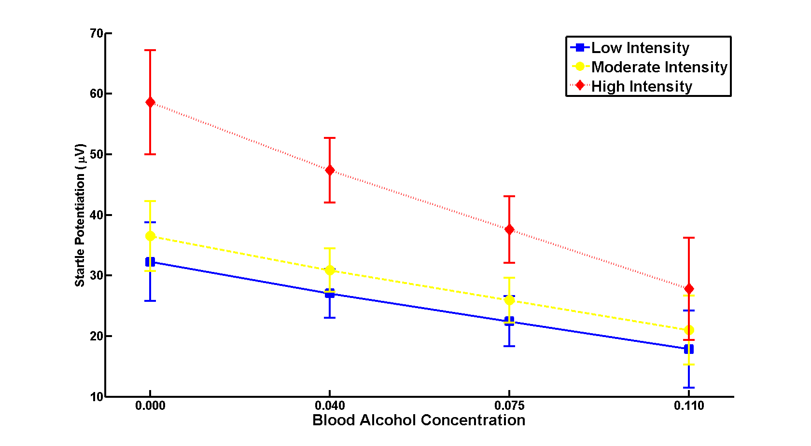
Quantitative Beverage Group

Slide 39
Quantitative IV: Between Subjects Main Effect
dDose$FPS_Mean = rowMeans(dDose[c('FPS_Low','FPS_Mod', 'FPS_Hi')])
mMean = lm(FPS_Mean ~ BAC,data=dDose)
Coefficients:
Estimate Std. Error t value Pr(>|t|)
(Intercept) 45.394 5.112 8.880 6.12e-14 ***
BAC -271.981 74.789 -3.637 0.00046 ***
---
Signif. codes: 0 ‘***’ 0.001 ‘**’ 0.01 ‘*’ 0.05 ‘.’ 0.1 ‘ ’ 1
Residual standard error: 28.27 on 90 degrees of freedom
Multiple R-squared: 0.1281, Adjusted R-squared: 0.1184
F-statistic: 13.23 on 1 and 90 DF, p-value: 0.0004599

Slide 40
Quantitative IV: Between Subjects Simple Effects
mLow = lm(FPS_Low ~ BAC,data=dDose)
Coefficients:
Estimate Std. Error t value Pr(>|t|)
(Intercept) 34.973 4.908 7.126 2.48e-10 ***
BAC -208.943 71.806 -2.910 0.00456 **
mMod = lm(FPS_Mod ~ BAC,data=dDose)
Coefficients:
Estimate Std. Error t value Pr(>|t|)
(Intercept) 39.24 4.77 8.227 1.38e-12 ***
BAC -216.14 69.78 -3.097 0.00261 **
mHi = lm(FPS_Hi ~ BAC,data=dDose)
Coefficients:
Estimate Std. Error t value Pr(>|t|)
(Intercept) 61.964 7.095 8.734 1.23e-13 ***
BAC -390.857 103.795 -3.766 0.000296 ***

Slide 41
Quantitative IV: 1DF Threat Effects
Moderate vs. Low shock:
1df Threat contrast (at BAC=0) and 1df BAC x Threat contrast
dDose$FPS_MvL = dDose$FPS_Mod - dDose$FPS_Low
mMvL = lm(FPS_MvL ~ BAC,data=dDose)
Coefficients:
Estimate Std. Error t value Pr(>|t|)
(Intercept) 4.272 3.385 1.262 0.210
BAC -7.199 49.519 -0.145 0.885
Residual standard error: 18.72 on 90 degrees of freedom
Multiple R-squared: 0.0002348, Adjusted R-squared: -0.01087
F-statistic: 0.02114 on 1 and 90 DF, p-value: 0.8847

Slide 42
Quantitative IV: 1DF Threat Effects
High vs. Moderate/Low shock:
1df Threat contrast (at BAC=0) and 1df BAC x Threat contrast
dDose$FPS_HvML = dDose$FPS_Hi - (dDose$FPS_Mod + dDose$FPS_Low)/2
mHvML = lm(FPS_HvML ~ BAC,data=dDose)
Coefficients:
Estimate Std. Error t value Pr(>|t|)
(Intercept) 24.855 4.424 5.618 2.14e-07 ***
BAC -178.314 64.730 -2.755 0.00711 **
Residual standard error: 24.47 on 90 degrees of freedom
Multiple R-squared: 0.07776, Adjusted R-squared: 0.06751
F-statistic: 7.588 on 1 and 90 DF, p-value: 0.007108

Slide 43
Quantitative IV: 1DF Threat Effects
High vs. Moderate/Low shock:
1df Threat contrast (at mean BAC) and 1df BAC x Threat contrast
dDose$cBAC = dDose$BAC - mean(dDose$BAC)
mHvML = lm(FPS_HvML ~ cBAC,data=dDose)
Coefficients:
Estimate Std. Error t value Pr(>|t|)
(Intercept) 14.896 2.551 5.840 8.2e-08 ***
cBAC -178.314 64.730 -2.755 0.00711 **
---
Signif. codes: 0 ‘***’ 0.001 ‘**’ 0.01 ‘*’ 0.05 ‘.’ 0.1 ‘ ’ 1
Residual standard error: 24.47 on 90 degrees of freedom
Multiple R-squared: 0.07776, Adjusted R-squared: 0.06751
F-statistic: 7.588 on 1 and 90 DF, p-value: 0.007108

Slide 44
Quantitative IV: Omnibus Tests
mOmni = lm(cbind(FPS_Low,FPS_Mod,FPS_Hi) ~ BAC, data=dDose)
Threat = factor(c('Low', 'Mod', 'Hi'),levels=c('Low', 'Mod', 'Hi'))
idata <- data.frame(Threat)
mAnova = Anova(mOmni, idata=idata, idesign=~Threat, type=3)
summary(mAnova, multivariate=FALSE)

Slide 45
Quantitative IV: Omnibus Tests
Univariate Type III Repeated-Measures ANOVA Assuming Sphericity
SS num Df Error SS den Df F Pr(>F)
(Intercept) 189055 1 215782 90 78.8526 6.121e-14 ***
BAC 31709 1 215782 90 13.2253 0.0004599 ***
Threat 12874 2 51687 180 22.4172 2.027e-09 ***
BAC:Threat 3032 2 51687 180 5.2802 0.0059102 **
---
Mauchly Tests for Sphericity
Test statistic p-value
Threat 0.8169 0.00012343
BAC:Threat 0.8169 0.00012343
---
Greenhouse-Geisser and Huynh-Feldt Corrections
for Departure from Sphericity
GG eps Pr(>F[GG])
Threat 0.84523 2.617e-08 ***
BAC:Threat 0.84523 0.009098 **
---
HF eps Pr(>F[HF])
Threat 0.85966 2.061e-08 ***
BAC:Threat 0.85966 0.008739 **

