Slide 1
Unit 18 – The Analysis of within-subject variables (Part 2)
Today: the underlying math.
How does R compute the relevant F-/t-value for a given test?

Slide 2
Unit 18 – The Analysis of within-subject variables (Part 2)
Prestige
Liking
Moderator

Slide 3

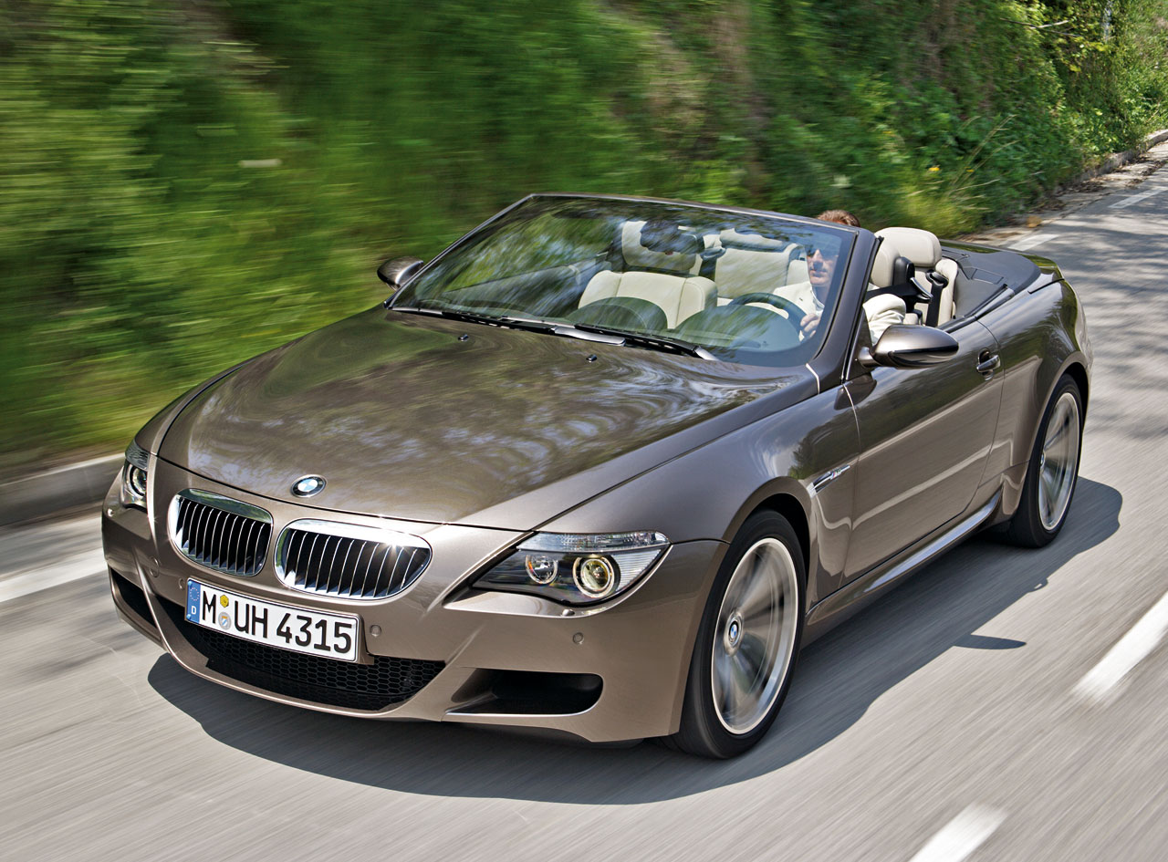
Low-prestige car
High-prestige car
prestige = 1
prestige = 2
prestigeC = -.5
prestigeC = .5

Slide 4
Unit 18 – The Analysis of within-subject variables
Prestige
Liking
Prestige is a within-subjects variable (a repeated measure).

Slide 5
R script within-subjects design:
d$id <- as.factor(d$id)
mod1 <- lmer(like ~ prestige + (1 + prestige|id), data=d)
summary(mod1)
Anova(mod1, type = 3, test = "F")

Slide 6
Linear mixed model fit by REML
Formula: like ~ prestige + (1 + prestige | id)
Data: d
AIC BIC logLik deviance REMLdev
179.4 189.5 -83.69 167.8 167.4
Random effects:
Groups Name Variance Std.Dev. Corr
id (Intercept) 3.86140 1.96504
prestige 0.23035 0.47995 -0.862
Residual 2.53088 1.59087
Number of obs: 40, groups: id, 20
Fixed effects:
Estimate Std. Error t value
(Intercept) 3.9000 0.9087 4.292
prestige 1.1500 0.5144 2.236
Correlation of Fixed Effects:
(Intr)
prestige -0.899
Analysis of Deviance Table (Type III Wald F tests with Kenward-Roger df)
Response: like
F Df Df.res Pr(>F)
(Intercept) 18.4186 1 19 0.0003938 ***
prestige 4.9979 1 19 0.0375760 *
---
Signif. codes: 0 ‘***’ 0.001 ‘**’ 0.01 ‘*’ 0.05 ‘.’ 0.1 ‘ ’ 1

Slide 7
Let's center prestige!
R script within-subjects design (with centered IV):
d$id <- as.factor(d$id)
d$prestigeC <- ifelse(d$prestige == 2, .5, -.5)
mod1b <- lmer(like ~ prestigeC + (1 + prestigeC|id), data=d)
summary(mod1b)
Anova(mod1b, type = 3, test = "F")

Slide 8
Linear mixed model fit by REML
Formula: like ~ prestigeC + (1 + prestigeC | id)
Data: d
AIC BIC logLik deviance REMLdev
179.4 189.5 -83.69 167.8 167.4
Random effects:
Groups Name Variance Std.Dev. Corr
id (Intercept) 2.78295 1.66822
prestigeC 3.59494 1.89603 -0.148
Residual 0.84858 0.92118
Number of obs: 40, groups: id, 20
Fixed effects:
Estimate Std. Error t value
(Intercept) 5.6250 0.4005 14.047
prestigeC 1.1500 0.5144 2.236
Correlation of Fixed Effects:
(Intr)
prestigeC -0.113
Analysis of Deviance Table (Type III Wald F tests with Kenward-Roger df)
Response: like
F Df Df.res Pr(>F)
(Intercept) 197.308 1 19 1.737e-11 ***
prestigeC 4.998 1 19 0.03758 *
---
Signif. codes: 0 ‘***’ 0.001 ‘**’ 0.01 ‘*’ 0.05 ‘.’ 0.1 ‘ ’ 1

Slide 9
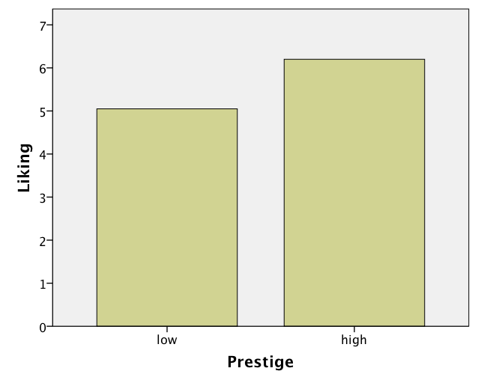
b = 1.15 (the "prestige effect")
M = 6.20
M = 5.05

Slide 10
The underlying math
How does R get to a F-value of 4.998?
Overview:
R estimates a series of regression models (one per participant)
It uses the regression coefficients in a new analysis as the dependent variable.

Slide 11
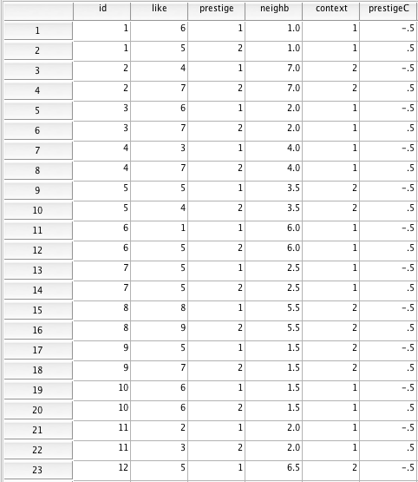

Slide 12
id = 1
6
7
Intercept
Slope
6
5
5
5.5
-1
4
3
2
like = b₀ + b₁prestigeC =
= 5.5 – 1*prestigeC ;
1
-.5
.5

Slide 14
id = 1
6
7
Intercept
Slope
6
5
5
5.5
-1
4
3
2
like = b₀ + b₁prestigeC =
= 5.5 – 1*prestigeC ;
1
-.5
.5
7
id = 2
Intercept
Slope
7
6
4
5
5.5
3
4
3
2
like = b₀ + b₁prestigeC =
= 5.5 +3*prestigeC ;
1
-.5
.5

Slide 15
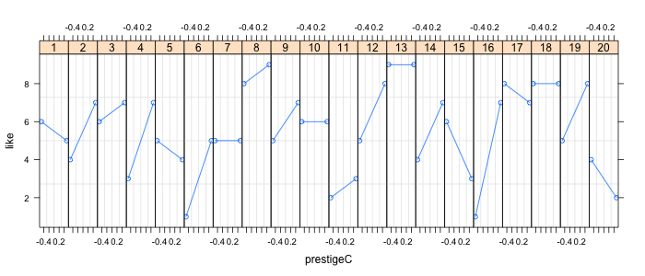
6
5
4
7
6
7
3
7
5
4
1
5
5
5
5
7
6
6
2
3
9
9
4
7
6
3
1
7
4
2
8
9
5
8
8
7
8
8
5
8

Slide 16
prestige effects
b_{0j} b_{1j}
averages differences
id lo_prest hi_prest intercepts slopes
Meaning of slopes?
1 6 5 5.5 -1
2 4 7 5.5 3
3 6 7 6.5 1
4 3 7 5.0 4
5 5 4 4.5 -1
6 1 5 3.0 4
7 5 5 5.0 0
8 8 9 8.5 1
9 5 7 6.0 2
10 6 6 6.0 0
11 2 3 2.5 1
12 5 8 6.5 3
13 9 9 9.0 0
14 4 7 5.5 3
15 6 3 4.5 -3
16 1 7 4.0 6
17 8 7 7.5 -1
18 8 8 8.0 0
19 5 8 6.5 3
20 4 2 3.0 -2
Meaning of intercepts?
M = 1.15

Slide 17
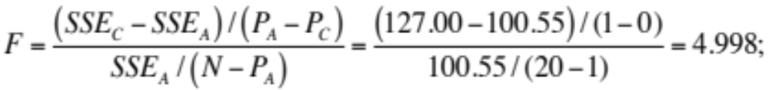
slopes = b₀ = 1.15 ;
b₀: Are the slopes reliably different from zero?
Model comparison:
C: Y = B₀ ; B₀ = 0 ;
slopes = B₀ = 0 ; P_{C} = 0 ; SSE_{C} = 127.00 ;
A: Y = b₀ ;
slopes = b₀ = 1.15 ; P_{A} = 1 ; SSE_{A} = 100.55 ;

Slide 18
The underlying math
Conclusion:
The 20 slopes are on average reliably different from zero.
Participants like the high-prestige car more than the low-prestige car (and this effect is significant).
There is a (statistical) effect of prestige on liking.

Slide 19
The underlying math
Recap. How did we come to this conclusion?
A two-step process:
1) We ran 20 regression analyses (one per participant) in which we regressed liking on prestige (N = 2).
2) We then tested whether the 20 prestige slopes (b_{1j}) were reliably different from zero (N = 20).
Questions?

Slide 20
Within-subject variables
Prestige
Liking
Neighborhood
Prestige is a dichotomous within-subject variable (coded 1 and 2) and neighborhood is a continuous between-subject variable (with scores varying from 1 to 7).

Slide 21
R script within-subjects design:
d <- lm.readDat ("data cars 2 restr.dat")
describe(d)
d$prestigeC <- ifelse(d$prestige == 2, .5, -.5)
d$neighbC <- scale(d$neighb, scale=F)
d$id <- as.factor(d$id)
mod2 <- lmer(like ~ prestigeC * neighbC + (1 + prestigeC|id), data=d)
summary(mod2)
Anova(mod2, type = 3, test = "F")

Slide 22
> mod2 <- lmer(like ~ prestigeC * neighbC + (1 + prestigeC|id), data=d)
> summary(mod2)
Linear mixed model fit by REML
Formula: like ~ prestigeC * neighbC + (1 + prestigeC | id)
Data: d
AIC BIC logLik deviance REMLdev
178.4 191.9 -81.22 159.8 162.4
Random effects:
Groups Name Variance Std.Dev. Corr
id (Intercept) 3.03060 1.7409
prestigeC 2.37724 1.5418 -0.210
Residual 0.70426 0.8392
Number of obs: 40, groups: id, 20
Fixed effects:
Estimate Std. Error t value
(Intercept) 5.62500 0.41126 13.677
prestigeC 1.15000 0.43508 2.643
neighbC 0.02415 0.20212 0.120
prestigeC:neighbC 0.62560 0.21383 2.926
Correlation of Fixed Effects:
(Intr) prstgC neghbC
prestigeC -0.157
neighbC 0.000 0.000
prstgC:nghC 0.000 0.000 -0.15

Slide 23
> Anova(mod2, type = 3, test = "F")
Analysis of Deviance Table (Type III Wald F tests with Kenward-Roger df)
Response: like
F Df Df.res Pr(>F)
(Intercept) 187.0715 1 18 5.977e-11 ***
prestigeC 6.9866 1 18 0.016524 *
neighbC 0.0143 1 18 0.906200
prestigeC:neighbC 8.5599 1 18 0.009029 **
---
Signif. codes: 0 ‘***’ 0.001 ‘**’ 0.01 ‘*’ 0.05 ‘.’ 0.1 ‘ ’ 1

Slide 24
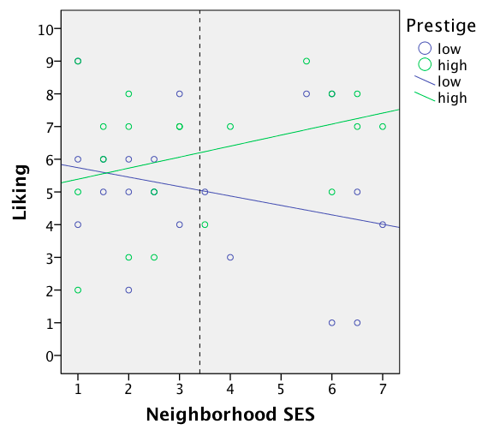

Slide 25
The underlying math
How does R get to F-values of 6.99 and 8.56?
Overview:
R estimates a series of regression models (one per participant)
It uses the regression coefficients in a new analysis as the dependent variable.

Slide 26
id = 1
6
7
Intercept
Slope
6
5
5
5.5
-1
4
3
2
like = b₀ + b₁prestigeC =
= 5.5 – 1*prestigeC ;
1
-.5
.5
7
id = 2
Intercept
Slope
7
6
4
5
5.5
3
4
3
2
like = b₀ + b₁prestigeC =
= 5.5 +3*prestigeC ;
1
-.5
.5

Slide 27
prestige effects
b_{0j} b_{1j}
averages differences
id lo_prest hi_prest intercepts slopes neighbC
1 6 5 5.5 -1 -2.4
2 4 7 5.5 3 3.6
3 6 7 6.5 1 -1.4
4 3 7 5.0 4 .6
5 5 4 4.5 -1 .1
6 1 5 3.0 4 2.6
7 5 5 5.0 0 -.9
8 8 9 8.5 1 2.1
9 5 7 6.0 2 -1.9
10 6 6 6.0 0 -1.9
11 2 3 2.5 1 -1.4
12 5 8 6.5 3 3.1
13 9 9 9.0 0 -2.4
14 4 7 5.5 3 -.4
15 6 3 4.5 -3 -.9
16 1 7 4.0 6 3.1
17 8 7 7.5 -1 -.4
18 8 8 8.0 0 2.6
19 5 8 6.5 3 -1.4
20 4 2 3.0 -2 -2.4

Slide 28
slopes = b₀ + b₁neighbC = 1.15 + .63*neighbC ;
b₀: Are the slopes reliably different from zero ?
C: slopes = 0 + b₁neighbC ; P_{C} = 1 ; SSE_{C} = 94.59 ;
A: slopes = b₀ + b₁neighbC ; P_{A} = 2 ; SSE_{A} = 68.14 ;
F(1,18) = 6.99 ; t(18) = 2.64 ; p < .02 ;
→ The main effect of prestige
b₁: Are the slopes related to neighborhood?
C: slopes = b₀ ; P_{C} = 1 ; SSE_{C} = 100.55 ;
A: slopes = b₀ + b₁neighbC ; P_{A} = 2 ; SSE_{A} = 68.14 ;
F(1,18) = 8.56 ; t(18) = 2.93 ; p < .01 ;
→ The prestige by neighborhood interaction

Slide 29
Fixed effects:
Estimate Std. Error t value
(Intercept) 5.62500 0.41126 13.677
prestigeC 1.15000 0.43508 2.643
neighbC 0.02415 0.20212 0.120
prestigeC:neighbC 0.62560 0.21383 2.926
Response: like
F Df Df.res Pr(>F)
(Intercept) 187.0715 1 18 5.977e-11 ***
prestigeC 6.9866 1 18 0.016524 *
neighbC 0.0143 1 18 0.906200
prestigeC:neighbC 8.5599 1 18 0.009029 **
How do we get the main effect of neighborhood?
How does R get to an F-value of .01?
We regress the intercepts on neighborhood centered!

Slide 30
prestige effects
b_{0j} b_{1j}
averages differences
id lo_prest hi_prest intercepts slopes neighbC
1 6 5 5.5 -1 -2.4
2 4 7 5.5 3 3.6
3 6 7 6.5 1 -1.4
4 3 7 5.0 4 .6
5 5 4 4.5 -1 .1
6 1 5 3.0 4 2.6
7 5 5 5.0 0 -.9
8 8 9 8.5 1 2.1
9 5 7 6.0 2 -1.9
10 6 6 6.0 0 -1.9
11 2 3 2.5 1 -1.4
12 5 8 6.5 3 3.1
13 9 9 9.0 0 -2.4
14 4 7 5.5 3 -.4
15 6 3 4.5 -3 -.9
16 1 7 4.0 6 3.1
17 8 7 7.5 -1 -.4
18 8 8 8.0 0 2.6
19 5 8 6.5 3 -1.4
20 4 2 3.0 -2 -2.4

Slide 31
intercepts = b₀ + b₁neighbC = 5.63 + .02*neighbC ;
b₀: Are the intercepts reliably different from zero ?
→ Not a theoretically interesting question
b₁: Are the intercepts related to neighborhood?
C: intercepts = b₀ ; P_{C} = 1 ; SSE_{C} = 60.94 ;
A: intercepts = b₀ + b₁neighbC ; P_{A} = 2 ; SSE_{A} = 60.89 ;
F(1,18) = .01 ; t(18) = .12 ; p = .91 ;
→ The main effect of neighborhood

Slide 33
Within-subject variables
Prestige
Liking
Context
Prestige is a dichotomous within-subject variable (coded 1 and 2) and context is a dichotomous between-subject variable (coded 1 and 2).
You tell me!

Slide 34
R script within-subjects design:
d <- lm.readDat ("data cars 2 restr.dat")
describe(d)
d$prestigeC <- ifelse(d$prestige == 2, .5, -.5)
d$contextC <- ifelse(d$context == 2, .5, -.5)
d$id <- as.factor(d$id)
mod2 <- lmer(like ~ prestigeC * contextC + (1 + prestigeC|id), data=d)
summary(mod2)
Anova(mod2, type = 3, test = "F")

Slide 35
> mod2 <- lmer(like ~ prestigeC * contextC + (1 + prestigeC|id), data=d)
> summary(mod2)
Linear mixed model fit by REML
Formula: like ~ prestigeC * contextC + (1 + prestigeC | id)
Data: d
AIC BIC logLik deviance REMLdev
172.5 186 -78.24 159.4 156.5
Random effects:
Groups Name Variance Std.Dev. Corr
id (Intercept) 2.01708 1.42024
prestigeC 3.90883 1.97708 -0.312
Residual 0.76385 0.87399
Number of obs: 40, groups: id, 20
Fixed effects:
Estimate Std. Error t value
(Intercept) 5.7197 0.3481 16.432
prestigeC 1.1869 0.5240 2.265
contextC 1.8939 0.6962 2.721
prestigeC:contextC 0.7374 1.0480 0.704
Correlation of Fixed Effects:
(Intr) prstgC cntxtC
prestigeC -0.243
contextC 0.100 -0.024
prstgC:cntC -0.024 0.100 -0.243

Slide 36
> Anova(mod2, type = 3, test = "F")
Analysis of Deviance Table (Type III Wald F tests with Kenward-Roger df)
Response: like
F Df Df.res Pr(>F)
(Intercept) 270.0091 1 18 2.778e-12 ***
prestigeC 5.1303 1 18 0.03609 *
contextC 7.4012 1 18 0.01403 *
prestigeC:contextC 0.4951 1 18 0.49068

Slide 37
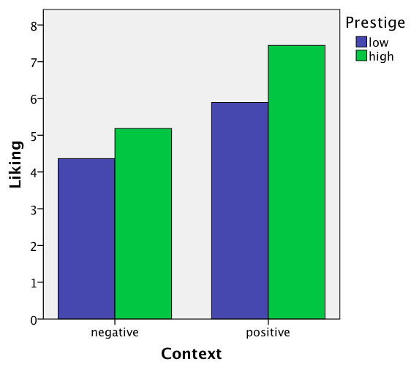

Slide 38
The underlying math
Main effect prestige: F(1,18) = 5.13 ;
Prestige by context interaction: F(1,18) = .495 ;
How does R get to these values?
Overview:
R estimates a series of regression models (one per participant)
It uses the regression coefficients in a new analysis as the dependent variable.

Slide 39
id = 1
6
7
Intercept
Slope
6
5
5
5.5
-1
4
3
2
like = b₀ + b₁prestigeC =
= 5.5 – 1*prestigeC ;
1
-.5
.5
7
id = 2
Intercept
Slope
7
6
4
5
5.5
3
4
3
2
like = b₀ + b₁prestigeC =
= 5.5 +3*prestigeC ;
1
-.5
.5

Slide 40
prestige effects
b_{0j} b_{1j}
averages differences
id lo_prest hi_prest intercepts slopes contextC
1 6 5 5.5 -1 -.5
2 4 7 5.5 3 .5
3 6 7 6.5 1 -.5
4 3 7 5.0 4 -.5
5 5 4 4.5 -1 .5
6 1 5 3.0 4 -.5
7 5 5 5.0 0 -.5
8 8 9 8.5 1 .5
9 5 7 6.0 2 .5
10 6 6 6.0 0 -.5
11 2 3 2.5 1 -.5
12 5 8 6.5 3 .5
13 9 9 9.0 0 .5
14 4 7 5.5 3 .5
15 6 3 4.5 -3 -.5
16 1 7 4.0 6 -.5
17 8 7 7.5 -1 -.5
18 8 8 8.0 0 .5
19 5 8 6.5 3 .5
20 4 2 3.0 -2 -.5
?

Slide 41
slopes = b₀ + b₁contextC = 1.19 + .74*neighbC ;
b₀?
The main effect of prestige
F(1,18) = 5.13 ; t(18) = 2.64 ; p < .02 ;
b₁?
The prestige by context interaction
F(1,18) = .495 ; t(18) = .704 ; p = .49 ;

Slide 42
Fixed effects:
Estimate Std. Error t value
(Intercept) 5.7197 0.3481 16.432
prestigeC 1.1869 0.5240 2.265
contextC 1.8939 0.6962 2.721
prestigeC:contextC 0.7374 1.0480 0.704
Response: like
F Df Df.res Pr(>F)
(Intercept) 270.0091 1 18 2.778e-12 ***
prestigeC 5.1303 1 18 0.03609 *
contextC 7.4012 1 18 0.01403 *
prestigeC:contextC 0.4951 1 18 0.49068
How do we get the main effect of context?
How does R get to an F-value of 7.40?
We regress the intercepts on context centered!

Slide 43
prestige effects
b_{0j} b_{1j}
averages differences
id lo_prest hi_prest intercepts slopes contextC
1 6 5 5.5 -1 -.5
2 4 7 5.5 3 .5
3 6 7 6.5 1 -.5
4 3 7 5.0 4 -.5
5 5 4 4.5 -1 .5
6 1 5 3.0 4 -.5
7 5 5 5.0 0 -.5
8 8 9 8.5 1 .5
9 5 7 6.0 2 .5
10 6 6 6.0 0 -.5
11 2 3 2.5 1 -.5
12 5 8 6.5 3 .5
13 9 9 9.0 0 .5
14 4 7 5.5 3 .5
15 6 3 4.5 -3 -.5
16 1 7 4.0 6 -.5
17 8 7 7.5 -1 -.5
18 8 8 8.0 0 .5
19 5 8 6.5 3 .5
20 4 2 3.0 -2 -.5

Slide 44
intercepts = b₀ + b₁contextC = 5.72 + 1.89*contextC ;
b₀?
Not a theoretically interesting question
b₁?
The main effect of context
F(1,18) = 7.40 ; t(18) = 2.72 ; p < .02 ;
Questions?

Slide 45
Within-subject variables
Prestige
Liking
Context
Neighborhood
Prestige varies within subjects, neighborhood and context vary between subjects.

Slide 46
R script mixed design:
d <- lm.readDat ("data cars 2 restr.dat")
describe(d)
d$prestigeC <- ifelse(d$prestige == 2, .5, -.5)
d$neighbC <- scale(d$neighb, scale=F)
d$contextC <- ifelse(d$context == 2, .5, -.5)
d$id <- as.factor(d$id)
mod3 <- lmer(like ~ prestigeC * neighbC * contextC + (1 + prestigeC|id),
data=d)
summary(mod3)
Anova(mod3, type = 3, test = "F")

Slide 47
Fixed effects:
Estimate Std. Error t value
(Intercept) 5.67957 0.37667 15.078
prestigeC 1.45931 0.38503 3.790
neighbC -0.11482 0.18498 -0.621
contextC 2.00991 0.75334 2.668
prestigeC:neighbC 0.67401 0.18909 3.565
prestigeC:contextC 0.06393 0.77007 0.083
neighbC:contextC 0.17011 0.36997 0.460
prestigeC:neighbC:contextC -1.13374 0.37818 -2.998
Response: like
F Df Df.res Pr(>F)
(Intercept) 227.3547 1 16.000 7.067e-11 ***
prestigeC 14.3647 1 15.999 0.001606 **
neighbC 0.3852 1 16.000 0.543551
contextC 7.1182 1 16.000 0.016839 *
prestigeC:neighbC 12.7058 1 15.999 0.002586 **
prestigeC:contextC 0.0069 1 15.999 0.934870
neighbC:contextC 0.2114 1 16.000 0.651852
prestigeC:neighbC:contextC 8.9874 1 15.999 0.008517 **
All tests have 1 and 16 degrees of freedom ; F(1,16) = …

Slide 48
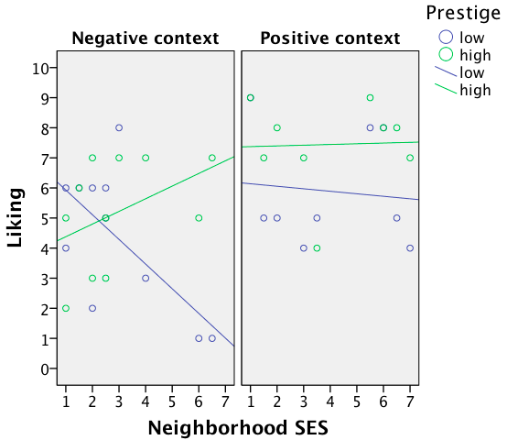

Slide 49
slopes = b₀ + b₁neighbC+ b₂contextC +
b₃(neighbC*contextC) =
= 1.46 + .67*neighbC + .06*contextC –
1.13(neighbC*contextC) =
b₀?
The main effect of prestige
F(1,16) = 14.36 ; t(16) = 3.79 ; p < .002 ;
b₁?
The prestige by neighborhood interaction
F(1,16) = 12.71 ; t(16) = 3.57 ; p < .003 ;
b₂?
The prestige by context interaction
F(1,16) = .01 ; t(16) = .08 ; p = .93 ;
b₃?
The three-way interaction
F(1,16) = 8.99 ; t(16) = 3.00 ; p < .009 ;

Slide 50
intercepts = b₀ + b₁neighbC+ b₂contextC +
b₃(neighbC*contextC) =
= 5.68 – .11*neighbC + 2.01*contextC +
.17(neighbC*contextC) =
b₀?
Not a theoretically interesting question
b₁?
The main effect of neighborhood
F(1,16) = .39 ; t(16) = .62 ; p = .54 ;
b₂?
The main effect of context
F(1,16) = 7.12 ; t(16) = 2.67 ; p < .02 ;
b₃?
The neighborhood by context interaction
F(1,16) = .21 ; t(16) = .46 ; p = .65 ;

Slide 51
Fixed effects:
Estimate Std. Error t value
(Intercept) 5.67957 0.37667 15.078
prestigeC 1.45931 0.38503 3.790
neighbC -0.11482 0.18498 -0.621
contextC 2.00991 0.75334 2.668
prestigeC:neighbC 0.67401 0.18909 3.565
prestigeC:contextC 0.06393 0.77007 0.083
neighbC:contextC 0.17011 0.36997 0.460
prestigeC:neighbC:contextC -1.13374 0.37818 -2.998
Response: like
F Df Df.res Pr(>F)
(Intercept) 227.3547 1 16.000 7.067e-11 ***
prestigeC 14.3647 1 15.999 0.001606 **
neighbC 0.3852 1 16.000 0.543551
contextC 7.1182 1 16.000 0.016839 *
prestigeC:neighbC 12.7058 1 15.999 0.002586 **
prestigeC:contextC 0.0069 1 15.999 0.934870
neighbC:contextC 0.2114 1 16.000 0.651852
prestigeC:neighbC:contextC 8.9874 1 15.999 0.008517 **
DV
intercepts
slopes
intercepts
intercepts
slopes
slopes
intercepts
slopes
Questions?

