Slide 1
Unit 18 – The Analysis of within-subject variables
Prestige
Liking
Moderator

Slide 2
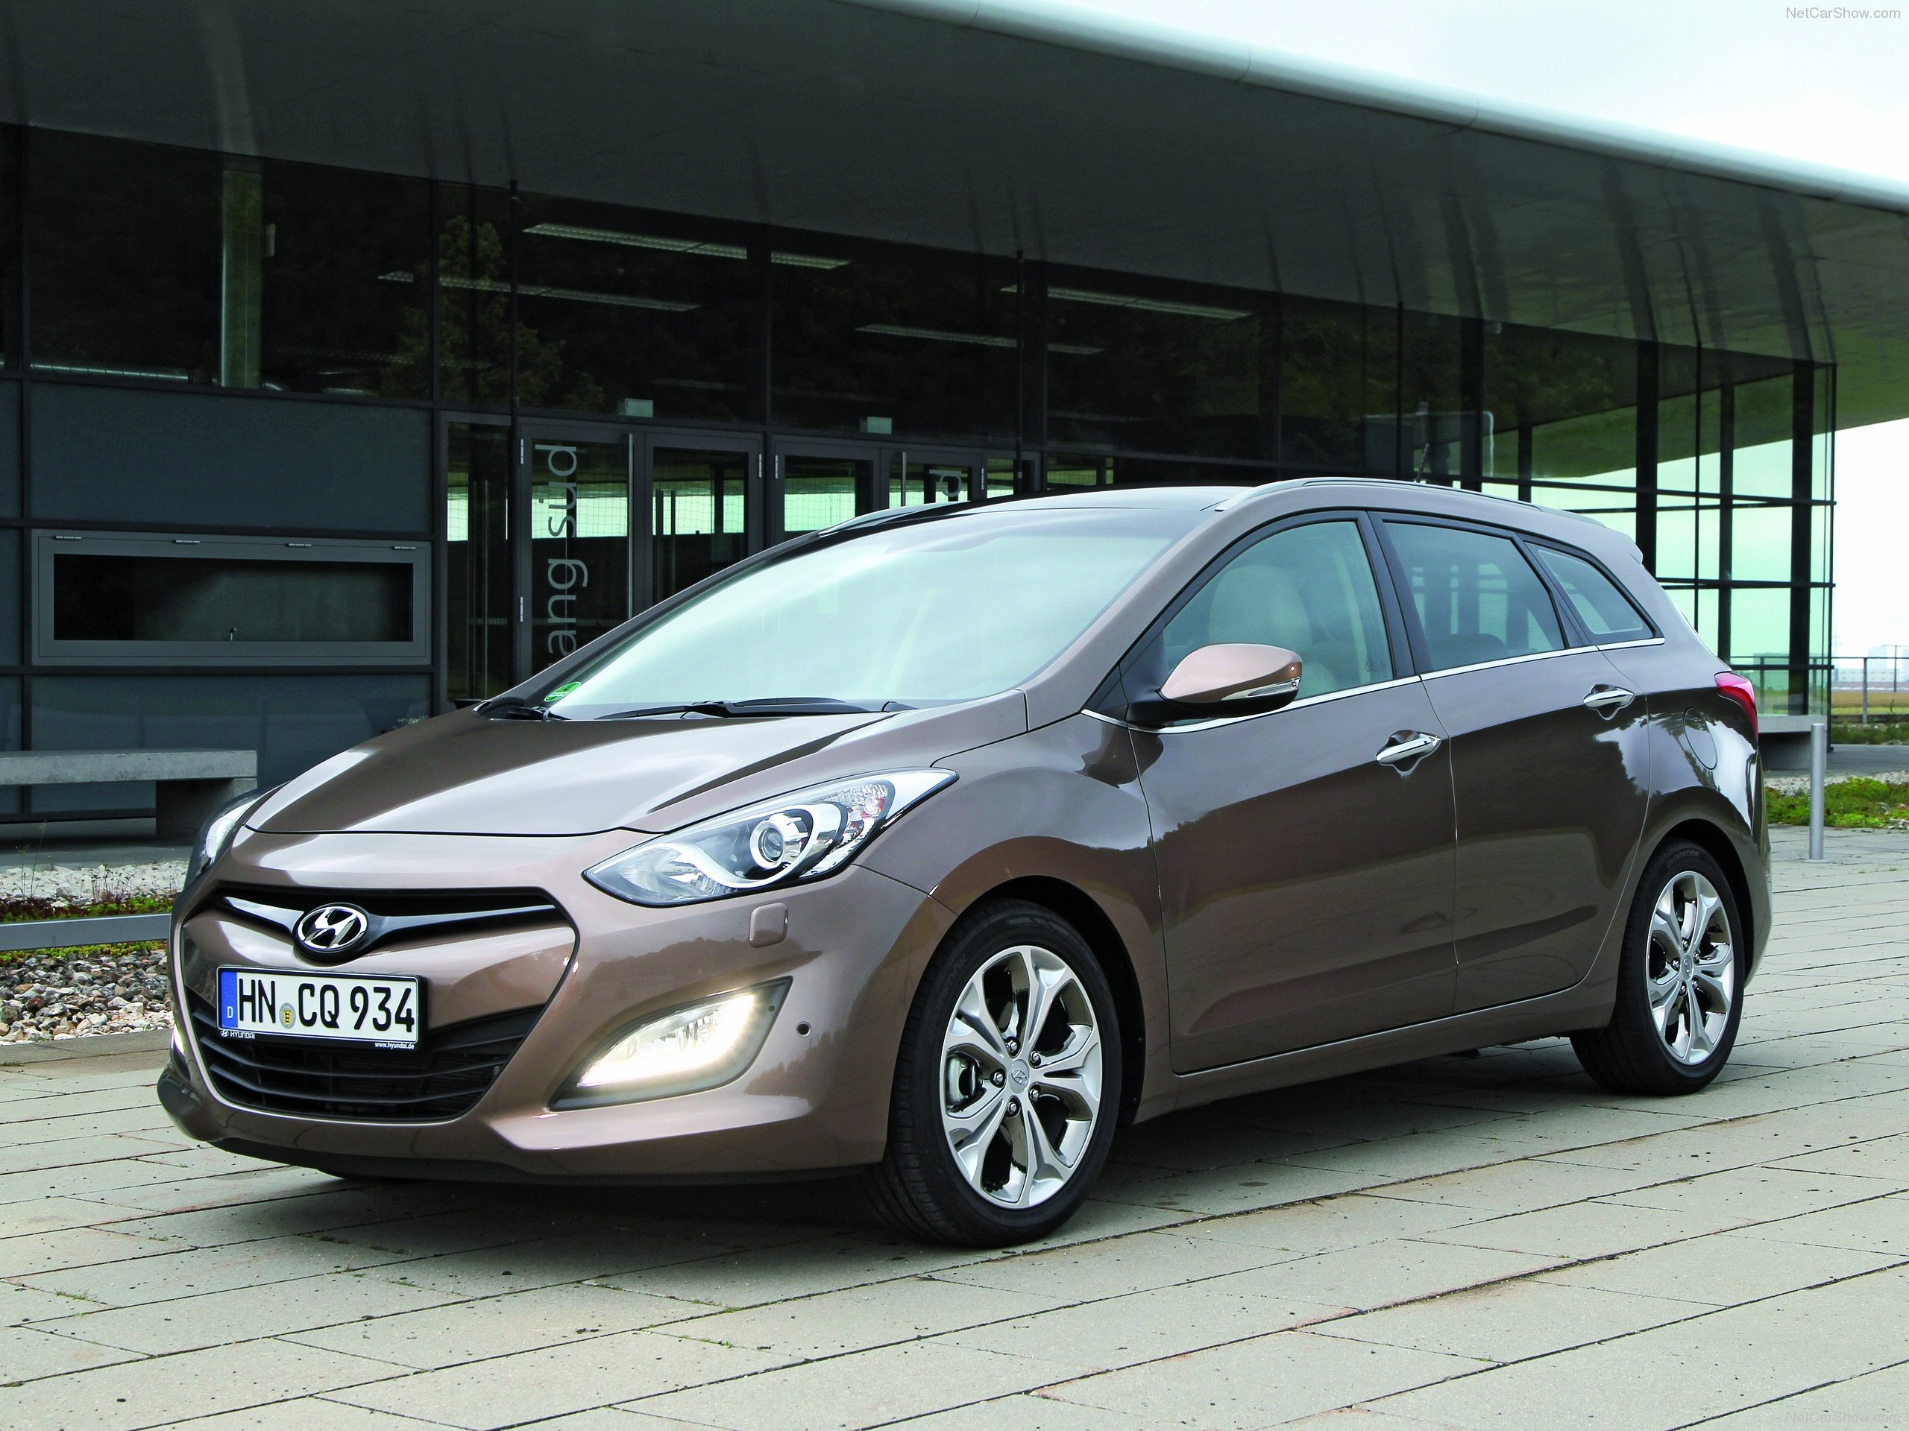
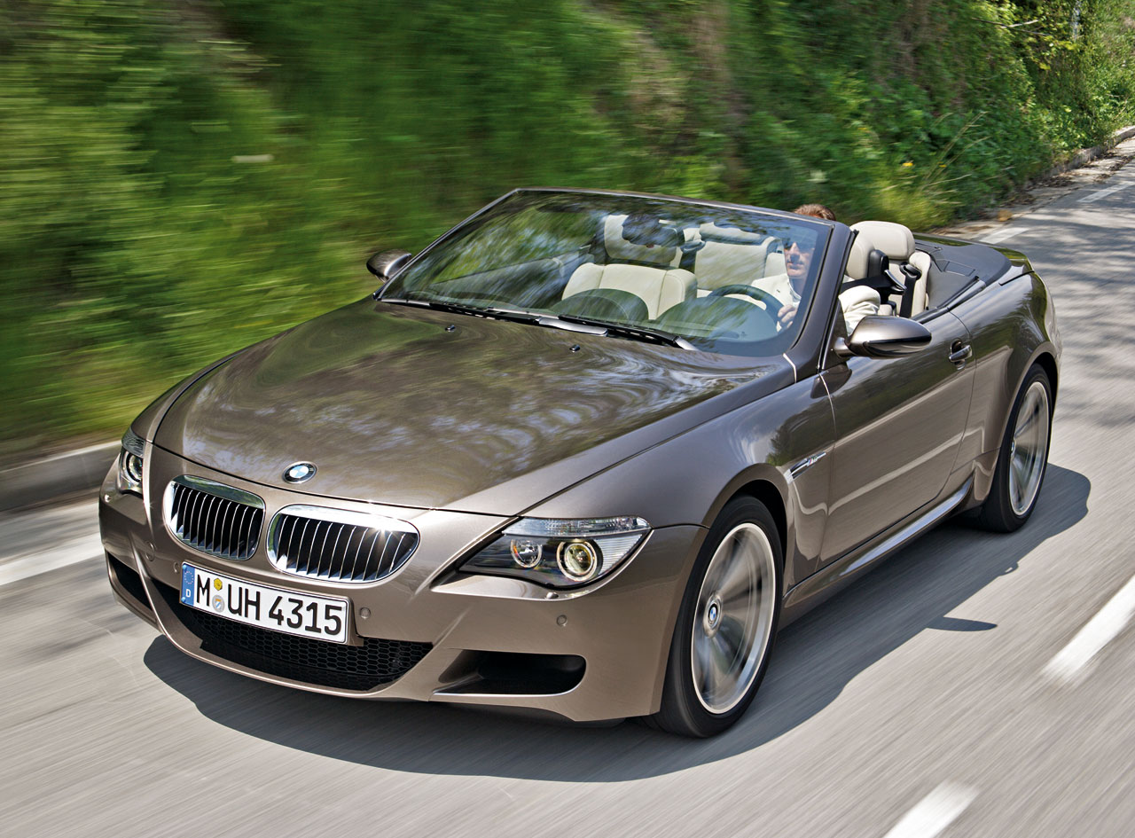
Low-prestige car
High-prestige car
prestige = 1
prestige = 2

Slide 3
Unit 18 – The Analysis of within-subject variables
Prestige
Liking
Let's start out with a between-subjects design.

Slide 4
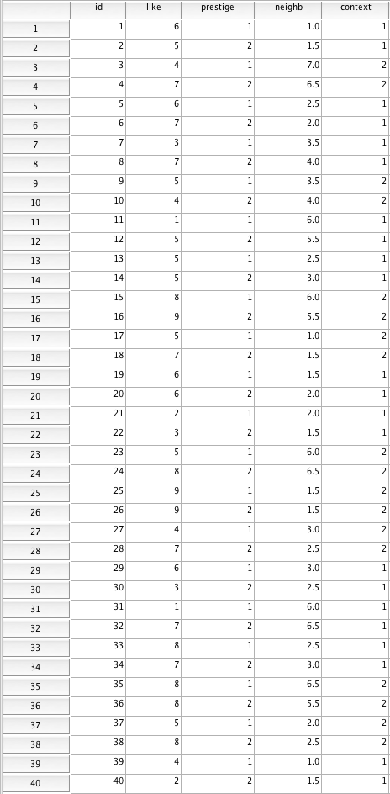
40 observations
40 participants
Observations
are independent!

Slide 5
> d <- lm.readDat ("data cars 2 betw.dat")
> describe(d)
var n mean sd median trimmed mad min max range skew
id 1 40 20.50 11.69 20.50 20.50 14.83 1 40 39 0.00
like 2 40 5.62 2.18 6.00 5.75 2.22 1 9 8 -0.37
prestige 3 40 1.50 0.51 1.50 1.50 0.74 1 2 1 0.00
neighb 4 40 3.42 1.95 2.75 3.31 1.85 1 7 6 0.50
context 5 40 1.45 0.50 1.00 1.44 0.00 1 2 1 0.19

Slide 6
> mod1prep <- lm(like ~ prestige, data=d)
> summary(mod1prep)
Call:
lm(formula = like ~ prestige, data = d)
Residuals:
Min 1Q Median 3Q Max
-4.200 -1.200 0.375 0.950 3.950
Coefficients:
Estimate Std. Error t value Pr(>|t|)
(Intercept) 3.9000 1.0642 3.665 0.000753 ***
prestige 1.1500 0.6731 1.709 0.095686 .
---
Signif. codes: 0 ‘***’ 0.001 ‘**’ 0.01 ‘*’ 0.05 ‘.’ 0.1 ‘ ’ 1
Residual standard error: 2.128 on 38 degrees of freedom
Multiple R-squared: 0.07134, Adjusted R-squared: 0.0469
F-statistic: 2.919 on 1 and 38 DF, p-value: 0.09569
> lm.sumSquares(mod1p)
SS dR-sqr pEta-sqr df F p-value
(Intercept) 60.840 0.3282 0.2611 1 13.4297 0.0008
prestige 13.225 0.0713 0.0713 1 2.9193 0.0957
Error (SSE) 172.150 NA NA 38 NA NA
Total (SST) 185.375 NA NA NA NA NA

Slide 7
Unit 18 – The Analysis of within-subject variables
Prestige
Liking
No effect of prestige in the between-subjects design.
What if we try a within-subjects design?
What would the study look like?
Advantages and disadvantages?

Slide 8
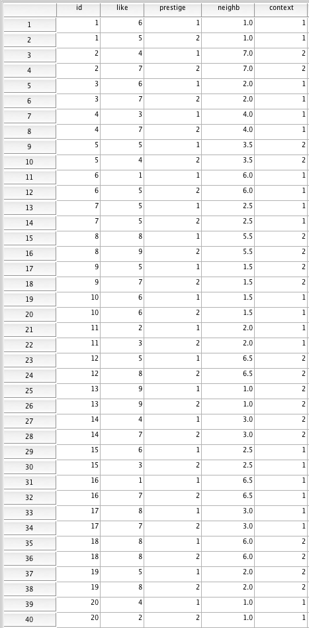
40 observations
20 participants
Observations
are non-
independent!

Slide 9
> d <- lm.readDat ("data cars 2 restr.dat")
> describe(d) # Note: R doesn't like SubID
var n mean sd median trimmed mad min max range skew
id 1 40 10.50 5.84 10.50 10.50 7.41 1 20 19 0.00
like 2 40 5.62 2.18 6.00 5.75 2.22 1 9 8 -0.37
prestige 3 40 1.50 0.51 1.50 1.50 0.74 1 2 1 0.00
neighb 4 40 3.40 2.06 2.75 3.28 1.85 1 7 6 0.49
context 5 40 1.45 0.50 1.00 1.44 0.00 1 2 1 0.19
40 observations
20 participants

Slide 10
R script between-subjects design:
mod1p <- lm(like ~ prestige, data=d)
summary(mod1p)
lm.sumSquares(mod1p)
R script within-subjects design:
d$id <- as.factor(d$id) # transforms id into a factor
mod1 <- lmer(like ~ prestige + (1 + prestige|id), data=d)
summary(mod1)
Anova(mod1, type = 3, test = "F")
lmer instead
of lm
Add
+ (1 + varname|id)
"Anova" instead of
"lm.sumSquares"
varname = name of within-subject variable

Slide 11
Linear mixed model fit by REML
Formula: like ~ prestige + (1 + prestige | id)
Data: d
AIC BIC logLik deviance REMLdev
179.4 189.5 -83.69 167.8 167.4
Random effects:
Groups Name Variance Std.Dev. Corr
id (Intercept) 3.86140 1.96504
prestige 0.23035 0.47995 -0.862
Residual 2.53088 1.59087
Number of obs: 40, groups: id, 20
Fixed effects:
Estimate Std. Error t value
(Intercept) 3.9000 0.9087 4.292
prestige 1.1500 0.5144 2.236
Correlation of Fixed Effects:
(Intr)
prestige -0.899
Analysis of Deviance Table (Type III Wald F tests with Kenward-Roger df)
Response: like
F Df Df.res Pr(>F)
(Intercept) 18.4186 1 19 0.0003938 ***
prestige 4.9979 1 19 0.0375760 *
---
Signif. codes: 0 ‘***’ 0.001 ‘**’ 0.01 ‘*’ 0.05 ‘.’ 0.1 ‘ ’ 1

Slide 12
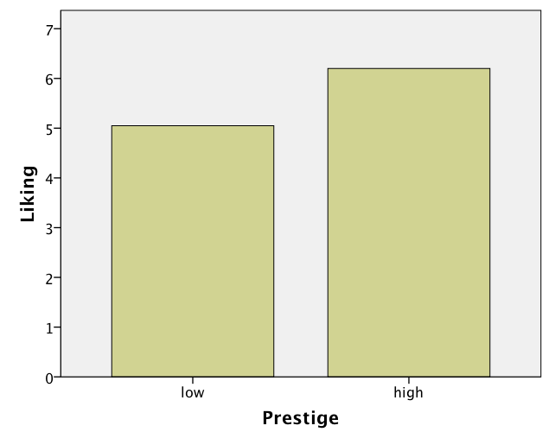

Slide 13
Fixed effects:
Estimate Std. Error t value
(Intercept) 3.9000 0.9087 4.292
prestige 1.1500 0.5144 2.236
Response: like
F Df Df.res Pr(>F)
(Intercept) 18.4186 1 19 0.0003938 ***
prestige 4.9979 1 19 0.0375760 *
F(1,19) = 5.00, p < .04
PA – PC
N – PA
How many parameters are we testing against 0?
N = # of participants
PA = # of purely between-subjects parameters we are estimating

Slide 14
Conclusion
The effect of prestige is statistically significant.
Our hypothesis is confirmed.
Participants like the high-prestige car significantly more than the low-prestige car.

Slide 15
Take-home message
R script between-subjects design:
mod1prep <- lm(like ~ prestige, data=d)
summary(mod1prep)
lm.sumSquares(mod1prep)
R script within-subjects design:
d$id <- as.factor(d$id)
mod1 <- lmer(like ~ prestige + (1 + prestige|id), data=d)
summary(mod1)
Anova(mod1, type = 3, test = "F")
Questions?

Slide 16
Within-subject variables
Let's add a continuous between-subjects variable to the design.
New hypothesis: The effect of prestige on liking is moderated by "neighborhood SES". The more affluent the participants' neighborhood the more they prefer the high-prestige over the low-prestige car.

Slide 17
Within-subject variables
Prestige
Liking
Neighborhood
Let's start with a between-subjects design.

Slide 18
40 observations
40 participants
Observations
are independent!

Slide 19
d <- lm.readDat ("data cars 2 betw.dat")
describe(d)
d$prestigeC <- ifelse(d$prestige == 2, .5, -.5)
d$neighbC <- d$neighb - mean(d$neighb)
mod2prep <- lm(like ~ prestigeC * neighbC, data=d)
summary(mod2prep)
lm.sumSquares(mod2prep)

Slide 20
Residuals:
Min 1Q Median 3Q Max
-3.5223 -1.2327 0.1668 1.0450 3.5792
Coefficients:
Estimate Std. Error t value Pr(>|t|)
(Intercept) 5.61761 0.33195 16.923 <2e-16 ***
prestigeC 1.14536 0.66389 1.725 0.0931 .
neighbC 0.09273 0.17311 0.536 0.5955
prestigeC:neighbC 0.59141 0.34623 1.708 0.0962 .
---
Signif. codes: 0 ‘***’ 0.001 ‘**’ 0.01 ‘*’ 0.05 ‘.’ 0.1 ‘ ’ 1
Residual standard error: 2.099 on 36 degrees of freedom
Multiple R-squared: 0.1442, Adjusted R-squared: 0.07288
F-statistic: 2.022 on 3 and 36 DF, p-value: 0.1282
SS dR-sqr pEta-sqr df F p-value
(Intercept) 1262.085956 6.8083 0.8883 1 286.3961 0.0000
prestigeC 13.116342 0.0708 0.0764 1 2.9764 0.0931
neighbC 1.264519 0.0068 0.0079 1 0.2869 0.5955
prestigeC:neighbC 12.857908 0.0694 0.0750 1 2.9178 0.0962
Error (SSE) 158.644267 NA NA 36 NA NA
Total (SST) 185.375000 NA NA NA NA NA

Slide 21
Within-subject variables
Prestige
Liking
Neighborhood
Now let's consider a study in which "prestige" varies within subjects (is a repeated measure).
We are predicting an interaction between a within-subjects and a between-subjects variable.

Slide 22
40 observations
20 participants
Observations
are non-
independent!

Slide 23
R script between-subjects design:
d <- lm.readDat ("data cars 2 betw.dat")
describe(d)
d$prestigeC <- ifelse(d$prestige == 2, .5, -.5)
d$neighbC <- scale(d$neighb, scale=F)
mod2p <- lm(like ~ prestigeC * neighbC, data=d)
summary(mod2p)
lm.sumSquares(mod2p)
R script within-subjects design:
d <- lm.readDat ("data cars 2 restr.dat")
describe(d)
d$prestigeC <- ifelse(d$prestige == 2, .5, -.5)
d$neighbC <- scale(d$neighb, scale=F)
d$id <- as.factor(d$id)
mod2 <- lmer(like ~ prestigeC * neighbC + (1 + prestigeC|id), data=d)
summary(mod2)
Anova(mod2, type = 3, test = "F")

Slide 24
> mod2 <- lmer(like ~ prestigeC * neighbC + (1 + prestigeC|id), data=d)
> summary(mod2)
Linear mixed model fit by REML
Formula: like ~ prestigeC * neighbC + (1 + prestigeC | id)
Data: d
AIC BIC logLik deviance REMLdev
178.4 191.9 -81.22 159.8 162.4
Random effects:
Groups Name Variance Std.Dev. Corr
id (Intercept) 3.03060 1.7409
prestigeC 2.37724 1.5418 -0.210
Residual 0.70426 0.8392
Number of obs: 40, groups: id, 20
Fixed effects:
Estimate Std. Error t value
(Intercept) 5.62500 0.41126 13.677
prestigeC 1.15000 0.43508 2.643
neighbC 0.02415 0.20212 0.120
prestigeC:neighbC 0.62560 0.21383 2.926
Correlation of Fixed Effects:
(Intr) prstgC neghbC
prestigeC -0.157
neighbC 0.000 0.000
prstgC:nghC 0.000 0.000 -0.15

Slide 25
> Anova(mod2, type = 3, test = "F")
Analysis of Deviance Table (Type III Wald F tests with Kenward-Roger df)
Response: like
F Df Df.res Pr(>F)
(Intercept) 187.0715 1 18 5.977e-11 ***
prestigeC 6.9866 1 18 0.016524 *
neighbC 0.0143 1 18 0.906200
prestigeC:neighbC 8.5599 1 18 0.009029 **
---
Signif. codes: 0 ‘***’ 0.001 ‘**’ 0.01 ‘*’ 0.05 ‘.’ 0.1 ‘ ’ 1

Slide 26
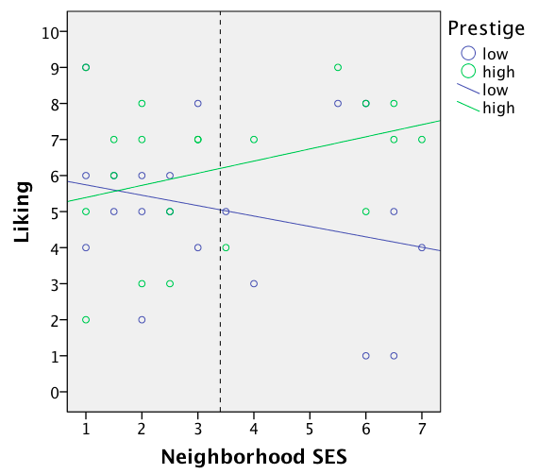

Slide 27
Fixed effects:
Estimate Std. Error t value
(Intercept) 5.62500 0.41126 13.677
prestigeC 1.15000 0.43508 2.643
neighbC 0.02415 0.20212 0.120
prestigeC:neighbC 0.62560 0.21383 2.926
F Df Df.res Pr(>F)
(Intercept) 187.0715 1 18 5.977e-11 ***
prestigeC 6.9866 1 18 0.016524 *
neighbC 0.0143 1 18 0.906200
prestigeC:neighbC 8.5599 1 18 0.009029 **
F(1,18) = 6.99, p < .02
F(1,18) = 8.56, p < .01
PA – PC
N – PA
How many parameters are we testing against 0?
N = # of participants
PA = # of purely between-subjects parameters we are estimating

Slide 28
Conclusion
The effect of prestige is statistically significant. The prestige by neighborhood interaction is also statistically significant.
Our hypothesis is confirmed.
Participants like the high-prestige car significantly more than the low-prestige car, and this effect increases with the SES of the neighborhood participants live in.

Slide 29
Within-subject variables
Let's add a dichotomous between-subjects variable to the (original) design.
Participants judge the two cars either in the context of negative images (context = 1) or in the context of positive images (context = 2).
New hypothesis: The effect of prestige on liking is moderated by context. The difference in liking between the high- and the low-prestige car will be more pronounced in the positive than in the negative context.

Slide 30
Within-subject variables
Prestige
Liking
Context
Let's start with a between-subjects design.
What is such a design called?

Slide 31
d <- lm.readDat ("data cars 2 betw.dat")
describe(d)
d$prestigeC <- ifelse(d$prestige == 2, .5, -.5)
d$contextC <- ifelse(d$context == 2, .5, -.5)
mod2bprep <- lm(like ~ prestigeC * contextC, data=d)
summary(mod2bprep)
lm.sumSquares(mod2bprep)

Slide 32
Residuals:
Min 1Q Median 3Q Max
-3.4444 -1.0076 -0.1818 1.6364 3.6364
Coefficients:
Estimate Std. Error t value Pr(>|t|)
(Intercept) 5.7197 0.3081 18.567 < 2e-16 ***
prestigeC 1.1869 0.6161 1.926 0.06199 .
contextC 1.8939 0.6161 3.074 0.00401 **
prestigeC:contextC 0.7374 1.2322 0.598 0.55332
---
Signif. codes: 0 ‘***’ 0.001 ‘**’ 0.01 ‘*’ 0.05 ‘.’ 0.1 ‘ ’ 1
Residual standard error: 1.939 on 36 degrees of freedom
Multiple R-squared: 0.2702, Adjusted R-squared: 0.2093
F-statistic: 4.442 on 3 and 36 DF, p-value: 0.009354
> lm.sumSquares(mod2bprep)
SS dR-sqr pEta-sqr df F p-value
(Intercept) 1295.511364 6.9886 0.9054 1 344.7217 0.0000
prestigeC 13.945707 0.0752 0.0934 1 3.7108 0.0620
contextC 35.511364 0.1916 0.2079 1 9.4492 0.0040
prestigeC:contextC 1.345707 0.0073 0.0098 1 0.3581 0.5533
Error (SSE) 135.292929 NA NA 36 NA NA
Total (SST) 185.375000 NA NA NA NA NA

Slide 33
Within-subject variables
Prestige
Liking
Context
Now let's consider a study in which "prestige" varies within subjects (is a repeated measure).
We are predicting an interaction between a within-subjects and a between-subjects variable.
What is such a design called?

Slide 34
40 observations
20 participants
Observations
are non-
independent!

Slide 35
R script between-subjects design:
d <- lm.readDat ("data cars 2 betw.dat")
describe(d)
d$prestigeC <- ifelse(d$prestige == 2, .5, -.5)
d$contextC <- ifelse(d$context == 2, .5, -.5)
mod2bprep <- lm(like ~ prestigeC * contextC, data=d)
summary(mod2bprep)
lm.sumSquares(mod2bprep)
R script mixed design:
d <- lm.readDat ("data cars 2 restr.dat")
describe(d)
d$prestigeC <- ifelse(d$prestige == 2, .5, -.5)
d$contextC <- ifelse(d$context == 2, .5, -.5)
d$id <- as.factor(d$id)
mod2 <- lmer(like ~ prestigeC * contextC + (1 + prestigeC|id), data=d)
summary(mod2)
Anova(mod2, type = 3, test = "F")

Slide 36
> mod2 <- lmer(like ~ prestigeC * contextC + (1 + prestigeC|id), data=d)
> summary(mod2)
Linear mixed model fit by REML
Formula: like ~ prestigeC * contextC + (1 + prestigeC | id)
Data: d
AIC BIC logLik deviance REMLdev
172.5 186 -78.24 159.4 156.5
Random effects:
Groups Name Variance Std.Dev. Corr
id (Intercept) 2.01708 1.42024
prestigeC 3.90883 1.97708 -0.312
Residual 0.76385 0.87399
Number of obs: 40, groups: id, 20
Fixed effects:
Estimate Std. Error t value
(Intercept) 5.7197 0.3481 16.432
prestigeC 1.1869 0.5240 2.265
contextC 1.8939 0.6962 2.721
prestigeC:contextC 0.7374 1.0480 0.704
Correlation of Fixed Effects:
(Intr) prstgC cntxtC
prestigeC -0.243
contextC 0.100 -0.024
prstgC:cntC -0.024 0.100 -0.243

Slide 37
> Anova(mod2, test = "F")
Analysis of Deviance Table (Type III Wald F tests with Kenward-Roger df)
Response: like
F Df Df.res Pr(>F)
(Intercept) 270.0091 1 18 2.778e-12 ***
prestigeC 5.1303 1 18 0.03609 *
contextC 7.4012 1 18 0.01403 *
prestigeC:contextC 0.4951 1 18 0.49068
---
Signif. codes: 0 ‘***’ 0.001 ‘**’ 0.01 ‘*’ 0.05 ‘.’ 0.1 ‘ ’ 1

Slide 38
Fixed effects:
Estimate Std. Error t value
(Intercept) 5.7197 0.3481 16.432
prestigeC 1.1869 0.5240 2.265
contextC 1.8939 0.6962 2.721
prestigeC:contextC 0.7374 1.0480 0.704
Response: like
F Df Df.res Pr(>F)
(Intercept) 270.0091 1 18 2.778e-12 ***
prestigeC 5.1303 1 18 0.03609 *
contextC 7.4012 1 18 0.01403 *
prestigeC:contextC 0.4951 1 18 0.49068
F(1,18) = 4.87, p < .05
F(1,18) = .50, p = .49
PA – PC
N – PA
How many parameters are we testing against 0?
N = # of participants
PA = # of purely between-subjects parameters we are estimating

Slide 39
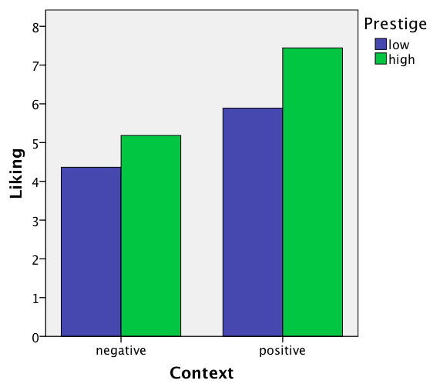

Slide 40
Conclusion
The effect of prestige is statistically significant. The prestige by context interaction is not statistically significant.
Our interaction hypothesis is not confirmed.
Participants like the high-prestige car significantly more than the low-prestige car, and this effect does not seem to be affected by whether participants judge the cars in a positive or a negative context.

Slide 41
Within-subject variables
Let's add a continuous between-subjects variable and a dichotomous between-subjects variable to the (original) design.
New hypothesis: We predict a three-way interaction. We predict that the prestige by neighborhood interaction is stronger when cars are judged in a negative rather than a positive context.

Slide 42
Within-subject variables
Prestige
Liking
Context
Neighborhood
Let's start with a between-subjects design.

Slide 43
d <- lm.readDat ("data cars 2 betw.dat")
describe(d)
d$prestigeC <- ifelse(d$prestige == 2, .5, -.5)
d$neighbC <- scale(d$neighb, scale=F) # centers the variable neighb
d$contextC <- ifelse(d$context == 2, .5, -.5)
mod3bprep <- lm(like ~ prestigeC * neighbC * contextC, data=d)
summary(mod3bprep)
lm.sumSquares(mod3bprep)

Slide 44
Coefficients:
Estimate Std. Error t value Pr(>|t|)
(Intercept) 5.64427 0.29970 18.833 < 2e-16 ***
prestigeC 1.54550 0.59939 2.578 0.01473 *
neighbC -0.08322 0.15699 -0.530 0.59973
contextC 2.02112 0.59939 3.372 0.00196 **
prestigeC:neighbC 0.68991 0.31399 2.197 0.03536 *
prestigeC:contextC 0.03364 1.19878 0.028 0.97779
neighbC:contextC 0.20528 0.31399 0.654 0.51792
prestigeC:neighbC:contextC -1.39869 0.62797 -2.227 0.03308 *
---
Signif. codes: 0 ‘***’ 0.001 ‘**’ 0.01 ‘*’ 0.05 ‘.’ 0.1 ‘ ’ 1
Residual standard error: 1.808 on 32 degrees of freedom
Multiple R-squared: 0.4358, Adjusted R-squared: 0.3124
F-statistic: 3.531 on 7 and 32 DF, p-value: 0.006386
SS dR-sqr pEta-sqr df F p-value
(Intercept) 1.159294e+03 6.2538 0.9172 1 354.6935 0.0000
prestigeC 2.172991e+01 0.1172 0.1720 1 6.6484 0.0147
neighbC 9.183151e-01 0.0050 0.0087 1 0.2810 0.5997
contextC 3.716240e+01 0.2005 0.2622 1 11.3701 0.0020
prestigeC:neighbC 1.577984e+01 0.0851 0.1311 1 4.8279 0.0354
prestigeC:contextC 2.573943e-03 0.0000 0.0000 1 0.0008 0.9778
neighbC:contextC 1.397051e+00 0.0075 0.0132 1 0.4274 0.5179
prestiC:neighbC:contextC 1.621446e+01 0.0875 0.1342 1 4.9609 0.0331
Error (SSE) 1.045901e+02 NA NA 32 NA NA
Total (SST) 1.853750e+02 NA NA NA NA NA

Slide 45
Within-subject variables
Prestige
Liking
Context
Neighborhood
Now let's consider a study in which "prestige" varies within subjects (is a repeated measure).
Like before, we are predicting a 3-way interaction.

Slide 46
40 observations
20 participants
Observations
are non-
independent!

Slide 47
R script between-subjects design:
d <- lm.readDat ("data cars 2 betw.dat")
describe(d)
d$prestigeC <- ifelse(d$prestige == 2, .5, -.5)
d$neighbC <- scale(d$neighb, scale=F)
d$contextC <- ifelse(d$context == 2, .5, -.5)
mod3bprep <- lm(like ~ prestigeC * neighbC * contextC, data=d)
summary(mod3bprep)
lm.sumSquares(mod3bprep)
R script mixed design:
d <- lm.readDat ("data cars 2 restr.dat")
describe(d)
d$prestigeC <- ifelse(d$prestige == 2, .5, -.5)
d$neighbC <- scale(d$neighb, scale=F)
d$contextC <- ifelse(d$context == 2, .5, -.5)
d$id <- as.factor(d$id)
mod3 <- lmer(like ~ prestigeC * neighbC * contextC + (1 + prestigeC|id),
data=d)
summary(mod3)
Anova(mod3, type = 3, test = "F")

Slide 48
Random effects:
Groups Name Variance Std.Dev. Corr
id (Intercept) 2.35390 1.53424
prestigeC 1.70455 1.30558 -0.218
Residual 0.51096 0.71482
Number of obs: 40, groups: id, 20
Fixed effects:
Estimate Std. Error t value
(Intercept) 5.67957 0.37667 15.078
prestigeC 1.45931 0.38503 3.790
neighbC -0.11482 0.18498 -0.621
contextC 2.00991 0.75334 2.668
prestigeC:neighbC 0.67401 0.18909 3.565
prestigeC:contextC 0.06393 0.77007 0.083
neighbC:contextC 0.17011 0.36997 0.460
prestigeC:neighbC:contextC -1.13374 0.37818 -2.998
Correlation of Fixed Effects:
(Intr) prstgC neghbC cntxtC prstgC:nC prstgC:cC nghC:C
prestigeC -0.164
neighbC -0.002 0.000
contextC 0.101 -0.016 -0.265
prstgC:nghC 0.000 -0.002 -0.164 0.044
prstgC:cntC -0.016 0.101 0.044 -0.164 -0.265
nghbC:cntxC -0.265 0.044 -0.092 -0.002 0.015 0.000
prstgC:nC:C 0.044 -0.265 0.015 0.000 -0.092 -0.002 -0.164

Slide 49
> Anova(mod3, test = "F")
Analysis of Deviance Table (Type III Wald F tests with Kenward-Roger df)
Response: like
F Df Df.res Pr(>F)
(Intercept) 227.3547 1 16.000 7.067e-11 ***
prestigeC 14.3647 1 15.999 0.001606 **
neighbC 0.3852 1 16.000 0.543551
contextC 7.1182 1 16.000 0.016839 *
prestigeC:neighbC 12.7058 1 15.999 0.002586 **
prestigeC:contextC 0.0069 1 15.999 0.934870
neighbC:contextC 0.2114 1 16.000 0.651852
prestigeC:neighbC:contextC 8.9874 1 15.999 0.008517 **
---
Signif. codes: 0 ‘***’ 0.001 ‘**’ 0.01 ‘*’ 0.05 ‘.’ 0.1 ‘ ’ 1

Slide 50
Fixed effects:
Estimate Std. Error t value
(Intercept) 5.67957 0.37667 15.078
prestigeC 1.45931 0.38503 3.790
neighbC -0.11482 0.18498 -0.621
contextC 2.00991 0.75334 2.668
prestigeC:neighbC 0.67401 0.18909 3.565
prestigeC:contextC 0.06393 0.77007 0.083
neighbC:contextC 0.17011 0.36997 0.460
prestigeC:neighbC:contextC -1.13374 0.37818 -2.998
Response: like
F Df Df.res Pr(>F)
(Intercept) 227.3547 1 16.000 7.067e-11 ***
prestigeC 14.3647 1 15.999 0.001606 **
neighbC 0.3852 1 16.000 0.543551
contextC 7.1182 1 16.000 0.016839 *
prestigeC:neighbC 12.7058 1 15.999 0.002586 **
prestigeC:contextC 0.0069 1 15.999 0.934870
neighbC:contextC 0.2114 1 16.000 0.651852
prestigeC:neighbC:contextC 8.9874 1 15.999 0.008517 **
All tests have 1 and 16 degrees of freedom ; F(1,16) = …

Slide 51
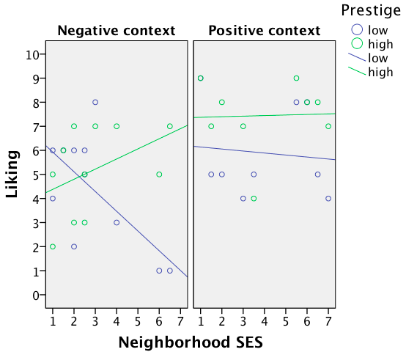

Slide 52
Conclusion
The three way interaction is significant.
Our hypothesis is confirmed.
The more affluent a participant's neighborhood, the more s/he will prefer a high- over a low-prestige car, and this effect is stronger when cars are presented in a negative rather than a positive context.

