Slide 1
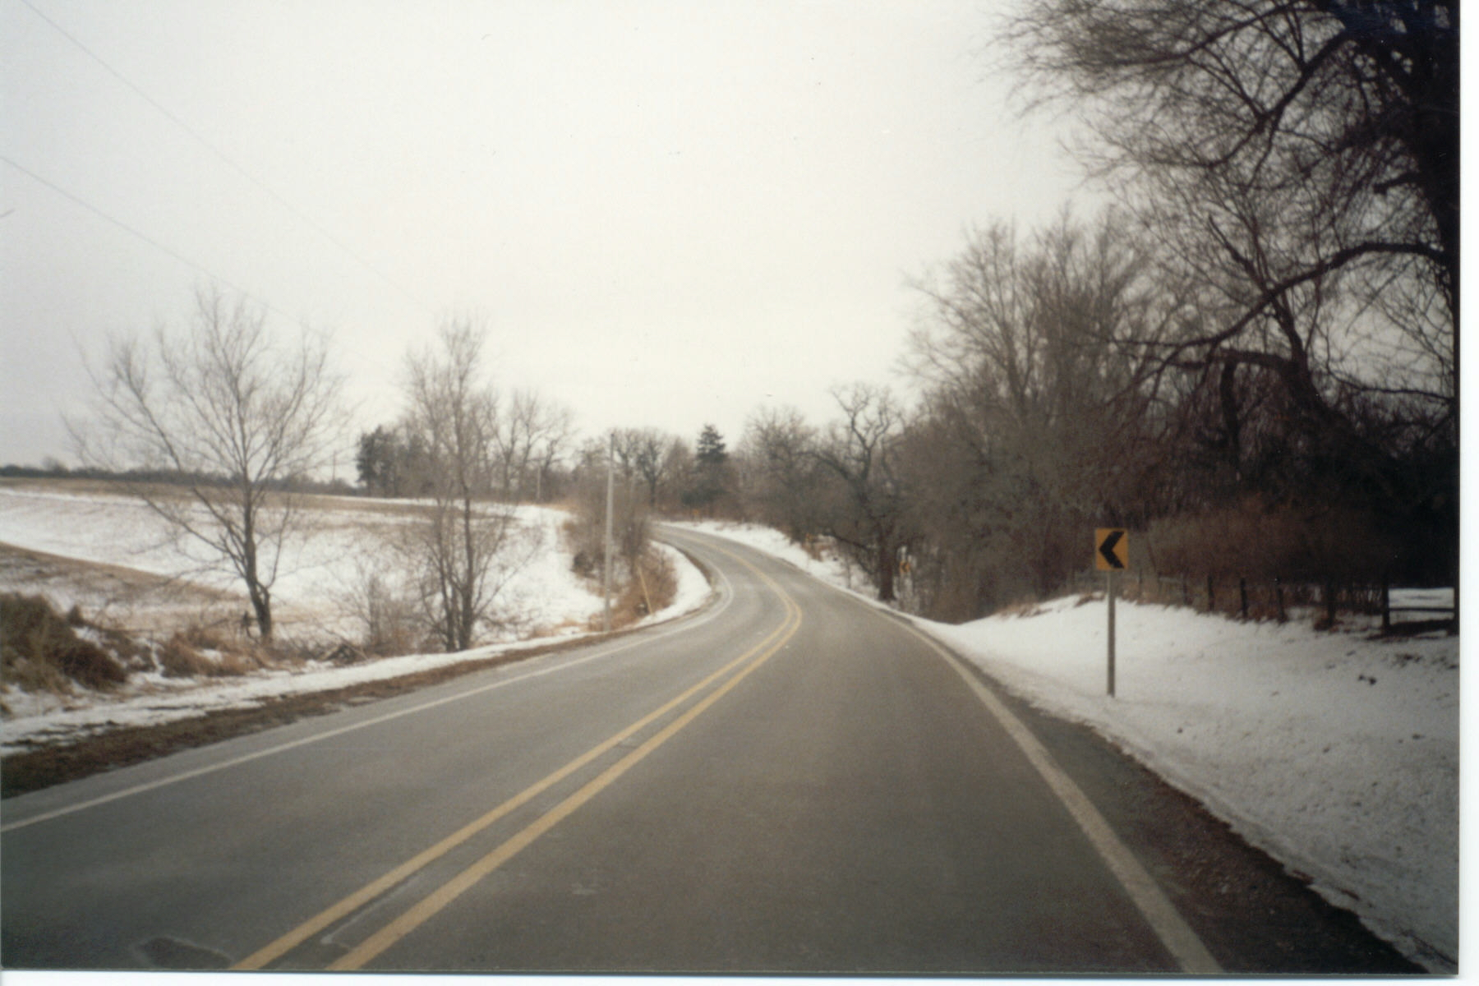

Rural Mental Health: Challenges and Opportunities Caring for the Country
Dennis F. Mohatt
WICHE Mental Health Program

Slide 2
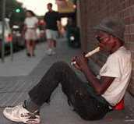
What do many Americans think of when they picture persons with mental illness?
A homeless person on a city street
An out-of-control teenager in a large metropolitan school
A person on a locked hospital ward
Persons making poor choices
Someone else

Slide 3

Few Americans Picture
A farmer or rancher with serious depression
The stress associated with changing rural economies
Someone driving 150+ miles to a clinic
A traveling psychiatrist
Migrant farm workers
Rural America

Slide 4
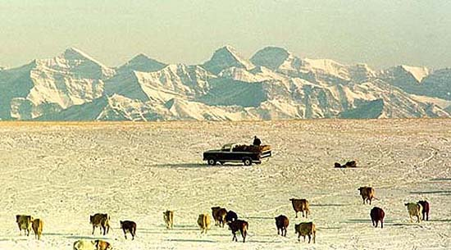
The cold hard facts
More than 60% of rural Americans live in mental health professional shortage areas
More than 90% of all psychologists and psychiatrists, and 80% of MSWs, work exclusively in metropolitan areas
More than 65% of rural Americans get their mental health care from their primary care provider
The mental health crisis responder for most rural Americans is a law enforcement officer

Slide 5
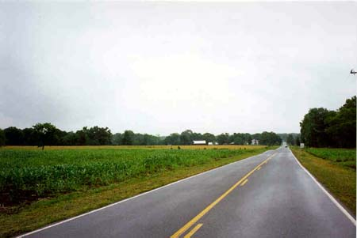
What’s different in the country?
Not prevalence – rural/urban rates of mental disorders are pretty much the same.
Accessibility (getting there and paying)
Availability (someone there when you are)
Acceptability (choice, quality, knowledge)

Slide 6
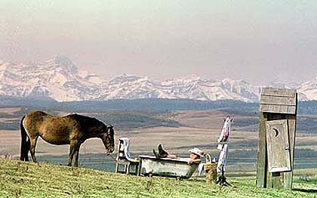
ACCESSIBILITY
Rural Americans travel further to provide and receive services
Rural Americans are less likely to have insurance benefits for mental health care
Rural Americans are less likely to recognize mental illnesses, and understand their care options

Slide 7
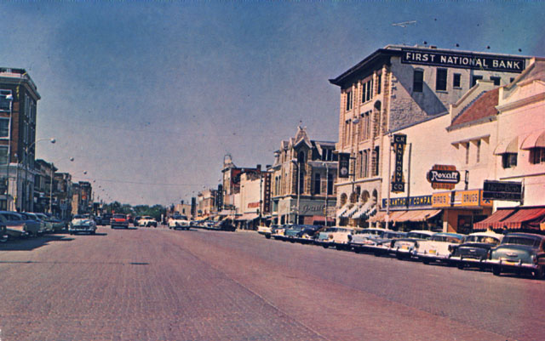
AVAILABILITY
Rural areas suffer from chronic shortages of mental health professionals
Specialty providers highly unlikely to be available in rural areas
Comprehensive services often not available
CMHCs expected to serve all

Slide 8
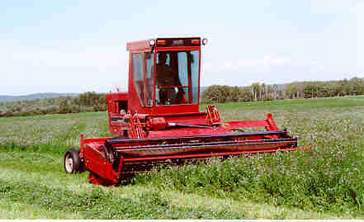
ACCEPTABILTY
Few programs train professionals to work competently in rural places
Rural people often lack choice of providers
Stigma
Urban models assumed to work for rural

Slide 9
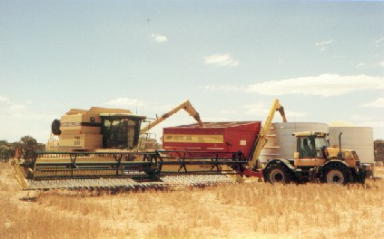
How it should be….
Comprehensive continuums of care
Quick, easy, convenient access
Providers who are culturally competent
Systems and providers work together, share resources, and focus on what works
No wrong door

Slide 10
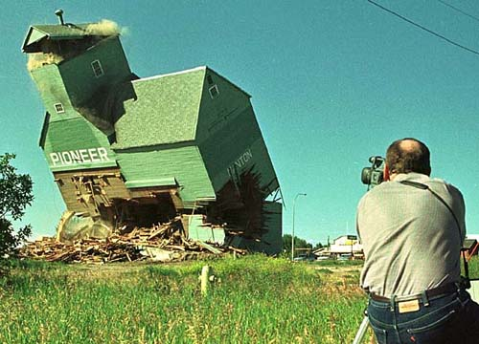
The way it is…
Rural people not well informed
Providers are isolated from each other
Service access is confusing & complex
Services are fragmented
Providers plan “what pays” rather than “what works”
Rural people enter care later, sicker, and with a higher level/cost

Slide 11
How did it get this way?
Stigma/Discrimination
Lack of a rural plan
Lack of sustained effort to prepare and deploy professionals for rural practice
One size fits all planning and funding
Mental Health Care is “optional”

Slide 12
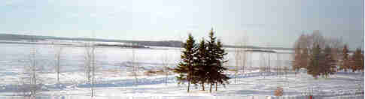
What can we do?
Advocacy
Public Education
Improve Primary Care/Mental Health Integration
Take rural into account – get a plan

Slide 13
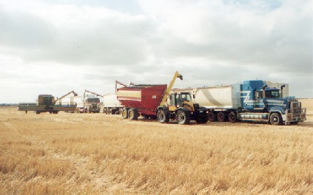
Programs that work: Nebraska
The State in partnership with the Center for Rural Affairs, operates a program that:
  Trained hotline workers about mental health
  Trained mental health workers about farm issues
  Provides vouchers to rural persons in need to obtain services from a range of providers

Slide 14
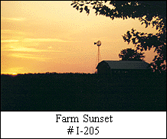
Programs that work: Illinois
Farm Resource Center (Cairo) recruits professionals and paraprofessionals with farming and rural backgrounds to work as outreach workers. Provide short-term crisis support, information, and referral. Operates now with displaced mining communities in West Virginia, Ohio, and Pennsylvania

Slide 15
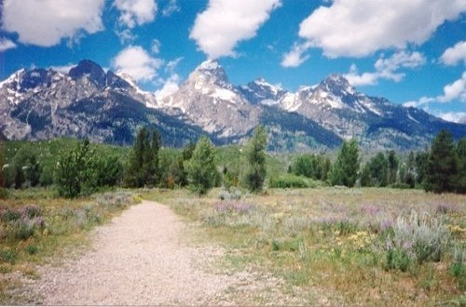
Programs that work: Wyoming
State Hospital in Evanston provides transport services for persons needing hospital care (removing the Sheriff from the equation), deploys staff psychiatrists and others to circuit practice across the state in primary care offices, mental health centers, nursing homes, and community hospitals. State actively partners with community to recruit professionals and support training of own.

Slide 16
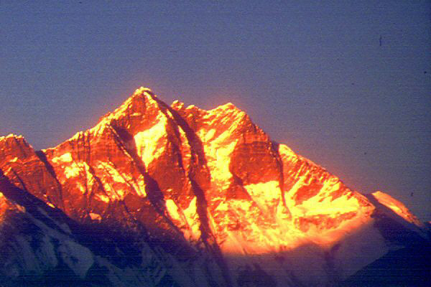
Programs that work: Alaska
Partnership between University of Alaska-Fairbanks and Native Health Cooperatives train and supports Village Mental Health Aides to provide care and support to persons with mental illnesses in remote Native villages in Alaska’s interior.

Slide 17

Programs that work: Colorado
Collaborative venture by CMHC and MBHO operates “warm-line” staffed by trained consumer/peer advisors to assist callers in non-crisis matters and provide support, information, and referral.

Slide 18
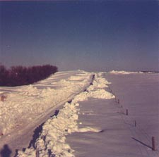
Programs that work: Michigan
Mental Health Center serving rural area of the Upper Peninsula closed its outpatient clinics and relocated staff to family medicine clinics across the area. Resulted in increased referrals, fewer “no-shows” and cancelled appointments, and reduced cost of operation.

Slide 19
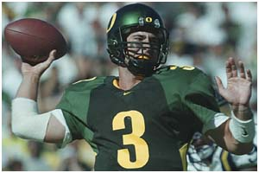
Programs that work: Oregon
Telehealth partnership between multiple Oregon CMHCs, primary care providers, and the Oregon Health Sciences Hospital provides specialty consultation and enables families to be included in care provided to individuals admitted to distant inpatient facilities.

Slide 20
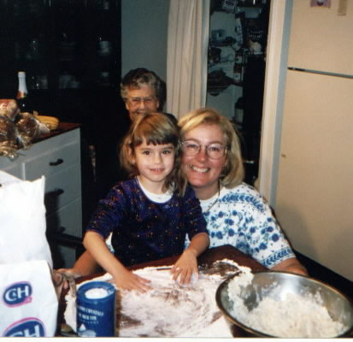
Most Vital Rural Resource
Charismatic Leadership
  One person often makes the difference
  One person leaving often changes things
  Nurture each other
  Grow your own
  P I E
  www.wiche.edu

