Slide 1


Electricity, Electronics and Psychophysiology
A Theoretical and Applied Introduction
John J. Curtin, Ph.D.
University of Wisconsin, Madison

Slide 2
Benefits of Understanding Electricity
We do all of our measurement with electrical devices
  Often need to have them built (or build them ourselves)
  Very frequently need to troubleshoot them
  At least need to understand them
The majority of the signals we measure are electrical signals (and the others are quickly transformed to electrical by a transducer)
  An understanding of electricity will help us understand the processing that we do to these signal
  Also it will aid understanding of the factors that affect their acquisition
Electrical models provide an ideal context to develop critical thinking skills

Slide 3
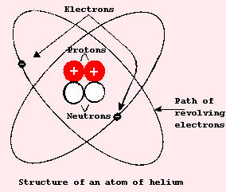
The Atom
All matter is made of atoms that are combined together into molecules
The atom is composed of protons, neutrons and electrons
  Protons have a positive charge
  Electrons have a negative charge
  Neutrons are neutral

Slide 4
Free Electrons & Current
A stable atom has the same number of electrons and protons and is therefore electrically neutral.
However, free electrons can be produced by applying a force to the atom.
The movement of free electrons along a wire is electric current

Slide 5
Conductors & Insulators
Electric current moves easily through some materials and less easily through other materials
Materials that have very “tightly bound” electrons have few free electrons when an electric force is applied. These materials are insulators (e.g. rubber, glass, dry wood)
Materials that allow the movement of a large number of free electrons are called conductors (e.g., silver, copper, aluminum)
  Electrical energy is transferred through a conductor by means of the movement of free electrons that move from atom to atom
  Displaced electrons continue to “bump” each other
  The electrons move relatively slowly but this movement creates electrical energy throughout the conductor that is transferred almost instantaneously throughout the wire (e.g., billiard ball example, wind vs. sound example)

Slide 6
Static Electricity
If something has an excess of electrons, it is negatively charged; a deficiency of electrons leads to a positive charge.
Like charges repel each other and unlike charges attract each other.
When two objects that have unequal charge are brought near to each other, an electric force (in this case, attraction) exists between them.
Static electricity (electrostatic force) is maintained because no current can flow between the two objects.

Slide 7
Static Electricity Demonstration
Static electricity is created by applying a friction force between two objects (comb and hair)
The friction force transfers electrons from one object (hair) to the other (comb)
Electrostatic force exists between the comb and paper because the comb is now negatively charged relative to the paper.
Electrostatic forces are best established between insulators. Why?
  Because insulators don’t transfer free electrons easily when an electric force (in contrast to friction) is applied. Therefore, current will not flow between them.

Slide 8
Current, Voltage, Resistance
Current is the rate of flow of electrons/charge
  It is abbreviated as I
  It is measured in amperes
  One ampere is defined as one coulomb (Q; 6.28 X 10¹⁸) of electrons flowing past a point each second (Q/s)
Voltage is a force that pushes/drives the electrons/charge
  It is also referred to as electromotive force or difference in potential.
  It is abbreviated as E or EMF
  Voltage is measured in volts (v)
  Voltage source will have a polarity (negative and positive side)
  Current flows from negative to positive (changing conventions)
  AC/DC: Alternating current (polarity of source reverses) or Direct current (polarity is constant)
Resistances are the barriers to the flow of charge
  It is abbreviated as R
  It is measured in ohms

Slide 9
Coulombs Law of Charges
Charged bodies attract or repel each other with a force that is directly proportional to the product of their charges and that is inversely proportional to the square of their distance between them.
Electric force is caused by differences in charge
In a complete circuit, this force (electromotive force, difference in potential, voltage) is created by a battery (or other electric force producing source like a generator) and drives (pushes) electrons through a conducting wire.

Slide 10
Water Example of Electric Circuit
The reservoir is the battery or other voltage source*
Valve is a switch
The water is the charge (electrons)
Water pressure is is the voltage*
The pipe is the conductor (wire)*
The rate of flow (volume/s) is the current*
Constrictions in the pipe represent resistors

Slide 11
Ohms Law
Ohms Law
The current in a circuit is proportional to the voltage and inversely related to the resistance
E = I * R
I = E/R
R = E/I
E
E
I
R

Slide 12
Circuit Diagrams
Battery (short side is negative terminal)
Wire conductor
Resistor
Light bulb (or other load)
Open switch
Closed switch
Ground

Slide 13
Series Circuit Analysis
A 4v battery is placed in a series circuit with a 2Ω resistor.
What is the total current that will flow through the circuit?
E = IR
4v = I * 2 Ω
I = 2a
2Ω
4v
I = ?

Slide 14
Series Circuit Analysis
What voltage is required to produce 2a though a circuit with a 3Ω resistor.
E = IR
E = 2a * 3Ω
E = 6v
3Ω
?
I = 2a

Slide 15
Series Circuit Analysis
What resistance is required to limit the current to 4a if a 12 v battery is in the circuit?
E = IR
12 = 4a * R
R = 3Ω
3Ω
12v
I = 4a

Slide 16
Series Circuit Analysis
Resistance in series sum together when calculating total resistance
What is the current in the circuit below?
E = IR
12 = I * (2Ω + 4Ω)
I = 2a
2Ω
4Ω
12v
I = ?

Slide 17
Series Circuit Analysis
Resistance in series sum together when calculating total resistance
What is the resistance of the light bulb?
E = IR
12 = 4 * (2Ω + R)
R = 1Ω
R = ?
2Ω
12v
I = 4

Slide 18
Kirchhoff’s Law of Voltages
The algebraic sum of all voltages in a complete circuit is equal to zero
If we consider the source voltage to be positive, there will be a negative “voltage drop” across each resistor
The voltage drop across each resistor can be calculated with Ohms law
-4v
-8v
2Ω
4v
4Ω
12v
0v
12v
I = 2
12v

Slide 19
Kirchhoff’s Law of Voltages
Calculate the total current flow and the voltage drop across each resistor
Relative to point d, what will be the voltage at points, a, b and c
a vs. d= 24v
b vs. d= 15v
c vs. d= 3v
-3v
-12v
1Ω
c
4Ω
d
24v
I = 3
b
-9v
a
3Ω

Slide 20
Series vs. Parallel Circuits
Series Circuits
A series circuit is a circuit in which the current can only flow through one path.
Current is the same at all points in a series circuit
Parallel Circuits
In contrast, in a parallel circuit, there are multiple paths for current flow.
Different paths may contain different current flow. This is also based on Ohms Law
Total resistance in a parallel circuit
1 = 1 + 1 + 1 + 1
R_{tot} R₁ R₂ R₃ R_{n}
Total resistance will be less than the smallest resistor**

Slide 21
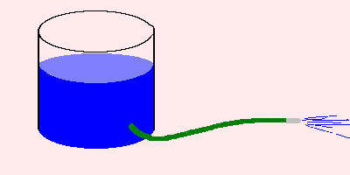
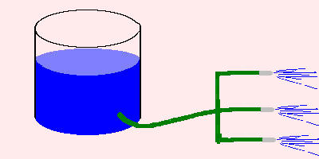
By Analogy: Series Vs Parallel
E
I
R₁
R₂
E
R₁
I₁
R₂
I₂
R₃
I₃

Slide 22
Parallel Circuits
What is the total current below?
1. First calculate total resistance
1 = 1 + 1 + 1
R_{tot} 5 10 30
1 = 1
R_{tot} .333
R_{tot} = 3 Ω
2. Then use E = IR
30v = I * 3 Ω
I = 10a
5Ω
10Ω
30v
30Ω

Slide 23
Parallel Circuits
What is the current through a?
What is the current through e?
What is the current each branch b-d?
10a
10a
Same voltage is across each path
b: E= IR 30= I*5 I= 6a
c: 30= I*10 I= 3a
d: 30= I*30 I= 1a
b
5Ω
e
c
10Ω
d
a
30v
30Ω
I_{tot} = 10a

Slide 24
Shortcuts to Total R in Parallel
If all N branches have the same resistance, total resistance is equal to the resistance of one branch divided by the number of branches
Total resistance=
Total current=
Current in b=
10Ω
3a
b
1Ω
30Ω
e
c
30Ω
d
a
30v
30Ω

Slide 25
Shortcuts to Total R in Parallel
If there are only two branches, the total resistance is equal to the product of the resistances divided by the sum of the resistances
Total resistance=
12 * 4 = 3 Ω
12 + 4
12Ω
4Ω
30v

Slide 26
Compound Circuits
What is the:
Total resistance?
Total current flow?
Current flow through b
Current flow through c
Current flow through d
Voltage between b and d
Voltage between c and d
Voltage between d and e
b
3Ω
e
d
a
2Ω
c
20v
6Ω

Slide 27
Compound Circuits
Total resistance:
In compound circuits, reduce all parallel parts to a single resistance until you have a simpler series circuit
The resistance between a and b is 2 Ω
Therefore, total resistance is 4 Ω (2 + 2)
b
3Ω
e
d
a
2Ω
c
20v
6Ω

Slide 28
Compound Circuits
Total current:
E = I*R
20v = I * 4 Ω
I_{tot} = 5a
b
3Ω
e
d
a
2Ω
c
20v
6Ω

Slide 29
Compound Circuits
Current flow through b
We need to know the voltage drop across b-d
Voltage drop across e-d will be 10v (E= 5a * 2 Ω)
Therefore, voltage drop across each parallel branche (c and b) must be 10v
Current flow in b: 10 = I * 3 Ω; = 3.33a
Current flow in c: 10 = I * 6 Ω; = 1.67a
b
3Ω
e
d
a
2Ω
c
20v
6Ω
I_{tot}= 5a

Slide 30
Compound Circuits
Current flow through b
Alternatively, we calculated earlier that the total resistance of the parallel portion of the circuit was 2 Ω
Therefore, the voltage drop across a-d is 10v (E=I_{tot}R)
We can now proceed
b
3Ω
e
d
a
2Ω
c
20v
6Ω
I_{tot}= 5a

Slide 31
More Practice Simplifying Parallel Circuits
2Ω
5Ω
1.
8Ω
9Ω
12Ω
10Ω
2Ω
8Ω
24Ω
2.
12Ω

Slide 32
More Practice Simplifying Parallel Circuits
2Ω
8Ω
24Ω
2.
12Ω
2Ω
6Ω
4.
20Ω
3.
12Ω

Slide 33
Some Intuitive Questions (and Answers)
In the following circuit with source voltage V and Total current I, which resistor will have the greatest voltage across it?
The resistor with the largest resistance (30 Ω)
Which resistor has the greatest current flow through it?
Same for all because series circuit
If we re-ordered the resistors, what if any of this would change?
Nothing would change
10Ω
20Ω
V
I
30Ω

Slide 34
Some Intuitive Questions (and Answers)
If we added a resistor in series with these, what would happen to the total resistance, total current, voltage across each resistor, and current through each resistor?
Total resistance would increase
Total current would decrease
Voltage across each resistor would decrease (All voltage drops must still sum to total in series circuit; Kirchhoff’s law of voltages)
Current through each resistor would be lower (b/c total current decreased, but same through each one)
10Ω
20Ω
V
I
30Ω

Slide 35
Some Intuitive Questions (and Answers)
In the following circuit with source voltage V and Total current I, which resistor will have the greatest voltage across it?
All the same in parallel branches
Which resistor has the greatest current flow through it?
The “path of least resistance” (10Ω)
What else can you tell me about the current through each branch
They will sum to the total I (currents sum in parallel circuits; Kirchhoff’s law of current)
10Ω
20Ω
V
30Ω
I

Slide 36
Some Intuitive Questions (and Answers)
If we added a resistor in parallel with these, what would happen to the total resistance, total current, voltage across each resistor, and current through each resistor?
Total resistance would decrease
Total current would increase
Voltage across each resistor would still be V
Current through each resistor would be higher and would sum to new total I
10Ω
20Ω
V
30Ω
I

Slide 37
A Practical Application: Voltage Dividers
It is often necessary to build voltage dividers to reduce the voltage of a signal.
Bringing a signal from an external amplifier into the Neuroscan amps
Bringing the electric signal of the startle noise probe into the amplifier
How could you make a voltage divider to reduce the voltage of a signal?

Slide 38
Voltage Dividers
V
E
NS Amp
Hi input impedance (R_{big})
Describe the current in this circuit and the voltage measured by the NS amplifier
  Very little current flows because amps provide hi resistance
  NS Amps measure full voltage, E

Slide 39
Voltage Dividers
V
R₁
E
NS Amps
Hi input impedance (R_{big})
What would the effect of adding a resistor, R1, on the circuit?
  The total resistance will increase to R_{big} + R1.
  Current will reduce (not much if R1 is small compared to R_{big})
  NS amps will measure less voltage (but unknown b/c don’t know R_{big})

Slide 40
Voltage Dividers
V
R₁
E
NS Amps
Hi input impedance (R_{big})
R₂
What would the be the effect of adding a resistor, R2, on the circuit?
  Total resistance will reduce
  R2 is much smaller than Rbig, then resistance of parallel portion is approx R2
  Voltage drop across R2 and R_{big} will be same.

Slide 41
Voltage Dividers
V
15K
E
a
c
NS Amps
Hi input impedance (R_{big})
5K
b
Relative to ground what is the E at points A, B, C?
  a: E
  b: 0
  c: ¼ E
  We have made a 4:1 voltage divider

Slide 42
Voltage Dividers
V
R1
E
a
c
NS Amps
Hi input impedance (R_{big})
R2
b
General formula:
Ratio of E measured by NS amps will be R2/(R1 + R2)
If use too large Rs, then cannot neglect Rbig when figuring resistance of parallel branch
If use too small Rs, will draw too much current from voltage source and could damage it.

Slide 43
A Practical Example: Measuring SC
We want to measure conductance (1/R) through a subject. Explain how the circuit below accomplishes this.
Voltage across R1 and subject will be equal and remain constant as SR changes (very small voltage change over R2 b/c R2 << SR)
Current in subject branch is a function of SR (b/c SR >> R2)
Voltage change over R2 is proportional to current in this branch E=IR) and therefore inversely proportional to SR (which is conductance)
R2
NS Amps
R1
V
SR
I
R1 + R2 << SR

Slide 44
DC Current vs. AC Current
Direct current (DC) flows in one direction the circuit.
Alternating current (AC) flows first in one direction then in the opposite direction.
Same definitions apply to alternating voltage (AC voltage):
DC voltage has a fixed polarity.
AC voltage switches polarity back and forth.
Much of this info was borrowed from:
http://www.sweethaven.com/acee/forms/toc01.htm

Slide 45
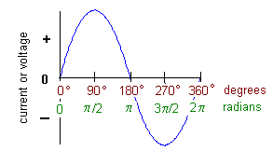
The Sinusoidal AC Waveform
The most common AC waveform is a sine (or sinusoidal) waveform.
The vertical axis represents the amplitude of the AC current or voltage, in amperes or volts.
The horizontal axis represents the angular displacement of the waveform. The units can be degrees or radians.

Slide 46
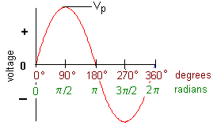
Instantaneous Voltage and Current
v = V_{p}sinθ
where
v = instantaneous voltage in volts
V_{p} = the maximum, or peak, voltage in volts
θ = the angular displacement in degrees or radians

Slide 47
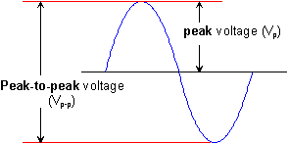
Peak and Peak-to-Peak Voltage
Peak voltage is the voltage measured from the baseline of an ac waveform to its maximum, or peak, level.
Peak-to-peak voltage is the voltage measured from the maximum positive level to the maximum negative level.

Slide 48
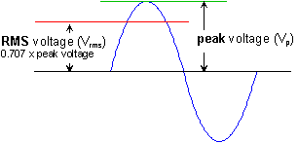
Root-Mean-Square (RMS) Voltage
AC levels are assumed to be expressed as RMS values unless clearly specified otherwise.
RMS voltage is the amount of dc voltage that is required for producing the same amount of power as the ac waveform.
The RMS voltage of a sinusoidal waveform is equal to 0.707 times its peak value.

Slide 49
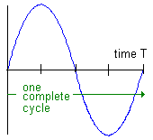
Period of a Waveform
The period of a waveform is the time required for completing one full cycle.
  symbol: T
  Unit of measure: seconds (s)
One period occupies exactly 360º of a sine waveform

Slide 50
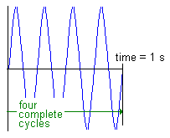
Frequency of a Waveform
The frequency of a waveform is the number of cycles that is completed each second.
  symbol: f
  Unit of measure: hertz (Hz)
This example shows four cycles per second (4 Hz)
Conversions between period and frequency
  f = 1/T T = 1/f

Slide 51
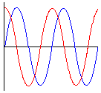
Phase Angle
The phase angle of a waveform is angular difference between two waveforms of the same frequency.
  Symbol: θ (theta)
  Unit of measure: degrees or radians
Two waveforms are said to be in phase when they have the same frequency and there is no phase difference between them.
Two waveforms are said to be out of phase when they have the same frequency and there is some amount of phase shift between them.

Slide 52
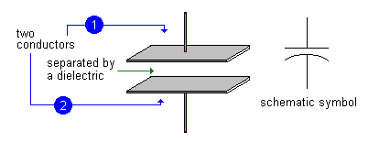
Capacitors
A capacitor (aka condensor) consist of two conductors separated by a dielectric material
Dielectric material is a good insulator (incapable of passing electrical current) that is capable of passing electrical fields of force

Slide 53
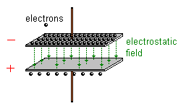
Charged Capacitor
A capacitor is said to be charged when there are more electrons on one conductor plate than on the other.
The plate with the larger number of electrons has the negative polarity. The opposite plate then has the positive polarity.
When a capacitor is charged, energy is stored in the dielectric material in the form of an electrostatic field.

Slide 54
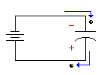
Electrostatic Induction
When an electron is added to one plate of a capacitor, one electron is driven away from the opposite plate.
Or you can say that when an electron is pulled away from one plate of a capacitor, another electron is drawn to the opposite plate.
No matter how you look at it, this is the principle of electrostatic induction at work in a capacitor.

Slide 55
Capacitance
The quantity of charge that a capacitor can hold (per volt across its plates) is referred to as its capacitance (C)
C = Q/E
Capacitance is measured in farads
C increases as the size of the plates increase
C increases as the dielectric constant increases
C increases as the distance between the plates decreases

Slide 56
Charging and Discharging
When this electrostatic effect increases the imbalance of electrons between the two plates:
  The electrostatic field grows stronger.
  The amount of energy stored in the dielectric increases.
  The capacitor is said to be charging.
When this electrostatic effect decreases the imbalance of electrons between the two plates:
  The electrostatic field grows weaker.
  The amount of energy stored in the dielectic decreases.
  The capacitor is said to be discharging.

Slide 57
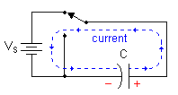
Capacitor Charge and Discharge (DC)
The source of current in this circuit is the DC voltage supply, Vs.
Current flows through this circuit in a counter-clockwise direction.
The current charges the plates of the capacitor, but does not flow through the capacitor, itself.
Current flows in this circuit until the capacitor is completely charged--until the voltage across the plates of the capacitor is equal to the voltage source, Vs.

Slide 58
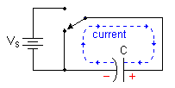
Capacitor Charge and Discharge (DC)
The source of current in this circuit is the energy that has been stored in the capacitor.
Current flows through this circuit in a clockwise direction.
The current discharges the plates of the capacitor, but does not flow through the capacitor, itself.
Current flows in this circuit until the capacitor is completely discharged--until the voltage across the plates of the capacitor is zero.

Slide 59
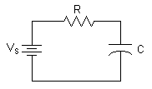
RC Time Constant
The time constant (τ; tau) of a series RC circuit is the product of the resistance and the capacitance:
= RC
where
τ = time constant in seconds
R = resistance in ohms
C = capacitance in farads

Slide 60
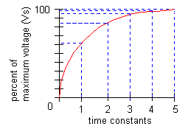
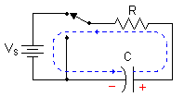
RC Charge Curve
A capacitor in a series RC circuit does not charge at a steady rate. Rather, the rate of charge is rapid at first, but slows considerably as it reaches full charge.
During each time constant, the capacitor charges 63.2% of the remaining distance to the maximum voltage level.
A capacitor is considered fully charged at the end of 5 time constants.

Slide 61
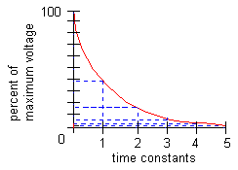
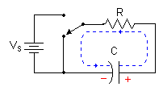
RC Discharge Curve
A capacitor does not discharge at a steady rate. Rather, the rate of discharge is rapid at first, but slows considerably as the charge approaches zero.
During each time constant, the capacitor discharges 63.2% of the remaining distance to the minimum voltage level.
A capacitor is considered fully discharged at the end of 5 time constants.

Slide 62

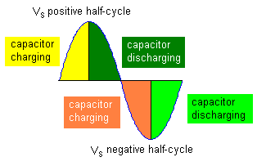
Capacitor Charge and Discharge (AC)
Applied voltage is increasing during the positive half-cycle and current flows through the circuit clockwise to charge the plates of the capacitor.
Applied voltage is decreasing during the positive half-cycle and current flows through the circuit counter-clockwise to discharge the plates of the capacitor
Applied voltage is increasing during the negative half-cycle and current flows through the circuit counter-clockwise to charge the plates of the capacitor with the opposite polarity.
Applied voltage is decreasing during the negative half-cycle, current flows through the circuit clockwise to discharge the plates of the capacitor

Slide 63
Capacitive Reactance
Reactance is the opposition to current flow presented by capacitors (and inductors)
Capacitive reactance(X_{C})= 1 / (2 π f C)
Holding capacitance constant, what happens to X_{C} as f increases?
There is less and less reactance to the current flow as the frequency of the voltage source increases
In contrast, what happens to resistance across a resistor as frequency increases?
It does not change

Slide 64
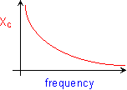
Capacitive Reactance
The amount of capacitive reactance (XC) changes inversely with the applied frequency (f):
  Increasing frequency causes XC to decrease.
  Decreasing frequency causes XC to increase.

Slide 65
Impedance
In a resistive and reactive circuit, impedance is the total opposition to current in the circuit.
Impedance = sqrt (R² + X_{C}²)
Current can still be determined from voltage (using Ohms law) but need to substitute impedance for resistance when calculating total current in a circuit
Total voltage drop across resistor and capacitor will not equal source voltage. Instead Vs = sqrt (V_{C}² and V_{R}²)

Slide 66
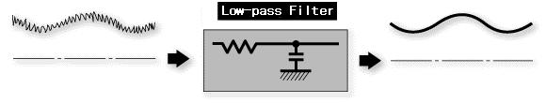
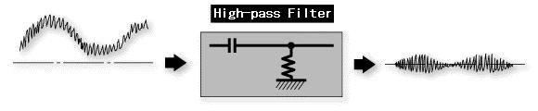
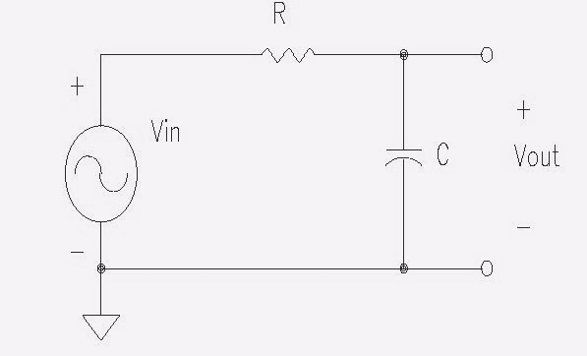


A Practical Application: Low & Hi Pass Filters
Which is the low pass and which is the hi pass filter?
C
R

Slide 67
A Practical Application: Low & Hi Pass Filters
How would you calculate the current in the diagrams below?
Know that the total resistance = sqrt (R² + X_{C}²)
Therefore, total current = V_{in} / R_{tot}
C
R

Slide 68
A Practical Application: Low & Hi Pass Filters
Is the current the same throughout the circuits?
Yes, they are series circuits
Which will have the higher voltage drop, the R or the C?
Depends on which has the higher resistance/reactance. The voltage will drop differentially over the R and C with the bigger drop over the bigger resistance/reactance
C
R

Slide 69
A Practical Application: Low & Hi Pass Filters
Holding capacitance constant, what happens to X_{C} as f increases?
There is less and less reactance to the current flow as the frequency of the voltage source increases
X_{C} = 1 / (2 π f C)
C
R

Slide 70
A Practical Application: Low & Hi Pass Filters
What happens to resistance across a resistor as frequency increases?
It does not change
C
R

Slide 71
A Practical Application: Low & Hi Pass Filters
Describe the relative voltage drops across the C for low and high frequency voltage source.
As the frequency increases, the relative resistance of the C vs. R will grow smaller (b/c X_{C} drops and R remains constant)
Therefore, the relative voltage drop across the C will be greater for low than high frequency voltages
C
R

Slide 72
A Practical Application: Low & Hi Pass Filters
Describe the relative voltage drops across the R for low and high frequency voltage source.
As the frequency increases, the relative resistance of the R vs. C will grow larger (b/c R remains constant while X_{C} drops)
Therefore, the relative voltage drop across the R will be smaller for low than high frequency voltages
C
R

Slide 73
A Practical Application: Low & Hi Pass Filters
C
R

Slide 74
Time constant of Low pass Filter
Why describe the time constant of a low pass filter?
F_{LP} = 1 / (2 π τ)
τ = R * C
Does this make sense?
As capacitance increases, we are selecting lower F
Makes sense, from what we know about X_{C}= 1 / (2 π f C).
Not intuitive though (yet)
As R increases, we are selecting lower F
Don’t have an understanding of this (yet)

Slide 75
Time constant of Low pass Filter
Want the majority of voltage of signal to be measured across the C
It takes time to charge the C (τ)
It takes longer to charge a capacitor with a big capacitance (can hold a lot of charge
It takes longer to charge if R is big b/c it slows the current
We only have until the peak of the half cycle
Want the time to peak of half cycle (or longer) to charge the capacitor

Slide 76
Demo of Characteristics of a Low Pass Filter
A visual demo of a low pass filter’s effects is available at:
http://www.st-and.ac.uk/~www_pa/Scots_Guide/experiment/lowpass/lpf.html
Use 1500000ohm R
6 nF capacitor
10 vs.60 Hz signal

Slide 77
Unit Modifiers for Reference
Smaller
Deci = 10⁻¹
Centi = 10⁻²
Milli = 10⁻³ m
Micro = 10⁻⁶ μ
Nano = 10⁻⁹
Pico = 10-¹² p
Fento = 10⁻¹⁵
Larger
Kilo = 10³ k
Mega = 10⁶
Giga = 10⁹
Tera = 10¹⁵
Examples:
5ma = .005a
10kΩ = 10000 Ω

Slide 78
Filters
Filters are designed to reduce noise
Typically signal is distinguished from noise on the basis of frequency component
Types of filters
High pass, low pass, band pass and notch filters
Other info
Cut-off point for a filter indicates that activity at that frequency is attenuated by 70%.
Performance operating characteristics are also important:
  Want to maintain all signal up to cut off and eliminate all signal beyond cut-off
  Avoid ringing

Slide 79
Hardware vs. Digital Filters
Online analog (hardware) filters.
Needed to reduce aliasing. Must be done prior to digitization
Also can reduce large noise oscillations that are outside the operating range of the A/D converter and will saturate amplifier.
Problems include
Phase distortion of recursive filters.
Loss of information that could later be important
Digital filters typically have better POC
Recommendation: Use broad (bandpass or lowpass) hardware filter and handle remaining filtering offline with digital filters

Slide 80
Sampling Rate
Sampling rate
Fast vs. slow measures
Nyquist frequency: Must sample at twice the frequency of the signal or aliasing will occur
Missing peak
High sampling rates will lead to large files and typically need to be reduced but better to do that reduction offline rather than at signal acquisition

Slide 81
Other Steps
Signal averaging
Reduction of noise
Latency jitter (woody filter) and smearing
Artifact reduction
Eyeblink effects on ERP
Missed heart beats
Baseline correction
Measures are relative change from baseline

