Slide 1
Clinical Psychophysiology
September 11 & 16, 2008
Notes:
BNC history:P
U. of Florida, 1981-1998
2 NIMH, 1998 - 2005 (Chief, Adult Psychopathology & Prevention Research Branch
3 Applied interests in emotions and disorders

Slide 2
Basic electronics in psychophysiology
Need to understand how electronics affects the measurements that we use
Conceptual and practical aspects of making recordings
Safety
Notes:
“any strong feeling” -- Princeton
“ … emotion is the language of a person’s mental state of being, normally based in or tied to the person’s internal (physical) and external (social) sensory feeling. Wikipedia.
Izard: emotion experience is “a feeling state or motivational condition, a direct and immediate product of the particular neural processes associated with that emotion”
Izard: 9 emotions: interest, enjoyment, surprise, distress, disgust, anger, shame, fear, contempt.”
Any of them: sex, jealousy?
“OUP: “incidents of coordinated changes in several areas, including what has been called the “reaction triad” of physiological arousal, motor expression, and subjective feeling, in response to either an internal or an external event of significant importance to an individual”
“feelings such as happiness, sadness, anger, elation, irritation, etc. The specific definition of emotion is difficult to qualify as it is a completely subjective experience.” access.autistics.org
Panksepp: presents six basic emotion systems
Ekman: specific emotions are: happiness, interest, surprise, feaer, anger, sorrow, disgust.
Izard:

Slide 3
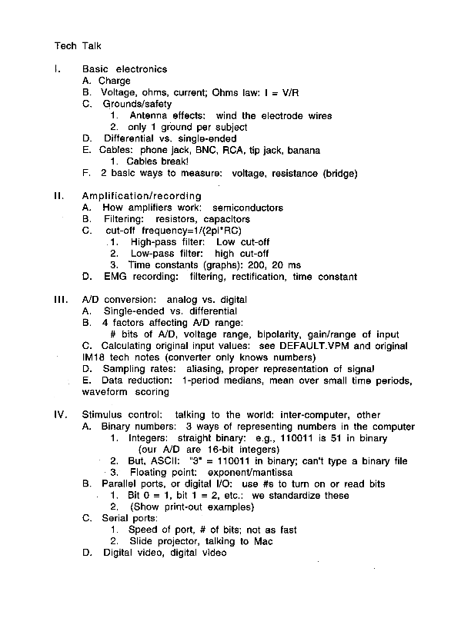

Slide 4
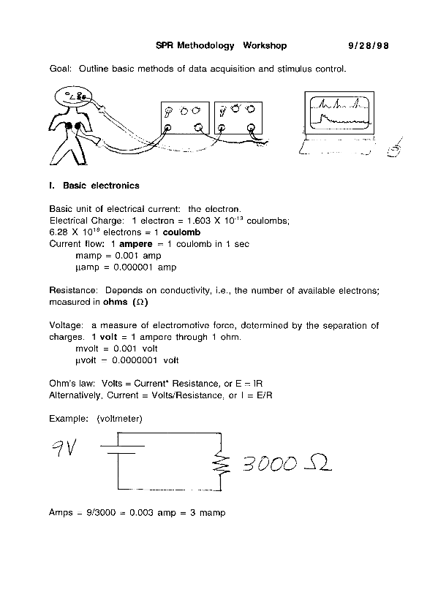
*

Slide 5
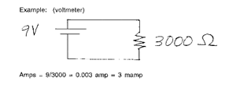
A simple example:
+
Volts across 3000 ohm resistor: 9 V
(in opposite direction from battery)
-- “Conventional” current flow vs. electron flow
Units of Measure
1/1,000 = 1 * 10⁻³
= 1 milliamp, millivolt
(mamp, mv)
1/1,000,000 = 1 * 10⁻⁶
= 1 microamp, 1 microvolt
(µa, µv)

Slide 6
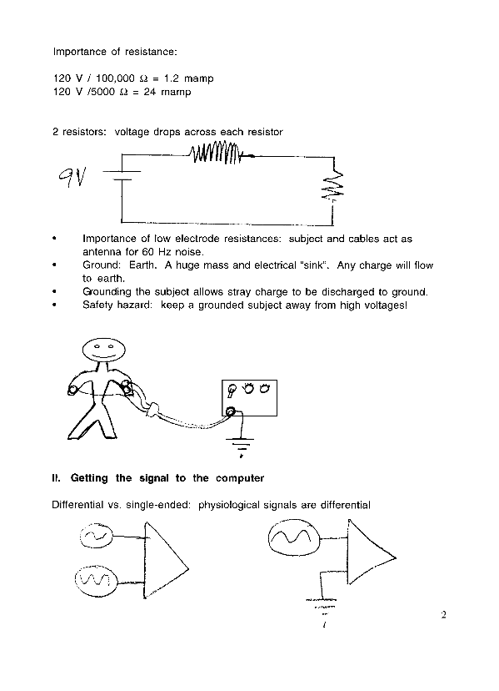
A more complicated example
What is the total resistance?
6K + 3K = 9K
3000 Ω
6000 Ω

Slide 7
What is the total resistance?
6K + 3K = 9K
3000 Ω
6000 Ω
What is the current?

Slide 8
What is the total resistance?
6K + 3K = 9K
3000 Ω
6000 Ω
What is the current?
I=E/R
I=9/9000
I= 0.001 amp
= 1 mamp

Slide 9
Voltage across the 6K resistor?
E = IR
= .001 * 6000
= 6 V
3000 Ω
6000 Ω

Slide 10
What is the total resistance?
6K + 3K = 9K
6000 Ω
3000 Ω

Slide 11
What is the total resistance?
6K + 3K = 9K
What is the current?
I = 9/9000 = .001 amp
= 1 mamp
6000 Ω
3000 Ω

Slide 12
Voltage across the 3K resistor?
6000 Ω
3000 Ω

Slide 13
Voltage across the 3K resistor?
E = IR
= .001 * 3000
= 3 V
6000 Ω
3000 Ω

Slide 14
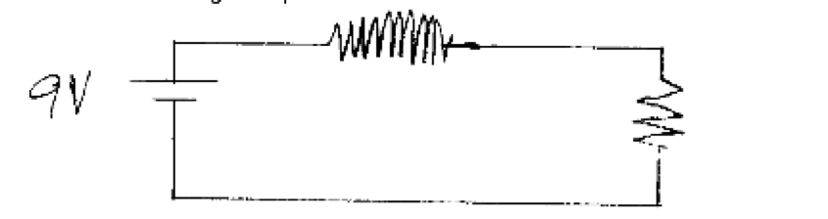
Parallel Resistors
R3
R1
R2
R_{1.2} = R₁ * R₂
R₁ + R₂
R1 = 4000, R2 = 12,000
= 4000 * 12,000
16,000
R _{1.2} = 3,000 ohms *(3K)
I.e., less than either R singly (water analogy: multiple channels)

Slide 15
Parallel Resistors: Continued
R3
R1
R2
R3 = 6,000 ohms
R _{1.2} = 3,000 ohms
I = ?
V (R3) = ?
V (R1.2) = ?

Slide 16
Parallel Resistors: Continued
R3
R1
R2
R3 = 6,000 ohms
R _{1.2} = 3,000 ohms
I = 9 / (6K + 3K) = 9/9K = .001 = 1 mamp
V (R3) = ?
V (R1.2) = ?

Slide 17
Parallel Resistors: Continued
R3
R1
R2
R3 = 6,000 ohms
R _{1.2} = 3,000 ohms
I = 9 / (6K + 9K) = 9/9K = .001 = 1 mamp
V (R3) = .001 * 6K
= 6 V
V (R1.2) = .001 * 3K
= 3K

Slide 18
Parallel Resistors: Continued
6V “dropped”
3V “dropped”
R3
R1
4,000
R2
12,000
R3 = 6,000 ohms
R _{1.2} = 3,000 ohms
I = 9 / (6K + 9K) = 9/9K = .001 = 1 mamp
I (R1) = E/R
= 3/4,000
= 0.75 mamp
I (R2) = E/R
= 3/12,000
= 0.25 mamp
Total I, R1 & R2: 0.75 + 0.25 = 1 mamp

Slide 19
Some implications of Ohm’s law:
The larger the resistance,
the more voltage is dropped
across it. Therefore, keep
electrode resistances low
Want a very high resistance
in the bioamplifier; this
minimizes current flow in the
circuit, avoids “loading” the
low-current source
Low resistances also help
avoid antenna effects along
the electrode cables.
6000 Ω
1,000,000 Ω

Slide 20
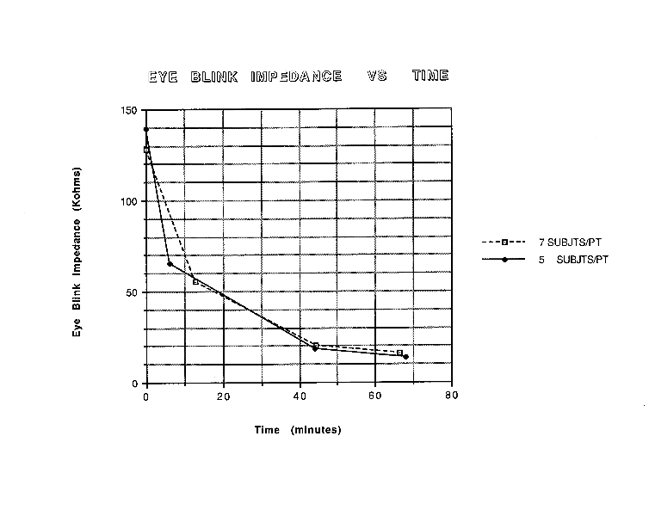

Slide 21
Differential vs. single-ended
Inputs to amplifier
6000 Ω
1,000,000 Ω

Slide 22
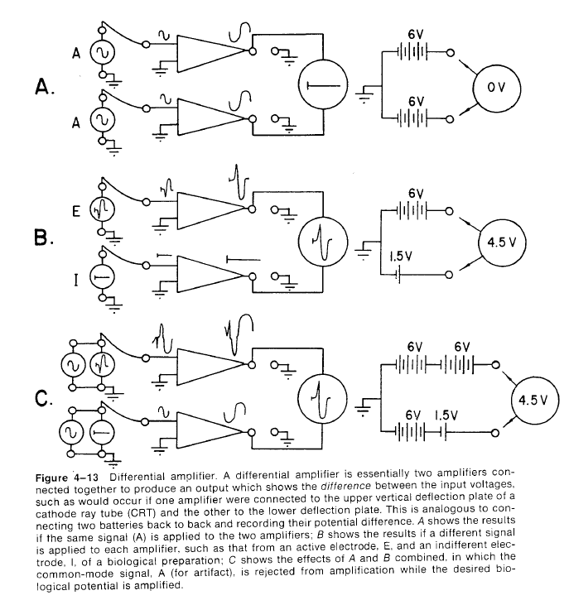
Differential vs. single-ended

Slide 23
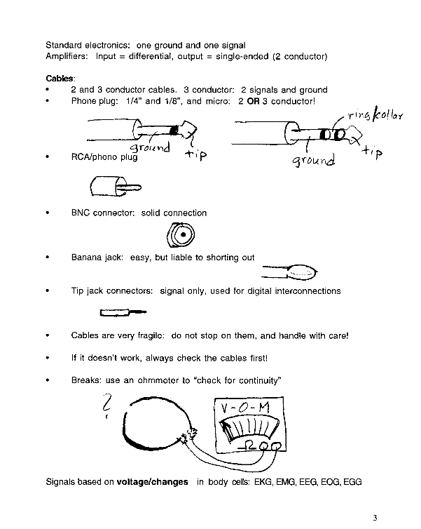
Standard amplifiers: single-ended Input & output
Bioamplifiers: Differential input single-ended output

Slide 24
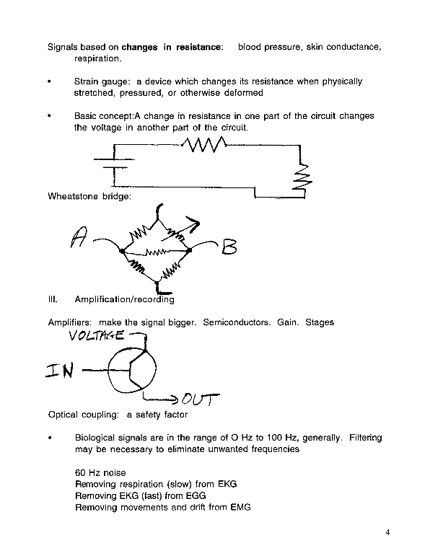
Voltage:
Ground:

Slide 25
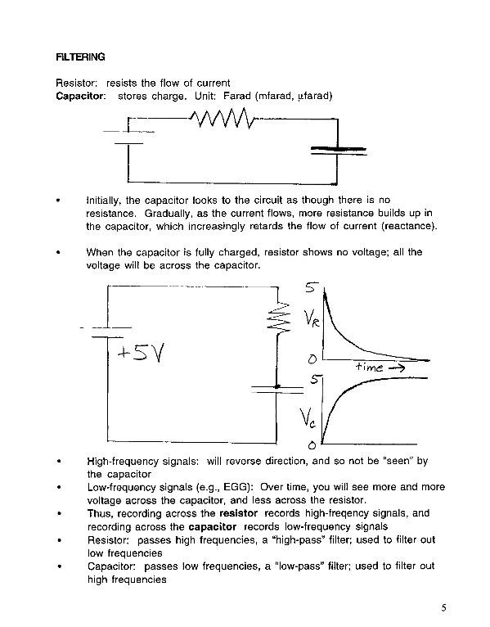
Time domain

Slide 26
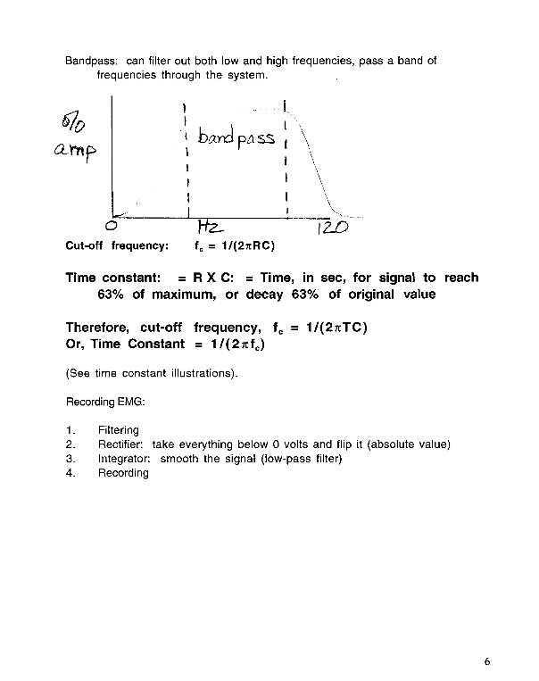
Decibel = dB =
20 * log (V1/V2)
Frequency domain
Cutoff frequency =
“3 dB down”, I.e.:
20 * log (.707/1) =
20 * -.15 = -3.01

Slide 27
Time constant = 200 ms
f_{c}?
Frequency domain

Slide 28
Time constant = 200 ms
f_{c}?
f_{c} = 1/(2*3.14*0.2)
f_{c} = 0.8 Hz
Frequency domain

Slide 29
Want f_{c} of 2 Hz.
TC setting?
Frequency domain

Slide 30
Want f_{c} of 2 Hz.
TC setting?
TC = 1/(2*3.1416* f_{c})
TC = 0.079 s, 79 ms
Frequency domain

Slide 31
Want TC of 5 sec.
f_{c} setting?
f_{c} = 1/(2*3.1416* 5)
f_{c} = 0.031 Hz
Frequency domain
“skirt”

Slide 32
Summary:
Time constant Cutoff frequency
79 ms 2 Hz
200 ms 0.8 Hz
5000 ms 0.031 Hz
Thus, the LONGER the time constant, the
LOWER the cutoff frequency

Slide 33
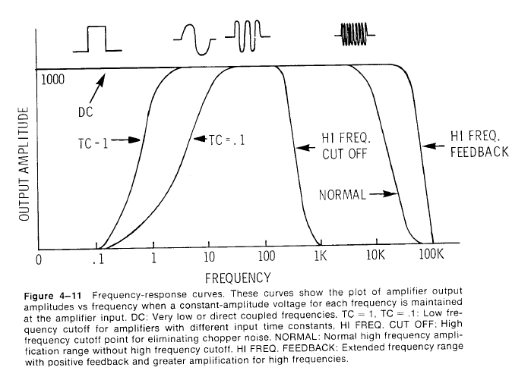
Octave: = doubling of frequency

Slide 34
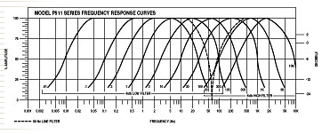
Grass Instruments: time constant chart

Slide 35
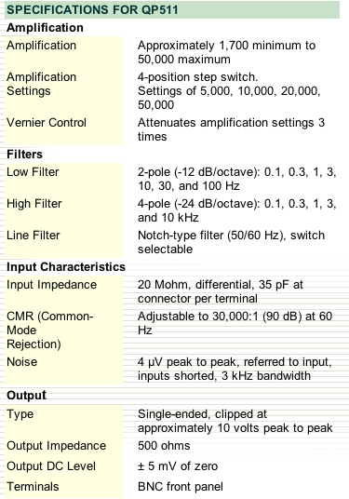

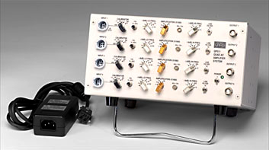

Slide 36
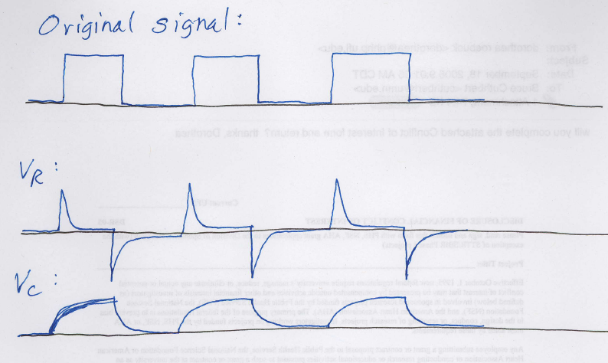

Slide 37
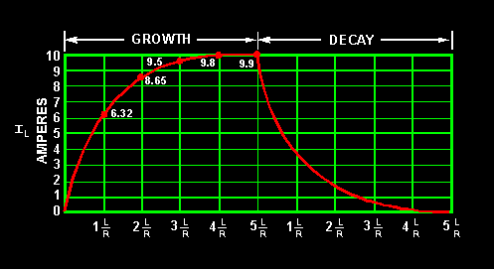

Slide 38
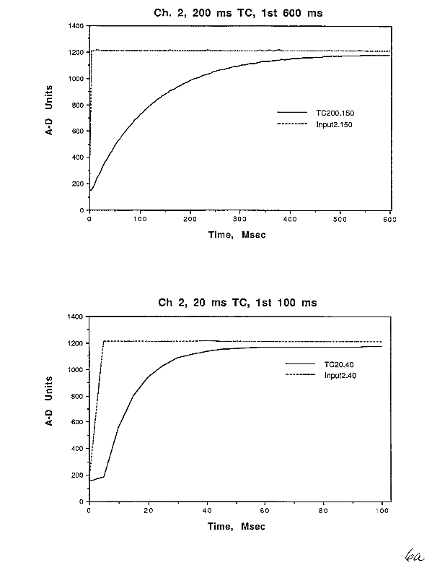

Slide 39
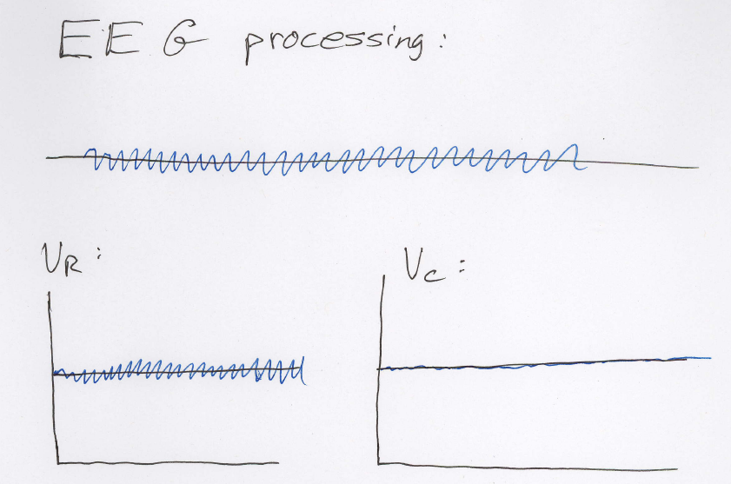

Slide 40
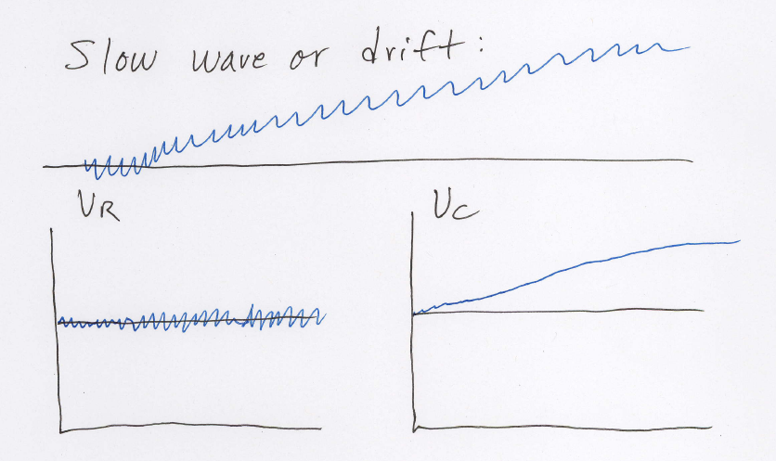
E.g., important for zero-crossing scoring algorithms

Slide 41
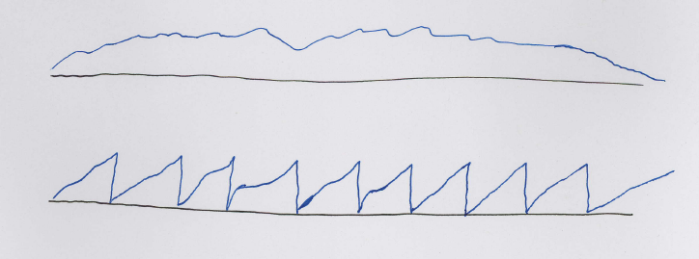
True Integration: Constantly integrate input signal

Slide 42
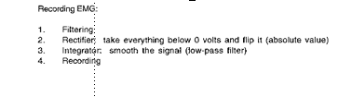

Slide 43
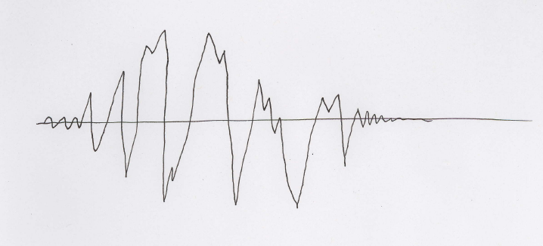
“Averagor” integrator: Actually, a capacitor signal

Slide 44
“Averagor” integrator: Actually, a capacitor signal
Would like an envelope representation of input signal;
How to get it?

Slide 45
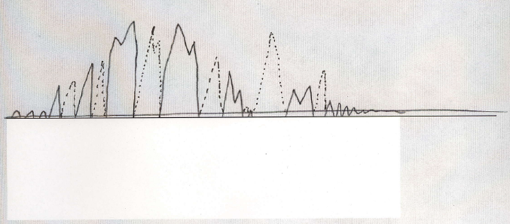
Rectification: absolute value of signal input
(analog or digital); NB, output frequency is doubled

Slide 46
Long time constant
Short time constant
“Averagor” integrator: capacitor-coupled
Time constant can be adjusted to fit signal

Slide 47
Two major types of filters
1) Finite impulse response (FIR): Given a string of 0’s with a single “1” (impulse), output will return to 0 eventually (no feedback)
2) Infinite impulse response (IIR): Given an impulse, the output will (theoretically) never return to 0, due to feedback
Can be analog or digital; an RC circuit is the simplest IIR filter, as the output is exponential
Well-known analog IIR filters: Butterworth, Bessel, Chebyshev
Notes:
“any strong feeling” -- Princeton
“ … emotion is the language of a person’s mental state of being, normally based in or tied to the person’s internal (physical) and external (social) sensory feeling. Wikipedia.
Izard: emotion experience is “a feeling state or motivational condition, a direct and immediate product of the particular neural processes associated with that emotion”
Izard: 9 emotions: interest, enjoyment, surprise, distress, disgust, anger, shame, fear, contempt.”
Any of them: sex, jealousy?
“OUP: “incidents of coordinated changes in several areas, including what has been called the “reaction triad” of physiological arousal, motor expression, and subjective feeling, in response to either an internal or an external event of significant importance to an individual”
“feelings such as happiness, sadness, anger, elation, irritation, etc. The specific definition of emotion is difficult to qualify as it is a completely subjective experience.” access.autistics.org
Panksepp: presents six basic emotion systems
Ekman: specific emotions are: happiness, interest, surprise, feaer, anger, sorrow, disgust.
Izard:

Slide 48
Two major types of filters
IIR filters are more common in analog circuits because they are based on RC circuit designs
Digital filters are increasingly popular with greater computer power
Typically, the “raw” signal is saved so one can try different filter algorithms
Notes:
“any strong feeling” -- Princeton
“ … emotion is the language of a person’s mental state of being, normally based in or tied to the person’s internal (physical) and external (social) sensory feeling. Wikipedia.
Izard: emotion experience is “a feeling state or motivational condition, a direct and immediate product of the particular neural processes associated with that emotion”
Izard: 9 emotions: interest, enjoyment, surprise, distress, disgust, anger, shame, fear, contempt.”
Any of them: sex, jealousy?
“OUP: “incidents of coordinated changes in several areas, including what has been called the “reaction triad” of physiological arousal, motor expression, and subjective feeling, in response to either an internal or an external event of significant importance to an individual”
“feelings such as happiness, sadness, anger, elation, irritation, etc. The specific definition of emotion is difficult to qualify as it is a completely subjective experience.” access.autistics.org
Panksepp: presents six basic emotion systems
Ekman: specific emotions are: happiness, interest, surprise, feaer, anger, sorrow, disgust.
Izard:

Slide 49
IIR filter considerations
IIR: can design more efficient filters with shorter algorithms
IIR: easier to get sharper cutoff frequency definition
IIR: But, IIR has non-linear phase distortion across frequencies; may or may not be a problem
Notes:
“any strong feeling” -- Princeton
“ … emotion is the language of a person’s mental state of being, normally based in or tied to the person’s internal (physical) and external (social) sensory feeling. Wikipedia.
Izard: emotion experience is “a feeling state or motivational condition, a direct and immediate product of the particular neural processes associated with that emotion”
Izard: 9 emotions: interest, enjoyment, surprise, distress, disgust, anger, shame, fear, contempt.”
Any of them: sex, jealousy?
“OUP: “incidents of coordinated changes in several areas, including what has been called the “reaction triad” of physiological arousal, motor expression, and subjective feeling, in response to either an internal or an external event of significant importance to an individual”
“feelings such as happiness, sadness, anger, elation, irritation, etc. The specific definition of emotion is difficult to qualify as it is a completely subjective experience.” access.autistics.org
Panksepp: presents six basic emotion systems
Ekman: specific emotions are: happiness, interest, surprise, feaer, anger, sorrow, disgust.
Izard:

Slide 50
FIR filter considerations
FIR: typically involve longer, more complex algorithms
FIR: More difficult to get sharper cutoff frequencies, steep “skirts”
FIR: FIR has linear phase distortion across frequencies,so phase is maintained
Notes:
“any strong feeling” -- Princeton
“ … emotion is the language of a person’s mental state of being, normally based in or tied to the person’s internal (physical) and external (social) sensory feeling. Wikipedia.
Izard: emotion experience is “a feeling state or motivational condition, a direct and immediate product of the particular neural processes associated with that emotion”
Izard: 9 emotions: interest, enjoyment, surprise, distress, disgust, anger, shame, fear, contempt.”
Any of them: sex, jealousy?
“OUP: “incidents of coordinated changes in several areas, including what has been called the “reaction triad” of physiological arousal, motor expression, and subjective feeling, in response to either an internal or an external event of significant importance to an individual”
“feelings such as happiness, sadness, anger, elation, irritation, etc. The specific definition of emotion is difficult to qualify as it is a completely subjective experience.” access.autistics.org
Panksepp: presents six basic emotion systems
Ekman: specific emotions are: happiness, interest, surprise, feaer, anger, sorrow, disgust.
Izard:

Slide 51
Digital filtering: Increasingly popular
Simplest FIR: moving average filter (e.g., 4 points)
0 0 0 0 0 10 30 10 0 0 0 0 0
0 0 2.5 10 12.5 12.5 10 2.5 0 0

Slide 52
Digital filtering: Increasingly popular
Simplest: moving average filter (e.g., 4 points)
0 0 0 0 0 10 30 10 0 0 0 0 0
0 0 2.5 10 12.5 12.5 10 2.5 0 0

Slide 53
Digital filtering: Increasingly popular
Simplest: moving average filter (e.g., 4 points)
0 0 0 0 0 10 30 10 0 0 0 0 0
0 0 2.5 10 12.5 12.5 10 2.5 0 0

Slide 54
Digital filtering: Increasingly popular
Simplest: moving average filter (e.g., 4 points)
0 0 0 0 0 10 30 10 0 0 0 0 0
0 0 2.5 10 12.5 12.5 10 2.5 0 0

Slide 55
Digital filtering: Increasingly popular
Simplest: moving average filter (e.g., 4 points)
0 0 0 0 0 10 30 10 0 0 0 0 0
0 0 2.5 10 12.5 12.5 10 2.5 0 0

Slide 56
Computer arithmetic
Binary: powers of 2 (sets of on/off switches)
Binary Digit = bit
Byte = 8 bits
Binary numbering:
0 = 0
1 = 1 decimal
10 = 2 decimal
11 = 3 decimal
01111111 = 1+2+4+8+16+32+64 = 127
11111111 = 1+2+4+8+16+32+64+128 = 255
2 bytes = 16-bit word, 32767 to -32768, or 0 to 65535
Notes:
“any strong feeling” -- Princeton
“ … emotion is the language of a person’s mental state of being, normally based in or tied to the person’s internal (physical) and external (social) sensory feeling. Wikipedia.
Izard: emotion experience is “a feeling state or motivational condition, a direct and immediate product of the particular neural processes associated with that emotion”
Izard: 9 emotions: interest, enjoyment, surprise, distress, disgust, anger, shame, fear, contempt.”
Any of them: sex, jealousy?
“OUP: “incidents of coordinated changes in several areas, including what has been called the “reaction triad” of physiological arousal, motor expression, and subjective feeling, in response to either an internal or an external event of significant importance to an individual”
“feelings such as happiness, sadness, anger, elation, irritation, etc. The specific definition of emotion is difficult to qualify as it is a completely subjective experience.” access.autistics.org
Panksepp: presents six basic emotion systems
Ekman: specific emotions are: happiness, interest, surprise, feaer, anger, sorrow, disgust.
Izard:

Slide 57
4 ways that bits are used in computers
Program code (assembler, compiler, linker)
Numeric data
ASCII data (codes) [American Standard Code for Information Interchange)
Patterns of bits used to read or control the environment
Notes:
“any strong feeling” -- Princeton
“ … emotion is the language of a person’s mental state of being, normally based in or tied to the person’s internal (physical) and external (social) sensory feeling. Wikipedia.
Izard: emotion experience is “a feeling state or motivational condition, a direct and immediate product of the particular neural processes associated with that emotion”
Izard: 9 emotions: interest, enjoyment, surprise, distress, disgust, anger, shame, fear, contempt.”
Any of them: sex, jealousy?
“OUP: “incidents of coordinated changes in several areas, including what has been called the “reaction triad” of physiological arousal, motor expression, and subjective feeling, in response to either an internal or an external event of significant importance to an individual”
“feelings such as happiness, sadness, anger, elation, irritation, etc. The specific definition of emotion is difficult to qualify as it is a completely subjective experience.” access.autistics.org
Panksepp: presents six basic emotion systems
Ekman: specific emotions are: happiness, interest, surprise, feaer, anger, sorrow, disgust.
Izard:

Slide 58
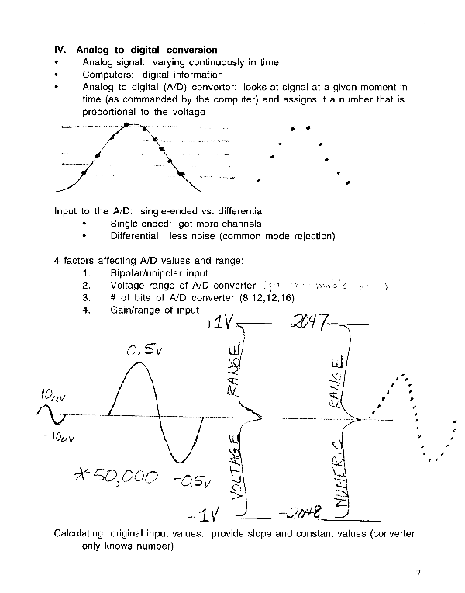

Slide 59
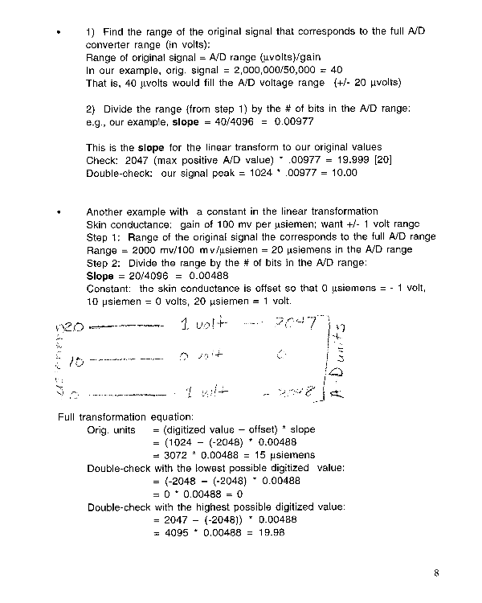
µs
20 ------- 1 volt -------- 2047
10 ------- 0 volt --------- 0 A/D
0 ------- -1 volt ------- -2048

Slide 60
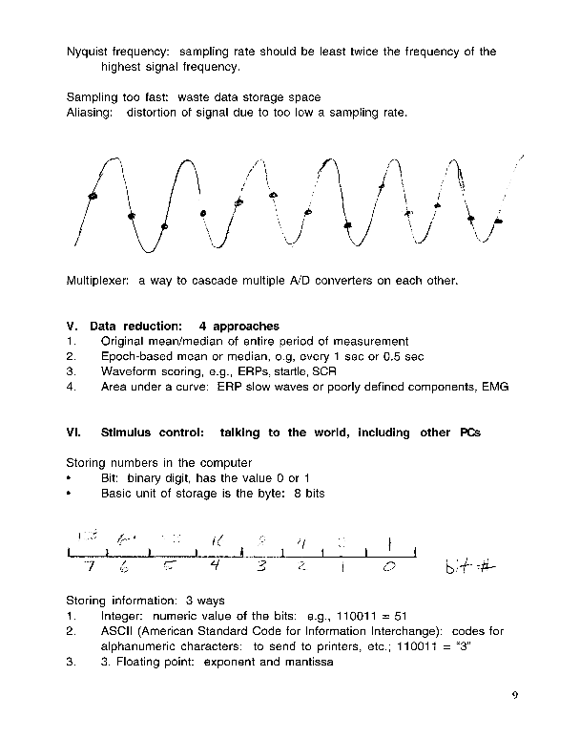
**

Slide 61
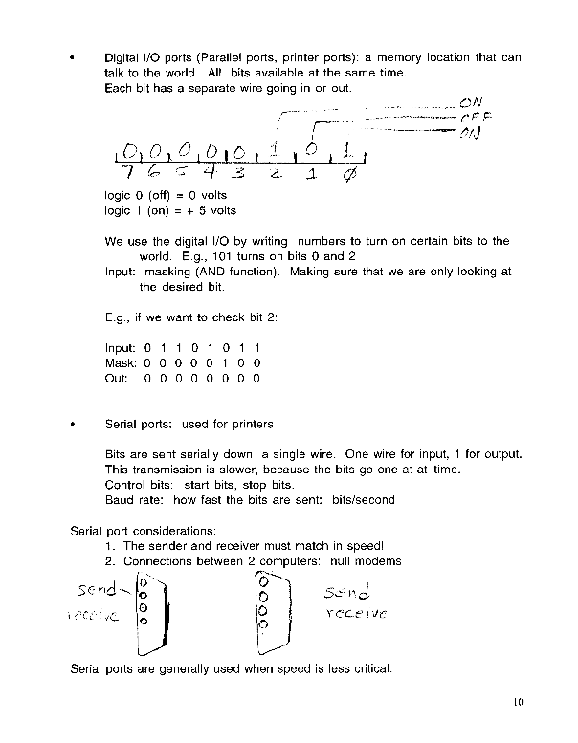

Slide 62
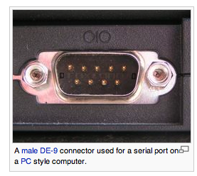
Parallel vs. serial ports
Digital inputs/outputs: TTL (transistor-transistor logic)
The 2 values are 0 V or +5 V
Digital I/O often uses parallel ports (older printer standard)
Serial port data: RS-232 or RS-422
Typically sends ASCII data (codes)
+3-15 V = “Off”; – 3-15 V = “on” (0 V = undefined)
Notes:
“any strong feeling” -- Princeton
“ … emotion is the language of a person’s mental state of being, normally based in or tied to the person’s internal (physical) and external (social) sensory feeling. Wikipedia.
Izard: emotion experience is “a feeling state or motivational condition, a direct and immediate product of the particular neural processes associated with that emotion”
Izard: 9 emotions: interest, enjoyment, surprise, distress, disgust, anger, shame, fear, contempt.”
Any of them: sex, jealousy?
“OUP: “incidents of coordinated changes in several areas, including what has been called the “reaction triad” of physiological arousal, motor expression, and subjective feeling, in response to either an internal or an external event of significant importance to an individual”
“feelings such as happiness, sadness, anger, elation, irritation, etc. The specific definition of emotion is difficult to qualify as it is a completely subjective experience.” access.autistics.org
Panksepp: presents six basic emotion systems
Ekman: specific emotions are: happiness, interest, surprise, feaer, anger, sorrow, disgust.
Izard:

Slide 63
