Slide 1
Practical security scanning for busy network administrators
Jim Davis
D7: Data Science Institute
jjdavis@email.arizona.edu

Slide 2
Security scanning tries to find problems before bad actors do
A network security scanner looks for servers in some address range to identify where a service is running, or to probe that service for vulnerabilities
Typical servers would be web servers like Apache or IIS, or Windows computers exporting network shares, or Linux servers running Samba to export network shares, or even a Windows desktop with remote desktop access enabled
But there are atypical servers too.

Slide 3
Different services run on particular ports and protocols. For instance, web servers listen for connections on TCP port 80 or 443, and the remote desktop protocol uses TCP port 3389
So a bad actor with a remote desktop protocol exploit in hand would use a network scanner to search for computers listening for TCP connections on port 3389
A network scanner could simply identify that a computer is listening on a particular port, and so is probably running the service associated with that port (TCP/3389 ⬄ RDP).

Slide 4
A network scanner could identify a computer accessible via the remote desktop protocol and also probe that computer to see if it has a known vulnerability, such as CVE-2012-0002 (MS12-020), that could be exploited
So scanning can be for surveying, testing for an exploit vulnerability, or both
And in some cases, like known but unpatched vulnerabilities or 0-day exploits, surveying may be all the bad actors need.

Slide 5
So as the (busy) network administrator for the Arizona Research Labs IP space, I’ll set things up to run network security scans
First I need to look up the networks I’m responsible for, using the Netmanager’s database at https://www.telcom.arizona.edu/netmgr/

Slide 6
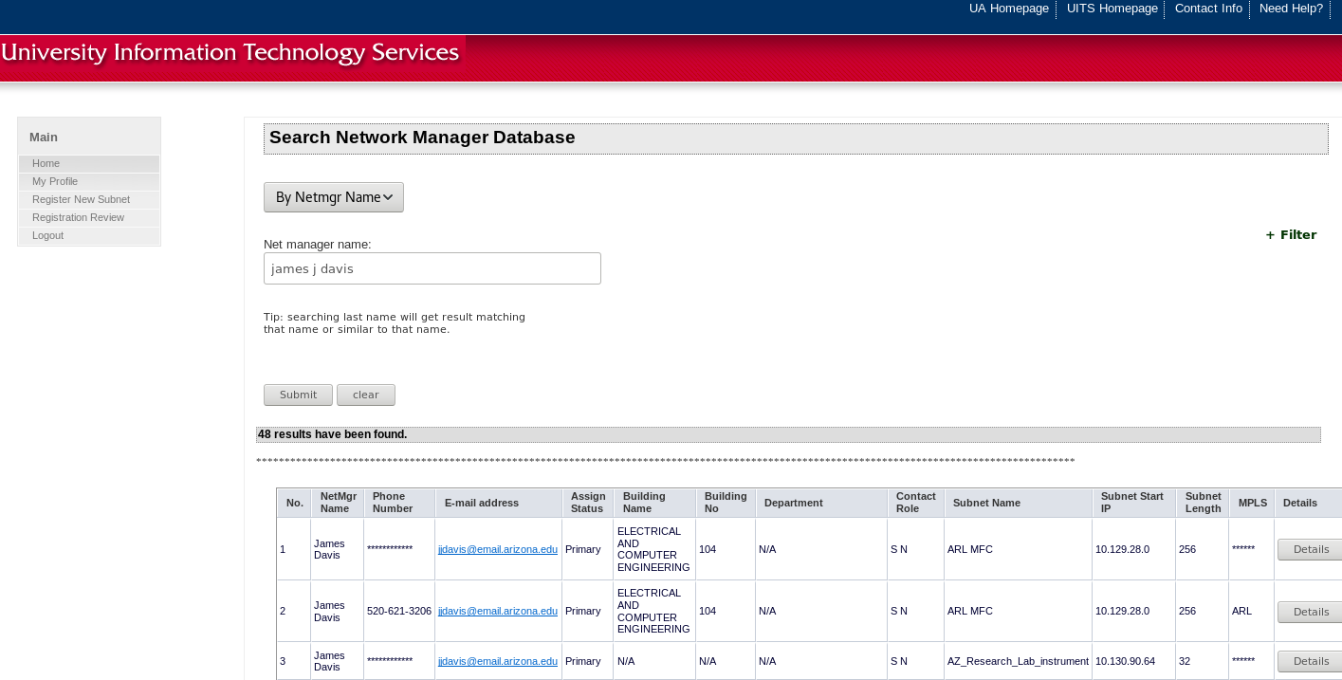

Slide 7
This gives me a list of subnet start IPs and subnet lengths. It’s handier to have that information in CIDR format; I’ll convert it with a subnet cheat sheet like https://www.aelius.com/njh/subset_sheet.html
A subnet with a start IP of 10.130.161.0 and a subnet length of 64 would be 10.130.161.0/26 in CIDR format
Repeat for each subnet from the Netmanager’s database to get a file of networks in CIDR format.

Slide 8
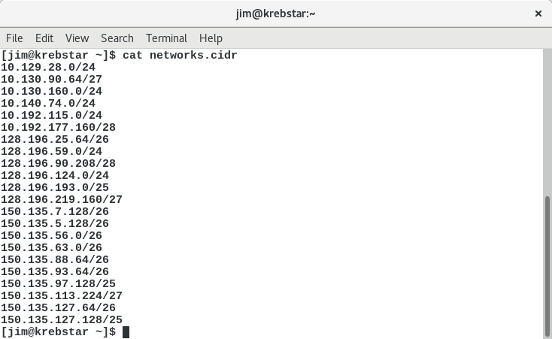

Slide 9
There are several different scanning approaches:
Scanning from off campus, using someone else’s tools
Scanning from off campus, using your own tools
Scanning from on campus, using someone else’s tools
Scanning from on campus, using your own tools

Slide 10
Choosing on campus or off campus scanning is influenced by what UITS lets through the campus networking border
As a research-oriented university, there aren’t a lot of border restrictions – though exactly what those restrictions are may be hard to find
Historically SMB (TCP/435 and such) has been blocked at the border, so a search from off campus shouldn’t identify any SMB servers. However…
There was a brief period in early June when the SMB blockade was accidentally lifted.

Slide 11
Off campus scanning with your own tools used to be difficult because it wasn’t easy to find a suitable off campus computer
However with cheap virtual machines available through Amazon, Google, Microsoft, and others, that’s a practical option now.

Slide 12
CVE-2017-5698 (INTEL-SA-00075)
https://www.eff.org/deeplinks/2017/05/intels-management-engine-security-hazard-and-users-need-way-disable-it
In a nutshell, a significant number of recent computers with Intel chipsets had a (Minix-based) server running inside them and that server was vulnerable to remote exploits
A sign of the Internet of Things future? Atypical servers with their own set of vulnerabilities.

Slide 13
Here’s an off campus scanning approach, using someone else’s tools
https://shodan.io is a search engine for the Internet of Things. Like Google, they run spiders that search for stuff though instead of looking for cute cat pictures they’re looking for devices. Their spiders found quite a few vulnerable computers across the Internet
They have free and paid options – the free option requires registering (and they haven’t spammed me, so far)
Once you have an account you can take a list of networks in CIDR format and plug them in to their search page
Try port:"16992" Intel net:"128.196.0.0/16“ for instance.

Slide 14
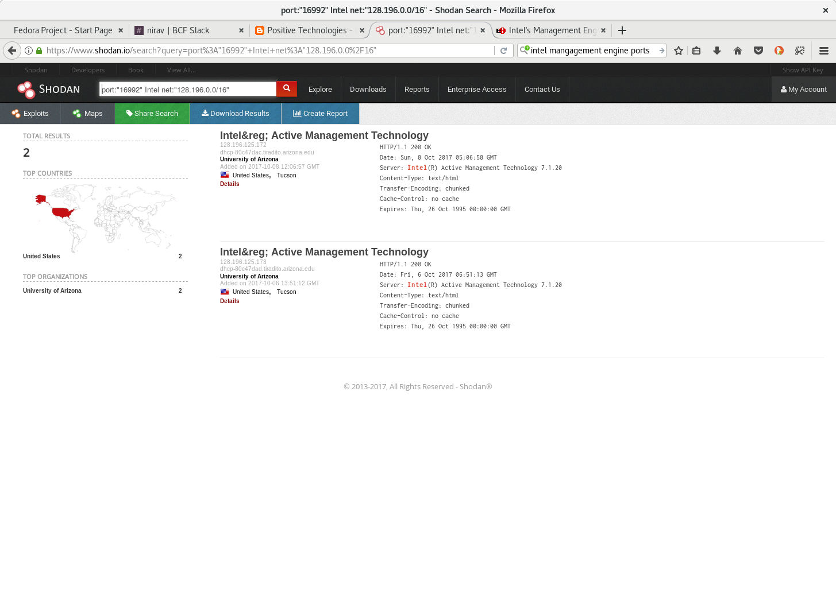

Slide 15
However the shodan.io spiders can’t see computers on the 10.* space, and as with all spiders the information may be out of date
For scanning the 10.* space let’s try testing from on campus with our own tools.

Slide 16
Nmap is a free and open source network scanner that runs on Linux and Windows. Download it from https://nmap.org or on Linux install it from your distro’s package manager
It has a blizzard of options. But the basic command line usage for both Windows and Linux is simple (and there is a Windows GUI too):
nmap some address range -p some port range –open [ -oN output file ]

Slide 17
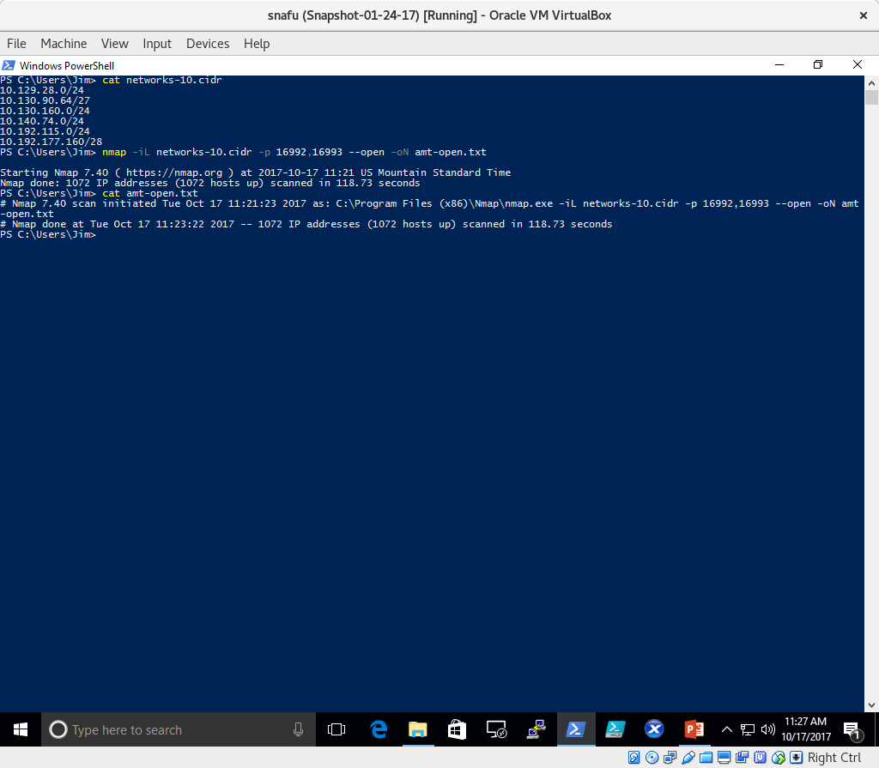

Slide 18
So in the previous example the address range was the various 10.* subnets in ARL, read from a file, and the port range was the ports used by AMT.

Slide 19
CVE-2017-0143 (MS17-010)
https://nvd.nist.gov/vuln/detail/CVE-2017-0143
The “Wanna Cry” ransomware attack, affecting certain SMB servers
In the previous case – the Intel AMT issue – I don’t particularly need those servers running, and a survey approach suffices
Here I definitely need SMB servers running, so while surveying helps I want to go beyond that and do my own probing for vulnerabilities.
Notes:
https://nvd.nist.gov/vuln/detail/CVE-2017-0143

Slide 20
Nmap can probe for vulnerabilities by running scripts against targets
Scripts for testing many vulnerabilities come with the source code
Scripts are written in the Lua programming language (http://www.lua.org/docs.html)
nmap some address range -p some port range –open –script script file [ -oN output file ]
nmap -iL arl-nets.txt -p445 –open –script smb-vuln-ms17-010.nse –oN ouch.txt

Slide 21
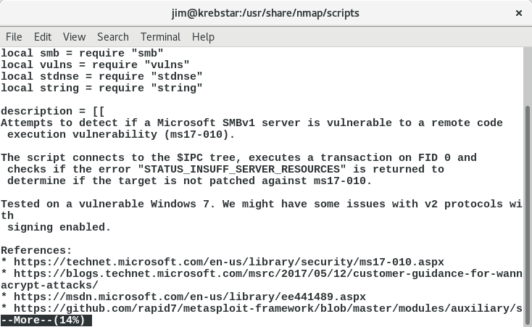

Slide 22
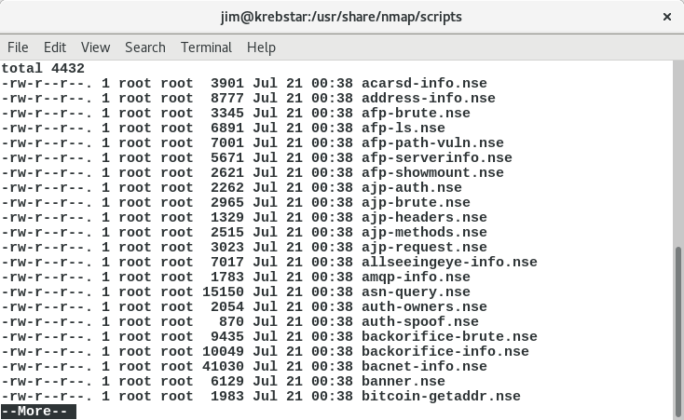

Slide 23
Here’s examples of particular nmap command lines for surveying or probing for vulnerabilities:
nmap 128.196.124.0/24 -p80,443 --open -oN 124-webservers.txt
nmap -iL arl-nets.txt -p80,81,443,8080 –open -oN arl-webservers.txt
nmap 128.196.124.0/24 -p445 –open -oN 124-smbservers.txt
nmap -iL arl-nets.txt -p445 –open –script smb-os-discovery.nse -oN smb-info.txt
nmap -iL arl-nets.txt -p445 –open –script smb-vuln-ms17-010.nse -oN ouch.txt

Slide 24
Nmap can be slow to scan large address spaces. Masscan is another free and open source scanner that isn’t as flexible as nmap, but can be much faster. You can get the source code from https://github.com/robertdavidgraham/masscan and Linux distros probably have it available through their package manager
It (reportedly) will run under Windows too, but you’d have to compile it yourself. I haven’t tried that
http://blog.erratasec.com/2013/09/masscan-entire-internet-in-3-minutes.html

Slide 25
Masscan doesn’t run scripts to check for vulnerabilities, but you can use it to quickly survey a large address space and then feed the results to nmap for vulnerability checking
It needs some firewall tweaking on the local computer to run at full speed
Masscan also takes addresses in CIDR format, but only on the command line.

Slide 26
