Slide 1

Wading into data-driven seas
ACP 2017 – Hyatt Minneapolis
February 18, 2017 @ 10:00
http://bit.ly/2ltAEwX

Slide 2
Quick overview
Introductions
Some background on data journalism
How data can be used to tell stories
Some data processing and visualization tools
Some tips
Taking questions

Slide 3
The Rise of Big Data
The Information Age has flooded the Internet with digital data tracking countless different subjects and issues
This data is being produced on a massive scale by government, academia and other institutions
A great deal of this information is publicly funded and available to the citizenry
The press has an obligation to sift and analyze this data to inform its audiences about trends and issues that affect them
It’s not a fad, it’s not a phase and it’s not going away
Learning data journalism skills will help you land a job

Slide 4
Using data to tell stories
Data journalism is both a genre of reporting, and a tool in a journalist’s toolbox
Data can be treated like any other source. You can ask it questions, verify its answers and use it to tell stories
Data can add additional backbone to a story that otherwise might be built primarily upon anecdotes

Slide 5
Kinds of data-driven stories
Analysis pieces about certain datasets
Visual stories (charts, maps, digital interactives)
Putting a data fact in every paragraph
Investigative/enterprise projects

Slide 6
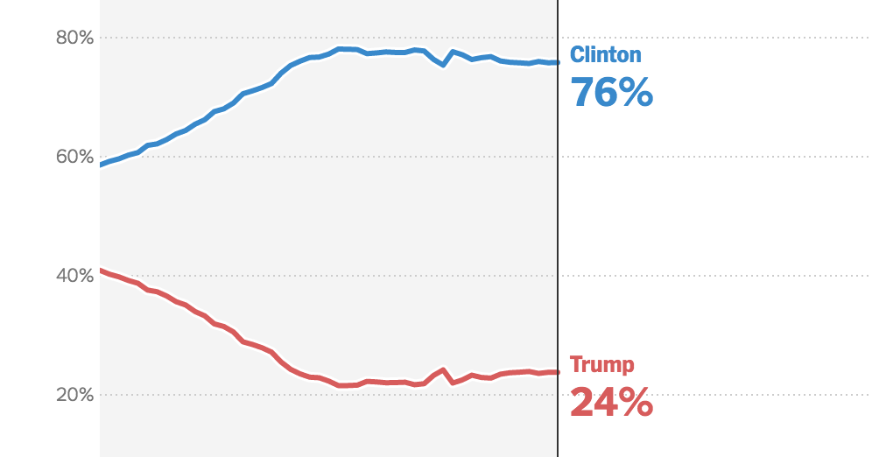
What data journalism is not
While it could be considered a subset of data journalism, we’re not talking about forecasting, for elections or otherwise.
The significant 2016 election polling errors are key examples as to how predicting outcomes with data can be a dicey prospect. While forecasts can be made, they shouldn’t be reported as fact or used to guide the public.
Data journalism is best as an analysis of the past and present rather than a prediction of the future.

Slide 7
Examples
Star Tribune's Data Drop | Link
The battle for the Minnesota House | Link
Police use-of-force deaths in Minnesota since 2000 | Link
The urban bias of Pokemon GO | Link
Explore the math and reading scores of Minnesota schools | Link
A timeline of Philando Castile's vehicle citations | Link
Where cars got towed from during Minneapolis snow emergencies | Link

Slide 8
Spreadsheets are key
Pick a spreadsheet. Excel is nice, but Google Sheets works very well too. Link
Spreadsheets are the bread and butter of data reporting. Ideally you want your data to be structured in easily searchable and sortable rows and columns.
Even if you receive data in a different format, the end result should virtually always be a spreadsheet.

Slide 9
Sources of data
Data Portals | Link
A massive listing of open data portals across the world
Open Minneapolis | Link
A great source of public city data
American FactFinder | Link
The U.S. Census Bureau's impressive lookup tool
Census Explorer | Link
Another cool tool from the U.S. Census Bureau
Minnesota Secretary of State | Link
Home of Minnesota election results going back multiple years

Slide 10
Mapping tools
CARTO | Link
A free (with limits) and powerful data mapping service
Mapbox | Link
Another free and powerful, though slightly more complex, data mapping service
QGIS | Link
A more advanced bit of GIS software for building data maps from shapefiles
Google Fusion Tables | Link
Make maps from spreadsheets

Slide 11
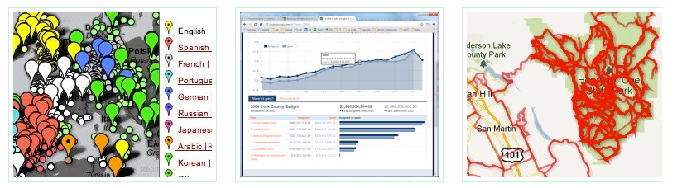
Charting tools
Google Charts | Link
DataWrapper | Link
Online Charts | Link
Silk |Link

Slide 12
Other data stuff
Tons of data tools | Link
StribLab resources | Link
StribLab Github | Link
Tabula | Link
Turn PDFs into spreadsheets
The Data Visualisation Catalogue | Link
What dataviz to use for what purpose
Visual Vocabulary | Link
How to visualize different kinds of data

Slide 13
Tips
Data journalism is digitally native, since data is most often produced and stored electronically
So learn some coding, because it helps you do more powerful things with data
Always ask for spreadsheets, avoid PDF/Word
“Breaking news data stories” aren’t really a thing, are extremely rare

Slide 14
Parting thoughts
Data journalism is very in demand
Be patient, it takes time to learn the skills and report data stories
Don’t worry about becoming an expert, especially overnight
Tell a data story you’re passionate about from the ground up to teach yourself and have something to show for your time

Slide 15
Questions
Q&A Time

Slide 16
Fin twitter: @JeffHargarten download this presentation: http://bit.ly/2ltAEwX

