Slide 1
Vulcan Activity Tracker
CMSC-4920-Senior Project 2
Group2
Team: Margo Bonal, John Gerega, Luke Ruffing

Slide 2

Motivation
Fitness web app for tracking campus athletic activities
Accessible on PC, tablets, phones
Combines multiple fitness tools into one platform
Connect with friends to build a fitness community
Supports student organizations needs
Free and accessible for all students

Slide 3






Development Stack
Development
Deployment

Slide 4


Collaboration Method
Shared Team Repository, Implemented Branching policies
SDL: Agile, assigned tasks merged upon completion

Slide 5
Project Goals
Modern UI
Aid Students overall organization by reducing app paywall
User Data Protection
SHA-256 & Argon2 paired with salt
Prevents GPU, ASIC, rainbow, and Parallel attacks
Users stored as unique id, never sent as raw data
Meet project specified criteria, successfully launch app, available online

Slide 6
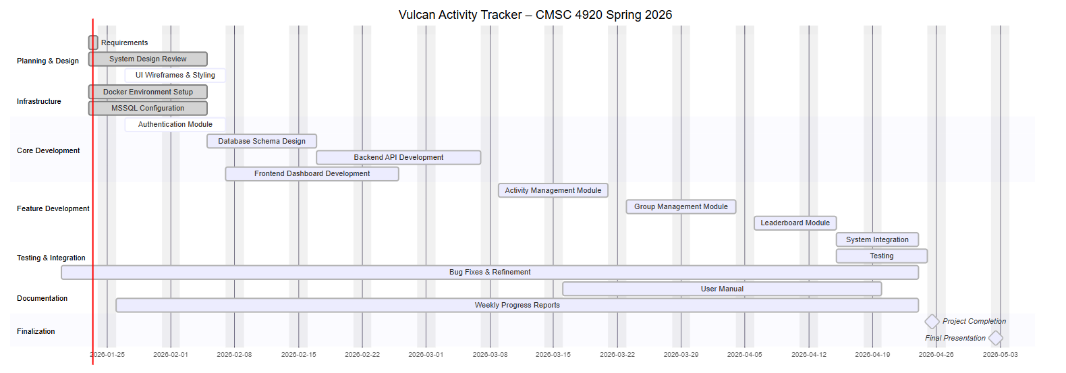
Gantt Chart
Documentation: https://jjdeuce06.github.io/VulcanActivityTracker/
Live: https://vulcanactivitytracker.onrender.com

Slide 7
Live Demonstration

Slide 8
Business Model
Estimated Production for 100 users/month:
Microsoft Azure SQL Server | $7 – $15
Azure Database | $7 – $20
Render Hosting | $7 – $15
Domain: | ~$1
Monthly Maintenance: | $5 – $10
MailerSend Starter Subscription | $28
Total: | $55 – $89

Slide 9
Project Improvements
Email verification integration
AI Coach
Smart watch connectivity
Database scalability

Slide 10
Questions

